Slide 1
Agentic Foundations
Part 1: A model is not yet an agent
The restock example · Model, context, tools · The ablation · When not to build an agent
Part 2: A model cannot touch anything
The tool-call mechanism · The raw loop · Limits of reasoning · Reliable tools · Injection
Part 3: It forgets last Monday
From one model call to an agent you can trust
The OS analogy · Self-editing memory · How much to curate
Part 4: A second opinion has a price
Three kinds of stop · Planning search · Why multi-agent systems fail · The single-agent baseline
It answers · It acts · It remembers · It collaborates · It runs · It is limited
Part 5: It has to run somewhere
Pick by control flow · Resume safely · Protocols · The harness · Skills · Evals
Part 6: Now it can spend money
Where the controls sit · Lower the risk · Gate the action · How much autonomy
Notes: generative-ai/03-agentic-foundations
Notes:
Today we build one thing: a restock agent for a small warehouse. It starts as a single model call that orders 300 units of itemB. Each part of the lecture finds out what is wrong with the version before it, and fixes it. It cannot check itself, it cannot touch anything, it forgets last Monday, a second opinion costs more than expected, it has to run somewhere, and eventually it can spend money.

Slide 2
PART 1
A model is not yet an agent
The model ordered 300 units. Was that right?
Check the order with arithmetic the model cannot argue with
Agent = Model + Context + Tools, run in a loop
Remove a part and watch what breaks
Climb the ladder only as far as you need
The restock example · Model, context, tools · The ablation · When not to build an agent
2
Notes:
We begin with the smallest useful version and ask what it lacks. The answer gives us the definition of an agent, and also the rule for when not to build one.

Slide 3
The model ordered 300 units. Was that right?
The problem
Part 1 · A model is not yet an agent
Asked to order just in time, a model orders 300 of itemB and explains why. The explanation sounds fine. Nothing in the system can tell you whether it is.
The inventory example from Lakshmanan & Hapke, Generative AI Design Patterns, ch. 1
A plausible explanation is not a check, so anything that can be computed should be computed and compared with the model's answer.
Source: notes/01-agent-fundamentals.md
3
Notes:
The system prompt says you are an inventory manager who orders just in time, and gives stock and four weeks of sales for three items. The answer is to order 300 of itemB. The book warns that truly agentic behaviour is still aspirational, because the same input can yield a different plan on another run.
Source: notes/01-agent-fundamentals.md

Slide 4
Check the order with arithmetic the model cannot argue with
Part 1 · A model is not yet an agent
TEXT
The model picked the right item. The check agrees.
# weeks of cover = on hand / peak weekly sales
itemA: 3.0 cover, 2 to deliver -> ok
itemB: 1.1 cover, 2 to deliver -> ORDER NOW
itemC: 2.2 cover, 1 to deliver -> ok
proposed 300 of itemB:
on arrival, stock is -80 at peak sales
after delivery: 300 units, 3.3 weeks of cover
95% per step over 10 steps -> 59.9% end to end
95% per step over 100 steps -> 0.6% end to end
It missed a stockout. At peak sales, 80 units short before delivery.
Long runs compound. Assuming independent steps, 95% each is 60% over ten.
Code confirmed the item and found a stockout the model never mentioned, and per-step errors compound quickly over a long run.
Source: notes/01-agent-fundamentals.md
4
Notes:
This is the real output of the first code block in note 01, run on the book's data. The last two lines are arithmetic under an independence assumption, which is a simplification. Huyen makes the same compound-error point in AI Engineering, chapter 6.
Source: notes/01-agent-fundamentals.md

Slide 5
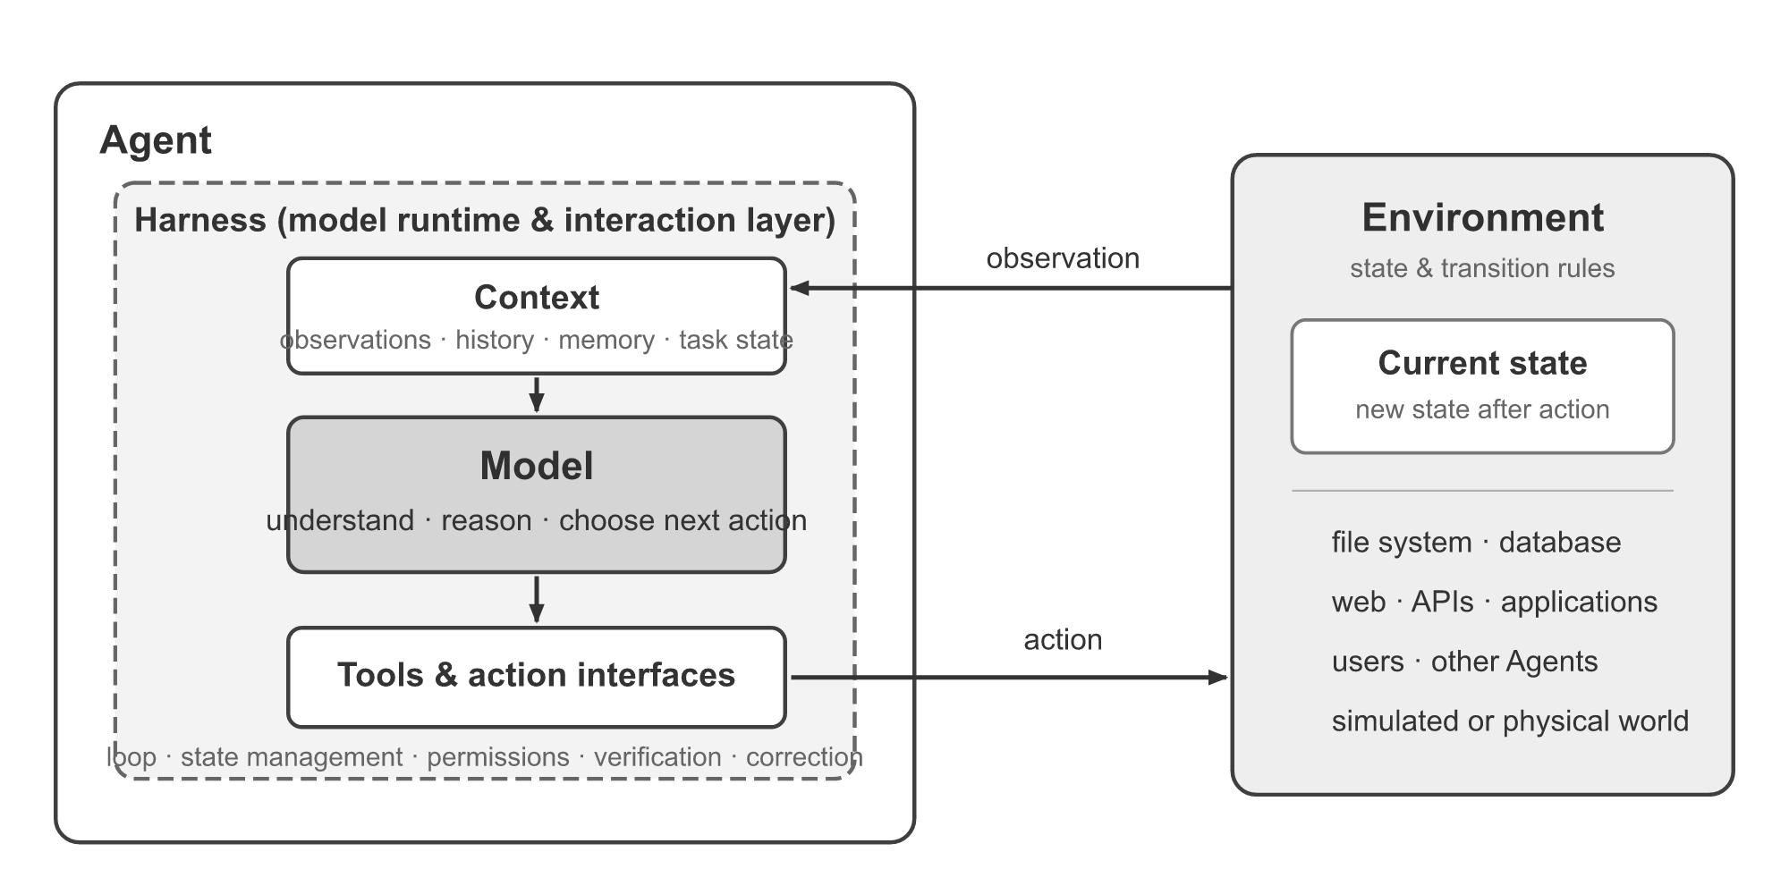
Agent = Model + Context + Tools, run in a loop
Part 1 · A model is not yet an agent
Model: decides what to do next.
Context: everything it can see when it decides.
Tools: the only way it affects anything.
The agent-environment loop and the model-harness structure (Bojie Li, AI Agents in Depth, 2026, Fig. 1)
An agent is a model that chooses actions from its context and uses tools in a loop, and memory or multi-agent designs are ways to manage those parts.
Source: notes/01-agent-fundamentals.md
5
Notes:
The rest of the lecture is about managing these three things across many steps. Memory manages context over time. Multi-agent splits context across roles. A harness is the code around the model.
Source: notes/01-agent-fundamentals.md

Slide 6
Remove a part and watch what breaks
Part 1 · A model is not yet an agent
Removed | Observed failure
Tool definitions | Cannot act at all: it does not know any tools exist
Tool results | No feedback, so it repeats the same call forever
Reasoning in assistant messages | Consecutive decisions contradict each other
Message history | Loses continuity, restarts and repeats finished steps
An agent can only decide on what is in its context, so every part of the context is load-bearing.
Source: notes/01-agent-fundamentals.md
6
Notes:
This is Experiment 1-1 in Li's book, which removes one part at a time. The tool-results row had been seen on robots before ReAct: Inner Monologue showed that writing success feedback back into the prompt is what closes the loop.
Source: notes/01-agent-fundamentals.md

Slide 7
Climb the ladder only as far as you need
Part 1 · A model is not yet an agent
Workflow
Autonomous agent
Steps cannot be skipped or reordered
Handles what you did not foresee
Injection is confined to one node
Costs more, and errors compound
Follows only preset exception branches
Needs explicit stop conditions
Fits: compliance-critical, decomposable work
Fits: tasks with unpredictable step counts
Fixed path
Path chosen at runtime
Prefer plain code, then a workflow, and use an autonomous agent only when the path depends on what it finds along the way.
Source: notes/01-agent-fundamentals.md
7
Notes:
Albada adds a rung below the LLM: plain code, chosen when inputs are predictable or certification demands deterministic logic. Our restock calculation is plain code. The judgment around suppliers is what might justify a model.
Source: notes/01-agent-fundamentals.md

Slide 8
PART 2
A model cannot touch anything
How does a text generator place an order?
Four steps under every framework
The whole agent in one screen
What reasoning steps cannot fix
What makes tool calls reliable
Tool output is untrusted input
The tool-call mechanism · The raw loop · Limits of reasoning · Reliable tools · Injection
8
Notes:
Our agent needs current stock, not a pasted table. Yet a model only writes text. So how does anything get done?

Slide 9
How does a text generator place an order?
The problem
Part 2 · A model cannot touch anything
It does not. The model proposes a call as text. Your code decides whether and how to run it.
The mechanism under every agent framework
The model only proposes tool calls, and your code runs them, which is what makes the boundary enforceable.
Source: notes/02-tool-use-and-react.md
9
Notes:
Everything in this part follows from that sentence. Because your code is the executor, your code can validate, refuse or ask a person. Toolformer called this tool use; OpenAI and Gemini call it function calling. The mechanism is the same.
Source: notes/02-tool-use-and-react.md

Slide 10
Four steps under every framework
Part 2 · A model cannot touch anything
Advertise
client: name, description, schema
Decide
model: text or a tool call
Execute
client: your code runs it
Observe
client: result goes back to the model
Repeat from Decide until the model answers without a call, or a budget runs out
Advertise, decide, execute and observe repeat until the model answers without a call or a step budget ends the run.
Source: notes/02-tool-use-and-react.md
10
Notes:
Client, model, client, client. Only one of the four steps is the model. ReAct is this loop with the reasoning written out between calls, and it is why the loop has a name in the literature.
Source: notes/02-tool-use-and-react.md

Slide 11
The whole agent in one screen
Part 2 · A model cannot touch anything
PYTHON
Results go back in: that is the feedback.
for step in range(max_steps):
reply = model(messages, tools=TOOLS)
messages.append(reply)
if not reply.tool_calls:
return reply.text
for call in reply.tool_calls:
result = TOOLS[call.name](**call.args)
messages.append(tool_result(call, result))
# out of budget: ask for a wrap-up, no tools
return model(messages, tools=[]).text
The cap is not optional: agents rarely stop on their own.
Make the last step a wrap-up, not a silent cutoff.
A minimal agent is a capped loop that runs tool calls and feeds back the results, ending in a wrap-up rather than a silent cutoff.
Source: notes/01-agent-fundamentals.md
11
Notes:
This is a condensed form of the runnable block in note 01, which uses a scripted model so that it runs offline. Note 02 shows the same loop against the Messages API with a stub client. No framework is needed to understand any of this.
Source: notes/01-agent-fundamentals.md

Slide 12
What reasoning steps cannot fix
Part 2 · A model cannot touch anything
CoT fails on | Their example | The fix
Gaps in knowledge | 300 km west of Hyderabad: confident steps, wrong city | Supply the fact: a tool
Exact computation | 84 m² × 10.7639 written as 903.20; true product 904.1676 | A calculator or code tool
Non-sequential expertise | Bridge play: experts weigh the whole hand | Expert examples or a specialist model
Reasoning helps a model apply a rule it knows, but missing facts and exact arithmetic need tools, so more thinking will not fix them.
Source: notes/02-tool-use-and-react.md
12
Notes:
These are from pattern P13 in Generative AI Design Patterns, chapter 5. Shown reasoning can also be a story told afterwards. The book's own success case applies a laminar-flow formula to give 84 cubic metres per second through a 25 cm pipe, about 1,700 metres per second, which is meaningless. So well-formed steps are not evidence of a correct answer.
Source: notes/02-tool-use-and-react.md

Slide 13
What makes tool calls reliable
Part 2 · A model cannot touch anything
One job per tool
Constrain arguments
Inject what you know
Return readable errors
The description is the only documentation the model reads.
Enums and a schema reject whole classes of bad calls at the boundary.
IDs, dates and user context come from code, never from the model.
A message the model can act on lets it retry. A stack trace does not.
Keep each tool to one job, validate arguments at the boundary, inject known values in code and return errors the model can act on.
Source: notes/02-tool-use-and-react.md
13
Notes:
The book's June 2025 guide is 3 to 10 tools. Past roughly ten, Oshin and Campos preselect the relevant few by retrieval. And if every query should start with a search, build that tool call in code and do not spend a model call deciding it.
Source: notes/02-tool-use-and-react.md

Slide 14
Tool output is untrusted input
Part 2 · A model cannot touch anything
Pattern | Idea
Action-Selector | The model picks fixed actions; tool output never returns to it
Plan-Then-Execute | Fix the plan before reading untrusted data
Map-Reduce | Process each untrusted item in an isolated call
Dual-LLM | A quarantined model reads the text and returns symbols
Code-Then-Execute | A program, not the model, handles the data
Context-Minimization | Drop untrusted spans before later steps
A tool result can carry an attacker's instructions, so choose the weakest design pattern that blocks the attack paths your tools open.
Source: notes/02-tool-use-and-react.md
14
Notes:
From Beurer-Kellner et al., 2025. Each pattern trades capability for safety. Our restock agent reading a supplier's email is exposed: that email lands in the context next to our instructions.
Source: notes/02-tool-use-and-react.md

Slide 15
PART 3
It forgets last Monday
The supplier changed delivery times. It forgot.
A core that fills up, an archive that must be searched
Does curating memory pay? Often not
Tools let it manage memory, not know when to
The OS analogy · Self-editing memory · How much to curate
15
Notes:
The supplier told us last week that delivery time had doubled. On Monday the agent starts from nothing and orders on the old figure. Long context is expensive and finite, so what should it keep?

Slide 16
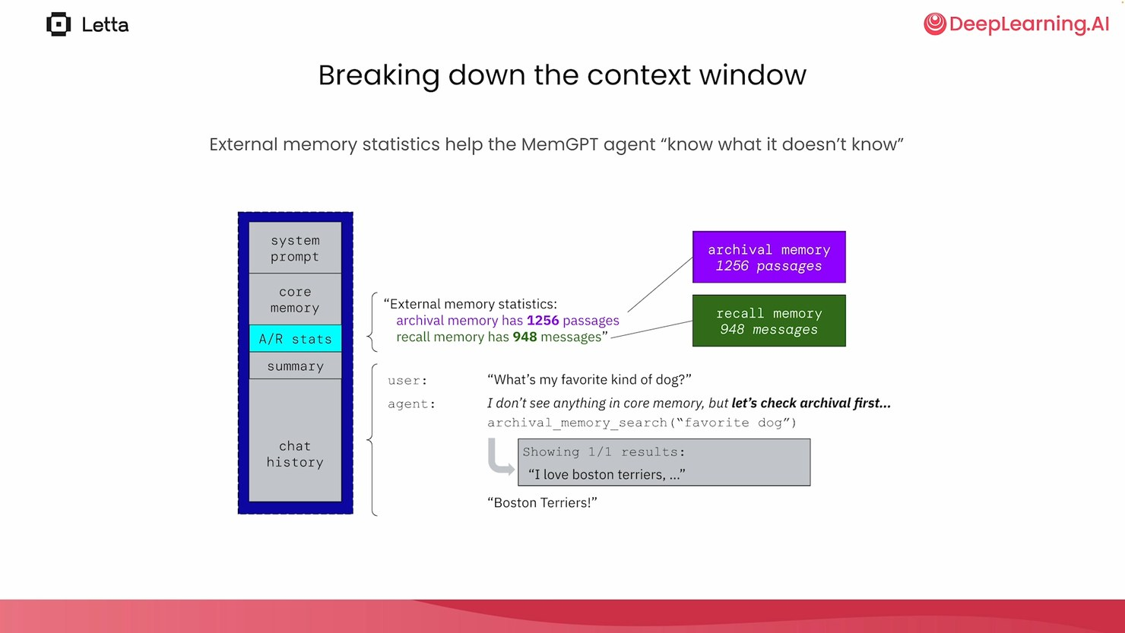
The supplier changed delivery times. It forgot.
The problem
Part 3 · It forgets last Monday
The context window is RAM: small and always visible.
Databases are disk: large, and reached by a tool.
The agent does its own paging.
Memory tiers in MemGPT (Packer & Wooders, Letta course, L2)
MemGPT treats the context window like an OS treats RAM, so the agent pages facts in and out of larger stores with its own tool calls.
Source: notes/03-memory-as-an-operating-system.md
16
Notes:
Agent state lives in a database, and each step compiles it into a prompt. Heartbeats let one user message drive a search, an edit and a reply. Memory theory itself is in context engineering note 06. This note covers what MemGPT and Letta add.
Source: notes/03-memory-as-an-operating-system.md

Slide 17
A core that fills up, an archive that must be searched
Part 3 · It forgets last Monday
TEXT
A readable error teaches: the agent moves detail to the archive.
ok
Error: core is full (limit 100). Move detail...
ok, 1 passages in archive
ok
--- next Monday, new session ---
<policy>Order just in time. Keep two weeks...</policy>
<supplier>Acme delivers itemB. See...</supplier>
[1 passages in archive, not shown]
search 'lead time' -> ['3 March: Acme lead time ...']
search 'delay' -> no match
Stats in context show what it is not seeing.
Search can miss: delay finds nothing here.
A small core plus a searchable archive works only if the agent knows the archive exists, is told when to search, and can phrase the search well.
Source: notes/03-memory-as-an-operating-system.md
17
Notes:
This is our own run of the block in note 03, with a scripted model and substring search, shortened to fit. A vector index would help with the delay query, but the design lesson stands. Agents do not save or search by default, so the system prompt has to say when.
Source: notes/03-memory-as-an-operating-system.md

Slide 18
Does curating memory pay? Often not
Part 3 · It forgets last Monday
Keep it verbatim
Let the agent curate
A dump or one file per session matched or beat curation on all four benchmarks
Left superseded preferences standing as current
The record survives, so later readers can correct errors
Condensing dropped REALTALK from 77.6% to 41.2%
A fact-preserving reorganization held at 77.6%
78.1% on PersonaMem at 32k tokens
37.5% in the same setup
Keep the verbatim record and curate only the index on top, because in Zhou et al. summarizing lost facts that a plain store kept.
Source: notes/03-memory-as-an-operating-system.md
18
Notes:
Zhou et al., July 2026, with gpt-5.4-mini building and searching filesystem stores. On PersonaMem, the right fact was still in the store for all 13 misses. A-MEM takes the safe route: it evolves links and index fields and never rewrites content. Video and audio have no verbatim record, so there the writer has to extract something.
Source: notes/03-memory-as-an-operating-system.md

Slide 19
Tools let it manage memory, not know when to
Part 3 · It forgets last Monday
Prompts: say when to save and when to search.
Memory is an attack surface
Tools: which memory tools exist, and what side effects they have.
An injected instruction saved today comes back next session looking like context. Record where each memory came from.
Management: block sizes, eviction, what gets summarized.
Content: the starting persona and preloaded documents.
Keep the source of truth in a tool. A stored delivery time goes stale. Store why a decision was made.
You control a memory agent through its prompts, tools, management policy and starting content, and any saved memory needs a recorded origin.
Source: notes/03-memory-as-an-operating-system.md
19
Notes:
The four levers are from the DeepLearning.AI course's conclusion. AgeMem found that with the same memory tools, prompted small models rarely update what they stored. So test behaviour by replaying conversations, not just by checking that inserts succeed.
Source: notes/03-memory-as-an-operating-system.md

Slide 20
PART 4
A second opinion has a price
Should we just add a reviewer agent?
A conversation needs three kinds of stop
Count the calls before you search over plans
Pick the topology by who needs to talk
Same model in every role? Try one agent first
Three kinds of stop · Planning search · Why multi-agent systems fail · The single-agent baseline
20
Notes:
A reviewer would catch a bad order. So we add one. Now we have a conversation that may not end, and costs that grow faster than agents.

Slide 21
Should we just add a reviewer agent?
The problem
Part 4 · A second opinion has a price
Cemri et al. found 40–80% of tasks failing in the multi-agent systems they studied. No single cause dominated.
Cemri et al., 2025, from expert annotation of about 150 conversation traces
A second agent adds a coordination problem as well as a check, so state what it does that one agent cannot before adding it.
Source: notes/04-multi-agent-design-patterns.md
21
Notes:
The 40 to 80 percent is across the systems that paper studied, not a universal rate. Ng's four patterns give the vocabulary: reflection, tool use, planning, multi-agent collaboration. The AutoGen course teaches each with one lesson, and that is the source of the conversation primitives in note 04.
Source: notes/04-multi-agent-design-patterns.md

Slide 22
A conversation needs three kinds of stop
Part 4 · A second opinion has a price
TEXT
Semantic stop: an explicit approval.
turn 1: buyer says 150;
reviewer: Too low, under three weeks of peak
turn 2: buyer says 300; reviewer: APPROVE
cap 3: agreed on 300; verifier says True
turn 1: buyer says 150; reviewer: Too low
cap 1: no agreement, escalate to a human
legal(planner, buyer, reviewer, executor) True
legal(planner, buyer, executor) False
Turn cap: escalate, do not guess.
Verifier: plain code, independent of both.
Transition graph: the buyer cannot skip review.
End a multi-agent conversation with a semantic stop, a turn cap that escalates and an independent verifier, and restrict who may speak after whom.
Source: notes/04-multi-agent-design-patterns.md
22
Notes:
This is the output of our stubbed block in note 04, reflowed to fit. Two models can agree on a wrong answer, which is why the verifier is code. The transition check is the group-chat lesson: a graph forbids what a prompt can only discourage.
Source: notes/04-multi-agent-design-patterns.md

Slide 23
Count the calls before you search over plans
Part 4 · A second opinion has a price
Depth | Thoughts | Width | LLM calls
1 | 3 | 1 | 4
2 | 3 | 2 | 12
4 | 3 | 3 | 40
4 | 3 | 5 | 56
Tree of Thoughts lifted Game of 24 from 4% to 74% with GPT-4, but its calls multiply with depth and width, so try cheaper options first.
Source: notes/04-multi-agent-design-patterns.md
23
Notes:
The counts are from our stub in note 04. Lakshmanan and Hapke report 41 calls for the depth 4, width 3 setup, consistent with one extra call for a summary, though the book does not itemize them. A search is only as good as its scorer. Graph of Thoughts adds merging, and repairing a failed plan node often beats replanning.
Source: notes/04-multi-agent-design-patterns.md

Slide 24
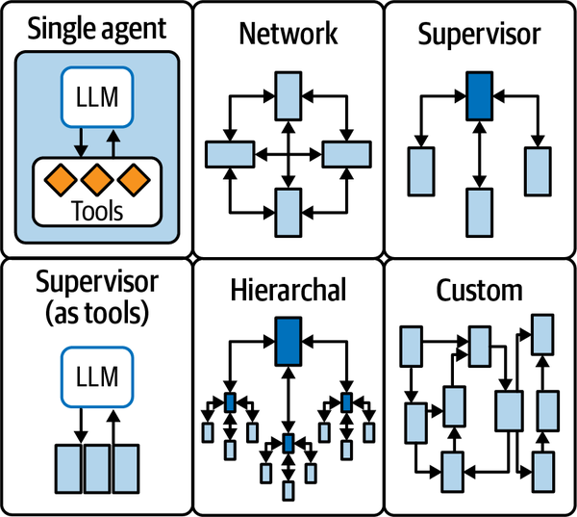
Pick the topology by who needs to talk
Part 4 · A second opinion has a price
Supervisor: one router, easy to reason about.
Network: free movement, derails easily.
Filter each handoff. Full history grows with every agent.
Single agent, network, supervisor, agents as tools, hierarchical, custom (Oshin & Campos, Learning LangChain, 2025, Fig. 7-3)
Fewer speakers and restricted edges make a multi-agent system easier to reason about, and handoffs should pass a filtered summary rather than full history.
Source: notes/04-multi-agent-design-patterns.md
24
Notes:
Koenigstein's table compares supervisor, hierarchical and swarm. The running rule from the note is to prefer shared state to messages for facts, since one block edit beats N messages.
Source: notes/04-multi-agent-design-patterns.md

Slide 25
Same model in every role? Try one agent first
Part 4 · A second opinion has a price
One agent, role-playing each step
The multi-agent workflow
HumanEval 92.1%; MBPP 81.4%
HumanEval 91.6%; MBPP 81.1%
HotpotQA 68.4%, a real drop
HotpotQA 72.1%
AFlow on HotpotQA: $0.53 (simulated cache cost)
AFlow on HotpotQA: $1.44
Xu et al., 2026, GPT-4o-mini
Same tasks
When every role uses one model, a single agent role-playing the steps can keep accuracy at lower cost, so make it the baseline to beat.
Source: notes/04-multi-agent-design-patterns.md
25
Notes:
The savings on closed models are a simulated KV-cache cost, not a billed one, and the trick cannot reproduce workflows that mix models. Read the software-company papers such as MetaGPT and ChatDev against this baseline. Each reports beating the other on its own benchmark.
Source: notes/04-multi-agent-design-patterns.md

Slide 26
PART 5
It has to run somewhere
Which framework, and what around it?
Pick a framework by what you program
One approval, two orders
The harness across the lifecycle
Load a skill only when the task matches
A correct answer can hide a bad process
Pick by control flow · Resume safely · Protocols · The harness · Skills · Evals
26
Notes:
The agent works on a laptop. Now the order has to wait for a person, restart cleanly, talk to a supplier's system, and carry a growing policy.

Slide 27
Which framework, and what around it?
The problem
Part 5 · It has to run somewhere
Most agent failures are configuration failures, the course argues: tools, prompts and guardrails, not the model.
Google × Kaggle, 5-Day AI Agents Intensive, Day 1. A framing, not a measurement
The engineering leverage sits mostly around the model, so choose a framework for its control flow and invest in what surrounds the loop.
Source: notes/06-google-adk-intensive.md
27
Notes:
Agent equals model plus harness. Treat the claim as the course's framing. It does match the pattern in this pillar: the demo is the easy part.
Source: notes/06-google-adk-intensive.md

Slide 28
Pick a framework by what you program
Part 5 · It has to run somewhere
Framework | You program | Lean toward it for
LangGraph | Nodes and edges over typed state | Explicit control, checkpoints, human approval
CrewAI | Roles plus tasks | A role-based pipeline with little code
Google ADK | Agent with sub-agents | Gemini and Vertex deployment
AutoGen 0.2 | Conversable agents | Dialogue prototypes; now succeeded
Letta | A persistent agent server | Long-lived memory
smolagents | CodeAgent | Code as action, open models
Frameworks differ in their unit of programming, so write down your control flow first and pick the one that matches, or none if it is a straight line.
Source: notes/05-framework-survey.md
28
Notes:
AutoGen's maintainers now point new work to Microsoft Agent Framework. The patterns still apply. Albada's mid-2025 rule is CrewAI or OpenAI Agents SDK for fast prototypes, LangGraph or AutoGen for production control. Many teams build directly on provider APIs.
Source: notes/05-framework-survey.md

Slide 29
One approval, two orders
Part 5 · It has to run somewhere
PYTHON
Resume re-runs the node. It does not continue mid-function.
def unsafe_node(state):
ORDERS.append(state["quantity"]) # side effect
answer = interrupt("Send the email?")
...
# resume re-runs the node from its first line
# unsafe: orders placed: [300, 300]
def approve_node(state): # pause only
return {"approved": interrupt("Order?") == "yes"}
def order_node(state): # act only
...
# safe: orders placed: [300]
Pause in one node, act in the next.
On resume an interrupted node runs again from its first line, so put the pause and the side effect in separate nodes.
Source: notes/05-framework-survey.md
29
Notes:
Note 05 models this rule in plain Python so that it runs without LangGraph, and these outputs are from that run. Koenigstein states the side-effect rule in chapter 2 of the Definitive Guide.
Source: notes/05-framework-survey.md

Slide 30
The harness across the lifecycle
Part 5 · It has to run somewhere
Configure
planning: AGENTS.md, rules, tools
Run
implementation: sandboxes, execution
Feed back
testing: errors go back to the model
Observe
production: hooks, cost, latency, drift
What production shows feeds the next round of configuration
Tests check deterministic parts. Evals check the rest.
The 80% problem: edge cases and integration take the expertise. The figure is the course's rule of thumb.
Total cost: generating is cheap. Running, fixing and maintaining remain.
The harness is configured in planning, runs during implementation, feeds errors back during testing and is observed in production.
Source: notes/06-google-adk-intensive.md
30
Notes:
From the Day 1 whitepaper. Depth is in the harness engineering pillar. Agents reduce capital expenditure, the upfront cost of building something, but operational expenditure remains.
Source: notes/06-google-adk-intensive.md

Slide 31
Load a skill only when the task matches
Part 5 · It has to run somewhere
TEXT
Metadata always, body on activation, references on demand.
level 1: 25 tokens always loaded
level 2: 66 tokens when the task matches
level 3: 6500 tokens only if the body says
50 skills, all loaded up front: 329,550 tokens
50 skills, one activated: 1,316 tokens
The description decides. A vague one fails silently.
Rough numbers: four characters per token, identical sizes.
Progressive disclosure keeps a skill's cost to one line of metadata until a task matches, so the description must carry the whole decision to activate.
Source: notes/06-google-adk-intensive.md
31
Notes:
Toy numbers from our block in note 06. Treat them as orders of magnitude. The course's claim that skills replace multi-agent systems holds where agents differ only in instructions. It does not provide parallelism, context isolation, reviewer independence or separate permissions, which note 04 still needs.
Source: notes/06-google-adk-intensive.md

Slide 32
A correct answer can hide a bad process
Part 5 · It has to run somewhere
Run | Output correct | Trajectory correct
careful | True | True
lucky | True | False
wrong | False | True
Output evaluation passes a run that ordered without checking stock, so also evaluate the trajectory, including the order of the steps.
Source: notes/06-google-adk-intensive.md
32
Notes:
The lucky run ordered without looking at the stock and will fail the first time the stock matters. Its final words are not evidence of how it got there, which also explains Huyen's reflection error: asked to place 50 people in 30 rooms, an agent placed 40 and reported success.
Source: notes/06-google-adk-intensive.md

Slide 33
PART 6
Now it can spend money
Does telling it the limit enforce the limit?
Lower the risk before you filter it
The gate is ordinary code
Controls sit on three positions
Where the controls sit · Lower the risk · Gate the action · How much autonomy
33
Notes:
Sooner or later the agent places a real order. A line in the system prompt saying do not exceed 500 is a request, not a limit. So what actually enforces one?

Slide 34
Does telling it the limit enforce the limit?
The problem
Part 6 · Now it can spend money
A prompt restriction is not a permission. Swap the prompt, and the same SQL agent runs the writes it refused before.
Phoenix & Taylor, Prompt Engineering for Generative AI, ch. 6
A system prompt asks the model to behave, so enforce every real limit in credentials and code.
Source: notes/07-guardrails-and-autonomy.md
34
Notes:
LangChain's default SQL-agent prompt stops it from running INSERT, UPDATE or DELETE. With a custom prefix and an unrestricted connection the same agent runs them. The limit has to live in the credentials.
Source: notes/07-guardrails-and-autonomy.md

Slide 35
Lower the risk before you filter it
Part 6 · Now it can spend money
P29 Template Generation — Model writes templates offline; a person reviews; code fills the slots.
1
P30 Assembled Reformat — Model only rephrases facts gathered by low-risk means.
2
P31 Self-Check — Model answers and token probabilities flag low confidence.
3
P32 Guardrails — Code layers around inputs, outputs, retrieval and tool parameters.
4
Ask how much the model needs to write at all, using reviewed templates and assembled facts first, with guardrails as the outer layer.
Source: notes/07-guardrails-and-autonomy.md
35
Notes:
From Generative AI Design Patterns, chapter 9. The restock email can be a template, the justification assembled from figures, and only the decision needs the model's freedom. Low token probability marks where a model had alternatives, so it routes to review rather than rejecting. The book's Vectara numbers show hallucination falling but not vanishing, even on summarization.
Source: notes/07-guardrails-and-autonomy.md

Slide 36
The gate is ordinary code
Part 6 · Now it can spend money
PYTHON
get_stock → allow
def gate(tool, args, approved_by=None):
if RISK.get(tool) is None:
return "deny: unknown tool"
if (tool == "place_order"
and args["quantity"] > 500):
return "deny: over the hard limit"
if RISK[tool] == "high" and approved_by is None:
return "ask human"
return "allow"
place_order 300 → ask human
place_order 300, approved → allow
place_order 9000, approved → deny
delete_supplier → deny
Rate each tool by what it can undo, default to deny, ask a person for risky calls and keep hard limits that no approval can override.
Source: notes/07-guardrails-and-autonomy.md
36
Notes:
These results are from the runnable block in note 07, with the limit inlined. People clicking through a queue are not a control on a typo of 9,000, which is why the hard limit applies even with approval. Keep approval for the irreversible, or approval fatigue sets in.
Source: notes/07-guardrails-and-autonomy.md

Slide 37
Controls sit on three positions
Part 6 · Now it can spend money
Input
relevance, safety, injection screens
Execution
risk rating, limits, approval
Output
PII and content checks
Retrieved data enters at the same point as user input, so injection is a design problem as well as a filtering one
Layer guardrails on inputs including retrieved data, on tool execution and on outputs, because no single check is enough.
Source: notes/07-guardrails-and-autonomy.md
37
Notes:
Guardrails running in parallel via asyncio.gather do not cancel the model call, so you still pay. Keep a dataset of attacks and benign look-alikes, and track misses and false blocks. Raieli and Iuculano judge that no agent is beyond level one, a research assistant, on Gao et al.'s scale, and Mitchell et al. argue fully autonomous agents should not be developed. Design for orchestrated autonomy.
Source: notes/07-guardrails-and-autonomy.md

Slide 38
Rules of thumb
Wrapping up
Compute what you can
Cap every loop
Treat tool output as untrusted
Check the model against arithmetic and plain code.
Budget steps, and make the last one a wrap-up.
Pick an injection pattern before you ship.
Small core, verbatim archive
Start with one agent
Enforce limits in code
Split for parallelism, isolation or permissions.
A prompt restriction is not a permission.
Curate the index, not the facts.
Compute what you can, bound the loop, distrust tool output, keep the record, start with one agent and enforce limits outside the model.
Source: notes/01-agent-fundamentals.md
38
Notes:
Each of these undoes a failure of the restock agent from earlier in the lecture. The full table is in the pillar README.
Source: notes/01-agent-fundamentals.md

Slide 39
Where to go next
Wrapping up
Frameworks in depth: LangGraph and Google ADK, in 04-agentic-frameworks.
Try it
Watching it run: tracing and scoring, in 06-observability.
Run the code in each note. The runnable blocks work offline with stubs, and the A2A one needs only Pydantic.
Deployed systems: 07-agentic-applications.
The engineering discipline: ai-engineering, on harness, loop and graph.
Next, study LangGraph and ADK in depth, then tracing and scoring, then deployed systems, with the harness discipline in ai-engineering.
Source: notes/07-guardrails-and-autonomy.md
39
Notes:
The labs for the two courses are upstream, linked in the README, and they need API keys.
Source: notes/07-guardrails-and-autonomy.md

