Slide 1
Eval Engineering
Part 1: What does better mean?
What an eval is · Defining correct · Datasets
Part 2: Who can you trust to grade?
Graders · LLM as judge · Calibration · Checks and critiques
Version B scores one point higher. Do you ship it?
Part 3: What do you actually measure?
Evaluating agents · RAG and grounding · Tracing
Part 4: Is the difference real?
Define correct, trust no grader you have not checked, and put an error bar on every number
Reading results · Evals in CI
Part 5: What happens after launch?
Production · Failure modes · A case study
Notes: generative-ai/08-eval/notes/01-14
Notes:
This talk follows one decision from start to finish. A support agent has two versions, B scores one point above A, and someone asks whether to ship. By the end we will have the machinery to answer, and the answer will be no. Every chapter of the pillar is one piece of that machinery.

Slide 2
PART 1
B scores 85%, A scores 84%. Do you ship B?
Every eval runs the same five steps
Six parts, many names
Tests gate merges, evals measure rates
A capability suite climbs, a regression suite holds
Write success down before you write a grader
Read a hundred traces before you build a grader
A suite of only positive cases rewards overreach
Public benchmarks keep their answers out of training in five ways
One row of the golden set, in full
What does better mean?
What an eval is · Defining correct · Datasets
2
Notes:
Before we can compare two versions we need a definition of better that a machine can check. That takes a vocabulary, written success criteria, and a dataset of real tasks. Nothing in this part involves a grader yet, and that order is deliberate.

Slide 3
B scores 85%, A scores 84%. Do you ship B?
The problem
Part 1 · What does better mean?
Version B scores 85%. Version A scores 84%. Do you ship B?
You cannot answer until better is written down so a machine can check it.
An eval is the definition of better for your system, written down so a machine can check it.
Source: notes/01-what-an-eval-is.md
3
Notes:
Here is the running example for the whole talk. Our support agent answers from help-centre articles and can issue refunds. Someone changed the prompt and the score moved from 84 to 85. Without an eval, every change to a prompt, model, tool or retrieval config is a guess. So first we have to say what that number is made of.
Source: notes/01-what-an-eval-is.md

Slide 4
Every eval runs the same five steps
The shape of every eval
Part 1 · What does better mean?
Task
from the suite
Run the system
k trials
Capture
trajectory and outcome
Graders
one per dimension
Aggregate
rate, error bar, decision
The rest of this talk is about doing one of these arrows well. Our 85% is the far right box, and we have not yet asked what fed it.
An eval runs tasks through k trials, captures what happened, grades each dimension and aggregates with an error bar.
Source: notes/01-what-an-eval-is.md
4
Notes:
Read this left to right. We take a task, run the system several times because outputs vary, record what it did and where it ended up, grade that, and aggregate. Notice the last box says error bar. Keep that in mind, because it is where our one-point gain will fall apart later.
Source: notes/01-what-an-eval-is.md

Slide 5
Six parts, many names
One vocabulary
Part 1 · What does better mean?
Anthropic, LangSmith, OpenAI and Inspect use different words for the same parts.
Term | What it is | Also called
Task | One test: an input plus success criteria | case, example, row
Trial | One attempt at a task. Outputs vary, so several per task | run, epoch
Trajectory | The full record: messages, tool calls, intermediate results | trace, transcript
Outcome | The end state: the answer, the file system, the DB row | final response
Grader | Code, a model or a person scoring one aspect of a trial | evaluator, judge, metric
Suite | Tasks run together for a system-level picture | eval set, benchmark
Task, trial, trajectory, outcome, grader and suite are the six parts; Inspect keeps dataset, solver and scorer swappable.
Source: notes/01-what-an-eval-is.md
5
Notes:
Every framework renames these, which makes the literature look more varied than it is. For our agent, the trajectory is the tool calls it made, and the outcome is whether a refund row exists. Inspect splits a task into dataset, solver and scorer, and that split is worth copying because you can swap each one alone.
Source: notes/01-what-an-eval-is.md

Slide 6
Tests gate merges, evals measure rates
Where evals begin
Part 1 · What does better mean?
Draw the line by determinism.
Unit test
Eval
Deterministic behaviour: rendering, schemas, retries, routing tables
Non-deterministic behaviour: quality, grounding, task success
Asserts exact values. Pass or fail
Many tasks, many trials. A rate with an error bar
Mock the model here
Never mock the model: you would measure the mock
retry fires 3 times on 429
grounded answer rate at least 0.90 on the golden set
Never assert an exact LLM string in a unit test: it flakes, then gets loosened until it checks nothing.
Source: notes/01-what-an-eval-is.md
6
Notes:
A common first mistake is to write an eval as a unit test with an exact string. It fails at random, someone relaxes it, and soon it checks nothing. Test the deterministic parts, like the retry on a 429. Measure the rest as a rate, over many tasks, against the real model.
Source: notes/01-what-an-eval-is.md

Slide 7
A capability suite climbs, a regression suite holds
Two suites, two questions
Part 1 · What does better mean?
Capability: what can it do? Tasks from the frontier, low to medium pass rate, run on demand
Tasks graduate
Regression: does it still do what it did? Mastered tasks and every fixed bug, near 100%, every change
Once a capability task passes reliably, it moves to the regression suite.
A drop means different things: little on a capability suite, a blocked release on a regression suite
Offline and online: curated tasks before release catch what you imagined; sampled traffic catches what you did not
An eval is not a benchmark score, a vibe check or a one-off, and it is not only about quality
Capability suites measure the frontier and regression suites protect what works, and passing tasks graduate from one to the other.
Source: notes/01-what-an-eval-is.md
7
Notes:
So which suite does our 85% come from? It matters. Fifteen percent failure on a regression suite is an emergency, and on a capability suite it is room to climb. A public benchmark cannot stand in for either one, since a leaderboard rank predicts little about your support bot.
Source: notes/01-what-an-eval-is.md

Slide 8
Write success down before you write a grader
Before any code
Part 1 · What does better mean?
Too vague to grade
Checkable
The steps to change their payout account, in their language, citing the article
User needs: a helpful answer
Must never happen: nothing bad
Never invent a menu path or leak another customer's data
Unit of success: it went well
Per turn grounded and complete; per conversation resolved in at most 6 turns
Two experts would disagree
Wrong menu path is a ticket; wrong tax answer is a fine
If two experts would not reach the same verdict on an output, fix the criteria rather than the grader.
Source: notes/02-defining-correct.md
8
Notes:
Asking a model to judge helpfulness simply moves the vagueness somewhere you cannot see it. Take our payout question and answer four things: what the user needs, what must never happen, the unit of success, and the cost of being wrong. That last one tells you how hard to gate.
Source: notes/02-defining-correct.md

Slide 9
Read a hundred traces before you build a grader
Find failures by reading
Part 1 · What does better mean?
1
Collect ~100 traces — Real if you have them, synthetic if you do not yet.
2
Open coding — A free-text note on the first thing that went wrong. No categories yet.
3
Axial coding — Group the notes into categories. Expect 5–15.
4
Count — Rank by frequency times cost. That ranking is your eval roadmap.
5
Repeat to saturation — Until new traces stop producing new categories, usually 50–100.
Do not build a grader for a failure mode you have not seen; reading traces produces the ranked list of what to measure.
Source: notes/02-defining-correct.md
9
Notes:
This is the least glamorous slide and the one with the best return. You read traces and write down the first failure in each, because later errors usually cascade from it. Then you group the notes into stable labels, one per fix. Those labels become the failure taxonomy we use for the rest of the talk.
Source: notes/02-defining-correct.md

Slide 10
A suite of only positive cases rewards overreach
Reward restraint too
Part 1 · What does better mean?
An agent that always calls issue_refund would ace a suite that only asks for refunds.
Positive
Negative
Boundary
Refund my order: calls issue_refund.
What is your refund policy? Answers, and does not call issue_refund.
I might want a refund, what are my options?
Out of scope
Adversarial
Why pair them
Can you file my taxes? Declines or escalates.
Prompt injection, social engineering, policy loopholes.
TrustLLM: Llama2-7b refused 94.5% of jailbreaks and also 49% of benign prompts.
Without negative cases, a change that calls tools more often looks like better recall while precision quietly breaks.
Source: notes/02-defining-correct.md
10
Notes:
Imagine a change that makes our agent eager to refund. A positive-only suite calls that a win. Safety has the same trap. TrustLLM scored models on jailbreaks they should refuse and on prompts that only sound harmful, and Llama2-7b looked strong on the first while refusing 49 percent of the second.
Source: notes/02-defining-correct.md

Slide 11
Public benchmarks keep their answers out of training in five ways
Public benchmarks
Part 1 · What does better mean?
Tactic | Benchmark | How
Unique answers | GAIA | Answers need several sources combined, some from attachments that are not on the web
Parameterized templates | AndroidWorld, τ²-bench | Fresh values every run, so a memorized action sequence will not replay
Temporal freshness | SWE-bench-Live | Keep adding tasks created after the training cutoff
Canaries | BIG-bench, Terminal-Bench | A unique GUID in the data; if a model can produce it, the set has leaked
Closed test set | HLE, SHADE-Arena | Keep some of it unpublished; SHADE-Arena published 5 of its 17 environments
A public benchmark protects its answers by design, because a canary only catches leaks and a public set cannot be both open and closed.
Source: notes/03b-splits-contamination-and-public-benchmarks.md
11
Notes:
Contamination is why a public score can overstate what you will see on your own traffic. Each tactic trades something. Canaries detect a leak but prevent nothing, and Terminal-Bench's authors call theirs largely a symbolic safeguard because every task is public. Templates and freshness change the rows instead of hiding them.
Source: notes/03b-splits-contamination-and-public-benchmarks.md

Slide 12
One row of the golden set, in full
Worked example
Part 1 · What does better mean?
JSON
Start at 20–50 real failures, hand-reviewed
{"id": "billing-refund-014",
"input": {"messages": [{"role": "user",
"content":
"I was charged twice for order 8812"}]},
"reference": {"expected_tool_calls": [
{"name": "lookup_order",
"args": {"order_id": "8812"}},
{"name": "issue_refund",
"match": "ANY_ARGS"}],
"expected_sources":
["help/billing/duplicate-charges"]},
"labels": {"intent": "billing",
"case_type": "positive", "language": "en"},
"eligibility": {"retrieval": true},
"provenance": {"source": "ticket"},
"graders": ["tool_trajectory", "grounding"]}
100–300 tasks give ±5–8 point error bars
Labels make slices possible later
Eligibility: a downstream gate never scores rows an upstream gate ruled unfair
Split and version: a v3 score and a v4 score are not comparable
A golden row carries a reference, labels for slicing, eligibility per gate, provenance and the graders that apply to it.
Source: notes/03-eval-datasets.md
12
Notes:
Here is a real shape. Order 8812 charged twice, with the tool calls we expect and the article it should cite. The language label looks like a detail now, but it is what will save us in part four. If the expected article is not in the index, the row is unfair for retrieval, and eligibility says so. Well-funded teams still threw out most of their tasks: reviewers kept 500 of 2,294 for SWE-bench Verified, so expect to reject rows in your own set. That closes part one: we can now say what better means and have rows that test it. Next question: who is allowed to grade them?
Source: notes/03-eval-datasets.md

Slide 13
PART 2
A grader is a measuring instrument that can be wrong
Code first, judge above it, humans to calibrate
One contract for every grader
A composite can hide a regression
One judge, one criterion, reason before verdict
Judges have known biases, and each has a fix
Elo depends on vote order, Bradley–Terry does not
Calibrate a judge before it gates anything
Agreement looks better than it is
Cross the code checks with the judge
Fix the largest class of error, then test once
A critique is a clue, not the cause
Who can you trust to grade?
Graders · LLM as judge · Calibration · Checks and critiques
13
Notes:
We have rows, so something has to score them. Code cannot judge everything and a model judge has biases of its own. This part builds a grader stack, and then asks what evidence a judge must show before it is allowed to block a release.

Slide 14
A grader is a measuring instrument that can be wrong
The problem
Part 2 · Who can you trust to grade?
Your 85% is only as good as the grader that produced it. Who checked the grader?
A fluent answer with a made-up fact can still score well.
A grader is a measuring instrument, so a score means nothing until you know how that instrument errs.
Source: notes/04-graders.md
14
Notes:
Back to our decision. We said B scored 85, but what scored it? If a model judge is more impressed by longer answers and B writes longer answers, that one point may measure nothing about quality. So treat the grader as an instrument and ask how it errs.
Source: notes/04-graders.md

Slide 15
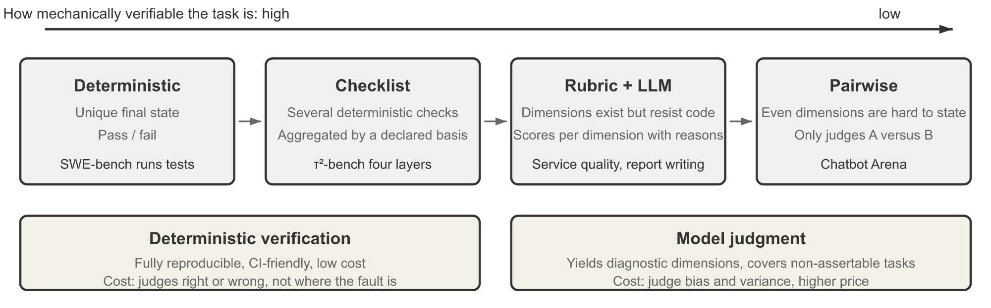
Code first, judge above it, humans to calibrate
The stack
Part 2 · Who can you trust to grade?
Code: deterministic, free, hard to argue with
Separated evaluator: runs the output, does not just read it
LLM judge: semantic quality at volume. Biased, needs calibration
A spectrum of verification modes (Li, AI Agents in Depth, 2026, Fig. 7-4, Apache-2.0)
Humans: 5–10% of graded rows, to calibrate the judge
Graders are layers rather than alternatives: run code first and stop early, so judge budget goes where judgment is needed.
Source: notes/04-graders.md
15
Notes:
Read the figure from deterministic to model judgment. For our agent, whether the refund row exists is a code check, and whether the tone is kind needs a judge. Humans do not grade everything. They label a small share so we can tell whether the judge can be trusted.
Source: notes/04-graders.md

Slide 16
One contract for every grader
Worked example
Part 2 · Who can you trust to grade?
PYTHON
requires: skip with context_missing, do not guess
class Grader(Protocol):
name: str
version: str
# e.g. {"retrieved_context"}
# skip if missing
requires: set[str]
def grade(self, task, output,
trajectory=None,
context=None) -> GraderResult:
...
# GraderResult: score, passed, reasoning,
# dimensions, labels, grader_version
reasoning: the explanation, or the failing check
labels: taxonomy labels this trial earned
grader_version: every score traceable
Give every grader the same input and output shape so graders become swappable, composable and reportable the same way.
Source: notes/04-graders.md
16
Notes:
The field to notice is requires. A grounding grader needs passage text. If it gets none, it should report context_missing and skip, not invent a verdict. We will see at the end of the talk that a real team lost time to exactly this bug. Versions make any score traceable afterwards.
Source: notes/04-graders.md

Slide 17
A composite can hide a regression
Combining scores
Part 2 · Who can you trust to grade?
Weighted composite alone
Hybrid with a veto
+5 relevance and −5 grounding makes a flat score
Must-pass: schema valid, no citation hallucination
Worse for users who need correct answers
Then 0.5 grounding + 0.3 completeness + 0.2 relevance at least 0.75
A fluent answer with a made-up fact still scores well
A hallucination fires a veto: the total is 0
Prefer binary pass or fail per dimension with vetoes for never-events, because a weighted average can trade grounding for relevance.
Source: notes/04-graders.md
17
Notes:
Suppose B gained five points on relevance and lost five on grounding. A weighted score reports no change, and yet users now get wrong answers politely. So vetoes come first and weights second. And prefer binary verdicts per dimension, because whether something is a 3 or a 4 has no stable answer.
Source: notes/04-graders.md

Slide 18
One judge, one criterion, reason before verdict
Worked example
Part 2 · Who can you trust to grade?
TEXT
Grade a third party's work, never your own
You are evaluating whether an answer
to a query is clear.
[BEGIN DATA]
Query: {query}
Answer: {response}
[END DATA]
"clear": easy to follow, answers the query.
"unclear": confusing, off-topic,
hard to act on.
EXPLANATION: <step-by-step reasoning>
LABEL: "clear" or "unclear"
Precise PASS and FAIL definitions
2–4 few-shot cases near the boundary
Delimited inputs; critique, then fixed-format label
A CANNOT_GRADE escape, or the judge guesses
Parse judge verdicts strictly and treat an unparseable verdict as a grader error, not a FAIL.
Source: notes/05-llm-as-judge.md
18
Notes:
This is a judge you can copy. It tests one thing, with defined labels and delimited inputs, and it writes its reason before its verdict. It also needs a way out. Without CANNOT_GRADE the judge will guess on impossible cases, and those guesses land in your pass rate.
Source: notes/05-llm-as-judge.md

Slide 19
Judges have known biases, and each has a fix
What goes wrong
Part 2 · Who can you trust to grade?
Bias | What happens | Fix
Position | Pairwise judges favour one slot | Run both orders. A win must hold in both
Verbosity | Longer answers score higher | Rubric says length is not quality. Track score against length
Self-preference | Favours its own model family | Judge with a different family
Leniency | Borderline cases pass | Explicit FAIL conditions. Tricky-FAIL few-shots
Format, authority | Confident tone and citations look right | Check citations in code
Limited capability | Cannot verify what it cannot do | A reference, a code check or a stronger judge
Once biases are controlled, strong judges agree with humans about as often as humans agree with each other, over 80%.
Source: notes/05-llm-as-judge.md
19
Notes:
Look at verbosity. If B got wordier, this judge prefers it regardless of quality, and our one point could live entirely in that row. These biases are not exotic. The same ones appear in human feedback, as we will see. The fixes are mostly cheap, like running both orders. Where a score will not work, pairwise votes can become a ranking through Elo, as long as a win holds in both orders, but a ranking cannot monitor production.
Source: notes/05-llm-as-judge.md

Slide 20
Elo depends on vote order, Bradley–Terry does not
Pairwise ranking
Part 2 · Who can you trust to grade?
Li's offline simulator: 3,000 battles between eight models with known skills, 10% ties. Elo (K = 4) run on five shuffles of the same battles.
Model | True skill | Bradley–Terry | Elo min | Elo max
gpt-4 | 1250 | 1116 | 1114 | 1133
claude-3-opus | 1225 | 1114 | 1100 | 1110
gemini-1.5-pro | 1180 | 1058 | 1051 | 1068
mixtral-8x7b | 1075 | 974 | 955 | 988
vicuna-13b | 935 | 876 | 862 | 887
Use Elo for a live leaderboard and a Bradley–Terry fit with bootstrap intervals for any ranking you publish or gate on.
Source: notes/05b-pairwise-ranking-elo-and-bradley-terry.md
20
Notes:
Both methods recover the true order and the gaps between models. The absolute level differs because each anchors its own mean. The point is the Elo spread: up to 34 points from vote order alone at K = 4, and 148 points at K = 32, enough to swap the top two. With an LLM judge doing the voting, swap the order on every pair and count a win only if it holds both ways.
Source: notes/05b-pairwise-ranking-elo-and-bradley-terry.md

Slide 21
Calibrate a judge before it gates anything
The gate to the gate
Part 2 · Who can you trust to grade?
A heuristic can gate. A calibrated judge can gate at its threshold. An experimental judge only tracks.
1
Get human labels — 100–200 outputs labelled PASS or FAIL by your domain expert.
2
Split — Train for few-shots, dev to iterate, test to measure once.
3
Run on dev — Build the confusion matrix against the human labels.
4
Read disagreements — Each is a prompt problem, a criteria problem or a hard case.
5
Measure on test once — That is the reported number. Record judge model and prompt version.
An uncalibrated judge never gates a release, and a threshold change without fresh evidence moves it back to experimental.
Source: notes/15-calibration-against-human-labels.md
21
Notes:
This is the same discipline as training a model. Tune on dev, report on test, and look at test only once. Then report two error rates separately: true positive rate, so you do not block good releases, and true negative rate, so you catch bad outputs. For a release gate, the second usually matters most.
Source: notes/15-calibration-against-human-labels.md

Slide 22
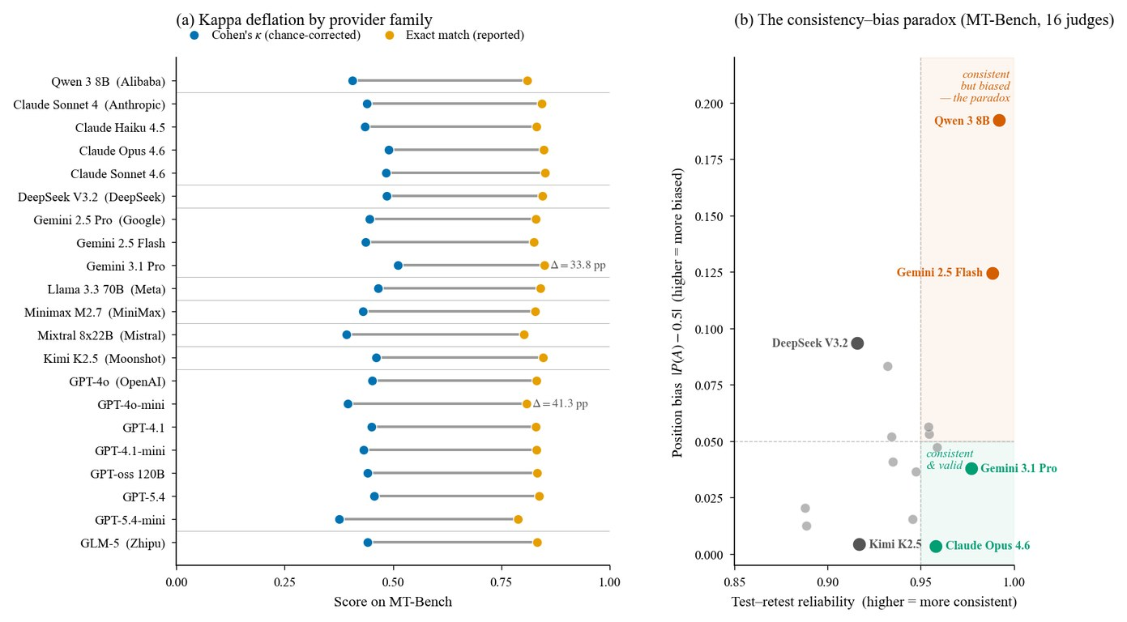
Agreement looks better than it is
Evidence
Part 2 · Who can you trust to grade?
21 judges on MT-Bench: raw agreement exceeds Cohen's κ by 33.8–41.3 points
85% agreement corresponds to κ near 0.48
Qwen 3 8B repeats itself (α 0.992) with the strongest position bias (0.192)
Correct the rate: true ≈ (p̂ + TNR − 1) / (TPR + TNR − 1)
Norman et al., Reliability without Validity (2026), Fig. 1
Lead with kappa rather than raw agreement, because a judge can be perfectly repeatable and still be reliably biased.
Source: notes/15-calibration-against-human-labels.md
22
Notes:
The left panel is agreement near 0.8 next to kappa near 0.4 to 0.5, the same judges measured two ways. On the right, a judge that gives the same verdict nearly every time also has the strongest position bias. A deterministic judge just reproduces its bias exactly. So run the swap check, even on a judge that never changes its mind.
Source: notes/15-calibration-against-human-labels.md

Slide 23
Cross the code checks with the judge
Beyond the rates
Part 2 · Who can you trust to grade?
TEXT
Read code fail, judge pass first: three false passes say 30 days where the cited document says 14
on dev, 560 rows lenient strict
code pass, judge pass 377 538
code pass, judge FAIL 161 0
code FAIL, judge pass 3 3
code FAIL, judge FAIL 19 19
t00689: both fail, the label says PASS, and a person decides
The 161: all labelled PASS, 151 of them Dutch. TPR 10/161 on Dutch, 367/378 on English
Cross code checks with the judge to find what to fix, then read the false passes first. Agreement with code never replaces human labels.
Source: notes/14-calibrating-judges-with-checks-and-critiques.md
23
Notes:
This exercise tests the procedure and measures no real model. The judges are deterministic rules, the human labels are planted failures, and only 42 of 1,400 rows are FAIL, split 12, 21 and 9 across train, dev and test. The false passes came from comparing numbers with every retrieved document, so the fix is on the judge's side: compare against the cited source. The language slice stays after Holm's correction across 19 tests, and cutting one flag within another shows that two other slices are partly language in disguise.
Source: notes/14-calibrating-judges-with-checks-and-critiques.md

Slide 24
Fix the largest class of error, then test once
The calibration record
Part 2 · Who can you trust to grade?
Rule judges and planted failures: this tests the procedure, and says nothing about a real model.
Version | TPR | TNR | kappa
v0 lenient, dev | 0.699 | 0.857 | 0.120
v1 no overlap rule, dev | 0.998 | 0.857 | 0.896
v2 numbers against cited documents, dev | 0.998 | 1.000 | 0.976
v2 on test, once | 550/551 | 9/9 | 0.946
Each change must win on dev. The test's 9/9 has a Wilson interval of 0.70 to 1.00, and its perfect score is a property of this setup.
Source: notes/14-calibrating-judges-with-checks-and-critiques.md
24
Notes:
v2 is the code check: we rewrote the judge into the same rule, so nothing now cross-checks anything. Measurement has its own traps. Stop early and you lose what you came to measure: strict-judge TNR is 18/21 on every row, 11/14 on rows passing check A, and 0/0 on rows passing both. The disagreement queue, n = 415, shows TPR 0 and TNR 0 for a judge whose real values are 0.694 and 0.929, so use it to find fixes and never for rates. A random 105 rows give a TNR anywhere from 0.50 to 1.00, and a stratified 150 weighted by known odds of selection is still a valid probability sample.
Source: notes/14-calibrating-judges-with-checks-and-critiques.md

Slide 25
A critique is a clue, not the cause
Critiques as evidence
Part 2 · Who can you trust to grade?
What the research warns
What to do about it
Turpin 2023: 1 of 426 explanations mentioned the bias; accuracy fell by up to 36.3%
Tag critiques, fix the largest class, keep it only if it wins on dev
Chen 2025: models revealed a hint 25% and 39% of the time
Prompt fixes are hypotheses, not findings
Cue and edit tests are online: not run, no results here
Mittal and Arike: detect 88–94%, locate 56–68%, flag 40–55% of perfect chains
Human labels settle which judge is right
Almost none tests a judge on a rubric
Necessary, not sufficient
Use a critique to find what to change, and change the input to see whether the verdict follows, because it can leave out what moved the verdict.
Source: notes/14-calibrating-judges-with-checks-and-critiques.md
25
Notes:
These sources mostly test answering models, and Mittal and Arike grade reasoning chains rather than a judge's own critiques, so treat them as warnings. Tapwal's locked notes cut revisions after a reveal to 5 to 22% from 76 to 85%, but tied on 82 to 94% of near-equivalent pairs, which a release gate cannot copy as it stands. That closes part two: we trust our graders only as far as we have checked them. Next, what should they look at in an agent?
Source: notes/14-calibrating-judges-with-checks-and-critiques.md

Slide 26
PART 3
The agent says the refund went through
Outcome and trajectory fail independently
One task, k = 3: pass@k rises, pass^k falls
Measure accuracy against cost, with a simple baseline
An agent environment has five parts, and each can be wrong alone
Score each RAG stage on its own
Check grounding one claim at a time
A trace says where a run went wrong
What do you actually measure?
Evaluating agents · RAG and grounding · Tracing
26
Notes:
A single answer is easy to grade, but our agent takes actions over several steps and retrieves evidence. This part covers how to grade the path as well as the result, how to take grounding apart claim by claim, and why traces come before all of it.

Slide 27
The agent says the refund went through
The problem
Part 3 · What do you actually measure?
"I've issued your refund." There is no refund row. Which of your evals catches that?
Grade the end state, not what the agent says.
Grade the end state rather than the agent's words, because a false claim of success is the most important failure to catch.
Source: notes/06-evaluating-agents.md
27
Notes:
A judge reading that sentence would call it polite, clear and complete. Only a state check looks in the database and sees nothing there. For a coding agent the state is the test suite, and for a SQL agent it is the query result rather than the query text.
Source: notes/06-evaluating-agents.md

Slide 28
Outcome and trajectory fail independently
Two dimensions
Part 3 · What do you actually measure?
Outcome | Trajectory | What happened | Outcome-only eval says
Pass | Pass | Worked | Pass
Pass | Fail | Right answer by an unsafe or wasteful path: 40 paid API calls | Pass (wrong)
Fail | Pass | Reasonable process, external failure: tool timeout | Fail (not the agent)
Fail | Fail | Broken | Fail
Score outcome and trajectory separately, because an outcome-only eval passes a wasteful path and blames the agent for a timeout.
Source: notes/06-evaluating-agents.md
28
Notes:
Two of these four rows mislead you if you only look at the end. The agent that got there with 40 paid calls looks fine until the invoice comes, and the one defeated by a tool timeout gets blamed for someone else's outage. Grading both tells you which fix to make. Match tool calls only as strictly as the requirement: exact, in order, any order, or within an allowed set. For a refund, the rule that matters is an invariant: never issue_refund before lookup_order.
Source: notes/06-evaluating-agents.md

Slide 29
One task, k = 3: pass@k rises, pass^k falls
Worked example
Part 3 · What do you actually measure?
PYTHON
Run each task 3–10 times and report rates
p, k = 0.75, 3
# at least one of k succeeds
pass_at_k = 1 - (1 - p) ** k # 0.98
# all k succeed
pass_hat_k = p ** k # 0.42
pass@k fits systems that can retry and pick
pass^k fits a user who gets one try
HealthBench: o3 averages 0.60, worst-of-16 is a third lower
Log per attempt: summaries cannot be reconstructed
Report pass^k for customer-facing agents: a 75% agent passes 98% with three retries, but all three times only 42% of the time.
Source: notes/06b-components-trials-and-cost.md
29
Notes:
Same agent, same three trials, and the two numbers are 0.98 and 0.42. Which do you put on the slide for your boss? Every user of a support agent gets one try, so pass^k is the honest one. Also check the distribution, since 70 percent can mean flaky everywhere or a fixed set of impossible tasks.
Source: notes/06b-components-trials-and-cost.md

Slide 30
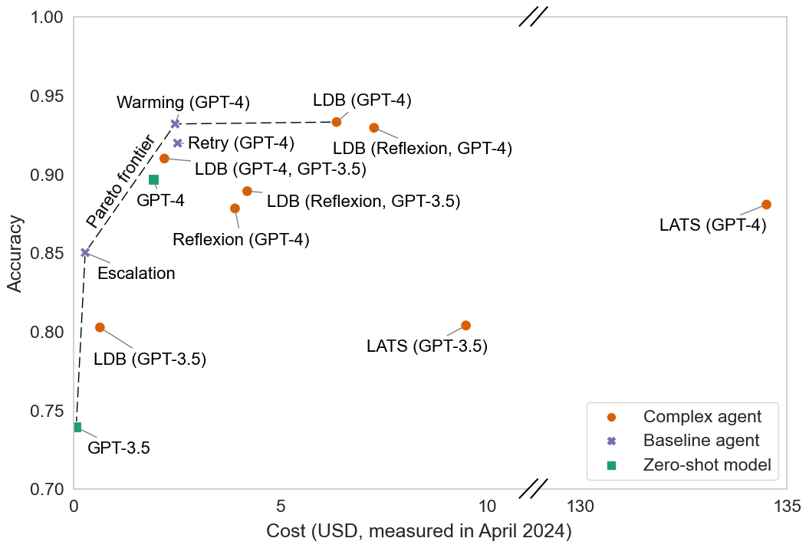
Measure accuracy against cost, with a simple baseline
Evidence
Part 3 · What do you actually measure?
HumanEval, 164 problems, five runs each, April 2024 prices
Warming baseline: 93.2% for $2.45
LDB with GPT-4: 93.3% for $6.36
LATS with GPT-4: 88.0% for $134.50
Refund agent, three turns: 9,500 input tokens, 470 output, $0.022
Kapoor et al., AI Agents That Matter (2024), Fig. 1
Plot accuracy against cost with simple baselines, because similar accuracy can differ by almost two orders of magnitude in cost.
Source: notes/06b-components-trials-and-cost.md
30
Notes:
A plain retry with rising temperature matched an elaborate agent at under half the cost, and it beat another at about a fiftieth. None of the original papers made cost a headline metric. So log tokens, steps, latency and cost per success on every trial, since pass rates miss efficiency regressions.
Source: notes/06b-components-trials-and-cost.md

Slide 31
An agent environment has five parts, and each can be wrong alone
Agent environments
Part 3 · What do you actually measure?
Part | Holds | Gets it wrong when
Dataset | Initial state, goal, optional reference solution | The goal is ambiguous
Environment state | Mutable records: orders, balances, files | It breaks business rules or cannot reset to the same start
Tools | Atomic operations: look up order, modify booking | They are so high-level they skip the planning you meant to test
Rubric | Binary, continuous or multi-dimensional score | The score does not match the criterion
Interaction protocol | Who acts when: single-shot, multi-turn, simulated user | The user model is unrealistic
Reset state for every trial, keep trials isolated, and check the task before the agent when it fails every time.
Source: notes/06c-agent-suites-and-environment-hygiene.md
31
Notes:
On BrowseComp, 21 of the 118 questions that Deep Research never solved had a bad reference answer, so a 0% task is suspect. Also keep the answer out of reach: reference answers, grader code and hidden tests belong where the agent's tools cannot read them.
Source: notes/06c-agent-suites-and-environment-hygiene.md

Slide 32
Score each RAG stage on its own
Grounded answers
Part 3 · What do you actually measure?
Retrieve
recall@k, hit rate
Rerank
MRR, nDCG@k
Context
context precision
Generate
faithful, complete
Cite
citations valid
Pick k to match what enters the prompt. Recall@50 is irrelevant if 5 are passed
Score generation only on generation-eligible rows
Faithful is not correct: faithful-but-wrong points at the corpus
Split a RAG eval by stage, so that a retrieval miss does not get counted as a bad answer and sent to the wrong team.
Source: notes/07-evaluating-rag-and-grounding.md
32
Notes:
Our agent gives a wrong answer about payouts. Was the article missing, ranked too low, or misread? One score cannot say. Measure each stage on the rows that are fair for it. An answer faithful to a stale document is a corpus problem, and no amount of prompt tuning fixes it.
Source: notes/07-evaluating-rag-and-grounding.md

Slide 33
Check grounding one claim at a time
Faithfulness
Part 3 · What do you actually measure?
Extract claims — Split into atomic statements. Settings, Payouts, click Edit, 2 days is three.
1
Verify each — Against passage text: supported, contradicted or not found.
2
Score — Supported over total. Report contradictions separately.
3
Tier the claims — Strict facts need near-verbatim support, paraphrase needs entailment, filler is exempt.
4
Pass the grader passage text, not pointers, because a grader handed URLs scores near zero or grades from its own knowledge.
Source: notes/07-evaluating-rag-and-grounding.md
33
Notes:
A whole-answer judge averages away the one wrong fact, so check claim by claim. Citations are even better, since code can check that a cited ID is in the retrieved set and that a quote really appears in the passage. Hand the grader the passage text. We come back to this at the end of the talk.
Source: notes/07-evaluating-rag-and-grounding.md

Slide 34
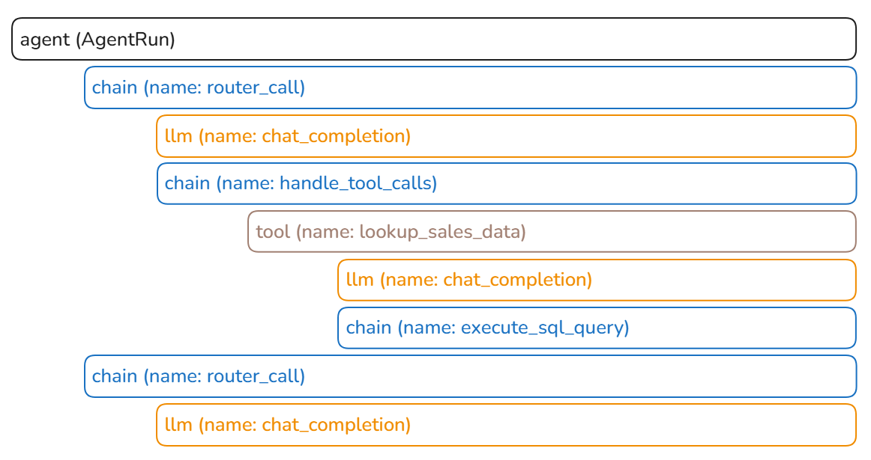
A trace says where a run went wrong
Where it all comes from
Part 3 · What do you actually measure?
Model call: model ID, full input, tokens, latency
Tool call: name, arguments, result or error
Retrieval: query, IDs and text, scores
Root: prompt, model, config and index versions
OpenTelemetry GenAI names make traces portable; every failure becomes a new row
DeepLearning.AI & Arize, Evaluating AI Agents (2025), Lab 2
Final-output evals say that something failed and traces say where, so record traces before you need them.
Source: notes/08-tracing-and-observability.md
34
Notes:
This span tree is one agent run. Scores attach right to the spans, so you are one click from the context of any failure. Run the same grader code on production samples as in CI, and turn failures into new rows. That closes part three: we can measure, so can we now call B better?
Source: notes/08-tracing-and-observability.md

Slide 35
PART 4
One point on a small suite is usually noise
Halving the error bar takes four times the tasks
Compare both versions on the same tasks
Slicing finds what the average hid
Slice by difficulty as well as topic
A report that supports a decision
Run first, assert second, with an artefact between
Gate against a baseline, on the interval
Is the difference real?
Reading results · Evals in CI
35
Notes:
Now we finally return to 84 and 85. Reading a result is statistics, and most of it is simple. This part puts error bars on that number, runs the comparison properly, slices it, and shows how to put the whole decision into CI so nobody has to argue about it.

Slide 36
One point on a small suite is usually noise
The problem
Part 4 · Is the difference real?
On 50 tasks, 80% and 72% are not distinguishable. So what is +1 worth?
Every number gets an error bar before it gets an opinion.
A rate from a finite suite is an estimate, and on 50 tasks a gap of 8 points can still sit inside the error bar.
Source: notes/09-reading-results.md
36
Notes:
Most teams have stared at a dashboard and celebrated a number like this. The numbers on the next slide show why they should not. On a small suite one flipped task moves the rate several points. So the question for our decision is not whether 85 beats 84, but how many tasks stand behind each.
Source: notes/09-reading-results.md

Slide 37
Halving the error bar takes four times the tasks
Sizing the error bar
Part 4 · Is the difference real?
SE = √(p(1 − p) / n). The 95% CI is p ± 1.96·SE. To detect 10 points, paired: 100–200 tasks. 5 points: 400–800. 2 points: 2,500+.
Tasks | SE at p = 0.80 | 95% CI
20 | 0.089 | 62% – 98%
50 | 0.057 | 69% – 91%
100 | 0.040 | 72% – 88%
300 | 0.023 | 75% – 85%
1,000 | 0.013 | 77% – 83%
Size the suite for the smallest change that matters: a 50-task golden set is a smoke detector, not an instrument for a 3-point tweak.
Source: notes/09-reading-results.md
37
Notes:
Read the second row: 50 tasks at 80 percent gives 69 to 91. The sizing numbers in the lead assume a paired comparison, 80 percent power and pass rates of about 70 to 85 percent. So decide what change matters before you collect tasks. Your 50-task set catches disasters, and that is a fine job for it.
Source: notes/09-reading-results.md

Slide 38
Compare both versions on the same tasks
Pairing
Part 4 · Is the difference real?
Two independent rates
Per-task differences
Most tasks pass or fail on both, so differences are mostly 0
A at 84%, B at 85%, each with its own wide interval
SE(Δ) = sd(differences) / √n, much smaller
Task-to-task variation swamps the difference
McNemar: only the discordant tasks count
B wins 14–6 is evidence. 11–9 is not
The error bars overlap and you learn nothing
Pairing cuts variance for free
Run both versions on identical tasks and analyse per-task differences, since only the tasks that flip carry evidence.
Source: notes/09-reading-results.md
38
Notes:
Most of the variance between tasks has nothing to do with your change, since some tasks are simply hard. Pairing subtracts that. The count that matters is flips. Also resist reading a tiny experiment, where seven questions means one flipped task moves a rate 14 points, and read the flipped transcripts.
Source: notes/09-reading-results.md

Slide 39
Slicing finds what the average hid
Worked example
Part 4 · Is the difference real?
Slice | n | A | B | Δ
Billing | 120 | 82% | 90% | +8
How-to | 150 | 88% | 89% | +1
Non-English | 40 | 75% | 58% | −17
Overall | 310 | 84% | 85% | +1
An overall gain of one point can ship a change that breaks one group of users, so slice before concluding and show n per slice.
Source: notes/09-reading-results.md
39
Notes:
Here is our answer. B gained eight points on billing, did nothing for how-to, and lost seventeen on non-English. Remember the language label on our row in part one. That single field is why we can see this. Without it we ship a regression and call it a gain.
Source: notes/09-reading-results.md

Slide 40
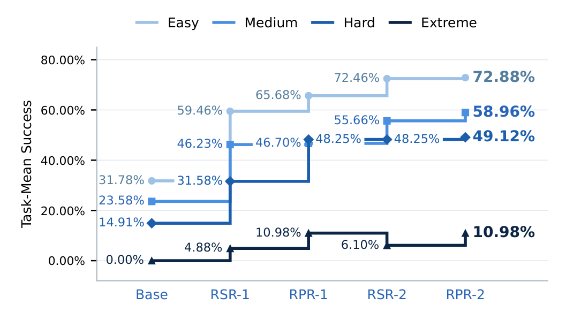
Slice by difficulty as well as topic
Evidence
Part 4 · Is the difference real?
Easy tasks: 32% to 73%. The headline gain lives here
Extreme tasks: 0, 4.9, 11.0, 6.1, then 11.0%
One pooled rate hides where progress stalls
Yang et al. (2026), Figure 10
Report difficulty strata, because a rising average can sit on top of a flat hard tail.
Source: notes/09-reading-results.md
40
Notes:
The same idea applies by difficulty. Across five training stages in Yang and colleagues, easy tasks more than doubled while extreme ones never got past 11 percent. Pool them and you would believe the system was improving evenly. Ask where a gain lives before you say what caused it.
Source: notes/09-reading-results.md

Slide 41
A report that supports a decision
Worked example
Part 4 · Is the difference real?
TEXT
Suite: support-golden v4 (n=310, 3 trials/task) Judge: grounding-v2 (TNR 0.88)
A (prod) B (candidate) Δ (paired)
Pass rate 84.2% ±3.9 85.1% ±3.8 +0.9 [−1.6, +3.4]
Non-English (40) 75.0% ±13 57.5% ±15 −17.5 [−29, −6] !
Errors / refusals 1.3% 4.2% !
Cost per success $0.014 $0.016 +14%
Flipped tasks read: 18 / 18. 9 of 11 regressions are refusal on non-English
Decision: do not ship. Investigate refusal behavior for non-English.
Count errors and refusals as failures or as their own rate, and never let them leave the denominator.
Source: notes/09-reading-results.md
41
Notes:
This is the answer to the question on our first slide: do not ship. Look at what lets someone act on it: dataset and judge versions, intervals, the paired delta, the slice, refusals as their own rate, and how many flipped tasks a person read. The overall interval includes zero, and the slice interval does not.
Source: notes/09-reading-results.md

Slide 42
Run first, assert second, with an artefact between
Into CI
Part 4 · Is the difference real?
Cheap suites on every change, costly ones on a schedule: code graders per commit, calibrated judges when prompts change, all graders nightly and pre-release.
Phase 1: Run
Phase 2: Assert
Load results, compute metrics and CIs per slice
For each task and trial: run the system, capture the trace, grade
Compare to baseline and thresholds
Write a row to results.jsonl
Emit pass or fail per gate and a report
Slow, costly, non-deterministic
Fast, free, deterministic
Splitting run from assert lets you change a threshold or add a slice in seconds without re-running a $30 suite.
Source: notes/10-evals-in-ci.md
42
Notes:
Now we automate that decision. Keep the expensive part apart from the arithmetic. Results become an artefact you can diff and attach to the PR, and retries are recorded instead of swallowed. Use path filters as well, so a README change does not trigger a 40 dollar judge run.
Source: notes/10-evals-in-ci.md

Slide 43
Gate against a baseline, on the interval
The regression gate
Part 4 · Is the difference real?
Rule | Example | Catches
Absolute floor | Schema at least 99%. Citation hallucination = 0 | Never-events
Relative to baseline | Grounding at most 3 points below prod (paired CI) | Regressions
Per-slice floor | No slice drops more than 10 points | Hidden slice losses
Efficiency budget | Cost per success at most 1.2× baseline. p95 at most 8 s | Silent cost blow-ups
Regression set | Fixed failures at least 95% pass | Re-broken bugs
Block when the upper bound of the difference is below −3, since a rule of blocking on any drop fires on noise half the time.
Source: notes/10-evals-in-ci.md
43
Notes:
Look at the third row: that is the rule that would have caught our B automatically, with no one needing to stare at a report. Gate on the interval, and update the baseline deliberately after each release. Assign owners too: one for the infrastructure, one for the criteria, and every engineer adds a row with each bug fix. That closes part four.
Source: notes/10-evals-in-ci.md

Slide 44
PART 5
Performance changes even when you change nothing
Climb the maturity ladder one rung at a time
Sample by rule, alert on drift, ramp every change
User feedback has biases of its own
Suspect the eval before you suspect the agent
Optimize hard and you will find the eval's gaps
Which judges earned a gate in the case study
Each gate hands the next one a named pool
What happens after launch?
Production · Failure modes · A case study
44
Notes:
A suite that passed before release tells you about the world as it was. The model changes, users change, and the eval itself goes wrong. This part covers the maturity ladder, what breaks once an eval is relied on, and one real team's system with its mistakes.

Slide 45
Performance changes even when you change nothing
The problem
Part 5 · What happens after launch?
We'll add evals later means we will have no signal when this breaks.
Providers ship new snapshots, users shift, tools change shape, the index goes stale.
Performance changes after launch even when you change nothing, through model updates, input shift, upstream changes and stale corpora.
Source: notes/11-production-and-the-maturity-ladder.md
45
Notes:
Suppose we fix B and ship it. A month later, the provider moves a snapshot behind the same alias and a tool changes its response shape. You touched nothing and quality dropped. Offline suites cannot see that. So how much production signal do you need, and in what order do you build it?
Source: notes/11-production-and-the-maturity-ladder.md

Slide 46
Climb the maturity ladder one rung at a time
Build order
Part 5 · What happens after launch?
more signal
0
0 · Vibes — Manual review. Catches what you happen to look at.
1
1 · Deterministic gates — Tests, schemas, hooks. Highest return per effort.
2
2 · Separated evaluator — Fresh context, runs the output. Behavioural failures.
3
3 · Failure evals and tracing — Regressions, and where a run broke. Production needs this.
4
4 · Continuous sampling — Drift alerts against a launch baseline.
Production needs at least level 3, failure evals with tracing, and deterministic gates give the highest return on the way there.
Source: notes/11-production-and-the-maturity-ladder.md
46
Notes:
Do not read this as a score to maximize. Read it as a build order. Deterministic gates are cheap and catch a lot. The line that matters is level three, since below it you cannot tell a regression from a bad day. Our suite sits at three by now, and sampling is the next rung.
Source: notes/11-production-and-the-maturity-ladder.md

Slide 47
Sample by rule, alert on drift, ramp every change
Running online
Part 5 · What happens after launch?
Sample 10–20% of traces by rule: 100% of negative feedback, plus escalations, high cost and long chats
Plumbing first
Two layers: humans sample and calibrate, while the judge scores everything and watches drift
An alert is first a question. Is the data valid, did a schema change, is it one outlier?
Drift: baseline at launch, same pipeline continuously, rolling windows, and watch the input mix too
Before A/B: shadow mode first, then a canary at 1–5% of traffic with rollback on regression
A/B: declare metric and size up front, keep guardrails, ramp 1%, 10%, 50%
Later: an eval environment can become a training environment, with the grader as reward
Judges alone drift unnoticed and humans alone do not cover real traffic, so sample by rule and have humans calibrate the judge.
Source: notes/11-production-and-the-maturity-ladder.md
47
Notes:
Sampling by rule means your review time lands on the failures. A random slice beside it keeps the rates unbiased. The order of release matters too: shadow mode teaches you what breaks at no risk to users, and a canary limits the damage. Peeking at an A/B test and stopping on a good day inflates false positives.
Source: notes/11-production-and-the-maturity-ladder.md

Slide 48
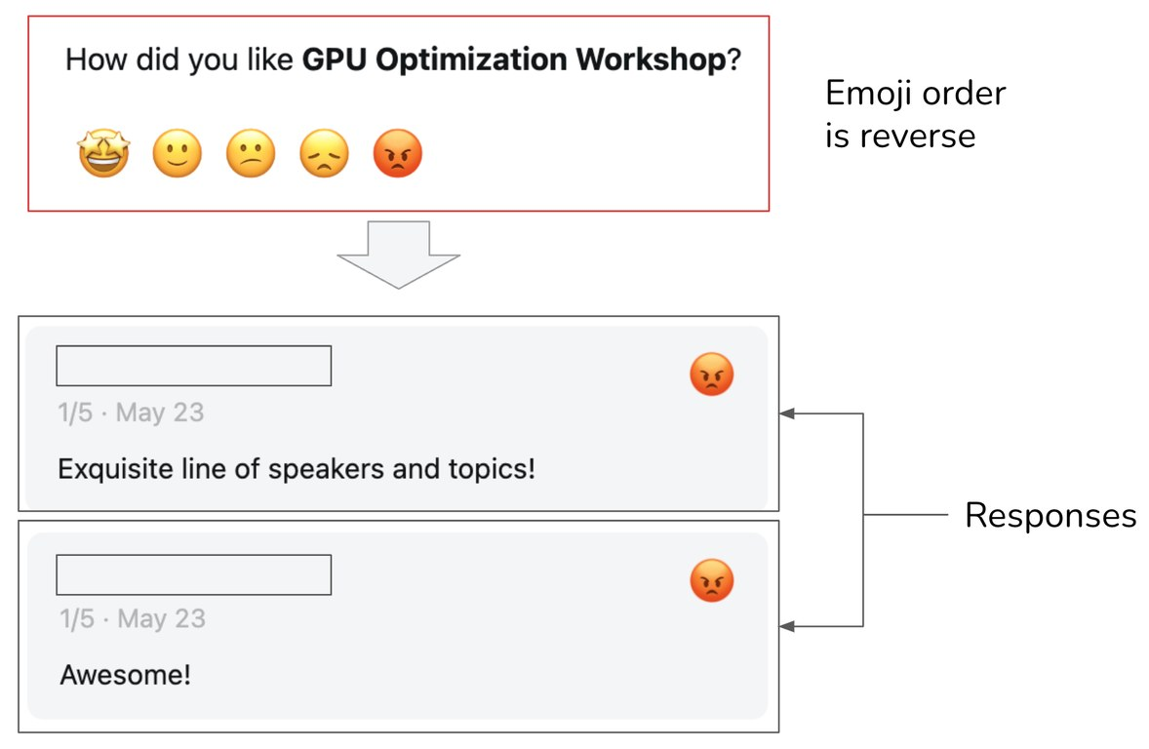
User feedback has biases of its own
Evidence
Part 5 · What happens after launch?
Broken UI: the angry emoji sat at five stars, so happy attendees left 1/5
Leniency: in 2015 Uber averaged 4.8, and below 4.6 risked deactivation
Position and preference: first gets clicks, longer gets picked
Degenerate loop: you only get feedback on what you showed
Trained on approval, models drift toward sycophancy (Sharma et al. 2023)
Huyen, AI Engineering (O'Reilly, 2025), Fig. 10-21
Test the feedback form and look at the rating distribution, because user signals carry the same biases as judges plus broken UI.
Source: notes/11-production-and-the-maturity-ladder.md
48
Notes:
Huyen's own workshop form put the angry face in the five-star position, so happy people gave one star and left warm comments. Thumbs-down data seems like ground truth, but it is another instrument that needs checking. And if feedback trains the system, its own outputs shape what it hears next.
Source: notes/11-production-and-the-maturity-ladder.md

Slide 49
Suspect the eval before you suspect the agent
When a number drops
Part 5 · What happens after launch?
1
Infrastructure — Errors, timeouts, 429s, OOM. Are error counts up?
2
Versions — Dataset, grader, judge model or config changed between runs?
3
Traces and grades — Read 10–20 failed transcripts with their grades. Is the grade right?
4
Slices — Is the drop concentrated in one category?
5
Only then the agent — Model, prompt, tools, logic.
Skipping straight to the agent fixes something that was not broken, so check infrastructure, versions, grades and slices first.
Source: notes/12-failure-modes.md
49
Notes:
Eval bugs look exactly like agent bugs. In the Evaluating AI Agents course lab, the SQL grader passes when no SQL ran, so a version that skips the tool earns a perfect score. Going straight to the prompt in that case fixes nothing, and it may break something. Work down this list in order.
Source: notes/12-failure-modes.md

Slide 50
Optimize hard and you will find the eval's gaps
Once people rely on it
Part 5 · What happens after launch?
A suite near 100% has stopped measuring: graduate it, add harder tasks, raise the bar.
Gap exploited | Example
Grader leniency | Answers padded until the verbosity-biased judge passes them
Narrow checks | Agent edits the tests, not the code. Valid schema, empty content
Proxy metric | Thumbs-up optimized into flattery. Escalations cut, so it will not escalate when it should
Visible tests | Overfits to the tests it can see
Repeated scoring | ARC Prize reused 100 private tasks and disclosed about 10,000 scores
Defend an eval with several dimensions, held-out tests, reading the biggest gains and refreshing tasks from production.
Source: notes/12-failure-modes.md
50
Notes:
Once a metric matters people and agents aim at it, which is Goodhart's law. Every score reported from a test set leaks a little about it. Evals also pile up debt, like thresholds nobody revisits and stale rows and copies of a grader that drift. Schedule the maintenance and retire metrics nobody acts on.
Source: notes/12-failure-modes.md

Slide 51
Which judges earned a gate in the case study
A real system
Part 5 · What happens after launch?
50 tasks, 25 liked and 25 disliked by users. Δ is liked minus disliked mean score.
Grader | Δ | Cohen's d | Verdict
Custom answer_relevancy v3 | +0.214 | 0.75 | Strong: ship
DeepEval answer_relevancy | +0.086 | 0.25 | Weak
Custom completeness | +0.030 | 0.07 | Marginal
DeepEval completeness | −0.042 | — | Inverted
Custom escalation | 0.000 | 0.00 | No signal: do not gate
DeepEval escalation | −0.080 | — | Inverted
Validate judges against users rather than other judges, and recalibrate per domain, because calibration does not transfer.
Source: notes/13-case-study-support-agent.md
51
Notes:
This team ran a multi-agent support system, close to ours. Two off-the-shelf judges scored disliked answers above liked ones. Their cross-check also showed low agreement because the grader had been fed URLs, not passages. That is the context_missing label we met in the grader contract.
Source: notes/13-case-study-support-agent.md

Slide 52
Each gate hands the next one a named pool
Worked example
Part 5 · What happens after launch?
JSON
Eight gates: corpus, index, retrieval, model, agent retrieval, generation, calibration, report
{
"run_id": "…",
"git_commit": "abc1234",
"gate": "retrieval_optimization",
"row_pool": "retrieval_eligible_gt",
"n": 0,
"config": {},
"metrics": {},
"failure_counts": {},
"known_exclusions": [],
"pass": true
}
Thirteen labels owned by the gate that fixes them
Pools narrow: all, mapped, retrieval, generation, quality sample
Every claim names gate, pool, n and artefact
Do not collapse corpus, retrieval, agent, generation and calibration into one score: each gate answers one question over a named pool.
Source: notes/13-case-study-support-agent.md
52
Notes:
This header is what keeps the blame honest. Without pools, a retrieval miss looks like a bad answer and the generation team gets blamed for the corpus team's gap. One blended score would have hidden every finding this team made. That is the talk: define, grade, measure, read, gate, and keep watching.
Source: notes/13-case-study-support-agent.md

Slide 53
Six rules to take with you
Rules of thumb
Wrap-up
Before any grader
The dataset
Graders
Write success down. Two experts must agree. Read 50–100 traces first.
Start with 20–50 real failures. Negatives and boundaries. Eligible rows only.
Code first. One judge per criterion. Read code-fail, judge-pass rows first. Uncalibrated judges never gate.
Agents and RAG
Reading and gating
Production
Outcome and trajectory. k trials, pass^k. Grounding claim by claim.
Error bars, paired comparisons, slices. Run, then assert, against a baseline.
Sample by rule. Humans calibrate the judges. Debug infra before the agent.
Define correct first, check graders against humans, grade state and path, read intervals and slices, gate on baselines, then keep sampling.
Source: notes/12-failure-modes.md
53
Notes:
If you remember only one card, make it the one you lack today. Most teams should start with the first two: write down what correct means, and turn twenty real failures into rows. Everything else in this talk gets easier once those two things exist.
Source: notes/12-failure-modes.md

Slide 54
Where to go next
Where next
Wrap-up
Lab: practice/eval-suite-ci/ (TypeScript) and practice/eval-suite-ci-py/ (Python): 24 cases, three graders, a baseline, paired regression testing, an exit code
The one idea to keep
Copy-ready: judge prompt (05), failure taxonomy (02), row schema (03), gate rules and CI workflow (10)
An eval is a measurement. Define correct before grading, trust no grader you have not checked against humans, and put an error bar on every number.
A real system: note 13, a multi-agent support system's eval design, mistakes included
A judge is wrong, now what? note 14, checks, slices and critiques as evidence
Course: DeepLearning.AI and Arize, Evaluating AI Agents, folded into notes 05, 06 and 08
Loops: ai-engineering/04-loop-engineering, where an eval becomes the optimizer's target
Start with the eval-suite-ci lab, then read the case study, and then see how an eval becomes a loop's target.
Source: notes/13-case-study-support-agent.md
54
Notes:
The lab runs offline with a stub by default, so you can try a paired gate today with no API key. Then read the case study, because its mistakes are the most instructive part. And when you are ready, the loop engineering pillar shows what happens when an agent optimizes against one of these evals.
Source: notes/13-case-study-support-agent.md

