Slide 1
RAG and retrieval
Part 1: Why retrieve, and the whole pipeline
What RAG solves, the smallest version, and the map of stages.
Part 2: Finding the right passage
Search, stores, chunking and reranking.
From one wrong refund answer to a system you can measure
Part 3: From passage to production
Generation, evaluation, tracing, cost and security.
Part 4: Case studies
Retrieval sets the ceiling
PRINCE, store choice and a semantic cache.
Part 5: Deciding what to build
Reading an ablation, and managed services against your own.
generative-ai/02-rag-retrieval
Notes:
This deck follows one wrong answer from Tallybook's support bot through the RAG pipeline, using the twelve chapters in this pillar.

Slide 2
PART 1
The bot said 14 days. The policy says 30.
RAG adds one step between the question and the model
The augmentation step is an f-string
Long context can beat RAG, at a price
Three generations of the same pipeline
Query-time stages run cheapest first
Ingestion quietly decides what can ever be found
When a single retrieval pass isn't the answer
Why retrieve, and the whole pipeline
What RAG solves, the smallest version, and the map of stages.
2
Notes:
First we set up the problem and draw the map. We go from one wrong refund answer to the smallest possible RAG, then to the stages a real pipeline adds.

Slide 3
The bot said 14 days. The policy says 30.
The problem
Part 1 · Why retrieve, and the whole pipeline
Retrieval sets the ceiling: the LLM can't cite a document the retriever never returned.
Nearly every RAG failure is a retrieval failure that looks like a model failure.
Source: notes/02-why-rag-and-the-augmented-prompt.md
3
Notes:
Tallybook's support bot tells a customer they have 14 days to get a refund. The current policy says 30. The model didn't invent this: the 14 came from a 2024 archive page that is still in the index. The answer reads perfectly, and it is wrong because of what retrieval handed the model. We will chase this one answer through the whole pipeline.
Source: notes/02-why-rag-and-the-augmented-prompt.md

Slide 4
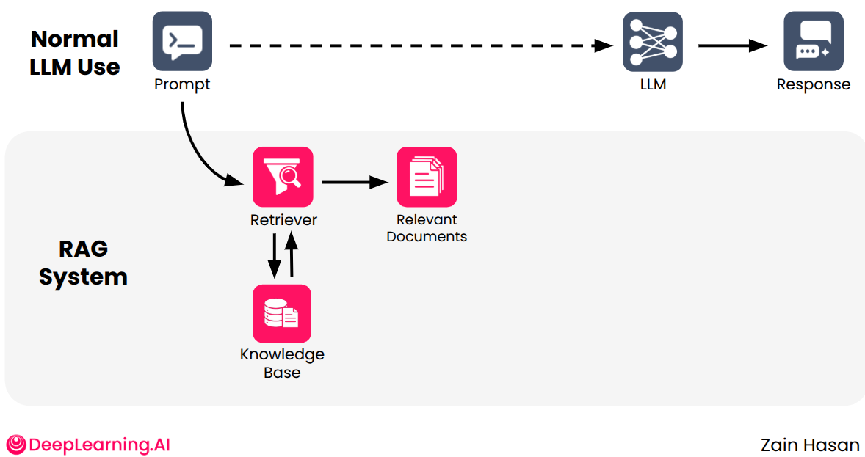
RAG adds one step between the question and the model
Part 1 · Why retrieve, and the whole pipeline
Solves: private, recent, hard-to-access facts.
No retraining: swap the index and the answers change.
Costs: latency, index upkeep, a new failure surface.
Normal LLM use above, a RAG system below (Hasan, DeepLearning.AI RAG course, Module 1)
RAG gives the model facts at inference time, in exchange for latency, an index to maintain and a new way to fail.
Source: notes/02-why-rag-and-the-augmented-prompt.md
4
Notes:
The top row is normal LLM use. Below it, a retriever fetches relevant documents and puts them into the prompt. That solves the knowledge gap for private, recent and hard-to-access facts, with no retraining. Lewis and colleagues swapped a 2016 Wikipedia index for a 2018 one and got world leaders right 68% of the time, with no change to the model. The costs are latency, an index to keep in sync, and a new way to fail.
Source: notes/02-why-rag-and-the-augmented-prompt.md

Slide 5
The augmentation step is an f-string
Part 1 · Why retrieve, and the whole pipeline
PYTHON
Retrieve, format, send: three steps.
from ragkit import DOC_BY_ID, Retriever
q = "how long do I have to get a refund"
hits = Retriever().hybrid(q, k=3)
docs = "\n".join(
f"[DOC {i}] {DOC_BY_ID[d].full}"
for i, d in enumerate(hits, 1))
prompt = f"""Answer only from the documents.
Cite as [DOC n]. Say if the answer is absent.
{docs}
Question: {q}"""
Everything later improves one of them.
Garbage in: a stale page gets quoted accurately.
A working RAG is a fetch plus an f-string, and every technique after this improves the fetch or the template.
Source: notes/02-why-rag-and-the-augmented-prompt.md
5
Notes:
This is the smallest possible RAG: fetch text, format it into a template, send it. Everything else in this course makes one of these steps better. Notice how the numbered documents and the instruction appear in the prompt. Later checks depend on them. If the 2024 archive page comes back from retrieve, the model will faithfully read it out.
Source: notes/02-why-rag-and-the-augmented-prompt.md

Slide 6
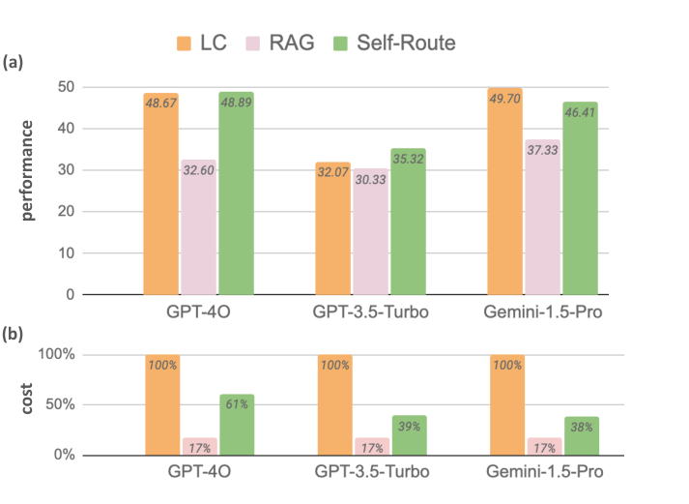
Long context can beat RAG, at a price
Part 1 · Why retrieve, and the whole pipeline
Self-Route: RAG first, full context on "unanswerable".
38–61% of the tokens, in that study.
A corpus bigger than the window still needs retrieval.
Long context against RAG on three models (Li et al., 2024, arXiv:2407.16833, Fig. 1)
Long context can win on quality with frontier models, but retrieval stays cheaper and is the only option for large corpora.
Source: notes/02-why-rag-and-the-augmented-prompt.md
6
Notes:
Why not put everything in the prompt? Li and colleagues found long context beat top-5 RAG on quality with frontier models, and their Self-Route answers with RAG first and falls back to the full context only when RAG says it can't answer. That recovered the quality at 38 to 61% of the tokens. Yu and colleagues saw quality peak and then fall as retrieved context grew. When the corpus doesn't fit the window, retrieval is the only option anyway.
Source: notes/02-why-rag-and-the-augmented-prompt.md

Slide 7
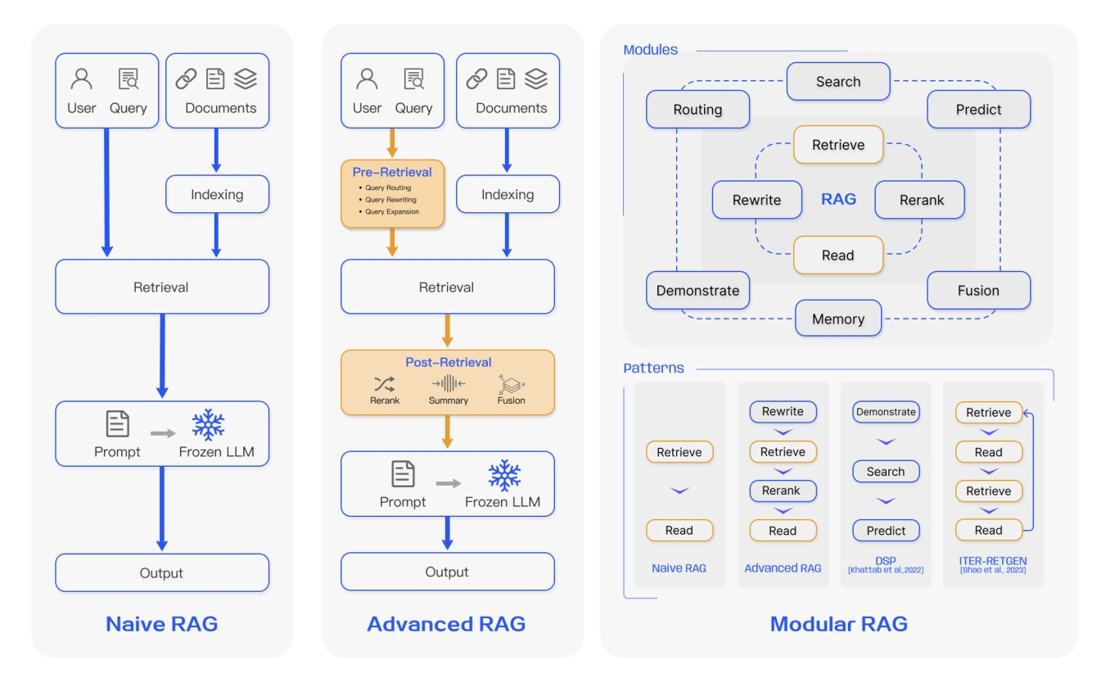
Three generations of the same pipeline
Part 1 · Why retrieve, and the whole pipeline
Naive: index, retrieve, read.
Advanced: adds pre- and post-retrieval.
Modular: swappable stages, composed.
Naive, advanced and modular RAG (Gao et al., 2024, arXiv:2312.10997, Fig. 3)
Naive, advanced and modular name how much machinery surrounds retrieval, so start naive and add what the eval justifies.
Source: notes/01-rag-pipeline.md
7
Notes:
Gao's survey gives us the vocabulary. Naive RAG is index, retrieve, read. Advanced RAG adds stages before and after retrieval. Modular RAG makes the stages swappable and composes them into patterns. You don't need to start at the right-hand side: most teams should begin naive, measure, and add stages where the eval shows a problem.
Source: notes/01-rag-pipeline.md

Slide 8
Query-time stages run cheapest first
Part 1 · Why retrieve, and the whole pipeline
Filter
hard constraints
Search
keyword and dense
Rerank
against the original question
Compress
dedupe, trim
Format
into the prompt
Cheap stages first: expensive ones see fewer items.
Metadata filter on updated is the first fix for the stale page.
Order stages so each narrows the set for the next, and always rerank against what the user actually asked.
Source: notes/01-rag-pipeline.md
8
Notes:
Each stage narrows the set, so the cheap ones go first and the expensive ones see fewer items. Filters come before search because a hard constraint is cheap and exact. Reranking comes after because it scores every pair. If you expand the query, rerank against the original question, since expansion is only a recall device and a rewrite could drift.
Source: notes/01-rag-pipeline.md

Slide 9
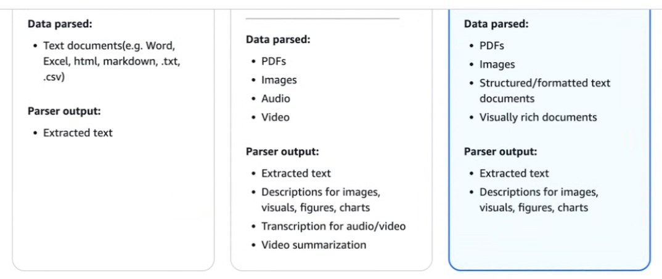
Ingestion quietly decides what can ever be found
Part 1 · Why retrieve, and the whole pipeline
Missing text can't be recovered by any later stage.
Check parser output before tuning retrieval.
Keep writes idempotent: content-derived ids.
Three parser tiers (AWS Bedrock Knowledge Bases, console screenshot)
Inspect what the parser produced first, because no retriever or reranker can recover text that ingestion lost.
Source: notes/01-rag-pipeline.md
9
Notes:
Retrieval can return only what parsing extracted. A text-only parser over a PDF-heavy corpus turns charts and tables into nothing or into garble, and then the retrieval layer looks broken: low recall and irrelevant chunks. These three tiers are from the Bedrock console, but the choice exists everywhere. So check what the parser produced before you tune k, rerankers or chunk size.
Source: notes/01-rag-pipeline.md

Slide 10
When a single retrieval pass isn't the answer
Part 1 · Why retrieve, and the whole pipeline
Text-to-SQL
Agentic RAG
Self-RAG and FLARE
Embeddings can't count, sum or compare. Aggregates are a routing decision to a query.
Worth it when questions decompose or need sources compared. On narrow ones a single pass ties it, faster.
Both decide when to retrieve. Self-RAG is fine-tuned with reflection tokens; FLARE retrieves on low-confidence drafts.
Route aggregates to SQL, add agent loops only for questions that decompose, and treat retrieval timing as a design choice.
Source: notes/01-rag-pipeline.md
10
Notes:
Three common extensions, each answering a different gap. Similarity search can't count or sum, so aggregates go to SQL. Agentic RAG helps when questions decompose, and costs latency on narrow ones. And Self-RAG and FLARE both decide when to retrieve: one is trained with reflection tokens, while the other just watches its own confidence on a draft.
Source: notes/01-rag-pipeline.md

Slide 11
Why did search like the wrong page?
Tallybook's scoreboard shows the blind spots
Fuse ranks, because scores don't share a scale
Measure recall first, then the ranking
HNSW trades a little recall for logarithmic search
What a database adds over a library
Chunking decides what a vector can mean
Clever chunking has to earn its cost
HyDE and hypothetical questions bridge the same gap
Over-retrieve, rerank, return few
Monday: find out which retriever is failing
PART 2
Finding the right passage
Search, stores, chunking and reranking.
11
Notes:
This part is the heart of the pillar: how to find the right passage, how to store vectors, how to cut up documents, and how to put the best chunks on top.

Slide 12
Why did search like the wrong page?
What breaks
Part 2 · Finding the right passage
Keyword search finds the error code. Dense search finds the paraphrase. A filter is what removes the 2024 page.
Three tools with different blind spots, and you usually need all of them.
Source: notes/03-keyword-semantic-and-hybrid-search.md
12
Notes:
The archive page shares almost every word with the current one, so of course search finds it. To reason about that, we need to know what each retrieval method can see. Keyword search sees exact terms, dense search sees meaning, and filters see metadata. Each one has a blind spot, and those blind spots hardly overlap.
Source: notes/03-keyword-semantic-and-hybrid-search.md

Slide 13
Tallybook's scoreboard shows the blind spots
Part 2 · Finding the right passage
Recall@3 by query kind over 20 labelled queries. Run it: uv run --with numpy python ragkit.py
Retriever | Code | Keyword | Paraphrase | All | MRR
BM25 | 1.0 | 1.0 | 0.2 | 0.60 | 0.56
Dense | 0.6 | 1.0 | 1.0 | 0.90 | 0.88
Hybrid | 1.0 | 1.0 | 0.9 | 0.95 | 0.74
BM25 misses paraphrases and dense misses exact codes, so hybrid raises recall even if it doesn't improve every metric.
Source: notes/03-keyword-semantic-and-hybrid-search.md
13
Notes:
These are real results from the practice kit: 18 pages, 20 labelled queries, recall at 3. BM25 gets all the codes and keywords, and only 0.2 of paraphrases. The small dense embedder does the reverse on codes. Hybrid repairs both. Yet look at MRR on the last column: dense ranks better than hybrid here, and with 20 queries that gap isn't proven. You can run this yourself with ragkit.py.
Source: notes/03-keyword-semantic-and-hybrid-search.md

Slide 14
Fuse ranks, because scores don't share a scale
Part 2 · Finding the right passage
PYTHON
Needs no calibration between retrievers.
def rrf(rankings, k=60):
scores = {}
for ranking in rankings:
for rank, doc in enumerate(ranking, 1):
scores[doc] = (scores.get(doc, 0)
+ 1 / (k + rank))
return sorted(scores, key=scores.get,
reverse=True)
print(rrf([["a", "b", "c"], ["c", "b", "d"]]))
# ['c', 'b', 'a', 'd']
k = 60: first is only about 1.2 × tenth.
Discards score magnitude.
RRF combines retrievers using ranks alone, so it needs no calibration and rewards documents both lists agree on.
Source: notes/03-keyword-semantic-and-hybrid-search.md
14
Notes:
BM25 scores are unbounded and cosine lives between minus one and one, so adding them lets the larger range swamp the other. RRF ignores the scores and uses only ranks. Each list gives a document one over k plus rank. At k of 60, first place is worth only about 1.2 times tenth place, so agreement across lists matters more than one list's opinion. The price is that you discard score magnitude.
Source: notes/03-keyword-semantic-and-hybrid-search.md

Slide 15
Measure recall first, then the ranking
Part 2 · Finding the right passage
Recall@k first
MRR
MAP
nDCG
A document not retrieved can't be used. Low recall caps the system.
When one good document is enough. Rewards the first hit's rank.
When you want all relevant documents high, with binary labels.
When your labels are graded.
Track recall first because it caps everything downstream, then pick MRR, MAP or nDCG according to your task and labels.
Source: notes/03-keyword-semantic-and-hybrid-search.md
15
Notes:
A document that was not retrieved can't be used, so low recall caps the whole system. Which ranking metric comes next depends on the task. And watch out for one finding: Salemi and Zamani saw human relevance labels predict RAG quality only weakly, with tau around 0.18 for provenance MRR on NQ, against 0.50 for eRAG, which scores each document by what the system's LLM does with it.
Source: notes/03-keyword-semantic-and-hybrid-search.md

Slide 16
HNSW trades a little recall for logarithmic search
Part 2 · Finding the right passage
Sparse top layer
long jumps
Greedy walk
move closer to the query
Drop a level
denser graph
Full bottom layer
beam search of width ef
M: links per node. efConstruction: beam while building. ef: beam at query time.
Higher values raise recall, at a cost in memory, build time or latency.
HNSW walks stacked graphs to get roughly logarithmic search, giving up exact results for tunable, measurable recall.
Source: notes/04-vector-databases-and-ann.md
16
Notes:
Exact KNN compares the query with each vector, which is linear in the corpus: at a billion vectors, that's a billion distances per query. HNSW builds stacked proximity graphs. Search starts in a sparse top layer and walks greedily closer at each level down to the full one. The cost is roughly logarithmic, and what you give up is the guarantee of the true top k.
Source: notes/04-vector-databases-and-ann.md

Slide 17
What a database adds over a library
Part 2 · Finding the right passage
IVF probes a few clusters, PQ shrinks memory, LSH builds fast. FAISS commonly combines IVF and PQ.
Library (FAISS)
Vector database
Fast index in your process
Create, update, delete, backups
You own persistence and updates
Metadata filters: pre-filter keeps k
Compare on recall, QPS, build time, size
Often keyword, hybrid and rerank too
An index
A system
Choose a database when you need updates, filters and persistence, and check whether its filters run before the search.
Source: notes/04-vector-databases-and-ann.md
17
Notes:
FAISS is an index in a library. A vector database adds what an application needs around it: updates, filters, persistence and usually keyword and hybrid search. The filter order matters. Post-filtering can return fewer than k results when the filter is selective. Pre-filtering keeps k, but it needs support in the index. For Tallybook, audience filtering must never leave you with an empty answer.
Source: notes/04-vector-databases-and-ann.md

Slide 18
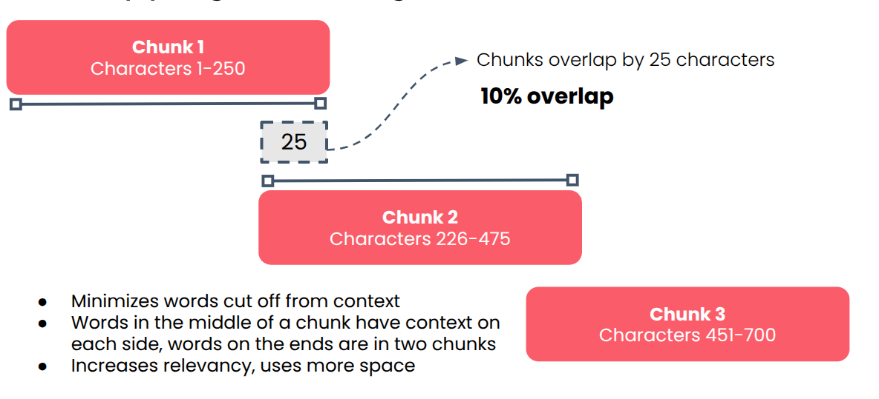
Chunking decides what a vector can mean
Part 2 · Finding the right passage
Too large: the vector drifts to the mean.
Too small: boundaries cut the meaning.
Overlap: 10–20% is a convention, so test it.
Fixed-size chunks with 10% overlap (Hasan, DeepLearning.AI RAG course, Module 3)
Chunk size trades meaning against precision, and the common overlap numbers are conventions to test on your own corpus.
Source: notes/05-chunking-query-parsing-and-reranking.md
18
Notes:
Why chunk at all? A whole document's vector averages its meaning, retrieval returns too much text, and embedders silently truncate past their limit. If chunks are too large, the vector drifts to the mean of the space. If too small, you store more and a boundary can cut the meaning in two. Overlap softens the boundary. Start at 10 to 20%, and test it, because it is a convention: book examples range from 1 to 20% and none measures it.
Source: notes/05-chunking-query-parsing-and-reranking.md

Slide 19
Clever chunking has to earn its cost
Part 2 · Finding the right passage
Results from each paper's own setup, so don't compare across rows.
Comparison | Dataset | Result | Source
Fixed vs semantic breakpoint | HotpotQA F1@5 | 90.59 vs 87.37 | Qu et al.
Element-based vs baseline | FinanceBench | 53.2% vs 48.2%, half the chunks | Jimeno Yepes et al.
Fixed-size chunking is a strong baseline, while structure-aware chunking pays on table-heavy documents, so measure before you switch.
Source: notes/05-chunking-query-parsing-and-reranking.md
19
Notes:
Here is the evidence. Qu and colleagues found fixed-size chunking beat breakpoint semantic chunking on HotpotQA, 90.59 against 87.37, and semantic chunking's big win came only on synthetic stitched documents. Element-based chunking does pay on table-heavy documents: 53.2% against 48.2% on FinanceBench, with about half the chunks. And contextual retrieval adds cost only at index time.
Source: notes/05-chunking-query-parsing-and-reranking.md

Slide 20
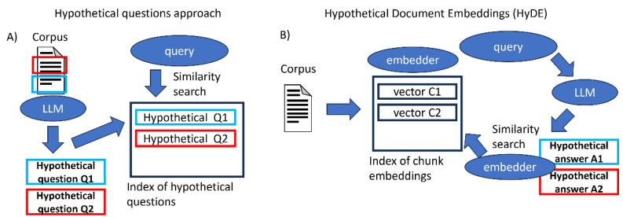
HyDE and hypothetical questions bridge the same gap
Part 2 · Finding the right passage
HyDE: fake answer, query time.
Hypothetical questions: index time.
Contextual retrieval: LLM-written context per chunk, also at index time.
Hypothetical questions against HyDE (Raieli & Iuculano, 2025, Fig. 6-4)
Generated text can bridge queries and documents, and doing it at index time avoids adding latency to each request.
Source: notes/05-chunking-query-parsing-and-reranking.md
20
Notes:
Queries and documents don't look alike. Both techniques fix that with a generated text, at different times. HyDE writes a fake answer at query time, and searches with it. Hypothetical questions are generated at index time and matched against the user's question, so they add no query latency. Multi-query and RAG-Fusion attack the same gap with several phrasings. Contextual retrieval is the other index-time option: an LLM writes 50 to 100 tokens of context per chunk, before embedding and BM25. Treat all of these as experiments.
Source: notes/05-chunking-query-parsing-and-reranking.md

Slide 21
Over-retrieve, rerank, return few
Part 2 · Finding the right passage
Hybrid search
over-retrieve 20–50
Cross-encoder
score each pair
Keep 3–10
fewer, better chunks
Bi-encoder: one vector per text, precomputed. ColBERT: per-token vectors, heavy storage.
Longer lists can lower answer quality even with gold present.
Over-retrieve cheaply, rerank with a cross-encoder, and pass few chunks, because a longer list can hurt the answer itself.
Source: notes/05-chunking-query-parsing-and-reranking.md
21
Notes:
A bi-encoder embeds each text alone so it can precompute. A cross-encoder reads query and document together: it's best and slowest, so it only reranks. ColBERT keeps per-token vectors and gets close to cross-encoder quality, at a heavy storage cost. Why rerank if recall is fine? Zhao and colleagues found answer quality falls as the list grows, even with the gold passage present.
Source: notes/05-chunking-query-parsing-and-reranking.md

Slide 22
Monday: find out which retriever is failing
Part 2 · Finding the right passage
Label 20 real queries with the documents that answer them, and split by kind.
Score BM25, dense and hybrid on recall@k before anything else.
Add the filter: exclude archived pages with metadata, not ranking.
Check parser output and your embedder's token limit.
Try one change at a time: chunking, reranking, query rewriting.
Label queries, split them by kind, score each retriever, and change one thing at a time so you know what helped.
Source: notes/05-chunking-query-parsing-and-reranking.md
22
Notes:
Here is what to do with this part next week. None of these needs a new system. Get labels first, since you can't improve what you can't score. A small handwritten query set beats none, and splitting it by query kind shows you the blind spots.
Source: notes/05-chunking-query-parsing-and-reranking.md

Slide 23
PART 3
The right page arrived. The answer can still be wrong.
Temperature reshapes the distribution; top-p trims it
The grounded prompt is what later checks depend on
Why a model can still get it wrong
RAG for knowledge, fine-tuning for behaviour
Evaluate by scope and by evaluator
Traces feed a flywheel
Cost and latency live in a few places
Prompt instructions are not access control
From passage to production
Generation, evaluation, tracing, cost and security.
23
Notes:
Now the passage is in the prompt. We look at what the model does with it, and then at what it takes to run and improve the system.

Slide 24
The right page arrived. The answer can still be wrong.
What breaks next
Part 3 · From passage to production
Retrieval sets the ceiling. Generation decides how close you get, and only production data tells you where you are.
A citation records what the model saw, not what it used.
Source: notes/06-generation-for-rag.md
24
Notes:
Now suppose retrieval worked, and both pages reached the prompt. What does the model do with 14 days and 30 days? This part covers what happens after retrieval, and then what it takes to run the system. Two findings frame it. Models can ignore good context, and high-scoring passages without the answer are the most damaging ones.
Source: notes/06-generation-for-rag.md

Slide 25
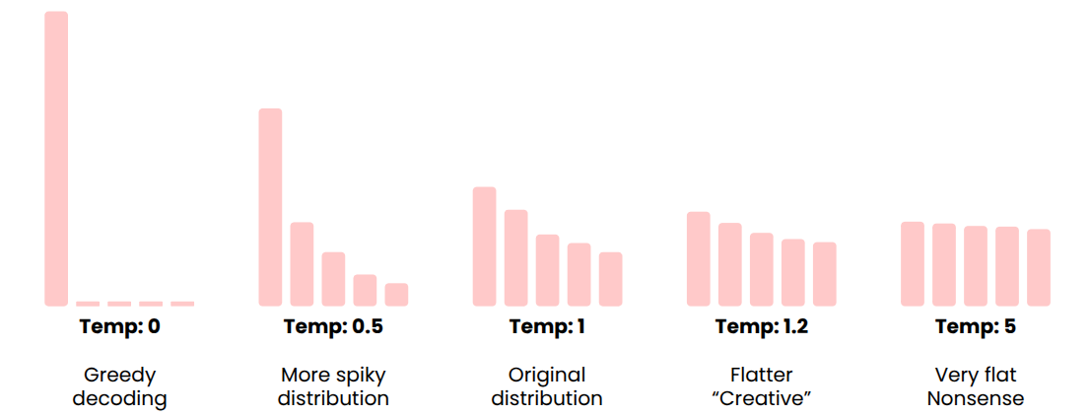
Temperature reshapes the distribution; top-p trims it
Part 3 · From passage to production
Temperature reshapes the distribution.
Top-p keeps the smallest set reaching p.
Factual RAG: low both, and a grounded prompt.
The same distribution at five temperatures (Hasan, DeepLearning.AI RAG course, Module 4)
Low temperature and low top-p reduce variety for factual answers, while truth still has to come from retrieved documents.
Source: notes/06-generation-for-rag.md
25
Notes:
For factual RAG we want a low temperature and a low top-p. Temperature changes the shape of the next-token distribution, and top-p keeps the smallest set of tokens whose cumulative probability reaches p, so it adapts to the model's confidence. These settings reduce variety. They don't make the answer true, which is why the prompt has to say: only from the documents, cite, and say if the answer is absent.
Source: notes/06-generation-for-rag.md

Slide 26
The grounded prompt is what later checks depend on
Part 3 · From passage to production
PYTHON
Only from the documents, plus a way out.
SYSTEM = ("Answer only from the documents. "
"Cite [DOC n] after each claim. "
"If documents conflict, prefer the "
"newest and say so. If the answer is "
"absent, say so.")
def render(docs):
return "\n".join(
f"[DOC {i}] ({d.updated}) {d.full}"
for i, d in enumerate(docs, 1))
Numbered citations make claims checkable.
Dates let the model see which page is stale.
A grounded prompt limits, cites and allows refusal, which gives you something to check even though it guarantees nothing.
Source: notes/06-generation-for-rag.md
26
Notes:
This is the system message over Tallybook. Each part has a job. The instruction limits the answer to the documents. The citation format lets you check each claim afterwards. The refusal gives the model a way out. Date the documents and you give the model a chance to prefer the current page. Don't expect too much from the wording, though: Zhao and colleagues saw nine prompt variants make no salient difference to pseudo-helpfulness.
Source: notes/06-generation-for-rag.md

Slide 27
Why a model can still get it wrong
Part 3 · From passage to production
Priors beat context
Pseudo-helpfulness
Distractors
The further a context departs from the model's prior, the more it trusts itself (Wu et al.).
It answers without the gold passage, from loose context or invention (Zhao et al.).
One high-scoring passage without the answer: up to a 25% drop (Cuconasu et al.).
A model can overrule good context or answer without any, and the worst passage scores highly while lacking the answer.
Source: notes/06-generation-for-rag.md
27
Notes:
Three measured failure modes. Wu and colleagues showed that the further a context departs from the model's prior, the more it trusts itself. Zhao and colleagues' pseudo-helpfulness is the model answering when the gold passage is absent. And Cuconasu and colleagues saw up to a 25% drop from a single high-scoring distractor added to the gold passage. That last one is our archive page.
Source: notes/06-generation-for-rag.md

Slide 28
RAG for knowledge, fine-tuning for behaviour
Part 3 · From passage to production
GPT-4 on an agriculture task: 75% baseline, 81% fine-tuned, 86% with RAG on top (Balaguer et al., 2024).
RAG
Fine-tuning
Knowledge and freshness
Behaviour, format and tone
Update an index, not weights
Needs data and retraining
Adds latency and a new failure surface
Goes stale as facts change
What it knows
How it acts
Use retrieval for facts that change and fine-tuning for behaviour, and expect the two to add up rather than compete.
Source: notes/06-generation-for-rag.md
28
Notes:
Balaguer and colleagues measured both on GPT-4, on an agriculture task: 75% at baseline, 81% fine-tuned, and 86% with RAG on top. So it isn't really a choice. Reach for retrieval when the problem is facts or freshness, and for fine-tuning when it's format or behaviour. RARE goes further and trains with the retrieved documents in the prompt. Tallybook's refund policy changes, so it belongs in retrieval.
Source: notes/06-generation-for-rag.md

Slide 29
Evaluate by scope and by evaluator
Part 3 · From passage to production
Code runs on everything, judges cover the rest, humans calibrate both.
Scope | Code | LLM judge | Human
Component | Recall@k, precision, router accuracy | Context relevance, RAGAS faithfulness | Labelled relevance judgements
System | Latency, cost, error rate | Response and citation quality | Thumbs, annotation, A/B tests
Cross scope with evaluator so that cheap code checks run everywhere, judges cover meaning and humans calibrate both.
Source: notes/07-rag-in-production.md
29
Notes:
Here is a simple way to organise evaluation. One axis asks what you are testing: a component or the whole system. The other asks who scores it. Code checks are cheap and run on everything. LLM judges cover what code can't. Humans calibrate both, and ARES formalises that with about 150 human labels. Most teams start with the top left and add outward.
Source: notes/07-rag-in-production.md

Slide 30
Traces feed a flywheel
Part 3 · From passage to production
Traces
every span, with scores
Failures
found in traffic
Datasets
labelled from failures
Experiments
test a fix
Deploy
and trace again
Log both: the original query and the rewrite, with chunk scores.
Watch hallucination rate, recall at k, p95 latency, cost per query.
Trace every span so that real failures become datasets, and let experiments on those datasets decide which fix ships.
Source: notes/07-rag-in-production.md
30
Notes:
A trace needs the original and rewritten query, retrieved chunks with scores, reranker output, the final prompt, the response, and tokens and latency per span. For our refund answer, the trace would show the archive page in the prompt within a minute. Then the failure goes into a dataset, you run an experiment on the fix, and the deployed fix makes new traces.
Source: notes/07-rag-in-production.md

Slide 31
Cost and latency live in a few places
Part 3 · From passage to production
Component latencies are the course's estimates; measure your own.
Lever | What it buys | What it costs
Fewer prompt tokens, lower top k | The largest cost saving | Risk to recall
int8 vectors | 4× less memory | Some precision
1-bit vectors | 32× less memory | Needs rescoring
Reranker | Better order, ~50 ms | Compute
Query rewriter | Better recall, ~300 ms | One LLM call
Router | Right source, ~200 ms | One more stage
Cut tokens before changing models, since most of the money and latency is in the LLM, and keep only stages that pay.
Source: notes/07-rag-in-production.md
31
Notes:
Most of the money goes on LLM tokens, so cut prompt size and top k first. Vector databases aren't negligible, though: Huyen reports them at a fifth to a half of model API spend at some companies. Latency is mostly the transformer. The course's estimates for the optional stages are below, so keep only those that move a metric. These are estimates, so measure your own.
Source: notes/07-rag-in-production.md

Slide 32
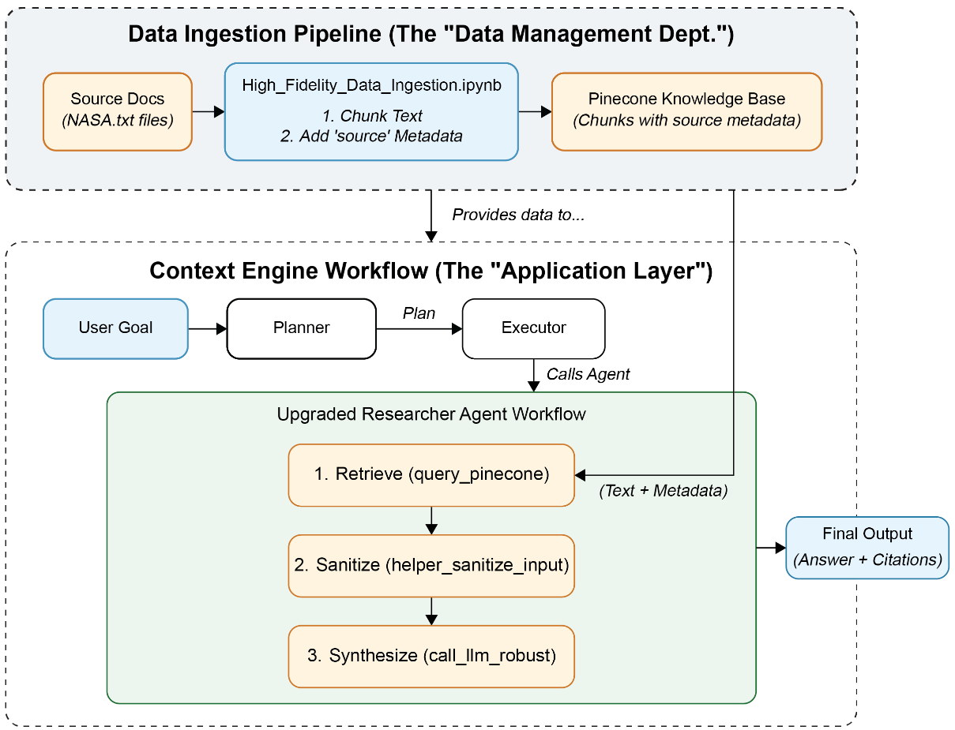
Prompt instructions are not access control
Part 3 · From passage to production
Filter by user at retrieval time.
Poisoning: separate ingestion, sanitise chunks.
Regexes are only a first filter.
A separate ingestion pipeline and sanitised retrieval (Rothman, 2025, Fig. 7-1)
Enforce permissions at retrieval and treat the corpus as an attack surface, because instructions in prompts protect nothing.
Source: notes/07-rag-in-production.md
32
Notes:
Two security rules. First, filter by user at retrieval, and separate tenants into their own collections or indexes, because anything that reaches the prompt can reach the answer. Second, the corpus is an attack surface: in PoisonedRAG, crafted documents get retrieved for a target question and steer the answer. This figure separates ingestion from the application and sanitises chunks. Regexes alone miss paraphrases, so add a model-based classifier.
Source: notes/07-rag-in-production.md

Slide 33
PART 4
Case studies
What does this look like at real scale?
PRINCE's query-time funnel
Counting is a Text-to-SQL job
When agentic RAG pays, and when to avoid it
Three questions pick a vector store
A semantic cache in a matrix multiply
The threshold has no clean setting
PRINCE, store choice and a semantic cache.
33
Notes:
A published production stack and two of our own project chapters, each applying the earlier stages under real constraints.

Slide 34
What does this look like at real scale?
The evidence
Part 4 · Case studies
A published stack and a project write-up: the same stages as before, with real constraints and removed features.
What a team took out is often the most useful thing it can tell you.
Source: notes/08-agentic-rag-prince.md
34
Notes:
Time for case studies. Bayer's PRINCE answers questions over clinical documents and structured data, and its numbers are specific enough to learn from. After that, our own support-agent project: which store to use and how to skip the pipeline altogether with a cache. Each one shows the earlier techniques with real constraints.
Source: notes/08-agentic-rag-prince.md

Slide 35
PRINCE's query-time funnel
Part 4 · Case studies
Parse
keywords, filter, 5 expansions
Hybrid × 5
0.7 kNN, 0.3 keyword
Max per chunk
k ≈ 20
Rerank
original question, k = 7
Answer
with citations
Pre-filter inside the vector query: results stay valid.
Max, not sum: paraphrases aren't independent votes.
PRINCE narrows from millions of vectors to seven chunks by filtering first, taking max scores and reranking on the original.
Source: notes/08-agentic-rag-prince.md
35
Notes:
Here is the funnel. It extracts keywords, a metadata filter and 5 expansions, runs 5 pre-filtered hybrid searches at 0.7 kNN and 0.3 keyword, takes the max score per chunk down to about 20, reranks to 7 with bge-reranker-large, and answers with citations. Pre-filtering shrinks millions of vectors to tens or hundreds first. It takes the max because paraphrases aren't independent votes. And the rerank target is the original question.
Source: notes/08-agentic-rag-prince.md

Slide 36
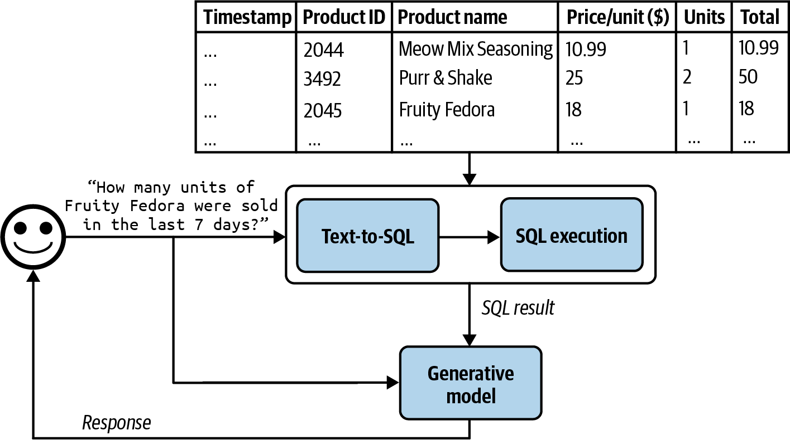
Counting is a Text-to-SQL job
Part 4 · Case studies
Dynamic few-shot: nearest question and SQL pairs.
Removed: an LLM reviewer. Mechanical checks won.
SELECT-only isn't enough: add a read-only role and timeout.
Tabular RAG: from question to SQL to answer (Huyen, AI Engineering, 2025, Fig. 6-7)
Send counting questions to SQL with retrieved examples and mechanical checks, since an LLM reviewer cost more than it caught.
Source: notes/08-agentic-rag-prince.md
36
Notes:
Similarity search finds passages. It can't filter, count or compare, so PRINCE runs a second pipeline inside the same agent. Dynamic few-shot stores question and SQL pairs in their own collection, retrieves the nearest ones and adds a new pair whenever a pattern fails. And here's what they removed: an LLM SQL reviewer that flagged valid queries as broken and cost more than it caught.
Source: notes/08-agentic-rag-prince.md

Slide 37
When agentic RAG pays, and when to avoid it
Part 4 · Case studies
Clarify first: it fixes scope, and fails fast when nothing can be searched.
Tools overlap as they multiply: domain sub-agents restore accuracy.
Repair metadata with NER, sending low confidence to a human queue.
Evaluate daily on live traffic, and on datasets for each significant change.
Avoid it when one shot works, latency is critical, or data quality is poor.
Agentic RAG pays for broad questions over messy data, and when one pass works, its extra machinery just adds latency.
Source: notes/08-agentic-rag-prince.md
37
Notes:
As tools multiply they overlap and selection accuracy falls. PRINCE added Think and Plan, and then domain sub-agents with their own tools and prompts. Clarifying intent fixes tools and scope before retrieval. NER repairs metadata, with a human quarantine queue for low confidence. Yet the honest conclusion is on the last bullet: avoid all this when one-shot retrieval works.
Source: notes/08-agentic-rag-prince.md

Slide 38
Three questions pick a vector store
Part 4 · Case studies
Whichever you choose, changing embedder means re-embedding the corpus and rebuilding the index.
If you have | Then consider | Watch for
About 100k vectors, modest load | Exact search | Measure it on your machine
Data already in Postgres | pgvector | Index limit: 2,000 dims for vector
BM25, dense and metadata in one query, at scale | OpenSearch, Elasticsearch | Operations
A live corpus | HNSW | Annoy needs a full rebuild
No wish to run anything | A managed service | Less visibility and chunk control
Vector count, dimensions and hybrid needs pick the store, and an embedder change means re-embedding wherever you are.
Source: notes/09-vector-database-comparison.md
38
Notes:
How many vectors, how many dimensions, and does a single query need keyword and dense together? On a laptop, exact search is fine around 100k vectors at a few hundred dimensions, with perfect recall and no parameters. pgvector's HNSW indexes vector columns only up to 2,000 dimensions, which matters with today's larger embedders. And changing embedder breaks every vector, so plan on a full re-embed.
Source: notes/09-vector-database-comparison.md

Slide 39
A semantic cache in a matrix multiply
Part 4 · Case studies
PYTHON
Hit: skips retrieval and generation.
import numpy as np
def lookup(query_vec, rows, vecs, t=0.9):
# vecs: unit vectors, one row per question
scores = vecs @ query_vec
best = int(np.argmax(scores))
if scores[best] >= t:
return rows[best]["answer"]
return None # miss: run the full pipeline
No ANN needed at a few hundred rows.
Row: vector, answer, sources, date, scope.
A cache lookup is a matrix multiply that skips the whole pipeline, and a wrong match goes to the user unchecked.
Source: notes/10-semantic-cache.md
39
Notes:
A cache skips the whole retrieval and generation path on a hit. In our project that saved about 3 to 6 seconds and two or more LLM calls, for the price of one embedding and a matrix multiply. At a few hundred rows you don't need an ANN index. Unlike an exact cache, it can match wrongly, and nothing downstream will check it. So the threshold is the design decision.
Source: notes/10-semantic-cache.md

Slide 40
The threshold has no clean setting
Part 4 · Case studies
Stress test with hand-written hard cases, so read it as a warning and not a hit rate.
Threshold too low
Threshold too high
Catches paraphrases
At 0.95: zero false hits
False hit: a confident wrong answer
Only 4 of 12 paraphrases kept
Nothing later checks it
Cheap, safe and little used
Wrong answers
A useless cache
Sweep the threshold on hard near misses for your own embedder, and invalidate rows whenever a source document changes.
Source: notes/10-semantic-cache.md
40
Notes:
Near misses have the same shape and a different meaning: a refund on my annual plan against my monthly plan. Our stress test had 12 hard paraphrases and 12 hard near misses. At 0.95 false hits went to zero, and only 4 of 12 paraphrases survived. So sweep it on your own labelled set, and choose on what each error costs. A threshold won't transfer across embedders or languages.
Source: notes/10-semantic-cache.md

Slide 41
PART 5
Everyone has a favourite fix. Which one do we build?
What an ablation of five configs showed
Ask how much of the table is noise
What a managed backend takes off your hands
Buy, buy, or build
One request, two retrieval modes
Never compare scores across backends
When to leave each option
Deciding what to build
Reading an ablation, and managed services against your own.
41
Notes:
Finally, how to decide. We read a real ablation, ask how much of it is noise, and then weigh buying the pipeline against building it.

Slide 42
Everyone has a favourite fix. Which one do we build?
The decision
Part 5 · Deciding what to build
Change one thing at a time, score it on the same queries, and let the table choose.
Then ask how much of the table is noise.
Source: notes/11-retrieval-improvements.md
42
Notes:
The team has a list: a newer model, multi-query, HyDE, a corrective loop, fine-tuning, or simply buying the whole thing from a cloud provider. An ablation is how you stop arguing. Change one thing at a time, score it on the same queries and let the table choose. And the catch is that a small eval set can tell you only about big differences.
Source: notes/11-retrieval-improvements.md

Slide 43
What an ablation of five configs showed
Part 5 · Deciding what to build
32 queries with gold URLs. The benchmark row comes from a ten-task smoke run.
Config | MRR | P@1 | Latency
va_staging benchmark | 0.625 | 0.625 | ~9.3 s
kb_adk + thinking | 0.583 | 0.531 | 7.3 s
kb_lg + CRAG | 0.547 | 0.531 | 7.7 s
kb_lg, no CRAG | 0.542 | 0.531 | 4.4 s
kb_adk baseline | 0.418 | 0.219 | 2.6 s
Ablations expose costs and interactions, like a loop that buys almost nothing and a setting that helps one agent only.
Source: notes/11-retrieval-improvements.md
43
Notes:
This is our project's real table: 44 tasks, 32 with gold URLs, so read small gaps with care. Thinking gave the ADK agent plus 0.165 MRR, but hurt the LangGraph agent with CRAG, because it changed citation style and broke the grader. CRAG itself gave plus 0.005 for plus 3.4 seconds, since the confidence gate short-circuited most runs. Meanwhile an LLM planner lost to a regex by 0.031 and added 4 seconds.
Source: notes/11-retrieval-improvements.md

Slide 44
Ask how much of the table is noise
Part 5 · Deciding what to build
PYTHON
Worst-case SE at 32 queries: 0.088.
import numpy as np
def paired_bootstrap(a, b, rounds=10_000):
# per-query scores for two systems
d = np.array(a) - np.array(b)
rng = np.random.default_rng(0)
i = rng.integers(0, len(d),
(rounds, len(d)))
means = d[i].mean(axis=1)
low, high = np.percentile(means, [2.5, 97.5])
return d.mean(), low, high
Paired: per-query difficulty cancels.
Interval crosses zero? Not proven yet.
Before you believe a gain on a small eval set, run a paired bootstrap on per-query differences and read the interval.
Source: notes/11-retrieval-improvements.md
44
Notes:
A bounded score has a standard deviation of at most 0.5, so the standard error of a mean over 32 queries is at most 0.088. So plus 0.03 isn't real yet. But the same queries go through both systems, so difficulty cancels. The paired bootstrap uses that: compute the per-query difference, resample queries, read the interval. In Tallybook's kit, dense beats hybrid by 0.133 MRR on 20 queries and the interval still crosses zero. That also sets the priority order for our shortlist: cheap information first. A newer model and the kb_rag backend are flags, multi-query is a node, HyDE depends on the backend, and DPO waits for 200 or more preference pairs.
Source: notes/11-retrieval-improvements.md

Slide 45
What a managed backend takes off your hands
Part 5 · Deciding what to build
Crawl
service
Chunk
service, sizes configurable
Hybrid search
service
Inject context
yours
Generate
yours
Yours as well: the eval, the scope, the text the LLM reads.
Wrong KB: plausible scores and no error, so log the KB ID.
A managed backend takes the index off your hands, while the eval and the decision about what goes in stay yours.
Source: notes/12-managed-rag.md
45
Notes:
So do we buy it? This was our Bedrock setup. The crawl, chunking, vector database and hybrid search are the service. Query transformation and generation are still ours. Crucially, the eval isn't in the flow: neither service knows whether your refund answer is right. And the service won't remove the 2024 page either. Dropping English duplicates and tiny pricing-table chunks was a decision we had to make.
Source: notes/12-managed-rag.md

Slide 46
Buy, buy, or build
Part 5 · Deciding what to build
As observed in the project, 2026. Check current docs.
 | Bedrock KB | Vertex AI Search | Own (kb_rag)
Chunking | Hierarchical, sizes configurable | Managed, opaque | Yours, 6 strategies
Hybrid search | HYBRID on supported stores | Internal | Yours
Reranking | Explicit, per query | Internal to :answer | Yours, 5 backends
Generation | Your LLM | Optional via :answer | Your LLM
Sessions | Caller owns | Native resource | Yours
Evaluation | Yours | Yours | Yours
Managed services differ in how much they hide, and the evaluation row reads the same across every option.
Source: notes/12-managed-rag.md
46
Notes:
Here are the three options our project ran. Bedrock leaves generation to you and shows you scores. Vertex is more opaque, and its answer endpoint can own retrieval and generation. It maintains sessions, too. And kb_rag is our own deterministic pipeline: retrieve once, rerank, generate. You get everything, including all the work. These rows reflect what the project saw in 2026, so check the current docs.
Source: notes/12-managed-rag.md

Slide 47
One request, two retrieval modes
Part 5 · Deciding what to build
PYTHON
Fast: 5 results, cosine threshold 0.4.
def config(rerank=False):
v = {"numberOfResults": 15 if rerank else 5,
"overrideSearchType": "HYBRID"}
if rerank:
v["rerankingConfiguration"] = {
"type": "BEDROCK_RERANKING_MODEL",
"bedrockRerankingConfiguration": {
"modelConfiguration": {
"modelArn": RERANK_ARN},
"numberOfRerankedResults": 5}}
return {"vectorSearchConfiguration": v}
Reranking: 15 to 5, threshold 0.05.
Threshold: client-side, not in the request.
Bedrock's two modes differ by one config object, and the score threshold you rely on is your own client-side code.
Source: notes/12-managed-rag.md
47
Notes:
The two Bedrock modes differ by one configuration object. Fast takes 5 results and no reranker, for the agent tool. Reranking takes 15 candidates down to 5, for eval and complex queries. Note that the score threshold isn't in the request at all: it's our client-side setting. And on an unsupported store, a hybrid request uses semantic search instead, so check your vector store. The chapter validates this with boto3's Stubber, with no AWS account.
Source: notes/12-managed-rag.md

Slide 48
Never compare scores across backends
Part 5 · Deciding what to build
Compare systems on eval metrics, never on these numbers.
Backend | Field | Range | Meaning
Bedrock fast | score | 0–1 | Cosine similarity
Bedrock reranker | score | 0.05–0.35 typical | Reranker relevance
GCP Search | relevance_score | 0–1 | Internal, undocumented
GCP :answer | grounding_score | 0–1 | Citation support
A score only means something within its own mode, so compare backends by running them on the same eval set.
Source: notes/12-managed-rag.md
48
Notes:
Four scores with four meanings. Cosine and reranker scores use different scales even within Bedrock. Vertex's relevance score has no documented meaning. And grounding is a different kind of quantity: it says whether the answer is supported by its sources, not whether they were the right ones. A well-grounded answer can still quote the stale refund page. So compare systems on MRR.
Source: notes/12-managed-rag.md

Slide 49
When to leave each option
Part 5 · Deciding what to build
Stay managed if
Build your own if
A small team, no wish to run an index
You must see or grade each stage
Default chunking passes your eval
You own every bug: \s+ broke heading detection
Your cloud already decided
You can staff the upkeep
Buy
Build
Buy unless your eval shows you need control, and when you build, budget for owning each line of the pipeline.
Source: notes/12-managed-rag.md
49
Notes:
These are one team's judgements, not measurements. Move from Bedrock to Google only if your whole infrastructure moves. Leave the answer endpoint when you need correction loops or control over synthesis, because you can't intercept its retrieval step. pgvector is right for local dev or a Postgres shop. And building your own means owning cleaning bugs: a single regex, slash-s-plus, destroyed the line breaks the heading-aware chunker needs.
Source: notes/12-managed-rag.md

Slide 50
Rules of thumb
Wrap-up
Ingestion and recall set the ceiling
Hybrid by default
Over-retrieve, then rerank
BM25, dense and RRF, with filters for constraints.
20–50 down to 3–10, against the original question.
Check parser output and Recall@k before any tuning.
Ground and cite
Trace from day one
Prove it
Low temperature, only from the documents, a way to refuse.
Filter by user at retrieval. Prompts aren't access control.
One change at a time, a paired test, and never compare raw scores.
Fix ingestion and recall first, default to hybrid plus reranking, and prove each change on your own eval set.
Source: notes/12-managed-rag.md
50
Notes:
Here's the whole pillar on one slide. If you only remember these, you can find the fault in most RAG systems. Start at the top, because the ceiling sits in ingestion and recall. And the bottom row is what keeps you honest: measure on your own queries, with a test that accounts for how few you have.
Source: notes/12-managed-rag.md

Slide 51
Where next
Wrap-up
Agentic foundations (generative-ai/03): retrieval as a tool an agent calls.
Eval pillar (generative-ai/08): the measurement discipline in depth.
Context engineering (ai-engineering/02): retrieval as one context lever.
Graph engineering (ai-engineering/05): knowledge graphs as a retrieval layer.
Practice: uv run --with numpy python ragkit.py in practice/, then delete kb-05.
Source: notes/12-managed-rag.md
51
Notes:
Next, retrieval becomes a tool an agent chooses to call, in agentic foundations. The eval pillar deepens the measurement ideas we've used. And the practice folder has the kit behind our Tallybook numbers. Delete page kb-05, rerun it, and see what happens to the refund question. That's the bug we started with.
Source: notes/12-managed-rag.md

