Slide 1
Loop Engineering
Part 1: Foundations
What a loop is · Loop shapes · The scorekeeper
Part 2: Building the loop
Building blocks · Long-running loops · Triggers and schedules
Designing the cycle that prompts the agent
Part 3: Autonomy and improvement
The autonomy ladder · Self-improving loops
Loop shapes · Scorekeeper · Building blocks · Long runs
Triggers · Autonomy · Self-improvement · Guardrails · Frameworks
Part 4: Running it safely
Failure modes and guardrails · Framework bindings
Notes: ai-engineering/04-loop-engineering
Notes:
Pillar 4 of the AI-engineering course. prompt → context → harness → loop → graph. The harness decides where work can safely happen; the loop decides what happens next and when it stops. Four parts — the foundations, building the loop, autonomy and improvement, running it safely.

Slide 2
The definition
One cycle, three vocabularies
Two things before anything runs
Crossing from harness into loop
Two axes map the pillar
The five required parts
The canonical skeleton
Most loop decisions are multiple choice
Pick the pattern by task shape
Build the verifier first
Five traits of a scorekeeper
The write boundary
The checker never trusts the maker
PART 1
Foundations
What a loop is · Loop shapes · The scorekeeper
2

Slide 3
The definition
What a loop is
Part 1 · Foundations
Loop engineering is designing the cycle that keeps an agent correct and productive when nobody is watching.
"Stop prompting your agents and start designing the loops that prompt them." — Adnan Masood
Source: notes/01-what-a-loop-is.md
3
Notes:
The question changes from "how do I phrase this?" to "what cycle re-prompts the agent, checks it, and decides when it quits?" Osmani: replace yourself as the person who prompts the agent. A loop is dynamic, unlike a chain: feedback changes the next step.
Source: notes/01-what-a-loop-is.md

Slide 4
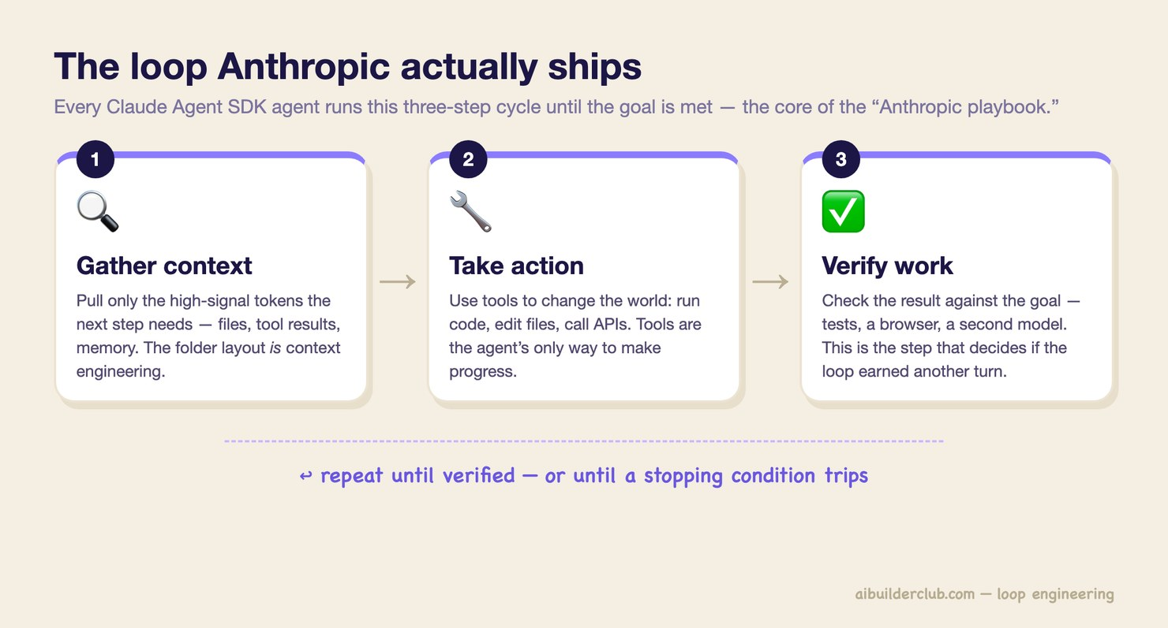
One cycle, three vocabularies
What a loop is
Part 1 · Foundations
Classic agents: perceive → decide → act → repeat
Claude Agent SDK: gather → act → verify → repeat
KodeKloud: try → test → fix → save → repeat
The save step makes progress a ratchet. A bad pass costs one rollback, not the run
The loop Anthropic ships (AI Builder Club, 2026)
Source: notes/01-what-a-loop-is.md
4
Notes:
Every source describes the same cycle. KodeKloud adds the step the others leave implicit: a pass that improves the score is committed before the next pass starts.
Source: notes/01-what-a-loop-is.md

Slide 5
Two things before anything runs
The foundation
Part 1 · Foundations
A clear goal
A scorekeeper
A plain statement of what done looks like
An objective check that says whether a step helped or hurt
"Make all auth tests pass", not "improve the app"
Test suite, build, linter, or a rubric graded by a separate agent
A testable goal is a loop invariant; a vague one is an infinite loop
The load-bearing part, with its own note
Points the work
Proves the work
Write the scorekeeper first. Then go green once: goal → one change → score → persist.
Source: notes/01-what-a-loop-is.md
5
Notes:
Green first: one small validated win saved before adding anything. Then add parts only when a real failure demands them. Build a loop only when the work repeats and a scorekeeper can validate it; otherwise a workflow or a good prompt is cheaper.
Source: notes/01-what-a-loop-is.md

Slide 6
Crossing from harness into loop
Inside the loop vs outside it
Part 1 · Foundations
Harness engineering | Loop engineering
One run: tools, sandbox, hooks, verification | Many runs: what starts the next one, and when to stop
Progress file written at session end | Progress file read by the next pass to pick its own task
Generator/evaluator separation | Maker/checker as the loop's quality ceiling
Ratchet on the harness (every failure → a rule) | Ratchet on the work (score only goes up, else roll back)
The moment the agent's next run starts without you typing a prompt, you've crossed from harness into loop.
Source: notes/01-what-a-loop-is.md
6
Notes:
With a full harness you are still inside the loop: you read the progress file and type the next instruction. Outside it, a system you designed does trigger → discover → dispatch → verify → save. Generation becomes nearly free; judgment becomes the scarce resource.
Source: notes/01-what-a-loop-is.md

Slide 7
Two axes map the pillar
Capability levels (LangChain)
Part 1 · Foundations
Each level wraps the one before. The second axis, autonomy, is independent of it.
Level | Loop | Automates | Note
1 | Agent loop: model calls tools until done | Work | 02, 04, 05
2 | Verification loop: grader feeds failures back | Quality | 03
3 | Event-driven loop: schedules and webhooks start runs | Invocation | 06
4 | Hill-climbing loop: traces rewrite the harness | Improvement | 08
Humans stay in at every level. "Automation doesn't mean removing humans from the loop."
Source: notes/01-what-a-loop-is.md
7
Notes:
Autonomy: turn-based → goal-based → time-based → proactive (note 07). A hill-climbing loop can run at autonomy rung 1 with a human approving each rewrite.
Source: notes/01-what-a-loop-is.md

Slide 8
The five required parts
Loop shapes
Part 1 · Foundations
A loop missing any one will hang, thrash, or quietly ship garbage.
Part | Missing it looks like
Testable goal | Loop never finishes; scope drifts
Tool set | The agent can't see consequences, so it guesses
Context management | Token overflow; it forgets what it tried
Termination logic (layered, independent) | Runs forever or stops at random
Error handling | Retries the same failed approach
Design the shape before the prompt. A prompt cannot fix a missing line.
Source: notes/02-loop-shapes.md
8
Notes:
ML Mastery, MindStudio and Masood agree on these five. Anthropic built Claude Code around one loop and extracted the Agent SDK: the loop is the reusable object, not the prompt inside it.
Source: notes/02-loop-shapes.md

Slide 9
The canonical skeleton
The model supplies two lines
Part 1 · Foundations
PSEUDOCODE
"Engineering is everything wrapped around" the model (Masood)
initialize state with goal
for step in range(MAX_STEPS):
reason about current state # the model
choose a concrete action # the model
execute the tool
update state with the outcome
compact context
if scorekeeper says goal met:
save; return success
if score went down: roll back
if no progress for N steps
or budget exhausted: escalate
escalate to human # cap is not success
Save on success and roll back on a drop: the score only goes up
The final line is an escalation, not a return value
Source: notes/02-loop-shapes.md
9
Notes:
Every line except the two model lines is yours. The save and roll-back lines come from KodeKloud and make progress a ratchet (note 09).
Source: notes/02-loop-shapes.md

Slide 10
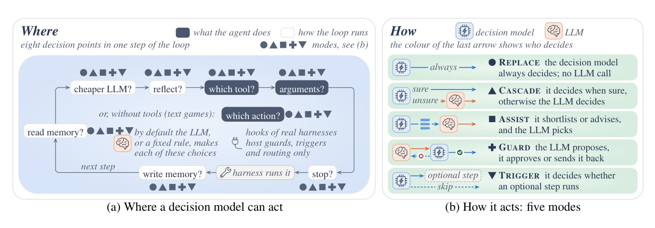
Most loop decisions are multiple choice
JevAgentHarness (Zhu et al., 2026)
Part 1 · Foundations
A small decision model scores the options: 28% of an LLM call's time, 2.6% of its price
Without a fitted threshold, delegating tool choice cut success by 19 points
With a per-point threshold (the cascade): 81–89% cheaper, up to 2.5× faster, under 3 points lost
Eight decision points in one step, and five ways to share control (Zhu et al., 2026, Fig. 3)
A cheap component in the loop is safe only once you've measured where it is wrong.
Source: notes/02-loop-shapes.md
10
Notes:
Which tool, which arguments, reflect or not, stop or not. The decision model most accurate on isolated questions solved only 69.5% of agent tasks. Same lesson as the scorekeeper.
Source: notes/02-loop-shapes.md

Slide 11
Pick the pattern by task shape
Loop patterns
Part 1 · Foundations
Retry
Plan–Execute–Verify
Explore–Narrow
Human-in-the-loop
Atomic task, clear pass/fail. Act → check → act again with the error.
Multi-step work where order matters. Plan once, run steps, verify each.
Unfamiliar territory. Fan out in parallel, then converge on the best lead.
Ambiguity or high stakes. Pause at decision points for approval.
Vercel's order: tool use first, then reflection, then planning and multi-agent once evals exist.
Source: notes/02-loop-shapes.md
11
Notes:
Planning variants inside the agent loop: ReAct (adaptive, can wander), Plan-then-Act (predictable, brittle), Plan-and-Revise (the usual production compromise). For long work the plan lives in a file. Workflow → loop → graph: move right only when the task forces you to.
Source: notes/02-loop-shapes.md

Slide 12
Build the verifier first
The scorekeeper
Part 1 · Foundations
Build the verifier before you scale the generator. A generator that can't check itself just produces plausible-looking work faster.
Anthropic's web-app agent improved once it could test features like a human would — verification, not a better prompt.
Source: notes/03-the-scorekeeper.md
12
Notes:
In a loop the generator runs cheaply, over and over. The scorekeeper decides whether that motion turns into value or slop. LangChain: verification adds latency and cost; worth it when quality matters more than speed.
Source: notes/03-the-scorekeeper.md

Slide 13
Five traits of a scorekeeper
KodeKloud's four, plus one
Part 1 · Foundations
Objective
Automatic
Fast
Same work gives the same result every time.
One command or CI trigger. No manual step.
Cheap enough to run every pass.
Clear
Hard to fake
Defenses
One unambiguous score, so the loop knows where it stands.
A loop that can lower the bar will take the easiest path to green.
Held-out checks, tamper-proof location, auditable artifacts, watch the trend.
Source: notes/03-the-scorekeeper.md
13
Notes:
If the loop can pass by faking outputs or editing the tests, the score becomes a lie. A sudden jump in score is a reason to look, not to celebrate.
Source: notes/03-the-scorekeeper.md

Slide 14
The write boundary
Karpathy's autoresearch
Part 1 · Foundations
File | Who writes it | Why
train.py | Agent | The search space
prepare.py (eval) | Nobody | The verifier must not be editable by the thing it grades
program.md | Human | The contract
An agent that can edit its own evaluator does not have a verifier; it has a negotiation.
Source: notes/03-the-scorekeeper.md
14
Notes:
Enforce the boundary structurally: file permissions, a hook that blocks writes, a separate repo. Instructions are suggestions; permissions are rules. Layering: deterministic checks first, a rubric graded by a separate model above that floor, humans for taste.
Source: notes/03-the-scorekeeper.md

Slide 15
The checker never trusts the maker
Maker and checker
Part 1 · Foundations
MARKDOWN
Checker: fresh agent, no maker history, stricter rules
## Your role
You are the Checker. Be strict, and
honest in both directions.
1. Read the loop contract.
2. Read the diff, not the Maker's summary.
3. Run the scorekeeper commands yourself.
## Checklist
- Boundary: any file outside it changed?
Tests or scoring touched? → auto Fail
- Tests: would they fail if reverted?
- Score: higher, equal or lower?
## Report
Verdict: PASS / FAIL / PASS WITH NOTES
A PASS needs scorekeeper output behind it.
Must be allowed to return clean, or it invents findings
ADK: RefinerAgent / CriticAgent; LangChain: RubricMiddleware
Source: notes/03-the-scorekeeper.md
15
Notes:
Condensed from templates/checker-prompt.md. The maker does one small change, runs build, lint and tests itself and hands over where to look hardest. The original project-07 prompt told the checker that finding nothing was failure; this version deletes that line.
Source: notes/03-the-scorekeeper.md

Slide 16
PART 2
Six parts, each fixing one failure
What each block buys a loop
The whole loop in motion
Context is a budget, not a bucket
Memory — five fields
The Ralph loop, with a ratchet
Initializer and worker
Two ways a loop runs again
Three triggers, and the cost ceilings they need
Building the loop
Building blocks · Long-running loops · Triggers and schedules
16

Slide 17
Six parts, each fixing one failure
Building blocks
Part 2 · Building the loop
Part | Fixes this failure
Automations | You are still the one pressing go
Worktrees | A bad try breaks main; parallel agents collide
Skills | The agent re-guesses your conventions every pass
Connectors / plugins | The loop can only edit local files
Sub-agents | Main context floods; the maker grades itself
Memory | Each restart forgets what was done
Add a part when you see the failure it fixes, not before.
Source: notes/04-building-blocks.md
17
Notes:
Osmani and KodeKloud list the same six. Osmani's names: heartbeat, parallel safety, intent preservation, environmental integration, separation of concerns, the spine.
Source: notes/04-building-blocks.md

Slide 18
What each block buys a loop
Building blocks
Part 2 · Building the loop
Worktrees
Skills
Connectors
Sub-agents
Disposable, concurrent experiments. git worktree add ../try -b try; a failed try costs one remove.
Steps, not essays, loaded only when the task matches. Skipping them is intent debt.
From "here's the fix" to "PR opened, ticket linked". Least privilege: read-only by default.
Fresh context, one job, distilled return. Explorer → implementer → verifier.
Source: notes/04-building-blocks.md
18
Notes:
Full access (merge, delete, manage permissions): avoid, or put a human approval in front and audit every use. Sub-agents return only the result; the main loop never sees the messy middle.
Source: notes/04-building-blocks.md

Slide 19
The whole loop in motion
One pass, KodeKloud's sequence
Part 2 · Building the loop
one pass
Goal + scorekeeper — required before anything runs
1
Read memory, make a worktree — where did I leave off; a safe place to try
2
Load the skill, make ONE change — the steps for this kind of job
3
Score it — the scorekeeper, not the agent's own claim
4
Save or roll back, update memory — the ratchet, then the next pass starts
5
Source: notes/04-building-blocks.md
19
Notes:
How the six parts fit into one pass. One small change per pass keeps every step testable and revertible.
Source: notes/04-building-blocks.md

Slide 20
Context is a budget, not a bucket
Long-running loops
Part 2 · Building the loop
A loop that runs for hours must forget on purpose and remember on disk. Progress lives in files, not in the context window.
Context rot, context anxiety and session end all have the same fix.
Source: notes/05-long-running-loops.md
20
Notes:
Feed each pass the smallest set of high-signal tokens the next step needs: just-in-time retrieval, compact inside the loop, offload big outputs, push heavy reads into sub-agents.
Source: notes/05-long-running-loops.md

Slide 21
Memory — five fields
Read at the start of every pass
Part 2 · Building the loop
Field | Example
Goal | All tests in tests/auth/ pass
Last score | 41/47 passing
What was tried | Mocking the clock in test_expiry: no change
What is next | Check token refresh path in auth/session.py
Waiting for a human | Approve dropping the legacy cookie
"What was tried" earns its place. Without it, a fresh pass reruns the attempt that failed an hour ago.
Source: notes/05-long-running-loops.md
21
Notes:
Three tiers: now and recent read every pass, archive only when needed. Keep memory small. Context drift: when the world changes and the notes don't, the loop acts on a stale picture with full confidence. Date every note. Template: templates/loop-state.md.
Source: notes/05-long-running-loops.md

Slide 22
The Ralph loop, with a ratchet
Huntley's loop, production-grade
Part 2 · Building the loop
BASH
Iteration cap, wall-clock cap, a done check run by the scorekeeper, a stall check
best=$(score)
for ((i = 1; i <= MAX_ITERS; i++)); do
past_deadline && exit 2 # clock
$AGENT_CMD < "$PROMPT_FILE" # fresh ctx
now=$(score)
if worse; then # undo
git reset --hard; ((stall++))
elif better; then # keep
git commit -qam "pass $i"
best=$now; stall=0
else ((stall++)); fi
done_check && exit 0 # success
((stall >= STALL_LIMIT)) && exit 3
done
exit 1 # cap != success
Exit codes tell success (0) from cap (1), clock (2), stall (3)
Harnesses now ship it: stop hooks, /goal
Source: notes/05-long-running-loops.md
22
Notes:
Simplified from templates/ralph.sh (the note has the full condensed version with awk comparisons and git clean). Each run starts with a fresh context; the filesystem carries everything between runs.
Source: notes/05-long-running-loops.md

Slide 23
Initializer and worker
Anthropic, long-running agents
Part 2 · Building the loop
Initializer (runs once)
Worker (every session)
Turns the task into files
Reads the progress log and git history
Feature list, progress log, scaffolding, init script
Picks one unfinished item, implements and tests it
Commits them
Commits, updates the log, exits cleanly
The plan on disk
One item per session, leave the repo clean
Loops lean toward reset over compaction: state is already on disk, so clear the window and hand off through files.
Source: notes/05-long-running-loops.md
23
Notes:
Compaction summarizes the transcript in place (one long session; risk of summary-of-a-summary drift). Reset clears the window and hands off through files (multi-session; anything not written down is lost).
Source: notes/05-long-running-loops.md

Slide 24
Two ways a loop runs again
Triggers and schedules
Part 2 · Building the loop
Run-until-done
Timer
Pass after pass, immediately
On an interval or cron
Stops on the finish signal or a cap
Never stops by itself; each run is short
Needs a precise done
Must be cheap when there's nothing to do
/goal
/loop 5m, /schedule
Does this thing have an end? Yes → /goal. No, it's ongoing watching → /loop.
Source: notes/06-triggers-and-schedules.md
24
Notes:
Capability level 3: the agent becomes a component running continuously. The common mistake is /loop 10m "keep implementing the payment system": each pass starts from scratch unless it reads a state file.
Source: notes/06-triggers-and-schedules.md

Slide 25
Three triggers, and the cost ceilings they need
Triggers and schedules
Part 2 · Building the loop
Trigger | Fires on | Example
Manual | You | Interactive work you're watching
Event | Sentry error, ticket, failing CI, Slack | Investigate the alert and open a PR
Schedule | The clock | Nightly test-babysitting; 30-minute migration cycles
Prefer events to polling. Caps per run and per day, a no-op path that exits before the model, alerts on spend.
Source: notes/06-triggers-and-schedules.md
25
Notes:
A schedule that wakes to find nothing is the most common waste at level 3. Put a cheap deterministic pre-check in front. Oded Messer's skeptical note: much of level 3 is automation rediscovered; what's new is that the thing on the cron is nondeterministic, which is why the scorekeeper carries the weight.
Source: notes/06-triggers-and-schedules.md

Slide 26
The autonomy ladder
The evolve loop
The continual-evolution loop
Four edit targets, and the anti-busywork rule
Verify before you learn
Where the lesson goes
Self-modification is a release process
The gate runs outside the model
Plasticity costs stability
autoresearch: one file, one GPU, one metric
At the frontier — recursive self-improvement
PART 3
Autonomy and improvement
The autonomy ladder · Self-improving loops
26

Slide 27
The autonomy ladder
Climb one rung at a time
Part 3 · Autonomy and improvement
more handed off
1 — Turn-based — hand off tool approval within a turn. Where you learn how tasks fail
1
2 — Goal-based (/goal) — hand off the stop condition. Needs a measurable end state
2
3 — Time-based (/loop) — hand off the trigger to a clock. Session-scoped, your permissions
3
4 — Proactive (/schedule) — hand off trigger and session. Needs a verifier you trust unattended
4
Earn each handoff with a verifier. Skipping rungs is how you get a doom loop.
Source: notes/07-autonomy-ladder.md
27
Notes:
Rungs are cumulative. Rung 2 is pivotal: the first unattended loop; a weak verifier there becomes a weak verifier at 3 and 4 where nobody watches it fail. Time-based is the right resting place for most loops. The prerequisite for rung 4 is evidential, not technical.
Source: notes/07-autonomy-ladder.md

Slide 28
The evolve loop
Capability level 4
Part 3 · Autonomy and improvement
An evolve loop is a loop with a second, slower loop pointed at it. The fast loop does the work. The slow loop edits the fast loop.
It doesn't retrain weights; it rewrites files. Contract, state, triggers and procedure improve while the model stays fixed.
Source: notes/08-self-improving-loops.md
28
Notes:
LangChain: traces → analysis agent → rewritten harness config. The slow loop runs every 5–10 runs of the fast one and reads configuration, state and logs, and raw conversation history.
Source: notes/08-self-improving-loops.md

Slide 29
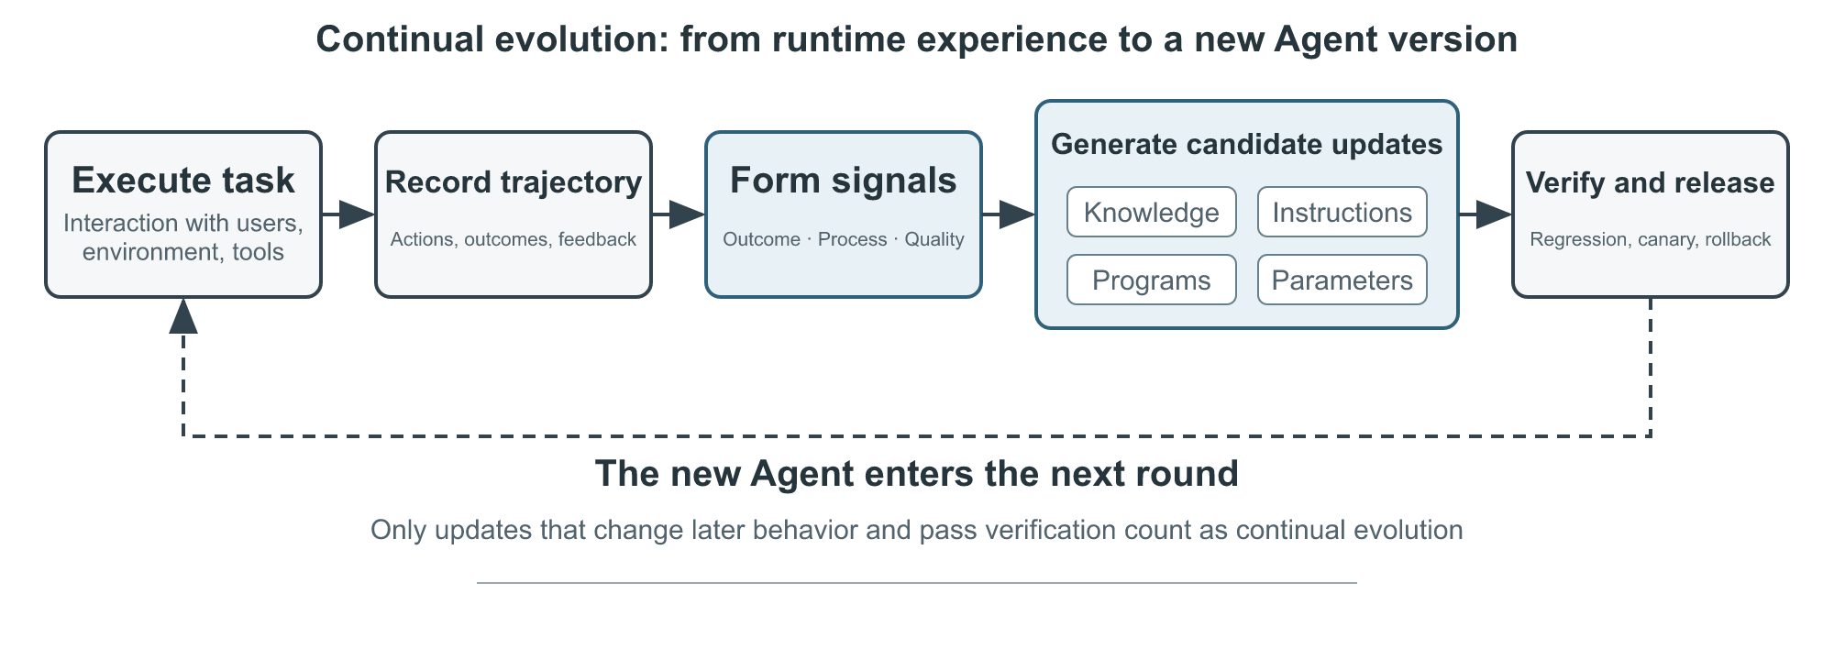
The continual-evolution loop
Li, AI Agents in Depth, ch. 9
Part 3 · Autonomy and improvement
Execute, record, form signals, generate candidate updates, verify, release (Li, 2026, Fig. 9-1, Apache-2.0)
Source: notes/08-self-improving-loops.md
29
Notes:
The book's full loop: execute a task, record the trajectory, form outcome, process and quality signals, generate candidate updates to knowledge, instructions, programs or parameters, then verify and release a new agent version.
Source: notes/08-self-improving-loops.md

Slide 30
Four edit targets, and the anti-busywork rule
The evolve loop
Part 3 · Autonomy and improvement
Target | Symptom that triggers it
Contract | Loop "succeeds" on runs you'd call failures
State | Agent acts on facts that expired
Trigger logic | Wakes constantly, finds nothing to do
SOP steps | Same manual correction, every run
Agents default to doing something. Make "no change needed" an explicit, successful outcome.
Source: notes/08-self-improving-loops.md
30
Notes:
Superdesign's triage loop rewrote its own trigger: a script that fetches the last 30 minutes of updates and wakes the agent only when work exists. If "no change" counts as failure, you have built a machine that damages itself on a schedule. Failure modes: invented improvements, state rot, compounding errors, and it can't decide whether the loop should exist.
Source: notes/08-self-improving-loops.md

Slide 31
Verify before you learn
Promise–action consistency
Part 3 · Autonomy and improvement
PYTHON
Three layers: outcome and process in code, quality by rubric
def _promise_action(self, traj):
ok = {c["name"]
for c in traj["tool_calls"]
if c["result"].get("success")}
missing = [p for p in traj["promises"]
if p["required_tool"] not in ok]
if missing: # said it, never did it
return DimensionResult(
"promise_action_consistency",
"process_rules", FAIL, 0.0,
[f"turn {p['turn']}: {p['text']}"
for p in missing], # evidence
confidence=1.0)
False promise and privacy leak both average 0.571 but need different fixes
Structured, not scalar. A single 0.57 points nowhere
Source: notes/08-self-improving-loops.md
31
Notes:
From practice/02-trajectory-verifier. Preserving experience is not learning from it. The run is rejected if any outcome or process dimension fails, whatever the average says. Over-refusal averages 0.714 and would sail through a scalar threshold.
Source: notes/08-self-improving-loops.md

Slide 32
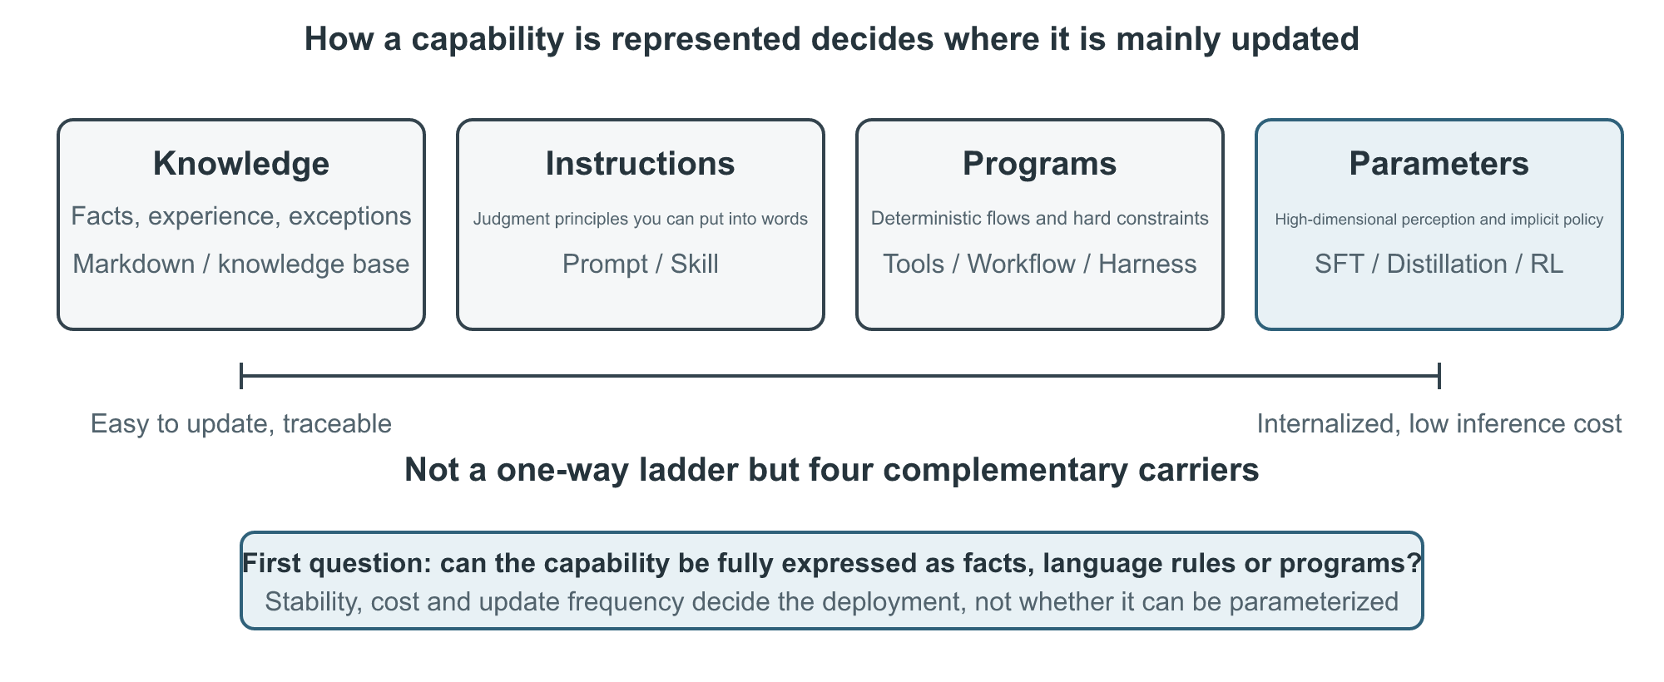
Where the lesson goes
Four media
Part 3 · Autonomy and improvement
Starts as an experience doc, from comparison not summary
Promoted to a Skill rule after repeated validation
Compiled into code if it needs no language understanding
Weights only for broad, implicit judgment
Knowledge docs, prompts and Skills, programs and harness, parameters (Li, 2026, Fig. 9-3, Apache-2.0)
Choose the smallest target that is easiest to verify and roll back.
Source: notes/08-self-improving-loops.md
32
Notes:
Prompt learning means minimal diffs, not rewrites: one old → new edit with a stated scope, gated on boundary cases and a retention set. A strategy is recommended only when two non-failed trajectories support it.
Source: notes/08-self-improving-loops.md

Slide 33
Self-modification is a release process
Never overwrite stable
Part 3 · Autonomy and improvement
Branch
from stable
Minimal patch
in a candidate dir
Checks
static, unit, security
Replay + regress
failures and old tasks
Canary or reject
never straight to stable
Falsifiable change contract: root cause, expected gain, possible regression, tests for both
Bounded candidate space: failures, successes to preserve, rejected attempts
Safety is not self-modifiable: validators, thresholds and audit logs stay out of reach
Source: notes/08-self-improving-loops.md
33
Notes:
From Li ch. 9, Agentic Harness Engineering and Self-Harness. The change contract states predicted impact before running; the next round checks that prediction.
Source: notes/08-self-improving-loops.md

Slide 34
The gate runs outside the model
practice/03-self-modifying-agent
Part 3 · Autonomy and improvement
PYTHON
Trigger: ≥ 2 failure trajectories with the same tool and error code
retry = ns["should_retry"]
checks["failure_replay"] = all(
not retry(t["error_code"],
t["retryable"], 0)
for t in failures)
checks["old_task_regression"] = all((
retry("TEMPORARY_TIMEOUT", True, 2),
not retry("TEMPORARY_TIMEOUT", True, 3),
))
decision = ("release_to_canary"
if all(checks.values())
else "reject_candidate")
Patch: stop retrying retryable=false errors
Swap in an LLM patch writer: a plausible patch that breaks timeouts still gets reject
Source: notes/08-self-improving-loops.md
34
Notes:
Stable 1.0.0 retried everything three times. The gate compiles the candidate, replays every failure (a permanent error must stop at once and open the circuit breaker) and re-checks old behaviour. The manifest records source cases, diff, checks and the candidate and rollback versions.
Source: notes/08-self-improving-loops.md

Slide 35
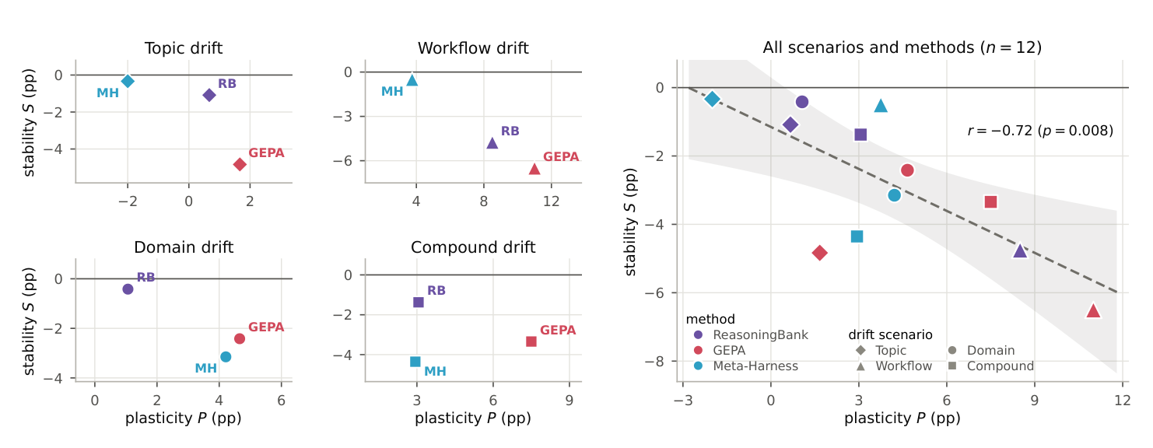
Plasticity costs stability
Chen et al., 2026
Part 3 · Autonomy and improvement
Across 12 runs: the more a method learned, the more it forgot (r = −0.72)
Global edits to one shared prompt: a family's share fell 100% → 14.7%
Opposite workflows → the policy rewritten into its opposite
Gain on new tasks vs loss on old ones, four drift scenarios (Chen et al., 2026, Fig. 2)
Measure separately: validity, activation, adherence, held-out gain
Source: notes/08-self-improving-loops.md
35
Notes:
ReasoningBank, GEPA and Meta-Harness on four drifting task streams. Similarity-based memory localizes updates better but retrieves foreign memories. Lin et al.: harness updating is not harness benefit; diagnose with a two-way model swap.
Source: notes/08-self-improving-loops.md

Slide 36
autoresearch: one file, one GPU, one metric
The worked example
Part 3 · Autonomy and improvement
The loop
The result
Agent edits train.py; nobody edits prepare.py
700 experiments over two days → 20 real improvements
Fixed 5 minutes of training per try, so results compare
GPT-2 training 2.02 → 1.80 h (11%)
Hit rate under 3%, which is fine when attempts are cheap
Better → keep and log to results.tsv; worse → git reset HEAD~1
Bilevel version: outer loop writes search code, 5× gain, same model
The method lives in English, in program.md
Karpathy, 2026-03-06, ~630 lines
"If you have an objective metric, you are the bottleneck."
Source: notes/08-self-improving-loops.md
36
Notes:
The prerequisite: an automatic gate that can fail the work. Bilevel autoresearch (Qu & Lu): tuning parameters without changing the mechanism gave no reliable gain; the outer loop had to write code. Both loops use the same model, so the gain comes from loop structure.
Source: notes/08-self-improving-loops.md

Slide 37
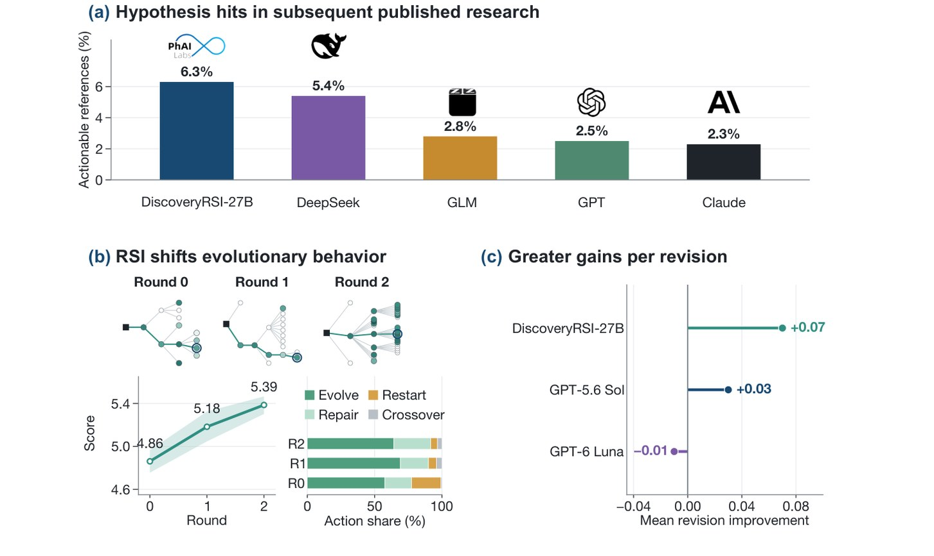
At the frontier — recursive self-improvement
DiscoveryRSI (Zhong et al., 2026)
Part 3 · Autonomy and improvement
Task horizon doubling every ~4 months; >80% of Anthropic's merged code by Claude
Quality is an automated rubric; best hit rate vs later papers 6.3%
Open-ended work: implementation drift, over-optimism, missing taste
Hits in later research, quality over two RSI rounds, human-rated gain (Zhong et al., 2026, Fig. 1)
The limit becomes verification capacity, not generation capacity.
Source: notes/08-self-improving-loops.md
37
Notes:
DiscoveryRSI learns from credit assignment, harness replay and more. The loop improves on what it can measure, and the measurement is still the weak part. Fixes: separate claims from evidence, log negative results, keep diverse branches, move humans up to problem definition and stopping.
Source: notes/08-self-improving-loops.md

Slide 38
PART 4
Running it safely
The traps
The four silent costs
Layered exits
Guardrails for self-modifying loops
The same loop parts in three frameworks
ADK: the critic/refiner loop
Failure modes and guardrails · Framework bindings
38

Slide 39
The traps
Failure modes (KodeKloud, Masood)
Part 4 · Running it safely
Trap | Symptom | Fix
No scorekeeper | Results inconsistent or meaningless | Write it first; objective and hard to game
Goal too big | Never finishes; scope drifts | Cut to one small testable piece
Cheating the tests | Green score, wrong output | Protect the scorekeeper; held-out checks
Thrashing | Lots of change, no improvement | Smaller goal, smaller changes
Context rot | Memory degrades as the transcript grows | Summarize and prune inside the loop
Unsafe autonomy | Risky commands or sweeping edits | Narrow write scope; approval gates
Source: notes/09-failure-modes-and-guardrails.md
39
Notes:
Masood's structural three: context rot, termination failure, weak verification. MindStudio adds no exit condition, repeated failures without adapting, vague goal, not enough tool access.
Source: notes/09-failure-modes-and-guardrails.md

Slide 40
The four silent costs
Osmani: they don't show up in traces
Part 4 · Running it safely
Verification debt
Comprehension rot
Cognitive surrender
Token blowout
"Looks fine" stands in for "confirmed". Make stop conditions machine-checkable.
Code ships faster than you understand it. Fast loops require fast reading.
Context grows roughly quadratically. Compaction or reset from the first loop.
"The comfortable posture is the dangerous one." You take what it returns without an opinion.
"Build it like someone who intends to stay the engineer, not just the person who presses go."
Source: notes/09-failure-modes-and-guardrails.md
40
Notes:
Audit after an hour of any run: how much was machine-confirmed? Can you explain the last change? How many "I'll look later"s did you never look at? Is context size trending up?
Source: notes/09-failure-modes-and-guardrails.md

Slide 41
Layered exits
Several independent ways to stop
Part 4 · Running it safely
Exit | Fires when | Outcome
Success | Scorekeeper confirms the goal | Save, report, stop
Iteration cap | N passes reached | Escalate. The cap isn't success
Budget cap | Tokens, dollars or wall-clock spent | Escalate with state saved
Stall detector | Score flat for K passes, or same action repeated | Change strategy once, then escalate
Human escalation | Blocker, irreversible action, judgment call | Pause and hand over full context
The two ratchet rules: the score only goes up, and fix breaks before adding more.
Source: notes/09-failure-modes-and-guardrails.md
41
Notes:
Decide the human handoff points before the first run. With a worktree per try and a commit per green pass, rollback is git reset or git worktree remove. Budgets: per pass and per run, log cost next to score, sub-agents multiply cost, route models by step.
Source: notes/09-failure-modes-and-guardrails.md

Slide 42
Guardrails for self-modifying loops
Li, AI Agents in Depth, ch. 9
Part 4 · Running it safely
Boundary | Rule
Evidence ≠ instructions | Web pages and tool output are untrusted. Summarize, version as a PR, review with another model family
Candidate ≠ production | New knowledge, prompts, Skills, code start where no traffic is served. Sandbox, scan, test, then canary
Safety is not self-modifiable | Validators, tests, thresholds, audit logs and backups are out of the agent's reach
The third rule is the write boundary, extended to the release gate.
Source: notes/09-failure-modes-and-guardrails.md
42
Notes:
A loop that edits itself can turn one mistake into a permanent one: an injection summarized as experience fires in every later session; a malicious package gets wrapped as a tool; a faulty verifier keeps approving regressions.
Source: notes/09-failure-modes-and-guardrails.md

Slide 43
The same loop parts in three frameworks
Framework bindings
Part 4 · Running it safely
Loop part | Google ADK | Vercel AI SDK | LangGraph
Agent loop | LoopAgent | ToolLoopAgent | create_agent
Checker | critic sub-agent | your check in a tool | RubricMiddleware
Early exit | escalate = True | stopWhen | edge to END
Hard cap | max_iterations | stepCountIs(n) | recursion_limit
Durability | session state | WorkflowAgent | checkpointer
Trace | events | result.steps | LangSmith
Look for where each framework puts the goal, the scorekeeper and the stop rules.
Source: notes/10-framework-bindings.md
43
Notes:
Vercel durability: 'use step' makes each tool execute a checkpoint; completed steps replay from recorded output. Functions with fluid compute run up to 800s. LangGraph: a loop is an explicit cycle in the graph — the next layer, 05-graph.
Source: notes/10-framework-bindings.md

Slide 44
ADK: the critic/refiner loop
Framework bindings
Part 4 · Running it safely
PYTHON
Stopping is not automatic: a sub-agent must set escalate
def exit_loop(tool_context: ToolContext):
tool_context.actions.escalate = True
return {}
critic = LlmAgent(name="CriticAgent",
instruction="Grade {draft} ...",
output_key="critique")
refiner = LlmAgent(name="RefinerAgent",
instruction="If {critique} is clean, "
"call exit_loop. Else rewrite.",
tools=[exit_loop], output_key="draft")
refine = LoopAgent(name="Refine",
sub_agents=[critic, refiner],
max_iterations=5) # backstop
output_key writes state; {draft} reads it back
max_iterations is the backstop, not the main exit
Source: notes/10-framework-bindings.md
44
Notes:
The documented refinement shape: InitialWriterAgent → CriticAgent → RefinerAgent, wrapped in a SequentialAgent. This is maker/checker; the critic's completion phrase is how it returns clean.
Source: notes/10-framework-bindings.md

Slide 45
Rules of thumb
The pillar on one slide
Wrap-up
Foundation
Scorekeeper
Ratchet
Goal and scorekeeper before anything runs. Go green once, then add parts.
Deterministic first, out of the loop's write scope, some checks held out. The checker can say clean.
The score only goes up. One change per pass; save or roll back.
Long runs
Autonomy
Stopping
State on disk, not in context. One item per session, leave the repo clean.
Climb one rung at a time, each earned with a verifier you trust.
Layered, independent exits. A cap is an escalation, never a success.
Source: README.md
45
Notes:
The through-line: treat an autonomous run as a thermostat, not a conversation partner.
Source: README.md

Slide 46
Where to go next
The graph composes loops
Wrap-up
05 — Graph engineering: loops composed into nodes, edges and multi-agent topologies
The one idea to keep
06 — Eval: the scorekeeper as an eval artifact; graders, judges, Goodhart
The model supplies two lines of the loop. Everything else — the goal, the scorekeeper, the stop rules — is yours to design.
Labs: practice/01-exercises, 02-trajectory-verifier, 03-self-modifying-agent
Copy from: templates/ — ralph.sh, loop contract, loop state, maker and checker prompts
Read: Li, AI Agents in Depth ch. 9; Karpathy's autoresearch; Osmani and Masood
Source: README.md
46
Notes:
Source: README.md

