Slide 1
Context Engineering
Part 1: Foundations
Why context is finite · Anatomy of the window · Budgeting it
The smallest set of high-signal tokens
Part 2: The levers
Retrieval · Compaction · Memory · Structure · Cognitive tools · Protocols · Isolation
Part 3: Practice
Finite attention · Anatomy · Budget
Retrieval · Compaction · Memory · Structure · Isolation · Failure · Evals
Failure modes · Evaluating context · Putting it together
Notes: ai-engineering/02-context-engineering
Notes:
Pillar 2 of the AI-engineering course. Prompt engineering writes the instructions; context engineering decides everything else that shares the window with them, on every call. Three parts: why the window is finite and how to lay it out, the levers that move content in and out, and how to diagnose and evaluate a context system.

Slide 2
PART 1
The thesis
Context rot starts long before the limit
What fills the window
System prompt altitude
Organize by frequency, stability and enforcement
Stable before dynamic — the cache is a prefix match
Patterns that break the cache (or the model)
The status bar — distill, don't retrieve
The window as an economy
Two rules matter more than any split
Progressive reduction — cut by ablation
Measure what each layer buys
Foundations
Why context is finite · Anatomy of the window · Budgeting it
2
Notes:
Notes 01–03. The constraint, what fills the window and in what order, and how to split the budget.

Slide 3
The thesis
Why every technique follows
Part 1 · Foundations
Find the smallest set of high-signal tokens that maximizes the likelihood of the outcome you want.
Anthropic's framing. It is a minimization: the instinct with a 1M window is to fill it, and the instinct is wrong.
Source: notes/01-why-context-is-finite.md
3
Notes:
Every chapter after this is a response to one constraint. Attention is a fixed budget divided across n² token pairs: doubling the context quadruples the pairs while the parameters that resolve them stay fixed. Token cost is not the binding constraint; quality degrades first. "It fits in the window" is not an argument for including something.
Source: notes/01-why-context-is-finite.md

Slide 4
Context rot starts long before the limit
Four failure shapes
Part 1 · Foundations
Recall and use of information decline gradually as occupancy grows. It is not a cliff at the window edge.
Shape | What it looks like
Middle neglect | Start and end recalled, the middle is not (lost in the middle)
Distractor sensitivity | Plausible-but-wrong content pulls the answer further off target as the window grows
Instruction decay | System-prompt rules obeyed early in a session are quietly dropped later
Needle degradation | A planted fact, present verbatim, is missed more often as filler grows
Filler degrades retrieval of the signal it surrounds. "Just in case" is a cost, not free insurance.
Source: notes/01-why-context-is-finite.md
4
Notes:
The last row is the important one: the fact is there, unmodified, and the model still misses it. Position-encoding interpolation extends the addressable range; it moves where rot starts, it does not repeal it. The return curve on added context turns negative, not just flat: past a point a marginal document makes output worse than omitting it.
Source: notes/01-why-context-is-finite.md

Slide 5
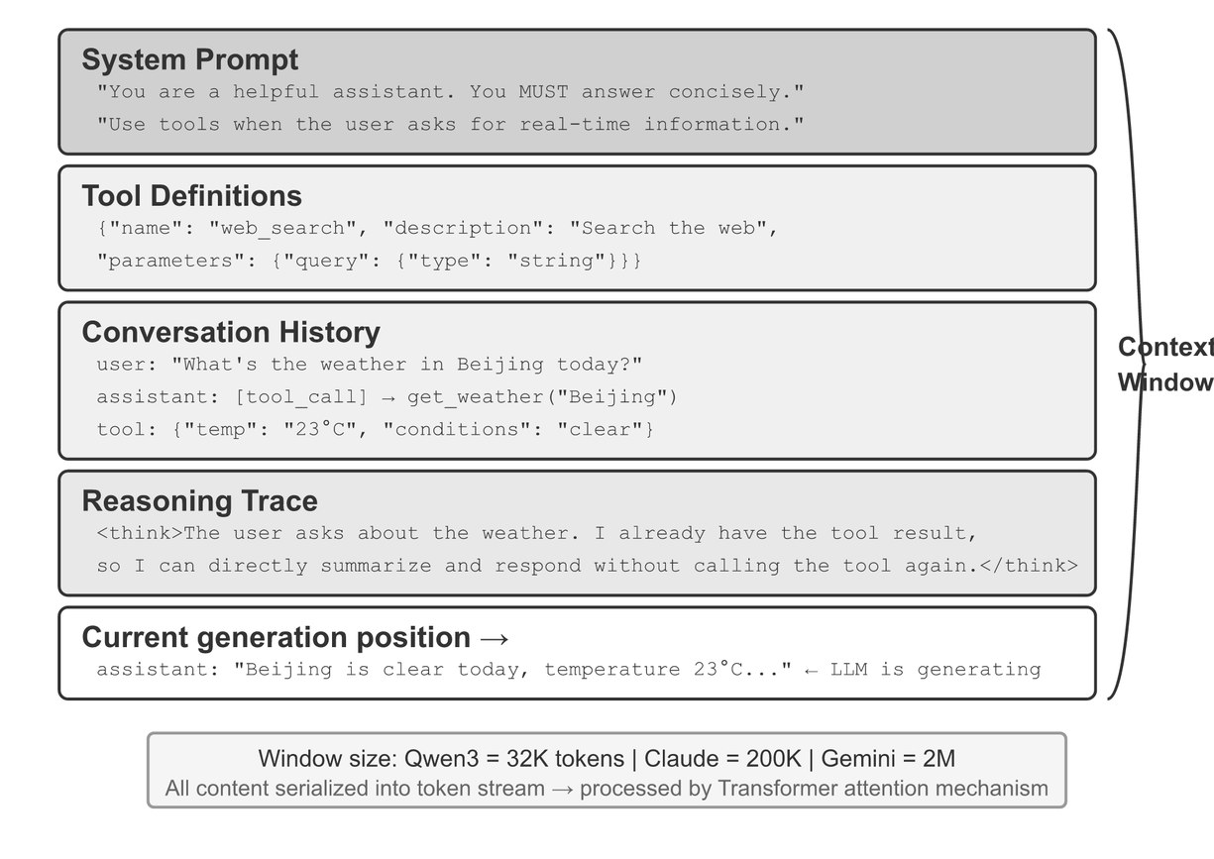
What fills the window
The components
Part 1 · Foundations
System prompt — role, framing, constraints
Tool definitions — resident every call
Retrieved knowledge and memory
Runtime state — date, user, permissions
History — including tool calls and results
The current turn — last
Li, AI Agents in Depth (2026), Fig. 2-1 (Apache-2.0)
Context engineering decides, per call, what occupies each slot and at what size.
Source: notes/02-context-anatomy.md
5
Notes:
Seven components, roughly in order. The formal view (Mei et al. survey) writes this as C = A(c_instr, c_know, c_tools, c_mem, c_state, c_query): context engineering is designing the assembly function A, not writing any one component.
Source: notes/02-context-anatomy.md

Slide 6
System prompt altitude
The Goldilocks zone
Part 1 · Foundations
Too low | Right altitude | Too high
Hardcoded if/else logic in prose | Specific enough to guide, flexible enough to generalize | Vague guidance that assumes context the model lacks
Brittle on any case not enumerated | Heuristics with clear signals | The model invents its own interpretation
"If the user says X, reply Y. If Z, reply W…" | "Prefer X when the signal is A; escalate when uncertain." | "Be helpful and use good judgment."
Adding a fourth conditional to a prompt? The fix is usually a tool or a code-level control, not a fifth.
Source: notes/02-context-anatomy.md
6
Notes:
The low-altitude failure is the common one in engineered systems, because every production bug tempts you to add one more rule. The result reads like a decision tree, is unmaintainable, and still misses the next edge case.
Source: notes/02-context-anatomy.md

Slide 7
Organize by frequency, stability and enforcement
The five layers
Part 1 · Foundations
always resident
1
Persistent instruction — identity, conventions, invariants. Test: true in nearly every task? (CLAUDE.md)
2
On-demand knowledge — skills and playbooks. ~10 tokens of description resident, the procedure loaded when triggered
3
Runtime injection — date, tenant, permissions, assembled at request time rather than stored in the prompt
4
Long-term memory — a compact index plus retrievable detail. Never a transcript pasted forward
5
Deterministic system — hooks, permissions, schemas, validators. A code control can't be talked out of enforcing itself
enforced in code
"The agent keeps doing X" is usually a hook, not a stronger sentence.
Source: notes/02-context-anatomy.md
7
Notes:
Organize by usage frequency, stability and enforcement requirement, not by topic. Skill descriptions are routing rules: "Use when … / Do not use when …", with negative examples. Where the full skill lands trades cache against instruction-following: appended to the system prompt breaks the prefix; read as a file is weaker; a dedicated Skill tool with resident metadata is the Claude Code answer.
Source: notes/02-context-anatomy.md

Slide 8
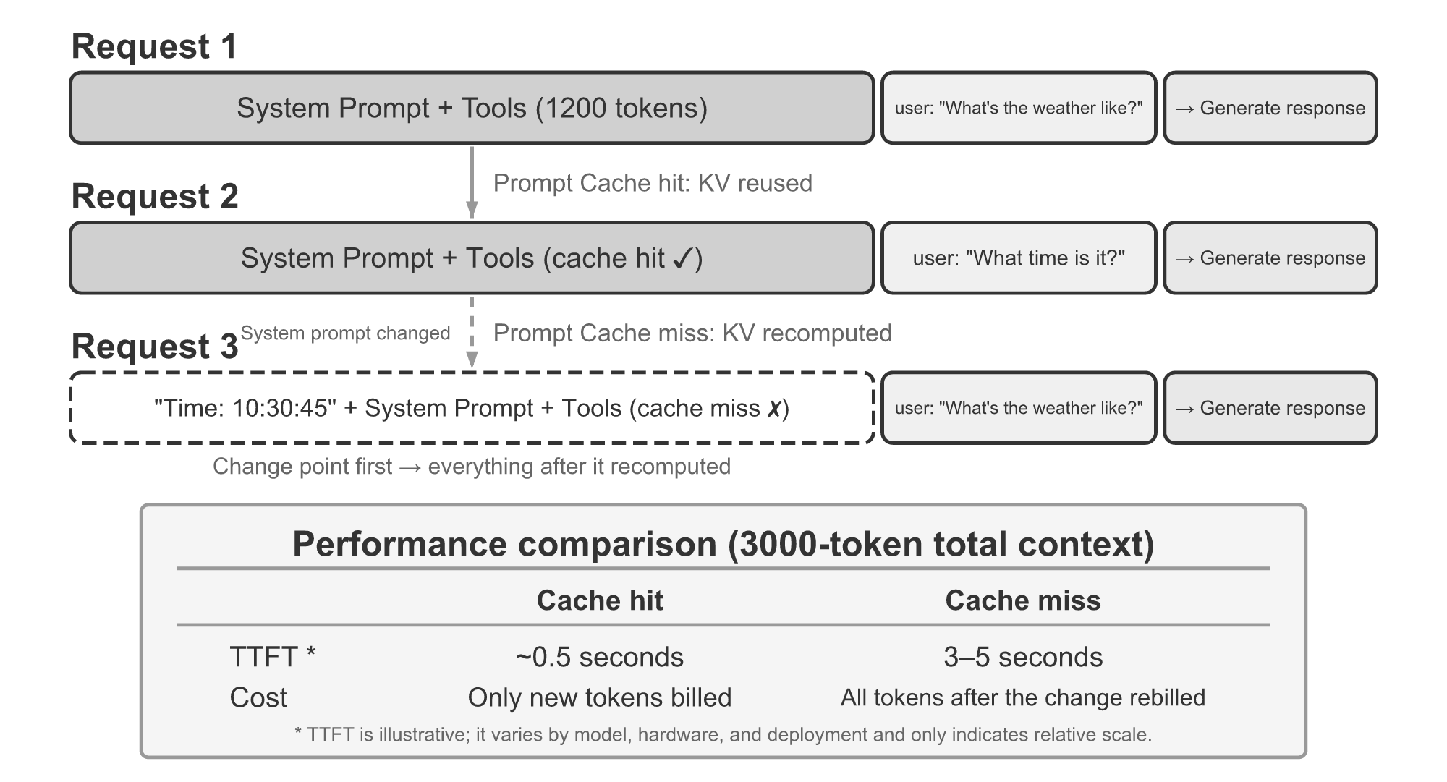
Stable before dynamic — the cache is a prefix match
Ordering
Part 1 · Foundations
The first differing token invalidates everything after it
Order: system → tools → stable memory, then retrieved → history → state → query
Cached reads cost about 1/10 of fresh prefill
Long documents above the query: up to 30% better (Anthropic)
Li, AI Agents in Depth (2026), Fig. 2-10 (Apache-2.0)
Cache economics and attention placement point the same way. Design for both from the start.
Source: notes/02-context-anatomy.md
8
Notes:
Anthropic needs explicit cache_control breakpoints, a minimum length of about 1024 tokens and a TTL of about 5 minutes; OpenAI caches prefixes automatically. Claude Code orders its prompt by cache boundary first, meaning second: each binary condition placed before the marker doubles the cache-key variants. Sub-agents are byte-aligned with the parent so side queries hit the parent's cache.
Source: notes/02-context-anatomy.md

Slide 9
Patterns that break the cache (or the model)
Li, Experiment 2-3
Part 1 · Foundations
One timestamp in a 100k-conversation/day system prompt: TTFT 0.5 s → 3–5 s, and the bill nearly doubled.
Pattern | What breaks | Fix
Timestamp in the system prompt | Prefix changes every request | Late message or a clock tool
Per-request user config (quota, balance) | Same | State at the end (status bar)
Reordering tools by usage | Hundreds of tokens re-prefilled per tool | Fixed order
Sliding-window history | Prefix shifts; old results vanish and calls repeat | Compaction, not truncation
Flattening to USER: / ASSISTANT: text | Leaves the trained format; tool results ignored | Structured API roles
Per-request few-shot swaps | Examples sit early and break the prefix | A fixed set per task type
Source: notes/02-context-anatomy.md
9
Notes:
The flattening row is mostly a model problem, not a cache problem: outside the trained chat template the model ignores tool results, repeats actions and writes text where a call was needed. Related: pass reasoning back. DeepSeek V4, Kimi K2 and GLM-5 require reasoning_content returned verbatim; Claude requires signed thinking blocks inside the tool loop.
Source: notes/02-context-anatomy.md

Slide 10
The status bar — distill, don't retrieve
Li & Shi, 11 models, ~24k evals
Part 1 · Foundations
XML
Weak models gain 40–54 points; a 2B model with a bar matches a frontier model without
<agent_status>
- phone_call: 3 invocations (Xfinity: 3/3 max)
- Current time: 2025-09-14 10:30:45
- TODO: [1] Cancel plan (in_progress)
</agent_status>
Strong models cut reasoning tokens 80–90%
Maintain it in code: a 20-line regex beat an LLM summarizer
Lossy: pairs-only bar on a triple question, 100% → 7.6%
Errors above ~10% are worse than no bar
In-context learning is closer to retrieval than reasoning. Give the model the count; don't make it count.
Source: notes/02-context-anatomy.md
10
Notes:
The harness appends the status bar at the end of each turn, next to the tokens being generated. An agent told "call each merchant at most 3 times" miscounts its own calls; "This is call #3 (3/3)" fixes it. Key–value entries beat the same facts as prose. Detailed errors with fix hints raised recovery from 60% to 95%. If an attacker can write to the bar it becomes an injection channel.
Source: notes/02-context-anatomy.md

Slide 11
The window as an economy
Three things to spend on
Part 1 · Foundations
Spend | Buys | Over-spent | Under-spent
Instructions — prompt, rules, examples | Behaviour you can rely on | Diluted attention; rules contradict | The model guesses
Evidence — docs, tool results, memory | Grounding | Distraction, rot | Hallucination
Working space — history, reasoning, output | Room to think and answer | Lost recent turns | Truncated output
Investments (a rule used every call) go in the stable prefix. Expenses (a tool result read once) get cleared.
Source: notes/03-budgeting-the-window.md
11
Notes:
Formally: argmax over the assembly function of expected reward, subject to |C| ≤ L_max. Two consequences. The constraint binds before L_max, so budget against the effective window. And a component's value is marginal: a second document that restates the first is "relevant" and worth close to zero.
Source: notes/03-budgeting-the-window.md

Slide 12
Two rules matter more than any split
Allocation
Part 1 · Foundations
Starting splits (pyramid, by task type) are heuristics. Measure, then adjust.
A starting split — complex reasoning
The rules
System 15% · Examples 25%
Reserve the output first — max_tokens plus the thinking budget come off the top
History 30% · Input 20%
Reserve 10%
Give every growing component a ceiling — history, tool results, retrieved chunks
Simple Q&A shifts to 70% history, 0% examples
The ceiling is what triggers compaction
A guess to measure against
A full window leaves no room to answer
Source: notes/03-budgeting-the-window.md
12
Notes:
The pillar's templates/control_loop.py ContextManager is the minimal version: reserve the output, then drop the oldest history entry until the rest fits. Use the model's tokenizer rather than a word count; words undercount tokens by about a quarter on English and more on code.
Source: notes/03-budgeting-the-window.md

Slide 13
Progressive reduction — cut by ablation
System prompt
Part 1 · Foundations
Before (~350 tokens)
After (~90 tokens)
You are a financial analyst with a PhD from Stanford and 15 years at Goldman Sachs and Morgan Stanley. You specialise in technology sector analysis with deep knowledge of SaaS business models…
You are a senior financial analyst specialising in tech stocks. Cover: 1. Fundamentals 2. Industry context 3. Macro factors. Balance quantitative data with strategic insight.
Persona biography
Task guidance, three sections
Remove anything whose deletion doesn't move an eval score. Few-shot returns fall fastest after the first example.
Source: notes/03-budgeting-the-window.md
13
Notes:
Write the full version, then cut elements one at a time while re-running the eval set. Two patterns account for most of the savings: task guidance over persona biography, and minimal scaffolding (three output sections, not seven). Example counts: 1–3 per class for classification, 2–5 for generation.
Source: notes/03-budgeting-the-window.md

Slide 14
Measure what each layer buys
Token efficiency
Part 1 · Foundations
PYTHON
layers = {"role": ..., "examples": ..., "constraints": ..., "audience": ...}
prompt = "Write a paragraph about climate change."
for name, text in [("base", "")] + list(layers.items()):
prompt = f"{text}\n\n{prompt}" if text else prompt
out = llm(prompt)
p, r = len(enc.encode(prompt)), len(enc.encode(out))
print(f"{name:12} prompt={p:4} response={r:4} score={judge(out):.2f}")
Track quality per prompt token. Response/prompt length ("token efficiency" upstream) rewards verbosity.
Source: notes/03-budgeting-the-window.md
14
Notes:
Adapted from the upstream course's 02_expand_context.py. The measurement loop: log tokens per component on every call; ablate one component and re-run the eval set; track quality per 1k tokens; plot score against total length and find where it bends down. That knee is the effective budget.
Source: notes/03-budgeting-the-window.md

Slide 15
Retrieve before inference, or during it
The pre-retrieval pipeline — cheap filters first
A tuned pipeline — Bayer's PRINCE
Hybrid retrieval and reranking
Contextual retrieval — add context at index time
A first production cut
RAG architectures — each step adds control
The compaction pipeline
What survives compaction, in order
Six compression strategies, one task
The production ladder — cheapest first
Memory formats — mix them
Memory hygiene — update over append
Designed memory vs. searching the raw record
Choosing a format
Output schemas — validate, and feed the error back
Cognitive tools — reasoning steps as isolated calls
Verify with code where you can
Protocol shells — prompt programs without code
Isolation — the most expensive lever
Tool descriptions are resident context
PART 2
The levers
Retrieval · Compaction · Memory · Structure · Cognitive tools · Protocols · Isolation
15
Notes:
Notes 04–10. Four levers in order of cost: Write (can it live outside the window?), Select (what comes back in?), Compress (can it be smaller?), Isolate (does it need its own window?).

Slide 16
Retrieve before inference, or during it
The biggest shift in the pillar
Part 2 · The levers
Pre-computed (RAG era)
Just-in-time (agentic)
Embed corpus and query, stuff top-k, generate
Keep identifiers: paths, IDs, queries (~10 tokens each)
Relevance guessed before the model reasons
The agent loads what its reasoning says it needs
50 files × 5k tokens = 250k
Index + 3 files = ~15.5k
Fast, deterministic, often wrong
Costs: latency, wandering, non-determinism
Hybrid default: pre-load what's needed on ≥80% of turns; leave the long tail to tools.
Source: notes/04-retrieval.md
16
Notes:
Anthropic calls this just-in-time context. Progressive disclosure: ls, grep, then read the three files that matter. Metadata carries signal for free: tests/integration/test_auth_retry.py tells the agent scope and purpose before a byte is read. Claude Code is the hybrid pattern: CLAUDE.md every session, everything else Read, Grep, Glob on demand.
Source: notes/04-retrieval.md

Slide 17
The pre-retrieval pipeline — cheap filters first
When you do retrieve upfront
Part 2 · The levers
Filter
permission, date, tenant
Search
hybrid top-k
Rerank
cross-encoder
Dedup + compress
query-conditional
Format
tags + source + date
Filter inside the vector query, not on the results. It's also a security control
Ranking ≠ retrieval — retrieve wide, rerank, send narrow
Dedup trap — a chunk hit by several sub-queries is often the most relevant one
Compress per query — a generic summary drops the detail the query needed
Source: notes/04-retrieval.md
17
Notes:
The full pipeline in the note has seven stages: metadata filtering, vector search, ranking, deduplication, compression, memory injection, structured formatting. Each stage narrows the candidate set, so cheap filters go first and every later stage gets cheaper.
Source: notes/04-retrieval.md

Slide 18
A tuned pipeline — Bayer's PRINCE
Martin Fowler, reliable LLM case study
Part 2 · The levers
millions
1
Extract keywords + a metadata filter — two concurrent LLM passes, e.g. eq(study_id, T123456-2)
2
Expand the query, n=5 — a smaller model rewrites the question into five variants
3
Pre-filter inside the vector DB — millions of vectors → tens or hundreds before any similarity math
4
Parallel hybrid search, 0.7 / 0.3 — kNN 0.7, keyword 0.3, found experimentally; union, max-score, keep ~20
5
Cross-encoder rerank, 20 → 7 — bge-reranker-large against the original question, not the rewrites
7 chunks
Each narrowing uses a mechanism more accurate and more expensive than the last.
Source: notes/04-retrieval.md
18
Notes:
Three things generalize past the numbers. Expansion multiplies retrieval, so the filter has to come first. Max-score aggregation is a dedup policy: multi-retrieval counts as signal without letting a chunk win by appearing everywhere weakly. The rerank scores against the user's actual question, because reranking against a rewrite would compound its drift. The 0.7/0.3 split is a corpus-specific result; for a new corpus, measure it.
Source: notes/04-retrieval.md

Slide 19
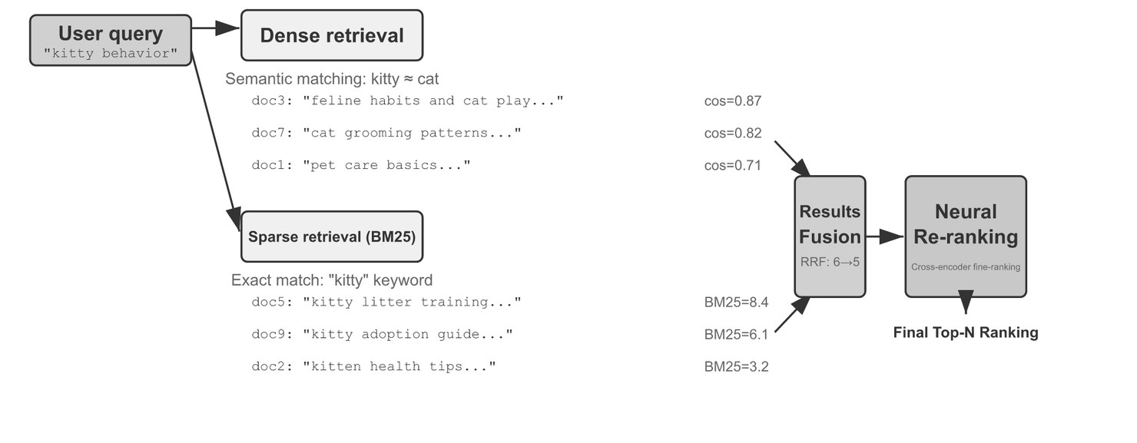
Hybrid retrieval and reranking
The production default
Part 2 · The levers
BM25 finds exact terms: names, error codes, IDs
Dense finds paraphrases
Fuse: RRF Σ 1/(60 + rank) is robust; weighted scores need normalizing first
Rerank the fused top ~50 with a cross-encoder
Li, AI Agents in Depth (2026), Fig. 3-9 (Apache-2.0)
Measure each stage: recall@k, MRR, nDCG
Source: notes/04-retrieval.md
19
Notes:
Dense scores run roughly 0–1 and BM25 scores run to tens, so weighted fusion without min-max normalization lets BM25 swamp the dense half. The note has both fusions as code. A cross-encoder reads query and candidate together (the interviewer); a bi-encoder compares two independent vectors (the résumé screen). Many reports, Anthropic's included, mean hit rate when they say recall@k. Check the definition and k.
Source: notes/04-retrieval.md

Slide 20
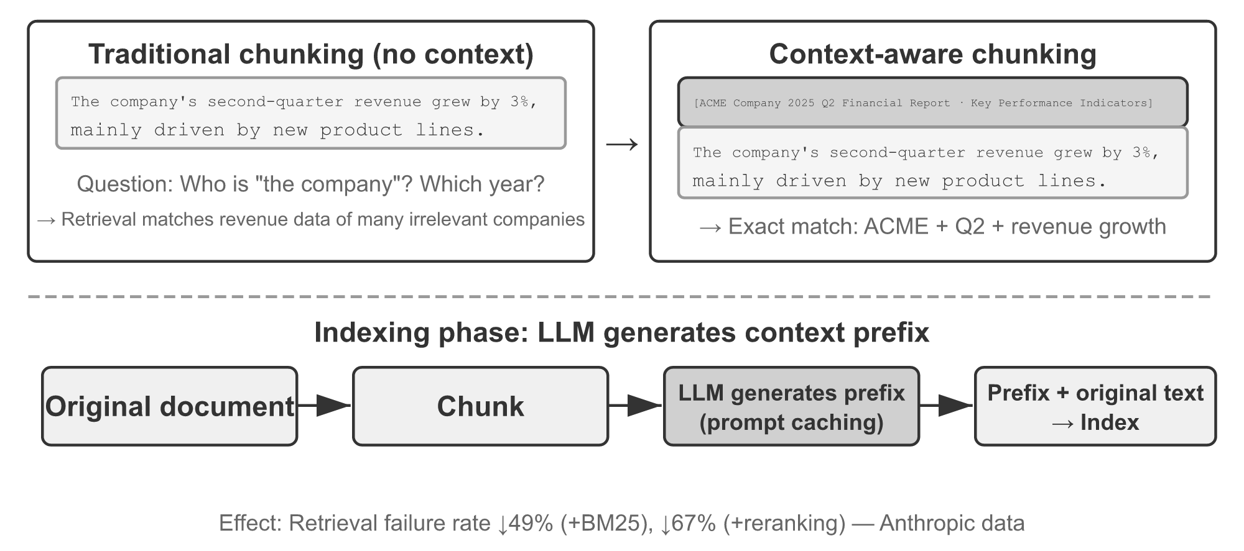
Contextual retrieval — add context at index time
Anthropic
Part 2 · The levers
"Q2 revenue grew 3%" — which company, which year?
An LLM writes a short prefix per chunk; index prefix + chunk
Top-20 failures −49% (contextual embeddings + BM25)
−67% with a reranker
About $1 per million document tokens with prompt caching
Li, AI Agents in Depth (2026), Fig. 3-14 (Apache-2.0)
Contextual retrieval adds at index time. Contextual compression removes at query time. Don't confuse them.
Source: notes/04-retrieval.md
20
Notes:
One step improves both retrieval paths: BM25 gains exact keywords (ACME, 2025 Q2) and the embedding gains the missing context. The indexing cost is low because every chunk of one document shares the document as a cached prefix.
Source: notes/04-retrieval.md

Slide 21
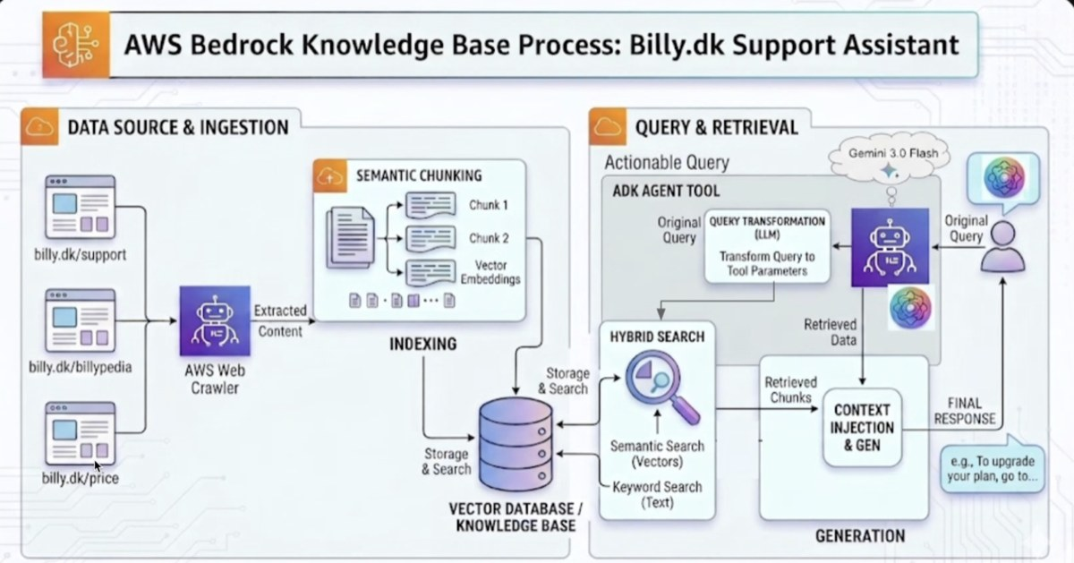
A first production cut
Worked example
Part 2 · The levers
Hybrid search: semantic and keyword together
Query transformation before retrieval: what users type rarely retrieves best
Missing: no rerank, no dedup
Those are the stages teams add after quality plateaus
Billy.dk support assistant on AWS Bedrock Knowledge Bases
Source: notes/04-retrieval.md
21
Notes:
Ingestion and indexing on the left, query and retrieval on the right. Ingestion sets the ceiling: a text-only parser over a PDF-heavy corpus silently drops every chart and table, and the retrieval layer then looks broken. Check what the parser produced before tuning k, rerankers or chunk size.
Source: notes/04-retrieval.md

Slide 22
RAG architectures — each step adds control
From naive to agentic
Part 2 · The levers
Architecture | Shape | Use when
Naive | embed → top-k → stuff into prompt | One-hop questions over a clean corpus
Modular | rewrite → retrieve → rerank → compress → generate | You need to swap one stage
Agentic | model decides whether, what and when; loops | Multi-step questions that decompose
Graph-enhanced | Entities and relations; retrieval walks edges | Multi-hop, "how is X related to Y"
Text-to-SQL | schema subset + retrieved few-shot + SELECT-only check | Counting, filtering, aggregation
A layer spanning structured and unstructured data needs a router, not a single index.
Source: notes/04-retrieval.md
22
Notes:
Li's Experiment 3-9 on legal Q&A: a simple question gives the same quality either way and non-agentic is faster. A compound question (negligent injury while intoxicated, with a prior theft conviction) separates them: the agent searches the sub-questions in parallel, sees the missing link, and runs a targeted second round. In PRINCE's Text-to-SQL path an LLM review step was removed: it flagged valid queries often enough to cost more than it saved. Deterministic validation beat model judgment.
Source: notes/04-retrieval.md

Slide 23
The compaction pipeline
Long-horizon agents
Part 2 · The levers
Prune
dead branches
Clear tool output
keep the conclusion
Extract state
files, decisions, TODOs
Summarize the middle
lossy but bounded
Keep recent verbatim
last N turns
Trigger at phase boundaries, not at 95% mid-edit; ~80% occupancy as a backstop
Identifiers verbatim: UUIDs, hashes, paths, PR numbers. One wrong digit fails the next call
Tool-result clearing first: highest value, lowest risk
Compaction rewrites the prefix, so each one pays a full re-prefill
Source: notes/05-compression-compaction.md
23
Notes:
Summarizing the last three turns is how a compaction loses the thread: the half-finished edit and the error being debugged live there. Compress for quality, not only length: ten searches scattered over 50k tokens make the model hunt; one structured summary turns a conclusion that had to be reasoned into one that can be looked up.
Source: notes/05-compression-compaction.md

Slide 24
What survives compaction, in order
Retention priority
Part 2 · The levers
1
Architectural decisions — "X over Y because Z", verbatim. Lose the reason and the agent re-litigates it
2
Modified files and critical changes — the diff so far is state, not history
3
Verification status — which tests ran, pass or fail
4
Unresolved TODOs and rollback notes — everything not yet done
5
Tool output — deletable. Keep the conclusion, drop the payload
40k tokens of test output → "17 passed, 2 failed". A rationale can't compress at all.
Source: notes/05-compression-compaction.md
24
Notes:
The asymmetry between 1 and 5 is the core insight. Summarizers also drop what looks re-acquirable: early decisions, the reasons behind constraints, and failed paths. Those are exactly what items 1–4 protect. Agents that write their state down survive compaction; agents that keep it in the transcript do not.
Source: notes/05-compression-compaction.md

Slide 25
Six compression strategies, one task
Li, Experiment 2-9
Part 2 · The levers
Track OpenAI co-founders' current roles with a 128K window. Seven searches return ~367k characters.
Strategy | Result
No compression | Overflowed at iteration 5. Failed
Summarize each result separately | 12 iterations, 277k tokens; facts repeated across pages
One combined summary | 10 iterations, 93k tokens; long inputs truncated at the tail
Context-aware (query + known state in the prompt) | 7 iterations, 40k tokens; a 148k-char page → 2k, every role change kept
Context-aware + citations | 223k tokens; lossy content, lossless index to the sources
Adaptive: batch at 80%, [COMPRESSED] marker | 175k tokens; full fidelity early on
Compression is understanding. The compressor needs near-main-model capability and the task in its prompt.
Source: notes/05-compression-compaction.md
25
Notes:
Context-aware compression cut tokens by more than 75%. Design principles: information value is uneven (decision points > evidence > noise); keep semantics intact ("Sutskever left OpenAI in May 2024", not "Sutskever left"); the same text should compress differently for different tasks. Isolation beats compression where it applies: a delegated search costs the parent two messages.
Source: notes/05-compression-compaction.md

Slide 26
The production ladder — cheapest first
Claude Code's five mechanisms
Part 2 · The levers
1
Tool-result budget — large outputs go to disk; the model sees a frozen preview
2
Delete noise outright — summarizing junk wastes tokens
3
API micro-compaction — server-side context editing; still breaks the cache after the edit point
4
Archival per-turn summaries — git log, not git squash
5
Full LLM compaction — last resort, with a circuit breaker for compaction-failure loops
Crash recovery: past ~30 minutes of runtime, write progress to disk. State on disk survives everything.
Source: notes/05-compression-compaction.md
26
Notes:
Ordered by cost and by how well each keeps the cache under control. OpenAI's Responses API exposes compaction directly: the compaction item is a checkpoint, and everything before it is discardable. The memory hierarchy view: the window is L1, the session store L2, long-term memory L3; compaction demotes, retrieval promotes.
Source: notes/05-compression-compaction.md

Slide 27
Memory formats — mix them
How memory is stored
Part 2 · The levers
Memory affects the model only by entering a window. Every memory decision is a context decision.
Format | Wins | Loses
Simple notes | Cheapest; passes basic recall | Links between facts (title, employer, team become three facts)
Enhanced notes | Nuance | Redundant; one change rewrites several paragraphs
JSON cards | Partial updates; predictable | Rigid when a fact fits three categories
Advanced JSON cards | Disambiguation: the user's dentist vs. their father's cardiologist | Expensive to generate and maintain
User as Code | Typed state from a fact log: aggregation ~99% vs. 6–43% | A notes field for what won't type
Advanced cards for critical, low-volume facts. Simple notes for high-volume, low-stakes ones.
Source: notes/06-memory.md
27
Notes:
Episodic memory grows linearly and rots; semantic memory is distilled from episodes and stays roughly constant. "Corrected me about commit format three times" becomes one fact. The trajectory is a log; long- term memory is an archive that gets rewritten, merged and pruned. User as Code is Li, arXiv 2606.16707.
Source: notes/06-memory.md

Slide 28
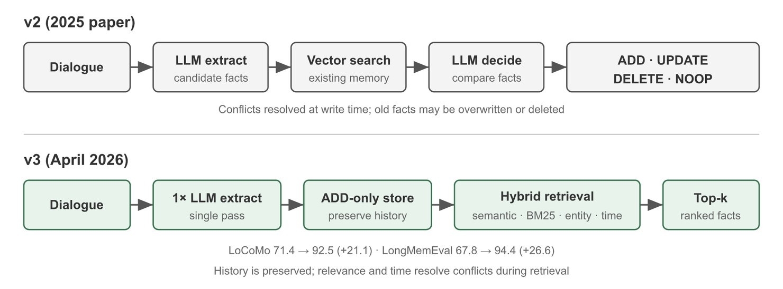
Memory hygiene — update over append
Mem0's write path
Part 2 · The levers
Extract candidate facts; vector-match against existing memories
LLM picks ADD · UPDATE · DELETE · NOOP
"Moved to Shanghai" UPDATEs "lives in Beijing"
Li, AI Agents in Depth (2026), Fig. 3-3 (Apache-2.0)
Absolute dates; don't store what's derivable
Verify a remembered file or flag still exists before acting
Append-only memory is slow-motion context poisoning.
Source: notes/06-memory.md
28
Notes:
Practices: update over append, delete what proved wrong, one fact per file, absolute dates, don't store what's derivable from the repo, verify before relying. Compaction for the store: score importance and archive, cluster similar entries, generalize episodes into rules. Sanitize logs locally: a 0.6B local model catches natural-language PII that regex misses, recall above 95%.
Source: notes/06-memory.md

Slide 29
Designed memory vs. searching the raw record
Peng, arXiv 2610.29823
Part 2 · The levers
One LoCoMo conversation: 419 turns, 152 questions.
Extraction-based memory (Mem0, Zep)
Raw history plus search tools
Beats full context only with the weakest reader (GPT-4o-mini, 78% vs. 74%)
A coding agent reading the raw history as one file: 99%
Ties or loses with strong models; the build alone costs more than a full-context run
At under half full context's cost
Same direction as index-plus-detail
The writer caps every reader: Opus 5.5 on a GPT-4o-mini graph, 45% vs. 43%
Caveats: one conversation, one run per cell
With a strong model, keep the source, make it searchable, and let the model decide what to load.
Source: notes/06-memory.md
29
Notes:
Read it as a direction, not a benchmark: most of the agents' lead came from photo captions only they could read. Li's two-tier answer combines the threads: a few critical facts resident as advanced cards, plus raw conversation chunks with contextual-retrieval prefixes searched on demand. Either tier alone fails.
Source: notes/06-memory.md

Slide 30
Choosing a format
Structured context
Part 2 · The levers
Structure compresses meaning, not tokens. The model spends less attention working out what each part is.
Format | Best for | Watch out for
XML-style tags | Wrapping documents, separating sections | Verbose; keep tag names meaningful
Markdown | Instructions, readable system prompts | Weak boundaries: a retrieved doc's ## collides with yours
JSON | Machine state, tool I/O | Token-heavy; escaping inside strings
YAML | Config-like nested state | Whitespace; ambiguous types
Tables | Comparable records | Wide tables lose alignment
Tags for boundaries, markdown for prose, JSON for anything a program reads back.
Source: notes/07-structured-context.md
30
Notes:
Three places schemas go: input schemas (a fixed task skeleton with visible empty slots), state schemas (small, structured, overwritten — MEM1's constant-size state beats a growing log), and output schemas. Version schemas: a change invalidates eval baselines just as a prompt change does.
Source: notes/07-structured-context.md

Slide 31
Output schemas — validate, and feed the error back
Without decode-time enforcement
Part 2 · The levers
PYTHON
Prefer the provider's structured-output mode
for _ in range(max_attempts):
raw = llm(prompt)
fenced = re.search(FENCE_RE, raw, re.DOTALL)
try:
text = fenced.group(1) if fenced else raw
obj = json.loads(text)
jsonschema.validate(obj, schema)
return obj
except (json.JSONDecodeError,
jsonschema.ValidationError) as e:
prompt += (f"\n\nYour previous response did not"
f" conform. Error: {e}. Try again.")
raise ValueError("no schema-valid response")
Otherwise: schema in the prompt + one filled example
The validator's message tells the retry what to fix
Keep jsonschema.validate for rules the provider's subset can't express
A malformed state block that gets re-injected compounds every turn. Validate at the boundary.
Source: notes/07-structured-context.md
31
Notes:
Condensed from the upstream course's 06_schema_design.py. With decode-time enforcement the parse step can't fail, but patterns and cross-field rules still need validation.
Source: notes/07-structured-context.md

Slide 32
Cognitive tools — reasoning steps as isolated calls
Ebouky et al., IBM Research 2025
Part 2 · The levers
GPT-4.1 on AIME 2024: 26.7% → 43.3%, near o1-preview, with no training.
Tool | What it does
understand_question | Core concepts, givens, goal, relevant techniques
recall_related | Analogous solved problems and their steps
examine_answer | Check the trace for errors and unmet constraints
backtracking | When stuck, find where it went wrong and try another path
Each tool runs in its own context. The model choosing when to call them beat a fixed sequence.
Source: notes/08-cognitive-tools.md
32
Notes:
The key design choice is isolation: the tool call goes out with only what that step needs, and only the result comes back. Best results came when the model chose which tool to call and when, not from a fixed sequence. Caveat: maths benchmarks, non-reasoning models. Reasoning models already run something like this internally, so scaffolding adds less.
Source: notes/08-cognitive-tools.md

Slide 33
Verify with code where you can
The self-correction loop
Part 2 · The levers
PYTHON
Loop: generate → validate → feed the problem back, max 3
def python_validator(response):
blocks = re.findall(CODE_RE, response, re.S)
if not blocks:
return False, "No Python code block found."
for i, block in enumerate(blocks, 1):
try:
compile(block, "<llm>", "exec")
except SyntaxError as e:
return False, f"Block {i}: {e}"
return True, "ok"
Same-model verifiers share blind spots; past 2–3 rounds they rarely help
A self-graded stop condition (score > 0.8) is a demo, not a pattern
Tests, parsers, calculators beat a model verdict
End a model verifier with a machine-readable verdict. Better, replace it with a deterministic check.
Source: notes/08-cognitive-tools.md
33
Notes:
From the upstream course's 03_control_loops.py. The opposite design is 07_recursive_patterns.py, which stops when the model's own regex-parsed score clears 0.8. A prompt program is the same idea at a larger scale: a list of operations with templates that read earlier outputs from shared state, so each step can be logged, diffed and evaluated.
Source: notes/08-cognitive-tools.md

Slide 34
Protocol shells — prompt programs without code
The NOCODE track
Part 2 · The levers
PROTOCOL
Real: explicit intent, inputs, steps and output improve consistency
/research.literature{
intent="Structured understanding of a topic",
input={ topic="Context compaction, 2024–26",
key_questions=[...], scope={...} },
process=[
/map{action="Foundations, streams, terms"},
/explore{action="Key works, methods, limits"},
/synthesize{action="Patterns, open questions"}
],
output={ findings="Per question, cited",
confidence="High/med/low + reason" }
}
Oversold: the syntax has no special power; markdown with the same four sections does as well
One action per step; inputs, not assumptions
Use it for shareable procedures with non-engineers
Source: notes/09-protocols.md
34
Notes:
Pareto-lang operations (/filter, /extract, /compress, /synthesize) map onto the context levers. The model has no parser; it reads /filter.relevance{threshold=0.7} as a compact, unambiguous instruction, and the brevity is the point. The "field operations" (/attractor.*, /resonance.*) belong to the speculative track.
Source: notes/09-protocols.md

Slide 35
Isolation — the most expensive lever
Sub-agents
Part 2 · The levers
Why it works
What it costs
3 sub-agents spend 230k exploring; the orchestrator sees ~6k
Lost shared context; duplicated or contradictory work
The sub-agent window is discarded, not merged
The summary is lossy: what it omits is gone
Orchestrator holds the plan; workers get a bounded task, minimal context, a return shape
Token multiplier: 230k real tokens for 6k visible
Clean windows for synthesis
Try Compress before Isolate
Sub-agents are for genuinely parallel, separable investigation. Pass the decisions, not just the task.
Source: notes/10-tools-and-multi-agent.md
35
Notes:
Sub-agents shouldn't decide overall strategy, because each sees only its slice. Isolation is also a security boundary: an injection in a sub-agent's window reaches the orchestrator only through the summary, which holds only if the summary is treated as data.
Source: notes/10-tools-and-multi-agent.md

Slide 36
Tool descriptions are resident context
Tool design is context engineering
Part 2 · The levers
Bad (~45 tokens)
Good (~9 tokens)
description: |
This skill handles the complete
deployment process to production.
It covers environment checks,
rollback procedures, and post-
deploy verification. Use this
before deploying any code to
production.
description: Use when deploying to
production or rolling back.
Plus: when NOT to use it, and what instead
Results are context too: paginate, return identifiers, return structured errors.
Source: notes/10-tools-and-multi-agent.md
36
Notes:
Tools consume context twice: definitions sit in every window, results enter per call. A tool returning 50k tokens of raw output reintroduces bulk loading through the tool layer. Tool overlap test: given this task, is there exactly one obviously correct tool? Skills plus open network access is a data-exfiltration path; default to network off with a minimal allowlist.
Source: notes/10-tools-and-multi-agent.md

Slide 37
PART 3
Five ways context fails
Prompt injection — layer the defenses
The diagnostic flow
Context evals instrument each stage
Ablation — the core context experiment
The maturity ladder — climb only when you must
Designing a context system — the order of questions
Appendix: the speculative field track
Practice
Failure modes · Evaluating context · Putting it together
37
Notes:
Notes 11–13, plus the 99 appendix. Diagnosing a context system, measuring it, and deciding how much machinery it needs.

Slide 38
Five ways context fails
Window before weights
Part 3 · Practice
Failure | Mechanism | Signature
Rot | Occupancy grows; recall degrades | Right earlier, wrong later; facts present but unused
Poisoning | A false statement is treated as ground truth | Confidently builds on something wrong
Distraction | Marginal content crowds out signal | Answers an adjacent question
Clash | Two contradictory pieces coexist | Inconsistent answers; arbitrary resolution
Injection | Adversarial instructions arrive as data | Follows instructions the operator never gave
Distinct causes with distinct fixes, routinely misdiagnosed as each other or as "the model isn't smart enough".
Source: notes/11-failure-modes.md
38
Notes:
Rot: compact at phase boundaries; the anti-fix is repeating the constraint louder, which adds tokens. Poisoning: freshness filters, citation checks, auditable memory; memory makes it permanent. Distraction: rerank hard and send narrow. Clash: explicit precedence (system > developer > user > retrieved, later supersedes earlier), and resolve on compaction rather than carrying both sides. "Use pnpm" at turn 12 does not remove "we use npm" from turn 3.
Source: notes/11-failure-modes.md

Slide 39
Prompt injection — layer the defenses
Context has no type system
Part 3 · Practice
probabilistic
1
Structural delimiting — wrap untrusted content in tags; it is data, never instructions
2
Trust zones — never promote a zone implicitly
3
Instruction hierarchy — the system prompt outranks retrieved content, unconditionally
4
Isolation — untrusted content in a discarded sub-agent window; its summary is data too
★
Code-level enforcement — a permission hook can't be talked out of denying a write
guaranteed
6
Egress control — allowlists, confirmation gates, no credentials in reachable context
Every context-level defense is probabilistic. Only code-level controls are guarantees.
Source: notes/11-failure-modes.md
39
Notes:
Attack surfaces grow with every context source: retrieved documents, tool results, web pages, uploads, sub-agent summaries, MCP responses, file contents, error messages. Injection is mostly harmful when it can act, which is why egress control matters.
Source: notes/11-failure-modes.md

Slide 40
The diagnostic flow
When an agent misbehaves
Part 3 · Practice
1
Print the actual window — what was sent, not what you think you assembled. Most bugs are assembly bugs
2
Check occupancy — above ~50%, suspect rot and distraction first
3
Search for contradictions — the wrong claim appears twice with different values → clash
4
Check provenance — no legitimate source for the wrong fact → poisoning or injection
5
Test in isolation — same task, minimal context. Works → context problem. Fails → prompt or capability
Step 5 is the one that gets skipped. It separates a context problem from a prompt problem.
Source: notes/11-failure-modes.md
40
Notes:
Source: notes/11-failure-modes.md

Slide 41
Context evals instrument each stage
The failure chain
Part 3 · Practice
Exists?
corpus
Retrieved?
select
Survived?
budget, compaction, order
Used?
faithfulness
Select: recall@k, precision@k, MRR
Use: faithfulness, context utilisation, citation accuracy. Faithful ≠ correct
Compress: plant N facts, compact, ask for each. A ratio means nothing without retention
Long context: length sweep at 10/25/50/75%; the knee is your budget
Cost: report tokens per successful task next to accuracy
Source: notes/12-evaluating-context.md
41
Notes:
An end-to-end score tells you something failed, not where. Evaluate at component, integration and system levels, and fix from the bottom up. Needle-in-a-haystack is the floor: Chroma's Context Rot shows degradation once the needle needs semantic matching or distractors are present.
Source: notes/12-evaluating-context.md

Slide 42
Ablation — the core context experiment
Set the budget by evidence
Part 3 · Practice
Remove one component, hold everything else fixed, re-run the eval set, record Δ quality and Δ tokens.
Δ quality | Δ tokens | Action
≈ 0 | large | Cut it
Small drop | large | Compress it
Large drop | any | Keep it; protect it from compaction
Grow the eval set from failures: every production context bug becomes a regression case.
Source: notes/12-evaluating-context.md
42
Notes:
The eval set must be measurable, representative (long-session, many-tool and stale-memory cases, not only clean single-turn questions), reproducible (pin model, temperature, index snapshot, prompt version) and actionable (each metric maps to a lever).
Source: notes/12-evaluating-context.md

Slide 43
The maturity ladder — climb only when you must
Putting it together
Part 3 · Practice
Level | What's in the window | Chapters
1 · Atom | Task + constraints + output format | 02
2 · Molecule | + examples (few-shot) | 02, 03
3 · Cell | + memory carried across turns | 05, 06
4 · Organ | Specialised contexts under an orchestrator | 10
5 · Cognitive system | + reasoning tools, schemas, verification loops | 07, 08
Most production failures at level 4 are level-2 problems. Each rung multiplies cost and failure modes.
Source: notes/13-putting-it-together.md
43
Notes:
The upstream course's biological metaphor, read as a maturity ladder. Reference architectures in the note: long-form generation (outline as state, constant-size window), problem solver with memory (the IBM loop plus a memory write), research assistant (isolate + compress at hand-off), adaptive tutor (a learner model injected as a short summary).
Source: notes/13-putting-it-together.md

Slide 44
Designing a context system — the order of questions
Putting it together
Part 3 · Practice
1
What does success look like? — build the eval set first
2
What's the smallest window that could work? — start at level 1 or 2
3
What does the model lack? — facts → retrieval; continuity → memory; method → cognitive tools
4
What grows? — a ceiling and a compaction rule for each
5
What can live outside the window? — write before select, select before compress, isolate last
6
What can go wrong? — walk the five failure modes against the design
Source: notes/13-putting-it-together.md
44
Notes:
The capstone: a per-component budget with ceilings measured on real traffic, an ablation table, a compaction rule with a fact-retention score, one failure mode reproduced and fixed, and a one-page design doc naming the lever each component serves. When the loop assembling context becomes stateful and conditional, you've crossed into the harness layer.
Source: notes/13-putting-it-together.md

Slide 45
Appendix: the speculative field track
Note 99, confidence: low
Part 3 · Practice
About a third of the upstream course treats context as a "semantic field". It's a metaphor, not a method.
Vocabulary you'll meet
What survives translation
Attractors, resonance, boundaries, quantum semantics
Early framing is sticky — restart rather than argue
"Protocols" like /attractor.co.emerge act as ordinary structured prompts
Salience is earned by structure, edge placement and restating at decision points
Real result underneath: symbolic mechanisms (Yang et al., ICML 2025)
Ambiguity is resolved by context — find the underspecified term
Ask what the measurable behaviour is
Source: notes/99-speculative-field-track.md
45
Notes:
Map each concept to a chapter: attractors to poisoning, boundaries to Select, decay to compaction. The budget mental model is the most directly useful of the five metaphors (garden, budget, river, biopsychosocial, alchemy). Pick one to explain a design; don't design from them.
Source: notes/99-speculative-field-track.md

Slide 46
Rules of thumb
The pillar on one slide
Wrap-up
Assembling
Getting content in
Keeping it small
Stable before dynamic. Reserve the output first; give every growing component a ceiling.
Just-in-time via identifiers. Hybrid search + reranker. Tag sources; let the model say "not here".
Clear tool results first. State in a small overwritten block. Distil episodes into facts.
Reasoning
Isolation
Shipping
Understand, solve, verify as separate calls. A deterministic check beats a model verifier.
Compress before Isolate. The orchestrator holds the plan; tool outputs are context.
Look in the window before the weights. Ablate to set the budget. Climb the ladder only on evidence.
Source: README.md#rules-of-thumb
46
Notes:
Source: README.md#rules-of-thumb

Slide 47
Where to go next
Each loop step assembles context
Wrap-up
03 — Harness engineering: when the loop that assembles context becomes stateful
The one idea to keep
–
Execution boundaries, orchestration, reliable agents (PRINCE)
Every token competes for a fixed attention budget. Justify each one's place, keep the rest one tool call away, and measure.
06 — Eval: RAG and grounding metrics, tracing where the tokens go
Run the code: the snippets in each note; practice/01 builds BM25 by hand
Read: Anthropic, Effective context engineering for AI agents; Li, AI Agents in Depth ch. 2–3
Copy from: templates/ — schemas, prompt programs, minimal-context YAML
Source: README.md
47
Notes:
Source: README.md

