Slide 1
Experiments and Causality
Part 1: One good test
Size it · Check the split · Right unit · Report an interval
Part 2: What you measure
Kinds of metric · The denominator trap · Sensitivity · Guardrails
Did the change cause the result?
Part 3: Many tests at once
CUPED · Safe peeking · SRM · Interference · The portfolio
Test · Measure · Scale · Infer · Match
Part 4: When you cannot randomise
Confounders and colliders · Simpson · Selection · DiD, IV, RD, synthetic control
Part 5: Matching and weighting
Overlap · Balance · Six designs on one scorecard · What bias remains · What the checks refute
Notes: data-analytics/03-experimentation-and-causality
Notes:
Larkspur is a fictional online plant shop testing a new checkout. We will run that test properly, discover that the answer depends on the metric, scale up to many tests at once, and then deal with the questions that cannot be randomised.

Slide 2
PART 1
One good test
Plans are the part you cannot fix afterwards
A test is a pipeline, and each stage can break it
The Larkspur result
What each planning choice costs
Two ways to get 5% wrong
Size it · Check the split · Right unit · Report an interval
2
Notes:
A controlled experiment is the only tool that removes every confounder, measured or not. This part is what must be right for one test to mean anything.

Slide 3
Plans are the part you cannot fix afterwards
The problem
Part 1 · One good test
Larkspur wants to know if a new checkout lifts conversion from 5.0% to 5.5%. Answering takes 31,231 users per arm, decided before the first user arrives.
Larkspur plan, 80% power at 5% significance
Sample size is set by the smallest effect worth detecting, and it must be fixed before the test starts.
Source: notes/01-ab-testing.md
3
Notes:
At 4,000 users a day, this test takes three weeks, 84,000 users in all. The sizing decides whether the test can answer the question at all.
Source: notes/01-ab-testing.md

Slide 4
A test is a pipeline, and each stage can break it
Part 1 · One good test
Hypothesis
one primary metric
Size
MDE, power, duration
Assign
hash at user level
Check
SRM before outcome
Decide
lift with interval
Unit: analyse what you randomised.
Order: the SRM check comes first, so a broken test never gets read.
Run the trust check before reading the outcome, because a broken split invalidates everything after it.
Source: notes/01-ab-testing.md
4
Notes:
The order matters psychologically as well as statistically. Once someone has seen a win, nobody wants to hear about the split.
Source: notes/01-ab-testing.md

Slide 5
The Larkspur result
Part 1 · One good test
TEXT OUTPUT
Lead with the interval: it states size and uncertainty together.
conversion A 4.93% B 5.58%
lift +0.64 points
95% CI [+0.34, +0.95]
p below 0.001
SRM p 0.33
relative +13.1% [6.7, 19.8]
SRM passes, so the rest can be read.
Report the lift with its interval and the SRM result, and treat the p-value as a supporting detail.
Source: notes/01-ab-testing.md
5
Notes:
The relative lift needs its own interval, since its denominator is itself estimated. A plain ratio of the bounds is not the right calculation.
Source: notes/01-ab-testing.md

Slide 6
What each planning choice costs
Part 1 · One good test
Starting from the Larkspur plan, how the required sample changes.
Change | Multiplier on users
Halve the minimum detectable effect | x 3.91
Power 80% to 90% | x 1.34
Significance 5% to 1% | x 1.49
Baseline 20% and not 5% | x 3.25
99/1 split in place of 50/50 | x 25.3
Sample size goes with the inverse square of the effect, so the choice of MDE dominates every other choice.
Source: notes/01-ab-testing.md
6
Notes:
The baseline row is the same absolute half-point lift on a higher baseline, where variance is larger. Skewed splits are expensive, which is why ramps end at 50/50.
Source: notes/01-ab-testing.md

Slide 7
Two ways to get 5% wrong
Part 1 · One good test
Both errors look like an ordinary analysis, and A/A tests expose both.
Analysing pageviews
Peeking twenty times
False positive rate 10.8% against 4.6% by user.
False positive rate 25.0% against 5.5%.
Stopping at the first low p selects for noise.
Pages from one user are not independent.
Fix: analyse at the randomised unit.
Fix: fixed horizon, or a sequential test.
unit error
stopping error
Peeking and the wrong unit each inflate false positives while the analysis looks entirely ordinary.
Source: notes/01-ab-testing.md
7
Notes:
Note the A/A false positive rate for the correct analysis, 4.6%, is what you would hope. Running A/A tests is how a platform finds these errors.
Source: notes/01-ab-testing.md

Slide 8
PART 2
What you measure
A falling metric, and a winning change
Four kinds of metric, read four different ways
A metric tree links the goal to what teams can move
Same test, opposite stories
A 5% change costs very different amounts
A guardrail needs its own test
Kinds of metric · The denominator trap · Sensitivity · Guardrails
8
Notes:
A correct test on the wrong metric gives a confident wrong answer. This part is about choosing and reading metrics.

Slide 9
A falling metric, and a winning change
The problem
Part 2 · What you measure
Moving a module up cut click-through per user by 40%. Clicks rose 74%, impressions rose 200%, and revenue went up.
Dmitriev et al., KDD 2017
A ratio can move because its denominator moved, so read numerator and denominator before the ratio.
Source: notes/02-metrics-and-kpi-design.md
9
Notes:
This is from Microsoft's catalogue of twelve metric pitfalls. The change was good, and the headline metric said the opposite.
Source: notes/02-metrics-and-kpi-design.md

Slide 10
Four kinds of metric, read four different ways
Part 2 · What you measure
Data quality
OEC
Guardrail
Diagnostic
Can I trust this test? SRM, event loss. Any failure stops the read.
Did it succeed? One number, chosen in advance, which decides launch.
Did it break a promise? Must not worsen beyond a margin.
Why did it happen? Explains the result and never decides it.
Name each metric's job before the test, because each kind is read with a different rule.
Source: notes/02-metrics-and-kpi-design.md
10
Notes:
A north star sits above this: the company number across quarters. The OEC is its experiment-sized proxy, which needs checking against long-term outcomes.
Source: notes/02-metrics-and-kpi-design.md

Slide 11
A metric tree links the goal to what teams can move
Part 2 · What you measure
North star
repeat customer revenue
OEC
revenue per user
Drivers
conversion, order value
Funnel
cart, address, payment
Identity check: conversion x orders per buyer x value per order = revenue per user.
Validate each proxy against what it stands in for.
Draw the tree first, since it shows which levers a team holds and where a proxy might drift from its parent.
Source: notes/02-metrics-and-kpi-design.md
11
Notes:
On our data the identity is 0.0454 x 1.026 x 56.00 = 2.612. If the parts stop multiplying back to the total, your definitions disagree.
Source: notes/02-metrics-and-kpi-design.md

Slide 12
Same test, opposite stories
Part 2 · What you measure
TEXT OUTPUT
The email brought people back for low-intent visits.
metric A B B vs A
conversion 0.045 0.052 +13.9%
revenue/user 2.612 2.882 +10.3%
sessions/user 2.590 3.113 +20.2%
conv/session 0.018 0.017 -5.2%
revenue/sess 1.008 0.926 -8.2%
Sessions grew faster than revenue.
When treatment can change the denominator, session metrics can fall while the business improves.
Source: notes/02-metrics-and-kpi-design.md
12
Notes:
Both readings are arithmetically right. That is why the metric definition has to be agreed in advance, including the unit and the denominator.
Source: notes/02-metrics-and-kpi-design.md

Slide 13
A 5% change costs very different amounts
Part 2 · What you measure
Users per arm by metric, using the 16σ²/Δ² rule on the same data.
Metric | SD | Users per arm
Revenue per user | 18.49 | 290,154
Revenue capped at 99.9th percentile | 16.44 | 247,386
Conversion | 0.215 | 125,290
Revenue is often right in concept and too noisy to use, so cap it or find a validated proxy.
Source: notes/02-metrics-and-kpi-design.md
13
Notes:
Forty users hold 13% of revenue here. Kohavi's worked example has the same pattern: over 409,000 on revenue and under 122,000 on conversion.
Source: notes/02-metrics-and-kpi-design.md

Slide 14
A guardrail needs its own test
Part 2 · What you measure
TEXT OUTPUT
Non-inferiority: the one-sided bound must clear a margin.
margin +50 ms, sd 900 ms
n= 400 +8 ms upper 112.7 cannot pass
n=20,000 +8 ms upper 22.8 pass
n=20,000 +45 ms upper 59.8 cannot pass
n=20,000 +70 ms upper 84.8 cannot pass
First row: a naive check would pass it.
Passing a guardrail means bounding the harm, which takes a preset margin and enough users.
Source: notes/02-metrics-and-kpi-design.md
14
Notes:
At Live Search, Kohavi and colleagues report that one extra second cut queries per user by 1% and ad clicks by 1.5%, which is why load time gets this status.
Source: notes/02-metrics-and-kpi-design.md

Slide 15
PART 3
Many tests at once
A rounding error, or a broken test?
CUPED: free power from last month's data
Looks inflate false positives, and two ways to pay
When the SRM fires, follow the pipeline
When individual tests mislead
CUPED · Safe peeking · SRM · Interference · The portfolio
15
Notes:
At scale the hard parts change. Effects are small, people look constantly, and the pipeline itself breaks.

Slide 16
A rounding error, or a broken test?
The problem
Part 3 · Many tests at once
A dashboard shows a 50.4/49.6 split on two million users. The p-value is about 1e-29, and the test must stop.
Larkspur synthetic example
A tiny imbalance on a huge sample means something is losing users, and it is unlikely to be doing so at random.
Source: notes/03-experimentation-at-scale.md
16
Notes:
In our simulation with no treatment effect, losing 4% of one arm's low-value users produced a significant fake win.
Source: notes/03-experimentation-at-scale.md

Slide 17
CUPED: free power from last month's data
Part 3 · Many tests at once
PYTHON
The covariate must predate exposure, or bias returns.
theta = np.cov(pre, post)[0, 1] / pre.var(ddof=1)
adj = post - theta * (pre - pre.mean())
# raw effect 0.101 SE 0.0488 z 2.08
# CUPED effect 0.123 SE 0.0348 z 3.53
# variance ratio 0.508 = 1 - rho^2
Deng et al. report about 50% at Bing.
CUPED removes ρ² of the variance at no traffic cost, as long as the covariate predates exposure.
Source: notes/03-experimentation-at-scale.md
17
Notes:
Across repeated simulations both estimators average about 0.12 and the CUPED spread is 30% smaller. It is the same estimate as regression on the centred pre-period value.
Source: notes/03-experimentation-at-scale.md

Slide 18
Looks inflate false positives, and two ways to pay
Part 3 · Many tests at once
Under the null, with the fixed threshold of 1.96 at every look.
Looks | False positive rate
1 | 4.8%
5 | 14.1%
20 | 24.5%
100 | 39.0%
5, O'Brien-Fleming | 5.2%
Every pair, mSPRT | 4.1%
People will look, so give them group-sequential boundaries or always-valid p-values.
Source: notes/03-experimentation-at-scale.md
18
Notes:
O'Brien-Fleming's five boundaries go 4.53, 3.2, 2.61, 2.26, 2.03: strict early and close to 1.96 at the end. The mSPRT median stop was 5,897 pairs against 6,272 fixed, with a tail past 12,932.
Source: notes/03-experimentation-at-scale.md

Slide 19
When the SRM fires, follow the pipeline
Part 3 · Many tests at once
Assignment
hash, reused salt
Execution
redirect, crash
Logging
bot filter, loss
Analysis
filter, start date
Slice the counts by browser, day and filter stage.
Our example: only Safari fails, 15,020 against 13,800.
Slicing the counts by dimension localises an SRM, and only then can you fix it and rerun.
Source: notes/03-experimentation-at-scale.md
19
Notes:
Fabijan and colleagues give a taxonomy and method for this. You generally can't reweight your way out, because you don't know who was lost.
Source: notes/03-experimentation-at-scale.md

Slide 20
When individual tests mislead
Part 3 · Many tests at once
Two ways the sum of the tests differs from the truth.
Interference
Winner's curse
Inside one market the A/B lift is +30.1%.
Shipped 19, measured total 18.6.
True total 9.2.
The real gain is +19.0%.
37% of what shipped did nothing.
Treatment takes units from control.
Fix: holdouts and shrinkage.
Fix: cluster or switchback.
fixed stock
200 experiments
The lifts a platform reports overstate what it delivered, through spillover and through selection.
Source: notes/03-experimentation-at-scale.md
20
Notes:
Cluster randomisation pays through the design effect: clusters of 1,000 with intra-cluster correlation 0.01 multiply variance by 11. Kohavi's eBay case is the auction version of interference.
Source: notes/03-experimentation-at-scale.md

Slide 21
PART 4
When you cannot randomise
Subscribers order more. So what?
Which controls help and which harm
Simpson's paradox: better everywhere, worse overall
Designs for when randomisation is off the table
Choosing a design
Confounders and colliders · Simpson · Selection · DiD, IV, RD, synthetic control
21
Notes:
Many questions come after the fact, or concern things you can't assign. Here is how to read them honestly.

Slide 22
Subscribers order more. So what?
The problem
Part 4 · When you cannot randomise
Loyalty-email subscribers placed 1.21 more orders. The true effect in this simulation is 0.30, and the other 0.91 is who chooses to subscribe.
Larkspur synthetic example
A naive comparison equals the effect plus selection bias, and randomisation is what makes the second term zero.
Source: notes/04-correlation-and-causation.md
22
Notes:
In potential outcomes terms, the comparison splits into the effect on those who opted in, and the difference their untreated outcomes would have had anyway.
Source: notes/04-correlation-and-causation.md

Slide 23
Which controls help and which harm
Part 4 · When you cannot randomise
The causal graph decides this, not the correlation matrix.
Variable | Path | Control? | Example result
Confounder | Z → X, Z → Y | Yes | Ice cream and drownings, r 0.517 to 0.027
Mediator | X → M → Y | No | Coupon effect 1.92 falls to 0.33
Collider | X → C ← Y | Never | Independent scores, r -0.01 to -0.68 among admitted
Draw the graph first, since controlling for the wrong variable creates bias and does not remove it.
Source: notes/04-correlation-and-causation.md
23
Notes:
Collider selection hides in any analysis restricted to survivors of a filter: reviewers, people who finished onboarding, customers still active.
Source: notes/04-correlation-and-causation.md

Slide 24
Simpson's paradox: better everywhere, worse overall
Part 4 · When you cannot randomise
TEXT OUTPUT
Severity drove both treatment and recovery, so stratify.
group control treatment
mild 90/100 90% 39/40 97.5%
severe 30/100 30% 80/160 50%
overall 120/200 60% 119/200 59.5%
In A/B tests, a changing split by day can do this.
Only the causal story says which table to trust, as the arithmetic is the same either way.
Source: notes/04-correlation-and-causation.md
24
Notes:
The classic case is Berkeley admissions in 1973. Bickel and colleagues found little bias within departments, because women applied more to departments that were harder to get into.
Source: notes/04-correlation-and-causation.md

Slide 25
Designs for when randomisation is off the table
Part 4 · When you cannot randomise
Each simulation has a known truth. Each design rests on an assumption the data can't prove.
Design | Naive | Design says | Truth | Assumes
Weighting | 1.21 | 0.34 | 0.30 | No unmeasured confounders
DiD | 1.48 | 0.43 | 0.40 | Parallel trends
IV | 8.80 | 2.79 | 3.00 | Exclusion, for compliers
RD, ±300 | 22.54 | 2.69 | 2.50 | No manipulation at cutoff
Synthetic control | 6.09 | 2.01 | 2.00 | Pre-period fit carries on
Pick the design from how treatment was assigned, then state and check the assumption it rests on.
Source: notes/04-correlation-and-causation.md
25
Notes:
The "naive" for DiD is treated minus control after launch; for synthetic control it's the city's before-and-after. Good-looking numbers don't validate the assumption. With diverging trends the DiD estimate doubled to 0.76 and looked just as confident.
Source: notes/04-correlation-and-causation.md

Slide 26
Choosing a design
Part 4 · When you cannot randomise
Control assignment?
A/B test
Rollout with pre-period?
DiD
Threshold?
RD
Randomised nudge?
IV
Rich covariates?
weighting, sensitivity
One treated unit, many donors: synthetic control.
Always: state the assumption in plain words.
Work down from the strongest design available, since each step down rests on a stronger assumption.
Source: notes/04-correlation-and-causation.md
26
Notes:
Regression alone isn't on this list as a design. A coefficient is a conditional association until a design or randomisation makes it causal.
Source: notes/04-correlation-and-causation.md

Slide 27
PART 5
The club's £95.54 is mostly who joins
Few non-joiners stand in for the likeliest joiners
Fix the design on balance alone
Every design pays in joiners or in effective controls
Every sound design lands high
The bad control that helped, and the world where it kills
A passed check says what it refutes, and no more
Matching and weighting
Overlap · Balance · Six designs on one scorecard · What bias remains · What the checks refute
27
Notes:
Now a question with data but no randomisation, where the generator is ours, so every design can be scored against a truth a real analyst never sees.

Slide 28
The club's £95.54 is mostly who joins
The problem
Part 5 · Matching and weighting
Six months after Fernhill's loyalty club opened, members had spent £95.54 more than non-members. The generator says the true effect on joiners is £23.38.
Fernhill Home, simulated: 9,456 customers, 3,746 joined. True ATT £23.38, ATE £15.96, ATC £11.10
People who choose a programme already differ, so fix who is compared with whom before reading any outcome.
Source: notes/05-matching-and-weighting.md
28
Notes:
The three truths differ because the people who join benefit more, so say which one you want before you pick a design. Adjusting will remove about £70, and the argument after that is about what remains.
Source: notes/05-matching-and-weighting.md

Slide 29
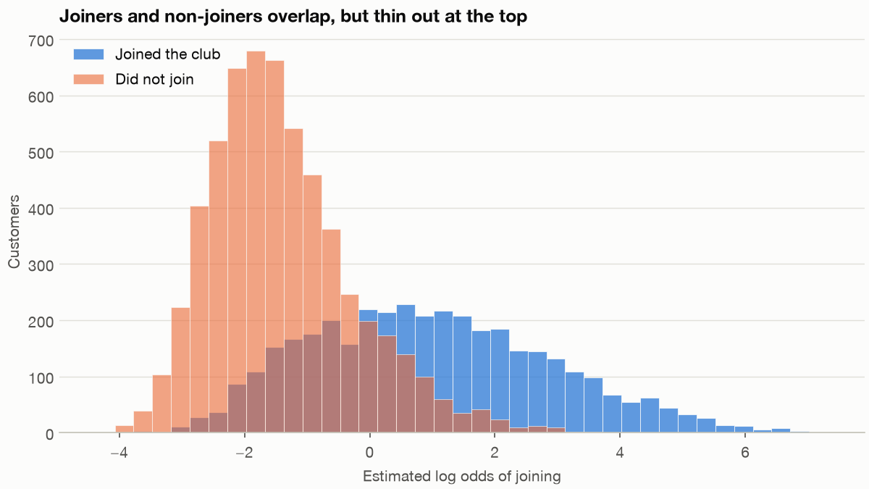
Few non-joiners stand in for the likeliest joiners
Part 5 · Matching and weighting
970 joiners above 0.9; 40 non-joiners.
29 joiners score above the highest non-joiner.
A non-joiner at 0.997 counts as about 330.
Estimated probability of joining, by group.
Any design that keeps every joiner must lean on a few non-joiners, and any design that does not has changed the question.
Source: notes/05-matching-and-weighting.md
29
Notes:
Look at this chart before you run anything, because it sets the trade for the rest of the part. The scores run from 0.024 to 0.999 for joiners and 0.012 to 0.997 for non-joiners.
Source: notes/05-matching-and-weighting.md

Slide 30
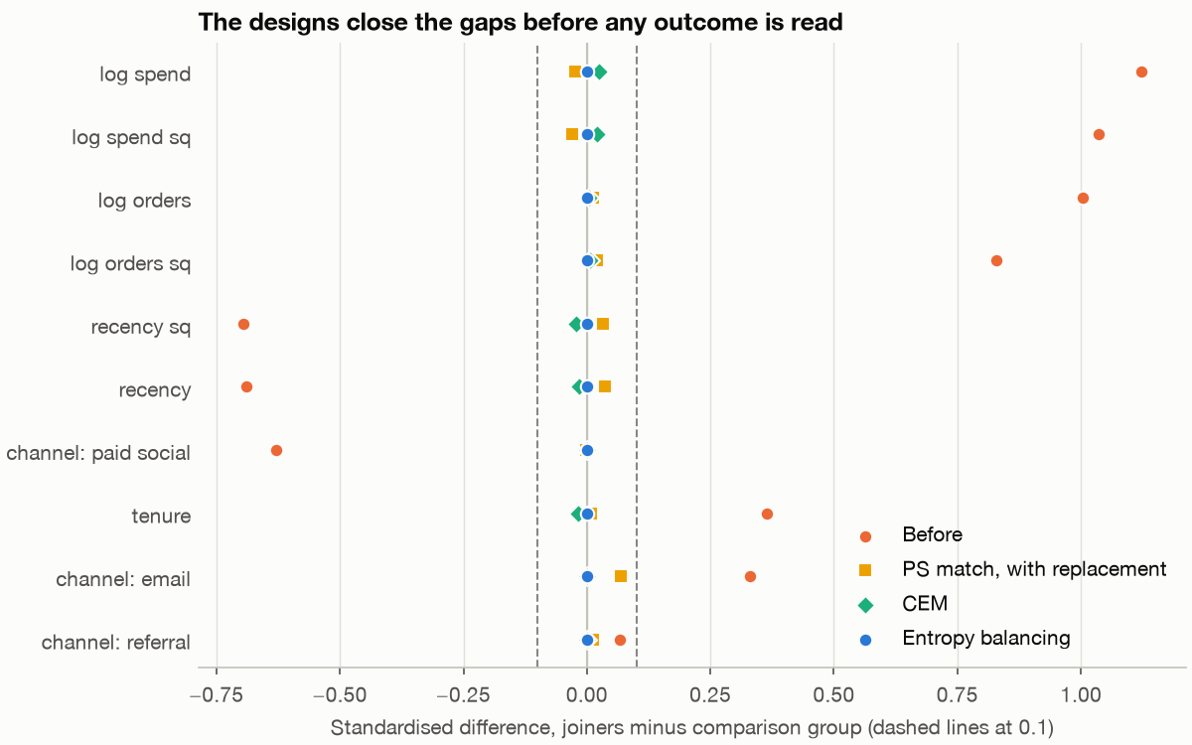
Fix the design on balance alone
Part 5 · Matching and weighting
Before: a full SD gap on orders (1.00) and spend (1.12).
Nine of ten fail 0.25 on SMD; four fail variance ratio.
None of this reads the outcome.
Love plot. One row per covariate, one mark per design.
Design on the covariates with the outcome hidden, and remember balance covers only what you observed.
Source: notes/05-matching-and-weighting.md
30
Notes:
Stuart reports Rubin's 2001 guideline: regression adjustment can be trusted when the absolute standardised difference is below 0.25 and the variance ratio lies between 0.5 and 2. A regression here would extrapolate, so we use a stricter line of 0.1 for the designs.
Source: notes/05-matching-and-weighting.md

Slide 31
Every design pays in joiners or in effective controls
Part 5 · Matching and weighting
TEXT OUTPUT
5,710 weighted controls are worth 107.
design kept eff_n max|SMD|
CEM 2202 1106 0.024
PS match, repl. 3682 246 0.069
PS match, no repl. 1972 1972 0.018
Propensity weights 3746 107 0.167
Entropy balancing 3746 267 0.000
CEM kept 59% of joiners; truth for them is £17.31, not £23.38.
Report effective sample and who was kept, because dropping joiners changes the question rather than the bias.
Source: notes/05-matching-and-weighting.md
31
Notes:
Effective sample is the sum of weights squared over the sum of squared weights. One non-joiner holds 8.6% of the control weight under propensity weights. Estimates then run from £15 to £32, and most of that spread is not bias: CEM's £20.96 and no-replacement matching's £18.26, which kept 53% with a truth of £15.32, target different people.
Source: notes/05-matching-and-weighting.md

Slide 32
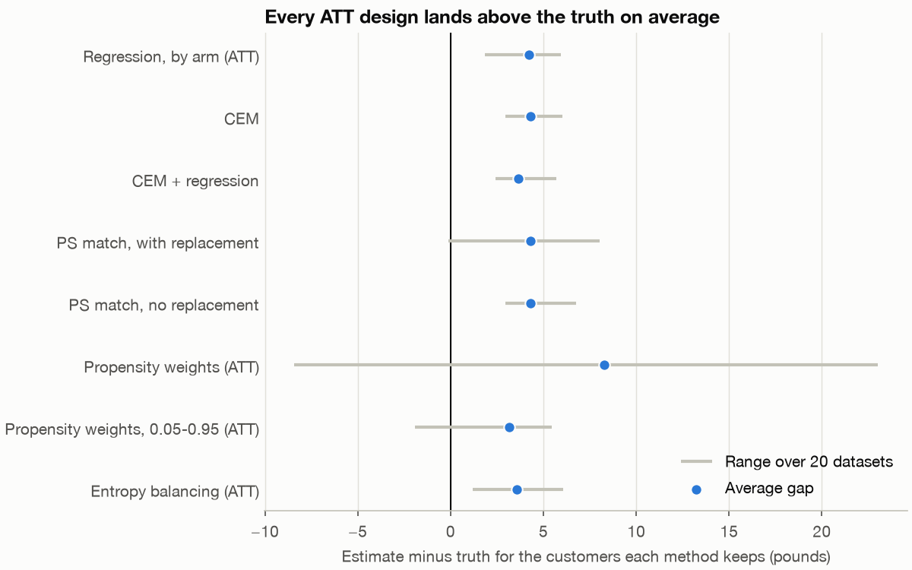
Every sound design lands high
Part 5 · Matching and weighting
Sound ATT designs: £3.15 to £4.31 high.
A perfect −£0.11 was luck; that design averages £4.31.
Add engagement: entropy falls from £3.59 to £0.15.
Gap to the truth on 20 datasets, by design.
When every design misses the same way the bias is shared, and only the missing variable removes it.
Source: notes/05-matching-and-weighting.md
32
Notes:
Plain propensity weights are the worst sound option here, with a mean gap of £8.27 and a standard deviation of £7.76. Balancing logged history moved the groups further apart on what nobody logged: the engagement gap rose from 0.29 to 0.48 standard deviations. The arithmetic checks out: £8 per standard deviation times 0.48 gives £3.81, close to the £3.59 we measured.
Source: notes/05-matching-and-weighting.md

Slide 33
The bad control that helped, and the world where it kills
Part 5 · Matching and weighting
Same customers and the same true ATT of £23.38. Only the role of next-period sessions differs.
Sessions do not cause spend
The club works through sessions
Sessions are a proxy for engagement
£14.10 of spend per session
Regression gap falls from £4.20 to £2.01
With sessions: £0.79
Without sessions: £31.60
Looks like a fix
Erases the effect
The data cannot tell these two worlds apart, so look for a proxy measured before treatment.
Source: notes/05-matching-and-weighting.md
33
Notes:
An analyst who saw the first result could conclude that post-treatment controls are safe. The second world shows why the rule stands.
Source: notes/05-matching-and-weighting.md

Slide 34
A passed check says what it refutes, and no more
Part 5 · Matching and weighting
What the checks returned
What was actually true
E-value 1.79; lower limit 1.64
Real bias about 15%
Rosenbaum Γ 2.35
E-value to reach the truth: only 1.20
Placebo (17.59 to 0.18) and random cause both passed
Engagement odds in pairs: median 1.68, 90th 3.34
All on a biased estimate
Plausibly weak confounder
Say what a check refutes, because these rule out a zero effect or a broken pipeline and not an estimate 15% high.
Source: notes/05-matching-and-weighting.md
34
Notes:
The true ratio of means is 1.207. Gamma times delta got the size roughly right, £4.16 against £3.11 on this dataset, but only with the true values plugged in, and an analyst has to guess them. Library defaults matter too: DoWhy's clipping turned £18.75 into £39.24.
Source: notes/05-matching-and-weighting.md

Slide 35
Rules of thumb
Wrap-up
Run the SRM first
Agree metrics early
Use the pre-period
Stop if it fails. Everything downstream depends on it.
One OEC, guardrails with margins. Show both parts of a ratio.
CUPED can halve variance, at no traffic cost.
Plan your looks
Draw the graph
Balance before outcome
Sequential methods, or a fixed end date.
It chooses controls and exposes the assumption.
Fix the design on balance alone, and say who was kept.
Most experiment failures are design and reading errors, and every one has a check you can automate.
Source: notes/05-matching-and-weighting.md
35
Notes:
These six catch most of what goes wrong. Everything here applies to online evaluation of LLM features too.
Source: notes/05-matching-and-weighting.md

Slide 36
Where to go next
Wrap-up
Bayesian analysis: the same checkout test, as a probability of being better.
Practice
Eval pillar in generative-ai: this machinery applied to LLM features.
Every chapter block runs as written. Change a seed and a parameter, and predict the result before you run it.
Read: Dmitriev et al. and Kohavi et al., both held in sources.
Causal: Cunningham's Mixtape, free online.
The next step is to rerun the chapters' simulations with your own company's numbers.
Source: notes/05-matching-and-weighting.md
36
Notes:
The Bayesian pillar picks up the same Larkspur checkout data, so you can compare the two answers directly.
Source: notes/05-matching-and-weighting.md

