Slide 1
LangGraph
Part 1: Why
From Chains to Graphs
A Visual Guide to
Stateful AI Agents
Part 2: What
Nodes · Edges · State · Reducers · Workflow & Agents
Graphs · State · Memory · Routing
Human-in-the-Loop · Multi-Agent · Observability
Part 3: Capabilities
Memory · Persistence & Durable Execution · HITL · Streaming · Subgraphs
Part 4: Production
Agent UI · Observability · Takeaways
Reference: docs.langchain.com

Slide 2
From Chains to Graphs
Why LangGraph exists
Part 1: Why
Traditional AI pipelines are linear and single-pass. LangGraph replaces them with cyclic, stateful graphs — enabling loops, branching, self-correction, and collaboration.
Pipelines — Traditional AI
Graphs — LangGraph
Sequential, predictable, single-pass
Cyclic, stateful, and autonomous
Excellent for defined, repeatable tasks
Agents reason, evaluate, loop, and collaborate
Cannot pause, loop, or self-correct
Continuous execution and adaptation
No memory across steps — every run starts fresh
Persistent memory across steps and sessions
loops back
A
B
C
Agent
Tools
End
Linear · No memory · No loops · One shot only
Cyclic · Stateful · Self-correcting · Autonomous · Collaborative

Slide 3
1 & 2. Nodes & Edges
The actors and logic of a graph
Part 2: What — Building Blocks
A LangGraph workflow is a directed graph. Nodes do the work; edges control the flow between them.
Nodes — The Actors
Edges — The Logic
A node is a single action or decision point. It receives the shared state as input, performs an action, and returns updates back to state.
It could be an LLM call, a tool execution, a data lookup, or a human approval step.
Edges connect nodes and define what happens next. Two kinds:
fixed edges that always go to the same node,
conditional edges that route based on the current state.
What a node can be:
Fixed edge — always goes to the same next node
LLM call
Ask the model a question or generate a response
always
Node A
Node A
Node B
Tool execution
Run a search, DB query, API call, or code
Conditional edge — routes based on current state
Human step
Wait for human input, approval, or review
Agent
Sub-graph
Nest an entire graph as a single node
loops
Custom logic
Any Python function — data transform, validation
YES
Need a tool?
NO
Tools
End

Slide 4
3. State
How agents remember within a run
Part 2: What — Building Blocks
State is the shared context that flows through every node. Each node can read from it and write partial updates back. It accumulates the full history of everything done so far.
LLM node
Shared State
Tool node
Human step
reads & writes
Router node
What state contains:
messages
— All conversation turns so far (with add_messages reducer)
tool_outputs
— Results from every tool call
decisions
— Routing choices and conditions met
custom fields
— Anything your workflow needs to track

Slide 5
3. Reducers for State
How agents remember within a run
Part 2: What — Building Blocks
A reducer is a function attached to a state field that defines HOW updates are merged — especially when nodes run in parallel. Without reducers, parallel nodes would overwrite each other's results.
Default (overwrite)
Last write wins. Simple fields like a status flag — only the final update survives.
operator.add
Appends to a list. Every node's output is kept. The most common pattern for messages.
add_messages
Smart append for chat — deduplicates by message ID, handles updates correctly.
Custom function
Write any merge logic: sum numbers, pick max score, merge dicts. Full control.

Slide 6
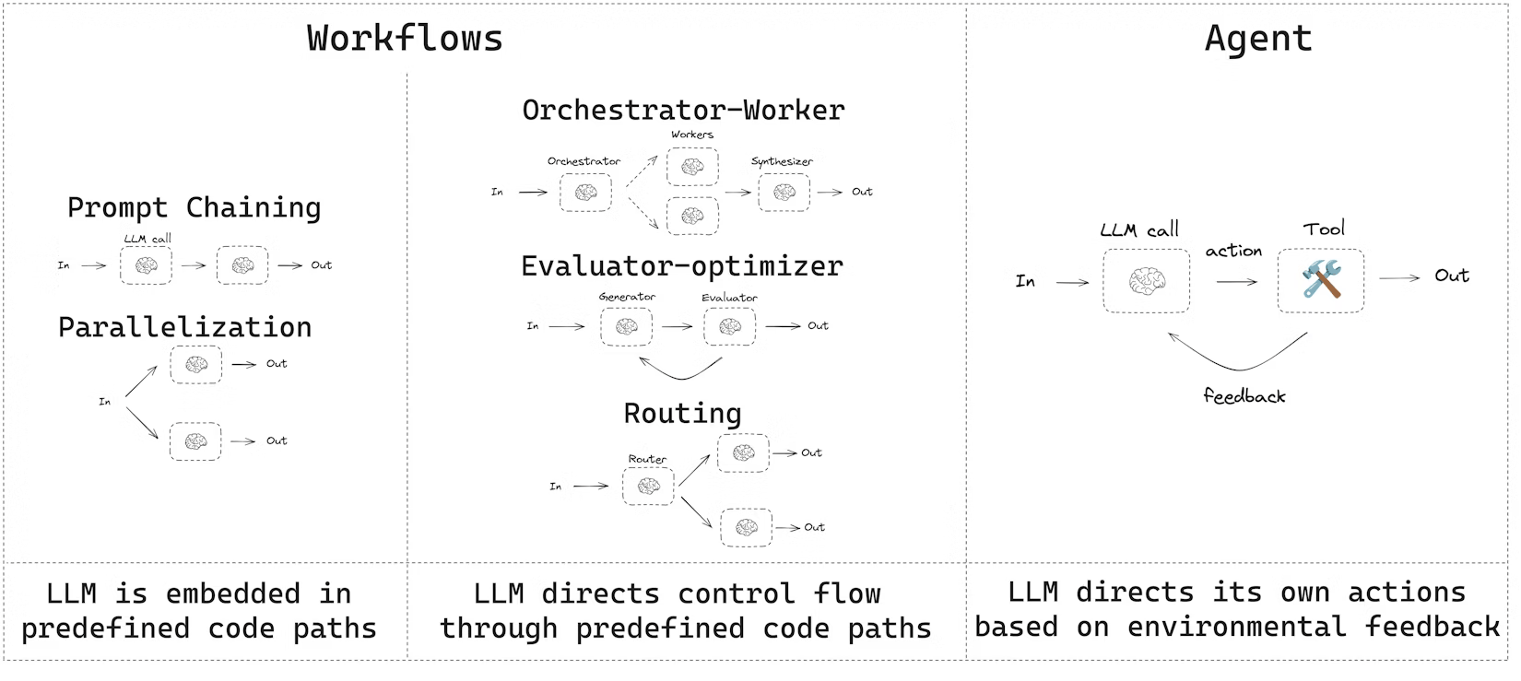
Workflows and agents
How agents remember within a run
Part 2: What — Building Blocks
Workflows have predetermined code paths and are designed to operate in a certain order.
Agents are dynamic and define their own processes and tool usage.

Slide 7
Memory: Short-term
State, Checkpointers & Context Management
Part 3: Capabilities — Memory
Short-term memory is the state that lives within a single conversation thread. LangGraph implements it through the State object and persists it via Checkpointers.
How Short-term Memory Works
Managing Context Window Growth
1. State schema
Define a TypedDict with fields and reducers. The add_messages reducer appends messages instead of overwriting.
Long conversations can exceed the LLM's context window. LangGraph provides built-in strategies to keep state lean:
Message Trimming
2. Checkpointer
Compile the graph with a checkpointer. LangGraph auto-saves state after every super-step.
Keep only the last N messages. Older messages are discarded. Fast and simple but loses older context. Best for real-time chatbots.
Summarisation
3. Thread ID
Every conversation gets a unique thread_id. State is scoped to that thread — different users stay isolated.
An LLM compresses older messages into a concise summary that replaces them. Preserves meaning while reducing tokens. Best for long tasks.
4. Resume
Provide the same thread_id on the next call. The graph resumes from the last saved checkpoint.
Selective Retention
The agent decides which facts are important enough to keep and explicitly stores them. Everything else can be dropped.

Slide 8
Memory: Long-term
Semantic · Episodic · Procedural — across sessions
Part 3: Capabilities — Memory
Long-term memory persists across sessions using the LangGraph Store — a namespaced key-value database. It mirrors three types of human memory from cognitive science.
Semantic
Episodic
Procedural
What:
What:
What:
Stores facts, concepts, and knowledge about users or domains.
Stores records of past experiences, actions, and task executions.
Stores the rules, instructions, and guidelines that govern agent behaviour.
Examples:
Examples:
Examples:
User preferences & profile
Past agent task history
System prompt / persona
Company-specific knowledge
Few-shot success examples
Self-updated via Reflection
Domain facts & entity data
How similar problems were solved
Tone & format rules
How stored:
How stored:
How stored:
Stored as a Profile (single JSON updated over time) or a Collection (many independent documents retrieved by semantic search).
Stored as examples that the agent retrieves and uses as few-shot prompts to guide future behaviour.
Stored in the LangGraph Store as an updatable prompt. The agent can rewrite its own instructions based on feedback — called Reflection.
Like remembering 'Paris is the capital of France'
Like remembering 'last time I did X, Y happened'
Like muscle memory — knowing HOW to do something
Write timing: 🔴 In the hot path — updated during the agent run (immediate, adds latency) · 🟢 In the background — async after the run (no latency impact, slight delay)

Slide 9
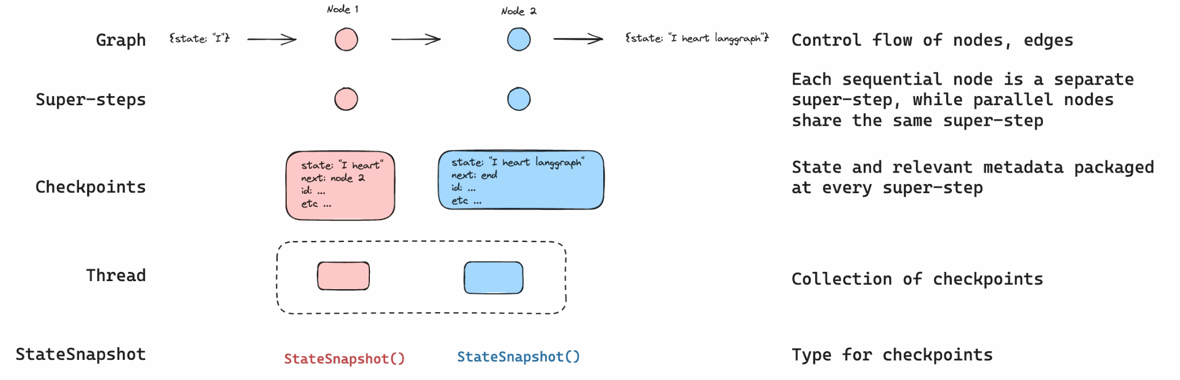
Persistence & Durable Execution
Checkpointer Backends · Threads · Fault Tolerance
Part 3: Capabilities
LangGraph has a built-in persistence layer that saves graph state as checkpoints. When you compile a graph with a checkpointer, a snapshot of the graph state is saved at every step of execution, organized into threads. This enables human-in-the-loop workflows, conversational memory, time travel debugging, and fault-tolerant execution.

Slide 10
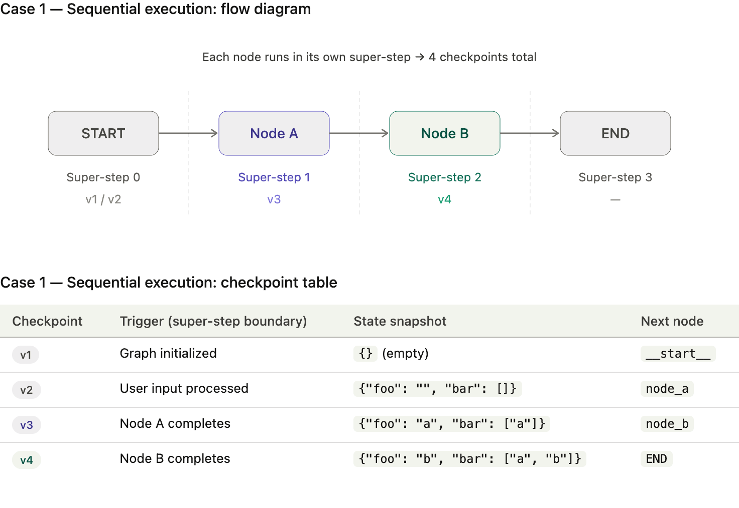
Persistence & Durable Execution
Checkpointer Backends · Threads · Fault Tolerance
Part 3: Capabilities
Thread (thread_id = 'user-abc-123')
Checkpoints
State snapshot saved to DB (SQLite / PostgreSQL) after every super-step. Agent can fail, restart, and resume from the exact point of failure using thread ID.

Slide 11
Persistence & Durable Execution
Checkpointer Backends · Threads · Fault Tolerance
Part 3: Capabilities
Checkpointer backends — choose based on your environment:
MemorySaver
SqliteSaver
PostgresSaver
RedisSaver
Development / Testing
Local / Prototype
Production
High-Performance Production
In-memory only. No setup needed. State is lost on restart. Use for quick prototyping and unit tests.
Persists to a local SQLite file. Survives restarts. Simple, no external service. Not suitable for high traffic.
Enterprise-grade. ACID transactions, concurrent users, horizontal scaling. Used in LangSmith itself.
Sub-millisecond checkpoint reads. Ideal for real-time agents and session TTL. Redis 0.1.0 redesigned for LangGraph.
DB: RAM
DB: SQLite file
DB: PostgreSQL
DB: Redis
✓ Zero setup
✓ Simple · Survives restarts
✓ Durable · Scalable · Queryable
✓ <1ms · Distributed · TTL support
✗ Lost on restart
✗ Not scalable
✗ Requires Postgres
✗ Memory cost

Slide 12
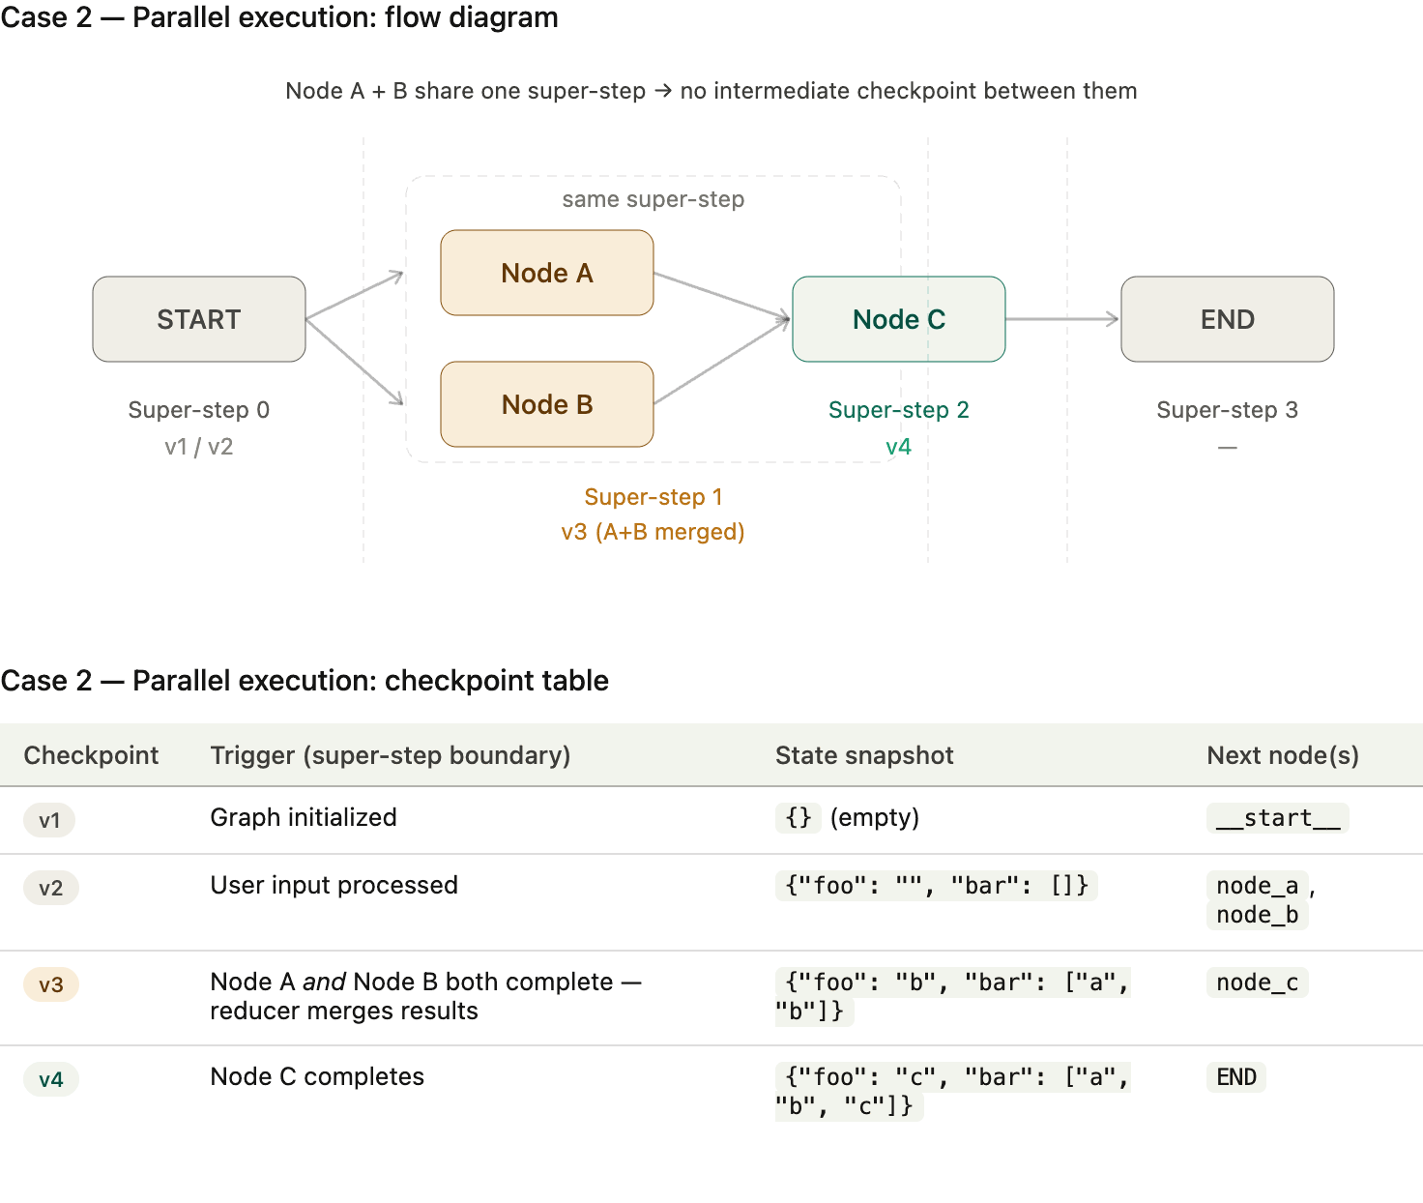
Persistence & Durable Execution
Checkpointer Backends · Threads · Fault Tolerance
Part 3: Capabilities
Reducers & Super-steps
When parallel nodes run simultaneously (a super-step), their outputs are merged by a Reducer — preventing collisions. Like operator.add appending to a list.
Time Travel
Types:
Replay: Retry from a prior checkpoint.
Fork: Branch from a prior checkpoint with modified state to explore an alternative path.
for testing & debugging.

Slide 13
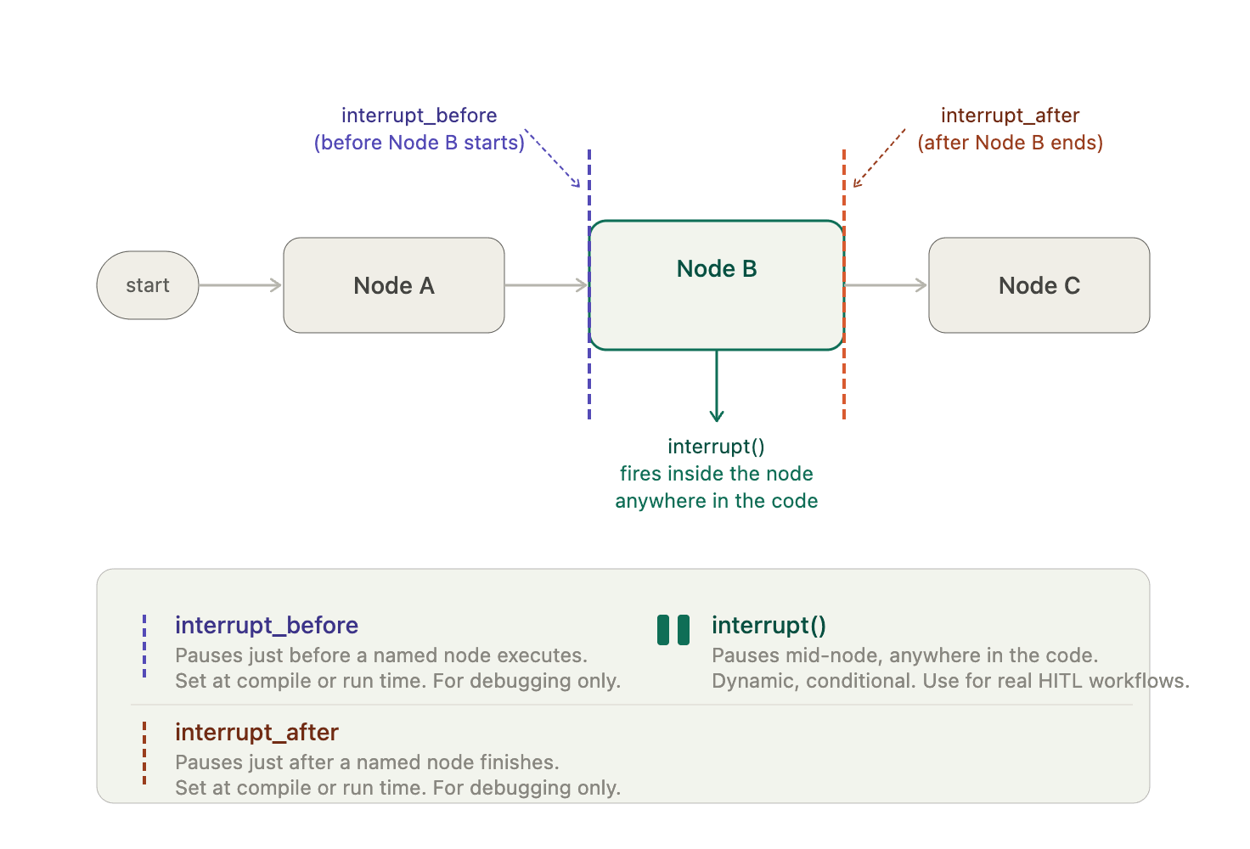
Human-in-the-Loop: Interrupt
Interrupt · Approve · Time Travel · Branching
Part 3: Capabilities
Static breakpoints firing before and after a node boundary
Interrupts pause graph execution at any point and wait for external input before continuing — enabling true Human-in-the-Loop (HITL) workflows.
Four main use cases:
getting approval before critical actions (like database writes or financial transactions),
letting a human review and edit LLM-generated content before it's used,
pausing before a tool actually executes,
collecting and validating human input in a loop.

Slide 14
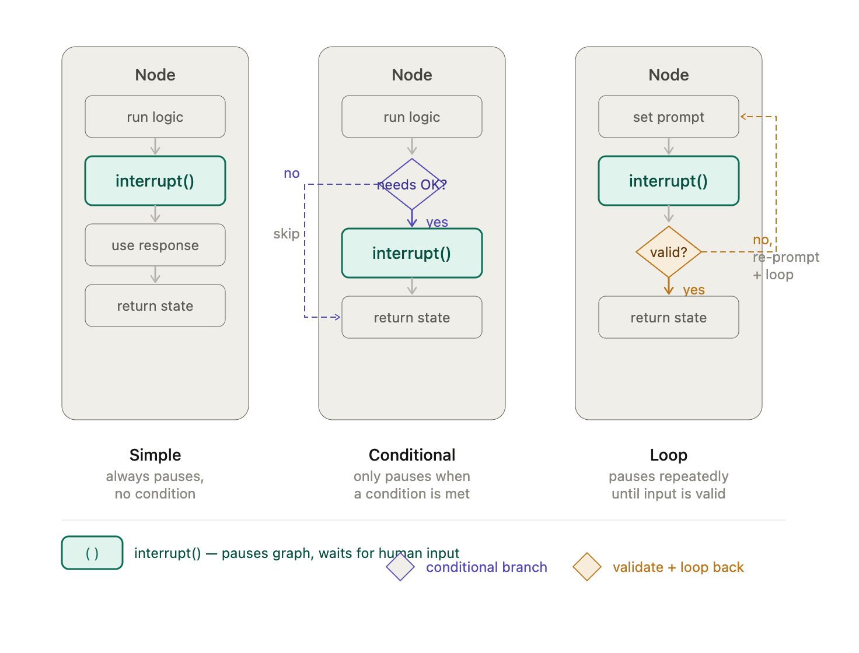
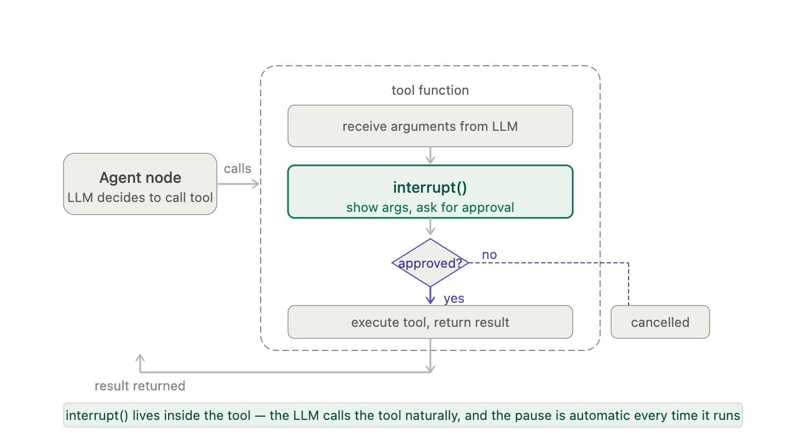
Human-in-the-Loop: Interrupt
Interrupt · Approve · Time Travel · Branching
Part 3: Capabilities
Dynamic interrupt() firing inside a node (mid-execution)

Slide 15
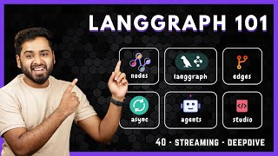
Streaming
Interrupt · Approve · Time Travel · Branching
Part 3: Capabilities

Slide 16
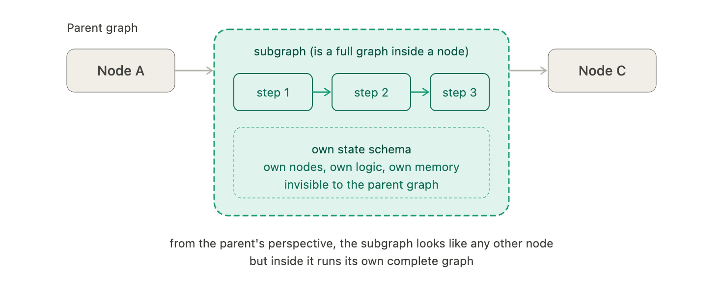
Subgraphs
Part 3: Capabilities
A subgraph is simply a graph used as a node inside another (parent) graph.
Subgraphs are useful for:
Building multi-agent systems
Reusing a set of nodes in multiple graphs
Distributing development: when you want different teams to work on different parts of the graph independently, you can define each part as a subgraph, and as long as the subgraph interface (the input and output schemas) is respected, the parent graph can be built without knowing any details of the subgraph

Slide 17
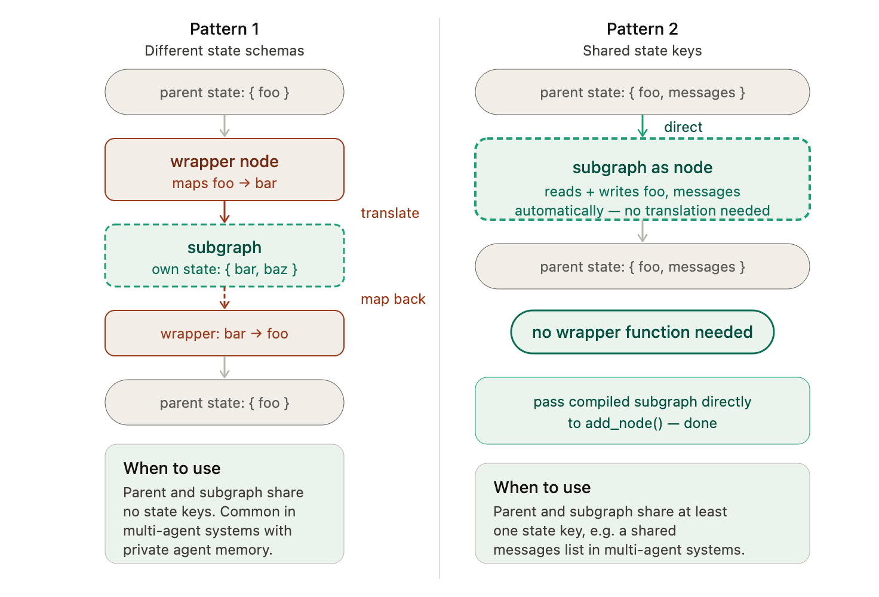
Subgraphs
Part 3: Capabilities

Slide 18
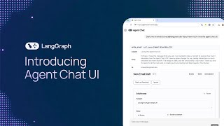
Agent Chat UI
Part 4: Production

Slide 19
Observability & Tracing
LangSmith · Evals · Production Monitoring
Part 4: Production
You cannot manage what you cannot see. LangSmith provides full visibility into every agent step — from development debugging to production monitoring.
Execution Tracing
Automated Evals
Production Monitoring
Visualise the exact path taken through the graph
Action advancement: did the agent make progress?
Track agent performance over time with dashboards
Inspect every node's input and output state
Context adherence: did it stay on-topic?
Alert instantly on quality or cost regressions
Measure latency and token count per step
Hallucination check: did it fabricate facts?
A/B test different graph configurations safely
Identify where loops occur and why they triggered
Detect infinite loops before hitting production
Monitor token cost per run across all users
Replay any historical run from its checkpoint
Run evaluations automatically on every deployment
Collect user feedback ratings to drive improvement

Slide 20
Key Takeaways
The complete picture
Part 4: Production
Graphs beat chains
Cyclic graphs replace linear pipelines — enabling loops, branching, and self-correction. This is the foundational shift.
Three building blocks
Every workflow: Nodes (actors) + Edges (logic) + State (memory). Reducers define how parallel updates merge safely.
Decision Making
Conditional edges and Intent Routing let a single graph handle branching logic and LLM-powered classification at runtime.
Multi-agent = scale
Supervisor, Handoff, and Parallel Swarm each offer different control/speed/cost trade-offs for orchestrating specialist agents.
Two tiers of memory
Short-term: State + Checkpointers (within thread). Long-term: Store + vector DBs (across sessions) — Semantic, Episodic, Procedural.
Durability requires a backend
MemorySaver → SQLite → PostgreSQL → Redis: choose your checkpointer based on scale and latency requirements.
Humans stay in control
Interrupt points pause agents before high-stakes actions. Time Travel lets anyone rewind to any checkpoint and fork alternatives.
docs.langchain.com/oss/python/concepts/memory · Architecting the Graph-Powered Enterprise (NotebookLM) · langchain-ai.github.io/langgraph

Slide 21
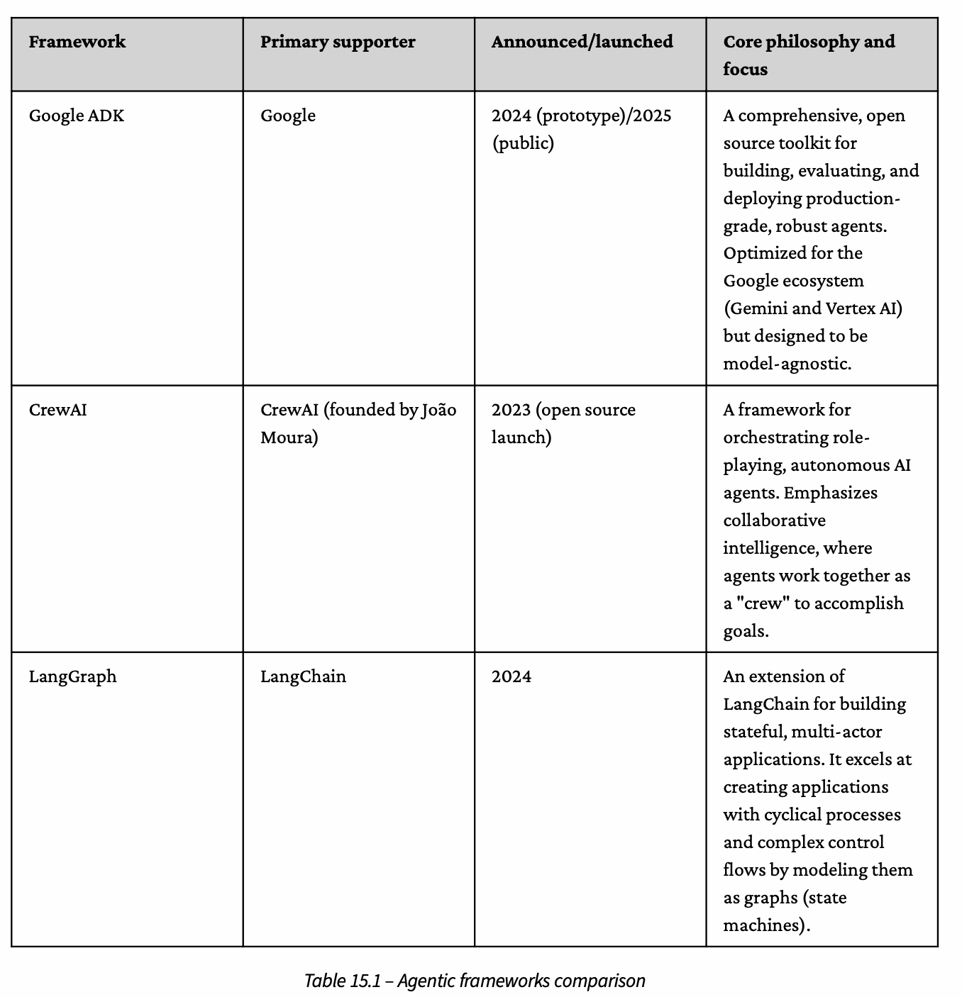
Comparison between ADK & Langgraph
LangSmith · Evals · Production Monitoring
Part 5: Comparison

Slide 22
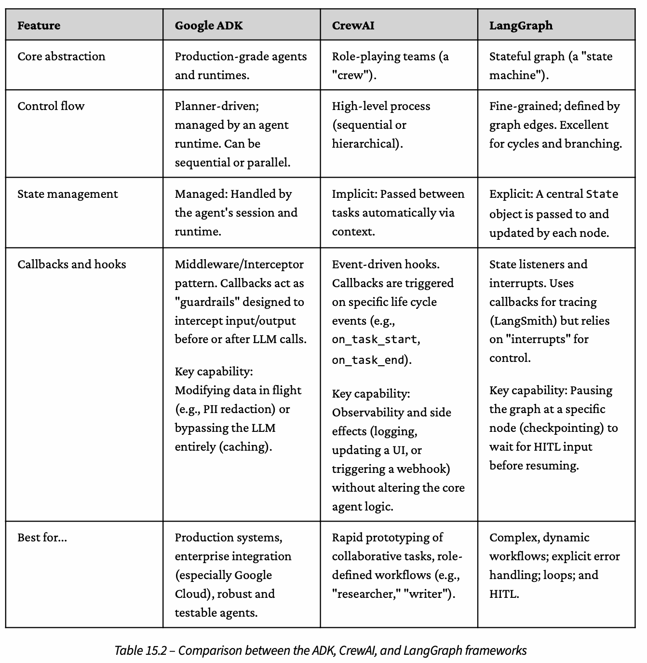
Comparison between ADK & Langgraph
LangSmith · Evals · Production Monitoring
Part 5: Comparison

Slide 23
Context Injection: RAG as a Subgraph
Part 3: Capabilities
Retrieval is not a step — it is a self-correcting loop nested as a subgraph. Poor results re-query before the LLM sees any context.
Corrective RAG — subgraph flow
Vector DB is external to LangGraph
LangGraph Store is key-value only. You bring Pinecone, pgvector, or Weaviate and wire it in as a tool node. LangGraph manages state around your retriever.
1. User Query
2. Retrieve (vector DB)
Write timing matters for latency
3. Grade Relevance
← not relevant: re-query
relevant ↓
Injecting docs into state in the hot path adds latency. For background indexing or post-run memory updates, use async writes to the LangGraph Store instead.
4. Inject into State
Subgraph = reusable retriever module
5. LLM Generate
Package retrieve-grade-inject as a subgraph. Any parent agent (task, notification, or chat) nests it as one node — same interface, swappable data sources.
Steps 2-4 = self-contained RAG subgraph — reusable in any parent agent

Slide 24
Trigger & Runtime: What Fires the Graph
Part 4: Production
LangGraph defines what happens inside a run. These are the systems that start it, host it, and route its output.
What triggers a graph run
Where the graph runs
HTTP / API call
Webhook / Event
Lambda / Serverless
A REST endpoint invokes the graph directly. The request payload becomes the initial state. Typical for chat agents and on-demand task execution.
External systems (GitHub, Stripe, Slack) POST an event. A lightweight receiver maps it to graph input. Drives notification agents and reactive workflows.
One graph run per invocation. No long-lived state in memory. Requires PostgreSQL or Redis checkpointer for durability. Cold-start can add 200-500ms.
Long-lived Worker
A persistent process hosts the graph. MemorySaver is viable for low-traffic agents. Simpler, but vertical scaling only.
Message Queue
Cron / Schedule
Kafka, SQS, or RabbitMQ delivers a job. Workers pull messages and invoke graph runs. Best for high-volume, async task agents with back-pressure.
A scheduler fires the graph on a timer. Used for digest emails, periodic RAG re-indexing, and proactive notification agents.
LangGraph Cloud
Managed runtime from LangChain. Handles deployment, scaling, and checkpointing. Built-in streaming and API endpoints. Reduces infra overhead.
Kubernetes Job / Pod
Full control over scaling and isolation. Each tenant or task type gets its own pod. Combine with PostgresSaver for production durability.
The checkpointer backend you choose (SQLite / PostgreSQL / Redis) must match your runtime: serverless needs external DB; long-lived workers can use in-memory.

Slide 25
Google ADK vs LangGraph: Where One Ends, One Begins
Part 5: Comparison
ADK trades control for speed. LangGraph trades speed for control. Most production systems need both zones.
Google ADK — Opinionated & Managed
LangGraph — Flexible & Code-first
Fast start
Full graph control
Agents, tools, and sessions in <50 lines. Built-in agent types (LlmAgent, SequentialAgent) handle 80% of patterns.
Any topology: cyclic, parallel, nested subgraphs. You define every edge and reducer. Nothing is hidden.
Google Cloud native
Any LLM / any cloud
Vertex AI models, Agent Engine deployment, Cloud Run scaling. No infra decisions.
OpenAI, Anthropic, Mistral, local models. Not locked to Google. Mix models per node.
→ extend
Built-in eval
Custom memory backends
Agent Evaluation framework baked in. Auto-grades tool use, quality, and safety.
Bring Pinecone, pgvector, Redis, or Postgres. Wire them into the Store or as tool nodes.
Opinionated memory
Production HITL
Session service + memory service provided. Less flexible, zero setup.
interrupt() anywhere. Time Travel to any checkpoint. Fork runs for A/B testing.
ADK stops here
LangGraph starts here
Custom graph topology, non-Google LLMs, bring-your-own DB, complex HITL, fine-grained reducer control — not supported.
You build the trigger layer, the output sinks, the auth model, the observability stack. More power, more decisions.
Use ADK for: quick prototypes, Google-native stacks, internal tooling. Use LangGraph for: production agents, complex memory, multi-cloud, full customisation.

Slide 26
Observability: LangSmith vs Langfuse
Part 4: Production
You cannot manage what you cannot see. Choose your observability stack based on control, cost, and vendor lock-in.
Both trace every node, log state, and surface latency. The difference is in deployment, cost, and ecosystem.
LangSmith (LangChain)
Langfuse (Open Source)
Managed SaaS
Self-host or cloud
Hosted by LangChain. Zero infra setup. Usage-based pricing — free tier available, costs scale with trace volume.
Open source (MIT). Run on your own infra for full data control. Cloud hosted option available. No per-trace pricing on self-hosted.
Native LangGraph integration
Framework-agnostic
One-line setup: set LANGCHAIN_TRACING_V2=true. Auto-traces every node, edge, and state mutation without code changes.
Works with LangGraph, OpenAI SDK, LlamaIndex, and raw API calls. Not locked to any framework. Single SDK across your stack.
Dataset & eval suite
Scores & human feedback
Built-in tools to build eval datasets from prod traces. Run LLM-graded evals (hallucination, quality) automatically on every deploy.
First-class support for capturing human ratings on traces. Feed scores back into prompt versioning and dataset creation.
Prompt playground
Prompt management
Edit and test prompts against captured traces. Tight feedback loop from prod observation to prompt iteration.
Version-controlled prompt registry with A/B deployment. Decouple prompt changes from code deploys.
Vendor lock-in
Manual LangGraph setup
Deeply tied to LangChain ecosystem. Proprietary data format. Switching costs are real if you later move off LangChain.
Requires explicit callback integration. Auto-tracing is less seamless than LangSmith. More setup work upfront.
Choose LangSmith for: fastest LangGraph setup, managed eval pipelines. Choose Langfuse for: data sovereignty, multi-framework stacks, cost control at scale.

