Slide 1
How LLMs work
Part 1: How a model works
Tokens · Attention · Scale · Decoding · Hallucination
LLM fundamentals: what a model is, how it is trained, and how to use one
Part 2: How it is trained and adapted
Pretraining · Cost and scale · SFT · Preference · LoRA
Part 3: How you use it, and run it
Prompts · Chains · A tiny GPT · The API · Open weights
It predicts · It is trained · You use it · You run it
Notes: generative-ai/01-llm-fundamentals
Notes:
Today we follow one thing: a support-ticket assistant that invents a refund policy. To understand why, we go through what a model is, how it gets trained, how to prompt and call it, and how to run it yourself. By the end you will know which lever fits which problem, and why the assistant still needs the next pillar.

Slide 2
Our assistant just invented a refund policy. Why?
From a customer message to one next token
Why tokens set both the bill and the blind spots
The causal mask is why one pass can train every position
Attention is short enough to hold in your head
A block adds an MLP, residuals and LayerNorm, and then you stack it
Parameters tell you the memory, not the ability
Chinchilla changed what a training budget should buy
Prefill is parallel, decode is one token at a time
Temperature reshapes the choice among the logits
Spending more compute and constraining the output
Why it invents things: two hypotheses, neither settled
Monday: check what your model can and cannot see
PART 1
How a model works
Tokens · Attention · Scale · Decoding · Hallucination
2
Notes:
We start from what the model sees. Everything surprising about LLMs follows from next-token prediction over subword tokens.

Slide 3
Our assistant just invented a refund policy. Why?
The problem
Part 1 · How a model works
An LLM predicts the next token. Almost everything surprising about it follows from that one sentence.
Plausible is what it was trained for. True was never in the loss.
Source: notes/01-tokens-and-embeddings.md
3
Notes:
A team ships a ticket assistant, and it confidently cites a refund policy that does not exist. Nothing crashed. To see why that was the expected behaviour, we start with what the model actually receives when a customer types a sentence. Then we follow that sentence all the way through to the next token.
Source: notes/01-tokens-and-embeddings.md

Slide 4
From a customer message to one next token
Part 1 · How a model works
Tokens
BPE subwords
Embeddings
a vector per token, plus position
Blocks
attention and MLP, stacked
Logits
a score per vocabulary item
Sample
pick one, append, repeat
Tokens, not characters or words, are the unit of cost and context.
Each step sees only tokens, which explains trouble with letters and counting.
The model turns tokens into vectors, mixes them with attention, and samples one next token at a time.
Source: notes/01-tokens-and-embeddings.md
4
Notes:
Here is the whole forward pass on one line. Text becomes integer tokens, tokens become vectors with a position signal, blocks of attention mix them, and the last position produces a score for each word in the vocabulary. We sample one, append it and go round again. The next few slides open each box.
Source: notes/01-tokens-and-embeddings.md

Slide 5
Why tokens set both the bill and the blind spots
Part 1 · How a model works
Same short sentence with GPT-4 tokenization: a median of 7 tokens in English, 72 in Burmese.
What tokens give you
What tokens cost you
A fixed vocabulary
Billing and limits per token
Any string can be encoded
Rare languages cost more, and often score worse
Units with more meaning than characters
Letters inside a token are not directly visible
Why BPE won
What to plan for
Tokens make any text encodable, but they set the bill and hide the letters, so measure in tokens.
Source: notes/01-tokens-and-embeddings.md
5
Notes:
BPE gives a fixed vocabulary that can still encode any string, and that design has two consequences. Since prices and limits are per token, some languages cost far more: a short sentence took a median of 7 tokens in English and 72 in Burmese. And since the letters sit inside a token, a model can read a string correctly and still fail to reverse it.
Source: notes/01-tokens-and-embeddings.md

Slide 6
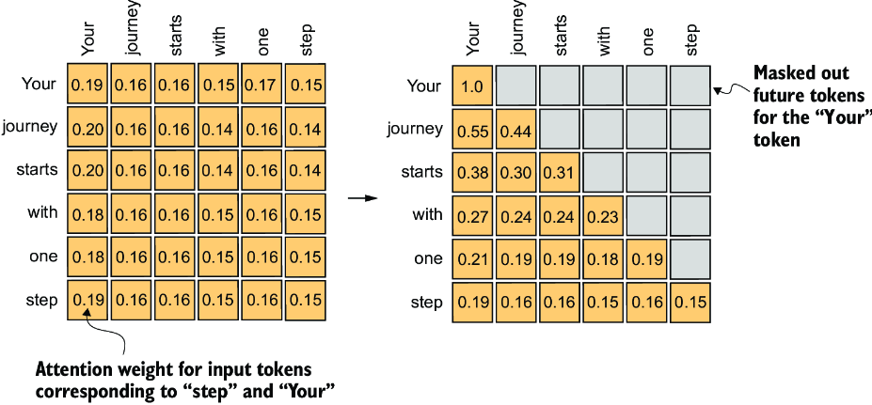
The causal mask is why one pass can train every position
Part 1 · How a model works
Query compares with each key; the weights average the values.
Mask: no position sees a later one.
Test: change a later token; earlier outputs stay the same.
Attention weights without and with the causal mask (Raschka, 2024, Fig. 3-19)
Attention weights tokens by relevance, and the causal mask makes one pass train every position honestly.
Source: notes/02-attention-and-the-transformer-block.md
6
Notes:
These are attention weights for one short sentence, without the mask on the left and with it on the right. The upper triangle is gone, so no position can see later ones. That one matrix lets a single forward pass train each position to predict the next token. And it gives us a test: change a later token, and nothing earlier may move.
Source: notes/02-attention-and-the-transformer-block.md

Slide 7
Attention is short enough to hold in your head
Part 1 · How a model works
PYTHON
Dividing by √d_k keeps the softmax from going one-hot.
def attend(q, k, v, mask):
# q, k, v: (batch, T, d_k)
s = q @ k.transpose(-2, -1)
s = s / k.shape[-1] ** 0.5
s = s.masked_fill(~mask, float('-inf'))
w = s.softmax(dim=-1) # (batch, T, T)
return w @ v
T × T scores: cost is quadratic in context.
Heads repeat this with their own projections.
Attention is a masked, scaled softmax over dot products, and its T by T matrix is what makes context expensive.
Source: notes/02-attention-and-the-transformer-block.md
7
Notes:
This is scaled dot-product attention with the mask. Dot products grow with dimension, so we divide by the square root of d_k to stop the softmax becoming one-hot. Anything masked goes to minus infinity, so it gets zero weight after the softmax. The real cost shows here too: the score matrix is T by T, so it is quadratic in context.
Source: notes/02-attention-and-the-transformer-block.md

Slide 8
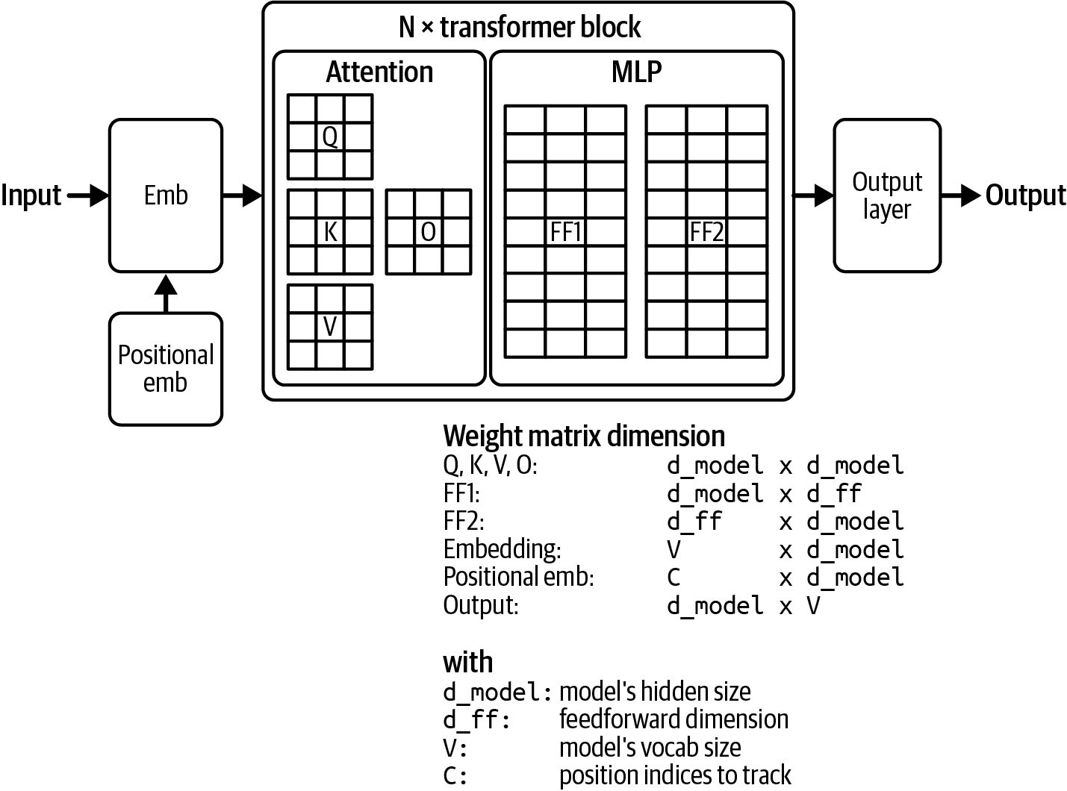
A block adds an MLP, residuals and LayerNorm, and then you stack it
Part 1 · How a model works
Residual: a direct path for gradients.
LayerNorm: stable activations, no batch statistics.
Attention dominates the cost of a block.
The composition of a transformer (Huyen, AI Engineering, 2025, Fig. 2-6)
A GPT is one block repeated: attention and an MLP, with residuals and LayerNorm to keep deep stacks trainable.
Source: notes/02-attention-and-the-transformer-block.md
8
Notes:
A block is attention followed by a position-wise MLP, each with a residual and a LayerNorm. Residuals give gradients a direct path through deep stacks. LayerNorm keeps activations in a stable range. GPTs are this block stacked, with an embedding underneath and a linear head on top.
Source: notes/02-attention-and-the-transformer-block.md

Slide 9
Parameters tell you the memory, not the ability
Part 1 · How a model works
Weights only. Serving adds the KV cache and activations.
Model | fp16 | int8 | 4-bit
GPT-2 small (124M) | 0.25 GB | 0.12 GB | 0.06 GB
Llama 2 7B | 14 GB | 7 GB | 3.5 GB
Llama 2 70B | 140 GB | 70 GB | 35 GB
Size a model as parameters times bytes before you download it, and treat the count as memory rather than ability.
Source: notes/03-scale-and-the-model-zoo.md
9
Notes:
Memory for the weights is parameters times bytes per parameter. So you can size a model on the back of an envelope before you download it. Note that this says nothing about ability. LLaMA's 13B beat the 175B GPT-3 on most benchmarks in its report, because it was trained on far more data per parameter.
Source: notes/03-scale-and-the-model-zoo.md

Slide 10
Chinchilla changed what a training budget should buy
Part 1 · How a model works
Kaplan (2020)
Chinchilla (2022)
Scale models up faster than data
Scale parameters and tokens about equally
Bigger felt safer
About 20 tokens per parameter
Inference-heavy operators may train past it
Overturned
The training optimum
Chinchilla says scale data and parameters together, yet operators train past 20 tokens per parameter to cut inference cost.
Source: notes/03-scale-and-the-model-zoo.md
10
Notes:
Kaplan's fit suggested bigger models with less data. Chinchilla found that for a fixed compute budget you should scale parameters and tokens about equally, at roughly 20 tokens per parameter. But it is a training optimum. If inference traffic dwarfs training, a smaller model trained past that point costs less over its life. And mixture of experts splits size from compute again.
Source: notes/03-scale-and-the-model-zoo.md

Slide 11
Prefill is parallel, decode is one token at a time
Part 1 · How a model works
Prompt
all tokens known
Prefill
one parallel pass
KV cache
keys and values kept
Decode
one pass per token
Input tokens are cheap in time; output tokens are sequential.
The KV cache grows linearly with context, on top of the weights.
Prefill reads in parallel and decode writes serially, and the KV cache trades growing memory for that speed.
Source: notes/04-decoding-and-inference-behaviour.md
11
Notes:
Two very different phases hide inside one request. Prefill reads the whole prompt in one parallel pass. Decode produces one token per forward pass, each waiting for the last. The KV cache means a new token needs to compute only its own keys and values, but the cache grows linearly with context, on top of the memory for the weights.
Source: notes/04-decoding-and-inference-behaviour.md

Slide 12
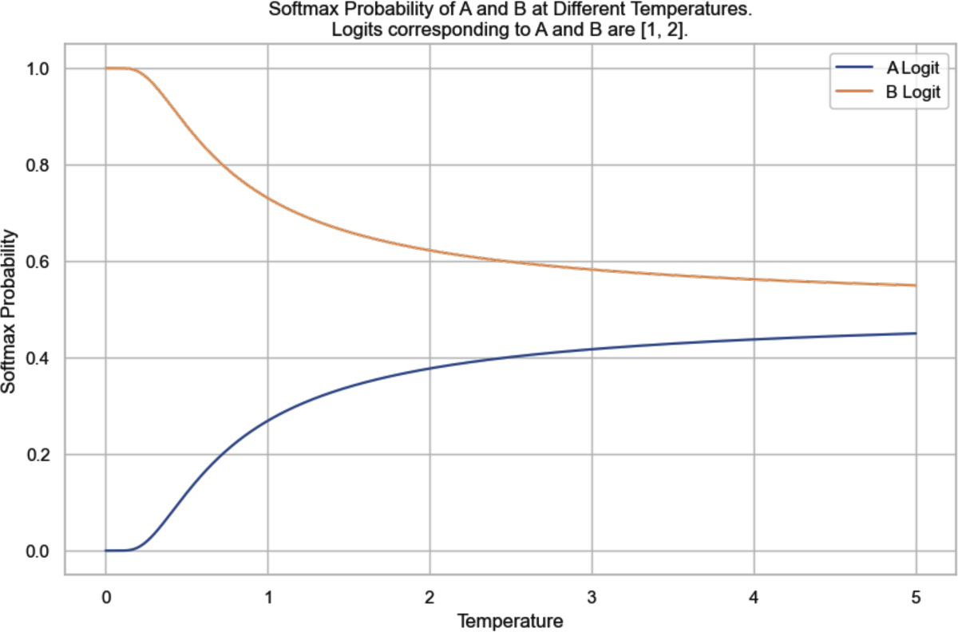
Temperature reshapes the choice among the logits
Part 1 · How a model works
Above 1 flattens, below 1 sharpens, 0 is argmax.
Top-k keeps a fixed count. Top-p adapts to the shape.
Temperature 0 on an API is still not fully reproducible.
Softmax probabilities of two tokens as temperature rises (Huyen, AI Engineering, 2025, Fig. 2-16)
Sampling settings shape which token gets chosen, and they control variety without making the answer true.
Source: notes/04-decoding-and-inference-behaviour.md
12
Notes:
Temperature divides the logits before the softmax. Above 1 flattens the distribution, and below 1 sharpens it. Zero is implemented as argmax. On the chart you can see two tokens with logits 1 and 2 drift towards each other as temperature rises. On your own open-weight model you control this. Current Claude models no longer accept it, which we return to later.
Source: notes/04-decoding-and-inference-behaviour.md

Slide 13
Spending more compute and constraining the output
Part 1 · How a model works
Test-time compute
Constrained decoding
GQA
Several samples per request, then choose. Quality rises with samples and so does cost.
Mask tokens the grammar forbids at each step. Shape is guaranteed, truth is not.
Several query heads share a key/value head, which shrinks the KV cache at small quality cost.
Decoding-time levers trade compute or memory for quality, and constraints fix an answer's shape but not its truth.
Source: notes/04-decoding-and-inference-behaviour.md
13
Notes:
Two more levers at decoding time. You can draw several samples and take the best, which spends compute at inference. And you can mask tokens the grammar forbids, which guarantees the shape. Shape is all it guarantees: a valid JSON object can still hold a wrong value. That distinction turns up in every structured-output system we use.
Source: notes/04-decoding-and-inference-behaviour.md

Slide 14
Why it invents things: two hypotheses, neither settled
Part 1 · How a model works
Snowballing
Imitating knowledge
Cannot tell given text from generated text
SFT shows confident answers
It learns the form without the facts
Each error becomes context for the next
Self-delusion
Mismatched internal knowledge
Treat hallucination as structural: both leading explanations come from how the model is trained, so design checks.
Source: notes/05-hallucination-and-base-vs-assistant.md
14
Notes:
Back to our invented refund policy. A base model is a text-continuer, so assistant behaviour had to be added in post-training. There are two main explanations for hallucination. One is that the model cannot tell given text from its own, so errors snowball. The other is that fine-tuning teaches it to imitate knowledge it does not have. Neither is settled, and both imply that you check its answers.
Source: notes/05-hallucination-and-base-vs-assistant.md

Slide 15
Monday: check what your model can and cannot see
Part 1 · How a model works
Count tokens in your real prompts, in each language you serve.
Size the model before you download it: parameters times bytes.
Check the chat template matches training. A mismatch degrades quality silently.
Compare samples to flag invented facts, knowing that consistent errors pass.
Calibrate self-reported confidence on your own data.
Measure tokens and memory, match the chat template, and verify facts instead of trusting a model's fluency.
Source: notes/05-hallucination-and-base-vs-assistant.md
15
Notes:
Here is what to do with this part next week. These checks cost almost nothing. SelfCheckGPT's idea, comparing samples, is a good cheap filter, but it can't catch an error the model makes consistently. And calibrate any self-reported confidence on your own data.
Source: notes/05-hallucination-and-base-vs-assistant.md

Slide 16
Should we train a model on five years of tickets?
One set of weights passes through several stages
The training objective fits on one slide
A small corpus teaches you to memorise
Price a run before you plan one
Continued pretraining adds knowledge, SFT adds behaviour
What goes wrong when you fine-tune
Preference training pays for separation, not confidence
RLHF needs a reward model and RL, DPO needs neither
LoRA starts as a no-op and trains only a small update
Prompt, retrieve or fine-tune?
PART 2
How it is trained and adapted
Pretraining · Cost and scale · SFT · Preference · LoRA
16
Notes:
Now we follow the weights through their stages, so we can pick the right lever instead of reaching for fine-tuning first.

Slide 17
Should we train a model on five years of tickets?
The problem
Part 2 · How it is trained and adapted
Pretraining buys knowledge, supervised fine-tuning buys format, preference optimization buys judgment, and LoRA makes the last two affordable.
Know which stage a problem belongs to before you reach for fine-tuning.
Source: notes/06-pretraining-data-and-objectives.md
17
Notes:
Someone will ask this. Before anyone reaches for a GPU, we need to know what training optimises, what it needs and what it costs. The short answer is that five years of tickets are several orders of magnitude too small to pretrain a base model. The longer answer is what this part covers: which stage of training a problem belongs to.
Source: notes/06-pretraining-data-and-objectives.md

Slide 18
One set of weights passes through several stages
Part 2 · How it is trained and adapted
Pretraining
knowledge, about 98% of compute
SFT
format and behaviour
Preference
judgment between answers
Serve
with a chat template
Same weights throughout: each stage inherits the last.
Your own training almost always begins after pretraining.
Weights flow from pretraining to fine-tuning to preference optimization, so choose the stage that matches your problem.
Source: notes/06-pretraining-data-and-objectives.md
18
Notes:
Follow the weights. Pretraining takes almost all of the compute, about 98% for InstructGPT, and builds the base model. Fine-tuning gives it format. Preference optimization gives it judgment. Each stage inherits what came before. Parameter-efficient methods make the later stages affordable to you, since they do not need retraining from scratch.
Source: notes/06-pretraining-data-and-objectives.md

Slide 19
The training objective fits on one slide
Part 2 · How it is trained and adapted
PYTHON
Labels are the input shifted by one.
for x, y in batches: # y is x shifted by one
logits = model(x)
loss = F.cross_entropy(
logits.view(-1, vocab),
y.view(-1))
opt.zero_grad()
loss.backward()
opt.step()
Teacher forcing makes training parallel.
Step 0 loss should be about ln(vocab).
Pretraining is next-token cross-entropy, parallel through teacher forcing, and step-0 loss near ln(vocab) checks the wiring.
Source: notes/06-pretraining-data-and-objectives.md
19
Notes:
The whole of pretraining is this loop. Inputs and labels are the same tokens shifted by one, so no human labels are needed. Each position sees the true previous tokens, which is teacher forcing, and that is why training is parallel while generation is not. Before you train, the loss should be about ln of the vocabulary size.
Source: notes/06-pretraining-data-and-objectives.md

Slide 20
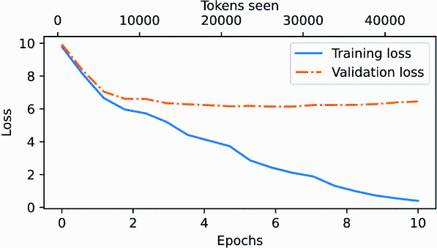
A small corpus teaches you to memorise
Part 2 · How it is trained and adapted
5,145 tokens, 10 epochs: train 0.39, validation about 6.4.
Company data is several orders of magnitude too small.
Memory: Adam keeps two extra values per weight.
Training and validation loss on a short story (Raschka, 2024, Fig. 5-12)
On little data a model memorises, so continue pretraining or fine-tune rather than pretraining on company data.
Source: notes/06-pretraining-data-and-objectives.md
20
Notes:
This is what overfitting looks like. On a 5,145-token story, ten epochs drive training loss to 0.39 while validation stalls near 6.4. The model is memorising. That is why your tickets alone will not pretrain a useful model: it would learn your tickets. Training also needs far more memory than inference, since Adam keeps two extra values per weight.
Source: notes/06-pretraining-data-and-objectives.md

Slide 21
Price a run before you plan one
Part 2 · How it is trained and adapted
Every pretraining figure reduces to a few multiplications.
Question | Arithmetic | Answer
Cloud bill, Llama 2 7B | 184,320 A100 GPU-hours at $30 per 8×A100 server-hour | about $691,200
Training memory, 1.5B params | Weights, gradients and 2 Adam statistics, 4 bytes each | 24 GB before activations
Tokens per parameter | 2T tokens on 7B parameters | 286, against Chinchilla's 20
Five years of tickets | 5 × 365 × 20,000 tickets × 300 tokens, a generous guess | 10.95B tokens, 0.55% of Llama 2's data
Do the multiplication first. Even generous ticket volumes are a fraction of a percent of Llama 2's data, so continue pretraining or fine-tune.
Source: notes/15-pretraining-runs-cost-and-scale.md
21
Notes:
This is the answer to the question that opened the part, in four lines of arithmetic. Llama 2 7B took 184,320 A100 GPU-hours, which is about $691,000 at $30 an hour for an eight-GPU server. Adam needs four values per weight, so 1.5 billion parameters take 24 GB before any activations. Llama 2 trained at 286 tokens per parameter, well past the Chinchilla ratio of 20, on purpose: a smaller model on more tokens costs more to train and less to run. The ticket volume is an assumption, chosen to be generous, and it still comes to 0.55% of what Llama 2 saw.
Source: notes/15-pretraining-runs-cost-and-scale.md

Slide 22
Continued pretraining adds knowledge, SFT adds behaviour
Part 2 · How it is trained and adapted
Continued pretraining
Supervised fine-tuning
Raw domain text
(instruction, response) demonstrations
Same next-token loss
Loss on response tokens, ignore_index=-100
Adds knowledge
Adds format and behaviour
InstructGPT: about 13,000 examples
A domain the base lacks
A skill or form it lacks
Same loss, different data: raw text adds knowledge, demonstrations add behaviour, so name what is missing first.
Source: notes/07-sft-and-instruction-tuning.md
22
Notes:
These two get confused, and they have the same loss. Continued pretraining feeds raw domain text, and adds knowledge. Supervised fine-tuning feeds demonstrations, and teaches a format. So you need to ask what is missing. InstructGPT used about 13,000 demonstrations, and typical sets run from 10,000 to 100,000, though much of the format gain arrives early.
Source: notes/07-sft-and-instruction-tuning.md

Slide 23
What goes wrong when you fine-tune
Part 2 · How it is trained and adapted
Unknown facts
Forgetting
Classification
The model fits them slowly and test accuracy falls. Early stopping or "I don't know" labels help.
Weights that held older knowledge move. Replay old data or limit which weights move.
Replace the head, train the last blocks, and take the loss on the last token.
Fine-tuning can damage what a model already knows, so stop early, replay old data and limit which weights move.
Source: notes/07-sft-and-instruction-tuning.md
23
Notes:
Fine-tuning has failure modes you can plan for. Teach a model facts it doesn't know, and it fits them slowly while its test accuracy falls. Moving weights makes it forget. And a classification head needs far less work than a full fine-tune. Early stopping and replay are cheap, so plan for them from the start.
Source: notes/07-sft-and-instruction-tuning.md

Slide 24
Preference training pays for separation, not confidence
Part 2 · How it is trained and adapted
PYTHON
Comparisons are cheaper than demonstrations.
def reward_loss(r_win, r_lose):
# -log sigmoid(r_win - r_lose)
gap = r_win - r_lose
return -F.logsigmoid(gap).mean()
# tied scores: loss = ln 2
# only the gap matters
Starts at ln 2 when the scores tie.
Best-of-N gets many gains with no RL training.
Preference training rewards the gap between winner and loser, which is why comparison data is such good value.
Source: notes/08-preference-optimisation-overview.md
24
Notes:
Comparing two acceptable answers is far cheaper than writing a good one, and it captures which of two right answers people prefer. The reward-model loss pushes the winner's score above the loser's. It starts at ln 2 when the scores are tied, and it depends only on their difference. Raising both does nothing.
Source: notes/08-preference-optimisation-overview.md

Slide 25
RLHF needs a reward model and RL, DPO needs neither
Part 2 · How it is trained and adapted
RLHF
DPO
Train a reward model on ranked pairs
Closed-form optimal policy
Run PPO against it
Classification loss on log-probability ratios
Delicate, with two models to train
Frozen reference model
The classic route
Often the practical start
DPO turns preference optimization into a classification loss, so you can start without a reward model or PPO.
Source: notes/08-preference-optimisation-overview.md
25
Notes:
The classic route trains a reward model, then runs PPO against it, which is delicate. DPO notices that the optimal policy has a closed form in the reward, so you can substitute it and get a classification loss on log-probability ratios against a frozen reference. Constitutional AI replaces human harm labels with model critiques against written principles. People still write those principles.
Source: notes/08-preference-optimisation-overview.md

Slide 26
LoRA starts as a no-op and trains only a small update
Part 2 · How it is trained and adapted
PYTHON
B starts at zero, so step 0 is the base model.
class LoRA(nn.Module):
def __init__(self, W, r, alpha):
super().__init__()
self.W = W.requires_grad_(False)
d_in, d_out = W.shape[1], W.shape[0]
self.A = nn.Parameter(
torch.randn(r, d_in) * 0.01)
self.B = nn.Parameter(
torch.zeros(d_out, r))
self.scale = alpha / r
def forward(self, x):
update = self.B @ self.A
W = self.W + self.scale * update
return x @ W.T
Commonly targets q_proj and v_proj.
QLoRA: a 4-bit NF4 base, for less memory.
LoRA trains a small low-rank update on frozen weights, merged for serving, so most teams should start there.
Source: notes/09-peft-and-fine-tuning-in-practice.md
26
Notes:
Full fine-tuning needs gradients and optimizer state for every weight, several times the model's memory. LoRA freezes the matrix and adds a low-rank update B times A. Because B starts at zero, the model is unchanged at step 0. Trained, the update gets merged for serving, with no overhead. QLoRA holds the frozen base in 4-bit NF4 for less memory in training.
Source: notes/09-peft-and-fine-tuning-in-practice.md

Slide 27
Prompt, retrieve or fine-tune?
Part 2 · How it is trained and adapted
Try them from the top. Each row costs more than the last.
Symptom | Lever
Wrong format or tone | Prompt: instructions and examples
Missing or stale facts | Retrieve: the next pillar
Format unstable after good prompting, with thousands of examples | Fine-tune, with LoRA first
Which of two right answers it prefers | Preference optimization
Prompt first, retrieve for facts, and fine-tune only for behaviour that good prompting could not stabilise.
Source: notes/09-peft-and-fine-tuning-in-practice.md
27
Notes:
This table is the decision you came for, and it answers the question we opened with. Missing or stale facts call for retrieval, whatever anyone tells you. A format that prompting can reach calls for prompting. Fine-tuning is for a behaviour that stays unstable after good prompting, when you also have thousands of examples. Try them in this order.
Source: notes/09-peft-and-fine-tuning-in-practice.md

Slide 28
A one-line prompt returned a paragraph about billing
Five principles, and the last two are about how you work
Wrap every call in a retry with a designed exit
LangChain makes each box a swappable Runnable
Five checks catch most model bugs
The request that worked last year can now return a 400
The tool loop has three details that hand-rolled code gets wrong
Open weights are not a licence
Will it fit? Read the real file sizes
Three runtimes, and when local beats the API
PART 3
How you use it, and run it
Prompts · Chains · A tiny GPT · The API · Open weights
28
Notes:
Finally, we put the model to work: a prompt, a chain, a build-it-yourself check, a hosted API and a local runtime.

Slide 29
A one-line prompt returned a paragraph about billing
The problem
Part 3 · How you use it, and run it
A prompt is the conditioning context for next-token prediction. It is the cheapest change you will ever make, because no weight moves.
Fix it, then measure it. One good output proves nothing.
Source: notes/10-prompting-fundamentals.md
29
Notes:
Now we use the thing. Our triage prompt says only: classify this ticket. Sometimes it returns billing, sometimes a paragraph about what billing is. Nothing in the model is broken. A prompt is the only thing we have changed so far, and it is the cheapest change we will ever make, because no weight moves.
Source: notes/10-prompting-fundamentals.md

Slide 30
Five principles, and the last two are about how you work
Part 3 · How you use it, and run it
Give direction
Specify format
Provide examples
Say who it is, what the job is and what good looks like.
JSON with allowed labels. Then validate it.
3–5 varied ones when format must be reliable.
Evaluate quality
Divide labor
Labelled, held-out set. Rate blind. Log parse rate and cost.
Split tasks so each step can be checked.
Give direction, format and examples, but evaluation on a labelled set is what turns a prompt into something you can trust.
Source: notes/10-prompting-fundamentals.md
30
Notes:
These are Phoenix and Taylor's five principles. Direction, format and examples are about what you write. Evaluation and division of labor are about how you work, and they matter the most, since output is sampled. Run each variant over a labelled set instead of judging from one good output.
Source: notes/10-prompting-fundamentals.md

Slide 31
Wrap every call in a retry with a designed exit
Part 3 · How you use it, and run it
Template
direction, format, examples
Model
a paid call
Validate
parses, label allowed
Label or human
after capped retries
Cap retries, and name the fallback.
Log accuracy, parse rate and calls per ticket.
Validate each reply, retry up to a cap, and route the rest to a human, logging what the retries cost.
Source: notes/10-prompting-fundamentals.md
31
Notes:
Here is the shape every production prompt ends up with. Template, model, then a check that it parses and the label is allowed. If it fails and retries are left, go again. If retries run out, it goes to a person. Every retry is a paid call, so log the calls alongside accuracy to see what the retry is costing.
Source: notes/10-prompting-fundamentals.md

Slide 32
LangChain makes each box a swappable Runnable
Part 3 · How you use it, and run it
PYTHON
A Runnable has invoke, batch and stream.
from langchain_core.language_models import (
FakeListChatModel)
from langchain_core.output_parsers import (
StrOutputParser)
from langchain_core.prompts import (
ChatPromptTemplate)
prompt = ChatPromptTemplate.from_template(
'Label this ticket: {ticket}')
model = FakeListChatModel(responses=['billing'])
chain = prompt | model | StrOutputParser()
chain.invoke({'ticket': 'charged twice'})
chain.batch([{'ticket': 'a'}, {'ticket': 'b'}])
Fake models test wiring, not quality.
Loops or approval? Move to LangGraph.
LCEL pipes Runnables into a chain that can batch and stream, and a fake model makes its wiring cheap to test.
Source: notes/11-langchain-basics.md
32
Notes:
LangChain's value is one common interface. A prompt, a model and a parser all implement invoke, batch and stream, so the pipe composes them and the chain gains those methods with no new code. A fake chat model makes wiring tests free and deterministic. That tests the plumbing and says nothing about answer quality.
Source: notes/11-langchain-basics.md

Slide 33
Five checks catch most model bugs
Part 3 · How you use it, and run it
Each takes minutes, on a model small enough for a laptop.
Check | Expected | If not
Loss at step 0 | About ln(vocab); 4.17 for 65 characters | Initialization or target shift
Overfit one batch | Loss falls towards 0 | Model or optimizer wiring
Causal mask | Earlier logits unchanged | Mask missing or transposed
Train vs val | Tracked together | Overfitting
Parameter count | Matches hand calculation | Tying or layer sizes
Write the model once and run these checks, since a bad mask still trains and only a direct test will reveal it.
Source: notes/12-build-a-tiny-gpt.md
33
Notes:
The fastest way to learn the model is to write one, as Karpathy and Raschka both have you do. The chapter's CPU script is about 80 lines and runs these checks. When the fine-tune produces garbage, these tell you whether you have a bad mask or a bad learning rate. Note that a missing mask still trains and the loss still falls.
Source: notes/12-build-a-tiny-gpt.md

Slide 34
The request that worked last year can now return a 400
Part 3 · How you use it, and run it
In older tutorials
What to use now
tool_choice forcing one tool
messages.parse with a schema
temperature, top_p, top_k
Or a strict tool under auto
Assistant prefill
Prompt names the tool, code checks the call
Thinking budgets
Adaptive thinking
400 on current models
claude-opus-5-5
Current Claude models reject forced tools and sampling settings, so use structured outputs or strict tools under auto.
Source: notes/13-calling-models-from-code.md
34
Notes:
The hosted API moves. On current Claude models, forcing a tool with tool_choice returns a 400. So do temperature, top_p and top_k on Opus 5.5, as well as assistant prefill and thinking budgets. If you copied code from an older tutorial, that is a likely cause. Read the 400's message, and pin the model id so changes are deliberate.
Source: notes/13-calling-models-from-code.md

Slide 35
The tool loop has three details that hand-rolled code gets wrong
Part 3 · How you use it, and run it
PYTHON
Entire content goes back.
for turn in range(max_turns):
r = client.create(messages)
if r.stop_reason == 'refusal':
return 'refused'
messages.append(
{'role': 'assistant', 'content': r.content})
if r.stop_reason != 'tool_use':
return text_of(r)
results = [run(b) for b in r.content
if b.type == 'tool_use']
messages.append(
{'role': 'user', 'content': results})
return 'hit the cap'
One user turn carries all results.
Cap turns; send tool errors as is_error.
Append all assistant content, send every result in one user turn, cap the turns, and check stop_reason first.
Source: notes/13-calling-models-from-code.md
35
Notes:
This loop is the seed of every agent. First, append the whole assistant content, or the API can't match results to calls. Second, return all results for a turn in one user message, each with its id. Third, cap the turns, since a model that keeps calling tools is a cost incident. The history goes back each time, which is why long loops get expensive.
Source: notes/13-calling-models-from-code.md

Slide 36
Open weights are not a licence
Part 3 · How you use it, and run it
Read from the licence pages and Hub metadata on 2026-11-02. Terms change, so check the exact repo.
Model | Licence | Notice
OLMo 2 7B | Apache 2.0 | Permissive
Qwen2.5 7B Instruct | Apache 2.0 | Sizes can differ: check the repo
DeepSeek-R1 | MIT | Allows commercial use and distillation
Gemma 4 E4B | Apache 2.0 | Earlier Gemma: custom terms
Llama 3.1 8B | Community License | 700M MAU clause, "Built with Llama", name prefix on models trained on outputs
Open weights differ in terms, so read the licence of the exact repo and of its base model before you build on it.
Source: notes/14-open-weight-models-and-local-inference.md
36
Notes:
Legal asks if tickets may leave the network. If not, we run a model ourselves, and first we must check we may. Terms differ by family and even by generation, and these were read on 2 November 2026. The Llama row is the surprising one. The obligations attach to what you ship, so a fine-tune inherits them.
Source: notes/14-open-weight-models-and-local-inference.md

Slide 37
Will it fit? Read the real file sizes
Part 3 · How you use it, and run it
Qwen2.5 7B Instruct GGUF files, from the Hugging Face Hub, read 2026-11-02.
Format | File GB | Bits per param
f16 | 15.24 | 16.02
Q8_0 | 8.10 | 8.51
Q6_K | 6.25 | 6.57
Q4_K_M | 4.68 | 4.92
IQ2_M | 2.78 | 2.92
Start with Q4_K_M, treat file size as a floor beneath the KV cache, and decide with your own eval rather than the name.
Source: notes/14-open-weight-models-and-local-inference.md
37
Notes:
Quantization names map to measured sizes. These are real file sizes from one community conversion of a 7.61B-parameter model. Q4 takes more than 4 bits per parameter, because of per-block scale data and tensors kept at higher precision. The file is a floor, since the KV cache grows with the context you ask for. Start at Q4_K_M, then compare with a larger file on your own eval.
Source: notes/14-open-weight-models-and-local-inference.md

Slide 38
Three runtimes, and when local beats the API
Part 3 · How you use it, and run it
Ollama
llama.cpp
transformers
When local wins
One command, and a local server on port 11434.
Control over layers and context, on the widest range of hardware.
The route to fine-tuning. Your sampling controls are back.
Data rules, weight access, offline, pinning. On cost, only at high steady volume.
Choose local for data rules and control, and work out cost with your own volume, because it rarely wins on price alone.
Source: notes/14-open-weight-models-and-local-inference.md
38
Notes:
Ollama for simplicity, llama.cpp for control and small devices, transformers for fine-tuning and research. As for when to run locally at all, the strong reasons are data residency, access to the weights, offline use and pinning. On cost alone the arithmetic is usually against you: with an assumed 1,000 dollars a month for a server, break-even against Haiku 5.5 was about 9 million short triage tickets a month.
Source: notes/14-open-weight-models-and-local-inference.md

Slide 39
Rules of thumb to carry out of the room
Wrap-up
Plausible, not true
Tokens are the unit
Check step 0
Design for hallucination. Do not hope it away.
Of cost, latency and context. Count them.
Loss near ln(vocab), or there is a bug.
Form, not facts
Measure prompts
Check stop_reason
Fine-tune for behaviour. Retrieve facts. LoRA first.
Labelled set, several runs, blind rating.
Cap loops, log usage, validate outputs.
Models predict plausible tokens, so count tokens, validate outputs, measure prompts and retrieve your facts.
Source: notes/05-hallucination-and-base-vs-assistant.md
39
Notes:
If you remember only this slide, you can still debug most LLM problems you will meet. Each rule goes with a part of the lecture, and each rests on the idea that we began with: the model predicts plausible next tokens.
Source: notes/05-hallucination-and-base-vs-assistant.md

Slide 40
Where this goes next
Wrap-up
02 RAG and retrieval: knowledge the model was not trained on.
03 Agentic foundations: the tool loop, grown up.
05 RL: post-training in depth.
08 Eval: how you know any of it worked.
ai-engineering 07, inference engineering: serving at scale.
The assistant still lacks your facts, so retrieval comes next, then agents, post-training depth and evaluation.
Source: notes/14-open-weight-models-and-local-inference.md
40
Notes:
The assistant is now well-prompted, called correctly and possibly local. It still does not know our refund policy, and that was where we began. The next pillar gives it knowledge it wasn't trained on. Then agents let it act, and the eval pillar tells you if any of this worked.
Source: notes/14-open-weight-models-and-local-inference.md

