Slide 1
Bayesian Analysis
Part 1: The update
Generative story · Prior to posterior · Closed form and sampler
Part 2: Trusting the sampler
One MCMC step · Diagnostics · Fix the model
Part 3: Priors and bandits
Prior predictive · Washout · Winner's curse · Thompson sampling
How likely, how much, and what should we do?
Part 4: Larkspur, answered
P(B > A) · Lift interval · Expected loss · Peeking
Part 5: From posterior to decision
Loss functions · Bayes action · Dollars
Update · Sample · Prior · Test · Decide · Scale · Pool
Part 6: Bayesian machine learning
EM · MCMC · Variational inference · Gaussian processes
Part 7: Partial pooling
The winner's number · Weights by size · Which tool · Over 1,000 datasets · When it fails · Few groups
Notes: data-analytics/04-bayesian-analysis
Notes:
Larkspur is the fictional plant shop from the experimentation pillar. Its checkout test is finished and the p-value is tiny, and the head of product asks a question a p-value cannot answer. We build the machinery to answer it, learn to distrust that machinery, and end with a decision in dollars.

Slide 2
PART 1
The update
The question a p-value cannot answer
One move, from story to decision
The sampler should agree with the algebra
Four stories, four direct answers
Generative story · Prior to posterior · Closed form and sampler
2
Notes:
Everything in the pillar is this one move: write how the data could have been generated, then condition on what you saw.

Slide 3
The question a p-value cannot answer
The problem
Part 1 · The update
Larkspur's checkout test is significant. The head of product asks how likely B is to be better, and how much it could cost to be wrong. A p-value answers neither.
Larkspur, the checkout test from the experimentation pillar
A p-value is about the data given no effect. Decisions need the probability of the effect given the data.
Source: notes/01-bayesian-inference.md
3
Notes:
The p-value is not wrong. It answers a different question. This pillar answers the one the stakeholder asked, and chapter 4 returns to Larkspur with the answer.
Source: notes/01-bayesian-inference.md

Slide 4
One move, from story to decision
Part 1 · The update
Story
how data arises
Prior
plausible before data
Likelihood
chance of this data
Posterior
plausible after
Decision
lowest expected cost
Story first: the model is the generative story written in code.
Output: a distribution you can ask direct questions of, not one number.
A posterior is prior times likelihood, renormalised, and everything else in the pillar follows from that.
Source: notes/01-bayesian-inference.md
4
Notes:
The generative habit is the thing to practise. If you cannot simulate fake data from the model, you do not yet have a model.
Source: notes/01-bayesian-inference.md

Slide 5
The sampler should agree with the algebra
Part 1 · The update
PYTHON
Closed form: mean 0.6207, sd 0.0632.
post = stats.beta(4 + 32, 4 + 18) # 32 of 50
print(post.mean(), post.std())
with pm.Model():
p = pm.Beta("p", 4, 4)
pm.Binomial("y", n=50, p=p, observed=32)
idata = pm.sample(1000, tune=1000)
draws = idata.posterior["p"].values.flatten()
print(draws.mean(), draws.std())
NUTS, 4000 draws: mean 0.6190, sd 0.0638.
Use it: a conjugate case is a test of your sampling setup.
Where a closed form exists, use it, and use it to check the sampler before you trust the sampler elsewhere.
Source: notes/01-bayesian-inference.md
5
Notes:
Beta prior plus binomial data gives a Beta posterior: add heads to the first number and tails to the second. The chapter's run is seeded, so your exact digits on the NUTS line will vary slightly without the seed.
Source: notes/01-bayesian-inference.md

Slide 6
Four stories, four direct answers
Part 1 · The update
Each answer is a statement about the unknown, with its uncertainty.
Problem | Model | Answer
Text messages | Poisson with a switchpoint | P(rate rose) 0.9994
Honest survey | Randomised response, 35 of 100 yes | Cheating 0.207, 95% [0.035, 0.392]
Challenger at 31F | Logistic regression on temperature | P(damage) 0.989, 95% [0.900, 1.000]
German tanks | Uniform on serial numbers, max 912 | Mean 982, 95% [913, 1186]
The same recipe handles counts, lies, launches and serial numbers, because only the story changes.
Source: notes/01-bayesian-inference.md
6
Notes:
For the tanks, the posterior mean, median and MAP disagree: 982, 958 and 912. Which one to report depends on a loss function, which is part five. The text-message story shows a latent switch as one more unknown: over 74 days the rate moves from 17.76 to 22.68 a day, and the switchpoint posterior puts 0.489 on day 45 and 0.354 on day 44, with no change-point test in sight.
Source: notes/01-bayesian-inference.md

Slide 7
PART 2
Trusting the sampler
A chain can look busy and learn nothing
Step size decides how much a chain learns
The same model with a new geometry
One MCMC step · Diagnostics · Fix the model
7
Notes:
Most real posteriors need a sampler, and a sampler can fail without raising an error. This part is how you tell, and what to do.

Slide 8
A chain can look busy and learn nothing
The problem
Part 2 · Trusting the sampler
A Metropolis chain accepts 98.7% of its proposals, which sounds healthy. From 19,000 kept draws it has an effective sample size of 11.
Step size 0.002, from the chapter's hand-written sampler
Acceptance rate does not measure health, and a sampler can fail without raising any error.
Source: notes/02-mcmc-and-pymc.md
8
Notes:
The chain accepts everything because every proposal is tiny. It barely moves, so the draws are almost copies of each other.
Source: notes/02-mcmc-and-pymc.md

Slide 9
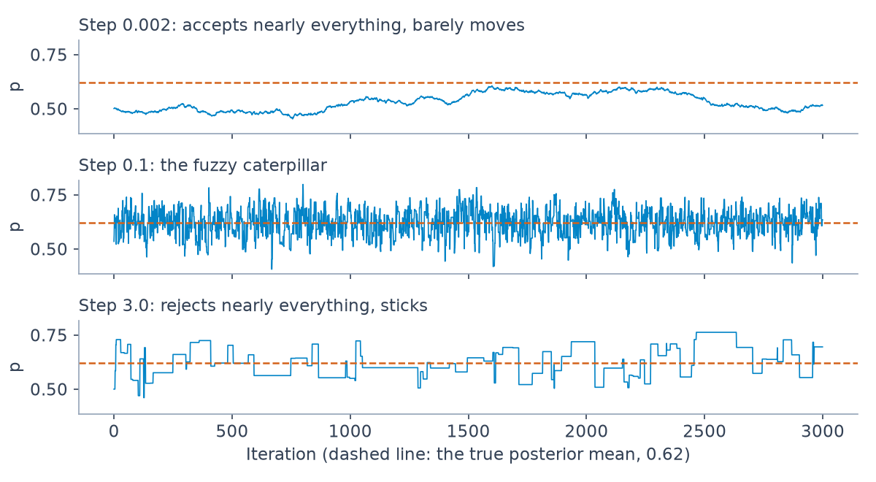
Step size decides how much a chain learns
Part 2 · Trusting the sampler
Step 0.002: accepted 98.7%, ESS 11.
Step 0.1: accepted 57.6%, ESS 3594.
Step 3.0: accepted 2.8%, ESS 278.
Three Metropolis chains on the same target. Generated by the code in notes/02-mcmc-and-pymc.md.
Both too small and too large waste draws, so read effective sample size and never the raw draw count.
Source: notes/02-mcmc-and-pymc.md
9
Notes:
Too small and the chain crawls. Too large and it rarely moves. NUTS tunes this during warm-up, which is why you should not hand-tune it for routine models.
Source: notes/02-mcmc-and-pymc.md

Slide 10
The same model with a new geometry
Part 2 · Trusting the sampler
PYTHON
Centred: 88 divergences, tau ESS 64.
with pm.Model():
mu = pm.Normal("mu", 0, 5)
tau = pm.HalfCauchy("tau", 5)
raw = pm.Normal("raw", 0, 1, shape=8)
theta = mu + tau * raw
pm.Normal("obs", theta, sigma, observed=y)
idata = pm.sample(1000, tune=1000)
print(int(idata.sample_stats["diverging"].sum()))
Non-centred: 2 divergences, tau ESS 2143.
Why: sampling raw removes the funnel between theta and tau.
The non-centred form leaves the model unchanged and removes the funnel the sampler could not cross.
Source: notes/02-mcmc-and-pymc.md
10
Notes:
Eight schools is from Gelman et al., Bayesian Data Analysis. Two divergences is not zero, so you would still raise target_accept and check again. Three fixes measured in the chapter: standardising the Challenger data took ESS from 304 to 2591, ordered means took label switching from r_hat 1.73 to 1.0, and non-centring eight schools took 88 divergences to 2. Bad diagnostics usually point at the geometry, so reparameterise before you add draws.
Source: notes/02-mcmc-and-pymc.md

Slide 11
PART 3
Priors and bandits
Wide is not the same as neutral
Data washes the prior out
Thompson sampling is one line of posterior
Prior predictive · Washout · Winner's curse · Thompson sampling
11
Notes:
Priors are assumptions you can test, by simulating from them. Once you have posteriors you can also act on them while you learn, which is what a bandit does.

Slide 12
Wide is not the same as neutral
The problem
Part 3 · Priors and bandits
A Normal(0, 10) prior on a logit coefficient looks harmless. It puts 65% of its mass on probabilities below 0.01 or above 0.99.
Simulated in the chapter, 200,000 prior draws
A prior that looks vague on one scale can be extreme on the scale you care about.
Source: notes/03-priors-and-bandits.md
12
Notes:
Normal(0, 1.5) puts almost nothing out there. Cauchy(0, 2.5), the Gelman et al. default, puts 32 percent there, which is why it is meant for standardised predictors. Simulate from the prior before you fit: on twenty-three launches, the chance it predicts all or none failing is 0.29 under Normal(0, 100), 0.18 under Normal(0, 5) and 0.02 under Normal(0, 1.5).
Source: notes/03-priors-and-bandits.md

Slide 13
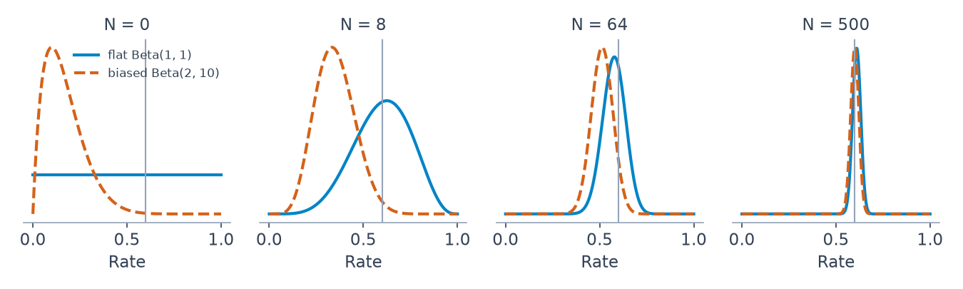
Data washes the prior out
Part 3 · Priors and bandits
Start: the two posterior means differ by 0.333.
At N=500: the gap is 0.010.
Thin data: that is where the prior decides.
Two priors on one coin. Generated by the code in notes/03-priors-and-bandits.md.
Priors matter most when data is thin, so spend your care on small segments and early looks.
Source: notes/03-priors-and-bandits.md
13
Notes:
Flat Beta(1,1) against a biased Beta(2,10). A prior is not a permanent thumb on the scale, unless it puts zero mass somewhere. Priors also take back a winner's inflation: of 2000 simulated experiments, 91 reach significance, their mean observed lift is 0.759 against a mean true lift of 0.246, and a prior fitted across all experiments brings it to 0.220. The last part returns to this with segments.
Source: notes/03-priors-and-bandits.md

Slide 14
Thompson sampling is one line of posterior
Part 3 · Priors and bandits
PYTHON
Allocation: traffic follows the chance each arm is best.
rng = np.random.default_rng(5)
p = np.array([0.85, 0.60, 0.75])
wins, trials = np.zeros(3), np.zeros(3)
for _ in range(1000):
draw = rng.beta(1 + wins, 1 + trials - wins)
i = np.argmax(draw)
wins[i] += rng.random() < p[i]
trials[i] += 1
print(trials.astype(int))
Regret at 2000 pulls: random 100.0, max mean 28.3, Thompson 22.8, 95% bound 14.6.
Not always best: the upper bound won on p of 0.15, 0.20, 0.10.
Sample once from each posterior, play the highest, and exploration follows from the remaining uncertainty.
Source: notes/03-priors-and-bandits.md
14
Notes:
The chapter's class-based version sends 926, 26 and 48 pulls of 1000 to the three arms. Regret is averaged over 300 runs. Thompson is the simple default rather than the winner in every setting.
Source: notes/03-priors-and-bandits.md

Slide 15
PART 4
Larkspur, answered
Now answer the head of product
Three answers from one posterior
Certain about direction, unsure about size
Peeking is not free here either
P(B > A) · Lift interval · Expected loss · Peeking
15
Notes:
Back to the question from the first slide. The closed form makes this cheap enough that no sampler is needed.

Slide 16
Now answer the head of product
The problem
Part 4 · Larkspur, answered
A: 2,079 conversions from 42,141. B: 2,335 from 41,859. How likely is B to be better, by how much, and what does each choice risk?
Larkspur checkout test, synthetic data with fixed seeds
The same counts that gave a p-value can answer the stakeholder's questions directly once you add a prior.
Source: notes/04-bayesian-ab-testing.md
16
Notes:
These are the same counts the experimentation pillar analysed, so the two answers can be compared side by side.
Source: notes/04-bayesian-ab-testing.md

Slide 17
Three answers from one posterior
Part 4 · Larkspur, answered
PYTHON
P(B > A): 0.99999.
rng = np.random.default_rng(1)
a = rng.beta(1 + 2079, 1 + 42141 - 2079, 400_000)
b = rng.beta(1 + 2335, 1 + 41859 - 2335, 400_000)
d = b - a
print((d > 0).mean())
print(np.percentile(d, [2.5, 97.5]) * 100)
print(np.maximum(-d, 0).mean() * 100) # ship B
print(np.maximum(d, 0).mean() * 100) # keep A
print((d > 0.005).mean(), (d > 0.010).mean())
Lift, 95%: +0.34 to +0.95 points.
Loss: ship B 0.000001 points, keep A 0.645 points.
Size: P(> 0.5pp) 0.83, P(> 1pp) 0.011.
P(B > A) is only one of the outputs, and the lift interval and expected loss are the ones that drive the decision.
Source: notes/04-bayesian-ab-testing.md
17
Notes:
Near certainty that B is better, but only 1 percent that the lift exceeds a full point. The first number alone would oversell this to anyone planning revenue.
Source: notes/04-bayesian-ab-testing.md

Slide 18
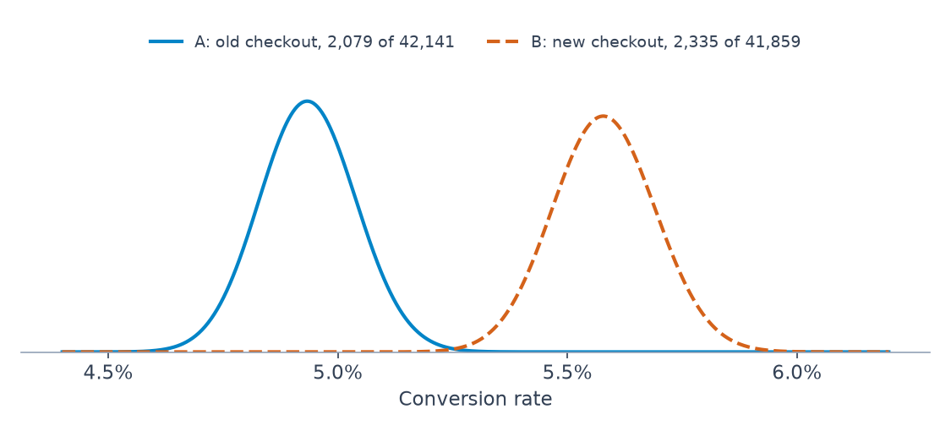
Certain about direction, unsure about size
Part 4 · Larkspur, answered
Clear: the two rates barely overlap.
Still wide: lift spans almost three-fold, +0.34 to +0.95.
Priors, day one: Beta(1,1) gives 0.950, Beta(500,9500) gives 0.689.
Larkspur's posteriors under uniform priors. Generated by the code in notes/04-bayesian-ab-testing.md.
With this much data the prior barely matters, but on day one it changes the answer from 0.950 to 0.689.
Source: notes/04-bayesian-ab-testing.md
18
Notes:
The day-one comparison is 900 visitors per arm, A 42 conversions and B 58. An informative prior centred on the historic rate is what stops a noisy first day from driving the decision.
Source: notes/04-bayesian-ab-testing.md

Slide 19
Peeking is not free here either
Part 4 · Larkspur, answered
Share of simulated tests that ship B, by true effect. Thirty-day tests.
Stopping rule | No effect | -0.5pp | +1pp | Mean day
P(B>A) > 0.95, last day only | 0.047 | 0.000 | 0.987 | 30.0
P(B>A) > 0.95, checked daily | 0.238 | 0.046 | 0.995 | 6.2
Expected loss < 0.05pp, daily | 0.589 | 0.143 | 1.000 | 3.9
Expected loss, daily from day 14 | 0.482 | 0.038 | 1.000 | 14.1
Calling it Bayesian does not make daily stopping safe, so choose the rule and judge it by its error rates.
Source: notes/04-bayesian-ab-testing.md
19
Notes:
The expected-loss rule ships most no-effect tests, since under no effect shipping costs little. Waiting until day 14 cuts the harmful ships at minus half a point from 14 percent to 4. That can be a fine choice, but only if you know that is what you chose.
Source: notes/04-bayesian-ab-testing.md

Slide 20
PART 5
From posterior to decision
Which number is the answer?
Each loss picks its own point
Stock by cost, not by the average
Larkspur's decision, in dollars
Loss functions · Bayes action · Dollars
20
Notes:
A posterior is not a decision. Adding what each mistake costs is what gets you from one to the other.

Slide 21
Which number is the answer?
The problem
Part 5 · From posterior to decision
One right-skewed posterior has a mean of 20.03, a median of 16.85 and a mode of 10. Each is the correct answer to a different question about cost.
Gamma(2, 10) posterior, from the chapter
A point estimate is a decision, and the loss function is what picks it.
Source: notes/05-loss-functions-and-decisions.md
21
Notes:
Reporting the mean quietly assumes squared loss. Most business costs are not squared and not symmetric.
Source: notes/05-loss-functions-and-decisions.md

Slide 22
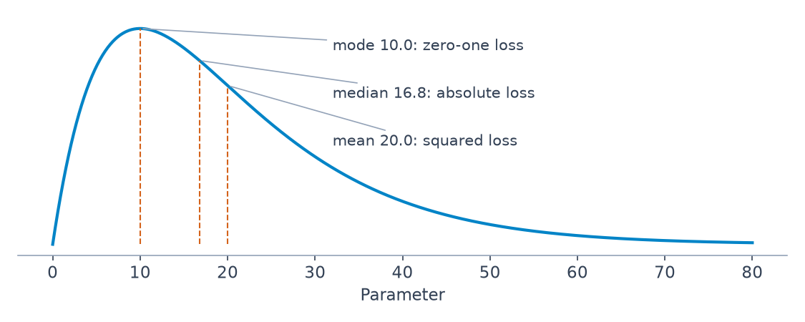
Each loss picks its own point
Part 5 · From posterior to decision
Squared loss: the mean.
Absolute loss: the median.
Narrow zero-one loss: the mode.
Bayes actions on a skewed posterior. Generated by the code in notes/05-loss-functions-and-decisions.md.
The Bayes action minimises expected loss under the posterior, and it moves when the costs move.
Source: notes/05-loss-functions-and-decisions.md
22
Notes:
Also in the chapter: the Price is Right bid falls from 14,700 to 11,800 as the risk of overbidding grows from 30,000 to 150,000, on a posterior mean of 20,000.
Source: notes/05-loss-functions-and-decisions.md

Slide 23
Stock by cost, not by the average
Part 5 · From posterior to decision
PYTHON
The mean says: stock 40, at a cost of 15.26.
rng = np.random.default_rng(2)
rate = rng.gamma(1 + 1200, 1 / (0.03 + 30), 8000)
demand = rng.poisson(rate)
def cost(q, short=5.0, over=1.0):
under = np.maximum(demand - q, 0)
extra = np.maximum(q - demand, 0)
return (short*under + over*extra).mean()
grid = np.arange(20, 70)
best = grid[np.argmin([cost(q) for q in grid])]
print(best, cost(40), cost(best))
The Bayes action: stock 46, at a cost of 9.92.
Why: a shortage costs five times an overstock.
With asymmetric costs the best action is not the mean, and using the mean has a price you can compute.
Source: notes/05-loss-functions-and-decisions.md
23
Notes:
This is the newsvendor problem. The answer lands near the 5/6 quantile of predictive demand, which you can check against the sampled grid.
Source: notes/05-loss-functions-and-decisions.md

Slide 24
Larkspur's decision, in dollars
Part 5 · From posterior to decision
Hypothetical: 480,000 visitors and $30 an order. Gain is $92,906 on average, 95% [$49,559, $136,395].
Cost to ship | Expected net gain | Chance of regret
$25,000 | $67,906 | 0.001
$60,000 | $32,906 | 0.069
$90,000 | $2,906 | 0.448
The same posterior can say ship or wait, depending on what shipping costs, so put that cost in the calculation.
Source: notes/05-loss-functions-and-decisions.md
24
Notes:
At 90,000 the expected gain is still positive, yet there is a 45 percent chance of losing money. The visitor count and order value are hypothetical, chosen to show the method. Replace them with your own.
Source: notes/05-loss-functions-and-decisions.md

Slide 25
PART 6
Bayesian machine learning
Past a certain size, you must approximate
Four approximations, one course
The ELBO you can check by hand
Mean-field ADVI cannot see correlation
EM · MCMC · Variational inference · Gaussian processes
25
Notes:
The coursework in practice/BayesianML is this part. The ideas are the same; the scale forces approximations, and each has a known way of being wrong.

Slide 26
Past a certain size, you must approximate
The problem
Part 6 · Bayesian machine learning
Latent labels, a VAE's encoder and a costly hyperparameter search all share one problem: the exact posterior is out of reach. Each approximation fails in its own way.
BayesianML coursework, weeks 2 to 6
Every scalable Bayesian method trades exactness for speed, and each has a failure you can check for.
Source: notes/06-bayesian-machine-learning.md
26
Notes:
EM returned local optima, ADVI understated correlated uncertainty, and a GP is only as good as its kernel. The chapter measures each.
Source: notes/06-bayesian-machine-learning.md

Slide 27
Four approximations, one course
Part 6 · Bayesian machine learning
EM
week 2, mixtures
MCMC
week 4, logistic
VI and VAE
week 5, ELBO
GP and BO
week 6, tuning
EM: 8 of 10 restarts reach log likelihood -1107.8; the others stop at -1186.9 and -1268.1.
MCMC: ESS of 155 under Metropolis and 3306 under NUTS.
Each method answers the same posterior question at a different point on the trade-off between speed and exactness.
Source: notes/06-bayesian-machine-learning.md
27
Notes:
The final assignment combines the VAE with Bayesian optimisation to search a latent space with human feedback. Restart EM, since a single run cannot show you it stopped short.
Source: notes/06-bayesian-machine-learning.md

Slide 28
The ELBO you can check by hand
Part 6 · Bayesian machine learning
PYTHON
Log evidence: -2.2655.
x = 2.0 # x ~ N(z, 1), z ~ N(0, 1)
log_ev = stats.norm.logpdf(x, 0, np.sqrt(2))
def elbo(m, s, n=200_000):
rng = np.random.default_rng(0)
z = m + s * rng.standard_normal(n)
recon = stats.norm.logpdf(x, z, 1).mean()
kl = -np.log(s) + (s*s + m*m) / 2 - 0.5
return recon - kl
print(log_ev - elbo(0.0, 1.0)) # q = prior
print(log_ev - elbo(1.0, 0.7071)) # q = exact
q at the prior: gap 1.1544.
q at the exact posterior: gap 0.0005, sampling noise.
The ELBO's gap to the log evidence is the KL divergence from the true posterior, so raising it improves the approximation.
Source: notes/06-bayesian-machine-learning.md
28
Notes:
A VAE's loss is this same expression, with an encoder network producing m and s for each data point, using the reparameterised draws shown here.
Source: notes/06-bayesian-machine-learning.md

Slide 29
Mean-field ADVI cannot see correlation
Part 6 · Bayesian machine learning
The chapter's Bayesian regression, fitted both ways.
Quantity | ADVI | NUTS
sd of a | 0.127 | 0.390
sd of a + b | 0.181 | 0.113
Correlation of a and b | -0.01 | -0.96
Mean-field variational inference is fast and misstates correlated uncertainty, so check it against NUTS on a small version.
Source: notes/06-bayesian-machine-learning.md
29
Notes:
The factorised q cannot represent the -0.96 correlation. It gets both spreads wrong: too narrow on a, too wide on a plus b. The chapter closes with a Gaussian process plus expected improvement, which spends each costly evaluation where it is most likely to beat the best so far: on one small tuning problem it reached a best log loss of 0.1016 against about 0.112 for random search. Treat that as a demonstration, not a benchmark.
Source: notes/06-bayesian-machine-learning.md

Slide 30
PART 7
The raw winner measured +3.17, and is truly +1.25
Each group's weight depends on how much data it has
Clustered errors, fixed effects, or multilevel
Over 1,000 datasets, pooling fixes the claim
Pooling pays when groups are noisy and exchangeable
With few groups, the spread is close to a guess
Partial pooling
The winner's number · Weights by size · Which tool · Over 1,000 datasets · When it fails · Few groups
30
Notes:
Every test in this pillar so far had one number to estimate. Most real analyses have many related numbers, one per market or segment. Partial pooling estimates them together.

Slide 31
The raw winner measured +3.17, and is truly +1.25
The problem
Part 7 · Partial pooling
Of 24 segments, the raw winner has 672 users an arm and measured +3.17. Pooling takes it to +1.27, and picks a different segment, truly better at +1.79.
Simulated experiment, 24 segments. Pooled pick: 8,102 users an arm
A segment wins by holding positive noise, so estimate the segments together before shipping one.
Source: notes/07-multilevel-models-and-partial-pooling.md
31
Notes:
This is the winner's curse from the statistics pillar, in the form an analyst meets it weekly. A hand-built grid and PyMC agree to within 0.014 in any segment, so this is arithmetic we can check.
Source: notes/07-multilevel-models-and-partial-pooling.md

Slide 32
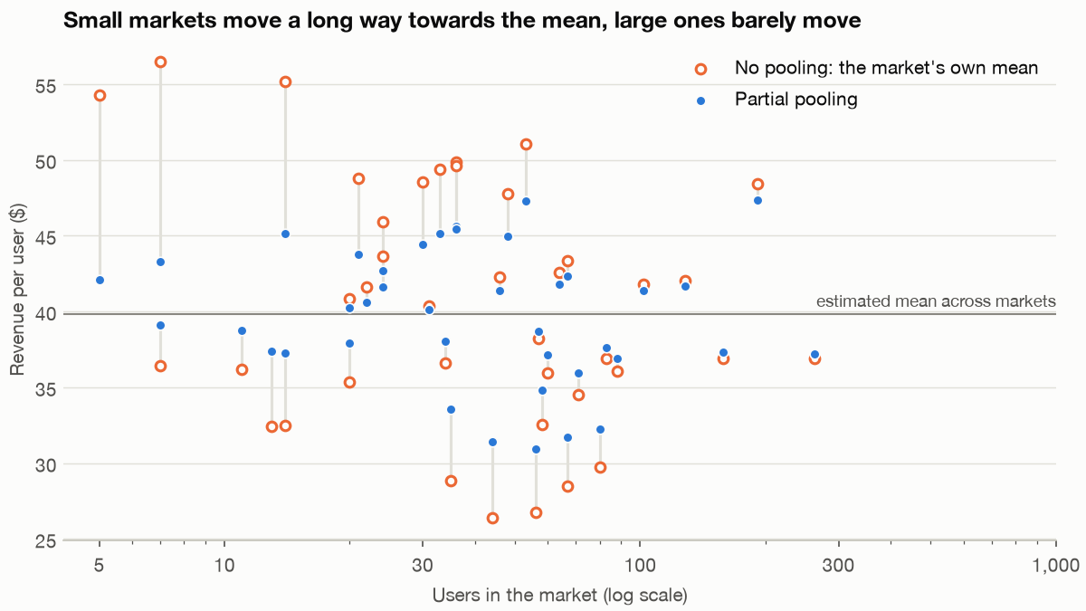
Each group's weight depends on how much data it has
Part 7 · Partial pooling
Weight on the group's data: τ²/(τ²+σ²/n).
5 users: $54.26 to $42.10, true $45.39, weight 0.16.
262 users: weight 0.91, barely moves.
RMSE over 200 datasets: none 5.13, complete 5.98, partial 3.47.
Raw market means pulled towards the overall mean, in proportion to their noise.
Partial pooling beat no pooling in 96% of datasets, because it trusts each group exactly as far as its data allows.
Source: notes/07-multilevel-models-and-partial-pooling.md
32
Notes:
The same structure explains why ignoring groups is costly. An intraclass correlation of only 0.036 multiplies the variance of a mean by about 5 at this cluster size.
Source: notes/07-multilevel-models-and-partial-pooling.md

Slide 33
Clustered errors, fixed effects, or multilevel
Part 7 · Partial pooling
With a market effect correlated with the discount, truth 2: pooled 3.04, random intercepts 2.83, fixed effects and within-between 1.99.
Tool | Use it when | Watch for
Clustered SEs | Groups are a nuisance | Too few clusters
Fixed effects or within-between | The group effect may correlate with a predictor | Group-constant variables are lost in fixed effects
Multilevel | Group estimates or their spread are the question | Needs exchangeable groups, and enough of them
Pick by the question, and when a group effect may correlate with a predictor, add its group mean or use fixed effects.
Source: notes/07-multilevel-models-and-partial-pooling.md
33
Notes:
McNeish and colleagues make the case for the simpler tool: by their count a multilevel model makes 10 assumptions and clustered standard errors 3. Bell and Jones note that standard random effects assume within and between effects are equal, and splitting a predictor into a group mean and a deviation removes that assumption. Plain random intercepts give 2.83 with nothing in the output to warn you. Also check for missing standard errors, which appeared silently in 7 of 400 runs, and for random slopes: leaving them out gave an SE of 0.222 where the model with slopes gave 0.276.
Source: notes/07-multilevel-models-and-partial-pooling.md

Slide 34
Over 1,000 datasets, pooling fixes the claim
Part 7 · Partial pooling
TEXT OUTPUT
Fixes how much you claim, nearly all of it.
1,000 datasets raw pooled
RMSE per segment 1.357 0.489
winner minus its true +2.93 +0.09
true lift of the pick 1.26 1.46
90% interval covers 0.90 0.90
truly best segment 1.98
Improves which you pick, partly.
Coverage is calibrated in both.
Pooling almost removes the overstatement and improves the pick, and it still leaves you short of the truly best segment.
Source: notes/07-multilevel-models-and-partial-pooling.md
34
Notes:
This is the argument of Gelman, Hill and Yajima. Classical corrections such as Bonferroni keep estimates where they are and widen intervals, whereas partial pooling moves the estimates themselves.
Source: notes/07-multilevel-models-and-partial-pooling.md

Slide 35
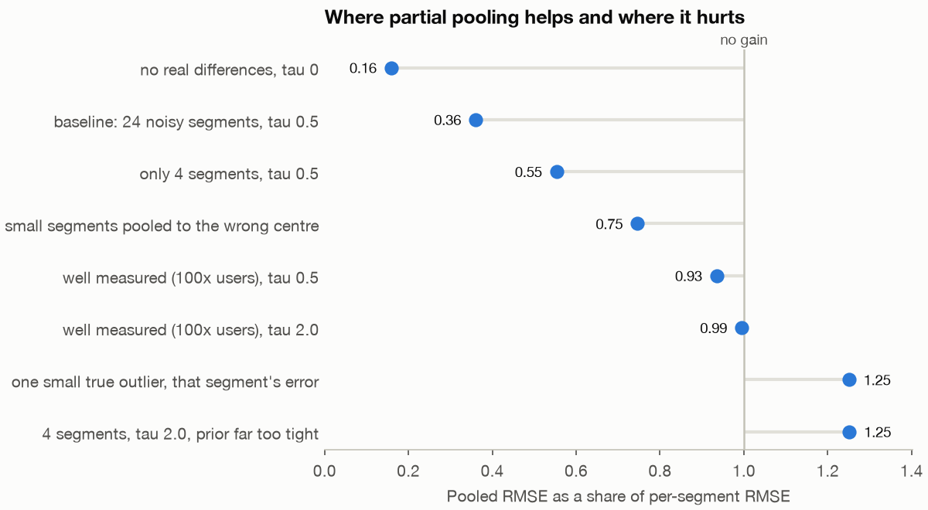
Pooling pays when groups are noisy and exchangeable
Part 7 · Partial pooling
No differences: 0.16; intervals too wide.
Well measured: 0.93 and 0.99, no gain.
True +5.0: pulled down 3.74, RMSE 3.01 to 3.76.
Wrong centre: −1.10; a size predictor fixes it.
Pooled RMSE as a share of per-segment RMSE, across eight scenarios. Below 1, pooling wins.
Shrinkage works against the rare real winner, so follow up a large raw effect with a new test.
Source: notes/07-multilevel-models-and-partial-pooling.md
35
Notes:
The baseline ratio is 0.36. In the outlier world the other 23 segments still improve, from 1.25 to 0.49. Adding size as a group-level predictor brings the wrong-centre RMSE back to 0.49.
Source: notes/07-multilevel-models-and-partial-pooling.md

Slide 36
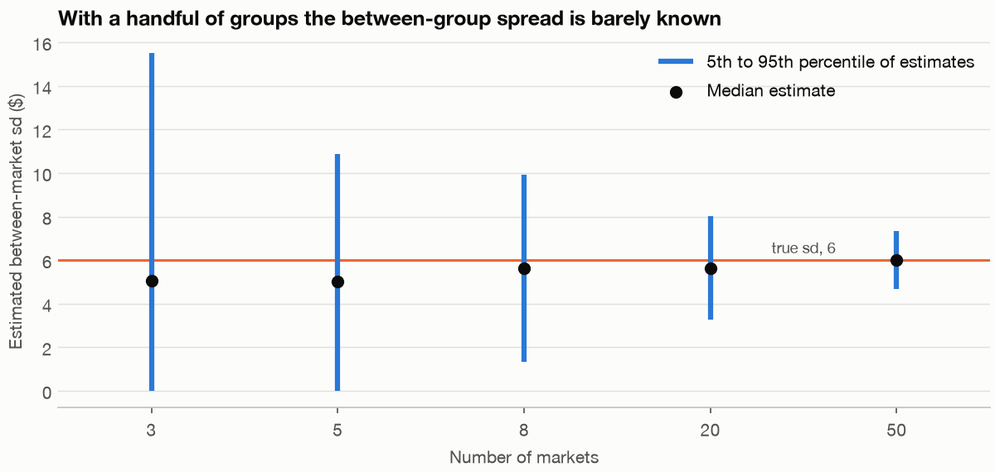
With few groups, the spread is close to a guess
Part 7 · Partial pooling
3 markets: τ from 0 to 15.53; zero in 11% of datasets.
50 markets: 4.67 to 7.34.
Half-normal(0.25) when τ = 2: ratio 1.25, covers 48%.
Estimated spread between groups, against the number of groups, with a true τ of 6.
With few groups the prior decides, so report a range of priors. As Gelman and Loken warn, inference can be sensitive to model assumptions.
Source: notes/07-multilevel-models-and-partial-pooling.md
36
Notes:
With 5 markets τ hits zero in 8% of datasets. MixedLM's single answer of 2.52 compares with a PyMC interval of 0.37 to 9.74, and a correlation can sit at the boundary of 1.00. On a logit scale, the within-market effect is not the population-averaged one: 0.500 against 0.306, and the typical market's 4.89% is not the average of 6.71%.
Source: notes/07-multilevel-models-and-partial-pooling.md

Slide 37
Rules of thumb
Wrap-up
Tell and test the story
Check the chain
Report three things
Write how the data arises, then simulate the prior.
r_hat, ESS and divergences before any result.
P(B > A), the lift interval and expected loss.
Fix the stopping rule
Price the mistake
Pool then check
Peeking costs error here too. Measure how much.
Choose the action with the lowest expected cost.
Estimate related groups together, and report a range across priors.
Most Bayesian failures are unchecked models and unpriced decisions, and each one has a check you can run.
Source: notes/07-multilevel-models-and-partial-pooling.md
37
Notes:
These six are what to carry out of the pillar. The rest is reference.
Source: notes/07-multilevel-models-and-partial-pooling.md

Slide 38
Where to go next
Wrap-up
Visualisation and storytelling: putting these answers in front of people.
Practice
Eval pillar in generative-ai: comparing LLM variants on small samples.
Every chapter block runs as written. Change a seed and a prior, and predict the result before you run it.
Read: Davidson-Pilon, then McElreath, then Gelman et al.
Beyond this pillar: model building in data-science, pipelines in data-engineering.
The next step is to run chapter 4 on your own test's counts and price the decision in chapter 5.
Source: notes/07-multilevel-models-and-partial-pooling.md
38
Notes:
The BayesianML coursework is kept as written and needs its pinned environment. The chapters run on current PyMC. McElreath's Statistical Rethinking lectures are free on YouTube if you want the long version of the last part.
Source: notes/07-multilevel-models-and-partial-pooling.md

