Slide 1
Natural Language Processing
Part 1: Text as numbers
Preprocessing · Bag of words · TF-IDF · Leaks
Part 2: Classification and its baseline
TF-IDF plus linear · Metrics · Reading weights
From bag of words to embeddings as features
Part 3: Text with no labels
Topics · Coherence · Clusters · Summaries
Part 4: Embeddings and entities
Turn text into numbers · Set a baseline · Spend only where it pays
word2vec · Bias · NER · CRF · F1
Part 5: Sentiment, three ways
Lexicons · TF-IDF · LSTMs · Why people feel it
Part 6: Embeddings as features
Fair comparison · Few labels · Clusters · Anomalies
Notes: data-science/03-nlp
Notes:
Text is the most common messy input a data scientist meets. We follow film descriptions and reviews from raw strings to features, through classifiers, topics, entities and sentiment, and finish by asking when a pretrained encoder is worth its cost. The habit throughout is a baseline first, then a measured comparison.

Slide 2
PART 1
Text as numbers
Your preprocessing already decided the answer
Bag of words throws away order and keeps counts
Fit TF-IDF on training text only, or you leak the test set
Removing stopwords turned "not good" from 0.02 to 0.99
Pick the cheapest text representation that keeps your signal
Preprocessing · Bag of words · TF-IDF · Leaks
2
Notes:
A model cannot read. Somebody decides how a review becomes a row of numbers. What does that decision cost?

Slide 3
Your preprocessing already decided the answer
The problem
Part 1 · Text as numbers
Remove "not" as a stop word, and the model can no longer tell "good" from "not good".
Measured on IMDb: "not good" flipped from 0.02 to 0.99 positive
Text decisions made before any model quietly set what that model is able to learn.
Source: notes/06-sentiment-analysis.md
3
Notes:
The same logistic regression, the same data, and one standard stop word list. Accuracy barely fell, which is why nobody noticed, but the model now calls "not good" positive with near certainty.
Source: notes/06-sentiment-analysis.md

Slide 4
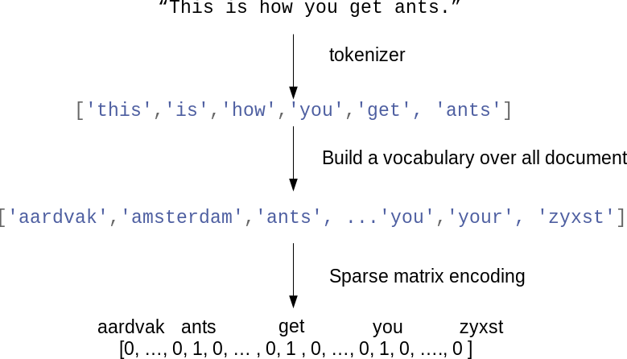
Bag of words throws away order and keeps counts
The first representation
Part 1 · Text as numbers
Each word in the vocabulary is one column
A document is a sparse row of counts
Figure: Müller and Guido, Introduction to Machine Learning with Python (O'Reilly, 2016).
Bag of words makes text tabular by keeping word counts and discarding their order.
Source: notes/01-text-representation.md
4
Notes:
Tokenise, build a vocabulary, count. Tens of thousands of columns, nearly all of them zero in any row. It looks too crude to work, and yet the next part shows how far it goes.
Source: notes/01-text-representation.md

Slide 5
Fit TF-IDF on training text only, or you leak the test set
Worked example
Part 1 · Text as numbers
PYTHON
IDF discounts words found everywhere
vec = TfidfVectorizer(
min_df=2, sublinear_tf=True,
ngram_range=(1, 2))
X_train = vec.fit_transform(train_text)
X_test = vec.transform(test_text)
Bigrams bring back "not good"
fit on test text is a leak
Fit the vocabulary and IDF weights on training text alone, because a vocabulary built on test text is a leak.
Source: notes/01-text-representation.md
5
Notes:
Three lines carry most of the classical toolkit. Sublinear term frequency stops a word repeated ten times counting ten times as much. Bigrams recover some order at the cost of many more columns.
Source: notes/01-text-representation.md

Slide 6
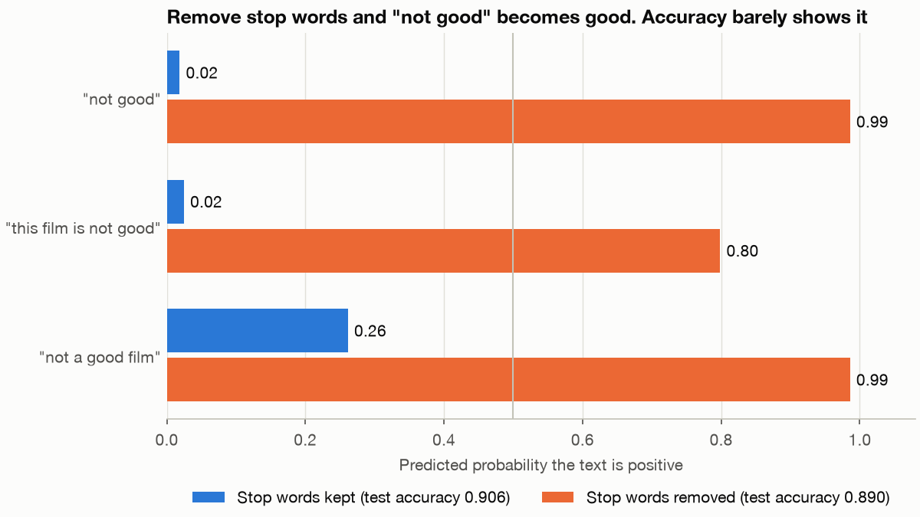
Removing stopwords turned "not good" from 0.02 to 0.99
Part 1 · Text as numbers
TF-IDF logistic regression on 25,000 IMDb reviews: P(positive) for 'not good' goes from 0.02 to 0.99 with stopwords removed, and accuracy from 0.906 to 0.890. Run practice/stopword_negation.py.
Your stopword list holds "not", so check what it deletes before you trust the small accuracy change.
Source: notes/01-text-representation.md, notes/06-sentiment-analysis.md
6
Notes:
Accuracy loses only 1.6 points, so the average hides it. Delete "not" and the sentence that remains is "good", so the model reads it as positive. Bigrams only help if the bigram is still there.
Source: notes/01-text-representation.md, notes/06-sentiment-analysis.md

Slide 7
Pick the cheapest text representation that keeps your signal
Decision guide
Part 1 · Text as numbers
Representation | Keeps | Use it for
TF-IDF | Rare and telling words | Linear baselines, keyword search
Averaged word vectors | Rough meaning | Small labelled sets, with pretrained vectors
Integer sequences | Word order | RNNs and transformers, with truncation decisions
Sentence embeddings | Meaning in context | Few labels, clustering, anomaly detection
Pick the cheapest representation that keeps the signal your task depends on.
Source: notes/01-text-representation.md
7
Notes:
This table is the pillar in miniature. Each row costs more than the last, and each is worth it only when the signal the cheaper row loses is the one you need.
Source: notes/01-text-representation.md

Slide 8
PART 2
Classification and its baseline
Before the transformer, fit this
Tune the vectoriser and the model together
Tune a text classifier in one pipeline, then read its weights
Accuracy 0.532 hides a Crime F1 of 0.067
TF-IDF plus linear · Metrics · Reading weights
8
Notes:
Someone suggests a transformer. What should you fit first, and how would you know if something beats it?

Slide 9
Before the transformer, fit this
The problem
Part 2 · Classification and its baseline
If you skip the baseline, you will not know whether a model costing a hundred times more is any better.
Film genres: majority class accuracy 0.315, tuned TF-IDF 0.532
A TF-IDF linear model takes seconds and sets the score that every expensive model must beat.
Source: notes/02-text-classification.md
9
Notes:
The task for most of today is to predict a film's first listed genre from its description, across the six commonest genres.
Source: notes/02-text-classification.md

Slide 10
Tune the vectoriser and the model together
Worked example
Part 2 · Classification and its baseline
PYTHON
Vectoriser in the pipeline: no leak
pipe = make_pipeline(
TfidfVectorizer(min_df=2, sublinear_tf=True),
LogisticRegression(max_iter=2000))
grid = GridSearchCV(pipe, {
"logisticregression__C": [0.1, 1, 10, 100],
"tfidfvectorizer__ngram_range":
[(1, 1), (1, 2), (1, 3)]},
cv=5, scoring="f1_macro").fit(X, y)
Scored by macro-F1: 0.423 on test
Keeping the vectoriser inside the pipeline lets every fold build its own vocabulary, so the score is honest.
Source: notes/02-text-classification.md
10
Notes:
Word2vec trained on this same small corpus reached only 0.35, well below this baseline.
Source: notes/02-text-classification.md

Slide 11
Tune a text classifier in one pipeline, then read its weights
The recipe
Part 2 · Classification and its baseline
Split
stratified, once
Vectorise
inside each fold
Linear model
tune C
Macro-F1
not just accuracy
Read weights
find the leaks
Tuned on the film task: accuracy 0.532, macro-F1 0.423.
Tune the vectoriser and model together inside cross-validation, then read the weights to catch surprises.
Source: notes/02-text-classification.md
11
Notes:
Putting the vectoriser in the pipeline means each fold builds its own vocabulary, so the cross-validated score is honest. Reading the top coefficients often exposes a word that gives the label away.
Source: notes/02-text-classification.md

Slide 12
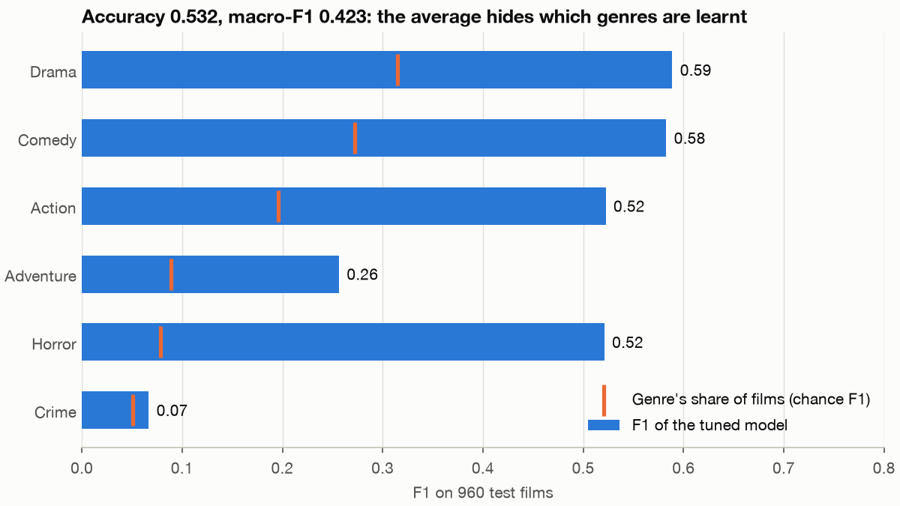
Accuracy 0.532 hides a Crime F1 of 0.067
Evaluation
Part 2 · Classification and its baseline
Accuracy is fine when topics are balanced and errors cost about the same.
Otherwise: macro-F1 for imbalance, PR-AUC for rare positives, log-loss for ranking.
Genre from film descriptions: accuracy 0.532, macro-F1 0.423, majority class 0.315. Crime, 5.1% of films, gets F1 0.067. Run practice/genre_f1.py.
Choose the metric from the costs of the errors, since accuracy on imbalanced text flatters a lazy model.
Source: notes/02-text-classification.md
12
Notes:
Genre has a 31.5% majority class, so accuracy alone would flatter a model that favours drama. Macro-F1 weights every genre equally, and Crime shows what that catches.
Source: notes/02-text-classification.md

Slide 13
PART 3
Text with no labels
What is in a corpus nobody has labelled?
NMF gave readable topics on short film descriptions
No knee: coherence slides from 0.352 to 0.322
Coherence barely moves, so read the topics
Topics · Coherence · Clusters · Summaries
13
Notes:
Ten thousand support tickets, no labels, and nobody will read them. What can you honestly say?

Slide 14
What is in a corpus nobody has labelled?
The problem
Part 3 · Text with no labels
With no labels there is no held-out accuracy to lean on, and a cluster number means nothing until a person names it.
With no labels you get candidate themes and groups, which a person still has to read and name.
Source: notes/03-topic-models-and-summarization.md
14
Notes:
We need phrases that matter, themes with a weight per document, and groups of similar documents. None of them comes with a score we can trust alone.
Source: notes/03-topic-models-and-summarization.md

Slide 15
NMF gave readable topics on short film descriptions
Which one
Part 3 · Text with no labels
Model | Input | Strength | Watch out for
LSI | TF-IDF | Fast and deterministic | Components mix opposed themes
LDA | Counts | Generative mixture per document | Depends on seed and pruning
NMF | TF-IDF | Sharp and readable topics | Choose k by reading
Run LDA on counts and NMF on TF-IDF, then choose by reading the topics, because metrics rarely decide it.
Source: notes/03-topic-models-and-summarization.md
15
Notes:
On the film data NMF gave readable themes such as falling in love, and true stories. LDA's topics were muddier on such short texts, which is a common result.
Source: notes/03-topic-models-and-summarization.md

Slide 16
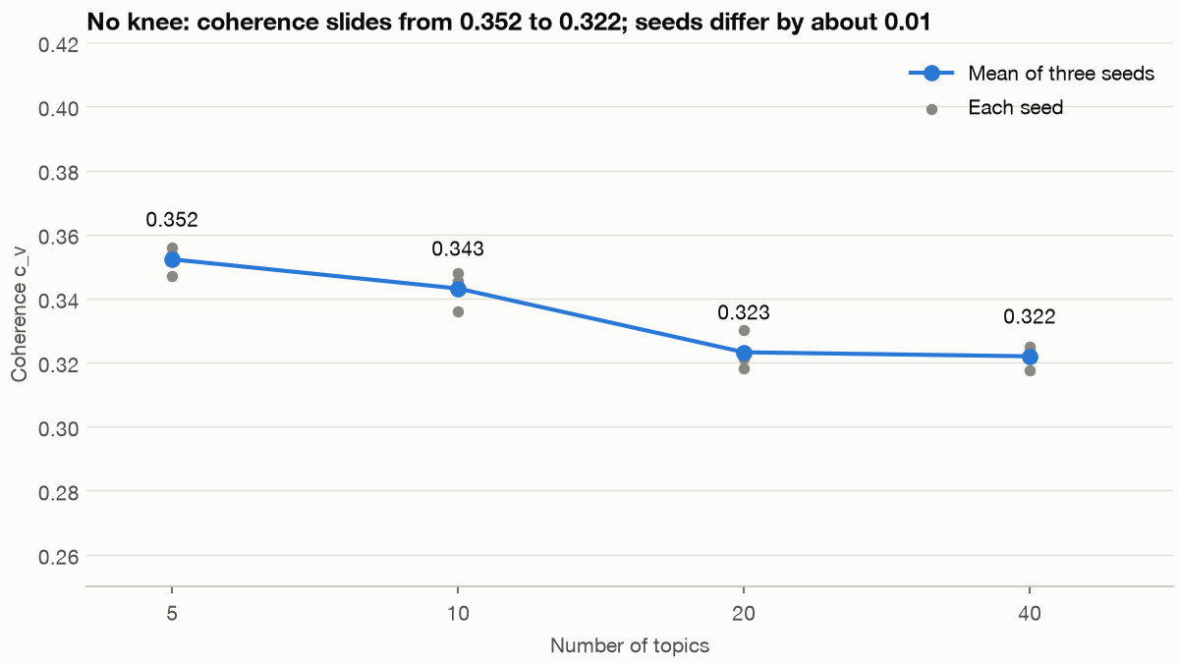
No knee: coherence slides from 0.352 to 0.322
Part 3 · Text with no labels
LDA on film descriptions, three seeds: mean c_v 0.352 at 5 topics and 0.322 at 40, with seeds about 0.01 apart. Run practice/topic_coherence.py.
Coherence shows no clear elbow on this corpus, so choose the topic count by reading the topics.
Source: notes/03-topic-models-and-summarization.md
16
Notes:
The whole range is 0.03, and the seeds spread about 0.01 at each size, so the small differences between neighbours aren't worth acting on. It is a gentle slide with no point that asks to be chosen. Read the topics.
Source: notes/03-topic-models-and-summarization.md

Slide 17
Coherence barely moves, so read the topics
Worked example
Part 3 · Text with no labels
TEXT
c_v, the score closest to human judgement, has no clean elbow
k=5 c_v=0.347
k=10 c_v=0.346
k=20 c_v=0.318
k=40 c_v=0.325
NMF topic: love, falls, falls love
-> Veer-Zaara, 2046, Never Again
Top documents show what words hide
Refit with a second seed
Coherence narrows the options, but only reading top words and top documents tells you what a topic is.
Source: notes/03-topic-models-and-summarization.md
17
Notes:
From five to forty topics coherence barely moves, and this seed's small recovery at forty is inside the noise between seeds, so it does not pick k for you. A topic is a pattern the model found, not a fact.
Source: notes/03-topic-models-and-summarization.md

Slide 18
PART 4
To TF-IDF, hotel is as far from motel as from banana
GloVe puts car near truck at 0.92, and good near bad at 0.80
Train word vectors in a few lines
Word vectors from a small corpus show real structure
NER pulls out who, where and when as typed spans
Score entities, not tokens
Embeddings and entities
word2vec · Bias · NER · CRF · F1
18
Notes:
Sparse columns treat hotel and motel as unrelated, and they cannot tell us who did what. Two more tools fix those two gaps.

Slide 19
To TF-IDF, hotel is as far from motel as from banana
The problem
Part 4 · Embeddings and entities
A word is known by the company it keeps, so learn a vector that predicts its neighbours.
The distributional idea behind word2vec, GloVe and FastText
Embeddings learn nearness from shared contexts, so related words stop being unrelated columns.
Source: notes/04-embeddings-and-similarity.md
19
Notes:
Every word in TF-IDF is its own axis, so similar words have nothing in common. Word2vec fits small dense vectors so that words appearing in similar contexts get similar vectors.
Source: notes/04-embeddings-and-similarity.md

Slide 20
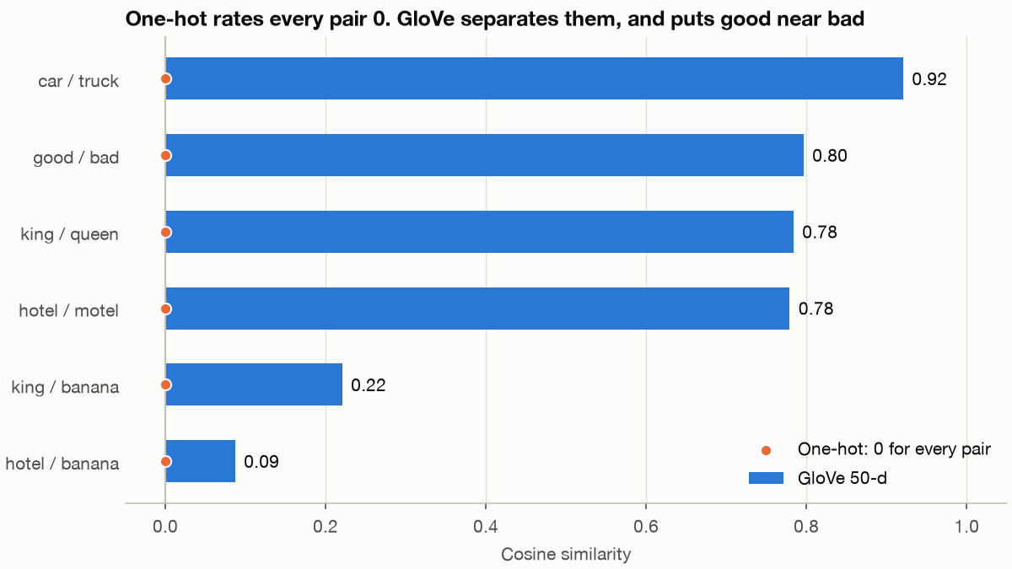
GloVe puts car near truck at 0.92, and good near bad at 0.80
Part 4 · Embeddings and entities
Cosine similarity in GloVe 50-d: hotel/motel 0.78, hotel/banana 0.09, good/bad 0.80. One-hot gives 0 for every pair. Run practice/word_similarity.py.
Vectors measure shared contexts, so opposites used in the same places score as similar.
Source: notes/04-embeddings-and-similarity.md
20
Notes:
To one-hot and TF-IDF, every different word is equally far. Vectors recover similarity from the contexts words appear in. Good and bad appear in the same contexts, so they sit close, which is why embeddings alone don't solve sentiment.
Source: notes/04-embeddings-and-similarity.md

Slide 21
Train word vectors in a few lines
Worked example
Part 4 · Embeddings and entities
PYTHON
vector_size was size in gensim 3
w2v = Word2Vec(sentences=sentences,
vector_size=100,
epochs=5, workers=4, seed=0)
w2v.wv.most_similar("war", topn=6)
Normalise before comparing vectors
gensim trains word vectors on a million tokens in seconds, so try them on your own corpus before downloading any.
Source: notes/04-embeddings-and-similarity.md
21
Notes:
The argument names changed in gensim 4, which is why old notebooks break.
Source: notes/04-embeddings-and-similarity.md

Slide 22
Word vectors from a small corpus show real structure
Worked example
Part 4 · Embeddings and entities
Our skip-gram, by hand
gensim Word2Vec, 12,390 words
king: george, france, washington
king: prussia, hamilton, madison
war: world, civil, treaty
war: revolution, civil, conflict
father: frank, wife, brother
father: brother, sister, husband
Even a small corpus yields real structure in seconds, and the neighbours reflect what that corpus is about.
Source: notes/04-embeddings-and-similarity.md
22
Notes:
These books are heavy on history, and so "king" has presidents among its neighbours. Neighbours include antonyms too, so do not treat them as synonyms.
Source: notes/04-embeddings-and-similarity.md

Slide 23
NER pulls out who, where and when as typed spans
From similarity to structure
Part 4 · Embeddings and entities
Named entity recognition: spans of text with types attached, such as person, organisation, place and date.
Pretrained models are domain-bound: they tag text that resembles what they trained on.
NER returns typed spans of text, and a pretrained tagger must be measured on your own domain before you trust it.
Source: notes/05-semantic-analysis-and-ner.md
23
Notes:
Similarity cannot tell a compliance team which companies appear in a contract. Named entity recognition can, as long as the text resembles what the tagger trained on.
Source: notes/05-semantic-analysis-and-ner.md

Slide 24
Score entities, not tokens
A trap in the metric
Part 4 · Embeddings and entities
An always-O tagger scores 0.849 token accuracy and finds nothing
Why a CRF
The CRF scores 0.969 token accuracy and 0.826 entity-level F1
It scores the whole tag sequence with hand-made features, and it trains in seconds.
Frequent types do well (gpe 0.95), and rare ones need more data
Learned transitions read like a grammar: O->I-geo is forbidden
Report entity-level F1, since token accuracy is dominated by the tag that means nothing.
Source: notes/05-semantic-analysis-and-ner.md
24
Notes:
Most tokens are outside any entity, so token accuracy is near 85% for a model that does nothing. Twelve thousand sentences of a tagged corpus were enough for 0.83.
Source: notes/05-semantic-analysis-and-ner.md

Slide 25
PART 5
Sentiment, three ways
Which method wins on 50,000 reviews?
Bigram TF-IDF reaches 0.906 on 25,000 reviews
With labels, TF-IDF beats lexicons and small networks on IMDb
Explanations turn a sentiment score into a reason
Lexicons · TF-IDF · LSTMs · Why people feel it
25
Notes:
Fifty thousand reviews. Are people happy, and why not? We can answer with a dictionary, a linear model, or a network.

Slide 26
Which method wins on 50,000 reviews?
The problem
Part 5 · Sentiment, three ways
A score of 72% positive answers the easy question. The one that matters is why the rest are not.
Same data, IMDb, for every method in this part
Sentiment asks two questions, how people feel and why, and only the second one tells you what to change.
Source: notes/06-sentiment-analysis.md
26
Notes:
The ranking surprises people. Before you see the table, guess the order of a dictionary, a linear model, and an LSTM.
Source: notes/06-sentiment-analysis.md

Slide 27
Bigram TF-IDF reaches 0.906 on 25,000 reviews
Worked example
Part 5 · Sentiment, three ways
PYTHON
Trained on 25,000 reviews, in seconds
vec = TfidfVectorizer(ngram_range=(1, 2),
min_df=2, sublinear_tf=True)
clf = LogisticRegression(max_iter=2000)
clf.fit(vec.fit_transform(train), y_train)
clf.score(vec.transform(test), y_test) # 0.906
Bigrams keep not good apart
Twenty-five thousand labels and a bigram TF-IDF model set a bar that small neural networks here did not reach.
Source: notes/06-sentiment-analysis.md
27
Notes:
Check this against the next table before you reach for a sequence model.
Source: notes/06-sentiment-analysis.md

Slide 28
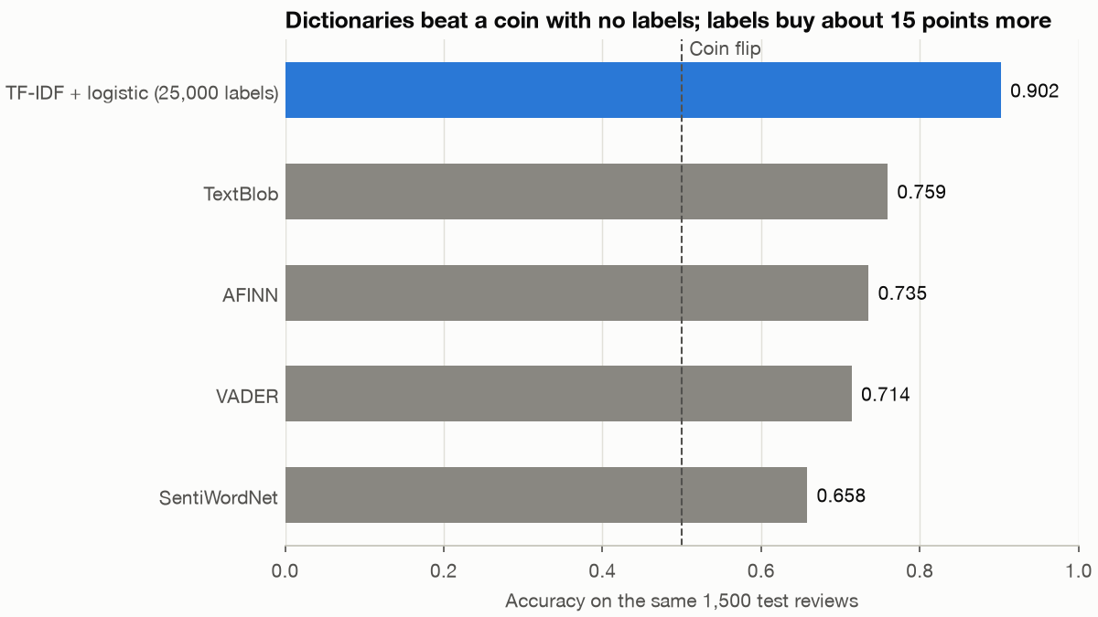
With labels, TF-IDF beats lexicons and small networks on IMDb
Worked example
Part 5 · Sentiment, three ways
From the note: averaged word2vec + dense net 0.831, and pooled, CNN and LSTM on 6,000 reviews about 0.80.
The same 1,500 test reviews: TF-IDF logistic 0.902, against TextBlob 0.759, AFINN 0.735, VADER 0.714 and SentiWordNet 0.658. Run practice/sentiment_methods.py.
With labels, TF-IDF bigrams beat both the lexicons and small neural networks on review sentiment.
Source: notes/06-sentiment-analysis.md
28
Notes:
TF-IDF on all 25,000 test reviews gets 0.906. The sequence models trained on 6,000 reviews, so that is not an even contest, but the point stands: the network has to earn its place. The lexicons remain useful when you have no labels at all.
Source: notes/06-sentiment-analysis.md

Slide 29
Explanations turn a sentiment score into a reason
Debugging and explaining
Part 5 · Sentiment, three ways
Check the padding
Wrong input length: 0.782 to 0.672
Read the weights
what drives the model
Explain one
LIME, locally
Model each class
topics of complaint
Truncating at a wrong length raised no error. Only a comparison showed it.
Explanations move from global weights to single predictions to themes, and each answers a different why.
Source: notes/06-sentiment-analysis.md
29
Notes:
Truncating at a wrong length raises no error, and only a comparison shows it. Then per-class topic models go from a score to something a product team can use.
Source: notes/06-sentiment-analysis.md

Slide 30
PART 6
Embeddings as features
Does a pretrained encoder make TF-IDF obsolete?
Encode once, then it is ordinary ML
The gap depends on how many labels you have
The same embeddings also cluster text and catch anomalies
Encoding is about fifty times slower than TF-IDF
Fair comparison · Few labels · Clusters · Anomalies
30
Notes:
A pretrained encoder turns any text into 384 numbers. We promised a fair comparison on the film task, so here it is.

Slide 31
Does a pretrained encoder make TF-IDF obsolete?
The problem
Part 6 · Embeddings as features
Encode once and cache the matrix, and from there on it is ordinary scikit-learn.
A sentence embedding is just a dense feature matrix, so all of classical ML applies to it again.
Source: notes/07-llm-embeddings-as-features.md
31
Notes:
Everything after the encoder is what you already know. The questions that are left are ordinary ML questions: how much does it help, and at what cost?
Source: notes/07-llm-embeddings-as-features.md

Slide 32
Encode once, then it is ordinary ML
Worked example
Part 6 · Embeddings as features
PYTHON
384 dimensions, cut off at 256 pieces
enc = SentenceTransformer(
"sentence-transformers/all-MiniLM-L6-v2")
X = enc.encode(texts, normalize_embeddings=True)
np.save(cache_path, X) # key by model name
clf = LogisticRegression(C=10, max_iter=3000)
clf.fit(X[train], y[train])
Everything after encode is scikit-learn
Encoding is the only slow step, so cache the matrix under the model's name and treat it as any other feature table.
Source: notes/07-llm-embeddings-as-features.md
32
Notes:
Swap the model name and the rest of the code does not change, which makes testing an encoder on your task one line.
Source: notes/07-llm-embeddings-as-features.md

Slide 33
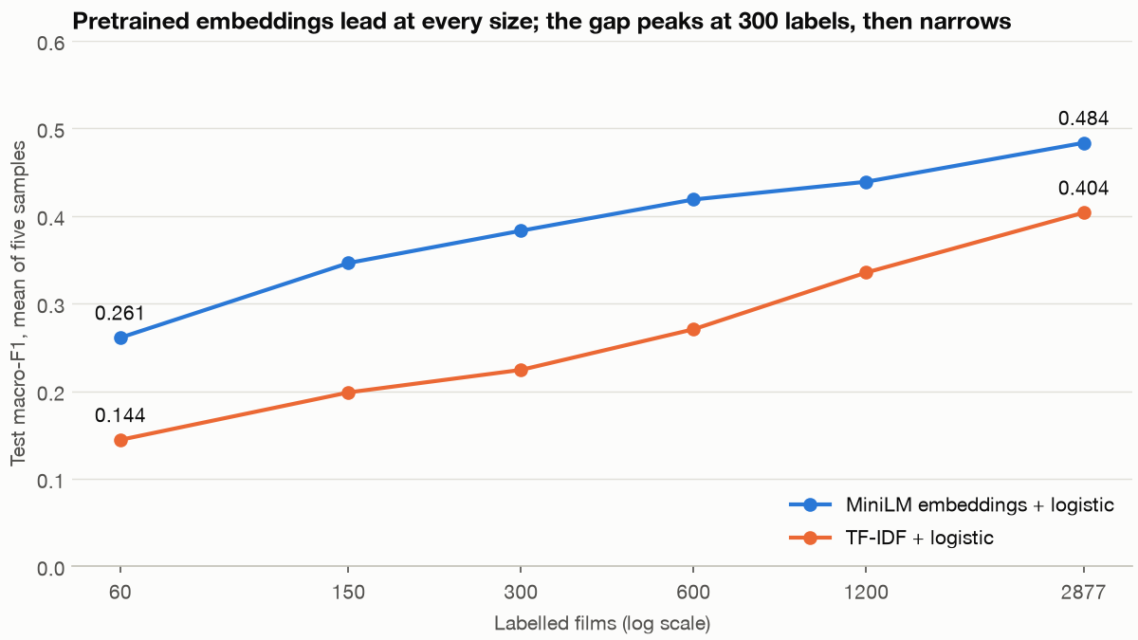
The gap depends on how many labels you have
Worked example
Part 6 · Embeddings as features
Macro-F1 over five samples: MiniLM 0.261 and TF-IDF 0.144 at 60 films; 0.484 and 0.404 at all 2,877. Run practice/labels_vs_f1.py.
The encoder leads at every size, by the most below about 1,000 labels, and TF-IDF gains ground as labels grow.
Source: notes/07-llm-embeddings-as-features.md
33
Notes:
At sixty labels MiniLM nearly doubles TF-IDF's score. With all the labels the gap is 0.08, and a bootstrap interval says it is real. TF-IDF tuned with a wider search reaches 0.423 here, so the lead would be 0.06.
Source: notes/07-llm-embeddings-as-features.md

Slide 34
The same embeddings also cluster text and catch anomalies
Beyond classification
Part 6 · Embeddings as features
Choice of classifier
Clusters
UMAP, HDBSCAN
Anomalies
Agreement with genre (NMI) about 0.14, against TF-IDF's 0.04 to 0.07.
Readable themes, while 54% of films stay labelled noise.
Ranks an intruder above a real film about 94% of the time (AUROC). TF-IDF's best, 0.64.
An RBF SVM's extra 0.01 is inside the noise. Boosting fell to 0.407.
Embeddings help most where there are no labels at all, in clustering and in anomaly detection.
Source: notes/07-llm-embeddings-as-features.md
34
Notes:
TF-IDF with SVD and a density detector scored below chance on anomalies, because unfamiliar text has a short vector that sits near the dense origin.
Source: notes/07-llm-embeddings-as-features.md

Slide 35
Encoding is about fifty times slower than TF-IDF
The cost
Part 6 · Embeddings as features
TF-IDF
MiniLM
Readable weights
Anonymous coordinates
About 744 bytes per short document
1,536 bytes per document
Blind to synonyms
Truncates long text silently
35,425 docs a second
616 docs a second on CPU
Encoding is about fifty times slower and its coordinates cannot be read, so make it earn that price on your task.
Source: notes/07-llm-embeddings-as-features.md
35
Notes:
Storage is closer than people expect on short text. Any model change means re-embedding everything, so keep the model name beside the matrix.
Source: notes/07-llm-embeddings-as-features.md

Slide 36
What to remember
Rules of thumb
Baseline first
Fit inside the fold
Mind the metric
TF-IDF and a linear model, before anything else.
Vocabulary, IDF, scalers and PCA all leak otherwise.
Macro-F1 for imbalance, entity F1 for NER.
Read the output
Encoders for few labels
Report the noise
Top words, top documents, top anomalies.
With no labels or few, the lead is largest.
A point or two on 960 films is not a win.
Fit a baseline before anything else, and make every extra cost beat it by more than the noise.
Source: notes/07-llm-embeddings-as-features.md
36
Notes:
If you keep one habit from today, keep the baseline. Everything else in this deck is a way to tell whether something beat it honestly.
Source: notes/07-llm-embeddings-as-features.md

Slide 37
Where next
Rules of thumb
Inside the encoder: neural text models, in deep learning
From the ground up: micrograd, makemore and nanoGPT, in LLMs from scratch
Retrieval: chunking and reranking, in the generative AI RAG pillar
Next, open up the encoder in deep learning, or use it for search in the RAG pillar.
Source: notes/07-llm-embeddings-as-features.md
37
Notes:
These embeddings are where three other parts of the course begin, each going further into the encoder or into what it is used for.
Source: notes/07-llm-embeddings-as-features.md

