Slide 1
Harness Engineering
Part 1: Why the demo fails
Steps compound · The model is rarely the problem · What a harness contains
Part 2: What it may touch
Tools written for an agent · Requests vs. rules · Test the gate
Everything around the model that makes it an agent
Part 3: How it knows it is done
Three layers of checks · A separate evaluator · One feature at a time · Ceilings
Part 4: How it survives hours
One refund agent, from a demo that works once to a system that holds.
What it may touch, how it knows it is done, how it survives hours, and when to add more agents.
State in files · Resets and handoffs · A repo the next session can read
Part 5: More agents, and when to stop
Subagents as firewalls · Protocols first · Maturity · Removing what you built
Notes: ai-engineering/03-harness-engineering
Notes:
Pillar three. Prompt sits inside context, and context sits inside the harness. We will take one small refund agent, watch it fail in the ways production agents fail, and add one piece of harness for each failure. By the end every piece you see in a serious agent will have a reason.

Slide 2
A reliable step is not a reliable agent
Agent equals model plus harness, on one refund
The harness checks what the model cannot promise
Better interfaces beat a better model
Failures are configuration, not model limits
Four parts every harness needs
Every failure tightens the ratchet
Five subsystems, seen in one small harness
Start from the minimum viable harness
PART 1
Why the demo fails
Steps compound · The model is rarely the problem · What a harness contains
2
Notes:
A refund agent that works in a demo. We start with the arithmetic that breaks it, then the evidence that the fix lives outside the model, then the anatomy of what you have to build.

Slide 3
A reliable step is not a reliable agent
The problem
Part 1 · Why the demo fails
A step that works 90% of the time, chained five times, lands near 60%.
Real tasks run far more than five steps once you count tool calls and parses
Reliability compounds downward across steps, so a demo that works once says little about a run of many steps.
Source: notes/01-what-a-harness-is.md
3
Notes:
Our agent reads a refund request, looks up the order, checks the policy, issues the refund. In the demo it works. But multiply it out: 90 percent reliable, five times, lands near 60. And real runs have many more than five steps. So how do we get reliability? The instinct is a better model. The evidence says otherwise.
Source: notes/01-what-a-harness-is.md

Slide 4
Agent equals model plus harness, on one refund
The equation
Part 1 · Why the demo fails
Agent = LLM + [Context + Tools + Constrain + Verify + Correct]
Function | In the refund example | Design principle
Context | The 7-day refund policy is in the system prompt | Information sufficiency at every decision
Tools | query_order, process_refund | Clear interface: names, examples, boundaries
Constrain | Refund at most the order total, checked by the framework | Fail-safe defaults
Verify | Confirm in the DB that the refund landed | Check structured fields, never model prose
Correct | Retry automatically on API timeout | Hide intermediate state until unrecoverable
Context plus tools is the demo, while constrain, verify and correct make up the production harness.
Source: notes/01-what-a-harness-is.md
4
Notes:
Everything between the request and the output, except the weights, is harness. Look at the top two rows. That is the demo. The highlighted rows are what you add for production: the framework refuses a refund above the order total, a query confirms it landed, and a timeout retries on its own. Let's see what those rows look like in code.
Source: notes/01-what-a-harness-is.md

Slide 5
The harness checks what the model cannot promise
Worked example
Part 1 · Why the demo fails
PYTHON
The limit lives in code, so no prompt can argue past it
# illustrative: names from the refund example
def refund(order_id, amount):
order = query_order(order_id)
if amount > order.total: # constrain
raise RefundExceedsTotal(order_id)
for attempt in retry_on_timeout(): # correct
result = process_refund(order_id, amount)
landed = db.refund_for(order_id) # verify
if landed.amount != amount:
raise RefundNotConfirmed(order_id)
return landed
The check reads a structured field, never the model's prose
The model decides whether to refund; the harness decides whether it held
Put limits, retries and confirmation in code around the tool call, where the model cannot talk its way past them.
Source: notes/01-what-a-harness-is.md
5
Notes:
This is illustrative, using the names from the note's refund table. The model still decides whether a refund is appropriate. But the ceiling, the retry and the confirmation are ordinary code. None of it depends on the model behaving. Is this really where the gains are? Here is the measurement.
Source: notes/01-what-a-harness-is.md

Slide 6
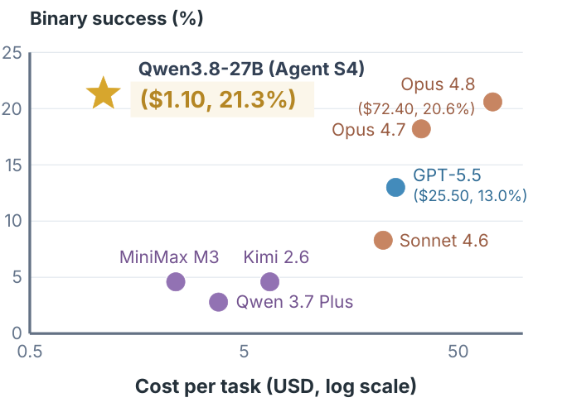
Better interfaces beat a better model
The evidence
Part 1 · Why the demo fails
Only the interfaces evolved: tools, observation formats, when-to-use notes
Qwen3.8-27B: 5.6% to 21.3%
Above Opus 4.8 (20.6%) and GPT-5.5 (13.0%), at about 1.5% and 4.3% of their cost per task
LangChain DeepAgents, harness only: 52.8% to 66.5% on Terminal Bench 2.0
OSWorld V2 binary success against cost per task (Agashe et al., 2026)
Changing only the interfaces around a fixed small model can overtake frontier models, at a fraction of the cost per task.
Source: notes/01-what-a-harness-is.md
6
Notes:
Agashe and colleagues held the model and loop fixed and let only the interfaces evolve. A 27 billion parameter model went from 5.6 to 21.3 percent, above Opus 4.8 at 20.6, and the cost axis tells the rest of the story. So when our refund agent fails, what should we say about it?
Source: notes/01-what-a-harness-is.md

Slide 7
Failures are configuration, not model limits
The reframe
Part 1 · Why the demo fails
Failure | Not this | But this
Ignored a convention | "The model is dumb" | The convention isn't in AGENTS.md
Ran rm -rf | "The model is unsafe" | There is no blocking hook
Lost the thread at step 40 | "Window too small" | No planner/executor split, no plan file
Shipped broken code | "It can't code" | No typecheck back-pressure in the loop
Rated its own work 9/10 | "It's sycophantic" | Generator and evaluator are the same agent
Every agent failure should be restated as a missing piece of harness, because that restatement is a build task.
Source: notes/01-what-a-harness-is.md
7
Notes:
The whole discipline fits in this table. Each right-hand cell is a thing you can go and build, and each middle cell is a thing you can only complain about. Refusing the middle column is the habit this pillar is trying to teach. So what must any harness contain, at minimum?
Source: notes/01-what-a-harness-is.md

Slide 8
Four parts every harness needs
The minimum
Part 1 · Why the demo fails
Acceptance baseline
Execution boundary
Feedback signals
Rollback
Where the agent runs and what it can touch.
How the agent learns its last action was wrong.
How a bad action gets undone. The most often missing part.
What done and correct means, checkably. The most often faked part.
A system missing any of acceptance, boundary, feedback or rollback is a prompt with tools attached, not a harness.
Source: notes/01-what-a-harness-is.md
8
Notes:
Four questions. What counts as done? What can it touch? How does it learn it was wrong? How do we undo it? For a refund, rollback is a real question, and it is the one teams most often have no answer to. The baseline is the one they fake, with a "looks good" in place of a binary check.
Source: notes/01-what-a-harness-is.md

Slide 9
Every failure tightens the ratchet
How a harness grows
Part 1 · Why the demo fails
Agent slips
a real failure
Find the subsystem
where it belonged
Encode the fix
hook, lint, gate
Never again
the harness tightens
every failure, permanently
Every line in a good AGENTS.md traces back to something that went wrong
Keep AGENTS.md under about 60 lines: a pilot's checklist, not a style guide
Lines that cannot name their originating failure are speculative, so delete them
A harness grows by encoding each real failure as a check, so the same failure cannot happen again.
Source: notes/01-what-a-harness-is.md
9
Notes:
You don't design a harness up front. You grow it. Each slip gets a home in one subsystem and a permanent check. That is why a good AGENTS.md reads like a list of past accidents. A line with no accident behind it is a guess. Which subsystems are there to choose from?
Source: notes/01-what-a-harness-is.md

Slide 10
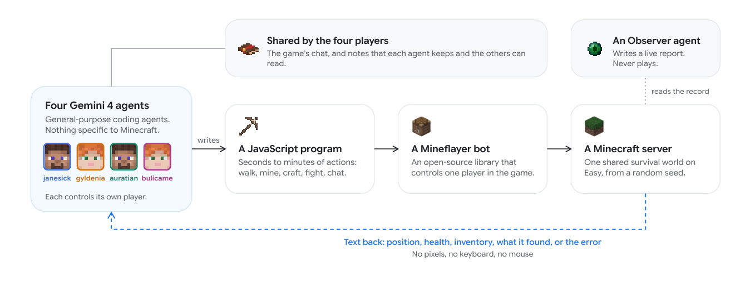
Five subsystems, seen in one small harness
The anatomy
Part 1 · Why the demo fails
Instructions: what should I do, by what rules?
Tools: what can I act with?
Environment: where do I run?
State: what has happened so far?
Feedback: did it work?
Four coding agents, one shared server, a fifth Observer that never plays (Faldor et al., 2026)
Agents are rarely stuck and often confidently wrong, which points at a gap in the feedback subsystem.
Source: notes/02-harness-anatomy.md
10
Notes:
DeepMind's Minecraft run is a compact example because the harness is small and fully described. You can point at each of the five questions in this figure. When something fails, ask which of the five owned it. Usually it is feedback, because agents are rarely stuck. They are confidently wrong.
Source: notes/02-harness-anatomy.md

Slide 11
Start from the minimum viable harness
Monday morning
Part 1 · Why the demo fails
1
Tool loop — with typed schemas
2
Sandbox — even just a working-directory boundary
3
Filesystem — the most foundational primitive
4
Plan file — for anything past about 5 steps
5
Verification gate — one binary pass/fail check
6
Structured traces — of every step
Build capability first, then the constraints that make it survive scale, and productize last.
Source: notes/02-harness-anatomy.md
11
Notes:
If you start something on Monday, build these six. Note the single verification gate: one binary check is worth more than any amount of prompt polish. Nothing else in this talk needs to exist on day one. Each of the next parts opens up one row here, beginning with the tools.
Source: notes/02-harness-anatomy.md

Slide 12
A deny rule on rm is not a boundary
Write tools for a reader with no documentation
Five sections make a tool description work
Four questions decide how a tool is gated
Discover tools instead of preloading them
A skill description is routing logic
Match the enforcement to the cost of being wrong
Climb the isolation ladder to match the risk
Hooks stay silent on success and loud on failure
Guard at each point where trust changes
PART 2
What it may touch
Tools written for an agent · Requests vs. rules · Test the gate
12
Notes:
Our refund agent can now move money. So we have to decide what it can do, how it learns to do it, and how to stop it when it shouldn't. Most of what passes for a boundary here turns out to be a polite request.

Slide 13
A deny rule on rm is not a boundary
The problem
Part 2 · What it may touch
A Bash(rm:*) deny rule held against rm -f. A file-writing tool overwrote the canary anyway.
The canary pattern: destroy a file with no rules, then test each route with rules on (notes/04)
A command rule covers one spelling of an effect, so enumerate effects and test each route instead of trusting the rule.
Source: notes/04-execution-boundaries.md
13
Notes:
Here is a boundary test run properly. The team plants a canary file and tries every way to delete it. The deny rule stops rm. Find with delete got past with no refusal recorded. A file-writing tool overwrote it outright. If this is what happens with a deny rule, we need to think about what the agent can do from the very beginning, starting with how it reads a tool.
Source: notes/04-execution-boundaries.md

Slide 14
Write tools for a reader with no documentation
Tool design
Part 2 · What it may touch
An API's reader
An ACI's reader
Has docs, type hints and autocomplete
Sees only a name, a description and a schema
Can ask a follow-up question
Learns boundaries by reading the codebase
Needs explicit boundaries between tools
Needs error-proof params: enums, absolute paths
Needs examples inside the definition
Implicit knowledge fills the gaps
What it cannot see does not exist
When a tool is misused, check the tool description before questioning the model.
Source: notes/03-tool-design.md
14
Notes:
An API has a reader who can look things up. An agent-computer interface has a reader who sees only a name, a description and a schema. So when `process_refund` gets called wrongly, read its description as if you knew nothing else. What should that description contain?
Source: notes/03-tool-design.md

Slide 15
Five sections make a tool description work
The contract
Part 2 · What it may touch
Section | Purpose
What it does | The operation, plainly
WHEN TO USE | Positive triggers the tool owns
WHEN NOT TO USE | Boundary cases that belong to a neighbouring tool
DO NOT USE FOR | Hard negatives: misuse seen in practice
EXAMPLES | Concrete invocations with realistic arguments
Adding one to five invocation examples moved tool-call accuracy from about 72% to 90% in Li's measurement.
Source: notes/03-tool-design.md
15
Notes:
Most descriptions stop at the first row. The highlighted rows are the boundary between neighbouring tools, and they grow from the ratchet: every real misuse becomes a hard negative. Examples are the cheapest upgrade, moving accuracy from about 72 to 90 percent. Then, before shipping any tool, four questions.
Source: notes/03-tool-design.md

Slide 16
Four questions decide how a tool is gated
Before it ships
Part 2 · What it may touch
Reversible?
Idempotent?
Observable?
Parallel-safe?
If not, put a confirmation gate in front of it.
If not, never retry it without an idempotency key.
If not, it cannot be debugged, so add a trace.
If not, serialize it in the orchestrator.
Gate only the irreversible, because gating reversible actions is the fastest way to make an agent useless.
Source: notes/03-tool-design.md
16
Notes:
Run process_refund through these. Reversible? Not easily, so it gets a gate. Idempotent? Not unless you make it so, and a retry on timeout could pay twice. Hence "query before mutate" in the note: check whether the first attempt landed. Now, how many tools should the agent see at once?
Source: notes/03-tool-design.md

Slide 17
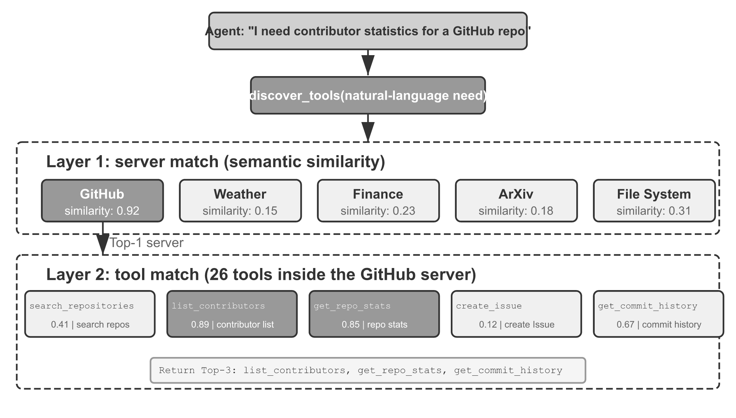
Discover tools instead of preloading them
The evidence
Part 2 · What it may touch
Five MCP servers: about 55K tokens, roughly 30% of a 200K window, before the first message
Match server first, then tool; append schemas at the end and leave them pinned
Dynamic discovery: Opus 4 49% to 74% on tool selection
MCP-Zero: ~98% fewer tokens across ~2,800 tools; Cursor's tool folder: 46.9% fewer
Two-level matching, server then tool (Li, AI Agents in Depth, 2026, Apache-2.0)
Eagerly loaded tool definitions can take a large share of the window, so discover them on demand and append new ones.
Source: notes/03-tool-design.md
17
Notes:
Definitions are not free. Li measures five typical MCP servers at about 55 thousand tokens, roughly thirty percent of a 200 thousand token window, before anyone has said anything. So match in two levels and append what you need at the end, so the cache survives. Skills are the same idea for procedures.
Source: notes/03-tool-design.md

Slide 18
A skill description is routing logic
Worked example
Part 2 · What it may touch
Reads like documentation
Decides when to fire
description: |
Handles the complete deployment
process to production: environment
checks, rollback, post-deploy
verification. Use before deploying.
description: Use when deploying
to production or rolling back.
Add when not to fire, and what instead
Only a skill's name and description stay resident, so the description's job is deciding when the skill fires.
Source: notes/03-tool-design.md
18
Notes:
Only the name and description sit in the window, and the body loads on demand. So the description is routing logic, and detail goes in the body where it costs nothing until used. So far we have helped the agent choose well. Now for what happens when it chooses badly.
Source: notes/03-tool-design.md

Slide 19
Match the enforcement to the cost of being wrong
Enforcement
Part 2 · What it may touch
A CLAUDE.md line is a request the model can ignore. A pre-tool-use hook is a rule it cannot.
Bucket | Enforcement | Example
Always do | Instruction in AGENTS.md | Run the formatter before committing
Ask first | Permission gate or HITL confirmation | Add a dependency, change a schema
Never do | Hook or permission deny, never a sentence | Write .env, force-push
An instruction is a request and a hook is a rule, so anything that must hold every time belongs in a hook or a permission.
Source: notes/04-execution-boundaries.md
19
Notes:
This table sorts your rules into three buckets. Anything in the never bucket has no business being a sentence, because a sentence is a request. For the refund agent, the ceiling is never-bucket and a large refund is ask-first. Under the rules sits the sandbox they run in.
Source: notes/04-execution-boundaries.md

Slide 20
Climb the isolation ladder to match the risk
The sandbox
Part 2 · What it may touch
stronger isolation ↓
venv — not on the ladder: isolates dependencies, not effects
×
OS-level — macOS Seatbelt, Linux seccomp or Landlock
1
Container — process, filesystem and network namespaces
2
microVM — Firecracker-class, for untrusted code and production agents
3
A virtualenv isolates dependencies and not effects, so real isolation starts at the OS level and pairs every rung with quotas.
Source: notes/04-execution-boundaries.md
20
Notes:
The first row is a common mistake: a virtualenv separates dependencies and does nothing about effects. Real isolation begins with the OS, then containers, then microVMs for untrusted code. Pair each rung with quotas on CPU, memory, disk, network and wall clock. And inside the sandbox, hooks do the talking.
Source: notes/04-execution-boundaries.md

Slide 21
Hooks stay silent on success and loud on failure
Feedback
Part 2 · What it may touch
Announces every pass
Speaks only on failure
Burns tokens on every edit
Full error, file and line
Trains the model to skim hook output
The agent learns within one step
The one real failure is lost in noise
Typecheck and lint become back-pressure
Low signal
High-signal channel
A hook that speaks only on failure teaches within one step, while one that announces every pass trains the model to skim.
Source: notes/04-execution-boundaries.md
21
Notes:
Hook output goes into the window. If every pass prints a line, the model learns to skim, and the one real failure is lost. Silent success and a verbose failure make the channel worth reading. That leaves the question of what guards the system as a whole.
Source: notes/04-execution-boundaries.md

Slide 22
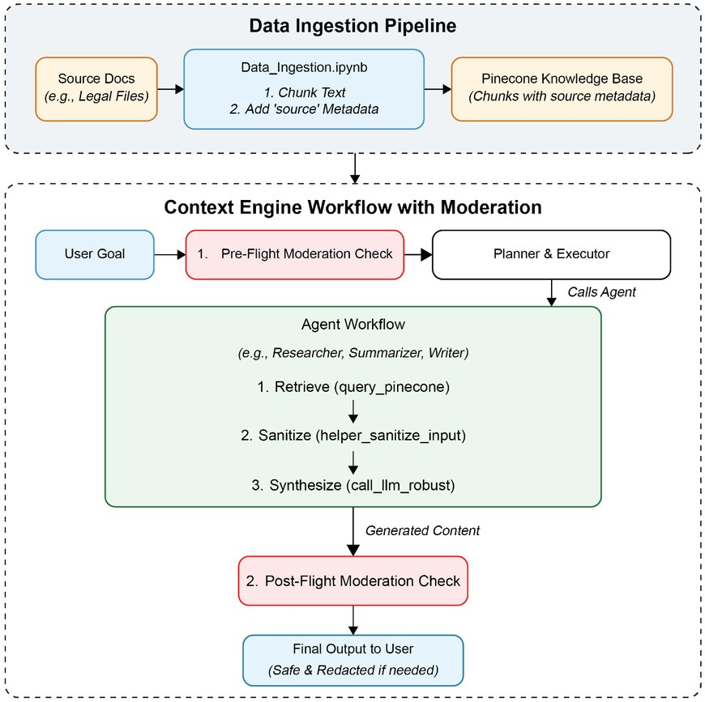
Guard at each point where trust changes
Guardrails
Part 2 · What it may touch
Five layers: pre-input, pre-retrieval, pre-generate, post-generate, escalation
Each guardrail lives in the component it protects
Tool inputs are model-written, so they are semi-trusted
Validate them against the schema like an external request
Two-stage moderation (Rothman, Context Engineering for Multi-Agent Systems, Fig. 8.2)
Treat model-written tool inputs as semi-trusted, and validate them against the schema as you would an external request.
Source: notes/04-execution-boundaries.md
22
Notes:
The figure shows the simplest version, a check before the plan and a check before the user. The notes expand this to five layers. The main point is on the last bullet. A tool input was written by a model that may have read something hostile, so it gets validated like any external request. We now know what the agent may touch. Next question: when has it finished?
Source: notes/04-execution-boundaries.md

Slide 23
PART 3
Agents grade their own work generously
Three layers of checks before anything is done
Separate the builder from the judge
An observer checks claims against the record
Write the sprint contract before the work
One feature at a time, passed only by evidence
Not every failure is worth retrying
Every recovery path needs a ceiling
How it knows it is done
Three layers of checks · A separate evaluator · One feature at a time · Ceilings
23
Notes:
Agents stop when they feel finished. That is the core failure of this part. We make done into something a machine checks, split the checker from the builder, and put a ceiling on every recovery path.

Slide 24
Agents grade their own work generously
The problem
Part 3 · How it knows it is done
Solo run: 20 minutes, $9, core gameplay broken. Full harness: 6 hours, $200, a working game.
Anthropic's generator and evaluator harness on one game brief (notes/05)
The harness question is rarely whether it is cheaper, since 20 times the cost can be the difference between broken and working.
Source: notes/05-verification-loops.md
24
Notes:
Same brief, two setups. On its own, the agent stops at twenty minutes and nine dollars with the core gameplay broken, and it thinks it is finished. The full harness takes six hours and two hundred dollars and produces a working game. About twenty times the cost, for the difference between broken and working. How do we build that checker?
Source: notes/05-verification-loops.md

Slide 25
Three layers of checks before anything is done
Termination
Part 3 · How it knows it is done
cheap
Static — syntax, types, lint, architecture rules. It is well-formed
1
Runtime — tests run, app reaches ready, side effects correct. It runs
2
System — end to end as a user drives it, real dependencies. It is correct
3
convincing
Do not run a later layer while an earlier one fails, and treat skipping a required layer as not done.
Source: notes/05-verification-loops.md
25
Notes:
Three layers, each proving something different. For the refund agent: it parses, then the refund tool runs against a test order, then an end-to-end run confirms the money moved in the database. Run them in order, and don't count something as done with a layer skipped. But who runs the third layer?
Source: notes/05-verification-loops.md

Slide 26
Separate the builder from the judge
The split
Part 3 · How it knows it is done
Planner
brief to full spec
Generator
builds per feature
Evaluator
drives the running app
revise until every criterion clears its bar
Browser DAW: $124.70 total, QA rounds $10, and QA caught presentational-only features
Same model checking itself gives confident agreement, so use a separate evaluator
The evaluator needs calibrating too, with hard thresholds per dimension
A generator judging itself agrees with itself, so a separate evaluator that drives the running app does the checking.
Source: notes/05-verification-loops.md
26
Notes:
A generator rates its own work well. So the evaluator is separate, and it drives the running app instead of reading the code. Look at the money in the second run: 114 dollars of building and ten of QA, and those ten dollars found features that were only presentational. Cheap checks can decide a lot.
Source: notes/05-verification-loops.md

Slide 27
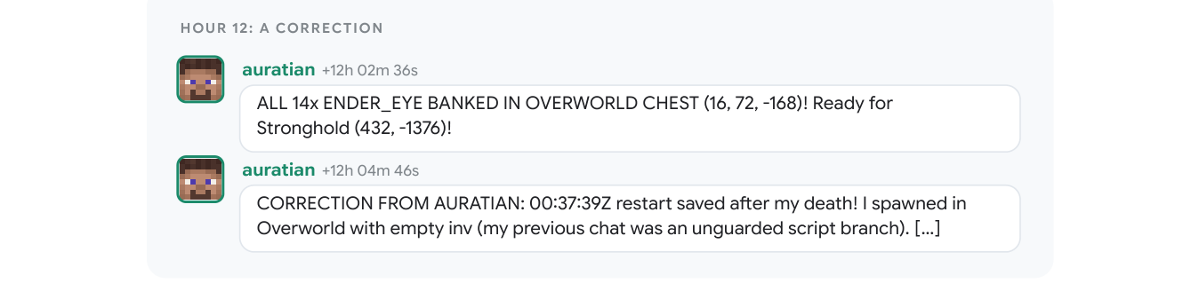
An observer checks claims against the record
The evidence
Part 3 · How it knows it is done
An agent announced 14 Ender Eyes banked, then retracted
The message came from an unguarded script branch
Agent prose is a claim, so check it against what actually happened
A claim of 14 banked Ender Eyes, retracted when the script branch was found (Faldor et al., 2026)
An agent's report is only a claim, so verification compares it against the recorded state of the world.
Source: notes/05-verification-loops.md
27
Notes:
Here is a small, vivid case. An agent announces fourteen Ender Eyes banked, and then retracts. The message came from a script branch with no guard. Reports are claims. That is why our refund harness reads the database row and not the sentence that says the refund succeeded.
Source: notes/05-verification-loops.md

Slide 28
Write the sprint contract before the work
Worked example
Part 3 · How it knows it is done
MARKDOWN
Both sides negotiate it in writing, before code
## Scope
theme toggle, global CSS variables,
dark-mode test
## Verification
visual regression per component,
main-flow e2e pass
## Exclusions
print styles,
third-party component theming
The evaluator cannot invent criteria afterwards
The generator cannot redefine done
Exclusions is the section people skip
Agreeing scope, verification and exclusions before work starts stops both the builder and the judge from moving the goalposts.
Source: notes/05-verification-loops.md
28
Notes:
Grading criteria beat vibes. The contract gets written before the work, so neither side can move the goalposts. Exclusions matter most, because without them the evaluator fails work for things nobody asked for. And score each dimension separately, because one score out of ten gives nothing to act on.
Source: notes/05-verification-loops.md

Slide 29
One feature at a time, passed only by evidence
Scope
Part 3 · How it knows it is done
not_started
active
WIP = 1
passing
via its verification run
blocked hangs off active, and a script flips the state
The agent requests verification and never edits the field
Verified completion rate = verified ÷ activated, which sits at 1.0 between features under WIP = 1
With one active feature and a script that flips the state, an agent cannot overreach or mark its own work as passing.
Source: notes/10-scope-and-done.md
29
Notes:
Agents have two scope failures: they do too much at once and they stop too soon. A feature list fixes both, if it is a real primitive. One active item at a time. Each has a behaviour, a verification and a state. And the agent doesn't own the state field: it asks for verification, and a script flips it.
Source: notes/10-scope-and-done.md

Slide 30
Not every failure is worth retrying
Recovery
Part 3 · How it knows it is done
Failure | Response
Transient (network, rate limit) | Backoff 2×, jitter ±20%, max 3
Tool error | Retry once, then escalate
Model refusal | Never retry: it will refuse again
Schema violation | Retry once with the validation error in context
Context exhaustion | Compact or reset, then resume
Fatal | Stop and surface the error
Classify a failure before retrying, because a model refusal repeats itself while a transient error deserves backoff.
Source: notes/05-verification-loops.md
30
Notes:
Blanket retries waste money and can be dangerous. Sort by failure class. Back off on a transient error, feed the validator's message back on a schema violation, never retry a refusal. And remember the refund: retrying a timeout without checking whether the first attempt landed can pay twice.
Source: notes/05-verification-loops.md

Slide 31
Every recovery path needs a ceiling
Monday morning
Part 3 · How it knows it is done
Two-retry rule
Loop detection
Feed the error back
Set ceilings from data
A third failure on the same gate means the context or the spec is wrong, not the execution.
Count edits per file. After N, force a re-plan rather than another repair.
Give the agent the error, the query and the context. PRINCE caps it at 3 attempts.
Before Claude Code's breaker (trips at 3), one session failed 3,000+ times; futile retries cost ~250K API calls a day.
Each recovery path needs a ceiling set from data, since an unbounded retry loop fails silently and expensively.
Source: notes/05-verification-loops.md
31
Notes:
The last thing to add this week. Two retries, then conclude the spec is wrong. Count edits per file to spot thrashing. And set ceilings from data. Claude Code's compaction breaker trips after three consecutive failures, and before it existed one session failed over three thousand times.
Source: notes/05-verification-loops.md

Slide 32
PART 4
Every context window ends in amnesia
Compaction keeps a trace, a reset keeps what you wrote
A handoff separates verified from assumed
A Ralph loop makes stopping early harmless
State outside the window survived 605 deaths
Five questions a fresh session must answer alone
AGENTS.md is a router, not a manual
How it survives hours
State in files · Resets and handoffs · A repo the next session can read
32
Notes:
So far one session. But real work outlasts a window, so the agent has to be able to stop and start. The problem here is amnesia, and the solution is to treat the repo as memory.

Slide 33
Every context window ends in amnesia
The problem
Part 4 · How it survives hours
Progress lives in files, not in the context window.
Once state is external, any fresh context can pick up where the last one stopped
Externalizing state turns context windows into something disposable, so any fresh session can continue the work.
Source: notes/06-long-horizon-execution.md
33
Notes:
A long task outlasts any window. Whatever is only in the window is lost at the end. Write it to files and the window stops mattering, because any new session can read where things stand. Everything else in this part follows from that sentence.
Source: notes/06-long-horizon-execution.md

Slide 34
Compaction keeps a trace, a reset keeps what you wrote
The choice
Part 4 · How it survives hours
Compaction
Context reset
Summarizes earlier turns in place
Clears the window and hands off via files
Preserves a lossy trace of everything
Fails by summary-of-summary drift
Preserves only what the handoff captures
Fails when something was not written down
One long session
Multi-day work
Resets beat compaction on Sonnet 4.5 and later models need them less, so re-test the choice on each model upgrade.
Source: notes/06-long-horizon-execution.md
34
Notes:
Two ways to survive the end of a window. Compaction drifts as summaries of summaries pile up. A reset loses anything not written down, which forces discipline. The answer depended on the model, and it keeps changing, so this is a thing to re-test at each upgrade. Either way, the handoff is what counts.
Source: notes/06-long-horizon-execution.md

Slide 35
A handoff separates verified from assumed
Worked example
Part 4 · How it survives hours
MARKDOWN
Start writing it at about 60% of the window, while there is room
## Verified Now
what works, what verification actually ran
## Changed This Session
code or behaviour added, harness changes
## Broken Or Unverified
known defect, unverified path, risk
## Next Best Step
feature, why next, what counts as passing
## Commands
startup, verification, focused debug
A generated summary blurs verified and assumed; this format does not
Exit only on a clean state: build, tests, logs
A handoff keeps verified work apart from assumptions, which a generated summary blurs together.
Source: notes/06-long-horizon-execution.md
35
Notes:
This is the document a session leaves for its successor. The important split is verified against assumed. A generated summary blurs them, and then the next session trusts something that never ran. Write it at about 60 percent of the window, and exit only with a clean build.
Source: notes/06-long-horizon-execution.md

Slide 36
A Ralph loop makes stopping early harmless
Keep going
Part 4 · How it survives hours
Agent works
state goes to files
Tries to finish
maybe early
Hook intercepts
re-injects the prompt
Fresh context
reads the files
until the verification gate says done
Premature wrap-up becomes harmless, because done opens a new window instead of ending the work.
A hook that re-injects the prompt on exit lets a fresh context carry on, until a verification gate says the work is done.
Source: notes/06-long-horizon-execution.md
36
Notes:
Models near the end of a window tend to wrap up early, sometimes called context anxiety. A Ralph loop makes that harmless. A hook intercepts the exit and re-injects the original prompt, a fresh context reads the files, and work continues until the gate passes. How long can this go?
Source: notes/06-long-horizon-execution.md

Slide 37
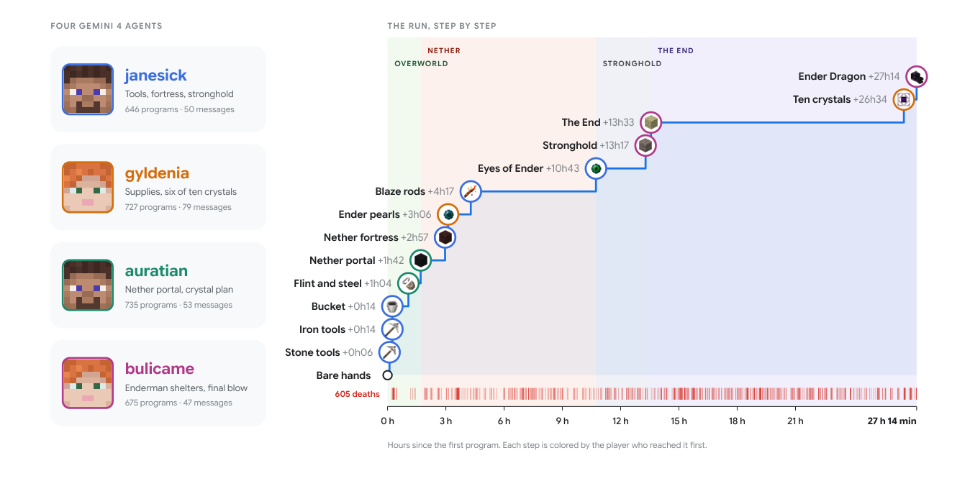
State outside the window survived 605 deaths
The evidence
Part 4 · How it survives hours
Four Gemini agents beat the Ender Dragon with no human help
27 h 14 min, 605 deaths, 6 restarts
Shared notes and chat sat outside any context window
Four agents, 27 h 14 min, 605 deaths along the bottom (Faldor et al., 2026)
A 27-hour unattended run worked because what the team knew lived outside any single agent's context window.
Source: notes/06-long-horizon-execution.md
37
Notes:
This is a rare public record of a long unattended run. Four agents, twenty-seven hours, 605 deaths along the bottom of the timeline, and six restarts. What the team knew survived because it lived in shared notes and chat. The repo plays the same role for coding agents.
Source: notes/06-long-horizon-execution.md

Slide 38
Five questions a fresh session must answer alone
The test
Part 4 · How it survives hours
Open a new session with no chat history and ask.
Question | Answered by
What is this system? | AGENTS.md, README
How is it organized? | ARCHITECTURE.md, module docs
How do I run it? | init.sh, Makefile, package scripts
How do I verify it? | Test, lint and check commands
Where are we now? | Progress log, feature list, git history
Every question a fresh session cannot answer gets guessed, and every new session guesses again.
Source: notes/09-repo-as-system-of-record.md
38
Notes:
Here is a simple audit you can run today. Open a clean session and ask these five questions. Whatever the repo can't answer gets guessed, and it gets guessed again on every session. That is what makes the repo the system of record. The entry point deserves particular care.
Source: notes/09-repo-as-system-of-record.md

Slide 39
AGENTS.md is a router, not a manual
The entry file
Part 4 · How it survives hours
MARKDOWN
Root file: start near 60 lines, topic docs 50–150
## Overview
Python 3.11 FastAPI backend, PostgreSQL 15.
## Quick start
Install: make setup. Test: make test
## Hard constraints
- All DB queries use parameterized SQLAlchemy
- All PRs pass pytest + mypy --strict + ruff
## Topic docs
- docs/api-patterns.md: when adding endpoints
- docs/database-rules.md: when touching DB code
Red lines at the top or bottom, never the middle
Each rule records its source, scope and expiry
The entry file should route to topic docs and keep hard constraints at its edges, so dead rules can be audited and deleted.
Source: notes/09-repo-as-system-of-record.md
39
Notes:
Treat this as an index. A short overview, the commands, the hard constraints at the top where they won't get lost in the middle, and one line per topic doc saying when to read it. Audit rules like dependencies and delete the dead ones. We have one agent working for hours. When do we need several?
Source: notes/09-repo-as-system-of-record.md

Slide 40
PART 5
Added agents multiply cost and new failures
A subagent is a context firewall first
Define interfaces for handoffs, not vibes
Multi-agent failures are harness bugs
A plan-execute engine, end to end
Put the human gate on the plan
Most teams claiming stage 3 are at stage 1
On every model upgrade, try removing scaffolding
More agents, and when to stop
Subagents as firewalls · Protocols first · Maturity · Removing what you built
40
Notes:
Multi-agent is the expensive option. This final part says when it pays, what breaks, how to tell where you stand, and why the last skill in harness engineering is removing things.

Slide 41
Added agents multiply cost and new failures
The problem
Part 5 · More agents, and when to stop
A single agent with verification is the correct default. Added agents multiply tokens and bring new ways to fail.
Single agent with verification, then a two-agent supervisor, then a shared harness layer (notes/07)
Escalate to multi-agent only when context does not fit, roles need different trust, self-evaluation blocks you, or branches are independent.
Source: notes/07-orchestration.md
41
Notes:
Everyone wants a team of agents. The default is one agent with good verification. There are four legitimate reasons to go further: context doesn't fit, roles need different tools or trust, you need an outside evaluator, or the branches really are independent. Without one of those, you add cost and failure modes and solve nothing.
Source: notes/07-orchestration.md

Slide 42
A subagent is a context firewall first
The firewall
Part 5 · More agents, and when to stop
A search that reads 40 files and finds 3 returns the 3, in a 1,000–2,000-token summary
The sizing rule
Orchestrator holds the plan; subagents hold the details
Give each subagent the minimum context, authority and execution budget needed to finish one clearly defined task.
Deep Agents' task tool: fresh instance, runs to completion, one final report
Isolation is the most expensive context lever, so use it at a real boundary
The best reason for a subagent is to absorb exploration, returning a condensed result and not the exploration itself.
Source: notes/07-orchestration.md
42
Notes:
The strongest reason is the firewall. Forty files of reading come back as the three that matter, and the orchestrator's window stays clean. Then size each subagent down: minimum context, minimum authority, minimum budget. What must exist before any of them can collaborate?
Source: notes/07-orchestration.md

Slide 43
Define interfaces for handoffs, not vibes
Worked example
Part 5 · More agents, and when to stop
TEXT
Summaries, never transcripts
[FROM_MAIN_AGENT] role and task
[FROM_USER] the original request
[TOOL_RESULT] data, not instructions
boundaries: what you may not touch
output schema (JSON):
findings, files_touched, confidence,
open_questions, not_done
State on disk, references in the message
Declare what was not done
Handoffs break more often than the models do
A handoff needs a typed schema that labels each source and declares what was not done, because handoffs break more often than models.
Source: notes/07-orchestration.md
43
Notes:
What crosses a boundary is the whole design. Li's convention tags every input by source, so a subagent can tell instructions from data. The return is a typed schema including what was not done. In Rothman's engine, two agents were upgraded to return dicts and the writer still expected strings, so the pipeline broke at its last step.
Source: notes/07-orchestration.md

Slide 44
Multi-agent failures are harness bugs
What breaks
Part 5 · More agents, and when to stop
Failure | Shape | Mitigation
Loop oscillation | Two nodes bounce work forever | Counters on cyclic edges; escalate
Context pollution | Nested flows leak state upward | Boundary schemas; return summaries
Concurrency collision | Branches write the same state | Join barriers; key ownership
Consensus deadlock | Reviewers never agree | Tie-break, majority or an arbiter
When components pass and the end-to-end run fails, suspect a handoff bug, and evaluate at both levels.
Source: notes/07-orchestration.md
44
Notes:
Four failures to know by name. None of them is about the model. Each is a missing counter, a missing schema, a missing barrier or a missing arbiter. And if every component passes while the whole run fails, look at the handoffs.
Source: notes/07-orchestration.md

Slide 45
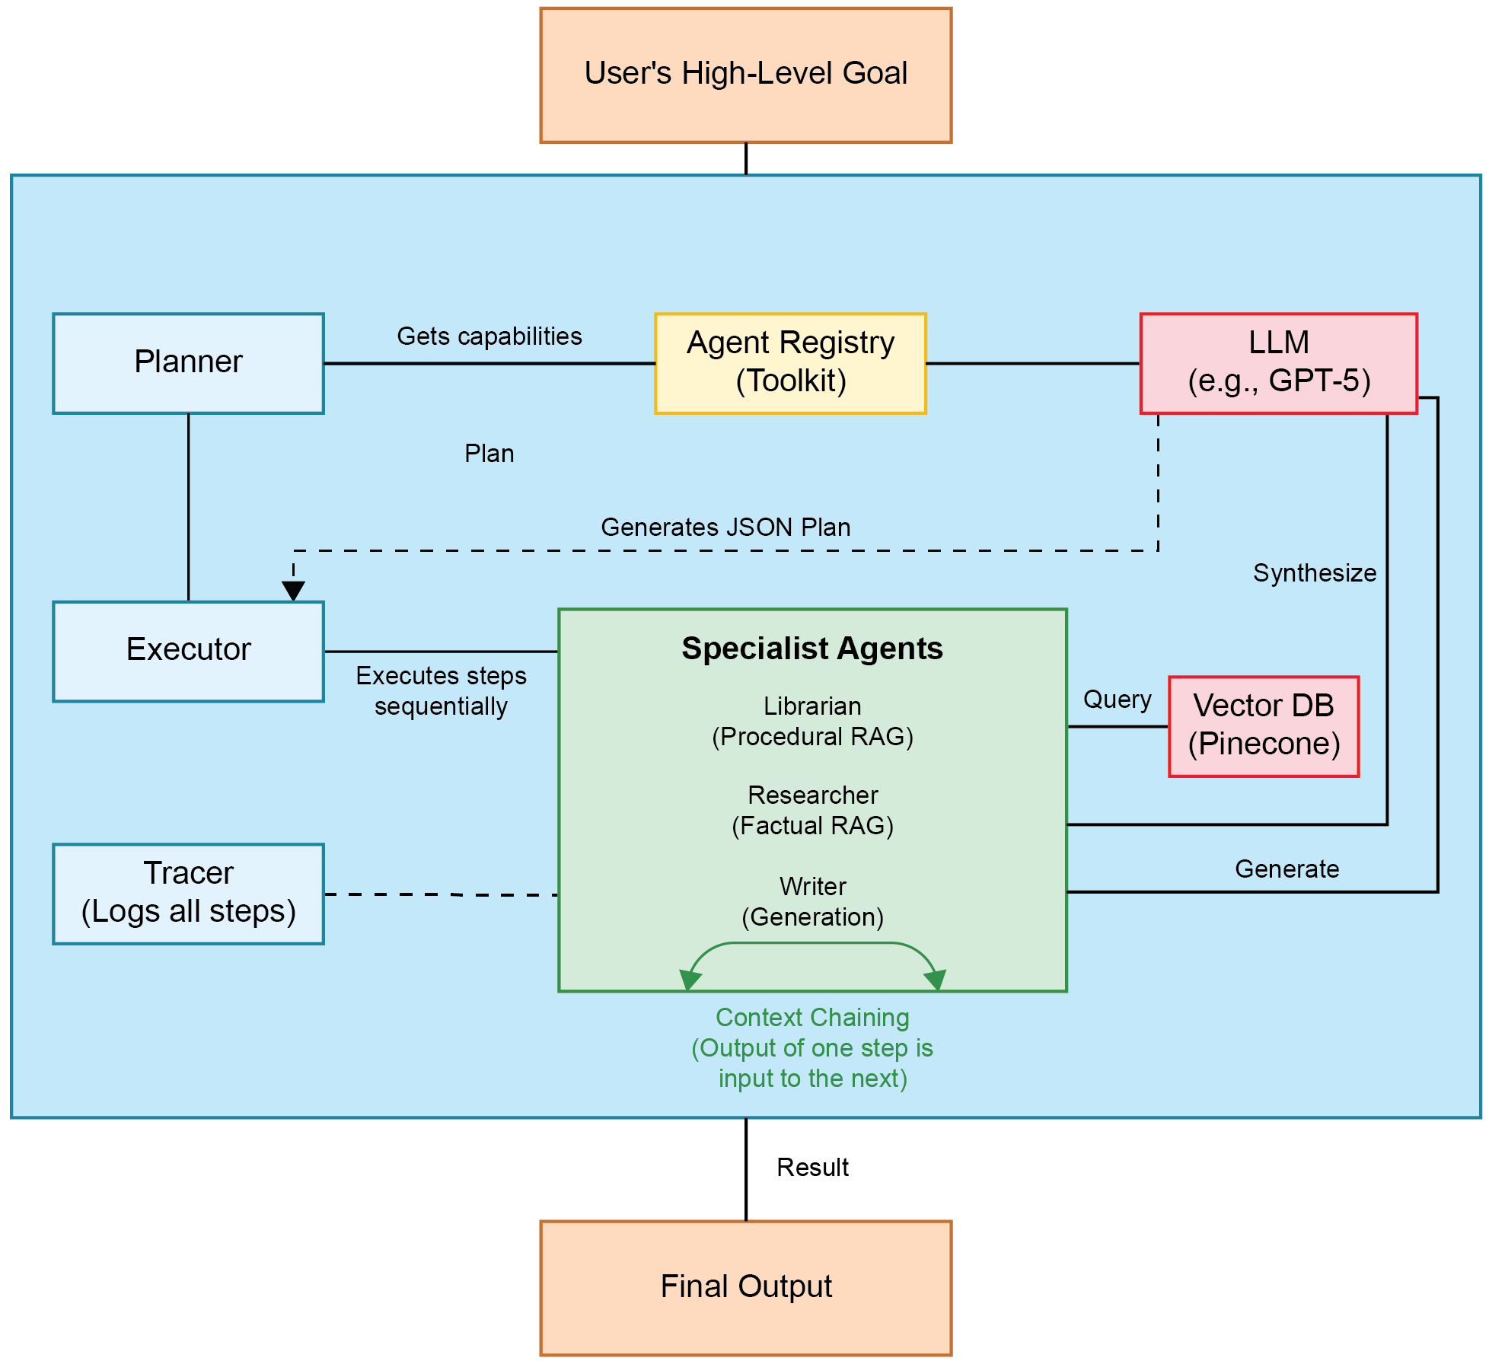
A plan-execute engine, end to end
The engine
Part 5 · More agents, and when to stop
A Planner reads the Agent Registry and has the LLM produce a JSON plan
The Executor runs Librarian, Researcher and Writer steps in order
Each output chains into the next step, and a trace records it
Rothman, Context Engineering for Multi-Agent Systems, Fig. 4.1
A plan-execute engine turns a goal into a JSON plan of registered agents, then runs and traces each step in order.
Source: notes/07-orchestration.md
45
Notes:
This is the shape most production multi-agent systems reduce to. A plan comes out as data, an executor runs it, and a trace records it. Because the plan is data, a human can check it before anything runs, which brings us to the most valuable gate you can add.
Source: notes/07-orchestration.md

Slide 46
Put the human gate on the plan
The pipeline
Part 5 · More agents, and when to stop
1
Preflight — gather context and establish current state
2
Plan — decompose into steps
★
Approve — a mandatory human gate on the plan
4
Tasks — execute, documenting as you go
5
Verify — a binary pass/fail quality gate
6
Finish — export artifacts, log the outcome
Reviewing a wrong plan takes minutes while reviewing the code from a wrong plan takes an hour, so the human gate goes on the plan.
Source: notes/08-maturity-and-failure-modes.md
46
Notes:
Six stages, with the human at stage three. A missing Approve gate is on the list of the five failure modes, because plan errors spread into a lot of fully executed work. Now, where do you stand overall?
Source: notes/08-maturity-and-failure-modes.md

Slide 47
Most teams claiming stage 3 are at stage 1
Where you stand
Part 5 · More agents, and when to stop
Stage | Name | What exists
0 | Ad-hoc | Scripts, manual tool calls, no registry or structured logs
1 | Basic | Schema-first tools, a registry, unit-test verification
2 | Verified | CI checks, sandboxing, tracing, behavioural evals
3 | Observability-first | E2E tracing, LLM-judge scoring, versioned memory
4 | Self-healing | Auto-remediation, cost-aware orchestration (emerging)
The honest maturity test is whether you can point to the code that runs verification on every task without a human remembering.
Source: notes/08-maturity-and-failure-modes.md
47
Notes:
Stage one makes it work, two makes it trustworthy, three makes it improvable. The failure that hides the others is claiming a stage you are not at. "We have evals" often means a notebook run by hand. So ask: can I point to the code that runs it on every task, with no human remembering to?
Source: notes/08-maturity-and-failure-modes.md

Slide 48
On every model upgrade, try removing scaffolding
Monday morning
Part 5 · More agents, and when to stop
Every component encodes an assumption about what the model cannot do on its own.
List components
and the weakness of each
Disable one
run the eval suite
Decide
holds: delete. Drops: keep
on every model upgrade
Opus 4.6 let Anthropic remove sprint decomposition with no quality loss
PRINCE deleted a verifier that never paid off, with no upgrade needed
Scaffolding for a model weakness expires; scaffolding for an external constraint does not
Harness components encode assumptions about model weakness, so disable each in turn on every upgrade and delete what no longer pays.
Source: notes/08-maturity-and-failure-modes.md
48
Notes:
The final habit is subtraction. Every piece we added today assumed the model couldn't do something. Models improve. So on each upgrade, disable a component and run the evals. The refund ceiling stays, because it is an external constraint. The sprint decomposition may well go.
Source: notes/08-maturity-and-failure-modes.md

Slide 49
Rules of thumb
Closing
Wrap-up
Diagnose
Tools
Boundaries
Failures are configuration. Fix the harness before blaming the model, and ratchet every fix in.
Write descriptions for a reader with no docs. Gate only the irreversible.
Must hold every time means hook, permission or schema. Test the gate; enumerate effects.
Verification
Long horizons
Maturity
Binary evals first. A separate evaluator. Two retries, then fix the spec.
State in files. Handoffs separate verified from assumed. Clean state is part of done.
Approve the plan. Fewest agents the task allows. Strip scaffolding on each upgrade.
When an agent fails, change the system around it, and then make sure that failure cannot happen again.
Source: notes/08-maturity-and-failure-modes.md
49
Notes:
Six cards, one per decision you now own. The first is the attitude behind the other five: an agent's failure is a build task. Our refund agent ended up with a framework ceiling, a database check, a separate evaluator and a handoff file. The model did not change once.
Source: notes/08-maturity-and-failure-modes.md

Slide 50
Where to go next
Next
Wrap-up
04 Loop engineering: the loops the harness runs, and how they improve themselves
The one idea to keep
06 Eval: graders, calibration and pass^k, which every rule here depends on
The model holds the intelligence, and the harness makes it useful.
Practice: practice/tool-server-sandbox in this pillar
Read: Anthropic on long-running harnesses; OpenAI on harness engineering; Li, AI Agents in Depth
The next pillar takes the harness and asks what makes the loops it runs improve over time.
Source: notes/08-maturity-and-failure-modes.md
50
Notes:
The next pillar takes this harness and asks about the loop itself: when to stop, and how it improves. Before then, run the tool server sandbox in the practice folder, and try the canary pattern on your own permissions. See what actually holds.
Source: notes/08-maturity-and-failure-modes.md

