Slide 1
Applied Analyses
Part 1: Forecasting
The decision · Backtesting · Which model · From forecast to plan
Part 2: Credit scoring
The sample problem · Weight of evidence · The cutoff · Basel
Part 3: Cohort and retention
The triangle · Rate and mix · Survival · Budget
Part 4: Funnel and conversion
A flat headline · Conditional steps · The control · The price
Ten business questions, each taken through to a recommendation
Part 5: Segmentation and RFM
The plan · Validation · Silence · Persuadable
Part 6: SQL for analytics
The bridge · Reconcile · The patterns · Fan-out
Part 7: Survival and event history
Censoring · One hazard ratio · When it wears off · Months and pounds
Part 8: States and sequences
Forecast · Score · Retain · Convert · Segment · Query · Survive · Sequence · Attribute · Operate
The pooled chain · Hidden types · Holdout · Clusters or mixtures
Part 9: Marketing measurement
Attribution · Incrementality · Mix models · A geo test · Moving budget · Customer value
Part 10: Operations and supply chain
Newsvendor · Safety stock · Queues · The price of a packer
Notes: data-analytics/06-applied-analyses
Notes:
Each part is one complete analysis: a business question, a dataset, a check against something known, and a recommendation with its limits. The methods differ from part to part, and the shape stays the same.

Slide 2
PART 1
Forecasting
She does not want a forecast
One split is one anecdote
The backtest loop
Beat seasonal naive before anything else
A buffer turns a forecast into a plan
The decision · Backtesting · Which model · From forecast to plan
2
Notes:
Fernhill's operations manager has to book temporary warehouse staff for the fourth quarter.

Slide 3
She does not want a forecast
The problem
Part 1 · Forecasting
How many people should the warehouse book for Q4, when too few costs £12 a unit and too many costs £4?
Fernhill operations, last Monday of September. Costs are assumptions.
A forecast matters only through the decision it sets, so start from the decision and its costs.
Source: notes/01-forecasting.md
3
Notes:
A late parcel costs three times an idle unit, so the right plan isn't the central estimate. Keep that in mind while we choose the model.
Source: notes/01-forecasting.md

Slide 4
One split is one anecdote
Rolling-origin backtest
Part 1 · Forecasting
Train
all weeks to the origin
Forecast
next 13 weeks
Score
MASE, coverage
Move
origin 13 weeks on
refit on the longer past
Eleven origins for selection, so every model faces many different seasons.
The twelfth is an exam quarter, kept out of model selection.
Score a forecast over many origins, and keep one final period out of selection altogether.
Source: notes/01-forecasting.md
4
Notes:
Selecting the best of seven models on the same backtest makes its score optimistic, which is why the last quarter stays out until the choice has been made.
Source: notes/01-forecasting.md

Slide 5
The backtest loop
Worked example
Part 1 · Forecasting
PYTHON
Refit at every origin.
origins = [len(units) - H * i
for i in range(12, 0, -1)]
for n_train in origins:
train = units.iloc[:n_train]
test = units.iloc[n_train:n_train + H]
# MASE scale from this origin's past only
scale = train.diff(SEASON).abs().mean()
for name, method in METHODS.items():
out = method(train)
The scale uses only past data, so no leakage.
Each origin refits on its own past and scales errors by its own past, so nothing leaks from the test weeks.
Source: notes/01-forecasting.md
5
Notes:
MASE divides the error by the in-sample error of the seasonal naive. Below 1 means better than that benchmark.
Source: notes/01-forecasting.md

Slide 6
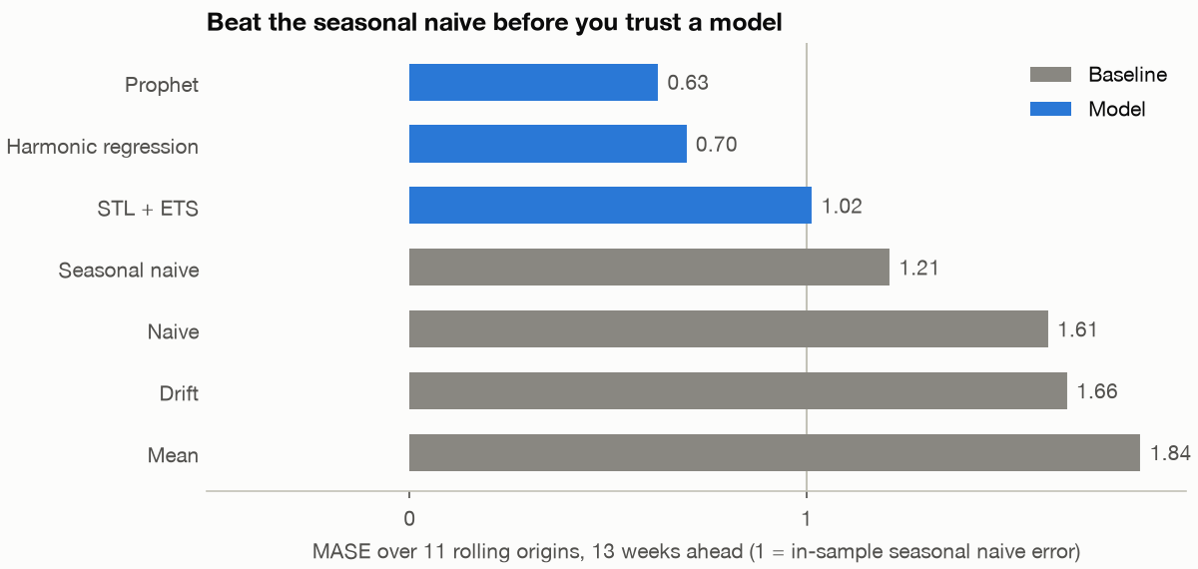
Beat seasonal naive before anything else
Model selection
Part 1 · Forecasting
Prophet 0.63 and harmonic regression 0.70 clear seasonal naive at 1.21.
Interval coverage differs: harmonic 93%, Prophet 75%, STL + ETS 48%, nominal 80%.
Eleven origins of 13 weeks on Fernhill's weekly units. Lower is better.
Prophet scored best, but its intervals covered 75% against a nominal 80%, so the plan's buffer comes from backtest errors.
Source: notes/01-forecasting.md
6
Notes:
A narrow interval from a good point forecast is still miscalibrated. Empirical errors from the backtest are a safer basis for the buffer.
Source: notes/01-forecasting.md

Slide 7
A buffer turns a forecast into a plan
The exam quarter
Part 1 · Forecasting
Plan | MASE | Mismatch cost
Last year's numbers (seasonal naive) | 1.24 | £38,876
Prophet forecast | 0.64 | £13,272
Prophet × 1.047 | n/a | £11,788
Staff to the forecast × 1.047, the cost-set 75th percentile, and keep seasonal naive as a tripwire. About £27,000 saved on one quarter.
Source: notes/01-forecasting.md
7
Notes:
Critical fractile: 12 / (12 + 4) = 0.75, and 1.047 is the 75th percentile of backtest errors. Refresh the plan weekly. The £27,000 is against last year's numbers, on assumed costs. Say what this doesn't cover: one exam quarter, assumed costs, and a demand series censored in the week of the outage.
Source: notes/01-forecasting.md

Slide 8
PART 2
Credit scoring
The sample is not the population
Weight of evidence, and the prior
The uncorrected model turns away 42% of applicants
Measuring a scorecard
The sample problem · Weight of evidence · The cutoff · Basel
8
Notes:
We step outside Fernhill to a real dataset: 1,000 German consumer loans from the 1970s.

Slide 9
The sample is not the population
The problem
Part 2 · Credit scoring
The file says 30% of loans go bad. The bank's book runs at about 5%. Which applications do we approve?
South German Credit, 1973 to 1975, as corrected by Grömping (2019)
A stratified sample ranks applicants correctly but gets every probability wrong until you correct for the prior.
Source: notes/02-credit-scoring.md
9
Notes:
Bad loans were oversampled, so the file's rate isn't the book's. Ranking survives this, and probabilities don't.
Source: notes/02-credit-scoring.md

Slide 10
Weight of evidence, and the prior
Worked example
Part 2 · Credit scoring
PYTHON
WoE makes each class linear in the log odds.
# per coarse class, on training data only
woe = np.log(table.pct_good / table.pct_bad)
iv = ((table.pct_good - table.pct_bad)
* woe).sum()
# move the log odds to the true bad rate
shift = (np.log(true_bad / (1 - true_bad))
- np.log(sample_bad / (1 - sample_bad)))
logit = np.log(p / (1 - p)) + shift
The shift is −2.10; Gini does not change.
WoE gives a linear, explainable model, and a constant log-odds shift corrects its probabilities without changing its ranking.
Source: notes/02-credit-scoring.md
10
Notes:
Adding a constant to the log odds preserves order. Mean PD falls from about 27% to about 5%, and test Gini stays at 0.48 with a bootstrap interval of 0.355 to 0.600.
Source: notes/02-credit-scoring.md

Slide 11
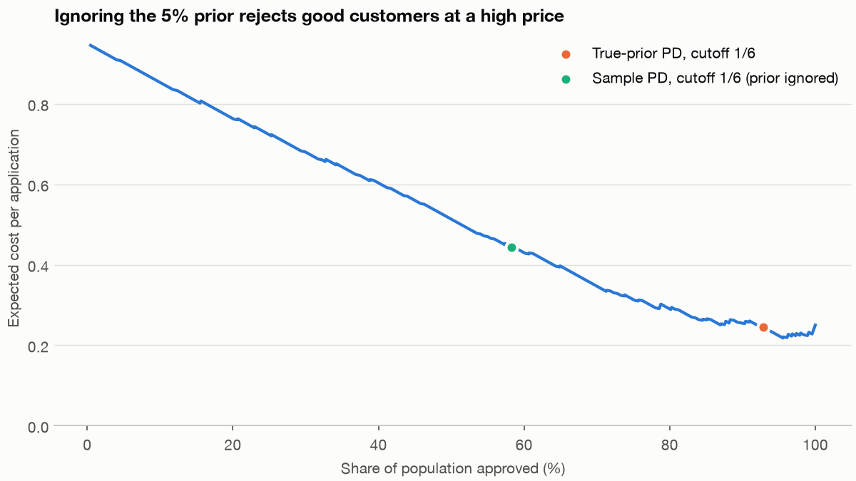
The uncorrected model turns away 42% of applicants
Setting the cutoff
Part 2 · Credit scoring
Sample PDs: approve 58%, cost 0.444. Corrected: approve 93%, cost 0.245.
Approve-all costs 0.250, so the model barely wins at 5:1.
Cost per application at a 5:1 cost ratio, by cutoff. South German Credit.
The prior correction nearly halved the expected cost, while the scorecard itself barely beat approving everyone at this cost ratio.
Source: notes/02-credit-scoring.md
11
Notes:
At 10:1 the gap is wider, 0.403 against 0.500. So the first conversation is about the true cost of a bad loan. Recommendation: approve above score 548 and treat that as provisional.
Source: notes/02-credit-scoring.md

Slide 12
Measuring a scorecard
Discrimination and drift
Part 2 · Credit scoring
Gini
KS
PSI
Ranking quality. Train 0.68, test 0.48, so report the test figure and its interval.
Largest gap between the score distributions of goods and bads. Test 0.41.
Has the population moved? Under 0.10 little shift, over 0.25 act. Rule of thumb only.
Gini and KS measure how well a score ranks, and PSI warns when the population has moved away from it.
Source: notes/02-credit-scoring.md
12
Notes:
PSI watches the inputs, or the score distribution. It can't see a change in the relation between score and default, which needs outcomes, and those arrive late. One Basel note before we move on: PD, LGD and EAD price expected loss, and the IRB formula turns them into capital for unexpected loss. With an assumed LGD of 60%, K is 8.06% at a PD of 10% and 3.45% at a PD of 0.5%, so capital rises more slowly than PD.
Source: notes/02-credit-scoring.md

Slide 13
PART 3
Cohort and retention
Did we lose customers, or buy worse ones?
Split the fall into rate and mix
A model with a mechanism
What each customer returns
The triangle · Rate and mix · Survival · Budget
13
Notes:
Back at Fernhill. The email budget was cut in January 2025 and paid social scaled to 2.6 times. Repeat buying fell.

Slide 14
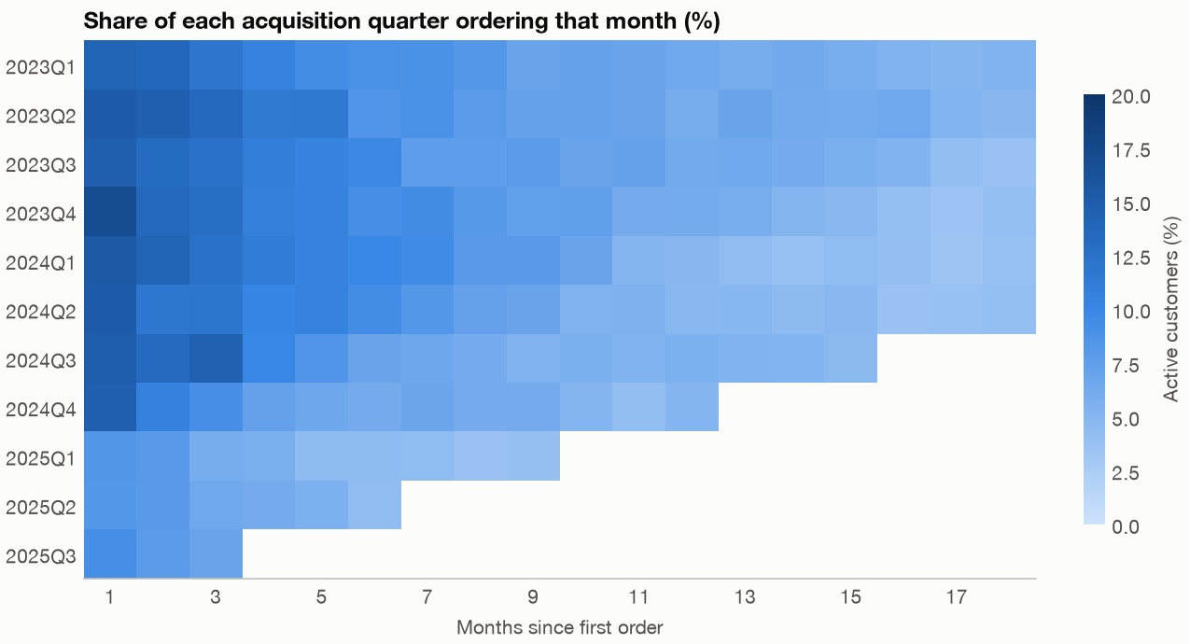
Did we lose customers, or buy worse ones?
The problem
Part 3 · Cohort and retention
Rows age a cohort, columns compare cohorts, diagonals are calendar time.
A band along a diagonal means something happened to everyone at once.
Share of each acquisition quarter ordering in each month of age.
A retention triangle shows age, cohort and calendar effects in one picture, which a single retention figure cannot.
Source: notes/03-cohort-and-retention.md
14
Notes:
Age equals period minus cohort, so they are perfectly collinear. You need an outside fact, such as knowing the date of the email cut.
Source: notes/03-cohort-and-retention.md

Slide 15
Split the fall into rate and mix
Decomposition
Part 3 · Cohort and retention
Rate effect, −6.2 points
Mix effect, −5.2 points
Every channel's repeat rate fell.
More customers came from paid social.
Only retention work can reach this.
Only the acquisition budget can reach this.
The fall from 31.6% to 20.2% was about half rate and half mix, so neither team's explanation alone was right.
Source: notes/03-cohort-and-retention.md
15
Notes:
Reversing the order gives −5.8 and −5.6, so the split is robust here. Report that sensitivity with the result.
Source: notes/03-cohort-and-retention.md

Slide 16
A model with a mechanism
Shifted-beta-geometric
Part 3 · Cohort and retention
PYTHON
Month 24, actual 23.8%: sBG 25.1%, exponential 8.7%.
def sbg_survival(a, b, t):
"""S(t) = B(a, b + t) / B(a, b)"""
t = np.asarray(t, dtype=float)
return np.exp(betaln(a, b + t)
- betaln(a, b))
Churn varies across customers, so leavers go first.
Fitted on six months, the sBG forecast month 24 far better than an exponential, because it models customers who differ.
Source: notes/03-cohort-and-retention.md
16
Notes:
The rate rises because the likely leavers have gone. We refit Fader and Hardie's table as a check, getting alpha of 0.668 for High End where the paper prints 0.688.
Source: notes/03-cohort-and-retention.md

Slide 17
What each customer returns
24-month margin per customer
Part 3 · Cohort and retention
Channel | Margin | Reading
Paid social | £32.68 | 1.0× its assumed cost per customer
Email | £10.95 | Budget cut in January
Organic | £10.45 | No direct acquisition cost
Referral | £4.39 | Small and cheap
Restore email with a holdout, and cap paid social, which only just returns its assumed cost, until its true cost is confirmed.
Source: notes/03-cohort-and-retention.md
17
Notes:
If paid social really costs £15 per customer, the ratio is about 2.2 and the case for scaling back weakens. A ratio without its horizon and margin assumption means nothing.
Source: notes/03-cohort-and-retention.md

Slide 18
PART 4
Funnel and conversion
The headline holds still while the devices part
One row behaves differently
Desktop as the comparison
Roll it back, and measure the rollback
A flat headline · Conditional steps · The control · The price
18
Notes:
A new mobile checkout page shipped on 15 September 2025. Conversion went from 7.48% to 7.60%.

Slide 19
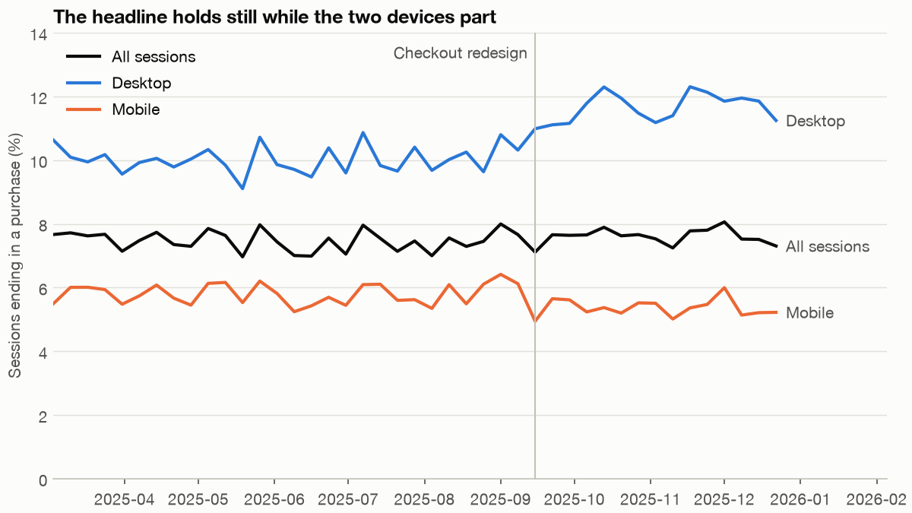
The headline holds still while the devices part
The problem
Part 4 · Funnel and conversion
Rate change at the old mix: +0.38. Mix towards mobile: −0.25.
Conversion rose 0.12 points, and mobile fell.
Weekly share of sessions ending in a purchase. Checkout redesign on 15 September.
An aggregate rate is a weighted average with moving weights, so a page can break while the headline holds still.
Source: notes/04-funnel-and-conversion.md
19
Notes:
Not strictly, since desktop moved with the total. The lesson is the same. The product manager's figure is correct, and it is the wrong one to stop at.
Source: notes/04-funnel-and-conversion.md

Slide 20
One row behaves differently
Conditional step rates, %
Part 4 · Funnel and conversion
Step | Mobile before | Mobile after | Desktop before | Desktop after
Visit to product | 54.9 | 54.9 | 62.0 | 62.0
Product to basket | 22.3 | 25.4 | 30.1 | 34.4
Basket to checkout | 61.9 | 61.3 | 68.2 | 68.0
Checkout to payment | 82.4 | 67.6 | 83.2 | 84.0
Payment to purchase | 93.3 | 93.0 | 94.8 | 95.5
Conditional rates isolate each step. Only mobile checkout-to-payment fell, and the basket lift on both devices is seasonal.
Source: notes/04-funnel-and-conversion.md
20
Notes:
No page changed at the basket step and both devices rose together. In this synthetic data we know that autumn intent is responsible. Good news upstream was covering bad news downstream.
Source: notes/04-funnel-and-conversion.md

Slide 21
Desktop as the comparison
Difference in differences
Part 4 · Funnel and conversion
PYTHON
Removes whatever hit both devices alike.
z = norm.ppf(.975)
did = mobile[0] - desktop[0]
did_se = np.hypot(mobile[1], desktop[1])
# mobile -14.8, CI -15.9 to -13.7
# desktop +0.8, CI -0.2 to +1.7
# diff -15.5, CI -17.0 to -14.1
Rests on parallel trends.
The drop is real and tied to the redesign. Mobile fell 15.5 points relative to desktop, with an interval far from zero.
Source: notes/04-funnel-and-conversion.md
21
Notes:
Reconcile with something that doesn't depend on the page. Mobile purchases fell even though the steps above improved, and a purchase is recorded when money moves.
Source: notes/04-funnel-and-conversion.md

Slide 22
Roll it back, and measure the rollback
Price and decision
Part 4 · Funnel and conversion
About 1,518 orders lost in 108 days, £79,865 revenue, £27,953 margin at an assumed 35%.
Each further week costs about £1,812 of margin.
97 sessions a day reach the step: +10 points takes 6 days to detect, +2 points takes 173.
Recommendation: a two-week 50/50 rollback, then send everyone to the winner.
Price the loss, then roll back as a test. Traffic at the step, not total traffic, limits how small an effect you can detect.
Source: notes/04-funnel-and-conversion.md
22
Notes:
The estimate is an upper-end figure, because some customers may have returned on another device. The analysis also says nothing about why customers abandon the page. That needs recordings and conversations.
Source: notes/04-funnel-and-conversion.md

Slide 23
PART 5
Segmentation and RFM
Who is the campaign paying for?
The target has already gone
Long silence cancels high frequency
The breakeven arithmetic
The plan · Validation · Silence · Persuadable
23
Notes:
A £4,000 win-back catalogue is ready to go to former big spenders. We test the plan before it ships.

Slide 24
Who is the campaign paying for?
The problem
Part 5 · Segmentation and RFM
Send £4,000 of catalogues to the At risk segment of former big spenders. Will they come back, and would they have bought anyway?
Fernhill CRM plan. Snapshot 30 June 2025, holdout to December.
A segmentation is a prediction, so test it on a later period before you spend on it.
Source: notes/05-segmentation-and-rfm.md
24
Notes:
Build features to the snapshot, and score them on the six months after. Nothing after the snapshot touches a feature.
Source: notes/05-segmentation-and-rfm.md

Slide 25
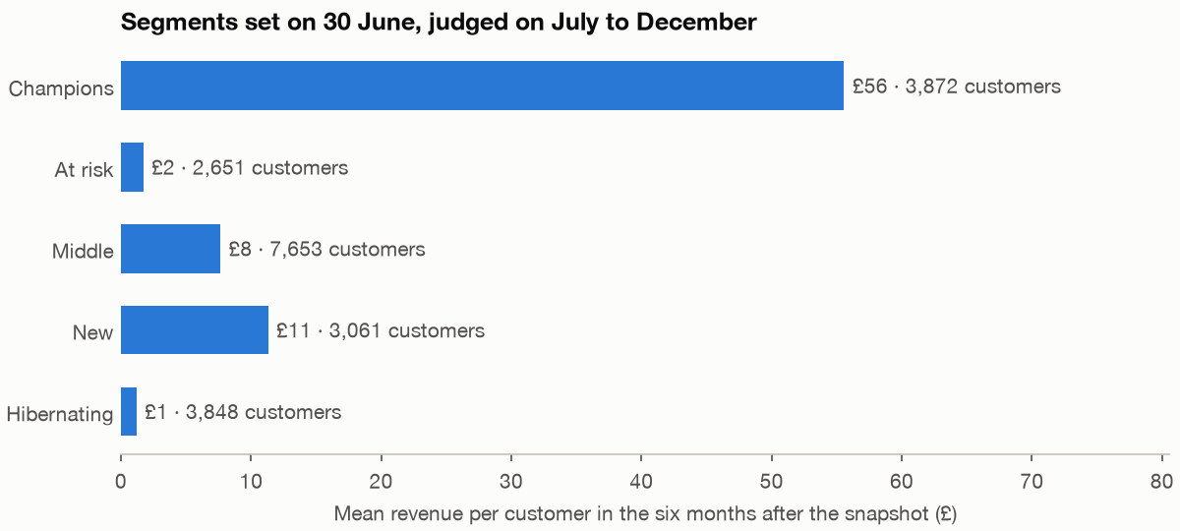
The target has already gone
Validation on a holdout
Part 5 · Segmentation and RFM
Champions: 18% of customers, 68% of future revenue.
At risk: £168 past value, 3% buy again, £1.72 future value.
Mean revenue per customer, July to December 2025, by segment set on 30 June.
On the holdout, At risk customers were worth about £2 each, despite a high past value, so most had already left.
Source: notes/05-segmentation-and-rfm.md
25
Notes:
Total spend mostly repeats frequency. A first version of this code broke frequency ties by row order, and the New segment fell from about 3,000 to 315. Always check what decides the ties.
Source: notes/05-segmentation-and-rfm.md

Slide 26
Long silence cancels high frequency
Mean future value, £, by recency and orders
Part 5 · Segmentation and RFM
Days since last order | 1 | 2 | 3-4 | 5+
0 to 60 | 18 | 34 | 54 | 113
61 to 180 | 9 | 21 | 34 | 67
181 to 365 | 6 | 10 | 17 | 22
366 or more | 1 | 2 | 3 | 1
A long silence from a frequent buyer suggests they have left, so frequent old customers are worth little.
Source: notes/05-segmentation-and-rfm.md
26
Notes:
Fader, Hardie and Lee (2005) find this bend in iso-value curves for CDNOW. Someone buying weekly who has been quiet for a year has probably gone. Someone buying once a year may just not be due. K-means adds little here: silhouettes sit near 0.3, and two clusters differing by order value have similar future value.
Source: notes/05-segmentation-and-rfm.md

Slide 27
The breakeven arithmetic
Worked example
Part 5 · Segmentation and RFM
PYTHON
RFM predicts who buys, not who is persuadable.
MARGIN, COST = .35, 1.50
aov = past.value.mean() # £52.67
lift = COST / (aov * MARGIN) # 8.1 points
# segment customers buy again needs
# At risk 2,651 2.6% 4.1x
# Hibernating 3,848 1.8% 5.5x
# Lapsing 1,206 45.2% 1.2x
Test Lapsing, half contacted, half held out.
Win-back of At risk can't pay. Test the Lapsing group against a random holdout, as only that measures persuasion.
Source: notes/05-segmentation-and-rfm.md
27
Notes:
Nearly half the Lapsing group buy anyway, and each one looks like a success. 589 per arm of 1,206 forces a split close to 50/50, costing about £900. The cost and margin are assumptions.
Source: notes/05-segmentation-and-rfm.md

Slide 28
PART 6
SQL for analytics
Two teams, two spreadsheets
The bridge is a chain of small steps
Both teams were right, about different rows
Patterns worth knowing by heart
The bridge · Reconcile · The patterns · Fan-out
28
Notes:
The year's revenue, written as one query that everyone can agree on. The language itself is in programming/sql.

Slide 29
Two teams, two spreadsheets
The problem
Part 6 · SQL for analytics
Revenue is up 2.1%. Marketing says new customers did it. Finance says customers are leaving. Who is right?
Fernhill board pack, 2025
When two teams disagree over a number, the job is often a shared definition, written as one query.
Source: notes/06-sql-for-analytics.md
29
Notes:
A bridge splits a period's total into labelled parts, so a change in the total becomes changes in the parts.
Source: notes/06-sql-for-analytics.md

Slide 30
The bridge is a chain of small steps
Windows and CTEs
Part 6 · SQL for analytics
SQL
WITH monthly AS (...), -- customer, month
history AS (
SELECT *, lag(month) OVER (
PARTITION BY customer_id ORDER BY month
) AS previous_month
FROM monthly
)
SELECT *, CASE
WHEN previous_month IS NULL THEN 'new'
WHEN date_diff('month', previous_month, month)
<= 3 THEN 'returning'
ELSE 'reactivated' END AS kind
FROM history
A window sees earlier rows without collapsing them, so the label comes from lag, and each CTE can be checked by itself.
Source: notes/06-sql-for-analytics.md
30
Notes:
With a six-month rule, 2025 reactivated falls from £230,947 to £102,942. Levels depend on the rule, but returning revenue falls either way, 24% or 18%.
Source: notes/06-sql-for-analytics.md

Slide 31
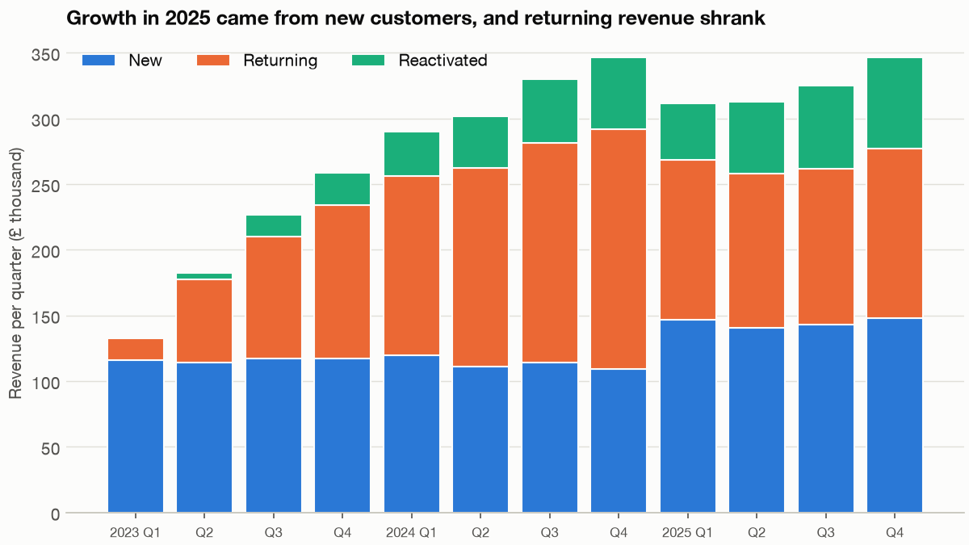
Both teams were right, about different rows
The answer
Part 6 · SQL for analytics
New +£124,260, reactivated +£55,021, returning −£152,017.
Total +£27,264. Reconciled to source within £1 of rounding.
Fernhill revenue per quarter by customer kind.
The 2.1% growth contains a 24% fall in revenue from customers who keep buying, so plan 2026 on the returning line.
Source: notes/06-sql-for-analytics.md
31
Notes:
Reconcile the total with the source. We also checked each kind against a pandas implementation, and the differences of a pound or two are rounding, which we explained rather than dismissed.
Source: notes/06-sql-for-analytics.md

Slide 32
Patterns worth knowing by heart
The toolkit
Part 6 · SQL for analytics
Date spine
Sessionise
Gaps and islands
Fan-out
Left join to every period, so empty weeks stay as zeros.
Flag gaps with lag, then a running sum of the flags numbers the sessions.
Running index minus row_number is constant along a consecutive run.
A non-unique join inflated revenue by 8.2% with no error. Aggregate first.
A handful of window and join patterns covers most analytics SQL, and a fan-out is the bug to look for first.
Source: notes/06-sql-for-analytics.md
32
Notes:
The one side is repeated, so its sums grow. Refunds were correct in both queries, so a spot check on refunds would have passed. Aggregate the many side to the one side's grain before joining.
Source: notes/06-sql-for-analytics.md

Slide 33
PART 7
Survival and event history
What is the welcome call worth?
Treat the censored as ended and the mean halves
The call works for ninety days, and then it stops
Months and pounds decide; hazard ratios do not
Censoring · One hazard ratio · When it wears off · Months and pounds
33
Notes:
Fernhill has a subscription box, and a welcome call that some new subscribers receive. The question is whether the call keeps them, and many of the answers are still in the future.

Slide 34
What is the welcome call worth?
The problem
Part 7 · Survival and event history
Adjusted for who gets called, its hazard ratio is 0.81. That number describes no subscriber at any tenure.
Fernhill subscription box, simulated, 5,061 subscribers. Unadjusted 0.681, adjusted 0.811
A single hazard ratio averages an effect that changes with time, so ask when the effect happens and what it is worth.
Source: notes/07-survival-and-event-history.md
34
Notes:
The call is not random: 37.9% of paid subscribers get one, 57.4% of organic and 78.2% of email. So the unadjusted number flatters it, and even the adjusted one is an average across a curve.
Source: notes/07-survival-and-event-history.md

Slide 35
Treat the censored as ended and the mean halves
Censoring
Part 7 · Survival and event history
TEXT OUTPUT
Both shortcuts answer a different question.
mean, days
among churned only 212.8
censored taken as end 250.9
true 401.8
estimate truth
KM median 255 248
restricted mean 361.1 355.0
Without a long enough window, report a restricted mean.
Subscribers still active have not ended, so use Kaplan-Meier and quote a median or restricted mean.
Source: notes/07-survival-and-event-history.md
35
Notes:
The channels differ: Kaplan-Meier medians are 139 days for paid, 288 organic, 350 email and 286 referral, with a log-rank chi-square of 296.7. A customer who leaves for another reason is a different problem: competing risks give 0.620 for a cancellation, where treating the other exit as censored gives 0.726. And the shifted beta-geometric forecast at month 36 reads 0.121 against a Kaplan-Meier 0.087, so check any parametric curve against the data.
Source: notes/07-survival-and-event-history.md

Slide 36
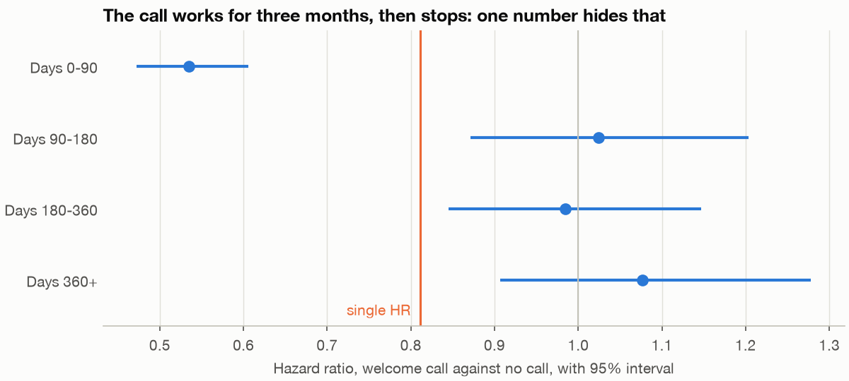
The call works for ninety days, and then it stops
Time-varying effects
Part 7 · Survival and event history
0 to 90 days: 0.535 [0.472, 0.606].
After: 1.024, 0.984, 1.076.
check_assumptions fails only on the call, p below 5e-5.
Truth: 0.6, recovered at 0.600 over 20 seeds.
Hazard ratio of the call by tenure band.
The call's whole effect sits in the first ninety days, and a test of proportional hazards tells you to look.
Source: notes/07-survival-and-event-history.md
36
Notes:
With a time-varying term, the call's early hazard ratio is 0.535 and its late one 1.024. Everything after ninety days is consistent with no effect, which also tells you when a second call might be worth trying.
Source: notes/07-survival-and-event-history.md

Slide 37
Months and pounds decide; hazard ratios do not
The decision
Part 7 · Survival and event history
Gain from the call | Estimate [interval] | Truth
Still subscribed, month 12 | 0.059 [0.033, 0.083] | 0.053
Still subscribed, month 24 | 0.033 | 0.029
Box-months in 24 months | 1.48 [0.91, 1.95] | 1.30
Margin per call | £14.85 [£9.09, £19.52] | assumed cost £4.00
The call looks worth extending, and the way to extend it is a randomised rollout, because this estimate is observational.
Source: notes/07-survival-and-event-history.md
37
Notes:
If the estimate is causal, net margin on the 2,235 subscribers with no call is about £24,000. Both the 35% margin and the £4 are assumptions, so put your own in. The answer changes below about 0.4 box-months of gain. A price rise on the 1,582 on the books gains £16.95, £23.56 or £24.14 depending on the scenario in the chapter.
Source: notes/07-survival-and-event-history.md

Slide 38
PART 8
States and sequences
One transition matrix misprices the customer
Four types hide inside the average
Mixtures and type chains beat the pooled chain on holdout
Clusters describe, mixtures predict
The pooled chain · Hidden types · Holdout · Clusters or mixtures
38
Notes:
Customers move between active, lapsed and churned. A transition matrix turns that into a value, and it is right only if all customers behave alike.

Slide 39
One transition matrix misprices the customer
The problem
Part 8 · States and sequences
A single Markov chain values a new customer at £431. The true value is £513.
Fernhill, simulated, with four customer types in the generator
A pooled chain averages customers who behave differently, so its forecast is wrong even when each transition looks right.
Source: notes/08-states-and-sequences.md
39
Notes:
The stay-active rate by previous state is 0.772, 0.521 and 0.679 in the pooled data, which looks like memory. Within the steady type it is 0.857, 0.859 and 0.880, so the apparent memory is mixed types. Over twelve other seeds, the pooled chain averages £415.8 against a true £515.0, so the bias is real.
Source: notes/08-states-and-sequences.md

Slide 40
Four types hide inside the average
Mixed populations
Part 8 · States and sequences
TEXT OUTPUT
N = (I − Q)⁻¹ gives months in each state.
type share value
steady 23.9% £1,486
drifter 27.4% £230
one_and_done 31.6% £53
comeback 17.0% £458
months to churn: pooled 11.31, true 13.91
Lapsed values run £5 to £1,259; pooled says £413.
The same state means different things by type, so a lapsed customer's value depends on who they are.
Source: notes/08-states-and-sequences.md
40
Notes:
The fundamental matrix is the shortcut for expected time in each state before churn. The range for lapsed customers is the slide's main point: a campaign priced at £413 is wrong for almost everyone it reaches.
Source: notes/08-states-and-sequences.md

Slide 41
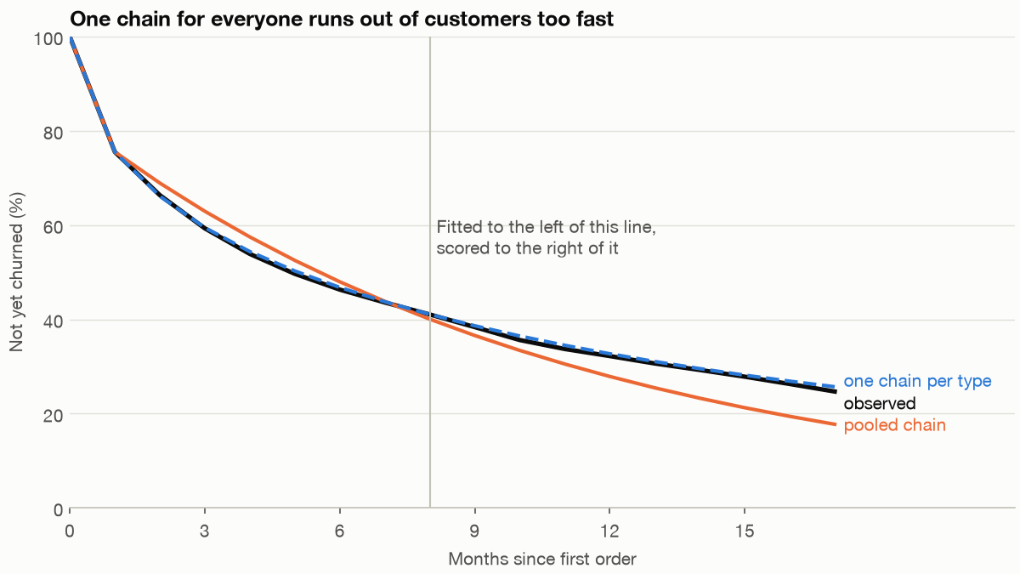
Mixtures and type chains beat the pooled chain on holdout
Holdout
Part 8 · States and sequences
Alive at 17: observed 0.247.
Pooled 0.178, type chains 0.257, mixture 0.280.
Revenue: 126.17; pooled 94.76, type chains 128.34, mixture 131.31.
Fit on months 0 to 8, then forecast. Each model against what happened.
Test a sequence model on later months, because the pooled chain's error only shows once its customers have had time to differ.
Source: notes/08-states-and-sequences.md
41
Notes:
Type chains need the true type, which a real analyst does not have, so read that line as the ceiling. The mixture needs no labels and gets within 4% of revenue, while overshooting survival.
Source: notes/08-states-and-sequences.md

Slide 42
Clusters describe, mixtures predict
Choosing a method
Part 8 · States and sequences
Feed clusters into the value
Fit a mixture of chains
Value £901, 1.75 times the truth
£454 to £592, depending on k
One cluster reaches £3,936
12 seeds: mean £504.7, truth £515.0
Agreement with true types: ARI about 0.40
Quote the range, not one k
Fine for description
Fit for the forecast
Clusters are a useful description and a poor input, so use a mixture for value and quote the range across k.
Source: notes/08-states-and-sequences.md
42
Notes:
One more thing a state model must allow: 22.0% of customers ever called churned later ordered again, so check that churned really is absorbing before you build on it.
Source: notes/08-states-and-sequences.md

Slide 43
PART 9
The dashboard credits paid social with half of sales
Shapley is fairer, and still about twice the truth
Priors and a geo test bring the averages down
The marginal stays uncertain, and email's is poorly known
Move £500 to £1,000, and the risk grows quickly after
Customer value passes a test built to be passed
Marketing measurement
Attribution · Incrementality · Mix models · A geo test · Moving budget · Customer value
43
Notes:
The finance lead asks where next quarter's budget should go, after a year of moving money to paid social because the dashboard said it closes almost half of all sales.

Slide 44
The dashboard credits paid social with half of sales
The problem
Part 9 · Marketing measurement
Last touch gives paid social 48.4% of conversions, and Shapley gives 32.6%. The true share is 16.9%.
Fernhill, simulated, 8,000 paths
Attribution shares out conversions that would often have happened anyway, so it cannot say what a channel causes.
Source: notes/09-marketing-measurement.md
44
Notes:
Both methods must hand out all 899 conversions, while the truth says about half would have happened with no touch at all. Dalessandro and colleagues reach the same place from theory and recast the result as channel importance rather than cause.
Source: notes/09-marketing-measurement.md

Slide 45
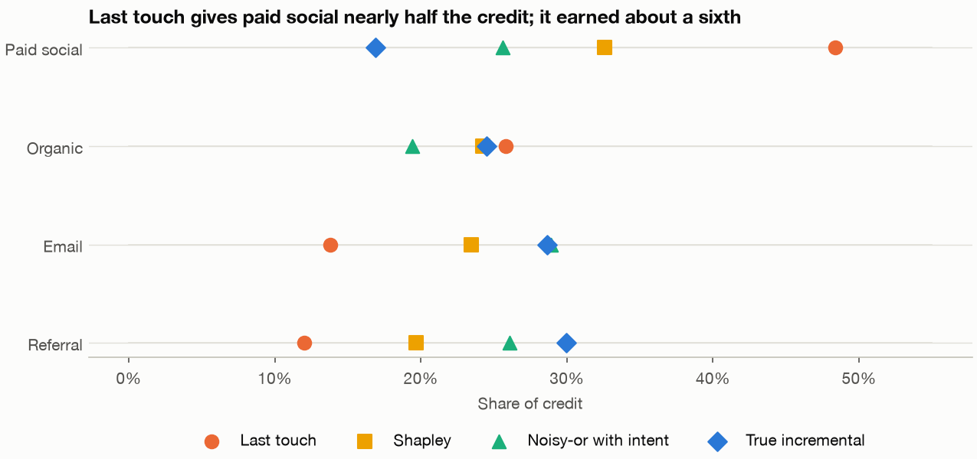
Shapley is fairer, and still about twice the truth
Attribution
Part 9 · Marketing measurement
12 seeds, paid social: last touch 47.5%, Shapley 29.0%, truth 16.8%.
Shapley is about twice the truth.
Noisy-or with intent: 18.0%, ranging 6.3% to 25.5%.
Share of conversions credited to each channel, against the true incremental share.
Even the true form with an unobservable variable pins down a 1% lift poorly, and this takes an experiment.
Source: notes/09-marketing-measurement.md
45
Notes:
The noisy-or fit uses a variable you would never observe, and it is still unreliable on any single seed. That is the argument for a geo test.
Source: notes/09-marketing-measurement.md

Slide 46
Priors and a geo test bring the averages down
Mix models
Part 9 · Marketing measurement
TEXT OUTPUT
Geo test: iROAS 1.491 [1.43, 1.57].
average ROAS, about 31 params, 157 weeks
paid social email
default 2.71 20.36
Jin priors 1.75 7.21
+ geo test 1.37 6.94
truth 1.29 4.0
It enters as a likelihood term, via add_lift_test_measurements, not as a prior.
Only the tested channel's average tightens.
A geo test fixes the average return over the tested spend, and leaves everything beyond that to the curve.
Source: notes/09-marketing-measurement.md
46
Notes:
Chan and Perry warn that mix models are correlational and cite 7 to 10 data points per parameter as a minimum. OLS gives email 0.46, and correlation between paid and email spend is minus 0.72, which is why the channels are hard to separate. Sampling needed care: largest R-hat 1.6 under PyMC's default and 1.04 under nutpie before the priors were changed.
Source: notes/09-marketing-measurement.md

Slide 47
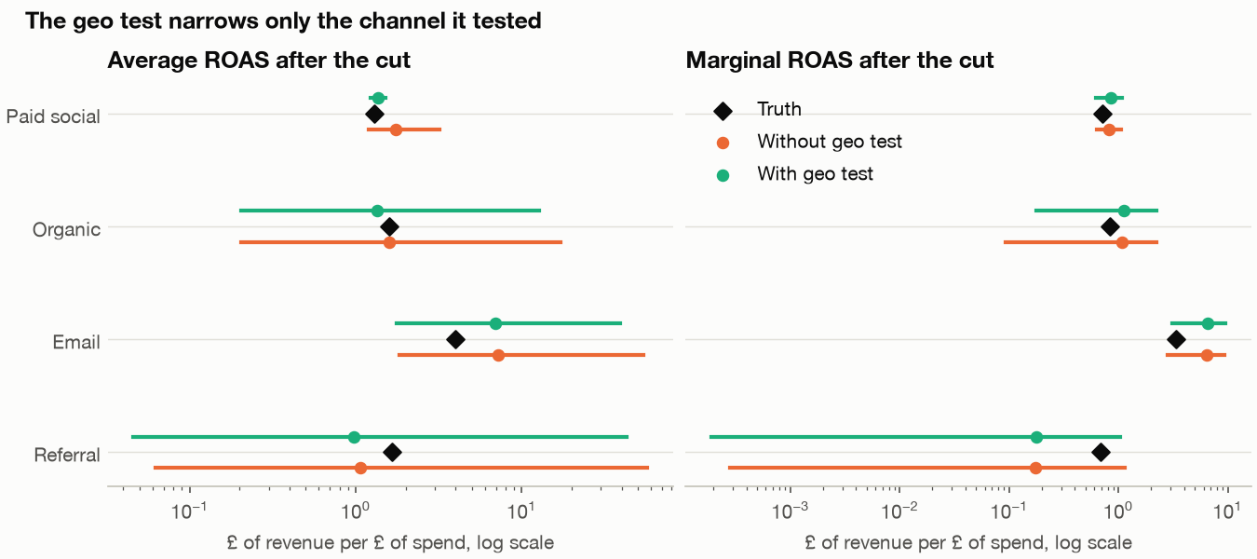
The marginal stays uncertain, and email's is poorly known
What the budget needs
Part 9 · Marketing measurement
Paid marginal: 0.86 [0.62, 1.08], true 0.71.
Email marginal: 6.51 [3.12, 9.53], true 3.38, about twice. Seeds 100 to 103: 2.09 to 3.47.
Caveat: an earlier run gave slightly different figures (6.43), unexplained. Don't lean on the second decimal.
Fitted against true ROAS, with 90% intervals. Only paid social's average tightens.
The decision needs the marginal, the data know it least, and email's marginal here is poorly known.
Source: notes/09-marketing-measurement.md
47
Notes:
The earlier run used the same seeds, before some late chart edits, and we could not explain the difference; two full runs of the final script gave identical output. Paid social's true figures at £7,300 are an average of 1.31 and a marginal of 0.71. With a gross margin of 61%, a pound of spend pays for itself only at a revenue ROAS of 1.63, and even the geo test's 1.49 is below that.
Source: notes/09-marketing-measurement.md

Slide 48
Move £500 to £1,000, and the risk grows quickly after
The recommendation
Part 9 · Marketing measurement
Moved a week | True gain | Model median | P(gain)
£250 | £550 | £908 | 1.000
£500 | £905 | £1,186 | 0.999
£1,000 | £1,232 | £1,124 | 0.983
£2,000 | £1,049 | £205 | 0.656
£4,000 | −£925 | −£2,700 | 0.001
Recommend a move of £500 to £1,000 a week and test it, because the model's sizing beyond that rests on curves the data barely see.
Source: notes/09-marketing-measurement.md
48
Notes:
The true best split would add about £1,280 a week. These are simulated tables. A test at current spend showing paid social's marginal above break-even would change the recommendation.
Source: notes/09-marketing-measurement.md

Slide 49
Customer value passes a test built to be passed
Customer value
Part 9 · Marketing measurement
BG/NBD and Gamma-Gamma
The number to quote
Holdout orders 1,841, forecast 1,847, +0.3%
Margin value £173 [£163, £184]
Truth £162, just outside
These data are BG/NBD by construction
Quote about £155 to £185
So this tests the code, not the idea
Scored on its own generator
Wider than the interval
Quote a range wider than the interval, and do not defend a channel with its LTV to CAC, which folklore wants above 3.
Source: notes/09-marketing-measurement.md
49
Notes:
LTV to CAC by channel runs from 2.53 for paid social to 12.09 for organic, with 3.58 and 5.37 for the others, and none of that says what an extra pound would do. The interval covers sampling error given a correct model, which is why the honest range is wider.
Source: notes/09-marketing-measurement.md

Slide 50
PART 10
Operations and supply chain
Ordering the forecast leaves money on the table
A 95% target gives 79% in the season that matters
The queue is busiest where the utilisation is not
The plan depends on what a parcel-hour is worth
Newsvendor · Safety stock · Queues · The price of a packer
50
Notes:
The forecast from the first chapter has now reached the warehouse floor. Three decisions: how much to order, how much to hold, and how many packers to roster.

Slide 51
Ordering the forecast leaves money on the table
The problem
Part 10 · Operations and supply chain
Ordering the forecast earns £48,191. Ordering at the fractile earns £49,177. Knowing demand exactly earns £49,827.
Fernhill, simulated expected profit on three lines; fractile about 0.73
When a leftover costs less than a lost sale, the best order sits above the forecast, at the cost ratio.
Source: notes/10-operations-and-supply-chain.md
51
Notes:
The gain is real and small: over seeds 100 to 111 it averaged 1.70% and was positive on 11 of 12. One real season is not a verdict: on real 2025 demand the fractile won on one line, lost on two, and ended £161 up. EOQ tells a similar story, taking cost from £10,767 to £9,860, about £907 a year.
Source: notes/10-operations-and-supply-chain.md

Slide 52
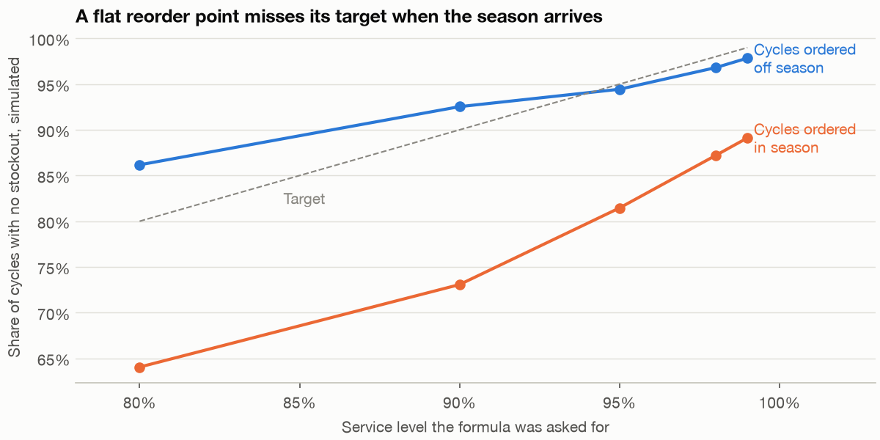
A 95% target gives 79% in the season that matters
Safety stock
Part 10 · Operations and supply chain
At 95%: off-season 94.8%, in-season 79.4%.
Asking 99% gets in-season to about 89%.
A seasonal reorder point: 94.7% for about £374 a year.
95% to 99%: +£2,005 on £4,839.
Delivered service against target, by season.
Fix the seasonal mean before buying more buffer, because the formula's failure is in the mean and the buffer is expensive.
Source: notes/10-operations-and-supply-chain.md
52
Notes:
The reorder point uses a year-round mean while in-season demand runs 60% higher. About a third of the safety stock is there only because deliveries vary, and leaving that out is the commonest mistake.
Source: notes/10-operations-and-supply-chain.md

Slide 53
The queue is busiest where the utilisation is not
Queues
Part 10 · Operations and supply chain
TEXT OUTPUT
Wed beats Mon on wait in 10 of 12 seeds.
day packers rho recorded Erlang C
Mon 6 0.849 2.91 3.89
Tue 5 0.720 1.17 1.62
Wed 4 0.838 4.35 4.93
Thu 4 0.784 1.98 3.49
Fri 4 0.725 1.96 1.89
Fewer packers wait longer at the same utilisation.
Little's law gap: 8.88e-16.
Waiting depends on crew size as well as utilisation, so read a queue model day by day.
Source: notes/10-operations-and-supply-chain.md
53
Notes:
Waits are in minutes. A check on Monday at 5 packers: utilisation is 1.03, Erlang C is infinite, and the simulation gives 18.9 minutes on a finite day. That is why five is out.
Source: notes/10-operations-and-supply-chain.md

Slide 54
The plan depends on what a parcel-hour is worth
The recommendation
Part 10 · Operations and supply chain
An extra packer costs £112 a day. Break-even value of a parcel-hour: Mon £5.66, Wed £6.20, Thu £8.95, Tue £17.04, Fri £19.03.
Value of a parcel-hour | Packers, Mon to Fri | Packer-days
£5 | 6, 5, 4, 4, 4 | 23
£7 | 7, 5, 5, 4, 4 | 25
£10 | 7, 5, 5, 5, 4 | 26
£20 | 7, 6, 5, 5, 5 | 28
The data do not say what waiting is worth, so show the plan at each value and let the business choose.
Source: notes/10-operations-and-supply-chain.md
54
Notes:
The recommended plan takes mean wait from 2.96 to 0.95 minutes and packer-days from 23 to 27, for £392 a week, on assumed contracts. Pack time is the other thing to confirm: 3.5 minutes in the operations data against 4.97 on the packing line changes the answer.
Source: notes/10-operations-and-supply-chain.md

Slide 55
Rules of thumb
Ten analyses, one shape
Wrap-up
Decide first
Beat a baseline
Check against the known
Price it and bound it
Write down the decision. If no result could change it, stop.
Compare with last year's numbers, approve-all, or doing nothing.
A synthetic truth, a published table, or a second implementation.
Turn a rate into money, then say what would change the answer.
Every analysis needs a decision, a baseline, a check against something known, a price, and honest limits.
Source: notes/10-operations-and-supply-chain.md
55
Notes:
Baselines were seasonal naive, approve-all, the exponential, desktop, and a holdout. Checks were the generator's known truth, Fader and Hardie's published table, and a pandas reimplementation. The later chapters add holdouts, geo tests and seeds, and each says what would change its recommendation.
Source: notes/10-operations-and-supply-chain.md

Slide 56
Where next
After data analytics
Wrap-up
Size tests properly: experimentation and causality, in this subject.
Learn the language under the bridge: the SQL module in programming/sql.
Take the modelling further: data science, starting with machine learning.
Run the scripts in practice/, and try each chapter's exercises.
Keep the shape of these analyses as the methods get harder, and practise on the scripts before moving on.
Source: notes/10-operations-and-supply-chain.md
56
Notes:
The UCI Online Retail dataset linked in the references is a good way to repeat chapters 3 and 5 on data that isn't ours.
Source: notes/10-operations-and-supply-chain.md

