Slide 1
Classical Machine Learning
Part 1: What kind of problem do you have?
Problems and families · A ladder of models · The map of this lecture
Part 2: What a model is
Bias and variance · Model families · First mistakes
Fit a model on a table, measure it honestly, explain it
Part 3: Honest inputs, honest scores
Domain features · Three rules · Leakage
Part 4: Winning on tables
Bagging and boosting · Boosting libraries · The training loop · Explaining the result
Problems and families · What a model is · Honest scores · Winning on tables · No labels · What it hides · People
Part 5: No labels
k-means and DBSCAN · Testing clusters on a music library
Part 6: What the number hides
Error costs · Losses · Threshold or SMOTE · Reading errors
Part 7: People and accountability
Three routes · Silent failures · Agreement · Random audit · Group gaps
Notes: data-science/01-classical-ml
Notes:
Today we take one question, will this person earn over 50 thousand dollars, and follow it from a first model to one we can defend to a reviewer. Adult census carries us through Part 4, then rare events and invoices take over. We start with a map of which problems exist and which families answer them. Then six sections build on each other, and most of them run the same way: what you need to know, what it looks like in practice, and what goes wrong and how to address it.

Slide 2
PART 1
What kind of problem do you have?
Which model should you use?
With a target, its type narrows the family
Beyond predicting a column, the question picks the tool
On any table, climb one rung at a time
Six sections, built on an honest score
Problems and families · A ladder of models · The map of this lecture
2
Notes:
We start before any model. What is being predicted, what decision hangs on it, and which family answers that? This is the map for everything that follows.

Slide 3
Which model should you use?
The problem
Part 1 · What kind of problem do you have?
Don't start from a model. The target narrows the family, the family brings a loss, and the decision picks the metric.
Name the target and the decision first, because they narrow the family, the loss and the metric.
Source: notes/11-choosing-a-metric.md
3
Notes:
People ask which model is best. That question has no answer until we know what is being predicted and what decision hangs on it. So before any algorithm, here is the map of problems and the families that answer them.
Source: notes/11-choosing-a-metric.md

Slide 4
With a target, its type narrows the family
Part 1 · What kind of problem do you have?
Target | Family | Metric | Baseline
A number | OLS, boosted regressors | RMSE, MAE, R² out of sample | Predict the mean
Yes or no | Logistic, boosted trees | PR-AUC, ROC-AUC, Brier, cost at a threshold | Base rate, majority class
A count | Poisson, negative binomial | Deviance, dispersion, MAE | Constant rate
A ranked list | Two-tower, learning to rank | NDCG, MRR, recall at k | Popularity
A forecast | ETS, boosting on lags | MASE, pinball | Seasonal naive
A metric with no baseline can't be read, so name the baseline along with the family and the metric.
Source: notes/11-choosing-a-metric.md
4
Notes:
Read each row from left to right. An RMSE of 2 is good or bad depending on what predicting the mean gets, which is why the baseline matters most. This lecture teaches tables, numbers and classes. Ranking and forecasting are taught in the time series and recommenders pillar, and the count model is in data analytics.
Source: notes/11-choosing-a-metric.md

Slide 5
Beyond predicting a column, the question picks the tool
Part 1 · What kind of problem do you have?
Question | Tools | Watch out
Fewer columns or a picture | PCA, NMF, t-SNE | t-SNE is for visualisation only
Groups in numeric columns | k-means, agglomerative, DBSCAN, Gaussian mixture | Each assumes a shape
Groups in mixed columns | FAMD or MCA then k-means, latent class, Gower | Run a shuffled control
Anomalies | Density estimate, isolation forest | Use a classifier if positives are many and stable
Why this answer? | Permutation importance, PDP, SHAP | It explains the model and not the world
Who bears the errors? | Impact ratio, error rates by group | The gaps can't all be closed together
Without a target to score against, every answer needs its own check, such as a control or a later task.
Source: notes/05-unsupervised-learning.md
5
Notes:
Not every question predicts a column. Sometimes we want structure, or the odd row out, or an account of what a model did. The last column is the warning for each, and most of these come back later.
Source: notes/05-unsupervised-learning.md

Slide 6
On any table, climb one rung at a time
Part 1 · What kind of problem do you have?
Each rung sets the bar for the next, shown here on adult census. AUC scores how well the model ranks people.
Dummy
0.759 accuracy
Logistic regression
AUC 0.901
Boosting
AUC about 0.93
Dummy on accuracy, the others on AUC.
Start with a dummy, then a linear model, then boosting, since each one gives a bar for the next.
Source: notes/09-training-and-tuning.md
6
Notes:
This is the running example of the lecture: predict who earns over 50 thousand dollars from the adult census. If a model can't beat always saying no, it has learned nothing. The rest of the lecture asks why we should believe each of these numbers.
Source: notes/09-training-and-tuning.md

Slide 7
Six sections, built on an honest score
Part 1 · What kind of problem do you have?
2
What a model is — What it estimates, and which family to try first
3
Honest inputs, honest scores — What the model may see, and whether its score is real
4
Winning on tables — Fit, tune and explain the strongest tabular model
5
No labels — Structure in the data, checked with the tools above
6
What the number hides — Rare events, the right metric, and which rows are wrong
7
People and accountability — Who decides, what corrections teach, and who bears the errors
Learn to measure honestly first, because every later method, including clustering, is checked with those tools.
Source: notes/01-statistical-foundations.md
7
Notes:
Most sections run the same way: what you need to know, what it looks like in practice, and what goes wrong and how to address it. Honest scoring comes early because every later section checks its work with it.
Source: notes/01-statistical-foundations.md

Slide 8
A perfect training score tells you nothing. Why?
Too simple misses signal, too flexible fits noise
Each family has one knob that sets its complexity
Every scikit-learn model is the same four lines
The maths scikit-learn hides fits in a few lines
Derive the gradient, check it, then size the step
Five ways a first model misleads you
PART 2
What a model is
Bias and variance · Model families · First mistakes
8
Notes:
First the vocabulary. What is a model estimating, why does it fail on people it has not seen, and which family do we try first?

Slide 9
A perfect training score tells you nothing. Why?
The problem
Part 2 · What a model is
We have the map, so we start at the bottom: what is a model estimating?
A forest scores 1.000 on the data it trained on, every time. The only score that counts is on people it has never seen.
Own run on breast cancer, where the same forest scores 0.972 on held-out data
Generalisation is the goal, so every score needs held-out data before it means anything.
Source: notes/01-statistical-foundations.md
9
Notes:
Memorising is easy. A deep tree or a forest can get every training row right. So the question this course keeps asking is about people the model did not see. What makes a model fail on them?
Source: notes/01-statistical-foundations.md

Slide 10
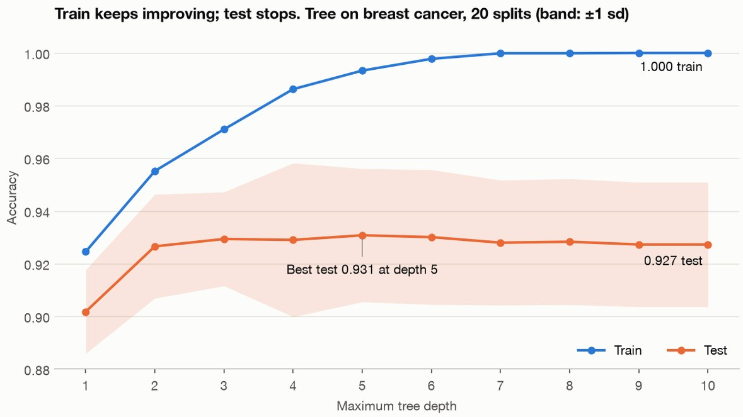
Too simple misses signal, too flexible fits noise
Part 2 · What a model is
Underfit: low train score and low test score.
Overfit: train pulls away from a test score that stops improving.
Every family has a knob that moves along this curve.
A tree on breast cancer, 20 stratified splits: depth 10 scores 1.000 on train and 0.927 on test, and test peaks at 0.931 at depth 5. Run practice/overfit_curve.py.
Read train and test together, since both low is underfitting and a wide gap is overfitting.
Source: notes/01-statistical-foundations.md
10
Notes:
This is the bias and variance picture. Too simple a family misses real structure, and too flexible a family follows the sample's noise. What we want is the middle, and each family gives us a knob for finding it.
Source: notes/01-statistical-foundations.md

Slide 11
Each family has one knob that sets its complexity
Part 2 · What a model is
Family | Knob | Good at | Fails when
kNN | n_neighbors | A quick first baseline | Many features or rows
Linear | alpha or C | Many features, fast | Non-linear signal without features
Naive Bayes | alpha | Sparse counts in one pass | You need probabilities
Decision tree | max_depth | Readable rules | High variance on its own
Kernel SVM | C and gamma | Small dense data | Large data; needs scaling
Small MLP | Layers and alpha | Dense signal given time | Needs scaling and tuning
Start with a linear model or kNN to learn the data, and learn one knob per family.
Source: notes/02-supervised-learning.md
11
Notes:
You don't need every parameter. For each family, know the one that controls complexity and how the family fails. Trees don't need scaling because each split reads one feature's order. Kernel SVMs do, because they use distance. The knob also sets the shape of the boundary: a linear model draws one flat cut, a tree draws axis-aligned boxes, and kernels and kNN draw smooth local curves. That shape is the model's assumption, and no family wins everywhere.
Source: notes/02-supervised-learning.md

Slide 12
Every scikit-learn model is the same four lines
Part 2 · What a model is
PYTHON
from sklearn.datasets import load_iris
from sklearn.model_selection import train_test_split
from sklearn.neighbors import KNeighborsClassifier
iris = load_iris()
X_train, X_test, y_train, y_test = train_test_split(
iris.data, iris.target, random_state=0)
knn = KNeighborsClassifier(n_neighbors=1) # 1. choose
knn.fit(X_train, y_train) # 2. fit
y_pred = knn.predict(X_test) # 3. predict
print(knn.score(X_test, y_test)) # 4. score: 0.974
The API is uniform by design, so estimators chain in pipelines and plug into search.
Source: notes/01-statistical-foundations.md
12
Notes:
The scikit-learn paper names this consistency as a goal of the library. Because the interface is the same, we can swap a family by changing one line. That is what makes trying several families from this table practical.
Source: notes/01-statistical-foundations.md

Slide 13
The maths scikit-learn hides fits in a few lines
Part 2 · What a model is
PYTHON
Gradient descent: [-3.63, 1.166] after 1,500 steps.
def h_linear(theta, X):
return X @ theta
def gradient_descent(X, y, theta, alpha=0.01,
iters=1500):
m = len(y)
for _ in range(iters):
error = h_linear(theta, X) - y
theta = theta - (alpha / m) * X.T @ error
return theta
def normal_equation(X, y):
return np.linalg.pinv(X.T @ X) @ X.T @ y
Normal equation: [-3.896, 1.193].
Running longer closes the gap.
Gradient descent walks towards the answer and needs a learning rate, while the normal equation solves for it directly.
Source: notes/02-supervised-learning.md
13
Notes:
This is for the audience who want the maths. The data is Ng's first exercise, the profit of a food truck against city population. X has a leading column of ones, and the normal equation is the closed form with no learning rate. The libraries hide this loop, and the note has the logistic version next to it.
Source: notes/02-supervised-learning.md

Slide 14
Derive the gradient, check it, then size the step
Part 2 · What a model is
Seed 0, 100 rows, 3 features, true weights (2, -1, 0.5), mean squared error.
1
Shapes — X @ w is (n × d)(d,) → one prediction per row. X.T @ r gives one number per feature.
2
Gradient — (2/n) · X.T @ (X @ w - y), a vector that points uphill.
3
Check it — Analytic −4.7218 against a central difference of −4.7218.
4
Step — η = 0.1: 20 steps recover (1.99, −1.00, 0.47), loss 0.0086.
!
Too far — η = 1.1: loss 1.4 × 10⁹. Above 2 / 2.40 = 0.83 it diverges.
Check a derived gradient against a central difference, and keep the learning rate below 2 over the largest eigenvalue or the loss explodes.
Source: notes/02-supervised-learning.md
14
Notes:
The same loop as the last slide, written so the shapes show. Stack the rows into X, and one matrix product gives every prediction; the transpose turns the residuals into one number per feature, which is why X transpose appears in the gradient and in the normal equation. A derivative is a slope you can measure by nudging a weight both ways, so compare the formula with that central difference before you trust it: here they agree to four decimals. Then the learning rate. At 0.1 twenty steps recover the true weights. At 1.1 the loss explodes. For this X the cutoff is 2 divided by the largest eigenvalue of 2/n X transpose X, which is 2.40, so anything above 0.83 diverges. The cutoff depends on the data, and that is why learning rates get tuned.
Source: notes/02-supervised-learning.md

Slide 15
Five ways a first model misleads you
Part 2 · What a model is
Pitfall | Symptom | Fix
Accuracy without the base rate | 76% on adult census is what always saying <=50K gets | Print the class shares before fitting
Reading the test set while developing | The score drops on real data | Tune on validation or folds
Bigger model for high variance | Train rises, test falls | Regularise, simplify or add data
Unscaled features for distance models | kNN or SVC scores near the dummy | Put a scaler in a pipeline
Coefficients read as causes | A correlated feature flips sign | Check stability across resamples
Check the base rate, keep the test set back, and scale for distance models before you trust a first score.
Source: notes/01-statistical-foundations.md
15
Notes:
These come from the pitfalls tables in the first two notes. Each has a symptom you can spot. That closes Part 2: we know what a model estimates and how it fails, but not yet whether its score can be believed.
Source: notes/01-statistical-foundations.md

Slide 16
PART 3
Honest inputs, honest scores
The same forest goes from -0.04 to 0.84. What changed?
Three rules keep a score honest
On adult census the dummy is already 0.759
On pure noise, a leaky selection step reports R² 0.90
Domain features · Three rules · Leakage
16
Notes:
We have a model and a test score. Now, did we give it the right input, and can the score be believed? Every later section relies on the answers.

Slide 17
The same forest goes from -0.04 to 0.84. What changed?
The problem
Part 3 · Honest inputs, honest scores
We have a model and a test score. Did it get the right input, and can the score be believed?
A random forest on a raw timestamp predicts Citi Bike rentals at R² -0.04. Give it hour and weekday, and it reaches 0.84.
Own run, reproducing the ladder in Müller and Guido, ch. 4. An R² below zero is worse than predicting the mean
Representation sets what any model can see, so try a domain feature before a bigger model.
Source: notes/03-feature-engineering-and-pipelines.md
17
Notes:
Trees cannot extrapolate, so a timestamp past the training range gives them nothing to split on. No model finds the commute pattern from the raw number. Someone who rides a bike writes it in one line. This is rentals per 3-hour slot for one station, August 2015, the first 184 slots training and the rest testing. Hour alone gets the forest to 0.60. A linear model on hour and weekday as numbers gets 0.13, because Monday isn't numerically related to Sunday. One-hot encoding with ridge gets 0.62, and one-hot pairs of hour and weekday get 0.85, which edges the forest on this split while each coefficient stays readable.
Source: notes/03-feature-engineering-and-pipelines.md

Slide 18
Three rules keep a score honest
Part 3 · Honest inputs, honest scores
Fit inside the pipeline
Test once
Metric from the costs
Any step with a fit goes inside it, so nothing is learned from the rows you score.
Choose on validation or folds. Every look at the test score is a choice that leaks.
Accuracy assumes both errors cost the same. Compare against a dummy first.
Put every fitted step in a pipeline, report the test score once, and choose the metric from what each error costs.
Source: notes/04-model-evaluation.md
18
Notes:
Three rules carry most of the weight in this pillar. The first comes from the pipelines note, the other two from the rules table in model evaluation. Slide after slide, watch for what breaks them.
Source: notes/04-model-evaluation.md

Slide 19
On adult census the dummy is already 0.759
Part 3 · Honest inputs, honest scores
A dummy always answers under $50k. AUC and AP (average precision) score how well the model ranks people, higher is better.
PYTHON
prep = make_column_transformer(
(StandardScaler(), make_column_selector(dtype_include="number")),
(OneHotEncoder(handle_unknown="ignore"),
make_column_selector(dtype_exclude="number")))
clf = make_pipeline(prep, LogisticRegression(max_iter=2000))
clf.fit(X_train, y_train)
scores = clf.predict_proba(X_test)[:, 1]
# dummy accuracy 0.759 | model accuracy 0.847
# AUC 0.901 | AP 0.754 (a random ranker's AP is 0.241)
# threshold 0.50: precision 0.725, recall 0.584
# threshold 0.61, tuned on validation: precision 0.783, recall 0.484
Beat a dummy, report a ranking metric too, and choose the threshold on validation from what each error costs.
Source: notes/04-model-evaluation.md
19
Notes:
Three quarters of the people earn under the line, so always answering no gets 0.759. The model is about nine points better. AUC and average precision say the ranking is strong. That does not yet tell us what to do with it. The threshold turns a score into a decision. Precision is, of those flagged, how many are real. Recall is, of the real ones, how many were caught. Holding the flagged group to about 80 percent precision costs a tenth of recall. Note the test precision of 0.783 misses the 0.80 validation target, which is what validation being optimistic looks like at small scale.
Source: notes/04-model-evaluation.md

Slide 20
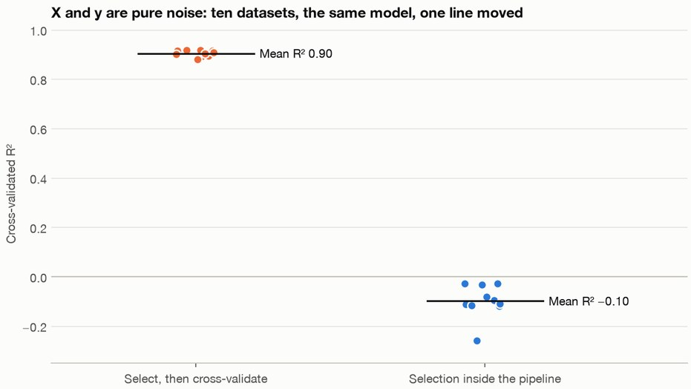
On pure noise, a leaky selection step reports R² 0.90
Part 3 · Honest inputs, honest scores
k-fold cross-validation: cut the rows into k parts, train on k-1, score on the part left out, and rotate.
Select, then cross-validate: selection saw every fold's target.
Cross-validate the pipeline: selection is refit inside each fold, and the score is honest.
fit runs fit_transform on each step. predict runs only transform.
Ten datasets of pure noise, keeping the top 5% of 10,000 columns: mean R² 0.90 leaky, -0.10 in a pipeline. Run practice/leaky_selection.py.
Any step with a fit goes in a pipeline, refit inside each fold, and the chain ships as one object.
Source: notes/03-feature-engineering-and-pipelines.md
20
Notes:
This is the most important bug in applied machine learning. Nothing crashes. You get a wonderful score. With scaling the bias is small, and with selection it is enormous. The note's single run on seed 42 gets 0.89 and -0.03, and the book's own run gets 0.91 and -0.25. Ten datasets give the bars here. Pipelines exist for this reason. The chain does the right thing in each fold, you can tune preprocessing jointly with the model, and the same object goes to production. That closes the section: we can now trust a score, so next we go looking for a better one.
Source: notes/03-feature-engineering-and-pipelines.md

Slide 21
One tree overfits. Many trees win. Why?
Each boosting round fits what the last rounds missed
Boosting libraries tie, within the noise of one seed
A leaky encoding drops test AUC from 0.927 to 0.811
Tuning gained 0.0009. Choosing the family gained 0.025.
Learning curves name the problem before you touch a knob
Regularisation is one idea: charge for complexity
The training loop as a 10-step checklist
Folds must mimic how new data will arrive
Why did the model reject this applicant?
Three questions, three tools
SHAP values add up to the model's score
Built-in importance credits random columns
PART 4
Winning on tables
Bagging and boosting · Boosting libraries · The training loop · Explaining the result
21
Notes:
With an honest score, we can look for the strongest model on a table. Then we run the whole loop around it, and finally explain what it learned.

Slide 22
One tree overfits. Many trees win. Why?
The problem
Part 4 · Winning on tables
With a score we can believe, we can look for the strongest model on a table.
Bagging averages deep trees to cut variance. Boosting adds shallow trees to cut bias. Together they are the default for tables.
Breiman 2001 for forests, Friedman 2001 for gradient boosting
Bagging averages deep trees to cut variance, and boosting adds shallow trees to cut bias.
Source: notes/06-ensembles.md
22
Notes:
Averaged trees have lower variance, but only so far: correlated errors don't average away. That's why forests also subset features. Boosting works the other way round, starting from weak trees and fitting the remaining error.
Source: notes/06-ensembles.md

Slide 23
Each boosting round fits what the last rounds missed
Part 4 · Winning on tables
Predict
Current ensemble scores every row
Gradient
Residuals, or y minus p for log-loss
Fit
A shallow tree to the gradient
Add
Scaled by the learning rate
Repeat until validation stops improving
Each new tree is one small step downhill on the loss.
Each new tree fits the loss's negative gradient, so boosting is gradient descent with trees as steps, and early stopping picks the rounds.
Source: notes/06-ensembles.md
23
Notes:
On adult census with no tuning beyond a lower learning rate, sklearn's histogram booster reaches 0.927 against 0.896 for a 300-tree forest on one-hot features. More forest trees can only average away variance, so the curve flattens. More boosting rounds keep fitting the training set, so the test curve turns over: at a rate of 0.05 boosting peaks at 0.928 with 200 trees and falls to 0.920 at 2,000. A forest on ordinal-coded columns reaches 0.900 at 500. That's why rounds get early stopping rather than a grid. Now which library?
Source: notes/06-ensembles.md

Slide 24
Boosting libraries tie, within the noise of one seed
Part 4 · Winning on tables
Adult census, five seeds, shared learning rate 0.05, early stopping, otherwise defaults.
Model | AUC | sd | Seconds
Random forest | 0.8969 | 0.0028 | 0.8
sklearn GradientBoosting | 0.9294 | 0.0030 | 15.7
sklearn HistGradientBoosting | 0.9291 | 0.0025 | 3.3
XGBoost | 0.9292 | 0.0025 | 0.5
LightGBM | 0.9295 | 0.0024 | 0.6
CatBoost | 0.9297 | 0.0030 | 5.9
On adult census the gap between libraries is 0.0006 and the seed moves it by 0.003, so choose by speed and fit to your stack.
Source: notes/07-boosting-in-practice.md
24
Notes:
No library won every seed. LightGBM led seed 0, CatBoost seed 1, XGBoost seed 3, and the classic booster seeds 2 and 4. Speed differs by a factor of 30, measured on a busy laptop, so treat that as rough. The script is in practice. Every library shares the same second-order core: we fit a one-tree XGBoost model in the note and recompute its leaves by hand, -1.1513 and 1.1729, and they match. They differ in how they find splits fast. Tune in order: learning rate, then rounds, leaves, leaf size, sampling, L1 and L2. Learning rates from 0.3 to 0.02, and leaves from 4 to 128, stay between 0.924 and 0.927, so on adult census the whole search moves AUC by under 0.003.
Source: notes/07-boosting-in-practice.md

Slide 25
A leaky encoding drops test AUC from 0.927 to 0.811
Part 4 · Winning on tables
A meaningless ID of about 3,000 levels is added to adult census. A greedy target mean puts each row's own label in its feature. An ordered one uses only earlier rows.
PYTHON
def ordered(ids, y, seed=0, a=1.0): # the same mean, using only earlier rows
order = np.random.default_rng(seed).permutation(len(ids))
total, count, out = {}, {}, np.zeros(len(ids))
for i in order:
k = ids[i]
out[i] = (total.get(k, 0.0) + a * prior) / (count.get(k, 0) + a)
total[k] = total.get(k, 0.0) + y.values[i]
count[k] = count.get(k, 0) + 1
return out
# no ID train AUC 0.950 test AUC 0.927
# greedy train AUC 0.967 test AUC 0.811
# ordered train AUC 0.953 test AUC 0.925
Any encoding that reads the target has to be fitted out of fold, whichever library you use.
Source: notes/07-boosting-in-practice.md
25
Notes:
With no ID column the test AUC is 0.927. The greedy encoding lets the model memorise. CatBoost's paper quantifies this: greedy statistics are 1.1 percent worse in log-loss on Adult and 40 percent worse on Amazon.
Source: notes/07-boosting-in-practice.md

Slide 26
Tuning gained 0.0009. Choosing the family gained 0.025.
Part 4 · Winning on tables
On the adult census test rows, moving from logistic regression to boosting adds 0.025 of AUC. A 32-trial search on top of boosting adds 0.0009.
AUC 0.9013, then 0.9263, then 0.9272, inside a bootstrap 95% interval of 0.9209 to 0.9337
On adult census boosting added 0.025 AUC and a 32-trial search 0.0009, so choose the family first.
Source: notes/09-training-and-tuning.md
26
Notes:
This surprises people. Accuracy did not move at all, 0.873 before and after. That fits the library table, where tuning moved AUC by under 0.003. So tuning is not where the score comes from. Training well is mostly about knowing what your number means. Let's see how to get one you can defend.
Source: notes/09-training-and-tuning.md

Slide 27
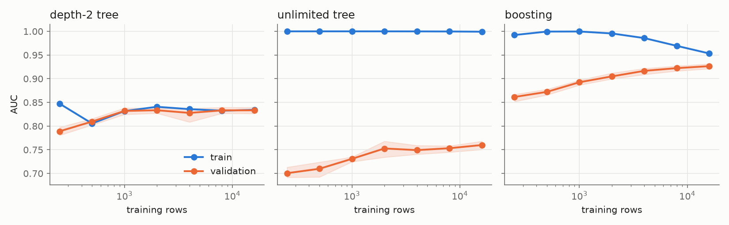
Learning curves name the problem before you touch a knob
Part 4 · Winning on tables
Train and validation AUC as rows grow. Low and together is underfitting, far apart is overfitting, high with a small gap is healthy.
At 16,000 rows, train then validation: depth-2 tree 0.834, 0.833. Unlimited tree 0.999, 0.760. Boosting 0.953, 0.927.
A small gap isn't enough: on adult census a depth-2 tree has a gap of 0.001 and sits nearly 0.1 AUC below boosting.
Source: notes/09-training-and-tuning.md
27
Notes:
Left panel, underfitting: more rows will not help, you need a richer model or better features. Middle panel, overfitting: the unlimited tree's gap only shrinks from 0.299 to 0.239 with 64 times the rows, so regularise. Right panel, healthy: move on, or add rows if they are cheap. The shaded band is the range over five fits.
Source: notes/09-training-and-tuning.md

Slide 28
Regularisation is one idea: charge for complexity
Part 4 · Winning on tables
Minimise training loss + λ × complexity. Scores are validation AUC.
Logistic: C
Tree: max_depth
Boosting: learning_rate
C=1 scores 0.902, C=1000 scores 0.891. Bigger C is a weaker penalty.
Depth 6 scores 0.879. Depth 24 scores 0.740, while train reaches 0.999.
A rate of 0.03 scores 0.908, and a rate of 1 scores 0.853.
Network: weight decay
Early stopping
Surprise: subsampling
None 0.860, decay of 10 0.904, and decay of 100 kills it at 0.500.
Stopping at step 1,000 matches L2: 0.9013 and 0.9016.
All rows scored 0.903 and a tenth of them 0.815. Popular advice lost here.
Set every knob with a validation curve, because a knob is only a hypothesis until the curve agrees.
Source: notes/09-training-and-tuning.md
28
Notes:
Signal repeats across rows and pays its way, and noise does not. These train on 1,500 rows, because 19,536 would hide much of the overfitting. The shape repeats: too little capacity, a peak, then train climbing while validation falls. Early stopping belongs here because weights start at zero and grow as training runs, so stopping early keeps them small. Training time and penalty strength are two handles on one thing. The subsampling result is one seed on a small sample, so it is a data point, not a law. AdamW multiplies the decay by the learning rate, so don't copy a good value between setups.
Source: notes/09-training-and-tuning.md

Slide 29
The training loop as a 10-step checklist
Part 4 · Winning on tables
CHECKLIST
Step What to do On adult census
1 Split Train, validation, test. Lock test away 19,536 / 6,512 / 6,513
2 Baseline Fit a dummy, then a simple model 0.759 acc., val. AUC 0.906
3 Default Fit a strong default, usually boosting Validation AUC 0.925
4 Curves Name the problem before touching a knob Gap 0.027, healthy
5 CV Compare fold by fold, against the spread Boosting +0.0197, sd 0.0025
6 Regularise Validation curve for the diagnosed knob Learning rate 0.03
7 Stop early Set patience, keep the best round Round 16, loss 0.2918
8 Search Random or TPE, fixed budget, check winner +0.0025-0.0041, report rows
9 Final Refit, read test once, give an interval 0.9272, 0.9209 to 0.9337
10 Stop A step moves less than the spread? Ship it
If a later step moves the score less than the spread, stop and ship.
Source: notes/09-training-and-tuning.md
29
Notes:
This is what you do on Monday. Steps 1 and 2 are practice rows, mock rows and exam rows, then a ladder of baselines. A person who reads validation scores and changes a setting is a learning algorithm too, so keep a test pile nobody touches. The dummy gets 0.759 because that is the share of people under 50K, and its AUC is 0.500. Step 6 was measured on 1,500 rows. Step 7 hides a trap: scikit-learn's HGB stops training but keeps the rounds it ran while waiting, so patience of 5, 25 and 100 gives log loss 0.2960, 0.3083 and 0.3561, and cutting back to the best round gives 0.2918 each time. Step 8: grid, random and TPE tied at 32 fits and five seeds, all within 0.0003 on search rows. And the winner flatters itself. Chosen on 100 rows it claims 0.9308 and truly scores 0.9223, an optimism of 0.0085, against 0.0013 at 1,000 rows (the point of Cawley and Talbot, 2010). Step 8's gain is on report rows. Step 9 refits on train plus validation and reads the test rows once. Reading the test pile while still deciding is the pitfall that makes the live score come in lower. You now have a number you can defend.
Source: notes/09-training-and-tuning.md

Slide 30
Folds must mimic how new data will arrive
Part 4 · Winning on tables
Your data | Splitter | Measured
Rare classes, or few rows | StratifiedKFold | On 200 rows, plain folds run from 0.2 to 0.35 positive. Stratified holds 0.275
Rows in groups, and new groups later | GroupKFold | Holding out occupations, AUC falls from 0.9279 to 0.9122, worst fold 0.8625
Rows arrive over time | TimeSeriesSplit | Citi Bike: shuffled folds claim R² 0.648, forward-only folds 0.590
If new data brings new groups or later dates, a shuffled split flatters the model.
Source: notes/09-training-and-tuning.md
30
Notes:
Holding out occupation asks how the model would do on a job it has never seen. Occupation stands in for customers, patients or stores, where the group split is usually the honest one. Spread jumps from 0.0041 to 0.0286. Adult has no time column, so the last row uses Citi Bike. Shuffling trains on next Tuesday to predict this Monday. Fold spread is only a rough size for noise, because folds share training rows: dividing the fold SD by root k was about 40% too confident on 500 rows. To compare two models, pair them fold by fold. Boosting beat logistic by 0.0197 on all five folds, with a paired SD of 0.0025 against 0.0041 and 0.0043 for each model alone.
Source: notes/09-training-and-tuning.md

Slide 31
Why did the model reject this applicant?
The problem
Part 4 · Winning on tables
Interpretability is not one property. Post-hoc explanations describe the model without being the model.
After Lipton, The Mythos of Model Interpretability
First name the question you are asking, because each tool answers a different one.
Source: notes/08-model-interpretability.md
31
Notes:
Lipton separates transparency, which means you can step through the model, from post-hoc explanation, which is everything we do here. Linear on heavily engineered features is not obviously transparent either.
Source: notes/08-model-interpretability.md

Slide 32
Three questions, three tools
Part 4 · Winning on tables
What does it rely on?
How does a feature act?
Why this row?
Permutation importance on held-out data
Partial dependence, with one line per row (ICE)
SHAP values for the row
Permutation is global, partial dependence shows shape, and SHAP explains one row, so match the tool to the question.
Source: notes/08-model-interpretability.md
32
Notes:
These three cover most real questions. All three depend on the data's correlations, as we'll see. LIME sits with SHAP as a local method, fitting a small surrogate around one row. Add a contrastive comparison when a person has to act on the answer.
Source: notes/08-model-interpretability.md

Slide 33
SHAP values add up to the model's score
Part 4 · Winning on tables
SHAP gives each feature a share of one row's score. The base value plus the shares should equal the model's raw score.
PYTHON
explainer = shap.TreeExplainer(model)
values = explainer.shap_values(X)
base = np.ravel(explainer.expected_value)[-1]
raw = model.predict_proba(X, raw_score=True)
# local accuracy gap: 0.0 across 2,000 rows
# base -2.387 + sum of SHAP 2.559 = 0.172
# education-num 13 +0.828
# relationship Husband +0.753
# marital-status Married-civ-spouse +0.653
# capital-gain 0 -0.253
Local accuracy means the base value plus a row's SHAP values equals its raw score, and you can check it.
Source: notes/08-model-interpretability.md
33
Notes:
This is a false positive, a 66-year-old married professional predicted at 0.543. Lundberg and Lee's theorem says Shapley values are the unique additive attribution with local accuracy, missingness and consistency. TreeExplainer makes it exact and fast for trees. It does not make the numbers causal. And explanations do not reliably help the reader. Miller (2019) finds people want contrastive, selected, causal answers. Dodge et al. (2019), with 160+ MTurk workers, find global and local styles reveal different fairness issues. Wang and Yin (2021) find that on low-expertise tasks none of four types reliably met all three goals. So when someone has to act on it, offer the contrast, you would have been approved if, and test the explanation on that person by the decisions they make with it.
Source: notes/08-model-interpretability.md

Slide 34
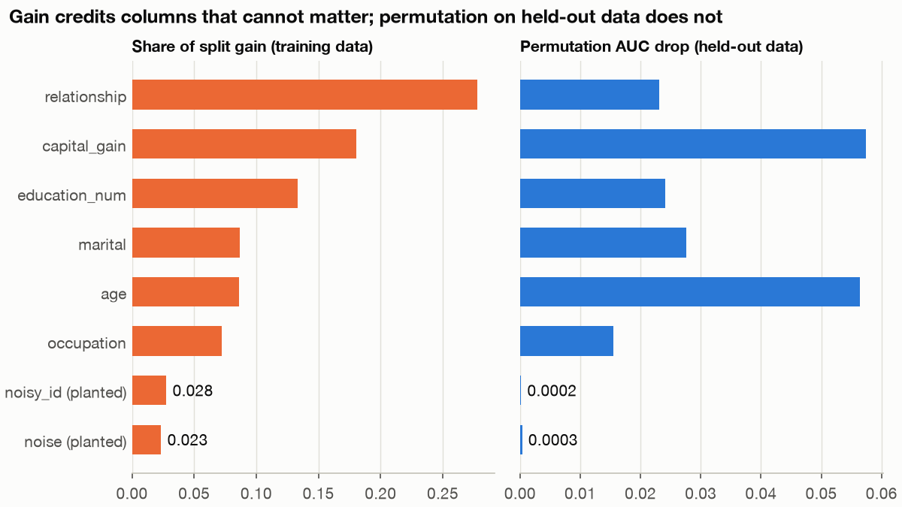
Built-in importance credits random columns
Part 4 · Winning on tables
LightGBM on adult census with two planted random columns: gain share 0.028 and 0.023, permutation AUC drop 0.0002 and 0.0003. Run practice/importance_noise.py.
Gain is measured on training data and credits overfit noise, so use permutation on held-out data.
Source: notes/08-model-interpretability.md
34
Notes:
Gain counts how much splitting a column did. Permutation shuffles it and measures the fall in AUC. The random columns rank above workclass, gender and race on gain. By permutation they fall to the bottom. But permutation has its own trap: add a noisy copy of age and age falls by a factor of nine, from 0.056 to 0.006. That closes the section: we can build, tune and explain the strongest model on a table. Next, what if there are no labels to score against?
Source: notes/08-model-interpretability.md

Slide 35
PART 5
No labels
No labels means no score. What now?
k-means misses the moons and DBSCAN finds them
Anomaly detection fits normal and flags the rest
Each clustering recipe hears different columns
The clusters looked sure and added nothing to the ranker
k-means and DBSCAN · Testing clusters on a music library
35
Notes:
Now the labels go away, and with them the score. We can use the forests, metrics and explanations we already have to check what we find.

Slide 36
No labels means no score. What now?
The problem
Part 5 · No labels
Now the labels go away, and with them the score.
Unsupervised learning has no ground truth, so no number tells you the structure you found is the one you wanted.
Judge by stability, by looking at the result, and by whether it helps a later task
Treat clusters and components as hypotheses to check, not results to report.
Source: notes/05-unsupervised-learning.md
36
Notes:
Two kinds of work live here. Transforming the data, with PCA, NMF or t-SNE, and grouping it, with k-means, hierarchical clustering or DBSCAN. Both end with a person looking at the output.
Source: notes/05-unsupervised-learning.md

Slide 37
k-means misses the moons and DBSCAN finds them
Part 5 · No labels
Two interleaved half-moons, 200 points, scaled first. ARI of 1.0 means perfect agreement with the true groups.
k-means
DBSCAN
You choose k
Finds the number of clusters
Assumes round clusters of similar size
Any shape, and flags noise
ARI 0.50 on moons
ARI 1.00 on moons
Can assign new points
eps is hard to set
Round clusters
Dense regions
Pick clustering by the cluster shape you expect, and scale first, because each one uses distance.
Source: notes/05-unsupervised-learning.md
37
Notes:
Neither is better in general. DBSCAN handles any shape, but too small an epsilon makes everything noise and too large makes one cluster. HDBSCAN removes most of that sensitivity.
Source: notes/05-unsupervised-learning.md

Slide 38
Anomaly detection fits normal and flags the rest
Part 5 · No labels
Fit a Gaussian to each feature. A row whose density falls below a cut-off, epsilon, is flagged as an anomaly.
PYTHON
def density(X, mu, var):
return np.prod(np.exp(-(X - mu) ** 2 / (2 * var))
/ np.sqrt(2 * np.pi * var), axis=1)
ex8 = loadmat("ex8/data/ex8data1.mat") # server metrics
mu, var = ex8["X"].mean(0), ex8["X"].var(0)
eps, f1 = select_threshold(ex8["yval"].ravel(),
density(ex8["Xval"], mu, var))
# epsilon 9.00e-05 F1 0.875 flagged 6 of 307
Fit on unlabelled normal data, choose the cut on a small labelled set, and score with F1.
Source: notes/05-unsupervised-learning.md
38
Notes:
Ng's exercise uses server latency and throughput. Anomalies are rare, so accuracy would say nothing. Use density when positives are few or may look new. Use a classifier when you have many stable positives. An isolation forest asks how easy a point is to cut off, not how likely it is. On this server data it doesn't win: AUC 0.878 against the Gaussian's 0.870, on nine anomalies, and forest seeds alone run from 0.870 to 0.887. It wins when anomalies sit in a gap between two regimes, 1.000 against 0.000 for a Gaussian per feature, and 60 noise columns take it from 0.965 to 0.489. Those two tables are generated by `practice/isolation_forest.py`.
Source: notes/05-unsupervised-learning.md

Slide 39
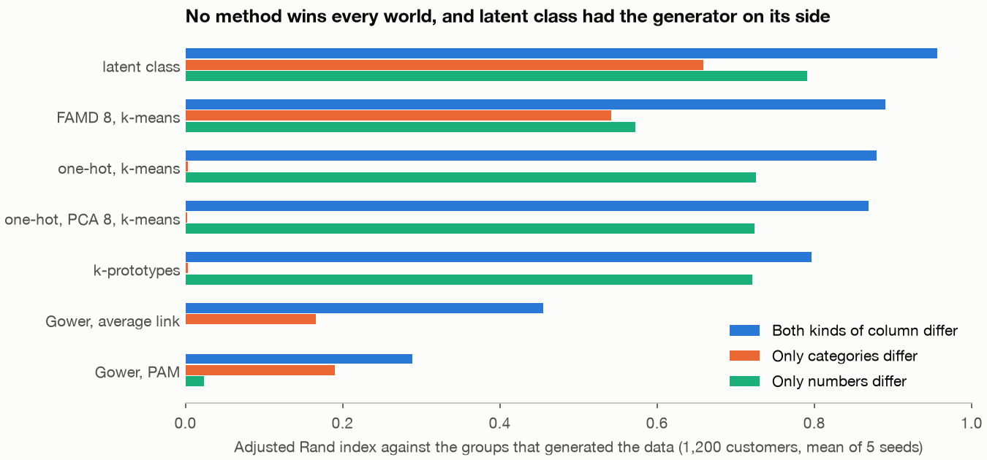
Each clustering recipe hears different columns
Part 5 · No labels
One-hot, k-means: 0.879 when numbers and categories both hold the groups, 0.003 when only categories do.
FAMD, k-means: 0.890 and 0.542, the only distance recipe that hears both here.
Gower, PAM: 0.289 with equal weights, because categories move the distance about three times as much.
CatBoost on the labels: 0.913 accuracy with no groups present, so it explains and can't validate.
ARI on 1,200 generated customers, mean of 5 seeds, in three worlds. Latent class has home advantage: the generator is its model.
Run every method against a shuffled-column control, and judge segments on an outcome that wasn't used to fit them.
Source: notes/05b-clustering-categorical-and-mixed-data.md
39
Notes:
Every method invents a distance for categories, and that choice decides whose columns get heard. FAMD z-scores the numbers and divides each centred dummy by the square root of its share, so each column can contribute at most 1 to any axis. MCA is the version for categories alone, and its raw percentages understate the first axis. Gower averages per-column scores and needs an n by n matrix, 80 GB at 100,000 customers. Latent class assumes columns are independent within a class, and it's the only one here that can answer "no groups" through BIC. All of these tables are generated, so read the shape and not the ranking. Published simulations also put Gower with PAM last, and they too draw numbers from normals. On Palmer penguins, numbers alone beat every mixed method, so which columns you include is itself a choice.
Source: notes/05b-clustering-categorical-and-mixed-data.md

Slide 40
The clusters looked sure and added nothing to the ranker
Case: clustering a music library
Part 5 · No labels
Suggest tracks for a saved playlist: 2,182 tracks, nine audio features, one LightGBM per playlist at AUC 0.870 on audio.
Check | Measured | What it means
Raw or scaled columns | Match to clusters on track length alone: 0.988 raw, 0.072 scaled | Unscaled, milliseconds are the clustering
Median top posterior | 0.992, with seed agreement of 0.718 | Confident inside one model, not proven right
Add cluster posteriors to the ranker | AUC -0.001 (95% CI -0.007 to +0.005) | Trees already carve the raw features
Swap audio for map position, genre group, year | AUC +0.050 (95% CI 0.028 to 0.075) | Losing the audio features cost nothing here
Test them on a later task: added to one music ranker, cluster features did not raise AUC.
Source: notes/05-unsupervised-learning.md
40
Notes:
A real project and real data, a personal recommender: a Gaussian mixture narrows the candidates and one LightGBM model per playlist ranks them. Three criteria gave three answers for k: BIC is lowest at 11, silhouette is best at 2 or 3, and seed agreement is best at 2. BIC scores fit with a penalty for extra parameters, and 11 to 13 sit within seed noise, and k=13 has a cluster of 11 tracks. Silhouette scores how much closer a point sits to its own cluster than the next one, so it favours k-means by construction. Shuffle each column separately, which destroys any real groups, and silhouette falls from 0.258 to 0.107, but BIC still picks k=7, so a BIC minimum doesn't show that groups exist. The project's k = 8 matches its eight genre groups, which is a product reason, so state it as one. Your columns decide what clusters mean too: match to decade is 0.714 on the project's 47 columns and 0.039 on the nine audio features. Playlist-mean columns scored AUC 1.000, which is a leak: one playlist, identical values. The surprise is that the clusters earned no place in the ranker. Spotify cut audio features from new apps in November 2024, so the lab tested whether losing them hurts, and on this task it doesn't. Two caveats. The same person wrote the genre taxonomy and filed the playlists, which flatters the proxies. And the non-members are tracks saved to other playlists, so this measures filing, not taste. The first row is why we scale, and the leak is why you look at any AUC of 1.000 twice. That closes the section: with no labels, every result needs a check from outside it. Next, back to labels.
Source: notes/05-unsupervised-learning.md

Slide 41
PART 6
97% accurate, and it catches no defaulters. What now?
Type I and Type II errors are business costs
Each loss rewards its own forecast
The threshold matters far more than resampling
Resampling can fool you twice
Different monitors see different kinds of drift
A noise fix gained 18.6 on rows read and lost 8.3 unread
What the number hides
Error costs · Losses · Threshold or SMOTE · Reading errors
41
Notes:
Back to labels, and to the number we said we could defend. What does it hide when the event is rare and the world moves, and which rows are wrong?

Slide 42
97% accurate, and it catches no defaulters. What now?
The problem
Part 6 · What the number hides
Back to labels, and to the number we said we could defend.
When 3 customers in 100 default, a model that approves everyone is 97% accurate and worthless.
Default of Credit Card Clients, 30,000 customers. We thinned the defaulters from 22.1% to 3%
Approving everyone scores 97% and catches no defaulter, so price each error and count the events.
Source: notes/10-imbalance-errors-and-drift.md
42
Notes:
The 3 percent is our choice. It changes the base rate and nothing else, so every absolute rate here belongs to that thinned population and not to any real book. A boosted model at the default threshold of 0.5 catches none of the defaulters. Its ranking is fine. What's missing is a decision rule. Count events, not rows. Detecting a 20 percent cut in defaults takes 11,452 rows per arm at 3 percent and 1,284 at 22 percent, which is similar in events, 343 and 282. ROC-AUC has an SD of 0.039 with 50 defaulters and 0.018 with 200. This test set of 4,818 rows holds only 145 defaulters, so report the event count and the SD of the score.
Source: notes/10-imbalance-errors-and-drift.md

Slide 43
Type I and Type II errors are business costs
Part 6 · What the number hides
Take H0 as "this applicant is good". Flip it and the names swap, so state yours. The costs below are assumptions.
Type I: decline a good customer
Type II: approve a defaulter
Costs the margin, assumed at 600
A loan of 5,000 at 60% loss costs 3,000
Quiet: nobody ever sees it
Loud: it lands in the accounts
Pushed down to 0.05: 452 of them
Pushed down to 0.05: 79 of them
Rate α
Rate β
Decline when P(default) reaches the lost-customer cost over both costs, 1/6 at 5:1, if the probabilities are real.
Source: notes/10-imbalance-errors-and-drift.md
43
Notes:
Pushing the threshold down trades one error for the other. At 0.05 the lender catches 45 percent of defaulters, but the rate of good customers declined goes from 1.5 to 9.7 percent, and it pays more at this ratio. The best alpha isn't a statistical constant like 5 percent. It comes from the price list. A thin margin of 150 makes the ratio 20:1 and the threshold 1/21. We carry both ratios.
Source: notes/10-imbalance-errors-and-drift.md

Slide 44
Each loss rewards its own forecast
Gneiting, 2011
Part 6 · What the number hides
Four constant forecasts on one skewed target, 100,000 lognormal draws. Bold marks the lowest loss in each column.
Forecast | Value | RMSE | MAE | Pinball 0.9 | MAPE
The mean | 1.648 | 2.191 | 1.261 | 0.631 | 1.978
The median | 0.996 | 2.286 | 1.125 | 0.824 | 1.125
90th percentile | 3.586 | 2.925 | 2.505 | 0.477 | 4.994
Best for MAPE | 0.367 | 2.538 | 1.323 | 1.174 | 0.684
Choosing a metric chooses the quantity you forecast, and a metric you tune against also chooses a threshold.
Source: notes/11-choosing-a-metric.md
44
Notes:
Nothing here is a better model, since all four are one number. Each column has a different winner, and the winner is the forecast built for that column. RMSE picks the mean, MAE the median, pinball its quantile. MAPE's favourite is 0.367, far under the median of 0.996, so about 84 percent of outcomes sit above it. Run practice/metric_map.py for these. The same goes for thresholds. On the 3 percent credit data at 5 to 1 costs, tuned on validation, accuracy's pick declines nobody. Balanced accuracy's declines 27 percent of applicants at 303 per 1,000, twice the 150.5 of approving everyone. MCC's pick is close to the cost-tuned one at 5 to 1, 150.1 against 148.8, and further at 20 to 1, 467.6 against 428.2, because MCC has no cost in it and cannot respond when the ratio changes. So only tune on a metric that holds your costs.
Source: notes/11-choosing-a-metric.md

Slide 45
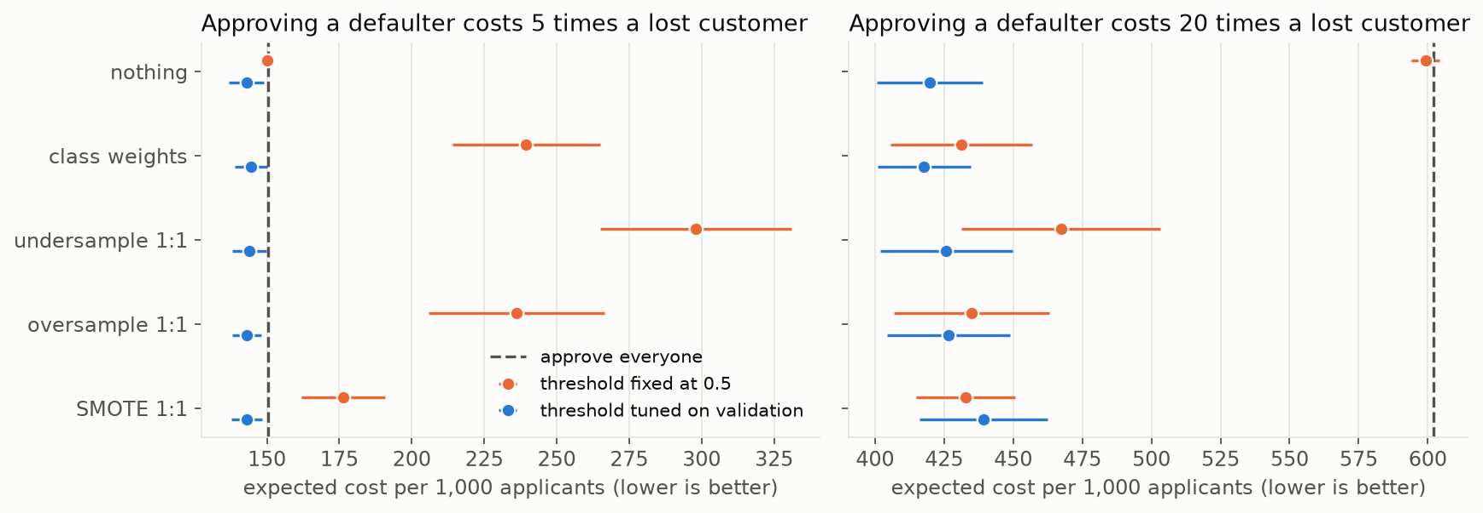
The threshold matters far more than resampling
Part 6 · What the number hides
SMOTE invents new rare-class rows. Cost per 1,000 applicants. At 5:1, SMOTE costs 176.4 with the threshold at 0.5 and 143.1 with it tuned.
Across 10 settings, SMOTE at 0.5 lost beyond noise in 8 and never won. With its own tuned threshold, it tied in all 10.
Tune the threshold and leave the data alone, since on the 3% credit file tuned costs span 142.4 to 144.5 per 1,000 applicants and the seed moves them by 5.9.
Source: notes/10-imbalance-errors-and-drift.md
45
Notes:
Orange is the threshold at 0.5 and blue is tuned on validation. Blue clusters, orange scatters. A 1:1 training set moves the 0.5 cut-off to about the base rate, which is what a 32:1 cost ratio would ask for, so resampling at 0.5 is threshold moving with an unstated cost ratio. No method beat doing nothing on ranking, and on ROC-AUC SMOTE was 0.022 lower. We expected SMOTE to help the neural net, and it didn't: 0.683 against 0.742. That is one small network on one dataset. Elor's 73 datasets support the tie for strong learners, not a general loss. Also a modest prize: at 5:1 the model saves only 5 percent against approving everyone, and at 20:1 it saves 30 percent.
Source: notes/10-imbalance-errors-and-drift.md

Slide 46
Resampling can fool you twice
Part 6 · What the number hides
PYTHON
The leak: folds hold copies of training rows, so CV measures memory.
# Wrong: resample, then split into folds
x_res, y_res = SMOTE().fit_resample(x, y)
cross_val_score(hgb(), x_res, y_res, cv=cv)
# leaked CV 0.984, test 0.703
# Right: the sampler lives in the pipeline
pipe = Pipeline([("scale", StandardScaler()),
("smote", SMOTE()),
("clf", hgb())])
cross_val_score(pipe, x, y, cv=cv)
# pipeline CV 0.697, test 0.703
The scores: SMOTE predicts a mean default risk of 0.305 on a book at 0.030.
The price: cost at the 1/6 rule is 777 against 143.
The repair: Platt scaling on validation returns the mean to 0.030.
Put the sampler in the pipeline, and if you resample, recalibrate on untouched data before you price.
Source: notes/10-imbalance-errors-and-drift.md
46
Notes:
The mistake is easy because fit_resample followed by cross_val_score is short and raises no error. ROC-AUC is the honest comparison here since it ignores the class mix. On probabilities, tuning the threshold hid the damage, because a threshold only needs order. A lender prices with a probability: SMOTE's raw scores predict 11.3 percent default among those approved, when 1.0 percent happens. After repair every method has the same Brier as doing nothing, 0.028, so resampling and its repair cancel out. That's why we leave the data alone.
Source: notes/10-imbalance-errors-and-drift.md

Slide 47
Different monitors see different kinds of drift
Part 6 · What the number hides
PSI measures how far a distribution has moved from its reference window, and needs no labels. These windows are simulated on real rows.
What happened | Worst feature PSI | Score PSI | ROC-AUC | Reading
No change | 0.011 | 0.007 | 0.764 | The noise floor
Covariate: towards low limits | 0.319 | 0.083 | 0.759 | Loud, and harmless to the model
Prior: default rate doubles | 0.011 | 0.008 | 0.757 | Nearly silent
Concept: what predicts default changes | 0.011 | 0.007 | 0.600 | Silent, only labels show it
Skew: features one month stale | 0.531 | 0.012 | 0.726 | The score monitor misses it
Skew: PAY_0 filled with 0 | 3.539 | 0.073 | 0.717 | Silently stopped working
Concept shift looks like no change at all, so monitor inputs as well as the score and get labels when you can.
Source: notes/10-imbalance-errors-and-drift.md
47
Notes:
Concept shift is the frightening row: identical features by construction, so every PSI equals the no-change row, while ROC-AUC falls. With PAY_0 filled, declines collapse from 2.4 to 0.1 percent and cost hits 150, the approve-everyone line. Amounts recorded in thousands are the opposite case, a huge alarm with moderate harm: worst feature PSI 7.706, score PSI 3.291, ROC-AUC 0.753. Stale features show 0.531 only when the coded column is binned by level, and 0.049 with quantile bins, so bin coded columns by level. The noise floor here was 0.011, and the 0.1 and 0.25 lines are conventions. In credit scoring labels arrive a year late, so input and prediction monitors are what you have.
Source: notes/10-imbalance-errors-and-drift.md

Slide 48
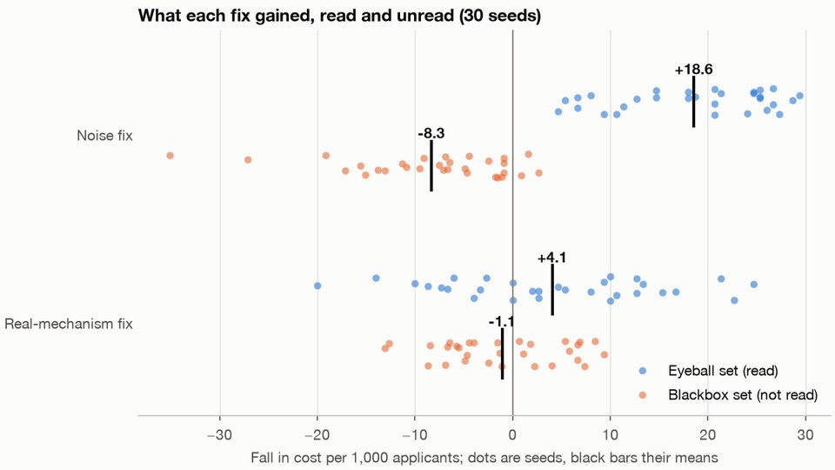
A noise fix gained 18.6 on rows read and lost 8.3 unread
Part 6 · What the number hides
Read the errors, patch the worst-looking slice, then rescore. Fall in cost per 1,000 applicants.
Mechanism fix: +4.1 read, -1.1 unread, so it did not work either.
Test set, used once: gain 5.5, interval -7.3 to 18.2, so no evidence of a gain.
Thirty seeds. The noise fix gains 18.6 per 1,000 on the rows read and loses 8.3 on the rows not read, on 27 of 30 seeds. Run practice/reading_errors.py.
Read errors on one set and score the fix on rows you did not read, because reading selects on noise.
Source: notes/12-reading-the-errors.md
48
Notes:
Look at the mean bars. Any slice picked for being bad looks fixable on the rows we read: it was bad by chance, and that badness doesn't repeat. We expected the real-mechanism fix to survive, and it did not, with 13 seeds above zero and 17 below. Boosted trees had already taken most of what those columns hold. Reuse a holdout to accept 20 rounds of noise patches and it reports a gain of 16.5, while a fresh half shows -1.9, so a held-out set can only select so many times before it becomes another training set. That closes the section: the number now comes with its costs and its blind spots. Next, who decides what to do with it?
Source: notes/12-reading-the-errors.md

Slide 49
PART 7
Reviewing everything beat one threshold. Why?
Price each route and the thresholds follow
Better policy saved 2.49 euros, a perfect model at most 0.07
A full queue should hold the coin flips, not the riskiest
The worst failures leave the dashboard green
What if silence is not approval?
Agreement is not correctness
Uncertainty sampling won on invoices and lost on real credit
Silence recovered by month 8, slowly and at a price
Correction rate can't tell a tired clerk from a good model
When base rates differ, you can't equalise every error
People and accountability
Three routes · Silent failures · Agreement · Random audit · Group gaps
49
Notes:
One threshold assumes only two answers. A score isn't yet a decision. Which cases may the model take alone, what can the people reviewing it teach it, what do they never see, and who bears the errors?

Slide 50
Reviewing everything beat one threshold. Why?
The problem
Part 7 · People and accountability
One threshold assumes only two answers. What if asking a person is a third?
A clerk on every invoice costs 4.471 euros each. A model with one threshold costs 5.802. Two thresholds with a review band between them cost 3.312.
Own simulation, with invoices and prices invented. Mean of 20 seeds on 50,000 test invoices
A third answer, ask a person, changes the question from how accurate the model is to which decisions it may take alone.
Source: notes/13-automate-review-or-reject.md
50
Notes:
The clerk beating the model isn't a law. It follows from a cheap clerk who catches 90 percent, and a higher review price would reverse it. A word on vocabulary: in the papers, reject means abstain and pass to a person. Here reject means sending an invoice back, which is an automated decision.
Source: notes/13-automate-review-or-reject.md

Slide 51
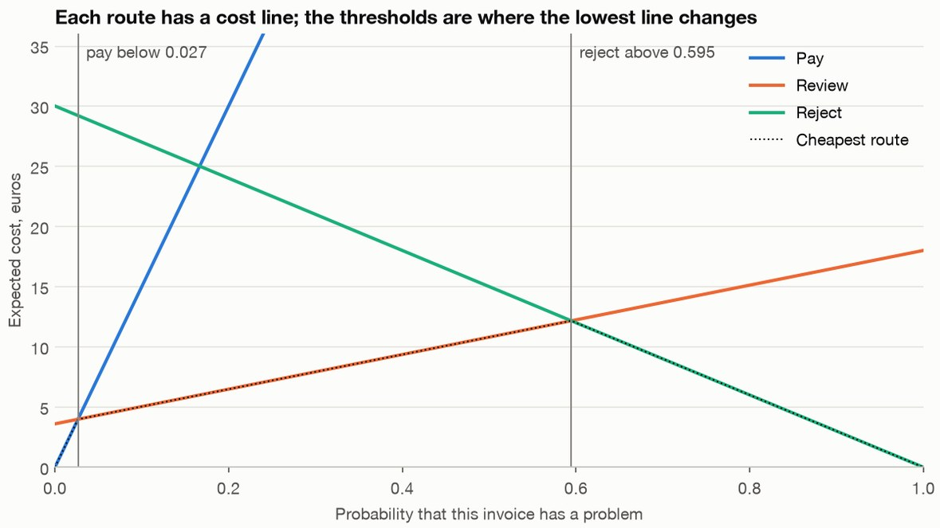
Price each route and the thresholds follow
Part 7 · People and accountability
Prices: paying a problem 150, sending back a good invoice 30, a clerk's four minutes 3.
This clerk catches 90%: pay below 0.027, reject above 0.595.
A perfect clerk: 0.020 and 0.900.
Each route's expected cost is a straight line in the probability of a problem. Generated invoices, invented prices. Run practice/review_queue.py.
No review route: reject above 0.167.
Write each route's cost as a line, take the crossings, and use the person's measured catch rate, not a perfect one.
Source: notes/13-automate-review-or-reject.md
51
Notes:
This is an old result, usually cited to Chow in 1970. Bartlett and Wegkamp state the symmetric form: never abstain if abstaining costs more than half an error. Our version lets the errors cost different amounts and the person be imperfect. Notice how low the pay threshold sits: we pay alone only under 2.7 percent, against a base rate of 6 percent. That follows from the 50 to 1 ratio of a paid problem to a review, not from anything about this model. At a review price of 20, a clerk who catches 60 or 75 percent has no band at all, so the rule falls back to one threshold. You can price a review route before you build the screen.
Source: notes/13-automate-review-or-reject.md

Slide 52
Better policy saved 2.49 euros, a perfect model at most 0.07
Part 7 · People and accountability
Seven policies on the same 50,000 test invoices, mean of 20 seeds. The model's AUC is 0.858, and the true probabilities reach only 0.861.
Policy | Decided alone | Reviewed | Error on paid | Euros per invoice
Pay everything | 1.000 | 0.000 | 0.061 | 9.076
Review everything | 0.000 | 1.000 | n/a | 4.471
One threshold | 1.000 | 0.000 | 0.030 | 5.802
Two, perfect clerk assumed | 0.506 | 0.494 | 0.011 | 3.427
Two, priced | 0.619 | 0.381 | 0.013 | 3.312
Two, searched on validation | 0.607 | 0.393 | 0.013 | 3.341
Two, priced, true probability | 0.625 | 0.375 | 0.013 | 3.242
Policy saved 2.49 euros per invoice; a perfect model adds at most 0.07, so fix policy first.
Source: notes/13-automate-review-or-reject.md
52
Notes:
Two thresholds beat one on every seed. The share decided alone fell from 100 to 62 percent, and that is the price of the saving, so treat it as a constraint and not a goal. Assuming a perfect clerk costs 0.115 euros and never opens the reject route. A grid search on 10,000 validation invoices wins on only 2 of 20 seeds, because it fits the validation noise, so with calibrated scores and known prices the formula needs fewer labels. Then the real credit file, at its natural 22.1 percent default rate, with an analyst we assumed: review 60, catching 70 percent. Two thresholds again beat one on all 20 seeds, by 93.58 per applicant, but only 24 percent is decided alone. With a weaker assumed analyst the saving falls to 17.94. Don't carry the invoice numbers into your system. Carry the method, then measure the catch rate and the review time.
Source: notes/13-automate-review-or-reject.md

Slide 53
A full queue should hold the coin flips, not the riskiest
Part 7 · People and accountability
OUTPUT
Highest score: a person can only agree at p of 0.953, so the queue costs money and changes little.
Review capacity, seed 0
Outside capacity, one threshold decides
capacity rule cost low_p high_p
0.200 expected saving 3.370 0.056 0.503
0.200 highest score 3.493 0.064 0.953
0.050 expected saving 4.661 0.137 0.257
0.050 highest score 5.279 0.290 0.953
0.020 expected saving 5.157 0.155 0.201
0.020 highest score 5.562 0.491 0.953
Expected saving: at 2% the band tightens around 1/6, where pay and reject cost the same.
Rank the queue by expected saving, since at 5% capacity the highest scores cost 5.279 against 4.661.
Source: notes/13-automate-review-or-reject.md
53
Notes:
The instinct is the riskiest first, and that's wrong. These are the invoices where the decision without a person is closest to a coin flip in euros. The queue that feels most useful to reviewers, because they keep finding real problems, is the one that wastes them. Costs can also vary by invoice. Scale a paid problem with the amount and set thresholds row by row: the error rate on paid invoices gets worse, 1.9 percent against 1.2, and the money lost on them falls from 1.194 to 0.763, with total cost going from 3.404 to 2.726. So a target like under 1.5 percent error can point the wrong way.
Source: notes/13-automate-review-or-reject.md

Slide 54
The worst failures leave the dashboard green
Part 7 · People and accountability
PSI measures how far the scores moved, and needs no labels. Each row is one change, with the truth known because we simulated it. Error on paid is 0.014 with no change.
Change | What you would see | What is true | What it takes
Class weights | AUC 0.855 against 0.857 | Pays 0.3% not 60%, cost 6.714 | Platt scaling, cost 3.348
Newer suppliers | PSI 0.251, the alarm rings | Error on paid stays 0.014 | Nothing. The model handled it
Twice the problems | PSI 0.009, looks stable | Error on paid 0.027 | Recalibrate: error 0.016, paid share 23%
New fraud type | PSI 0.001, paid share flat | Error on paid 0.033 | New labels and a retrain. Platt leaves 0.029
No score monitor can see a new fraud type, so buy labels on automated cases and check calibration near the thresholds.
Source: notes/13-automate-review-or-reject.md
54
Notes:
Platt scaling fits a small logistic curve that remaps scores to probabilities. Read the rows against what a dashboard can see. The largest PSI came with an unchanged error rate, so a high PSI is not bad news. The new fraud type is the silent one: nothing the model sees has changed, only what those inputs mean. Recalibration lifts every score and can't single out the round-amount invoices. Two more that look fine. The largest paid share that meets the target on validation broke it on 33.5 to 69 percent of draws, and a bound fixes that, though at 1 percent on 2,000 labels it pays nothing. A conformal set at 90 percent coverage keeps its promise and covers 3.4 percent of true problems, and calibrating per class gives 95.5 percent at alpha 0.05. On a contract number instead of a price, Selection with Guaranteed Risk (Geifman and El-Yaniv, 2017) never broke its target over 200 draws, but with a 2 percent target it took 10,000 labels to pay 65 percent against a possible 81. Certify 2 percent on 50,000 labels, introduce the new fraud, and the router pays 77 percent at 3.77 percent error. So the certificate describes data that no longer arrives. Conformal costs 3.231 at best against the priced 3.171, so it doesn't earn its place as a router. Next: where the labels come from.
Source: notes/13-automate-review-or-reject.md

Slide 55
What if silence is not approval?
The problem
Part 7 · People and accountability
Count silence as correct and the error on paid invoices reads 0.14%. The truth is 1.37%.
Own simulation, where 10% of problems surface later. A random audit of 530 invoices reads 0.0138, at 0.032 euros per invoice
Corrections cover only what the model showed people, so measure the rest with a random audit chosen before anyone looks.
Source: notes/14-learning-from-corrections.md
55
Notes:
In one month a clerk sees 71.5 percent of the problems. Another 14.2 percent were paid with nobody looking, and no correction will ever mention them. Silence is wrong by a factor of ten, and very precisely wrong, as its narrow range shows. The audit is unbiased and noisy, 0.0034 to 0.0255 over 500 draws. If the same clerk audits, you inherit their misses, 0.0124, so use a second person or seeded problems. A sample of suspicious invoices measures how suspicious invoices behave, so it can't give you a rate.
Source: notes/14-learning-from-corrections.md

Slide 56
Agreement is not correctness
Part 7 · People and accountability
Kappa scores agreement beyond chance, and 1 is perfect. Generated invoices, with cost in euros per invoice at the priced thresholds.
Check | Measured | What it means
Two annotators with a shared blind spot | Highest kappa, 0.797. Recall 0.000 on 13% of problems | Seed known problems
Same pair of annotators on 200 double labels | Kappa anywhere from 0.312 to 0.740 | The rare class drives it
Flip 5% of labels at random | AUC 0.857 to 0.851, pays 0.1%, cost 4.414 | 5,000 true labels restore 3.386
Miss problems on small invoices | AUC 0.830, cost 3.607 calibrated on true labels | Calibration can't fix ranking
Check annotators against a source of truth outside the pair, and keep a small set of trusted labels for calibration.
Source: notes/14-learning-from-corrections.md
56
Notes:
Kappa measures whether people agree, so two people trained the same way can agree on the same mistake. Confident learning reaches a precision of 0.121 to 0.347, and a plain rule wins on symmetric noise, so treat it as a list to review and not a rule. This isn't the paper's result: its image results are far higher, and we think the noise in the outcome is why, though we didn't test that. Eight labelling rules, combined two ways: a plain vote cost 3.773 and learned weights 4.119, at 1.02 votes per row. Learned weights losing is against the method's name. Ours is an independent EM sketch, not Snorkel's model, and the paper's own analysis predicts it at low label density. Add four copies of one rule and the learned weights collapse to an AUC of 0.562, because the model reads the copies' agreement as accuracy. We wrote the rules while knowing the generator, and every row was calibrated on 5,000 true labels, so both flatter the rules. The vote at 3.773 sits between 1,000 clerk labels at 4.021 and 5,000 at 3.696.
Source: notes/14-learning-from-corrections.md

Slide 57
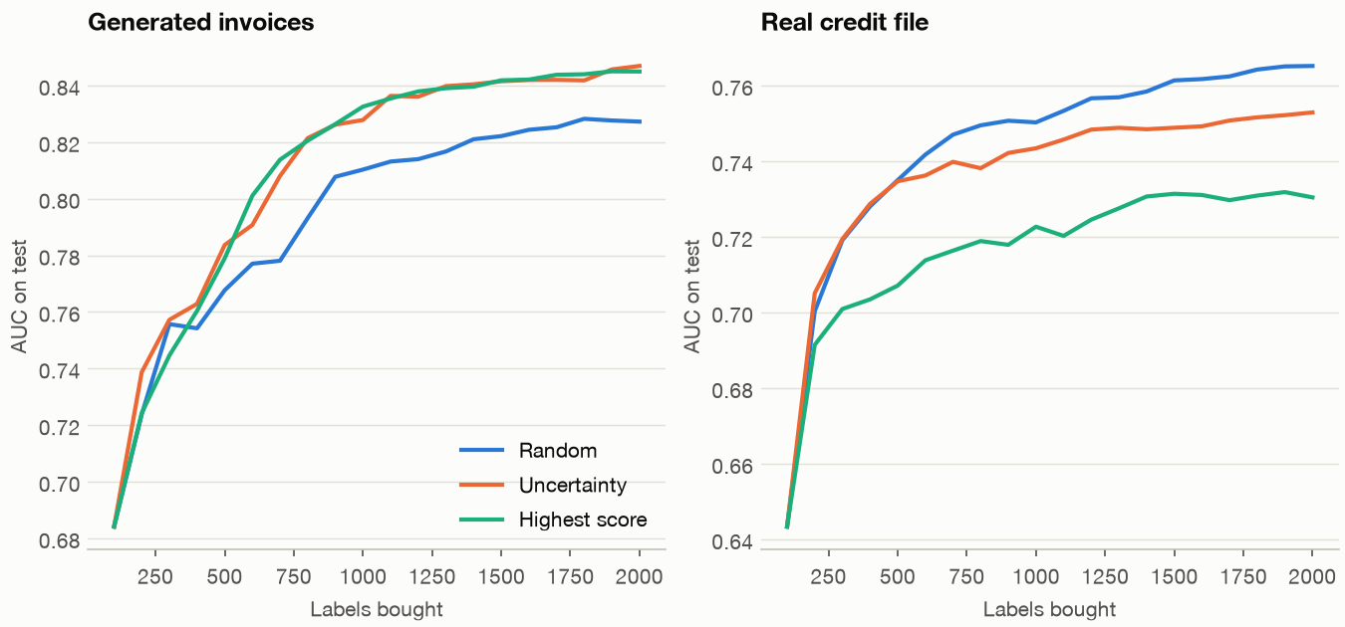
Uncertainty sampling won on invoices and lost on real credit
Part 7 · People and accountability
Invoices at 2,000 labels: AUC +0.020 and 0.206 euros cheaper, on all ten seeds.
Credit: AUC -0.012 boosted and -0.026 logistic, losing on all ten seeds.
Biased set: 46 to 48% defaulters against 22%.
Boosted model, 100 labels bought at a time. The credit file is real data, the invoices are generated. Run practice/learning_from_corrections.py.
Only a comparison on your data can tell, and it needs a random sample anyway.
Source: notes/14-learning-from-corrections.md
57
Notes:
We can't name the cause from this run. The survey by Settles has seen it before, and it admits publication bias may flatter active learning. The cost column on credit is more mixed: boosted is better by 0.802 on 6 of 10 seeds, on a cost near 244, and logistic is worse by 4.346. Two worries didn't appear on invoices: batches of 500 did as well as batches of 100, and missing 30 percent of problems left the gain at 0.022. A review queue is already an active learner of a sort, since the model chose the rows people see. Keep such a set for training, never estimate a rate from it, and use a random set for calibration.
Source: notes/14-learning-from-corrections.md

Slide 58
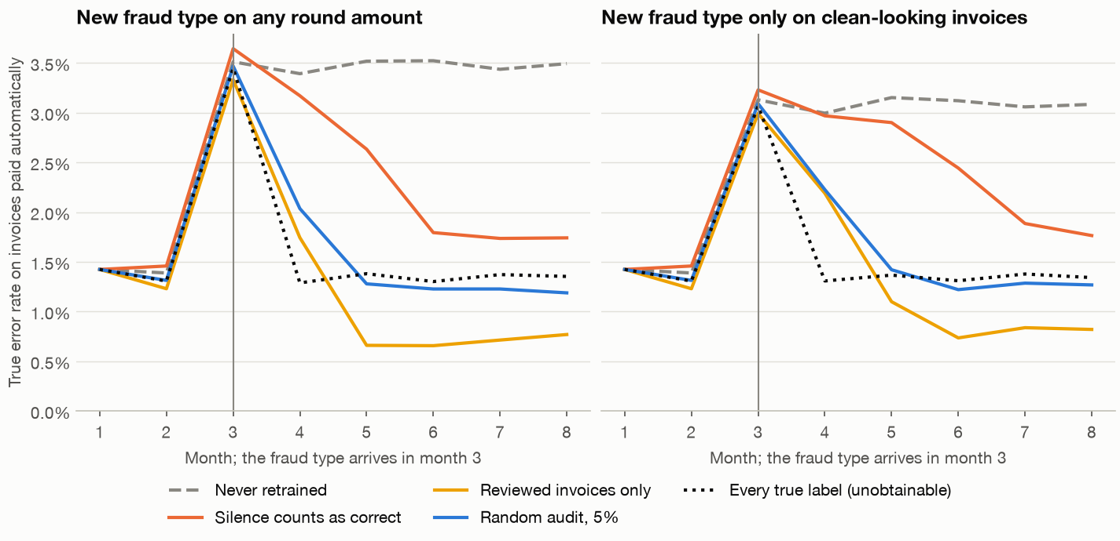
Silence recovered by month 8, slowly and at a price
Part 7 · People and accountability
We expected permanent blindness. No: at month 8 silence costs 3.905, the audit 3.890.
Month 5: silence still pays 33% of the new type, the audit 1.1%.
Eight months, 10,000 invoices each, mean of 8 seeds, all simulated. The new fraud type arrives in month 3.
Retrain on the labels you get, and keep a small random audit to measure, because silence recovers slowly and misreads the error.
Source: notes/14-learning-from-corrections.md
58
Notes:
Training on reviewed rows only, by month 5 it sends 95.6 percent to review. Over months 3 to 8, in euros per invoice against a 5 percent audit, silence costs +0.311, reviewed only +0.292 and never retraining +1.146. Audits of 2 and 5 percent trained about equally well. So the case against silence isn't permanent blindness. It's slower recovery, a lasting error on paid of 1.7 percent against 1.2, and a wrong measurement. Those are the left panel's numbers. In the harder right panel silence still pays 68.5 percent at month 5 against 7.9, and costs +0.393. How large an audit? For a drift from 1.3 to 3.3 percent, 100 invoices catch it 42 percent of the time, and 1,000 catch it almost always, for 3,000 euros per period. One result we can't fully explain: the audit policy pays less than the true-labels ceiling at month 8, 45.7 percent against 57.8. Failures also make good test cases, as a gate only: three candidates passed a 30-case suite at 1.000 and their costs ran from 4.146 to 3.864, so only fresh data can rank them.
Source: notes/14-learning-from-corrections.md

Slide 59
Correction rate can't tell a tired clerk from a good model
Part 7 · People and accountability
The clerk's catch rate falls from 0.9 to 0.3 and the final error doubles. The correction rate barely moves, and it goes the wrong way.
OUTPUT
case correction_rate problems_in_accepted final_error
strong model, clerk catch 0.9 0.210 0.012 0.023
strong model, clerk catch 0.6 0.213 0.049 0.036
strong model, clerk catch 0.3 0.217 0.083 0.049
weak model, clerk catch 0.9 0.182 0.011 0.024
weak model, clerk catch 0.6 0.181 0.043 0.038
A falling correction rate can mean a better model, a worse model or a clerk who stopped looking, so seed known problems.
Source: notes/14-learning-from-corrections.md
59
Notes:
The two effects cancel. A clerk who catches a problem the model suggested paying registers a correction, and so does a clerk who waves through a problem the model suggested rejecting. The weak model was trained on 2,000 invoices, and its correction rate of 0.182 reads as an improvement. It's a useful signal that something changed. It can't say what.
Source: notes/14-learning-from-corrections.md

Slide 60
When base rates differ, you can't equalise every error
Chouldechova; Kleinberg et al., 2017
Part 7 · People and accountability
An invented employer and generated applicants. One score, calibrated per group on a work sample that 0.345 of group A and 0.265 of B pass. Test rows, each cell reads A / B.
Decision rule | Selected | PPV: selected who pass | FPR: non-passers selected | FNR: passers missed
One cutoff at 0.45 | 0.308 / 0.173 | 0.621 / 0.601 | 0.178 / 0.094 | 0.446 / 0.608
Equal PPV, 0.62 | 0.309 / 0.152 | 0.621 / 0.616 | 0.179 / 0.080 | 0.444 / 0.646
Equal TPR | 0.257 / 0.228 | 0.653 / 0.565 | 0.136 / 0.135 | 0.514 / 0.514
Equal TPR and FPR, randomised | 0.197 / 0.173 | 0.687 / 0.601 | 0.094 / 0.094 | 0.608 / 0.608
With unequal base rates and imperfect prediction, equal PPV and FNR force unequal FPR, so someone has to choose which gap to close and own it.
Source: notes/15-fairness-in-automated-scoring.md
60
Notes:
Now, who bears the errors of an automated decision? Brackwater Freight is invented, it interviews the top 20 percent, and every number here describes the generator, in which we planted the gaps. Audits start with decisions and a group column. A model trained on past recruiter decisions, with the group column dropped, advances 22.8 percent of A and 10.7 percent of B, an impact ratio of 0.469, with an interval of 0.430 to 0.512. The four-fifths rule is a US federal employment rule of thumb, not a pass mark or a finding of discrimination, and its Guidelines were under rescission review on 4 November 2026. This is engineering, not legal advice. The table uses a different score, trained on audited work samples without proxies. Read down the columns. Chouldechova's identity, FPR = p/(1-p) x (1-PPV)/PPV x (1-FNR), holds exactly in every row, and Kleinberg's theorem says calibration and balance need perfect prediction or equal base rates. The last row levels down: A's selection falls from 0.308 to 0.197, with coin flips deciding some of it, and B gains nothing. The label is the next trap. Against recruiter history the naive model looks calibrated across groups, with a mean gap of 0.033, and against the work sample the gap is 0.124. Dropping the group column left 96.5 percent of decisions unchanged, because postcode alone identifies B at AUC 0.827. So an audit states the decision, the population, where each label came from, counts with intervals, the alternatives tried, the jurisdiction and date, and what is not established. It doesn't find out whether the model is fair. That closes the last section, so let's collect what to take with you.
Source: notes/15-fairness-in-automated-scoring.md

Slide 61
Rules of thumb for classical ML
Take it with you
Baseline first
Test once
Fit inside the fold
Dummy, then linear, then boosting. Each sets a bar.
Choose on validation or CV, and report test a single time.
Any step with a fit goes in the pipeline.
Cost sets the routes
Family before tuning
Keep watching
Price each error and each review, and leave the data alone.
Tuning gained 0.0009, the family 0.025. Compare across seeds.
Score monitors miss most drift, so audit a random sample nobody chose.
Most of classical ML's failures are in the measurement, not in the model.
Source: notes/09-training-and-tuning.md
61
Notes:
If you remember one slide, take this one. Nearly all of these are about believing your number rather than about choosing a cleverer algorithm.
Source: notes/09-training-and-tuning.md

Slide 62
Where to next
Take it with you
Deep learning: the MLP grows into backprop, CNNs and sequence models.
NLP: tree and linear models meet text, with bag-of-words and TF-IDF.
Practice: run the scripts and labs in practice/.
Exercises: try the Try-it section at the end of each note.
Pipelines, metrics and calibration carry over unchanged to every neural model that follows.
Source: notes/10-imbalance-errors-and-drift.md
62
Notes:
The classical families are done. Everything we did about splits, leakage, metrics and thresholds comes along with us. The next pillar starts from the small MLP and builds up from backprop by hand.
Source: notes/10-imbalance-errors-and-drift.md

