Slide 1
Framework
Simulation - State of the fab
Optimization - Schedule
Logs
Active lots
Remaining steps
Tool group
Machine id
Available at time stamp
Breakdown at time stamp (t)
Breakdown duration (d)
Not available period (t + d)
Stats
Machine availability – percentage
Machine breakdown – percentage
Operations assigned to machine
Sequence of operations on machine
Machine available time
Total operations scheduled per lot
Remaining steps
Start and end time of operations
1

Slide 2
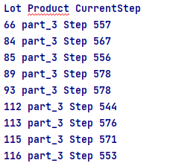
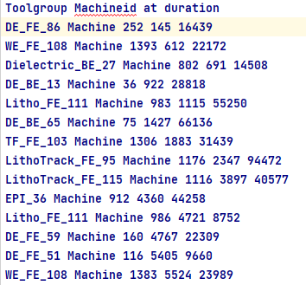
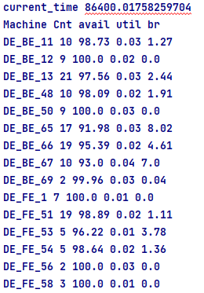
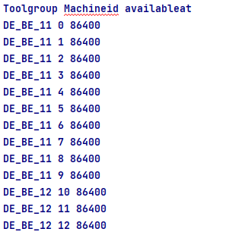
Framework
Simulation - State of the fab – at time t
Active lots
Breakdown log
Breakdown stats
Machine log
2

Slide 3
Framework
Strategy - Rescheduling
Based on machine breakdown and availability
Select proportion of machines in each tool group
State machine available for schedule or not
State if machine become available in scheduling periods (offline information)
If machine breakdown is not recorded in any group
Realistically set a threshold to avoid frequent re-scheduling
3

Slide 4
Framework
Rescheduling - Algorithm
Offline schedule
Start and end time of operation on machine
Simulate
Dispatching in optimization or dispatching in simulation?
Dispatch a lot to machine
If breakdown time < operation end time
Do rework on available machine slot
If breakdown end time > operation start time
Assign operation to available machine slot
4

Slide 5
Framework
To do
Integrate the Schedule into the Simulation
First, ensure simulation can read and apply the optimized schedule. This means:
Input Schedule: The simulation should start with the schedule generated by optimization model, dictating the sequence and timing of operations.
Resource Allocation: Allocate machines according to the schedule.
Parameters (stochastic and deterministic):
Processing times: Realistically set processing times as stochastic. However to verify the approach consider it deterministic in the simulation also. Later do experiments with different seed values
Breakdown times: If the period is known then it is deterministic and a scheduled down time. Develop strategies when it is uncertain or unknown
5

Slide 6
Framework
To do
Rescheduling algorithm - Reacting to Breakdowns
When a breakdown occurs, simulation needs to adjust the schedule dynamically. This involves:
Immediate Actions: Pause operations if necessary, reroute operations to other machines, initiate repair.
Rescheduling: Algorithm that can quickly generate a new feasible schedule considering the current state of the fab and the remaining tasks. Common approach include Heuristics, such as dispatch rules.
Remarks: Depending on the frequency of breakdowns select appropriate approach
Implement Feedback Loops
Ensure there's a feedback mechanism that:
Updates the System: Inform the simulation of any real-time changes, like a machine returning to service earlier than expected or a breakdown taking longer to fix.
Performance Metrics: Track the performance against the original schedule to measure the impact of breakdowns and the effectiveness of the rescheduling strategy.
6

Slide 7
Model
Communication script
Use same processing times
Use breakdown stats/log for machine availability
Simulation logs
WIP
Machine availability
Processing times
Breakdown stats/times
Schedule logs
Start time of operation
End time of operation
Machine allocation
Sequence
Communication script
Mimic
dispatch rule
allocation
sequence
Feedback loop
Update machine availability after repair
React to breakdown
7

Slide 8
Model – To start with
Communication script
Use same processing times
Use breakdown stats/log for machine availability
config: pypy
config: python 3
Simulation logs
WIP
Machine availability
Processing times
Breakdown stats/times
Schedule logs
Start time of operation
End time of operation
Machine allocation
Sequence
Communication script
Mimic
dispatch rule
allocation
sequence
Feedback loop
Update machine availability after repair
React to breakdown
8

