Slide 1
MINI PROJECT REPORT OF INTERNSHIP • 2026-27
Ames House Price Prediction System
An End-to-End Supervised Machine Learning Pipeline & Interactive Deployment
Presented By: Ramsha Fatima | Roll No: 2300101530112
Under the Supervision of: Mr. Arpit Dubey, Assistant Professor
Department of Computer Science and Engineering, United College of Engineering & Research, Prayagraj
Affiliated to Dr. A.P.J. Abdul Kalam Technical University, Lucknow | Organization: Innovation & Incubation Hub Foundation, MNNIT

Slide 2
CAPSTONE INTERNSHIP PRESENTATION
Chapter 1: Problem Statement & Project Objectives
The Real Estate Valuation Challenge
• Price Opacity: Property evaluations traditionally rely on manual heuristics and personal appraisal bias.
• Market Inefficiencies: Sellers, buyers, and mortgage lenders face substantial price variance for structurally comparable properties.
• Non-Linear Dynamics: Valuations are driven by complex multi-feature interactions (area, age, location, and finish).
• The Need: An automated, transparent, machine learning-driven pricing engine with empirical confidence bounds.
Project Mandate & Objectives
• End-to-End ML Lifecycle: Strict adherence to all 8 phases of data science and machine learning development.
• Ames Benchmark Dataset: Comprehensive analysis of 1,460 residential properties across 81 structural attributes.
• Target Accuracy Metric: Exceed an R² score of 0.85 on held-out test data on the genuine dollar scale.
• Multi-Model Benchmarking: Evaluate Ridge, Decision Trees, Random Forest, and XGBoost using 5-Fold Cross Validation.
• Interactive Deployment: Deploy a responsive web app on Streamlit Cloud with real-time 'What-If' counterfactual analysis.

Slide 3
CAPSTONE INTERNSHIP PRESENTATION
Chapter 2: Tools & Technology Stack Architecture
Python 3.11
CORE LANGUAGE
High-performance tabular processing & model execution runtime.
Pandas & NumPy
DATA MANIPULATION
Matrix vectorized calculations, tabular restructuring & log1p transforms.
Scikit-Learn
MACHINE LEARNING
Pipeline, ColumnTransformer, StandardScaler, Ridge & Random Forest.
XGBoost
GRADIENT BOOSTING
Extreme gradient boosted regression trees for non-linear residual learning.
Matplotlib & Seaborn
VISUALIZATION
Publication-ready statistical plots, correlation heatmaps, residual diagnostics.
Joblib
SERIALIZATION
Zero-overhead binary persistence of trained models and scaling pipelines.
Streamlit
APP FRAMEWORK
Reactive Python-native web application with dynamic state management.
Git & GitHub
VERSION CONTROL
Public open-source repository management with automated CI/CD flow.
Streamlit Cloud
CLOUD DEPLOYMENT
PaaS containerized microservice serving predictions globally 24/7.

Slide 4
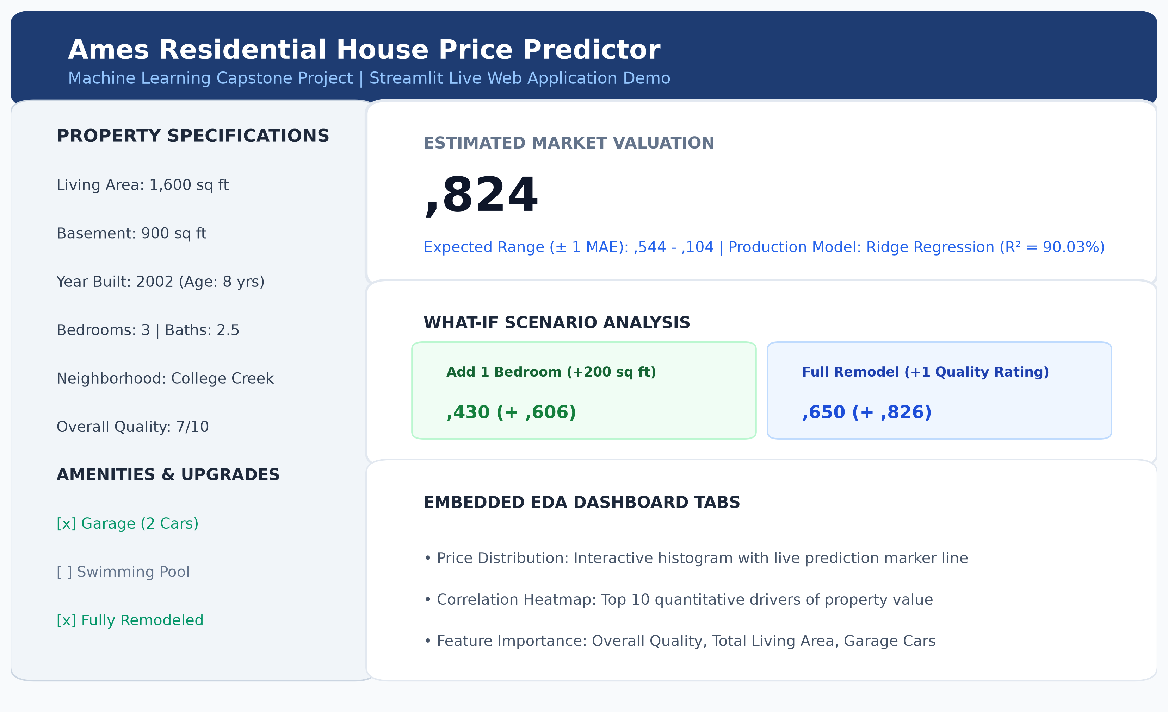
CAPSTONE INTERNSHIP PRESENTATION
Chapter 3: System Functionality & Live Application UI
Interactive Web Capabilities
• Real-Time Input Panel: Dynamic sliders for living area, basement sq ft, construction year, room counts, and neighborhood.
• Instant Fair Valuation: Point prediction plus empirical confidence range (± 1 MAE: $16,280).
• What-If Scenario Analyzer: Instant financial ROI feedback for adding a bedroom (+200 sq ft) or completing a full remodel.
• Embedded EDA Dashboard: Live tabs with market price distribution and correlation heatmaps.
• Zero-Crash Deployment: Relative pathing via pathlib and pinned dependency tree ensures 100% Linux cloud uptime.

Slide 5
CAPSTONE INTERNSHIP PRESENTATION
Chapter 4: End-to-End Machine Learning Lifecycle
Phase 1: Problem Definition
Identified residential price opacity; defined supervised continuous regression.
Phase 2: Data Collection
Fetched Ames benchmark dataset (1,460 records across 81 structural features).
Phase 3: Data Preprocessing
Removed 4 extreme outliers (GrLivArea > 4000); median & mode imputation; log1p transform.
Phase 4: Exploratory Data Analysis
Identified strong right-skewness, quality grading separation, and neighborhood price tiers.
Phase 5: Feature Engineering
Engineered Property_Age, Total_Living_Area, Total_Bathrooms, and amenity indicators.
Phase 6: Model Building & Tuning
Trained Ridge, Decision Tree, Random Forest, and XGBoost with 5-Fold Cross Validation.
Phase 7: Model Evaluation
Benchmarked on held-out 20% test split on genuine USD dollar scale (MAE, RMSE, R²).
Phase 8: Cloud Deployment
Deployed interactive Streamlit app to Streamlit Community Cloud with GitHub CI/CD.

Slide 6
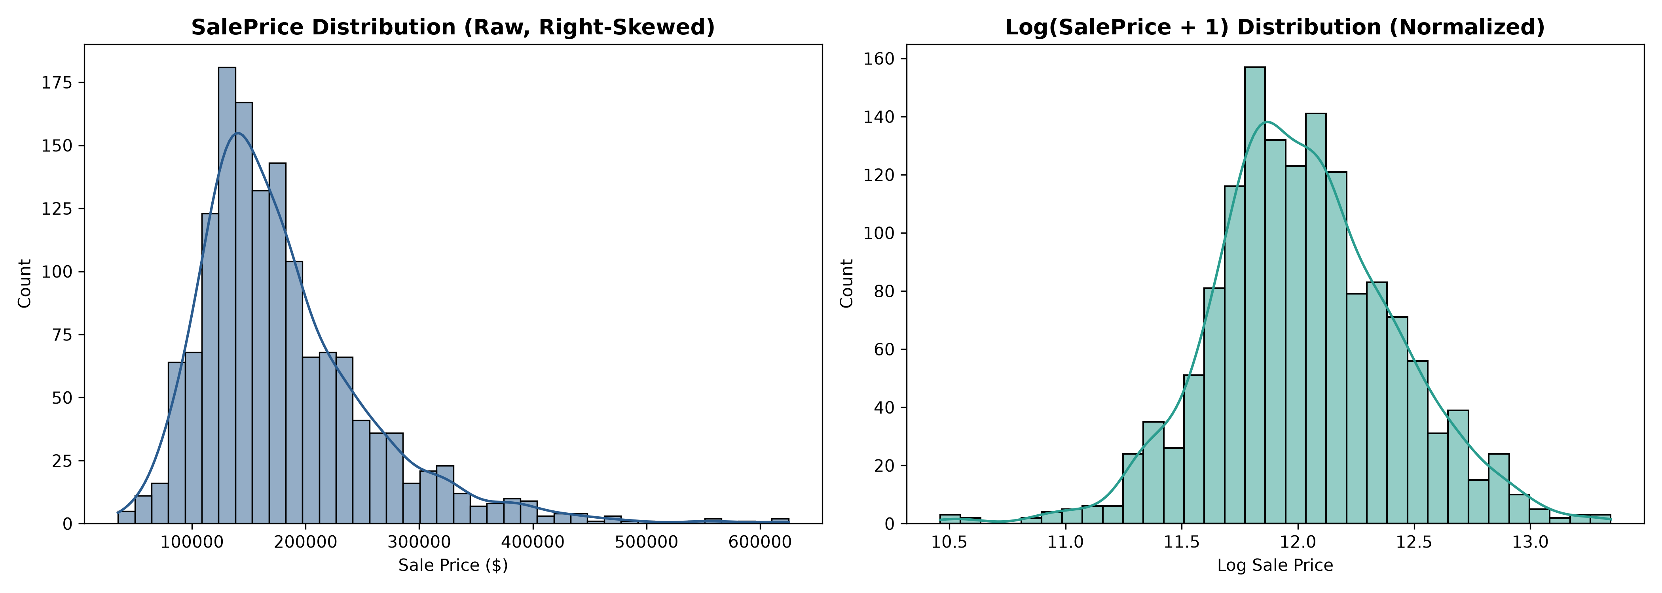
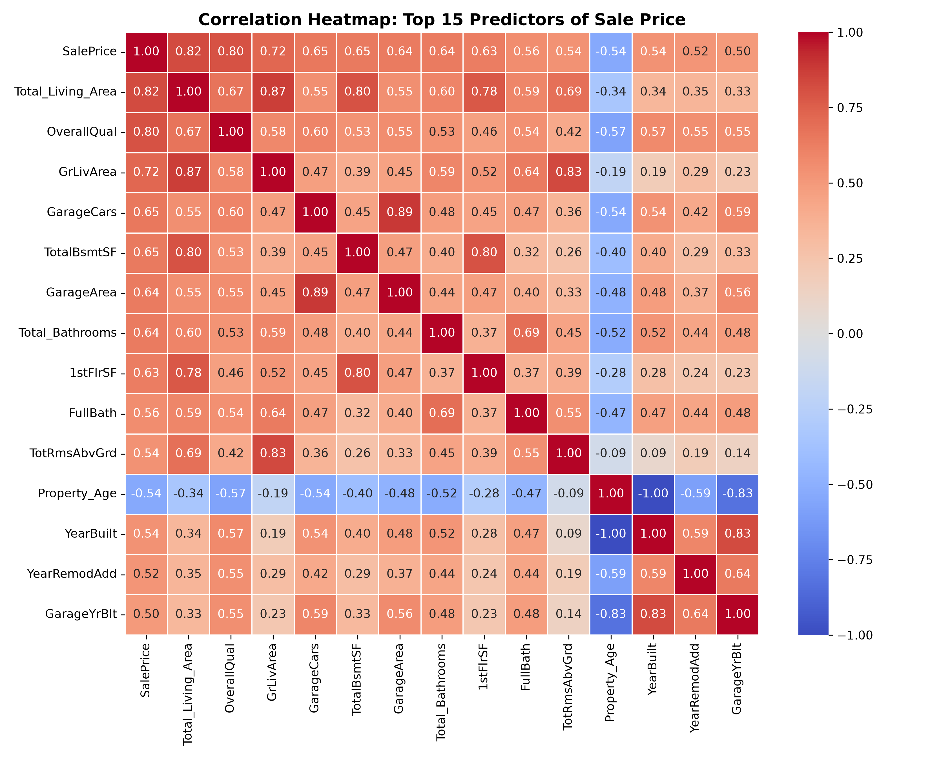
CAPSTONE INTERNSHIP PRESENTATION
Chapter 4: Exploratory Data Analysis (EDA) Key Insights
CRITICAL EDA TAKEAWAYS:
1. Target Log-Transform: Converted skewed $180k median distribution to normal bell curve, stabilizing regression variance.
2. Dominant Correlates: Overall Quality (r = 0.79), Living Area (r = 0.71), Garage Capacity (r = 0.64), and Basement Area (r = 0.61).

Slide 7
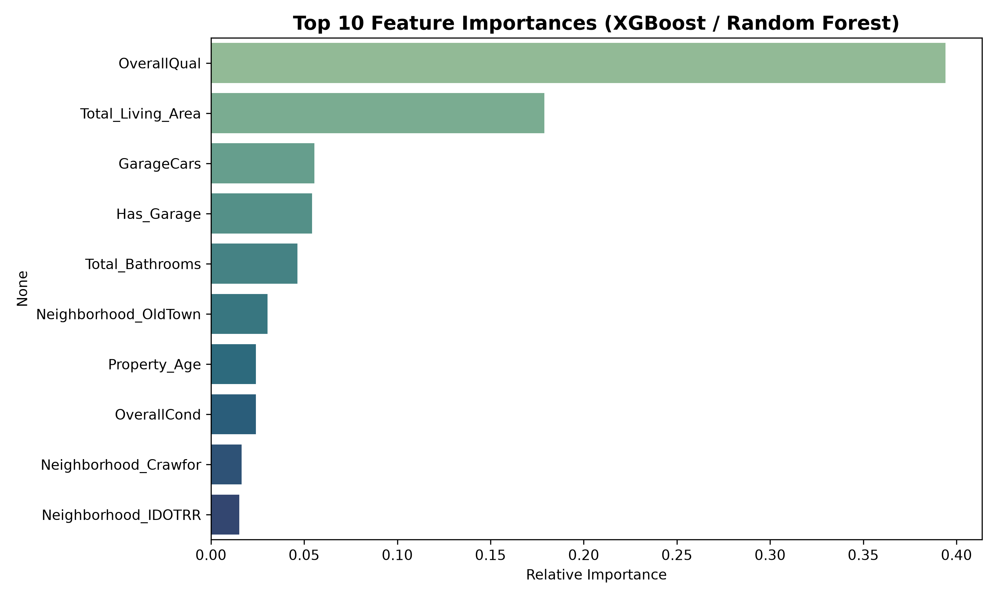
CAPSTONE INTERNSHIP PRESENTATION
Chapter 5: Feature Engineering & Top Value Drivers
Domain-Specific Formulations
• Property_Age = 2010 - YearBuilt
Quantifies true structural depreciation rather than arbitrary calendar dates.
• Total_Living_Area = GrLivArea + TotalBsmtSF
Combines above-ground and subterranean finished square footage for total usable area.
• Total_Bathrooms = FullBath + 0.5*HalfBath...
Unified sanitary metric capturing full and half fixtures throughout the house.
• Has_Pool & Has_Garage
Binary indicators transforming sparse counts into high-signal boolean flags.
• Is_Remodeled = (YearRemodAdd > YearBuilt)
Detects whether modern renovations have offset property age.

Slide 8
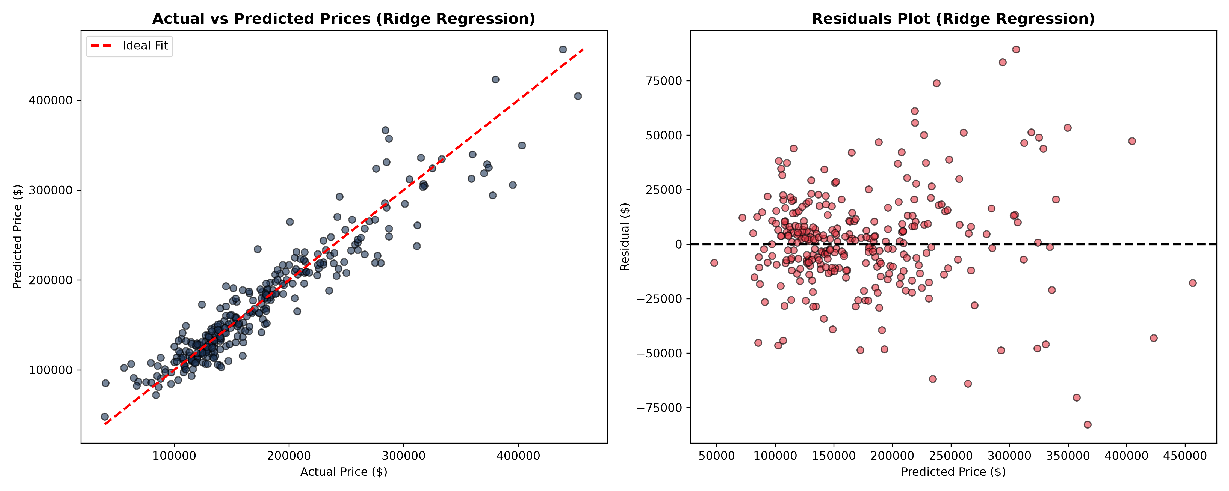
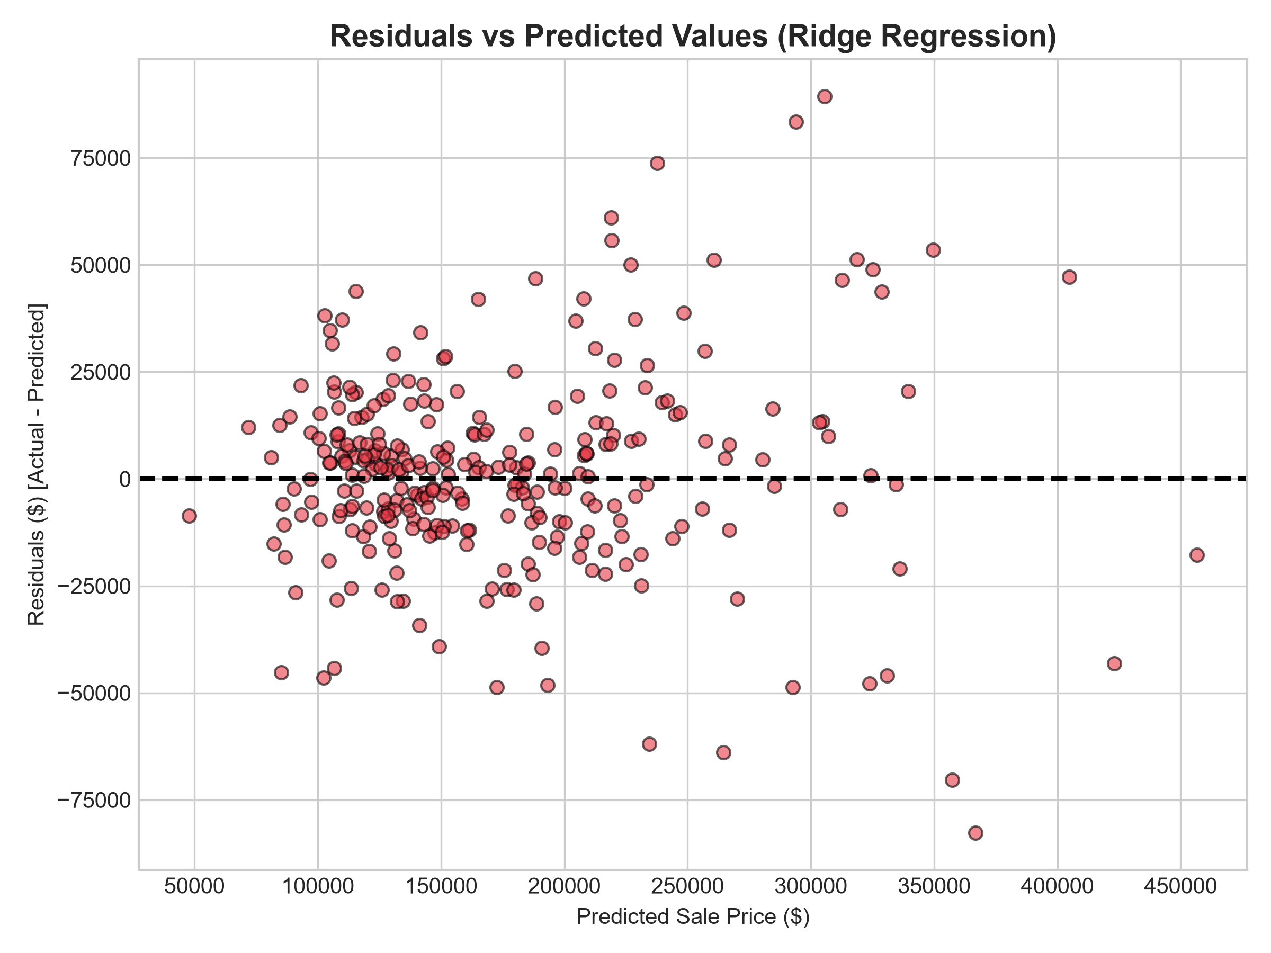
CAPSTONE INTERNSHIP PRESENTATION
Chapter 6: Model Evaluation & Comparative Benchmark
Model Architecture | MAE ($) | RMSE ($) | Test R² Score | Adjusted R² | 5-Fold CV Mean R²
Ridge Regression (Winner) | $16,280.23 | $22,871.54 | 0.9003 | 0.8863 | 0.8918 ± 0.015
XGBoost Regressor | $15,999.01 | $22,919.00 | 0.8999 | 0.8858 | 0.8916 ± 0.027
Random Forest Regressor | $17,309.61 | $25,384.09 | 0.8772 | 0.8599 | 0.8730 ± 0.027
Decision Tree Regressor | $22,916.82 | $32,449.46 | 0.7994 | 0.7711 | 0.7834 ± 0.026

Slide 9
CAPSTONE INTERNSHIP PRESENTATION
Chapter 7: Limitations & Environmental Constraints
1. Geographic & Demographic Specialization
Trained strictly on Ames, Iowa housing transactions. Market price baselines and architectural styles cannot be directly extrapolated to Indian metropolitan areas without local calibration.
2. Static Sample Boundary
Comprises 1,456 historical residential properties up to 2010. Does not account for post-2010 macroeconomic fluctuations such as inflation surges, interest rate shifts, and real estate market cycles.
3. Missing Multi-Modal Features
Does not incorporate unstructured visual imagery (interior quality photos, street appeal) or satellite GIS elevation and zoning data, which human appraisers naturally inspect.
4. Empirical Confidence Limits
The predicted valuation is accompanied by a ± 1 MAE ($16,280) interval; edge cases with extreme bespoke luxury configurations remain subject to higher variance.

Slide 10
CAPSTONE INTERNSHIP PRESENTATION
Chapter 8: Conclusion & Future Roadmap
Key Project Achievements
✓ Exceeded 85% Benchmark: Ridge achieved 90.03% R² and XGBoost achieved 89.99% R² on the genuine dollar scale.
✓ Validated Generalization: 5-Fold Cross Validation confirmed tight standard deviation (± 0.015), ruling out overfitting.
✓ Robust Pipeline Architecture: Sklearn ColumnTransformer prevented data leakage while handling scaling and categorical encoding.
✓ Live Public Deployment: Successfully deployed globally on Streamlit Community Cloud with interactive What-If simulation.
Future Technical Roadmap
➔ Indian Market Retraining: Collect Tier-1/Tier-2 Indian city property data (MagicBricks / 99acres) for domestic valuation.
➔ Computer Vision Integration: Use Convolutional Neural Networks (CNNs) / Vision Transformers to grade interior finishes from photos.
➔ Real-Time Financial APIs: Integrate real-time inflation and mortgage rate APIs for dynamic macro adjustments.
➔ RESTful Microservice: Wrap pipeline in FastAPI / Docker for seamless integration into real estate listing portals.

Slide 11
Project Demonstration & Code Access
Live Interactive Web Application:
https://house-price-prediction-ami5hudzy5cov9xj97dknk.streamlit.app/
Public GitHub Source Repository:
https://github.com/ramshaa01/house-price-prediction
Model Artifacts & Jupyter Notebook:
https://github.com/ramshaa01/house-price-prediction/tree/main/Notebook
Documentation & Viva Guide:
https://github.com/ramshaa01/house-price-prediction/tree/main/Documentation
Thank You! Questions & Discussion are Welcome.

