Slide 1
SUMMER INTERNSHIP PROJECT
House Price Prediction System
A Machine Learning Approach to Estimating Real Estate Value
STUDENT NAME
COLLEGE
Ramsha Fatima
United College of Engineering and Research
ROLL NUMBER
INTERNSHIP ORGANIZATION
2300101530112
Innovation & Incubation Hub, MNNIT Foundation
DEPARTMENT
ACADEMIC YEAR
Computer Science & Engineering
2026
GUIDE / MENTOR
Mr. Arpit Dubey
1

Slide 2





THE CHALLENGE
Problem Statement
Estimating a fair house price manually is difficult
Buyers, sellers, and agents often rely on guesswork or limited comparables, leading to inconsistent valuations.
Too many interacting factors
Location, size, age, amenities, and furnishing status all influence price simultaneously — hard for a human to weigh objectively.
?
Machine learning finds the patterns
A model trained on historical housing data can learn these relationships and generate consistent, data-driven estimates.
What is this
house really worth?
Real-world relevance
Used by real-estate platforms, banks for mortgage risk, investors, and urban planners to make faster, informed decisions.
Manual estimation vs.
data-driven prediction
2
House Price Prediction System | Summer Internship Project
Notes:
Open by framing the everyday problem: pricing a house is subjective and error-prone when done manually. Emphasize that many correlated features make this a natural fit for machine learning, and that this has real commercial applications in real estate tech, banking, and urban planning.

Slide 3





GOALS
Project Objectives
Predict house prices
Analyze housing features
Build a clean ML pipeline
Build a regression model that estimates median house value from property features.
Explore how location, income, age, and rooms relate to price through EDA.
Engineer a leakage-safe preprocessing and modeling pipeline using scikit-learn.
Compare multiple models
Support data-driven decisions
Train and evaluate Linear Regression, Random Forest, and XGBoost.
Provide objective, consistent price estimates for buyers, sellers, and analysts.
3
House Price Prediction System | Summer Internship Project
Notes:
Walk through the five objectives quickly — the core thread is: predict price, understand the data, build a proper pipeline, compare models fairly, and end up with something objective and usable.

Slide 4
THE DATA
Dataset Description
20,640
Property Records
Sample Rows (first 5)
longitude | latitude | age | income | ocean_proximity | median_house_value
-122.23 | 37.88 | 41 | 8.325 | NEAR BAY | 452,600
-122.22 | 37.86 | 21 | 8.301 | NEAR BAY | 358,500
-122.24 | 37.85 | 52 | 7.257 | NEAR BAY | 352,100
-122.25 | 37.85 | 52 | 5.643 | NEAR BAY | 341,300
-122.25 | 37.85 | 52 | 3.846 | NEAR BAY | 342,200
10
Total Columns
8 + 1
Numerical + Categorical Features
ocean_proximity categories
Category | Count
<1H OCEAN | 9,136
INLAND | 6,551
NEAR OCEAN | 2,658
NEAR BAY | 2,290
ISLAND | 5
Missing values: total_bedrooms has 207 nulls (~1%)
Duplicate rows: 0 found
1
Target Variable
Dataset: California Housing Prices (housing.csv) · Target: median_house_value
4
House Price Prediction System | Summer Internship Project
Notes:
This is the classic California Housing Prices dataset — 20,640 records, one row per district block. Point out the target variable and that ocean_proximity is the only categorical feature, dominated by <1H OCEAN and INLAND, with ISLAND being extremely rare (only 5 rows).

Slide 5





WORKFLOW
Methodology
1
2
3
4
Dataset
Collection
Data
Cleaning
Exploratory
Data Analysis
Feature
Engineering
5
6
7
8
Train-Test
Split
Model
Training
Model
Evaluation
House Price
Prediction
5
House Price Prediction System | Summer Internship Project
Notes:
Walk through the eight-stage pipeline left to right, top row then bottom row: from raw data collection through cleaning, EDA, feature engineering, the train-test split, model training, evaluation, and finally generating a price prediction.

Slide 6




PIPELINE
Data Preprocessing
Missing value imputation
total_bedrooms had 207 missing values (~1%). Median (numeric) / most-frequent (categorical) imputation, fit on the training set only to prevent data leakage.
Built as a single scikit-learn Pipeline
Raw Data
Duplicate check
Dataset checked for duplicate rows — none were found, so no rows were dropped.
Impute
Scale / Encode
Categorical encoding
ocean_proximity encoded using One-Hot Encoding (5 categories) via sklearn's OneHotEncoder.
Model-Ready Data
Feature scaling
80 / 20 Train-Test Split
All numerical features standardized with StandardScaler so no single feature dominates due to scale.
16,512 training rows · 4,128 test rows
6
House Price Prediction System | Summer Internship Project
Notes:
Highlight the leakage-safe design: missing-value statistics are computed from the training split only, never from the full dataset, before being applied to both train and test. Mention the ColumnTransformer cleanly separates numeric and categorical handling.

Slide 7
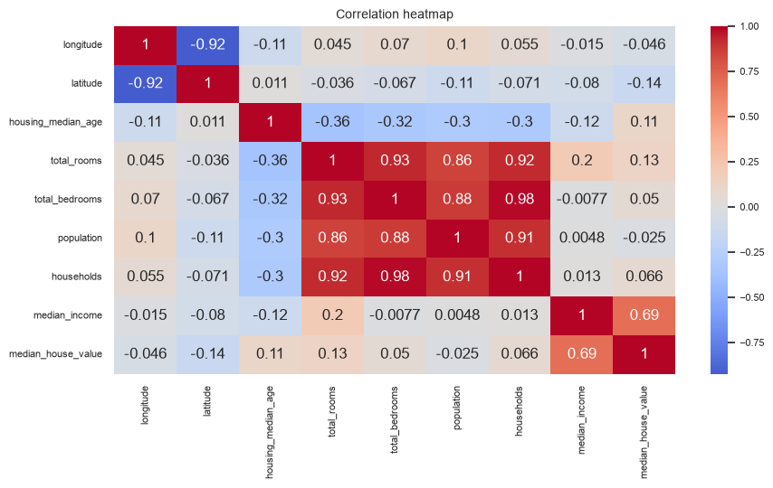
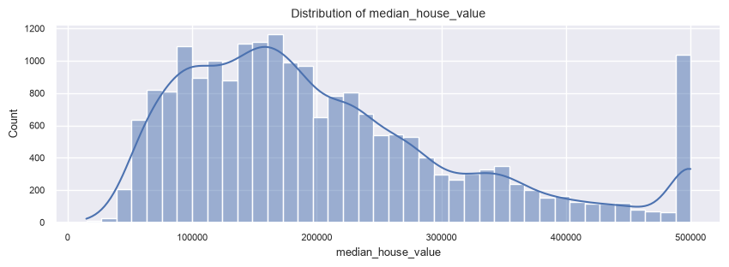
EXPLORATORY ANALYSIS
Exploratory Data Analysis (EDA)
Distribution of median_house_value (target)
Correlation heatmap across numerical features
Key Insights
median_income shows the strongest correlation with price (r = 0.688)
Target variable is right-skewed with a visible price cap near $500,001
latitude shows a weak negative correlation (r = -0.144); most other features are weakly correlated
7
House Price Prediction System | Summer Internship Project
Notes:
The heatmap shows median_income as by far the strongest predictor of price. The target histogram reveals a hard cap around $500,001 — a known artifact of this dataset where high-end values were top-coded, which slightly limits model accuracy at the top end.

Slide 8


ALGORITHMS
Regression Models
Linear Regression
Random Forest
XGBoost
Fits a straight-line relationship between features and price.
An ensemble of 100 decision trees averaging their predictions.
Gradient-boosted trees (100 trees, depth 6) built sequentially to correct prior errors.
WHY CHOSEN
WHY CHOSEN
WHY CHOSEN
Simple, fast, interpretable baseline.
Captures non-linearity and feature interactions.
State-of-the-art accuracy on tabular data.
ADVANTAGE
ADVANTAGE
ADVANTAGE
Easy to explain; low compute cost.
Robust to outliers; strong accuracy.
Highest accuracy in this project.
LIMITATION
LIMITATION
LIMITATION
Misses non-linear patterns in the data.
Larger model; less interpretable.
More hyperparameters to tune.
Evaluation Metrics:
MAE
RMSE
R² Score
8
House Price Prediction System | Summer Internship Project
Notes:
Three models were compared: Linear Regression as an interpretable baseline, Random Forest as a robust ensemble, and XGBoost as a gradient-boosted ensemble. All three share the same preprocessing pipeline so the comparison is fair. Metrics used: MAE, RMSE, and R² Score.

Slide 9

PERFORMANCE
Results & Model Comparison
Model | RMSE | MAE | R² Score
Linear Regression | 70,059 | 50,670 | 0.625
Random Forest | 48,942 | 31,628 | 0.817
XGBoost | 48,496 | 32,453 | 0.821
Metrics computed on the held-out 20% test set (4,128 rows)
Best Performer: XGBoost
Lowest RMSE and highest R² (0.821) on the test set
Random Forest achieved the lowest MAE (31,628), making it competitive despite a marginally lower R².
9
House Price Prediction System | Summer Internship Project
Notes:
Both ensemble methods dramatically outperform the linear baseline, jumping R² from 0.625 to over 0.81. XGBoost edges out Random Forest on R² and RMSE, while Random Forest actually has the lowest MAE — worth mentioning if asked which model is 'best' since it depends on the metric prioritized.

Slide 10
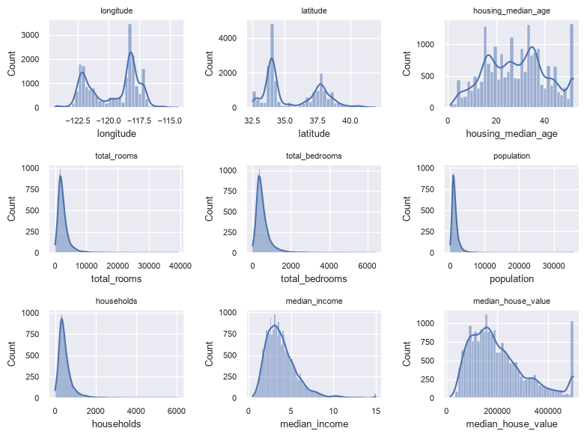
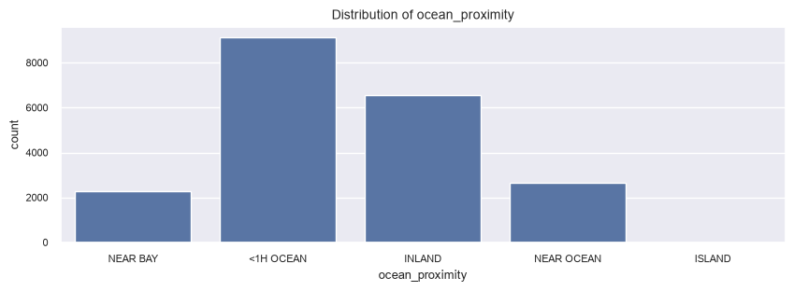
PROJECT IN ACTION
Notebook Outputs
Category counts for ocean_proximity
Direct outputs captured from the project Jupyter Notebook
Distribution plots for all numerical features
10
House Price Prediction System | Summer Internship Project
Notes:
These are real chart outputs generated directly inside the notebook, not mockups — useful to show the evaluator the actual working notebook if asked.

Slide 11



WRAPPING UP
Conclusion
Objective achieved
Built an end-to-end regression pipeline that predicts median house value from housing features.
Workflow followed
Data cleaning → EDA → leakage-safe preprocessing → model training → evaluation.
Model performance
XGBoost and Random Forest reached R² ≈ 0.82 on unseen data, far ahead of the 0.625 linear baseline.
Learning outcomes
Hands-on experience with sklearn pipelines, ensemble models, and honest train/test evaluation.
11
House Price Prediction System | Summer Internship Project
Notes:
Summarize: the pipeline works end-to-end, tree-based ensembles clearly beat the linear baseline, and the project gave hands-on experience with the full applied ML workflow — not just model fitting but leakage-safe preprocessing and honest evaluation.

Slide 12






WHAT'S NEXT
Future Scope
Deploy as a web application for live predictions
Integrate real-time property listing APIs
Hyperparameter tuning (GridSearchCV) for further gains
Train on a larger, more geographically diverse dataset
Thank You
Add interactive dashboards with cloud deployment
Questions?
House Price Prediction System
Summer Internship Final Evaluation
12
Notes:
Close with realistic next steps — deployment, real-time data, tuning, and dashboards — then open the floor for questions. Keep this brief; the goal is to signal the project has a clear path beyond the internship.

