Slide 1

ANDROID APPLICATION FRAMEWORK FOR QUICKLY DEVELOPING DB BACKED APPLICATIONS
      Submiited By
D.Shriram
1201FOSS0019
Guide : Mr. Sanjeev Kumar Shaini

Slide 2
Problem Definition
Creating Android Application UI will take time and requires sound knowledge of Android.
Need to write code for individual field value storage in sqlite database.
Theming of the Application need to be done only by using IDE.
All the users have access to the data added through android application. Need to write code for data abstraction.
Look and feel of the application takes time and effort by writing code.

Slide 3
Solutions
Users will be allowed to enter the required details about controls, data type and their size for their android application through a web application. This will be used to generate a dynamic xml file.
The dynamic xml file is included in the application resource to develop the mobile application.
Through Android Build tool, Apk file will be generated and it will be easy to deploy the apk file in any one of android device.

Slide 4
Solutions
The theming of the application can be done by allowing users to browse and choose their settings dynamically in the web page itself. Based upon this settings there will be another xml file generated for theming and look and feel of the application.
For each controls the users will also be allowed to choose their screen properties dynamically like data type and size.
Data abstraction is done by allowing users to specify admin access credentials so that the write access may be provided only to the admin after successful authentication.

Slide 5
DESIGN WORK FLOW
Web Application
USER
XML File
Android Application Framework
Apk file
SQLite Database
Mobile device

Slide 6
Software to be Used
Software | Purpose
PHP | Web Page to capture user's parameters
Sqlite | Database storage and control binding
Android Tools | Used for apk file creation.

Slide 7
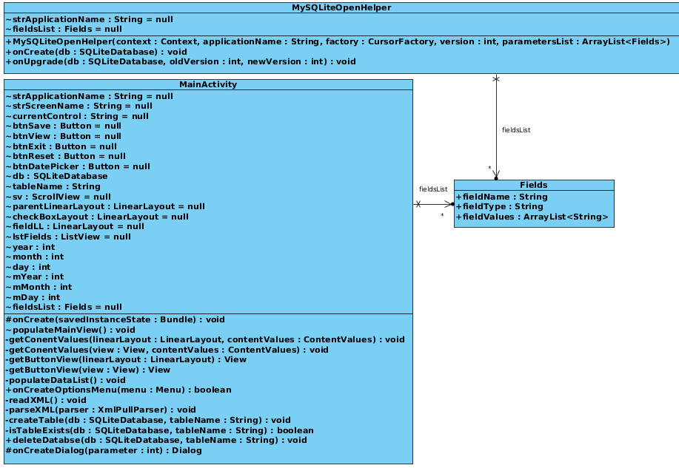
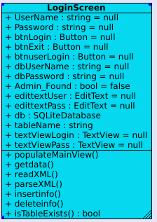

CLASS DIAGRAM

Slide 8
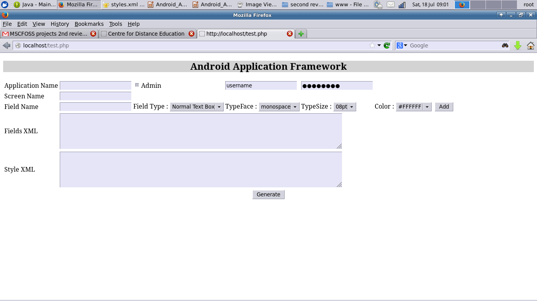
PHP Page

Slide 9
Dynamic Fields & Styles XML
<?xml version="1.0" encoding="UTF-8"?>
<fields>
<application_name>androidframework</application_name>
<screen_name>androidframework</screen_name>
<field><fieldname>name</fieldname><fieldtype>normaltext</fieldtype></field>
<field><fieldname>age</fieldname><fieldtype>normaltext</fieldtype></field>
<field><fieldname>phone number</fieldname><fieldtype>numbertext</fieldtype></field>
<field><fieldname>address</fieldname><fieldtype>normaltext</fieldtype></field>
<admincredentials><username>admin</username><password>password</password></admincredentials>
</fields>

Slide 10
Dynamic Fields & Styles XML
<resources xmlns:android="http://schemas.android.com/apk/res/android">
  <style name="AppTheme" parent="AppBaseTheme">
  <item name="android:typeface">monospace</item>
  <item name="android:textSize">10pt</item>
  <item name="android:textColor">#808080</item>
  </style>
  </resources>

Slide 11
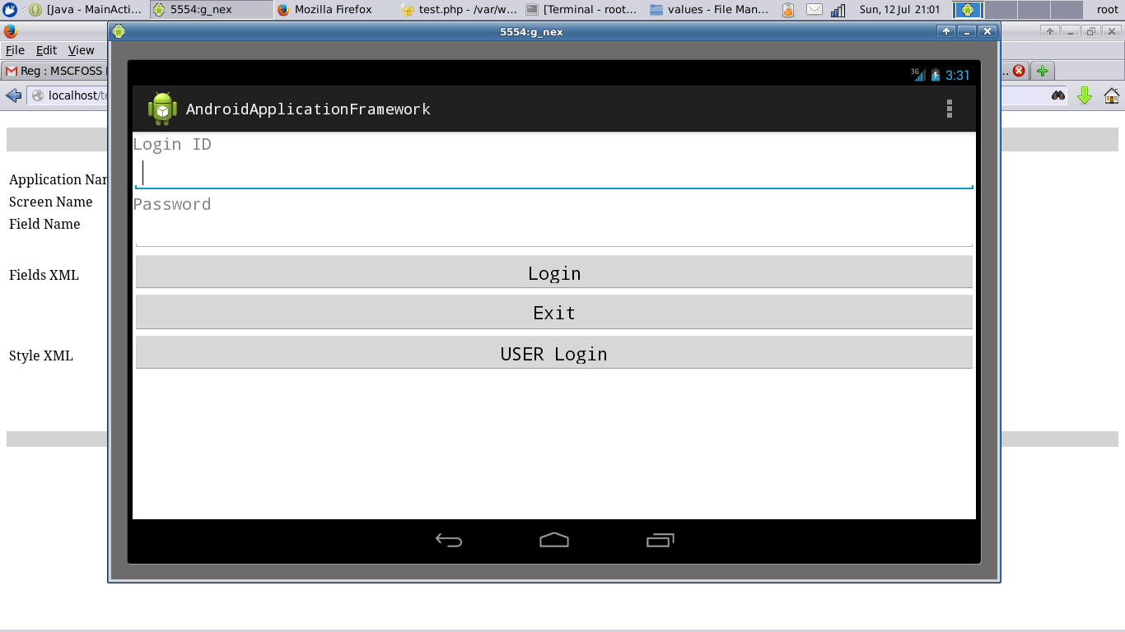
Android application

Slide 12
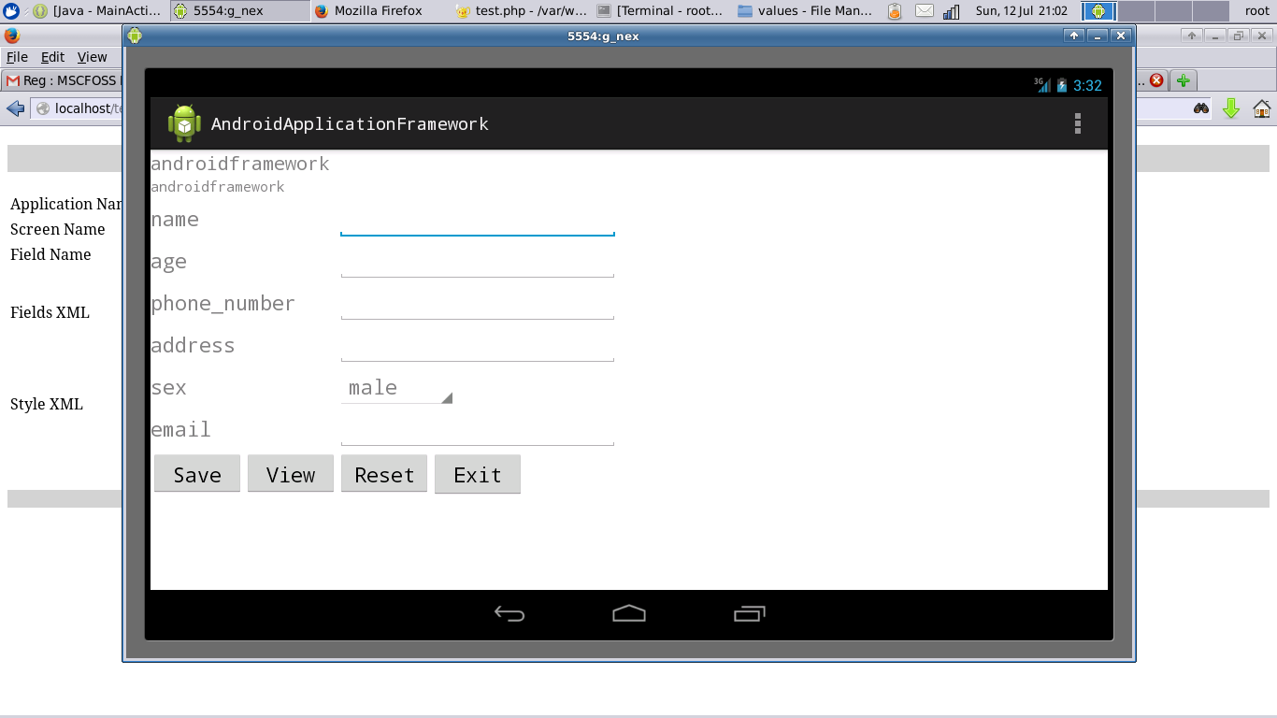
Admin User

Slide 13
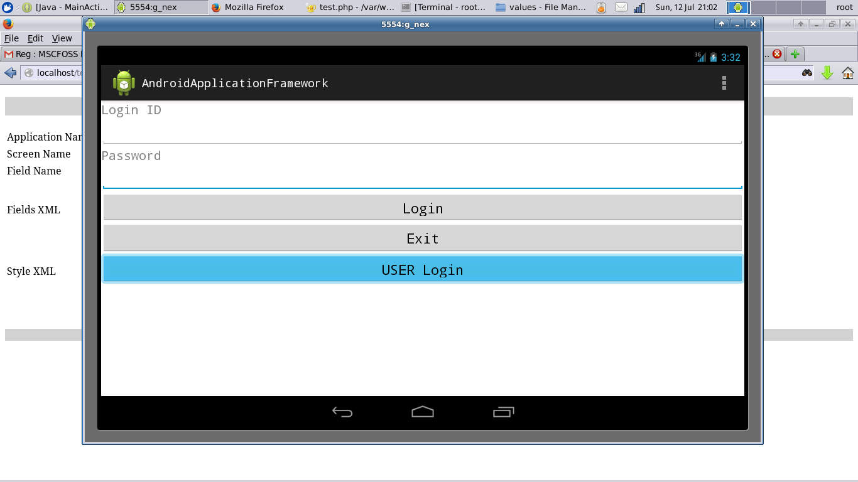
Normal User

Slide 14
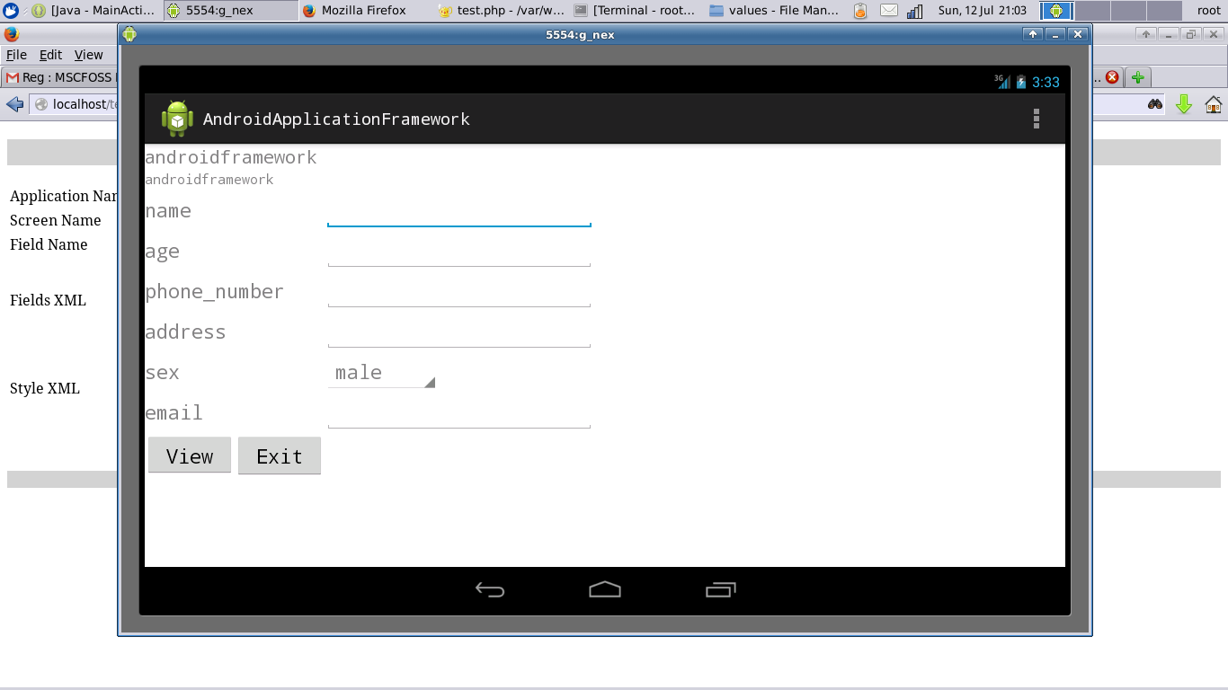
Normal User

Slide 15
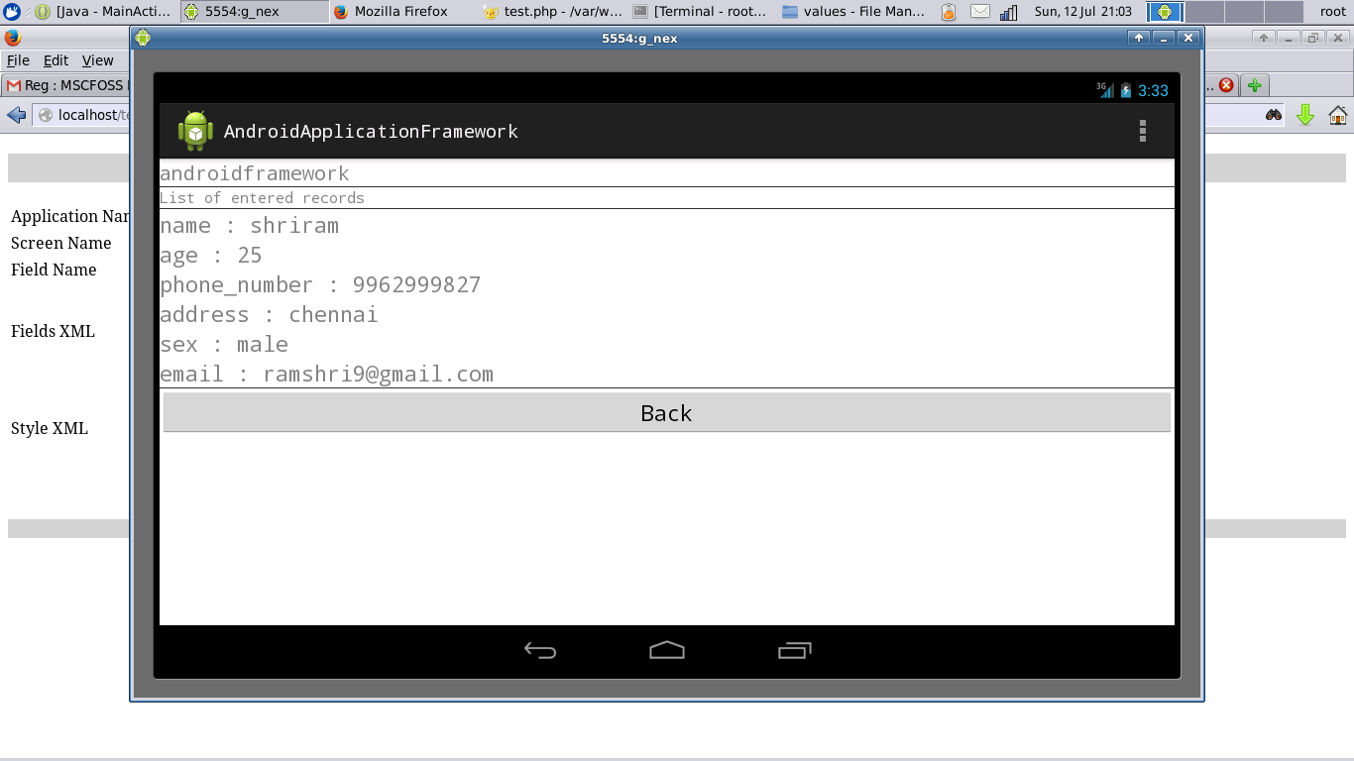
Normal User

Slide 16
SOURCE CODE INFORMATION
The Source Code of the Project can be found in Git Repository :
https://github.com/ramshri9/AndroidApplicationFramework
The Source Code is released under the GNU GENERAL PUBLIC LICENSE Version 2.

Slide 17
        Thank you

