Slide 1

Deep Learning in Biomedical Signals
Presenter:
Vishavpreet Singh
PhD Scholar @ AcSIR-CSIO

Slide 2

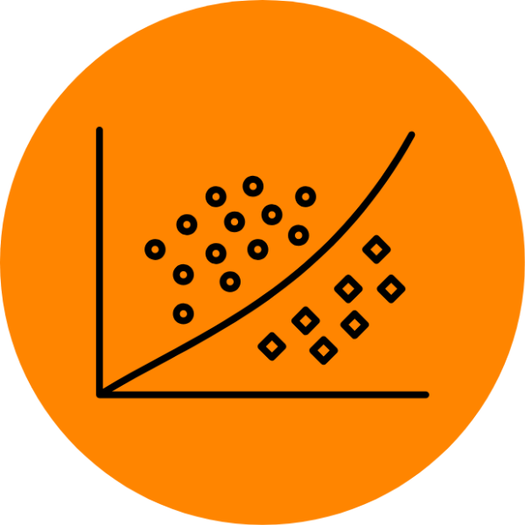



Prerequisites
Python Programming
or
familiarity with Programming basics
Machine Learning
Basics
Tensorflow
(A deep learning library)
Keras
(A wrapper for Tensorflow)

Slide 3
Outlines
1
Intro to Machine Learning
2
Intro to Deep Learning
3
Deep Learning Layers
4
Performance metrics
5
Other resources
6
Useful Libraries
5
Practical Example

Slide 4

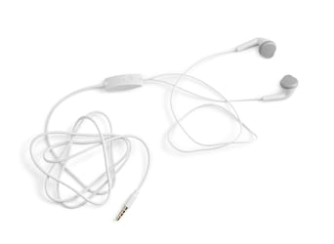
Introduction to Machine Learning
"A computer program is said to learn from experience E with respect to some class of tasks T and performance measure P if its performance at tasks in T, as measured by P, improves with experience E."
Two Different Objects

Slide 5
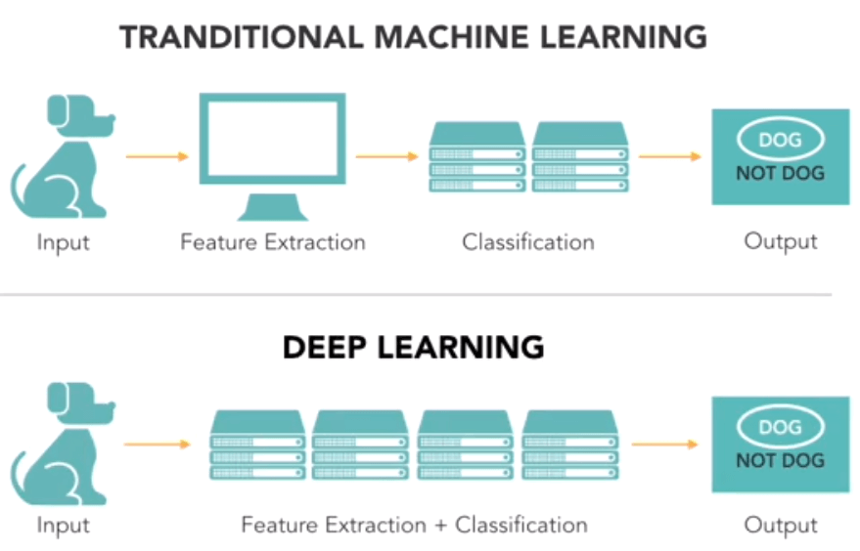
Introduction to Machine Learning
Database including
Dog/not dog
Human assisted Feature extraction (Manual or Automatic)
Classification algorithm
(SVM, Decision Tree, ANN, Random Forest, and many more)

Slide 6
Introduction to Deep Learning
Database including
Dog/not dog
Self Learning Feature extraction

Slide 7
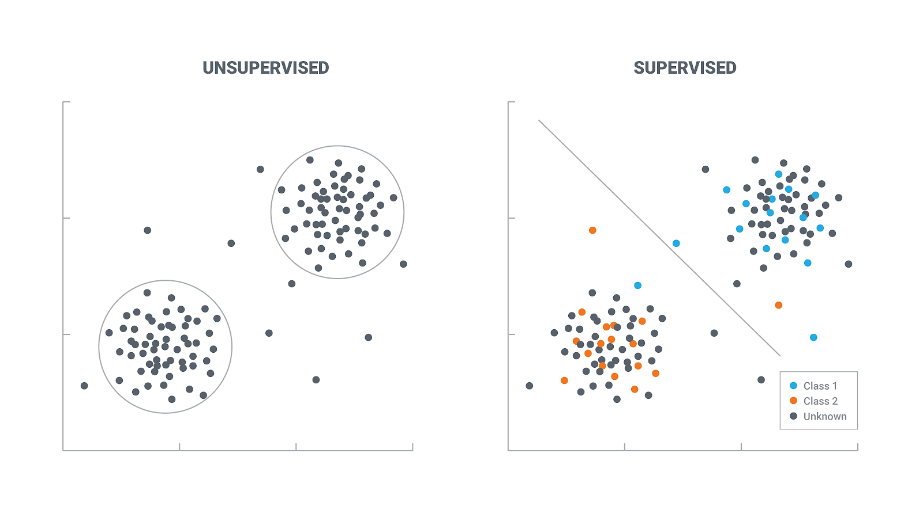
Algorithm Types

Slide 8
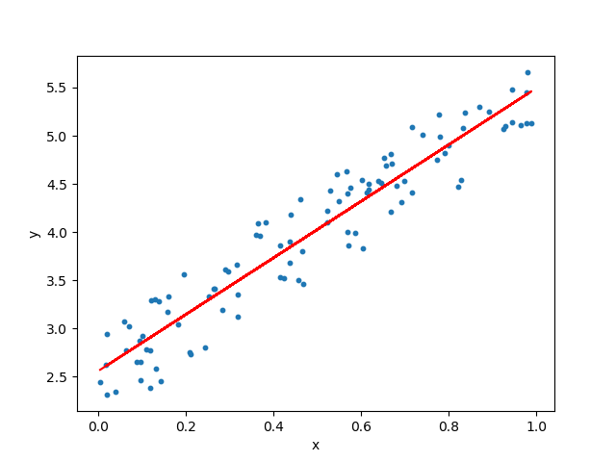
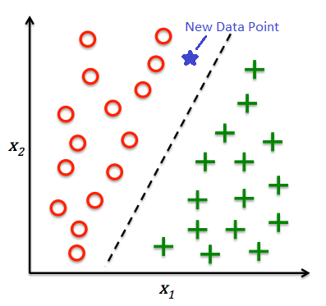
Problems in machine learning
(Supervised)
Classification
Regression

Slide 9
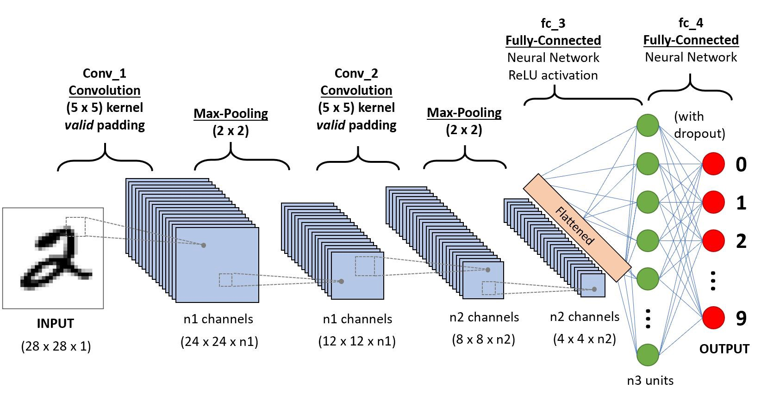
MNIST example using Deep Learning

Slide 10
Deep Learning Layers
Convolutional Layer
MaxPool Layer
Activation Layer
Dense Layer

Slide 11
Convolutional Layer

Slide 12
Maxpool Layer

Slide 13
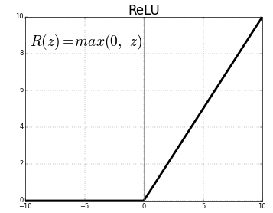
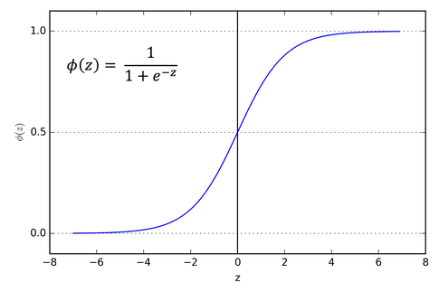
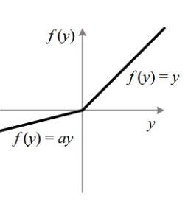
Activation Layer
Rectified Linear Unit(ReLU)
Softmax
Leaky Relu

Slide 14
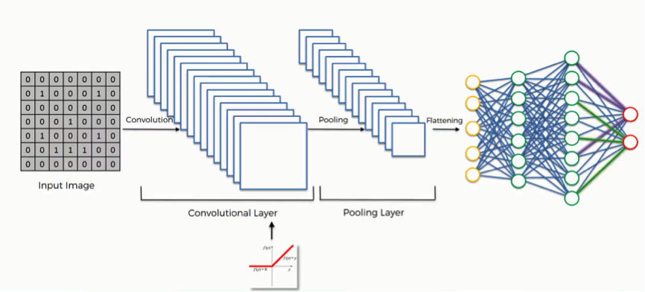
Dense Layer

Slide 15
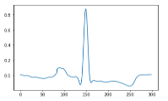
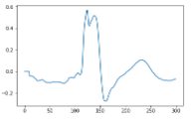
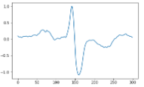
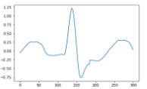
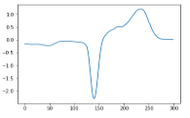
Practical Example with ANN and CNN
Normal
Paced Beats
Right Bundle
Branch Block
Left Bundle
Branch Block
Premature
Ventricular
Contraction

Slide 16
Useful resources
List of resources
https://devblogs.nvidia.com/deep-learning-nutshell-core-concepts/
https://in.mathworks.com/help/deeplearning/ug/list-of-deep-learning-layers.html
https://keras.io/
https://towardsdatascience.com/image-classification-in-10-minutes-with-mnist-dataset-54c35b77a38d
https://machinelearningmastery.com/how-to-develop-a-convolutional-neural-network-from-scratch-for-mnist-handwritten-digit-classification/
https://www.analyticsvidhya.com/blog/2020/01/fundamentals-deep-learning-activation-functions-when-to-use-them/

Slide 17

Thank you for
your
precious time
Email: dhanjal.Vishavpreet@gmail.com

