Slide 1
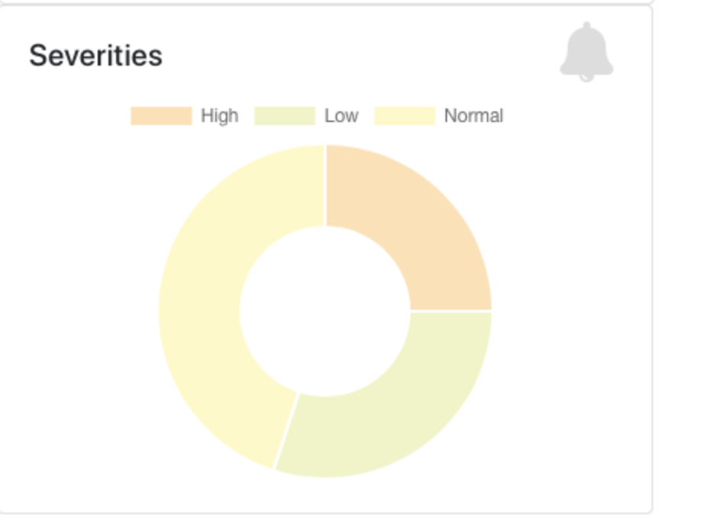
Unsuppressed findings
Top 10 Findings sorted by Level
Finding ID | Severity | Findings COunt | Percentage
ID1 | Error
ID2 | Error
ID3 | Error
ID4 | Warning
Findings Trend As per severity
Level | Findings Count | Percentage
Error
Warning
Total
Suppressed findings
Top 10 Findings sorted by Level
Finding ID | Severity | Findings COunt | Percentage
ID1 | Error
ID2 | Error
ID3 | Error
ID4 | Warning
Findings Trend As per severity
Level | Findings Count | Percentage
Error
Warning
Total

Slide 2
Findings IDs
65%
45%
25%
10%
2%
Findings count

