Slide 1
Expected Outcome of the Capstone project
The 12-minute presentation serves as a platform for students to showcase their capstone project, demonstrating their understanding, problem-solving abilities, and communication skills. The presentation should concisely cover the project’s key aspects, including the problem addressed, theoretical analysis, methodology, results, and conclusions.
Suggested Presentation Structure (12 minutes Presentation + 8 minutes Q&A)
Introduction & Problem Statement (3 minutes)
Briefly explain the project’s purpose and relevance.
Theoretical Foundation (3 minutes)
Discuss key theoretical concepts and methods used.
Practical Application (3 minutes)
Showcase your implementation, challenges faced, and the results.
Future Work & Conclusion (3 minutes)
Share potential future applications, possible improvements, and a final summary.
Q&A – Discussion (8 minutes)

Slide 2
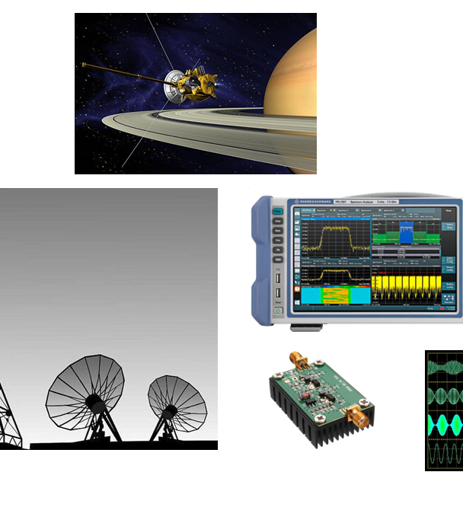
Project DEFI: Decision Feedback Equalizer for Mitigating Intersymbol Interference
Modulschlussprüfungen
Digital Communication (dcom)
Amstalden Ronny

Slide 3
Outline Subtitle
I Introduction & Problem Statement
Motivation
Problem Statement
III Simulation Setup
ISI-Channel with AWGN
DFE Implementation
Bit Error Rate Analysis
II Theoretical Background
Channel Dispersion
Post Cursor ISI
Decision Feedback Equalizer
IV Conclusion & Future Work

Slide 4
Introduction & Problem Statement
High-speed data transmission over physical channels causes Intersymbol Interference (ISI).
Eye diagrams collapse, Bit Error Rate (BER) increases.
Need: Robust equalization method.
Objective: Implement and evaluate a DFE to mitigate ISI effects on a known dispersive channel.

Slide 5
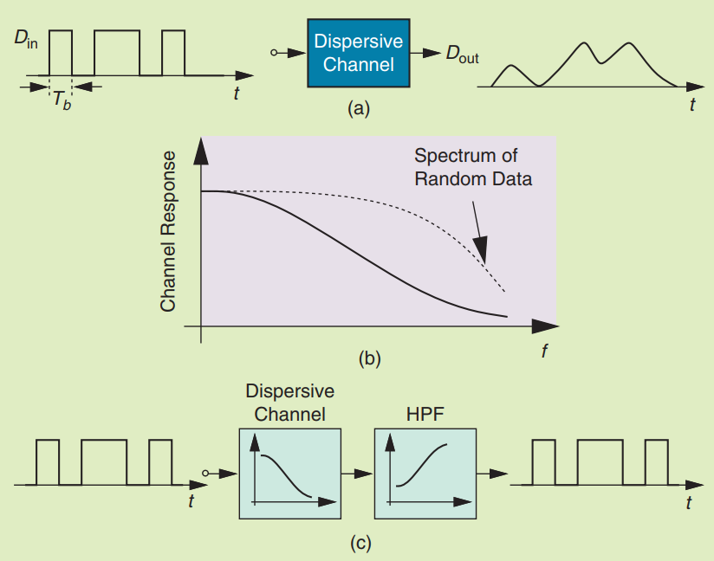
Theoretical Background
High-speed random data traveling through limited-bandwidth (lossy) channels becomes dispersed.
Data transitions (e.g., 010 or 101) may not fully resolve due to channel sluggishness (Fig. 1a).
This causes jitter — the zero-crossing times depend on symbol amplitude.
ISI increases bit detection errors and distorts timing.
In the frequency domain, the channel attenuates high-frequency components (Fig. 1b).
A high-pass filter (HPF) with inverse response can restore the signal shape (Fig. 1c).
Result: Received data becomes less dispersed and easier to detect accurately.
[1]

Slide 6
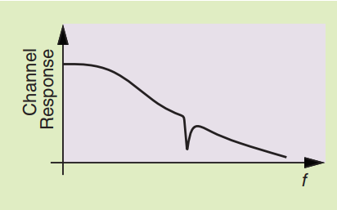
Theoretical Background
Limitations of Linear Equalizers
HPF is a linear equalizer, applying high-frequency boost to counter channel loss.
But for lossy channels, this approach runs into key problems:
Noise Amplification
Boosting high frequencies also amplifies high-frequency noise, degrading SNR.
Bandwidth and Power Tradeoffs
Large boost requires many filter stages → increases power and limits bandwidth.
3. Mismatch Compensation Failure
Real channels include impedance mismatches (connectors, vias, cables).
These create deep notches in frequency response (Figure) — hard to equalize linearly. [1]

Slide 7
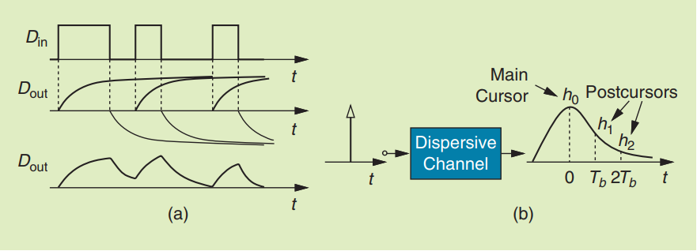
Theoretical Background
Postcursor ISI and DFE Operation
Due to channel imperfections, each bit spreads in time → creating tails that interfere with subsequent bits.
These tails at delays of Tb, 2Tb, ... are called postcursors (Fig. b).
This intersymbol interference (ISI) results from energy loss across the spectrum
[1]

Slide 8
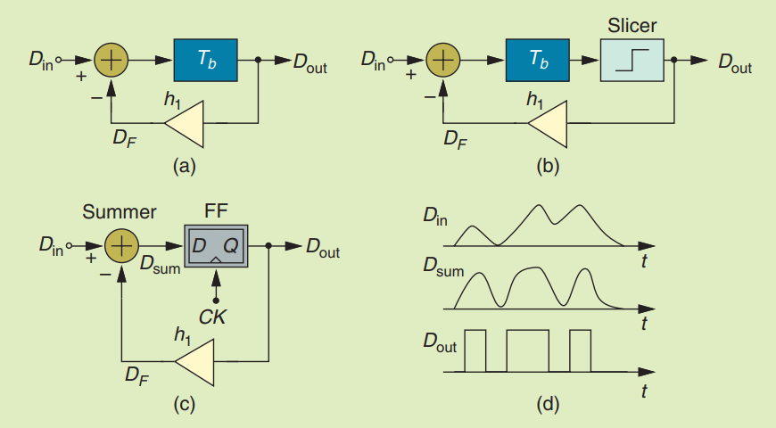
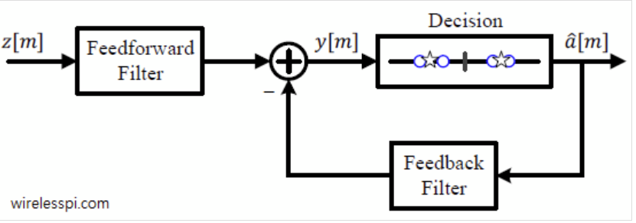
Theoretical Background
DFE Concept: Cancelling Postcursors
The DFE cancels ISI by reconstructing and subtracting these tails (postcursors) from the current bit.
First-order cancellation:
Delay the previous decision by 1 symbol (Tb)
Scale it by the first postcursor tap h1
Subtract it from the current input:
Din−h1⋅Dout=Dsum (Fig. a)
To suppress noise, a slicer (limiter) is introduced (Fig. b).
In practice, this is implemented using a flip-flop (FF), which:
Provides delay
Makes hard decisions (±1)
Feeds these decisions back (Fig. c) [1][2]

Slide 9
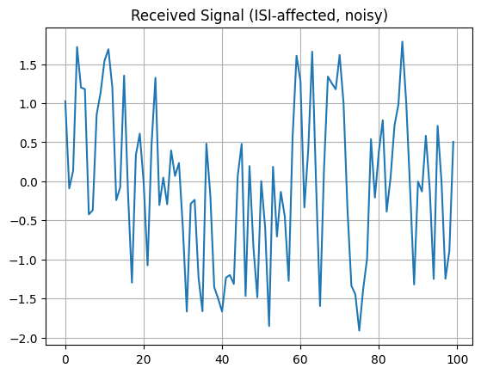
Practical Application
Simulation Setup – ISI Channel with Noise
Signal Generation
Generate random binary data (0s and 1s).
Map to BPSK symbols:
symbols=2⋅bits−1(values: ±1)
ISI Channel Modeling
Define a 2-tap channel with impulse response:
h[n]=[0.8,0.5]
This models mild postcursor ISI.
Pass the symbol stream through the channel using convolution and adding awgn.
r[n]=s[n]∗h[n] + n[n]
ISI-Channel with AWGN and SNR 10dB

Slide 10
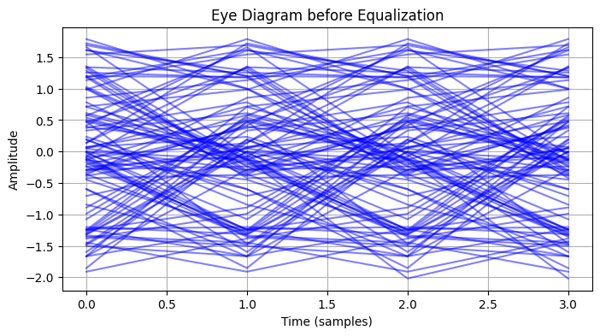
Practical Application
Data visualization
The eye diagram of the received signal before equalization reveals severe signal degradation:
The eye is heavily blurred and almost completely closed, both horizontally and vertically.
This indicates significant ISI, where symbols overlap and interfere with each other.
The horizontal closing is caused by timing uncertainty and ISI from neighboring bits, while the vertical blurring is a result of additive noise.
Eye-Diagram of the noisy data

Slide 11
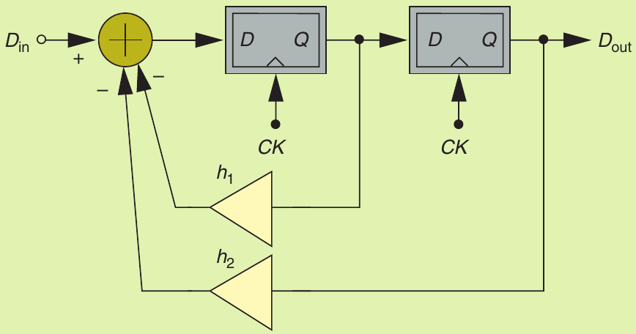
Practical Application
Implementing the DFE
Initialize: h1, h2 ← 0 # Feedback taps
decisions ← zeros(N)
For i = 2 to N-1:
d1 ← decisions[i−1]
d2 ← decisions[i−2]
y ← received[i] − h1*d1 − h2*d2
decisions[i] ← sign(y)
error ← transmitted[i] − y
h1 ← h1 + μ * error * d1
h2 ← h2 + μ * error * d2
[1][3]
2-Tap Architecture of the DFE

Slide 12
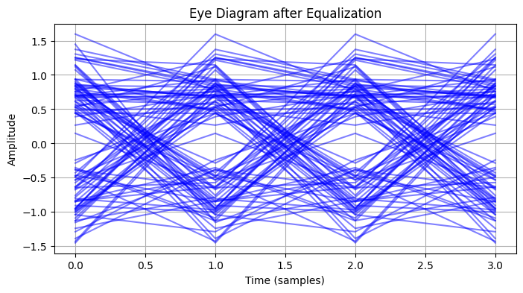
Practical Application
Evaluating DFE Performance
After applying the Decision Feedback Equalizer (DFE), the eye diagram shows a notable improvement
However, the eye is not fully open, which suggests that:
Some residual ISI remains, possibly due to higher-order postcursors not captured by the 2-tap DFE.
The presence of additive noise reduces the vertical eye opening, making symbol decisions more vulnerable to errors.
DFE does not improve decision errors caused by noise!
Eye-Diagram after DFE

Slide 13
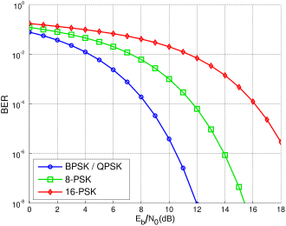
Practical Application
Bit Error Rate (BER) Analysis
The Bit Error Rate (BER) provides a quantitative measure of the system’s reliability before and after equalization.
Before DFE: The BER was 0.076, indicating a moderate error rate caused primarily by intersymbol interference (ISI) in the received signal.
After DFE: The BER dropped significantly to 0.009, demonstrating the effectiveness of the 2-tap Decision Feedback Equalizer in mitigating ISI and improving symbol detection accuracy..
[3]
Bit Error Rate as function of SNR

Slide 14
Conclusion Future Work
Successfully implemented a 2-tap Decision Feedback Equalizer (DFE) to reduce intersymbol interference (ISI) in a digital communication system.
The simulation results demonstrate a significant BER reduction from 0.076 to 0.009, confirming the effectiveness of the DFE in time-domain equalization.
The eye diagram and BER analysis both validate that the DFE greatly improves signal integrity by mitigating postcursor ISI — even though some residual noise and interference remain.
To further enhance system performance and reliability, several improvements can be explored:
Matched Filter Before DFE: Introduce a matched filter prior to the DFE stage to maximize the signal-to-noise ratio (SNR) at the sampling instant.
Feedforward Equalizer (FFE) Addition: To address precursor ISI, adding a feedforward filter stage before the DFE would allow equalization of both past and future ISI components.
Higher-Order DFE: Extend the DFE to more taps to handle longer ISI tails, especially in more dispersive channels.
Dynamic LMS Tuning: Implement an adaptive learning rate or switching between training mode and decision-directed mode for more stable convergence.

Slide 15
Bibliography
[1] B. Razavi, „The Decision-Feedback Equalizer“, IEEE Solid-State Circuits Mag., S. 5, Fall 2017.
[2] Q. Chaudhari, „How Decision Feedback Equalizers (DFE) Work“, Wireless Pi. Zugegriffen: 2. Juli 2025. [Online]. Verfügbar unter: https://wirelesspi.com/how-decision-feedback-equalizers-dfe-work/
[3] M. Werner, Nachrichtentechnik, Eine Einführung für alle Studiengänge, 8. Aufl. Wiesbaden: Springer Vieweg, 2017.

