Slide 1
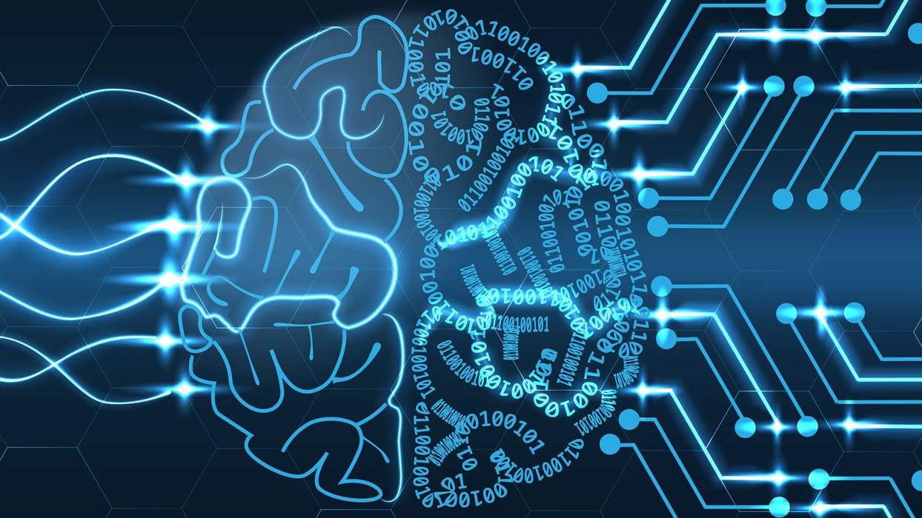
Image Classification using Convolutional Neural Networks
Ram Swaroop
Ramya Shetty
Remya Prabha

Slide 2
Contents
Introduction to CNN
About the Dataset
Steps involved in CNN
Convolution
Activation
Max pooling
Flattening
Full connection
Data Modelling and Evaluation
Conclusion

Slide 3
Convolutional Neural Networks
Convolutional neural network is a class of deep neural networks, most commonly applied to analyzing visual images.
CNNs are particularly useful for finding patterns in images to recognize objects, faces, and scenes.
They learn directly from image data, using patterns to classify images and eliminating the need for manual feature extraction.

Slide 4
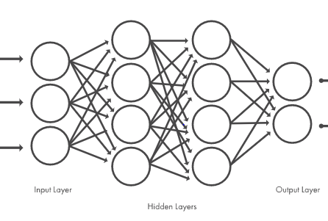
Convolutional Neural Networks
CNN is composed of an input layer, an output layer, and many hidden layers in between.

Slide 5
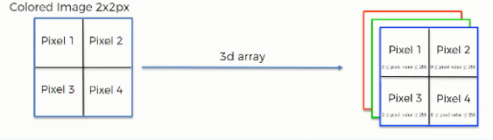
How CNN scan images ?
Black & white images are two-dimensional, whereas colored images are three-dimensional.
Each pixel inside a colored image is represented on three levels.
Since any color is a combination of red, green, and blue at different levels of concentration, a single pixel in a colored image is assigned a separate value for each of these layers.

Slide 6
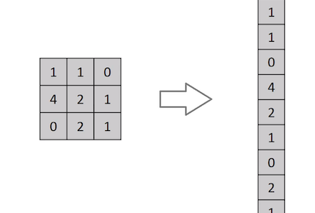
CNN over Feed- Forward Neural Networks
The accuracy of this prediction is very low.
CNN captures spatial arrangement of features unlike feed forward neural networks
The network can be trained to understand the sophistication of the image better.

Slide 7
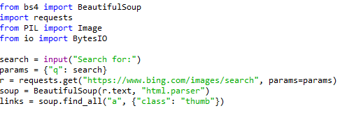
About Data
Images of Handbags and Footwear are scraped from the web using python beautiful soup class.
Around 500 images are used for training and 100 images are used to test.

Slide 8
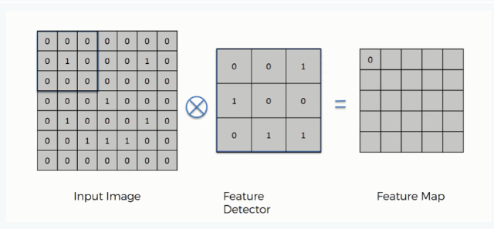
Convolution
The three elements in the convolution operation
Input image
Feature detector
Feature map

Slide 9
Convolution
Convolution is the first layer to extract features from an input image.
Convolution preserves the relationship between pixels by learning image features using small squares of input data.
The filters may have extracted features like the edges object or the color that distinguish different classes of images.
The feature map reduces the size of input images and larger the strides smaller the feature map.
There maybe some loss of information, However the purpose of the feature detector is to filter the parts of the information that are prominent.
Python code for Convolution
classifier.add(Conv2D(32, (3, 3), input_shape = (64, 64, 3)

Slide 10
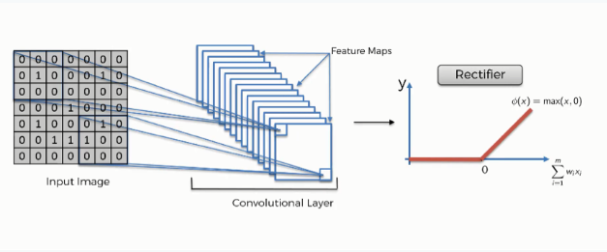
Rectified Linear Unit (ReLU)
The rectifier function is applied to increase the non-linearity in our images. This is done because the images are non linear.
The ReLU clips negative values to zero while keeping positive values unchanged.

Slide 11
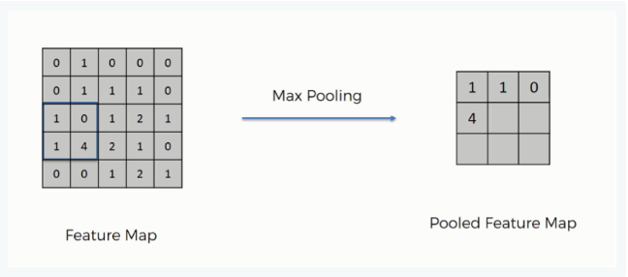
Max Pooling
The value of the corresponding node in pooling layer is calculated by taking the maximum of pixels contained in the particular window.

Slide 12
Max Pooling
There can be complex dataset with numerous image categories, which require large number of feature detectors each of which are responsible for finding a pattern in the image.
As a result the dimensionality of the convolution layer becomes large and can lead to overfitting.
Pooling minimizes the size of the images.
Also the property of spatial variance makes the network capable of detecting the object in the image without being confused by the differences in the image's textures, the distances from where they are shot, their angles, or otherwise.
Python code for pooling
classifier.add(MaxPooling2D(pool_size = (2, 2)))

Slide 13
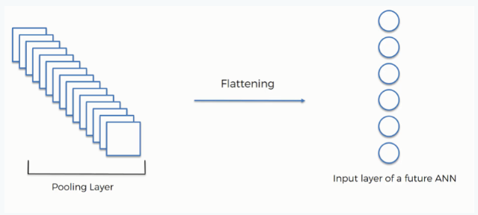
Flattening
The reason for flattening is that we need to insert this data into an artificial neural network.
Our pooled feature map is flattened into a column.
Python Code for flattening
classifier.add(Flatten())

Slide 14
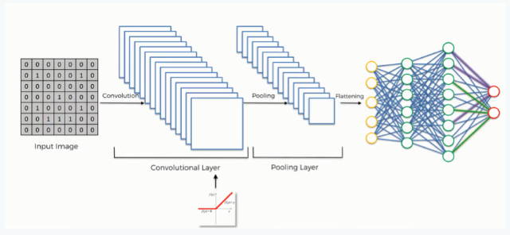
Full Connection
After the flattening step, the image is passed through an ANN.
The fully connected layer takes as inputs the output from the last convolution layer and does the computations in its hidden layers and produces class probability outputs in its output layer
By the end of this step, the neural network gives predictions for the image class.
The weights in the network are altered for optimization.

Slide 15

Full Connection
In the fully connected network each neuron in one layer is connected to each neuron in another layer.
If we look at a single neuron’s operation it looks like the following
Where X is the inputs
W are the weights
g is the activation function
Each neuron performs the above operation taking as inputs, the output of the previous neuron.
The last layer is softmax layer which outputs the probabilities of each image category.

Slide 16
Loss and Backpropagation
After the class prediction, it is compared with the true value and see how far is the predicted value away from real value.
The weights in the network at first are initialized to random values.
Backpropagation allows us to adjust weights to increase the efficiency.
The mathematical operation partial derivatives is used since we calculate weight contributions when everything else is held constant.
Next gradient descent which helps in optimization finding the global minimum.

Slide 17
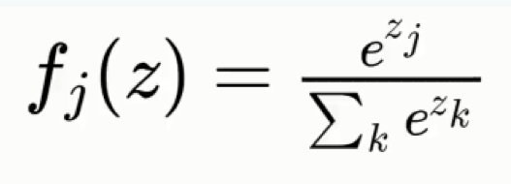
SoftMax function
Without the Softmax function the handbag and footwear classes will have probability which will not add up to 1.

Slide 18
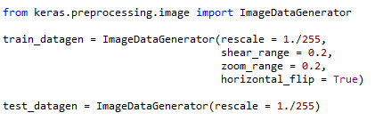
Fitting the CNN to the images.
Data Augmentation is done using the keras ImageDataGenerator class.
It allows us to enrich our dataset without adding much images.

Slide 19
Summary of the CNN model

Slide 20
Evaluating results
#Add the image and code for testing image classes.
#Add the efficiency of our model.

Slide 21
Conclusion
The CNN have high efficiency in image recognition and classification problems.
CNN models are computationally expensive.
Computer hardware like Gpu’s are required for quick processing.

