Slide 1



GAME-A-THON’26
TITLE PAGE
ARROWDEV
  Problem Statement ID –
  PS 3.1 (Track 3: FinTech)
  Problem Statement Title–
  FinCrew: help small businesses stay financially healthy and decide better
  Track –
  FinTech · SDG 8 · SDG 9 · SDG 16
  Team ID –
  [ add registered Team ID ]
  Team Name –
  OXRO LABS · Ram · Sumit · Masoom
MIND YOUR FUNDS
Oxro Labs Finance Desk
A finance manager that feels like a game: plan · track · grow.
Catches late payments, missed GST deadlines and fraud, and keeps the owner in control.
7.61 cr
27 days
MSMEs registered in India [1]
median small-business cash buffer [5]
₹36,014 cr
1.51 cr
bank fraud reported, FY25 [4]
active GST registrations [3]
8
SDG 8: Decent Work & Economic Growth
9
SDG 9: Industry, Innovation & Infrastructure
16
SDG 16: Peace, Justice & Strong Institutions
Ram
Engine · agents · database
Sumit
UI · gamification feel
Masoom
Trust · content · pitch
Product: Mind Your Funds · Oxro Labs Finance Desk | Stats and references: slide 6
Notes:
Intro: FinCrew answers PS 3.1. Product name: Mind Your Funds, deployed as the Oxro Labs Finance Desk. Add the registered Team ID before submitting.

Slide 2

PROBLEM STATEMENT
ARROWDEV
Problem
Target users / affected stakeholders
Invoices, bills, payroll, GST and cash flow sit in 6+ disconnected tools
No finance team: risks surface only after the damage (late payer, missed GSTR-1/3B, fake invoice)
The owner cannot answer "what must I act on today?" or prove what was done and why
New 45-day MSME payment rule and monthly GST deadlines add load
7.61 crore
registered MSMEs [1]
Excel sheets
Bank app
WhatsApp
Accountant / CA
Employees (payroll)
no single view
Owner?
Small business owner
30.1%
of India's GDP [2]
Approvers / admins
Company finance team
45.73%
of India's exports [2]
GST portal
Accounting tool
Paper bills
Customers & vendors
Lenders & GST authority
Existing gap
Why the problem needs to be solved
Existing tool | Does well | Gap for a small business
Spreadsheets | Flexible records | Manual, error-prone, no alerts or audit
Accounting software | Books and GST reports | Reactive: shows history, warns late
Banking / UPI apps | Balances, payments | No invoice, input-credit or deadline context
Monthly CA visit | Expert filing | Advice arrives after the due date
Reminder apps | Nudges | No link to ₹ at risk or proof of action
₹36,014 cr
bank fraud, FY25: 23,953 cases [4]
45 days
legal MSME payment limit since 1 Apr 2024; ₹20.7k cr dues, 85k cases [6]
₹22.08 L cr
gross GST FY25 from 1.51 cr taxpayers on strict deadlines [3]
₹20–25 L cr
estimated MSME credit gap [11]
2
Sources: [1] Min. of MSME AR 2025-26 · [2] PIB MSME Day 2025 · [3] PIB Eight Years of GST · [4] RBI AR 2024-25 · [5] JPMorgan Chase Institute · [6] Income-tax Act s.43B(h), MSME Samadhaan · [11] IFC estimate (as cited). Full list on slide 6.
Notes:
Problem: scattered tools, no finance team, no record. Stakeholders: owner, CA, employees, customers/vendors, lenders. Gap: existing tools are reactive. Why now: thin cash buffers (27 days), fraud, 45-day rule, GST deadlines.

Slide 3
PROPOSED SOLUTION
ARROWDEV
Solution overview
Key features
Mind Your Funds is an AI-assisted finance manager that makes a small business's money visible, safe and rewarding to manage. Deployed as the shared Oxro Labs Finance Desk.
Health score + alerts
Runway, collections and credit safety in one number
GST engine
CGST/SGST/IGST, input credit, GSTR-1/3B calendar
Approvals + roles
Admin, finance, viewer; spend limit enforced in DB
Bank CSV + recurring
Auto-match payments; monthly entries on autopilot
Tamper-evident audit
Who, what and why in a SHA‑256 chain
AI CFO (Groq)
Ask questions on aggregate numbers; stress test
Reports + GST invoices
P&L, aging, top parties, print to PDF
XP, streaks, quests
Badges, scratch reward, team leaderboard
PLAN
TRACK
GROW
4-agent crew: Collector · Treasurer · Sentinel · Scout
How it addresses the problem
Simple solution workflow
The PS asks | Our answer
What does the owner most need to know, and when? | Daily dashboard: health score, ₹ at risk, next 14 days; alerts ranked by urgency; GST and payroll dues flagged 5 days ahead
How are late payments, missed deadlines and suspicious activity caught? | Collector flags overdue invoices; calendar tracks GSTR-1 (11th) and GSTR-3B (20th) [10]; Sentinel checks duplicates, invalid GSTIN, unusually large bills
How does the owner stay in control, with a clear record? | Roles and approval above a spend limit; one-click actions; every action stored with who, what and why in a SHA‑256 chain
Play layer: surprises hit (late client, big expense, fraud, growth chance) | Practice Lab runs 90 days of shocks; Ghost Twin compares health with and without the crew
1 Capture
Invoice, bill, payroll, bank CSV
2 Validate
GSTIN checksum, CGST/SGST/IGST
3 Analyse
Forecast, aging, risk rules
4 Alert
Ranked cards with ₹ impact
5 Decide
Approve, reject or auto within limit
6 Record
Who, what, why: SHA‑256 chain
7 Reward
XP, streak, badge, scratch card
8 Improve
Health score, reports, AI CFO
Daily loop: check-in → quests → reward → streak → better books tomorrow
3
Deadlines per GST portal [10]; rates and dates are planning estimates, verify with a Chartered Accountant. Features shown are built and running in the prototype.
Notes:
Solution: one finance desk for the whole team. Walk the 8-step workflow, then map each PS question to a feature.

Slide 4
INNOVATION AND GAMIFICATION
ARROWDEV
What is unique about the solution
Gamification elements
Ghost Twin: same business, same shocks, crew switched off, so the benefit is measured, not claimed
Trust Dial: per-agent autonomy from "ask me" to "auto up to a ₹ cap"
Why-Receipts: who, what and why kept in a tamper-evident SHA‑256 chain
DB-enforced control: roles and approvals live in RLS and triggers, not just buttons
Stress test: cash in 30 days if every customer pays late
7
6
5
4
3
2
1
Levels 1→7: Starter, Tracker, Planner, Controller, Strategist, Finance Lead, CFO (0 → 2,400 XP)
Twin went bankrupt on day 30 (₹25,000 fraud paid). Crew ended with ₹4.73 L cash and blocked ₹70,000 of fraud.
Daily streaks
4 daily quests
11 badges
Goal ring
Scratch reward
Team leaderboard
Why the gamified approach is effective
Differentiation from existing solutions
Trigger
alert, story card, streak at risk
Action
collect, pay, file, log
Points reward outcomes (on-time collection and filing), never screen time
Variable reward (scratch card) and streaks build the daily habit that keeps the books current
Evidence: most empirical studies reviewed by Hamari et al. (2014) report positive effects of gamification [7]
Capability | Sheets | Accounting apps | Banking apps | This solution
Proactive risk alerts | No | Partly | Partly | Yes
GST credit check + filing calendar | No | Partly | No | Yes
Approval workflow with roles | No | Partly | No | Yes
Tamper-evident audit with reasons | No | No | No | Yes
Habit loop (XP, streaks, rewards) | No | No | Partly | Yes
Proof of benefit (Ghost Twin) | No | No | No | Yes
Investment
streak, goal ring, history
Reward
XP, scratch card, badge
4
Simulation: seed 42, engine in repo (crew accepts recommended action). XP values from the prototype. Comparison generalises typical tool categories. Ref [7]: Hamari, Koivisto & Sarsa, HICSS-47 (2014).
Notes:
Innovation: Ghost Twin, Trust Dial, audit trail, DB-enforced control. Gamification ties points to real financial behaviour. Compare to sheets, accounting software and banking apps.

Slide 5
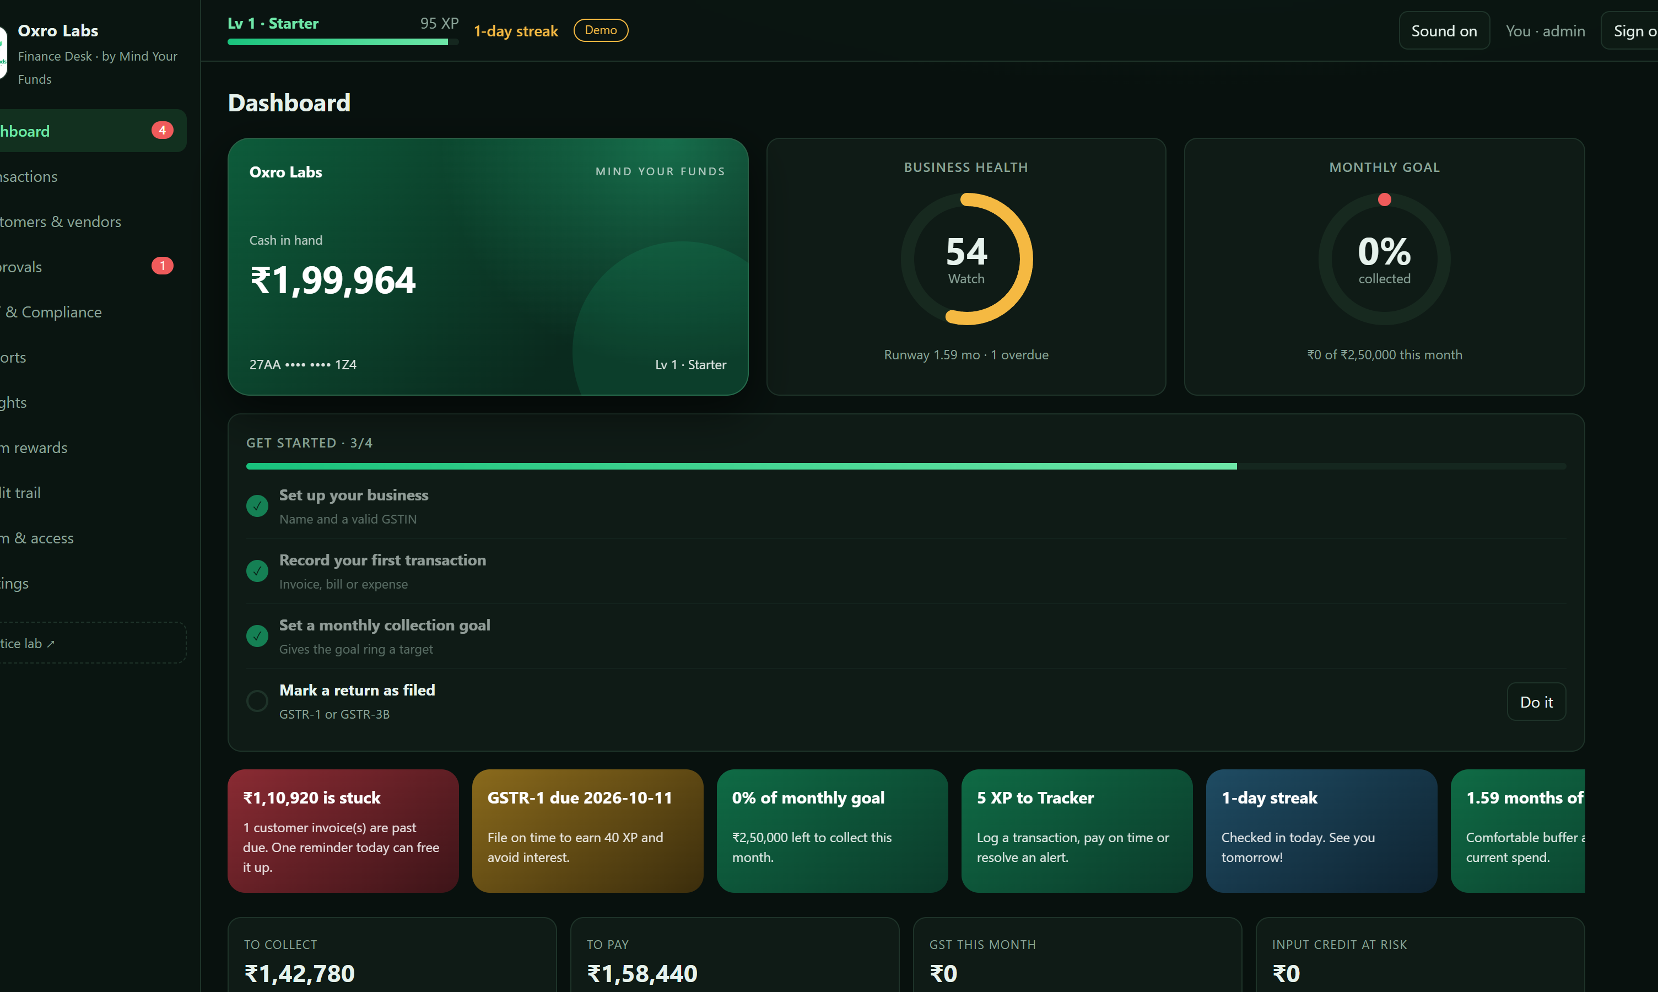
TECHNOLOGY AND IMPLEMENTATION
ARROWDEV
Tech stack
Frontend
Data & Auth
Business engine
AI
Trust & security
DevOps & QA
HTML5 · CSS3 · JS (ES modules)
SVG + Canvas charts
PWA + service worker
No framework, no build step
Supabase PostgreSQL
Auth: email / magic link
Row-Level Security [8]
Realtime + SQL migrations
GST: CGST/SGST/IGST, ITC
GSTIN checksum validator
Forecast, aging, alerts
XP, quests, bank CSV parser
Groq API (Llama, GPT-OSS) [9]
Netlify Function proxy
Model + template fallback
Aggregate numbers only
SHA‑256 hash-chained log
Org roles enforced in DB
Domain-locked invites
No secrets in the browser
Netlify hosting + functions
Supabase CLI migrations
Node self-check suite
Playwright screenshots
System architecture / workflow
Implementation methodology
Prototype / working model
Browser · PWA Finance Desk
Supabase
0
P0 · H0–2 Contracts frozen, repo and schema
Views
Dashboard · Transactions · Approvals · Reports · Rewards · Audit · Team
Auth (JWT)
P1 · H2–6 Skeleton in 3 parallel tracks
1
HTTPS+JWT
Postgres + RLS
orgs · members · entries · parties · filings · xp · activity_log
2
P2 · H6–11 Agents, GST, ledger, UI features
Engine
calc · gst · gamify · reports · bank · recurring
3
P3 · H11–15 Integration, gamification polish
Realtime
live sync across devices
4
P4 · H18–20 Hardening, deploy, self-checks
Realtime
P5 · H21–23 Pitch, demo video, submit
Repo layer
cloud (Supabase) or demo (browser storage)
5
Working today: 11 pages, 3 roles, 6 SQL migrations
Self-check suite passes (GST, ledger, reports, bank import, simulation)
Demo mode needs no keys; cloud mode uses Supabase
aggregates
Netlify Function
/api/groq
Groq API
Llama · GPT-OSS
3 tracks: Ram (engine · DB) · Sumit (UI) · Masoom (trust · content)
@SIH Idea submission- Template
Refs: [8] Supabase docs (RLS, Auth, Realtime) · [9] Groq API docs. Screenshot: live prototype dashboard (demo data).
Notes:
Tech: static PWA plus Supabase plus a tiny Netlify function for Groq. Architecture arrows show data flow. Methodology: phased, three parallel tracks, migrations first.

Slide 6
IMPACTS AND FUTURE SCOPE
ARROWDEV
Expected impact
Benefits to users
8
SDG 8 · Decent work & growth: protects payroll and cash so small firms keep jobs
Business owner
Finance team / CA
One daily view of cash, dues and risks
Less chasing, fewer penalties
Streak and goal ring make bookkeeping a habit
Clean registers and GST split, CSV export
Approvals and audit trail ready to review
Bank CSV reconcile cuts manual matching
9
SDG 9 · Industry & innovation: affordable digital finance rails for MSMEs
Employees & team
Customers & lenders
16
SDG 16 · Strong institutions: audit trail, fraud defence, transparency
Payroll never missed; clear approvals
XP and leaderboard build good habits
Role-based access: see only what you need
Timely, documented invoices and reminders
Verifiable records support credit decisions
WhatsApp-ready payment reminders
Scalability / feasibility
Future enhancements
Static PWA on a CDN plus managed Postgres: scales per tenant (org_id + RLS)
Multi-tenant by design: one workspace per company, invite codes, domain lock
Runs end to end on 6 versioned migrations; free tiers cover a pilot
Next · 0–3 months
Later · 3–9 months
Vision
Server-side XP (anti-cheat)
WhatsApp / email sending
Bank-statement templates
Offline sync for the PWA
Account Aggregator bank feed
E-invoice (IRN) and e-way bill
TDS, PF and ESI filings
Multi-GSTIN, multi-branch
ML late-payment prediction
Accountant portal, regional languages
On-chain anchor of ledger hash
Open API for ERP tools
References
[1] Ministry of MSME, Annual Report 2025-26: 7.61 cr registered MSMEs (31 Jan 2026). msme.gov.in
[2] PIB, Udyami Diwas – MSME Day 2025: ~30% of GDP, >45% of exports. pib.gov.in
[3] PIB, Eight Years of GST: 1.51 cr registrations; ₹22.08 lakh cr gross GST, FY25. pib.gov.in
[4] RBI Annual Report 2024-25: bank frauds ₹36,014 cr, 23,953 cases (via Business Standard)
[5] JPMorgan Chase Institute, "Cash Is King" (2016): median buffer 27 days; 25% hold ≤13
[6] Income-tax Act s.43B(h), 45-day MSME payments from 1 Apr 2024; MSME Samadhaan, Apr 2024
[7] Hamari, Koivisto & Sarsa (2014), "Does Gamification Work?", HICSS-47, doi:10.1109/HICSS.2014.377
[8] Supabase docs: Row Level Security, Auth, Realtime. supabase.com/docs
[9] Groq API docs: OpenAI-compatible chat completions. console.groq.com/docs
[10] GST portal: GSTR-1 (11th) and GSTR-3B (20th) due dates. gst.gov.in
[11] IFC estimate of India's MSME credit gap (₹20–25 lakh cr), as cited in industry reports
[12] UN Sustainable Development Goals 8, 9, 16. sdgs.un.org/goals
@SIH Idea submission- Template
Notes:
Impact: simulation shows the crew keeps health at 84 while the unassisted twin collapses by day 30. Targets are for a pilot. Future: server-side XP, bank feed, e-invoicing, ML.

