Slide 1
Biodiversity Data Analysis
Auto-generated summary presentation with visualizations and documentation

Slide 2
Project Overview
This project is part of the Codecademy Data Science path. It focuses on data cleaning, analysis, and visualization using species data from the US National Parks Service.

Slide 3
The Data
- species_info.csv: animal category, scientific name, common name, conservation status
- observations.csv: observations of each species in several parks over 7 days

Slide 4
Project Goals
1. Explore and clean the datasets
2. Merge the datasets and analyze patterns
3. Focus on endangered species and compare species across parks

Slide 5
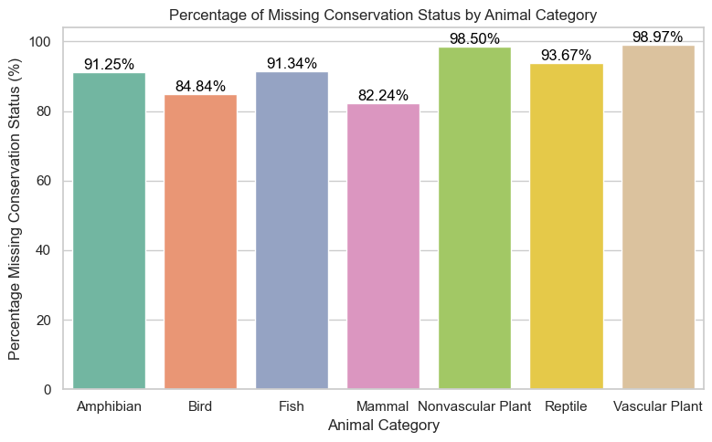
Figure 1
Notes:
### Observations
The missing values in conservation status seem nearly evenly distributed amoung the species categories.
There is no visible correlations between missing values and species category.

Slide 6
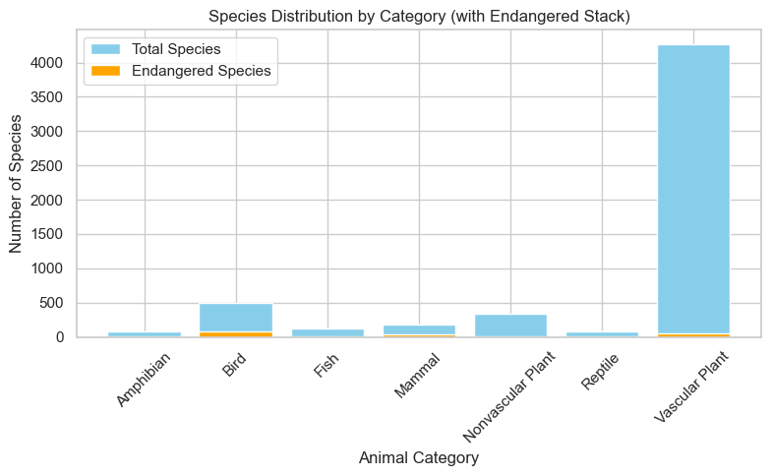
Figure 2

Slide 7
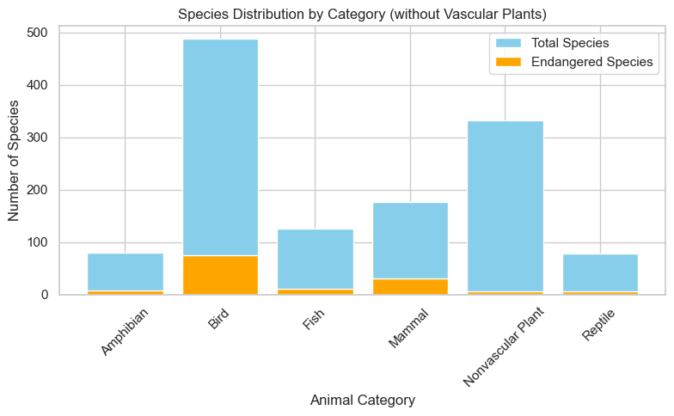
Figure 3
Notes:
### Observations
* The Vascular Plant category is by far the most populated category in the dataset. In has about 10 times more species than the next category in size, which is Birds.
* Categories which have visible percentages of endangered species are: Bird, Mammal, Fish.

Slide 8
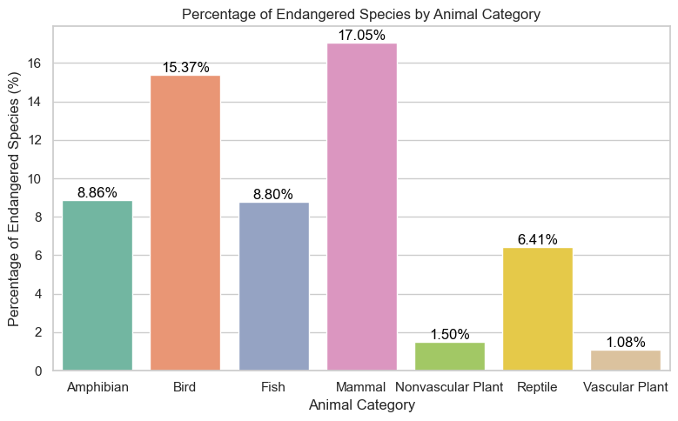
Figure 4
Notes:
### Observations
We can see that most species that are indicated as endangered in the dataset are either mammals or birds.
Relatively few of the plants species are considered endangered.

Slide 9
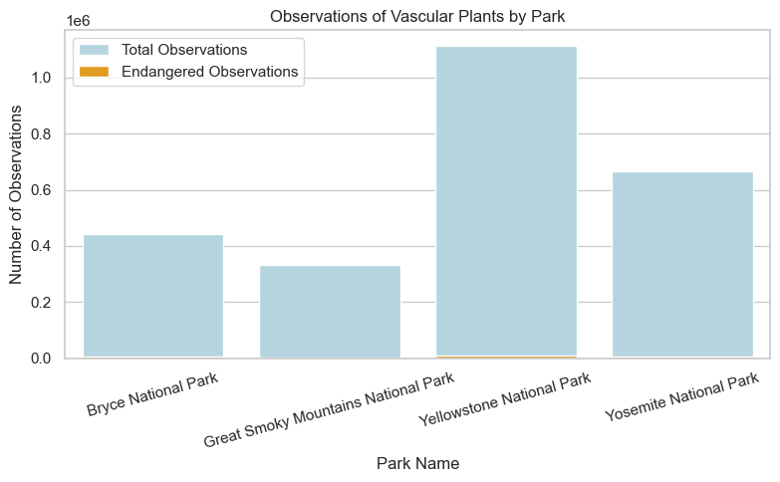
Figure 5
Notes:
### Observations
* The graphs for the four parks look very similar, even suspiciously so. The absolute number of observation are different, but the distributions look very similar.
* This can be the result of a bug in the code, but it can also indicate the the data is repeated and duplicated.
* I will check the last hypothesis.

Slide 10
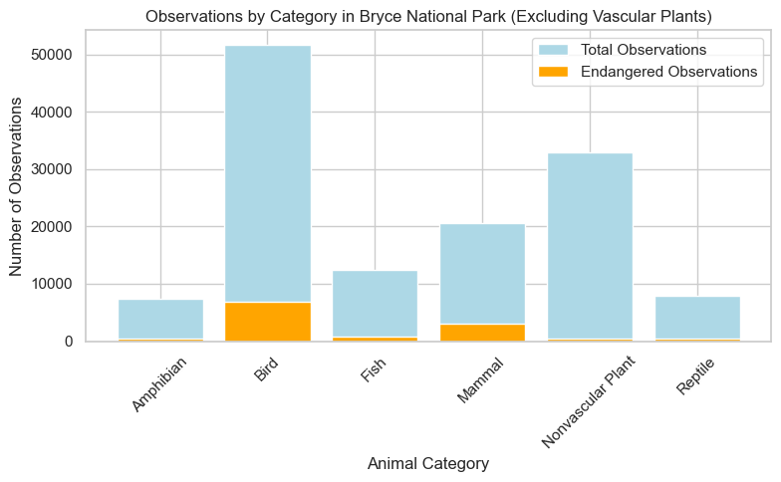
Figure 6
Notes:
### Observations
* The graphs for the four parks look very similar, even suspiciously so. The absolute number of observation are different, but the distributions look very similar.
* This can be the result of a bug in the code, but it can also indicate the the data is repeated and duplicated.
* I will check the last hypothesis.

Slide 11
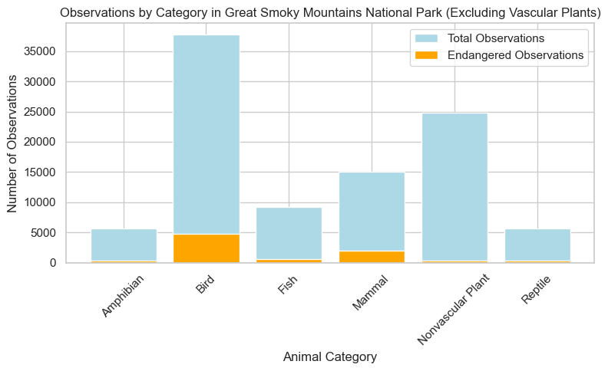
Figure 7
Notes:
### Observations
* The graphs for the four parks look very similar, even suspiciously so. The absolute number of observation are different, but the distributions look very similar.
* This can be the result of a bug in the code, but it can also indicate the the data is repeated and duplicated.
* I will check the last hypothesis.

Slide 12

Figure 8
Notes:
### Observations
* The graphs for the four parks look very similar, even suspiciously so. The absolute number of observation are different, but the distributions look very similar.
* This can be the result of a bug in the code, but it can also indicate the the data is repeated and duplicated.
* I will check the last hypothesis.

Slide 13
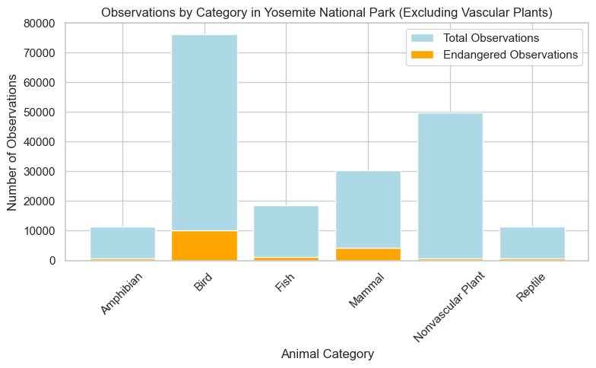
Figure 9
Notes:
### Observations
* The graphs for the four parks look very similar, even suspiciously so. The absolute number of observation are different, but the distributions look very similar.
* This can be the result of a bug in the code, but it can also indicate the the data is repeated and duplicated.
* I will check the last hypothesis.

Slide 14
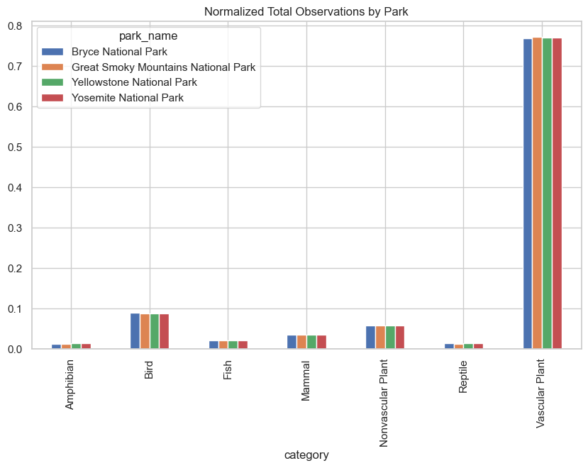
Figure 10
Notes:
### Observations
* Perfect correlation between parks, in the combined parks/catgories dataset!
* Although we did not find such a correlation between parks in the observations dataset before the combinination.
* Let's do several more checks.

Slide 15
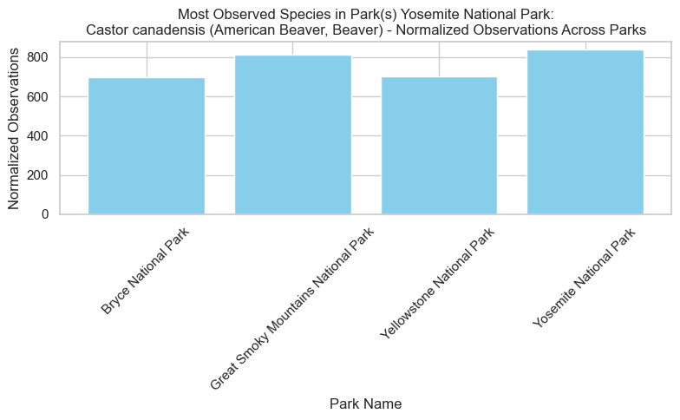
Figure 11
Notes:
### Observations
* We have seen the comparing total observations by species categories did not reveal differences between the parks, after scaling.
* But now we can se that maximual cases analysis does reveal differences between the parks. Different species are most-observed in different parks, at least in some of the cases. And even when the species are the same, the (normalized) observation counts are different.
* We have also applied a Chi-Square test for each of the graphs, to numerically verify that the differences between the normalized observations counts are significant, in the sense of deviating from a uniform (equal for all the parks) distribution.

Slide 16
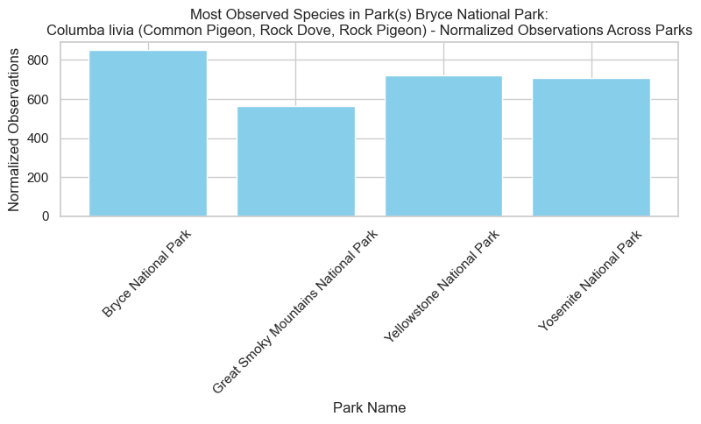
Figure 12
Notes:
### Observations
* We have seen the comparing total observations by species categories did not reveal differences between the parks, after scaling.
* But now we can se that maximual cases analysis does reveal differences between the parks. Different species are most-observed in different parks, at least in some of the cases. And even when the species are the same, the (normalized) observation counts are different.
* We have also applied a Chi-Square test for each of the graphs, to numerically verify that the differences between the normalized observations counts are significant, in the sense of deviating from a uniform (equal for all the parks) distribution.

Slide 17
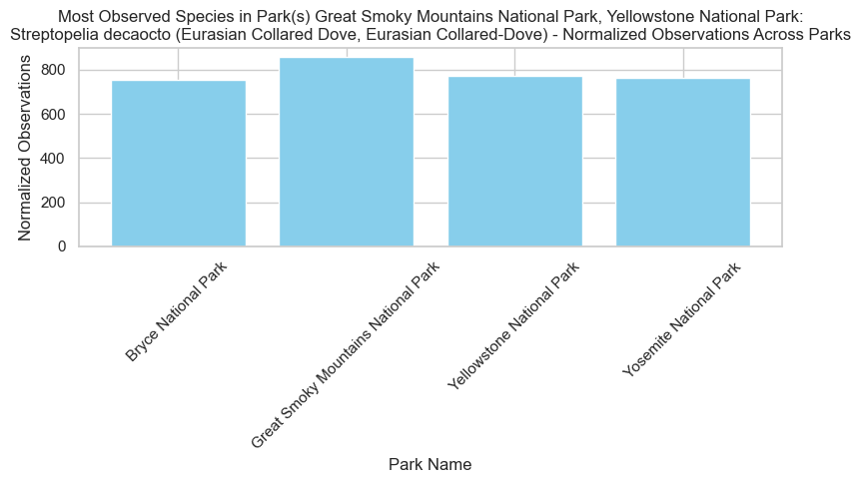
Figure 13
Notes:
### Observations
* We have seen the comparing total observations by species categories did not reveal differences between the parks, after scaling.
* But now we can se that maximual cases analysis does reveal differences between the parks. Different species are most-observed in different parks, at least in some of the cases. And even when the species are the same, the (normalized) observation counts are different.
* We have also applied a Chi-Square test for each of the graphs, to numerically verify that the differences between the normalized observations counts are significant, in the sense of deviating from a uniform (equal for all the parks) distribution.

Slide 18
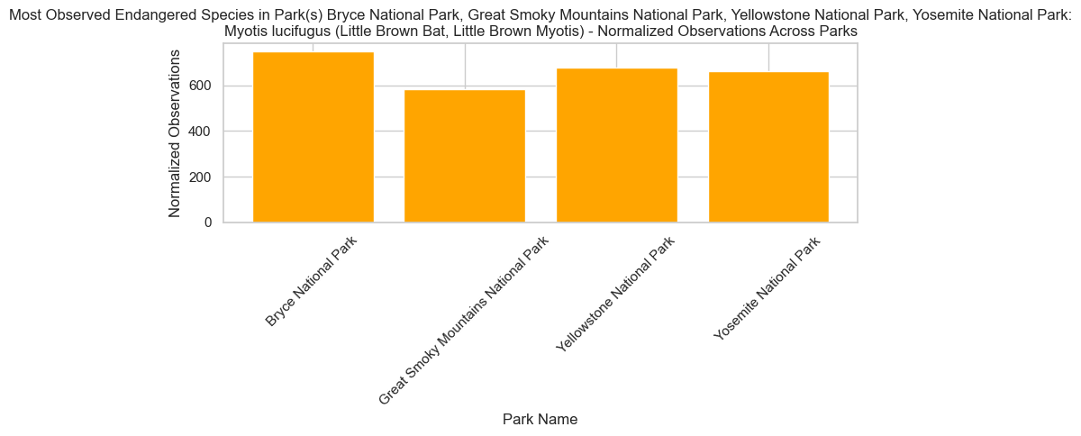
Figure 14
Notes:
### Observations
* We have seen the comparing total observations by species categories did not reveal differences between the parks, after scaling.
* But now we can se that maximual cases analysis does reveal differences between the parks. Different species are most-observed in different parks, at least in some of the cases. And even when the species are the same, the (normalized) observation counts are different.
* We have also applied a Chi-Square test for each of the graphs, to numerically verify that the differences between the normalized observations counts are significant, in the sense of deviating from a uniform (equal for all the parks) distribution.

Slide 19
Conclusions
• Duplicate rows were resolved by grouping species and summing observations.
• Observation counts across parks were nearly identical by category.
• Normalized data was used to identify and compare most observed species per park.
• Statistical tests confirmed significant differences between parks.
• Endangered bat species was most observed in Bryce, least in Great Smoky Mountains.
Notes:
Summary of your final findings:
- Duplicates handled carefully
- Observation patterns normalized and compared
- Statistically significant differences across parks
- Doves and beaver as top non-endangered species; bats as top endangered
- Discuss artificial nature and time-bound scope of the dataset

Slide 20
Questions?
Notes:
Invite the audience to ask questions.
Be ready to revisit the project motivation or methodology if needed.

