Slide 1
COVID-19 ANALYSIS: JUN 2020
Self introduction
Name: Rammohan Hanumantu
User ID: H12066
Topic: Mini Project

Slide 2
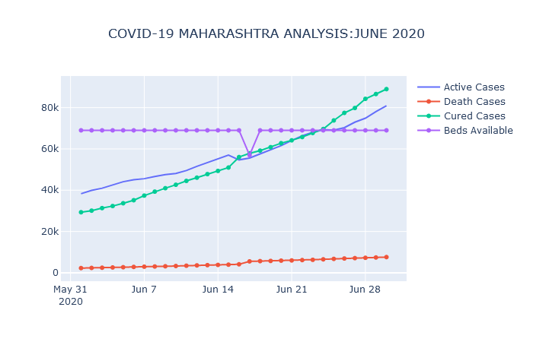
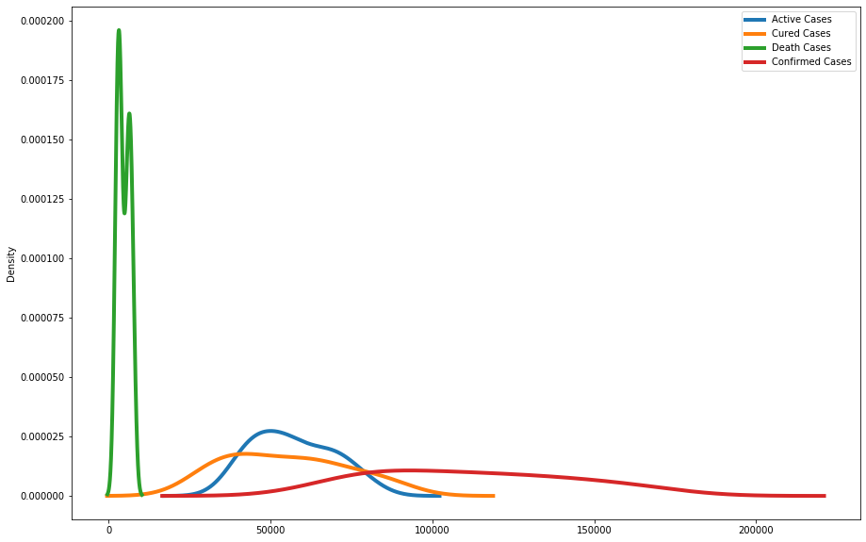
COVID-19 ANALYSIS: JUN 2020
Current Situation
Total Cases: 211987
Recovered: 115262
Active Cases: 87699
Deaths: 9026
Total Beds
Available: 68998

Slide 3
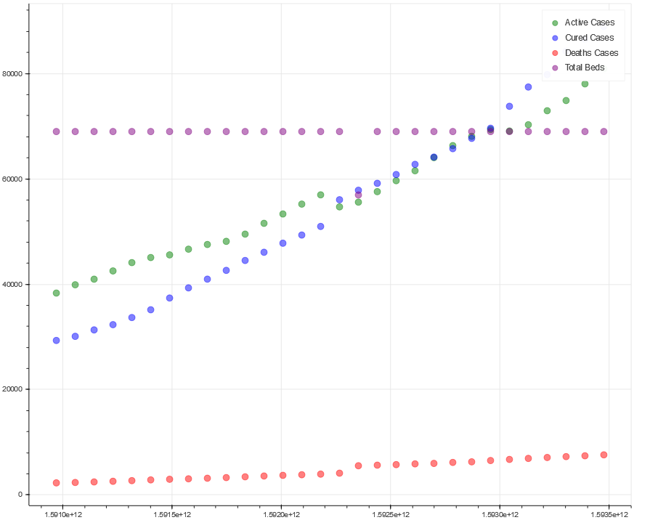
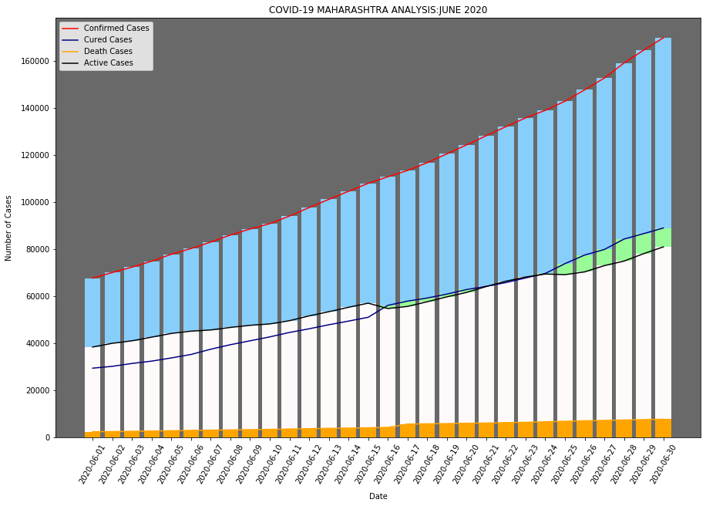
COVID-19 ANALYSIS: JUN 2020
Current Situation
Total Cases: 211987
Recovered: 115262
Active Cases: 87699
Deaths: 9026
Total Beds
Available: 68998

Slide 4
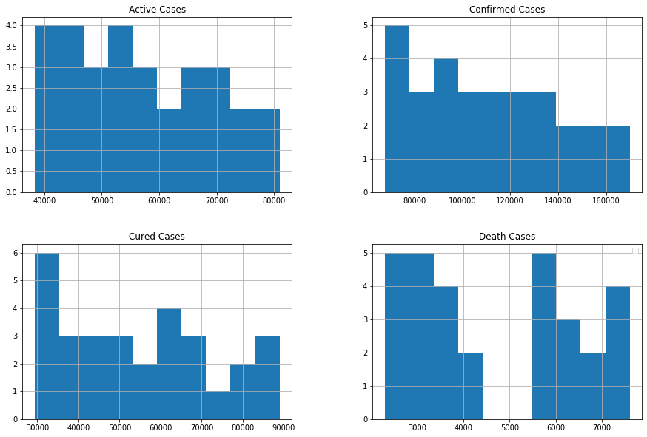
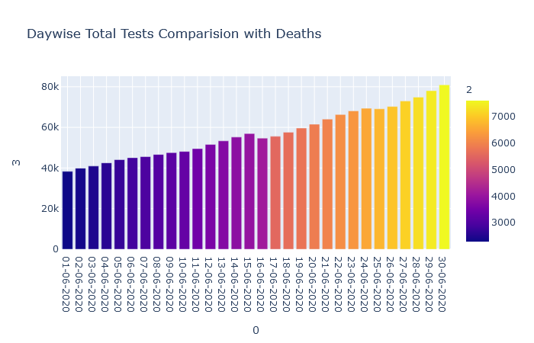
COVID-19 ANALYSIS: JUN 2020
Current Situation
Total Cases: 211987
Recovered: 115262
Active Cases: 87699
Deaths: 9026
Total Beds
Available: 68998

Slide 5
COVID-19 ANALYSIS: JUN 2020
Current Situation
Total Cases: 211987
Recovered: 115262
Active Cases: 87699
Deaths: 9026
Total Beds
Available: 68998
Problems Observed
Total no of beds are less wrt Active case
Urban area is the most effected
Less amount of testing

Slide 6
THANK YOU

