Slide 1
PV204 Term Project
Hardware Security Module for CryptBox (HSMCB) for File Encryption
27 Apr 2017
BIDARE VENKATESH GURUPRASAD, UCO:459196
GILLELA MARUTHI, UCO:459206
GOVIND PRASHANTH REDDY, UCO:459207
TANGUTURI RAMU, UCO: 459204
https://github.com/ramucs108/HSMCryptbox

Slide 2
Introduction
Objectives of the project
Selection of existing open-source application which requires password or key from user
Creation of applet which will provide secure key storage or processing
Creation of secure channel between original app and card

Slide 3
Work done
Selection of existing open-source application which requires password or key from user
An extensive internet search for suitable open source app was carried out
Jpass
Cryptbox
UPM
After studying its functionality, Cryptbox was found to be suitable for our project
Cryptbox was downloaded from the following URL:
https://www.codeproject.com/articles/546069/cryptbox

Slide 4
Work done
Analysis of the Cryptbox open source framework
Code walk through
16 man-hours effort (approx)
Complete java source code was analyzed
Comments were made in source file during code walkthrough
Starts with “//HSMCB COMMENT”
Uploaded onto git
Input validations were not done.
What does the framework do?
File Encryption and Decryption using Password Based Encryption (PBE)
Uses standard APIs of the Java Crypt library
import javax.crypto.Cipher;
import javax.crypto.SecretKey;
import javax.crypto.SecretKeyFactory;
import javax.crypto.spec.PBEKeySpec;

Slide 5
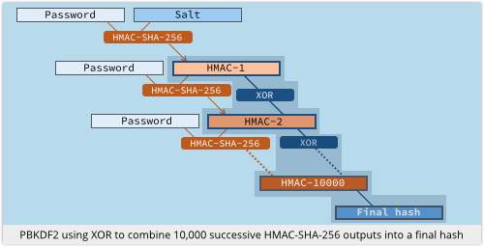
Work done
What does the framework do?
Password to be entered
User selects
Mode (Enc/Dec)
File to be Enc/Dec
User enters
Password & re-password
PBKDF number of Iterations
The Application
Generates a Random Number (Salt) – 8 bytes
Writes the Salt (8 bytes Random number) to encrypted file
Uses password and salt to generate PBKDF for user selected number of times using “PBEWithMD5AndDES” class of java
Encrypts/Decrypts the user selected file using DES
PDKDF Diagram Source: https://nakedsecurity.sophos.com

Slide 6
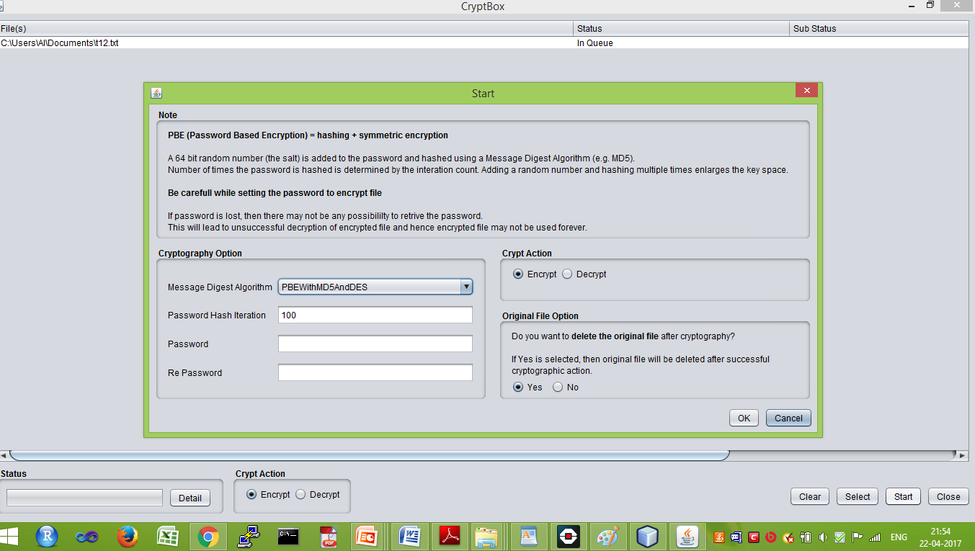
Work done

Slide 7


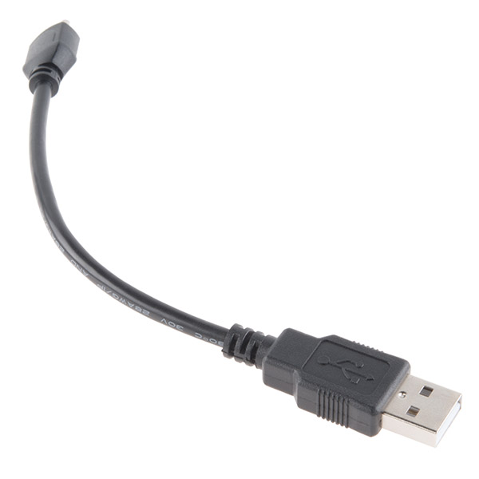

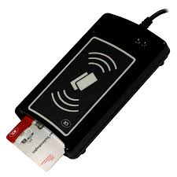

Work done – HSMCB High level Architecture
User enters password in HSMCB GUI
HSMCB
Challenge-Response based Secure Channel
Card reader with Java card

Slide 8
Work done
Our work
Design of secure channel protocol
Overall architecture
Message format
Design of applet functionalities
Worked out the development approach
Phase-1 (with simulator)
Implementation of each modules using simulator
Testing of functionalities
Phase-2 (with Java Card)
Implementation/modification of each module using java card
Testing of functionalities

Slide 9
Work done
Secure Channel Communication
Cryptographic primitives used
AES256, MAC-SHA256, Random Numbers
Security mechanisms
Authentication
Confidentiality
Integrity
Replay Protection
Security features
At any point of time, the system contains either plain text file or encrypted file.
Security best practice
Assumptions
Attacker can eavesdrop between PC and Java Card
The final encryption and decryption of the file will be carried out by PC application

Slide 10
Work done
Design of secure channel protocol
Sl. No. | Message Name | From | To | Remarks
1. | Challenge1 Message | Host | JC | Freshness ensured by Host Random no.
2. | (Challenge1 Response + Challenge2) Message | JC | Host | Freshness ensured by JC Random no.
3. | Challenge2 Response | Host | JC | Freshness ensured by Incrementing the Host Random no. & JC Random no.
4. | DES_KEY_FOR_FILE Response Message | JC | Host | Finally JC sends the key to be used for enc/dec the file

Slide 11
Work done
Protocol message Details
MESSAGE DETAILS | Action Taken
Message from Host to JC | Host encrypts (PIN+RanHost) using public key of Java Card , computes the MAC and appends it to the message. JC receives the packet, computes MAC and compares with incoming MAC. On success, it decrypts using its private key and generates session key K1 using sha256
Message from JC to Host | JC increments RanHost, adds its Random number RanJC, encrypts ((RanHost+1)+RanJC) using K1 and adds MAC of the packet. Host verifies MAC and decrypts the message and verifies RanHost+1
APDU HEADER
Pub _{JC}(PIN + RanHost)
MAC
APDU HEADER
ENC _{K1}((RanHost+1
) +RanJC)
MAC

Slide 12
Work done
Protocol message Details
MESSAGE DETAILS | Action Taken
Message from Host to JC | Host encrypts ((RanHost+2)+(RanJC+1) using K1, computes the MAC and appends it to the message. JC receives the packet, computes MAC and compares with incoming MAC. If success, it decrypts using K1
Message from JC to Host | JC encrypts ((RanHost+3)+DES_KEY), adds MAC of the payload and sends the message to host. Host verifies the MAC, RanHost+3 and accepts DES_KEY which will be used for file encryption/decryption
APDU HEADER
ENC _{K1}((RanHost+2) + +(RanJC+1))
MAC
APDU HEADER
ENC _{K1}((RanHost+3) + +DES_KEY)
MAC

Slide 13
Work done: Phase-1 : With simulator
Major Modules Developed
At Host end
Javacardprotocol
Input parameter:
Password
Output parameter:
DES_KEY to be used for file encryption
Description:
This function establishes the secure communication between Java card and the host machine. It generates host random number, sets the session key K1 at the Java card and finally generates the DES_KEY.
DecryptJCResponse
Input parameter:
Response from java card
Output parameter:
Success or failure of decoding.
Description:
This function takes the response from the java card/simulator, checks for MAC and nonce increment.

Slide 14
Work done: Phase-1 : With simulator
Major Modules Developed
At both Host JavaCard end
CheckNonce
Input parameter:
Received Nonce
Output parameter:
Success or failure
Description:
This function checks whether received nonce is valid or not
aes256encyrpt
Input parameter:
Message to be encrypted
Output parameter:
Encrypted message
Description:
This function takes the plain text and encrypts it.

Slide 15
Project features
Architecture design based on security primitives
Secure Channel protocol to protect from evesdropping
Incorporation of security primitives
Challenge response mechanism
Authentication
Confidentiality
Integrity
Replay Protection
500 LOC (approx-till now)
Travis CI service to Github repository
Security best practices
Deletion of original file after encryption

Slide 16
Work done: Phase-1 : With simulator
Sl. No. | Task | Tasks Performed
1. | Bidare Venkatesh Guruprasad | Team Coordination & Interaction Code walkthrough and crypt box analysis Development of architecture, protocol and documentation
2. | Gillela Maruthi | Code walkthrough Basic frameworks searching and analysis of several frameworks (including CryptBox) Coding of multiple transaction challenge response between Host and simulator
3. | Govind Prashanth Reddy | Understanding and analysis of Cryptbox Generation of control flow chart Integration of cryptbox software with new software modules of HSM including UI modifications Testing using analysis tools Integration activity
4. | Tanguturi Ramu | Git hub related activities including repository creation Coding of secure channel protocol communication for key setting Coding of simulator’s Simple Applet

Slide 17
Status: Work done v/s Work to be done
Sl. No. | Objective | Major Task | Work Done/ Under progress | Work to be done
1. | Selection of existing open-source application which requires password or key from user | Selection Of an existing basic framework | ✓ | --
 |  | Understanding of the basic framework’s functionalities | ✓ | --
2. | Creation of secure channel between host and card | secure channel architecture and protocol | ✓ | --
3. | Host application for secure channel communication | Implementation of functionalities and integration with basic crypt box framework | ✓ | To be done using Java card
4. | Applet application for secure channel communication | Implementation of functionalities and integration with basic crypt box framework | ✓ | To be done using Java card
5. | Integration and testing | Overall functionality testing | Under progress using simulator | To be done using Java card

Slide 18
Thank You

