Slide 1
Introduction to Machine Learning

Slide 2
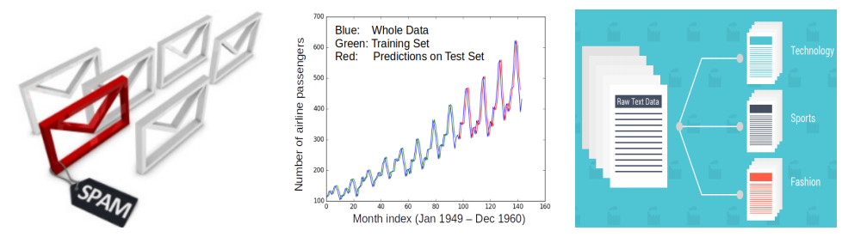
Machine Learning (ML)
Designing algorithms that ingest data and learn a model of the data
Machine learning is a branch of artificial intelligence (AI)
The learned model can be used to
Detect patterns/structures/themes/trends etc. in the data
Make predictions about future data and make decisions
Modern ML algorithms are heavily “data-driven”
No need to pre-define and hard-code all the rules (infeasible/impossible anyway)
The rules are not “static”; can adapt as the ML algo ingests more and more data

Slide 3










ML: From What It Does to How It Does It?
ML enables intelligent systems to be data-driven rather than rule-driven
How: By supplying training data and building statistical models of data
Pictorial illustration of an ML model for binary classification:
A Linear Classifier (the statistical model)

Slide 4
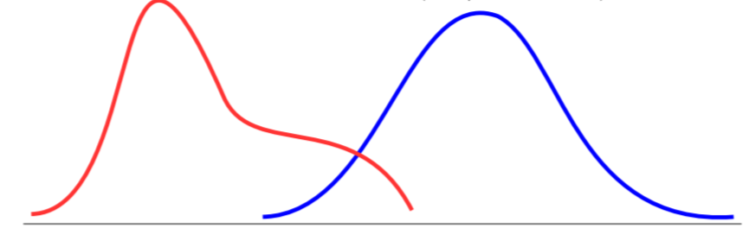

ML: From What It Does to How It Does It?
ML enables intelligent systems to be data-driven rather than rule-driven
How: By supplying training data and building statistical models of data
Pictorial illustration of an ML model for binary classification:
A Probabilistic Classifier (the statistical model)
P(“cat”|image)
P(“dog”|image)

Slide 5
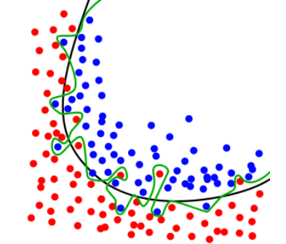
Overfitting = Bad ML
Doing perfectly on training data is not good enough
A good ML model must generalize well on unseen (test data)
Simpler models should be preferred over more complex ones!

Slide 6
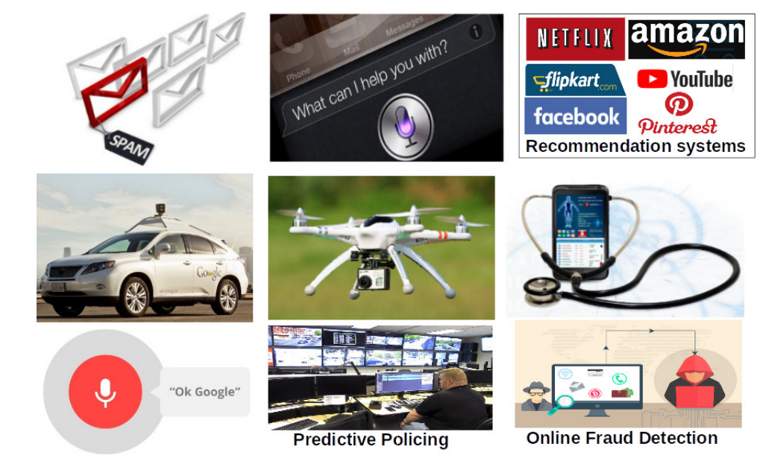
ML Applications Abound..
Picture courtesy: gizmodo.com,rcdronearena.com,www.wiseyak.com,www.charlesdong.com

Slide 7
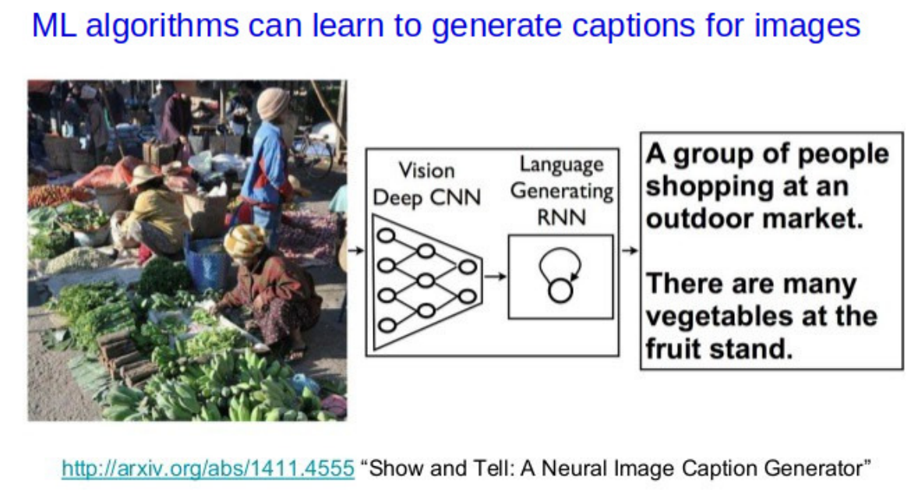
ML: Some Success Stories

Slide 8
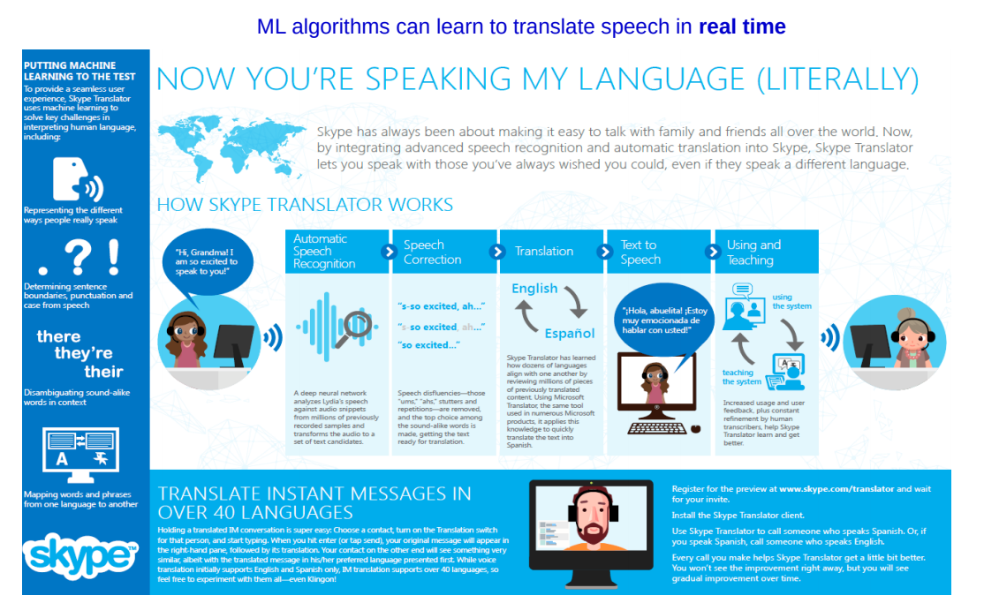
ML: Some Success Stories
Picture courtesy: https://news.microsoft.com/

Slide 9
Machine Learning Tools
Jupyter Notebook
Pytorch
Tensorflow
Scikit-Learn
Numpy
MatPlotLib
Open CV
Google Colab

