Slide 1
Cross-Validation

Slide 2


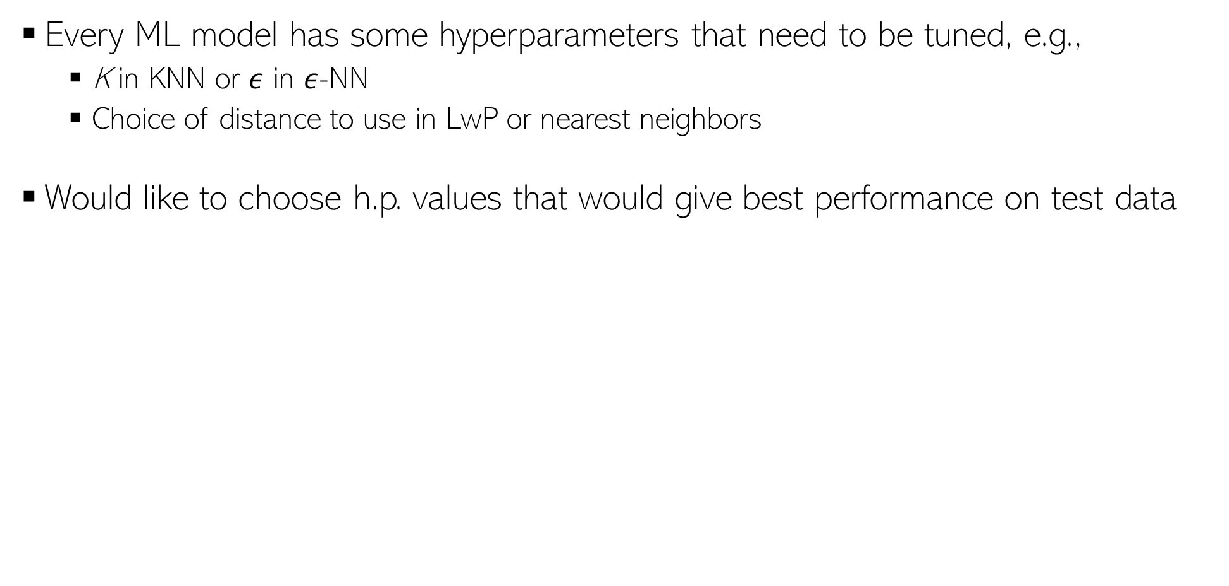
Hyperparameter Selection
Every ML model has some hyperparameters that need to be tuned, e.g.,
K in KNN
Would like to choose h.p. values that would give best performance on test data
Oops, sorry! What to do then?
Okay. So I can try multiple hyperparam values and choose the one that gives the best accuracy on the test data. Simple, isn’t it?
Beware. You are committing a crime. Never Ever touch your test data while building the model
Use cross-validation - usea part of your training data (we will call it “validation/held-out set”) as test data. That’s not a crime. ☺
Is validation set a good proxy to test set?
Usually yes since training set and test sets are assumed to be similar (plus, you are careful in choosing your validation set)

Slide 3


Cross-Validation
No peeking while building the model
Training Set (assuming bin. class. problem)
Test Set
Note: Not just h.p. selection; we can also use CV to pick the best ML model (Model Selection) from a set of different ML models (e.g., say we have to pick between two models we may have trained - LwP and nearest neighbors. Can use CV to choose the better one.
Class 1
Class 2
Actual Training Set
Randomly Split
Validation Set
Randomly split the original training data into actual training set and validation set. Using the actual training set, train several times, each time using a different value of the hyperparam. Pick the hyperparam value that gives best accuracy on the validation set
What if the random split is unlucky (i.e., validation data is not like test data)?
If you fear an unlucky split, try multiple splits. Pick the hyperparam value that gives the best average CV accuracy across all such splits. If you are using N splits, this is called N–fold cross validation

Slide 4

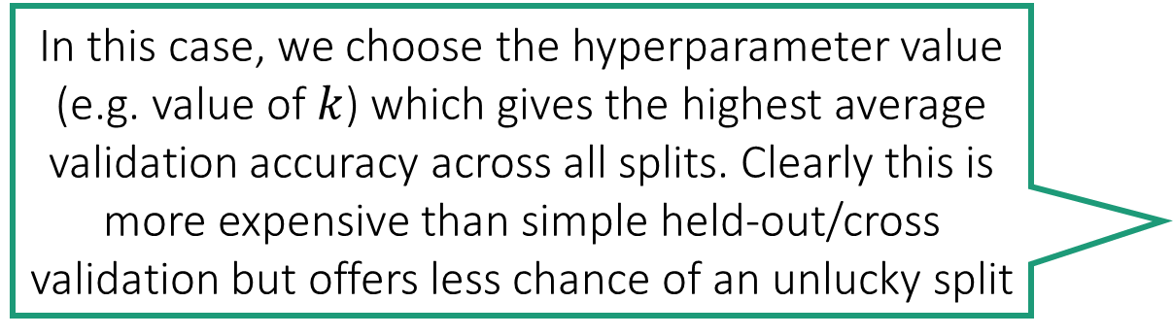
Multi-fold Cross Validation
In this case, we choose the hyperparameter value (e.g. value of $k$) which gives the highest average validation accuracy across all splits. Clearly this is more expensive than simple held-out/cross validation but offers less chance of an unlucky split
Split 1
Split 2
Split 3
Train
Train
Train
Validation
Validation
Validation

