Slide 1
Random Forest Classifier
Random Forest is a popular machine learning algorithm that belongs to the supervised learning technique. It can be used for both Classification and Regression problems in ML. It is based on the concept of ensemble learning, which is a process of combining multiple classifiers to solve a complex problem and to improve the performance of the model.
Random Forest is a classifier that contains a number of decision trees on various subsets of the given dataset and takes the average to improve the predictive accuracy of that dataset. Instead of relying on one decision tree, the random forest takes the prediction from each tree and based on the majority votes of predictions, and it predicts the final output.
The greater number of trees in the forest leads to higher accuracy and prevents the problem of overfitting.
The individual decision trees tend to overfit to the training data but random forest can mitigate that issue by averaging the prediction results from different trees. This gives random forests a higher predictive accuracy than a single decision tree.

Slide 2
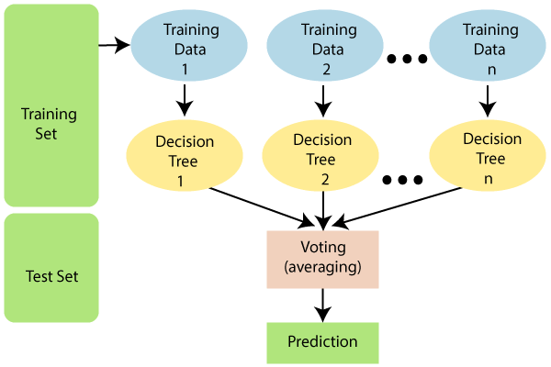
Random Forest Classifier
Random Forest works in two-phase first is to create the random forest by combining N decision tree, and second is to make predictions for each tree created in the first phase.
The Working process can be explained in the below steps and diagram:
Step-1: Select random K data points from the training set.
Step-2: Build the decision tree (DT) associated with the selected data points (Subset of training set).
Step-3: Choose the number n (total number of DTs) for decision forest that you want to build.
Step-4: Repeat Step 1 & 2 (n times) to create n DTs.
Step-5: For new data points, find the predictions of each decision tree, and assign the new data points to the category that wins the majority votes.

Slide 3






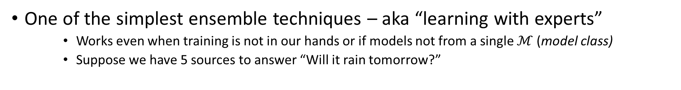
Voting Ensemble
No individual news network gets more than 66% correct predictions but if we take a majority vote, we are 100% correct all the time. The same trick is also popularly used in psephology (“poll of polls”)
One of the simplest ensemble techniques – aka “learning with experts”
Works even when training is not in our hands or if models not from a single $ℳ$(model class)
Suppose we have 5 sources to answer “Will it rain tomorrow?”
P
Gold Truth
Correct prediction
Q
N
N
Y
N
Y
Y
Y
Y
Y
Y
N
N
N
N
N
Y
Y
N
Y
N
Y
N
Y
Y
Y
Y
Y
Y
N
N
Y
N
Y
Y
Y
N
Incorrect prediction

