Slide 1
Decision Trees
A Decision Tree (DT) defines a hierarchy of rules to make a prediction
Root and internal nodes test rules. Leaf nodes make predictions
Decision Tree (DT) learning is about learning such a tree from labeled data
Root Node
Body
temp.
Warm
Cold
Non-mammal
An Internal Node
A Leaf Node
Gives
birth
Yes
No
Mammal
Non-mammal

Slide 2


Decision Trees for Supervised Learning
The basic idea is very simple
Recursively partition the training data into homogeneous regions
Within each group, fit a simple supervised learner (e.g., predict the majority label)
What do you mean by “homogeneous” regions?
Even though the rule within each group is simple, we are able to learn a fairly sophisticated model overall (note in this example, each rule is a simple horizontal/vertical classifier but the overall decision boundary is rather sophisticated)
A homogeneous region will have all (or a majority of) training inputs with the same/similar outputs

Slide 3





Decision Trees for Classification
5
NO
YES
Test input
$$x_{1}>3.5 ?$$
4
NO
YES
NO
YES
3
$$x_{2}>2 ?$$
$$x_{2}>3 ?$$
Feature 2 ($x_{2})$
2
Predict Red
Predict Green
Predict Green
Predict Red
1
1
2
3
4
5
6
Feature 1 ($x_{1})$
Remember: Root node contains all training inputs
Each leaf node receives a subset of training inputs
DT is very efficient at test time: To predict the label of a test point, nearest neighbors will require computing distances from 48 training inputs. DT predicts the label by doing just 2 feature-value comparisons! Way more fast!!!

Slide 4
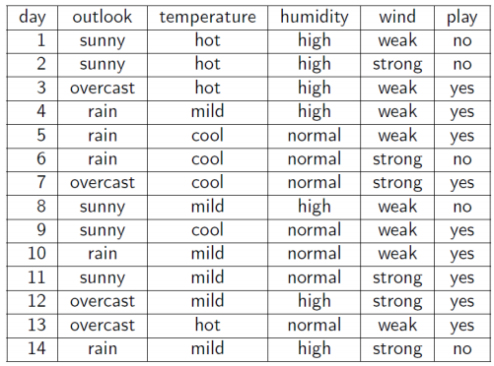
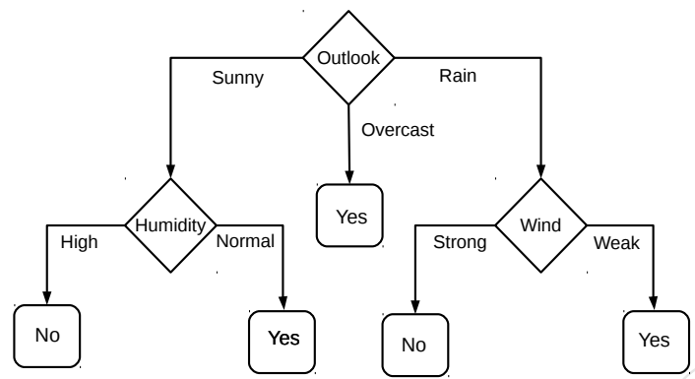
Decision Trees for Classification: Another Example
Deciding whether to play or not to play Tennis on a Saturday
Each input (Saturday) has 4 categorical features: Outlook, Temp., Humidity, Wind
A binary classification problem (play vs no-play)
Below Left: Training data, Below Right: A decision tree constructed using this data
Example credit: Tom Mitchell

Slide 5
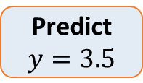


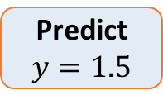

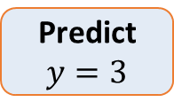

Decision Trees for Regression
Can use any regression model but would like a simple one, so let’s use a constant prediction based regression model
Another simple option can be to predict the average output of the training inputs in this region
4
3
2
1
NO
YES
$$x>4 ?$$
$$y$$
NO
YES
Predict $y=3.5$
$$x>3 ?$$
Predict $y=3$
Predict $y=1.5$
1 2 3 4 5
$$x$$
DT not only makes the problem more efficient at test time but also simplifies the problem because we have a simple model for each portion/region. A complete model comprises multiple simple models to construct a more sophisticated model (divide and conquer).

Slide 6
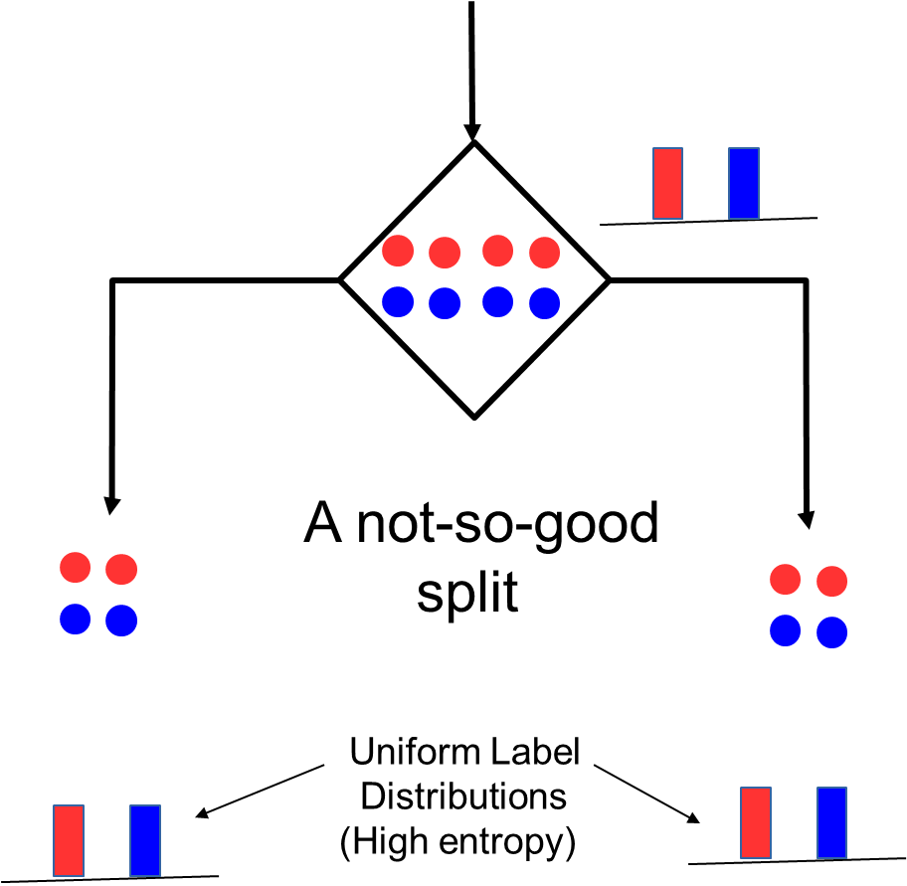
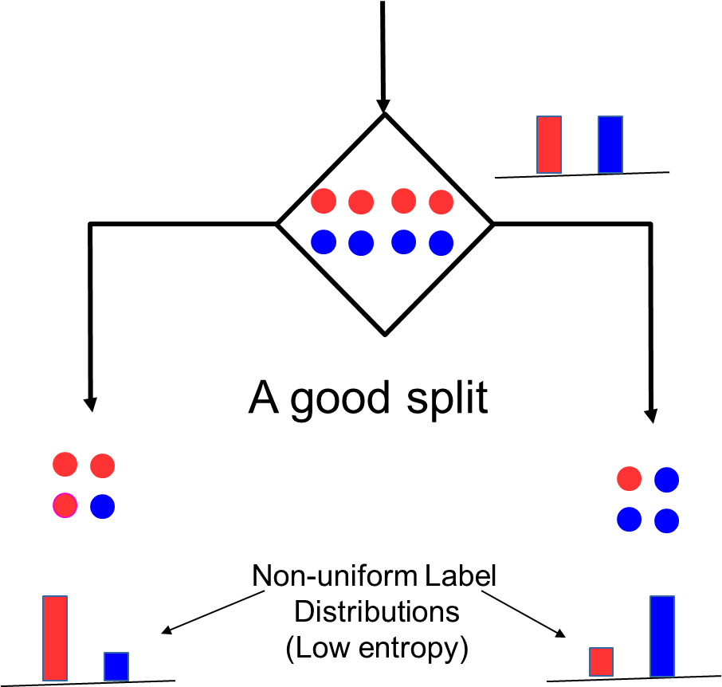
How to Split at Internal Nodes?
6
Recall that each internal node receives a subset of all the training inputs
Regardless of the criterion, the split should result in as “pure” groups as possible
A pure group means that the majority of the inputs have the same label/output
For classification problems (discrete outputs), entropy is a measure of purity
Low entropy ⇒ high purity (less uniform label distribution)
Splits that give the largest reduction (before split vs after split) in entropy are preferred (this reduction is also known as “information gain”)

