Slide 1
Online voting system
NAME : S. Archana
ROLL NO :1325-19-862-034
GUIDE NAME : CH VINOD

Slide 2
DESIGN

Slide 3
INPUT DESIGN
The input design is the link between the information system and the user. It comprises the developing specification and procedures for data preparation and those steps are necessary to put transaction data in to a usable form for processing can be achieved by inspecting the computer to read data from a written or printed document or it can occur by having people keying the data directly into the system. The design of input focuses on controlling the amount of input required, controlling the errors, avoiding delay, avoiding extra steps and keeping the process simple. The input is designed in such a way so that it provides security and ease of use with retaining the privacy. Input Design considered the following things:
What data should be given as input?
How the data should be arranged or coded?
The dialog to guide the operating personnel in providing input.
Methods for preparing input validations and steps to follow when error occur.

Slide 4
USE CASE DIAGRAM
An utilization case outline in the UML is a sort of conduct graph characterized by and made from a Use-case examination. Its motivation is to introduce a graphical diagram of the usefulness given by a framework regarding on-screen characters, their objectives (spoke to as use cases), and any conditions between those utilization cases. The fundamental motivation behind an utilization case outline is to indicate what framework capacities are performed for which on-screen character. Jobs of the on-screen characters in the framework can be delineated”.

Slide 5
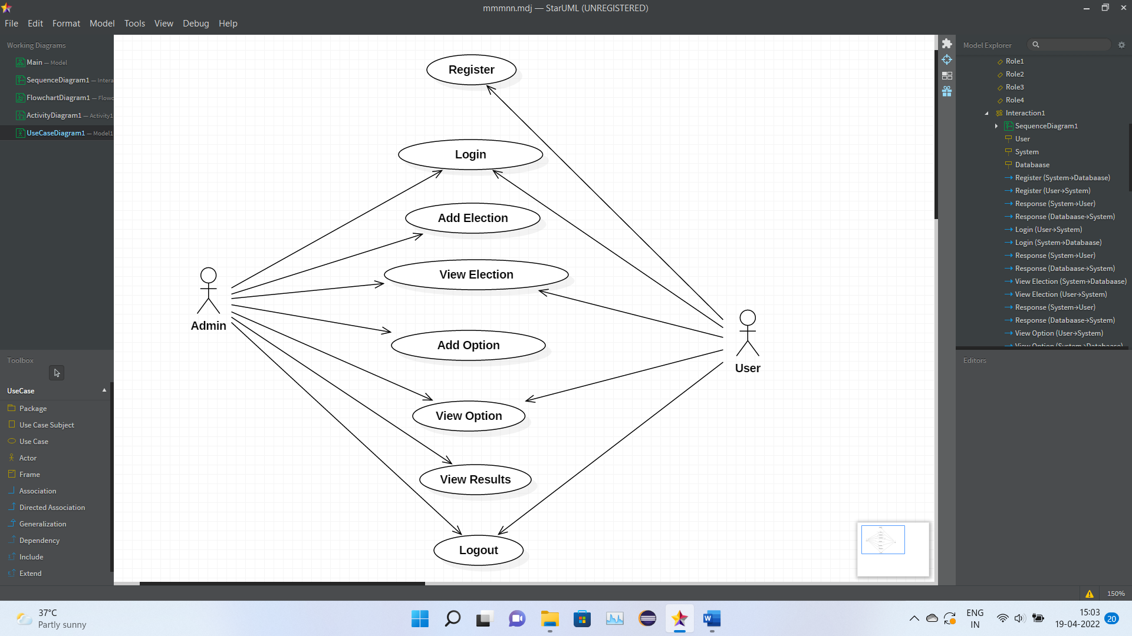
USE CASE DIAGRAM

Slide 6
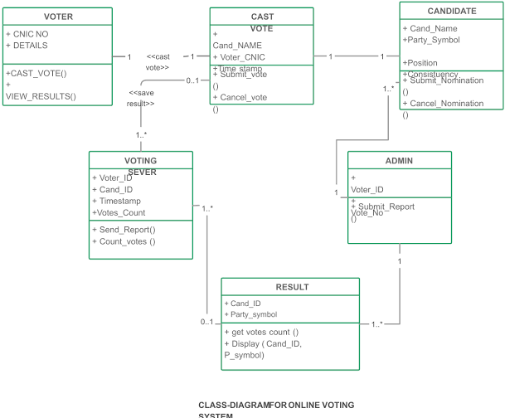
Class diagram

Slide 7
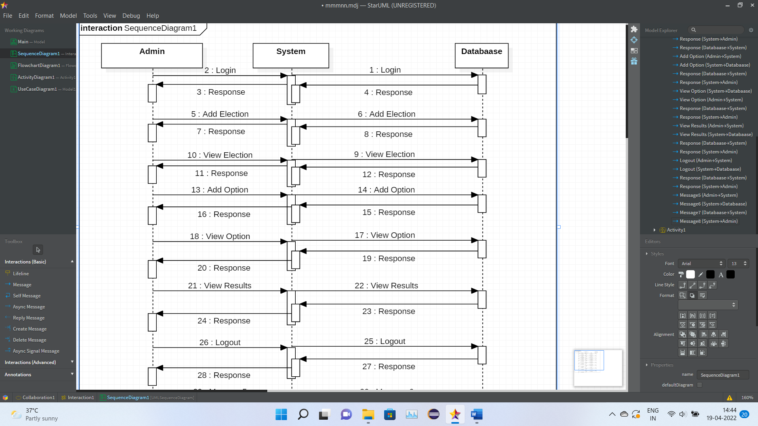
sequence diagram :

Slide 8
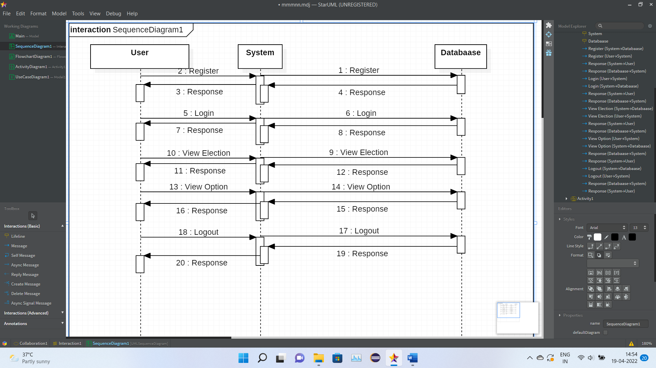

Slide 9
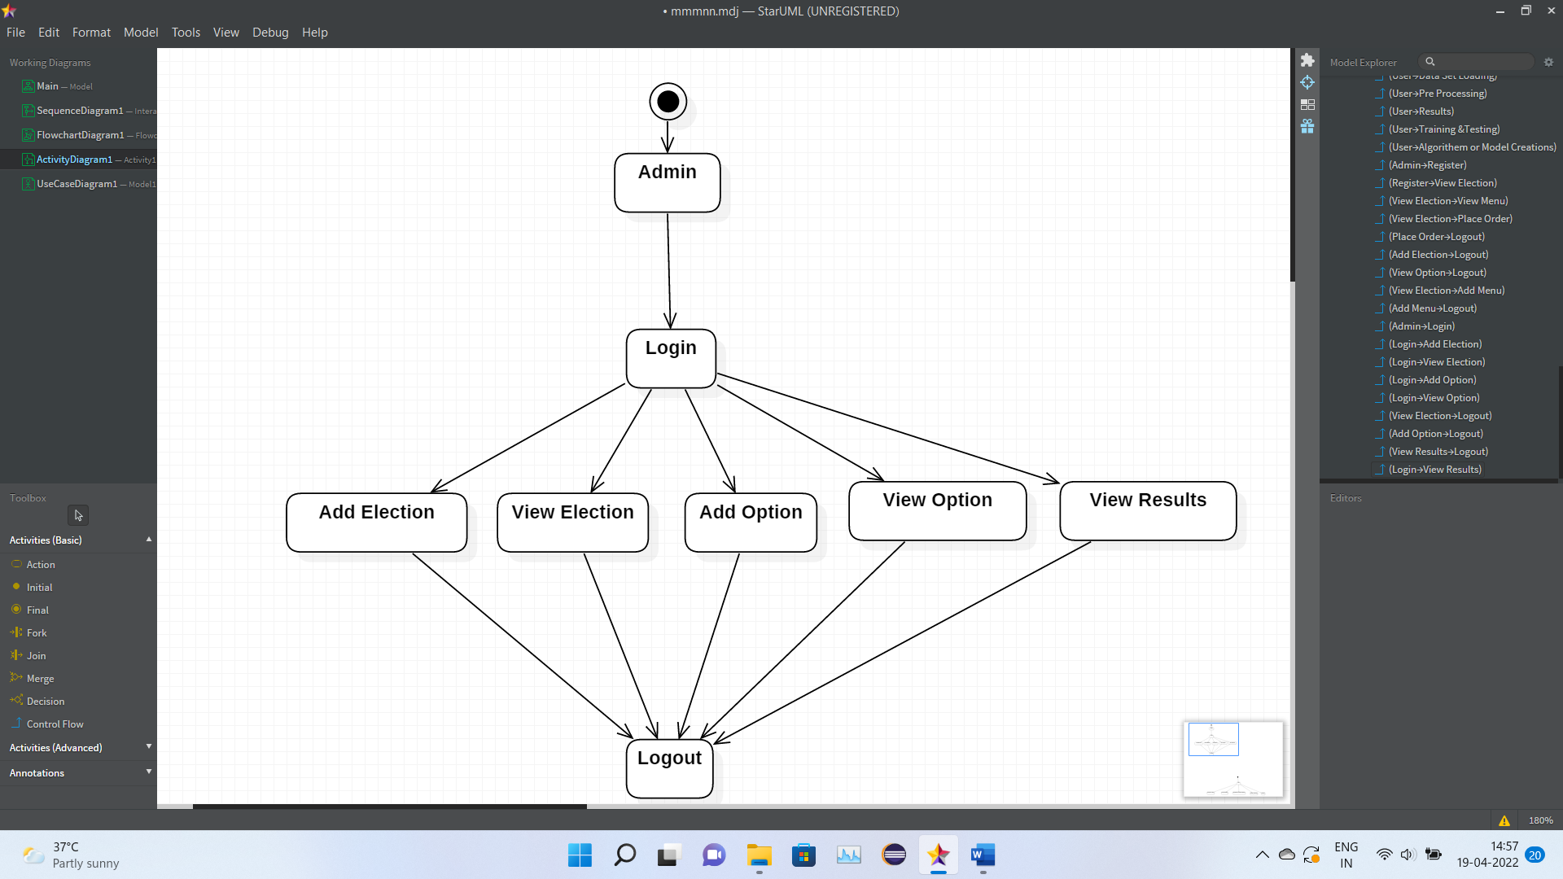
Activity diagram

Slide 10
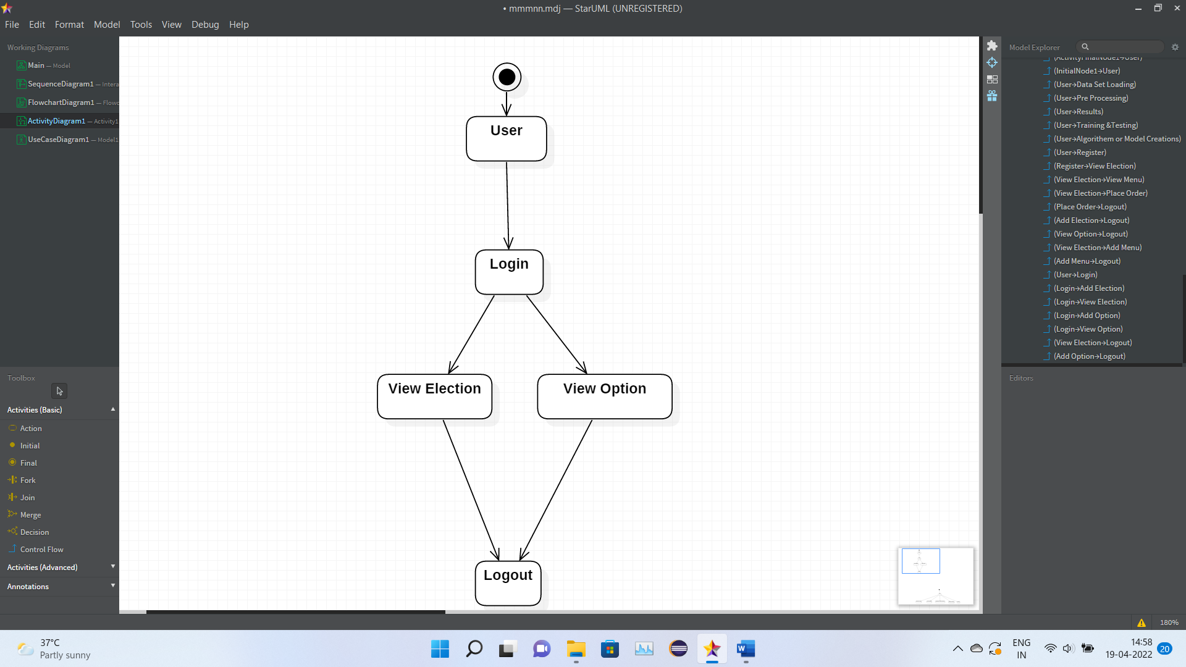

Slide 11
IMPLEMENTATION

Slide 12
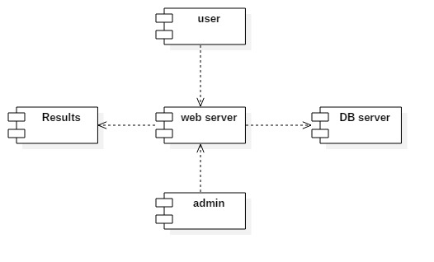
Component Diagram
The component diagram is a special purpose diagram, which is used to visualize the static implementation view of a system. It represents the physical components of a system, or we can say it portrays the organization of the components inside a system. The components, such as libraries, files, executables, etc.

Slide 13
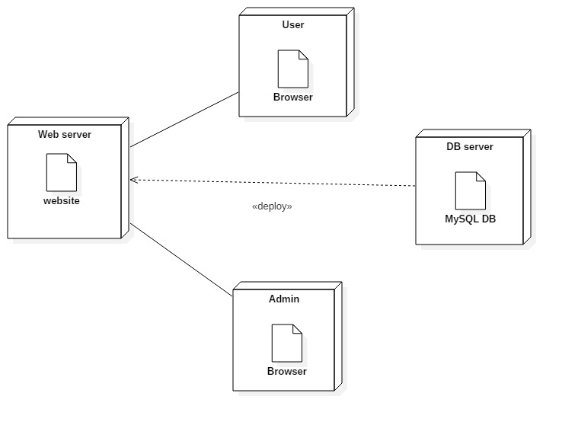
Deployment Diagram
A deployment diagram is a UML diagram type that shows the execution architecture of a system, including nodes such as hardware or software execution environments, and the middleware connecting them. Deployment diagrams are typically used to visualize the physical hardware and software of a system

Slide 14
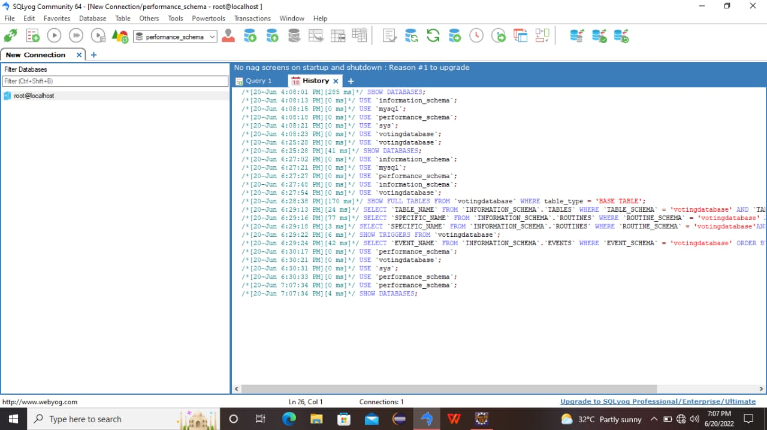
SAMPLE SOURCE CODE

Slide 15
TEST CASES
Testcase Id
Objective
Description
Expected Result
log001
To test the URL
1)Enter URL 2)Open the webpage 3)Check for GUI
Login validation page should open
log002
To test the GUI
1)open the webpage 2) check the GUI components
It should display webpage with label,email,password,submit…etc
log003
To validate the Login page
1)Open the login page 2)keep empty the input elements 3)click on login button
It should display error message as "Please enter email and password".
log004
To validate the login page
1)Open the login page 2)Enter valid credentials 3)click on login button
It should display message as "Login successfully ".

Slide 16
mv005
To validate the mobile number
1)Open the login page 2)Enter mobile with less than 10 digits 3)click on login button
It should display error message as "Please enter mobile number with 10 digits".
mv006
To validate the mobile number
1)Open the login page 2)Enter mobile with greater than 10 digits 3)click on login button
It should display error message as "Please enter mobile number with 10 digits".
mv007
To validate the mobile number
1)Open the login page 2)Enter mobile number starts with 6,7,8,9 digits 3)click on login button
It should sent OTP to the respective mobile number
mv008
To validate the mobile number
1)Open the login page 2)Enter mobile number doesnot starts with 6,7,8,9 digits 3)click on login button
It should display error message as "Please enter mobile number strats with 6,7,8,9 digits".
mv009
To validate the mobile number
1)Open the login page 2)Enter mobile number with special characters 3)click on login button
It should display error message as "Please enter mobile number with valid digits
mv010
To validate the mobile number
1)Open the login page 2)Enter mobile number with valid inputs 3)click on login button
It should sent OTP to the respective mobile number

Slide 17
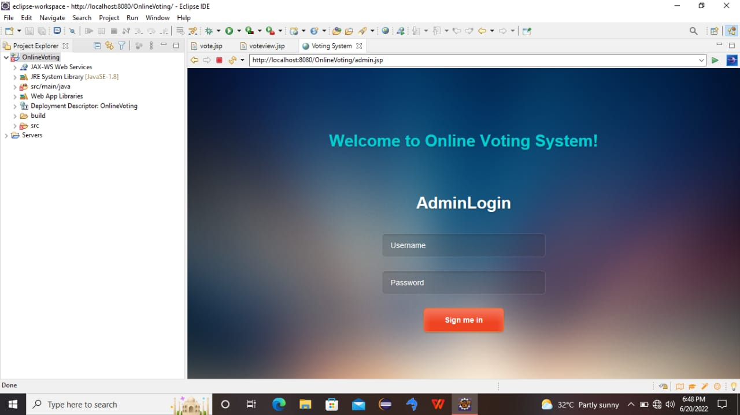
SCREEN SHOTS

Slide 18
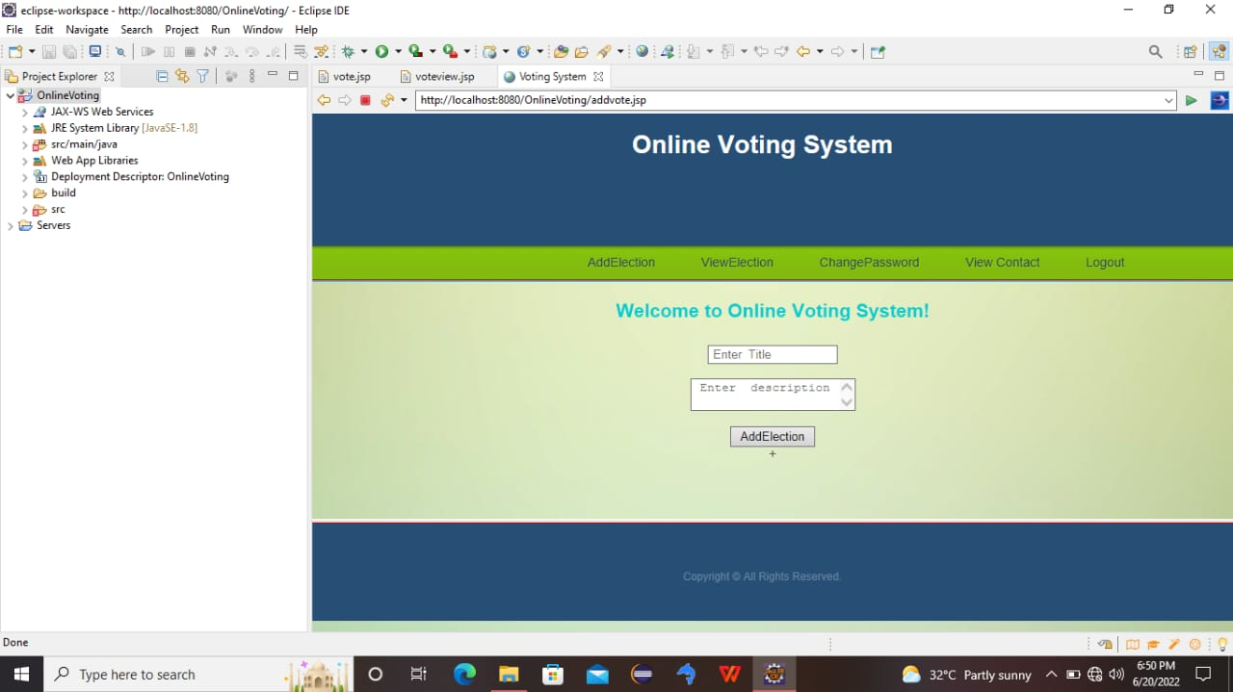

Slide 19
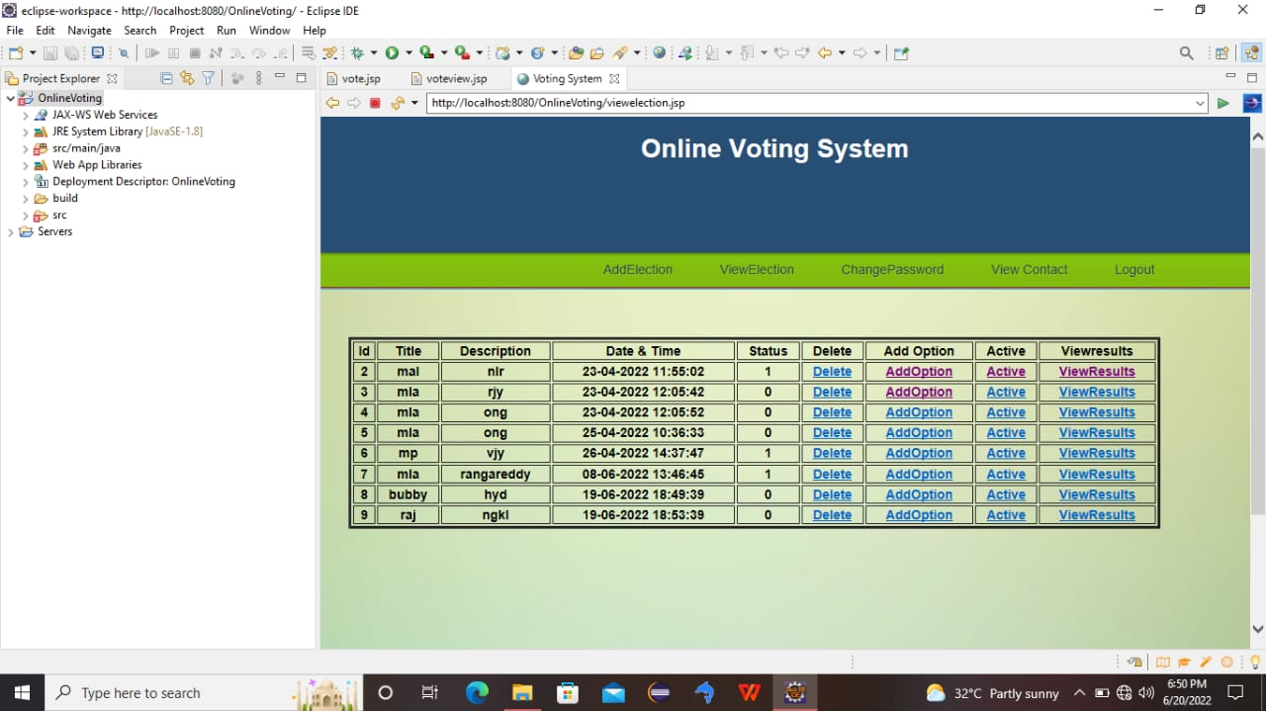

Slide 20
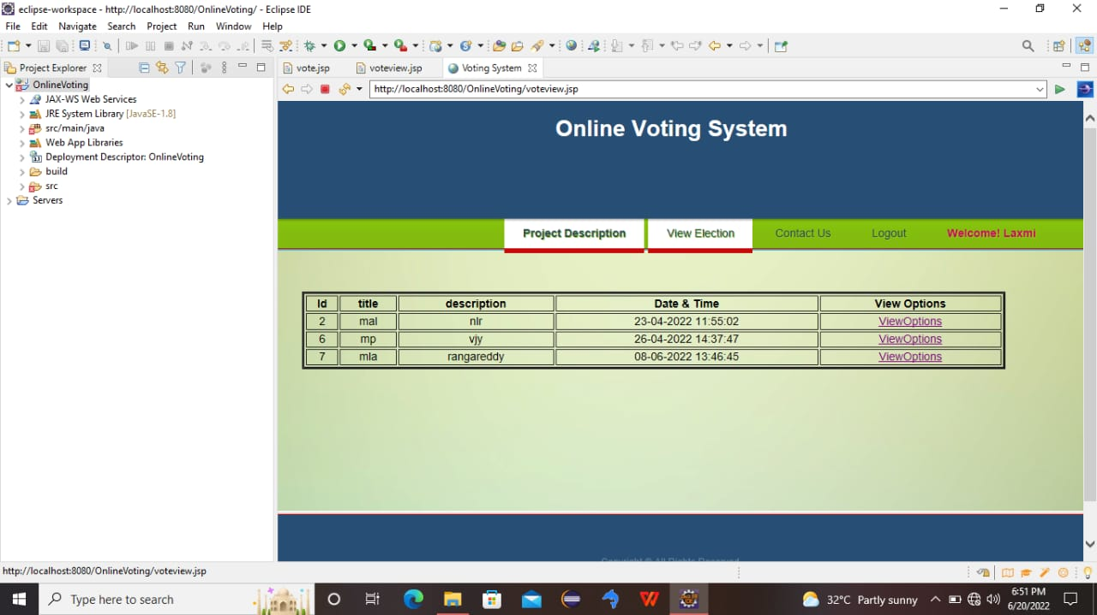

Slide 21
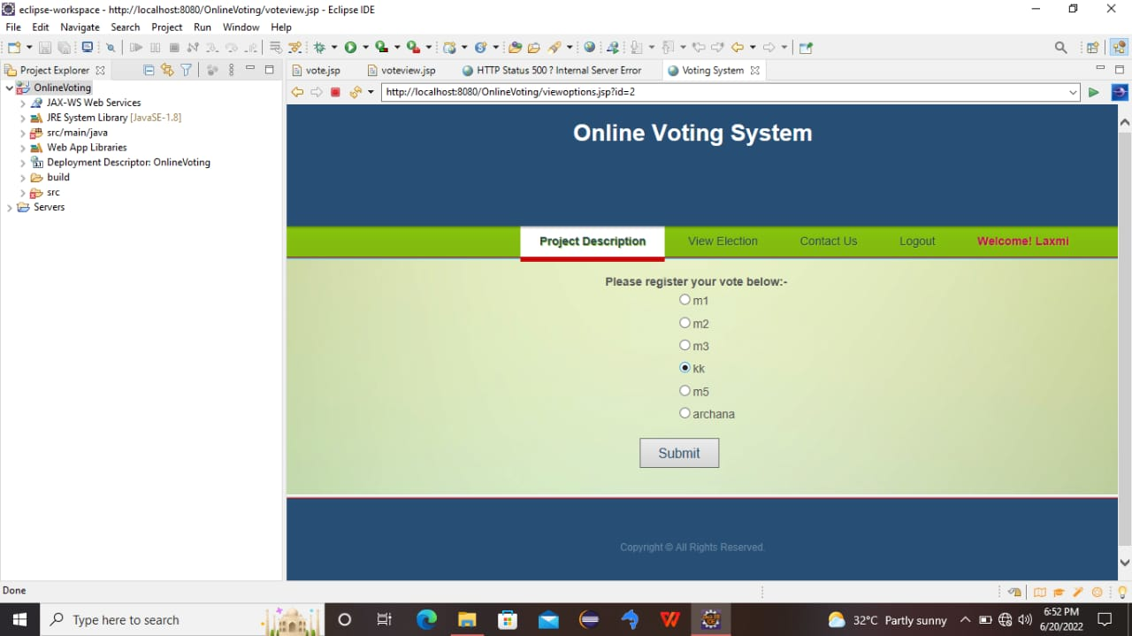

Slide 22
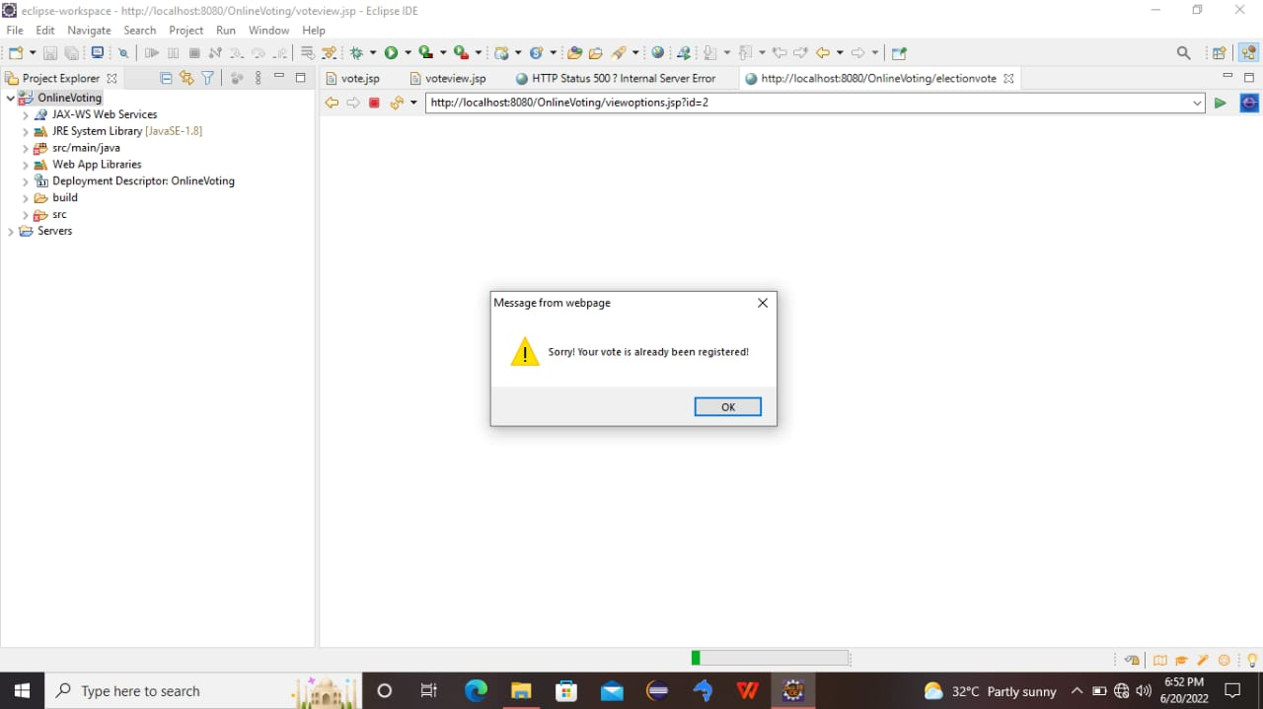

Slide 23


