Slide 1
Sales order creation in SAP – RPA Automation

Slide 2
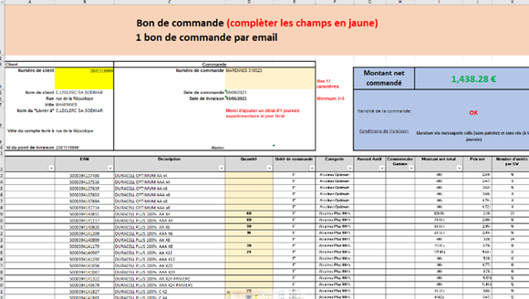
Customer send the excel file with the input data for sales order creation

Slide 3
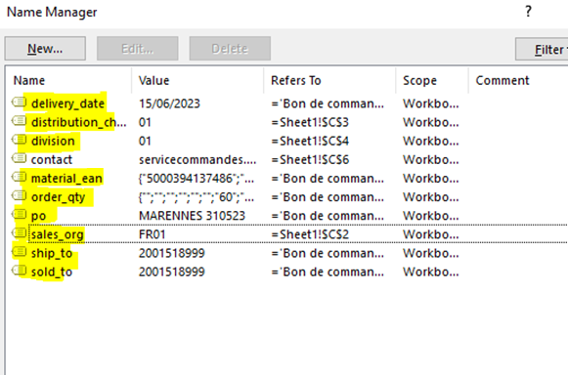
Excel contains data List of fields data that are SAP mandatory for creating the SO.

Slide 4
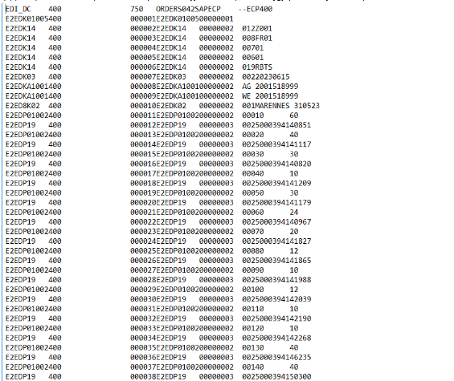
BOT picks the excel file and convert it to PO.text file

Slide 5
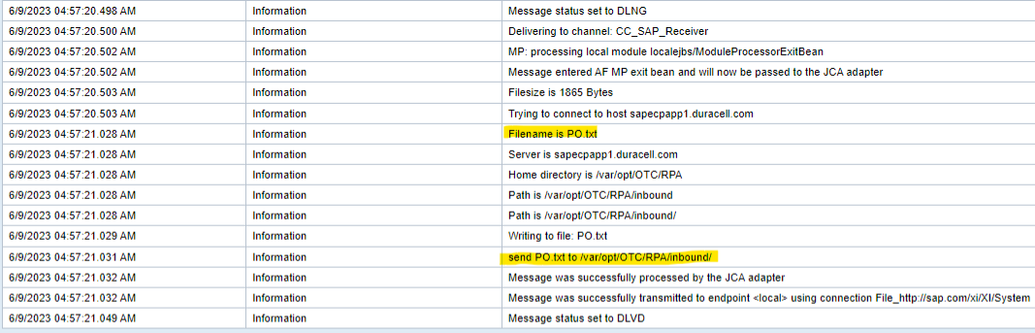
Before it reaches SAP system, PO system ( Middle ware) receives the excel data in the form of PO.Text file. PO system process the file and send to AL11 directory in SAP.

Slide 6
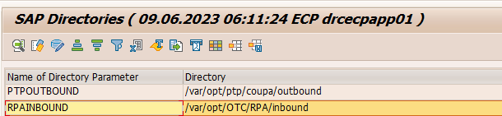
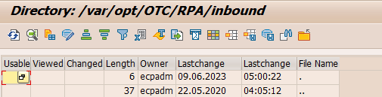
PO system passes the PO.text file to SAP system to T-Code AL11 directory

Slide 7

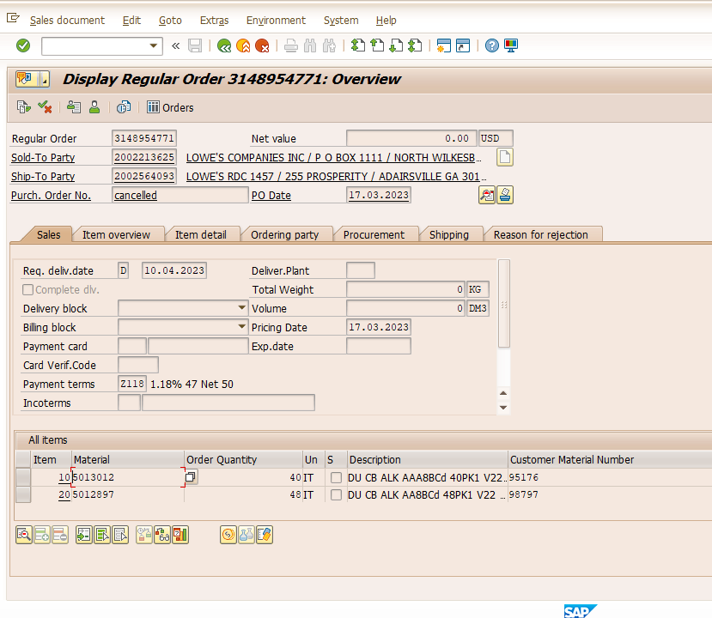
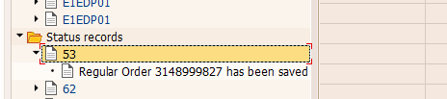
In SAP Batch job pick the PO.text file form AL11 and process them to idocs via Batch job Once, the Idoc Is processed in SAP system – Sales order gets created successfully in SAP system.

