Slide 1
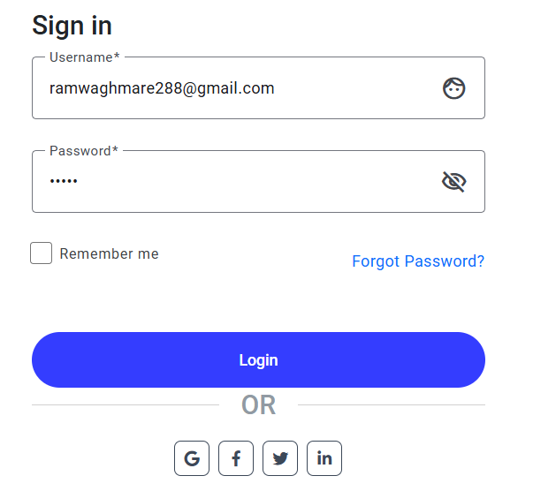
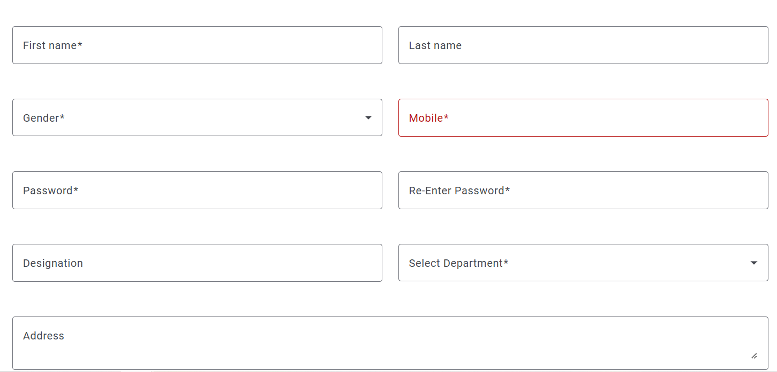
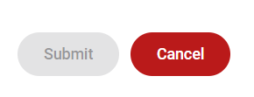
Sign Up

Slide 2


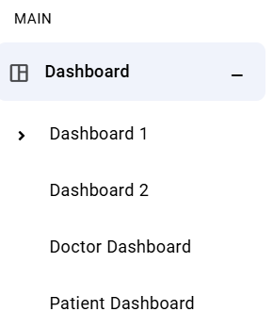
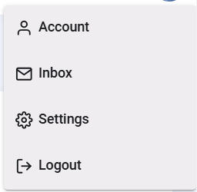
Admin
Neeraj Nikam
Manager _
All Managers
Add Manager
Edit Manager
Manager Profile
Super Distributer +
Distributer +
Retailer +
Kitchen +

