Slide 1

Promotion Impact Analysis on Sales – XYZ E-Commerce
The Team:
Aparna
Hariprasad
Prasanna
Ramya
Sai Krishna
Sridharan

Slide 2
Problem Statement
XYZ E-Commerce runs promotional campaigns to boost product sales across different categories and regions.
However, the effectiveness of these promotions on actual sales performance is not clearly understood.
The objective of this project is to analyze historical sales data to evaluate whether promotions have a significant impact on sales.
Using exploratory data analysis and regression modeling, the study aims to identify sales patterns, key influencing factors, and provide actionable insights to support data-driven marketing decisions.

Slide 3
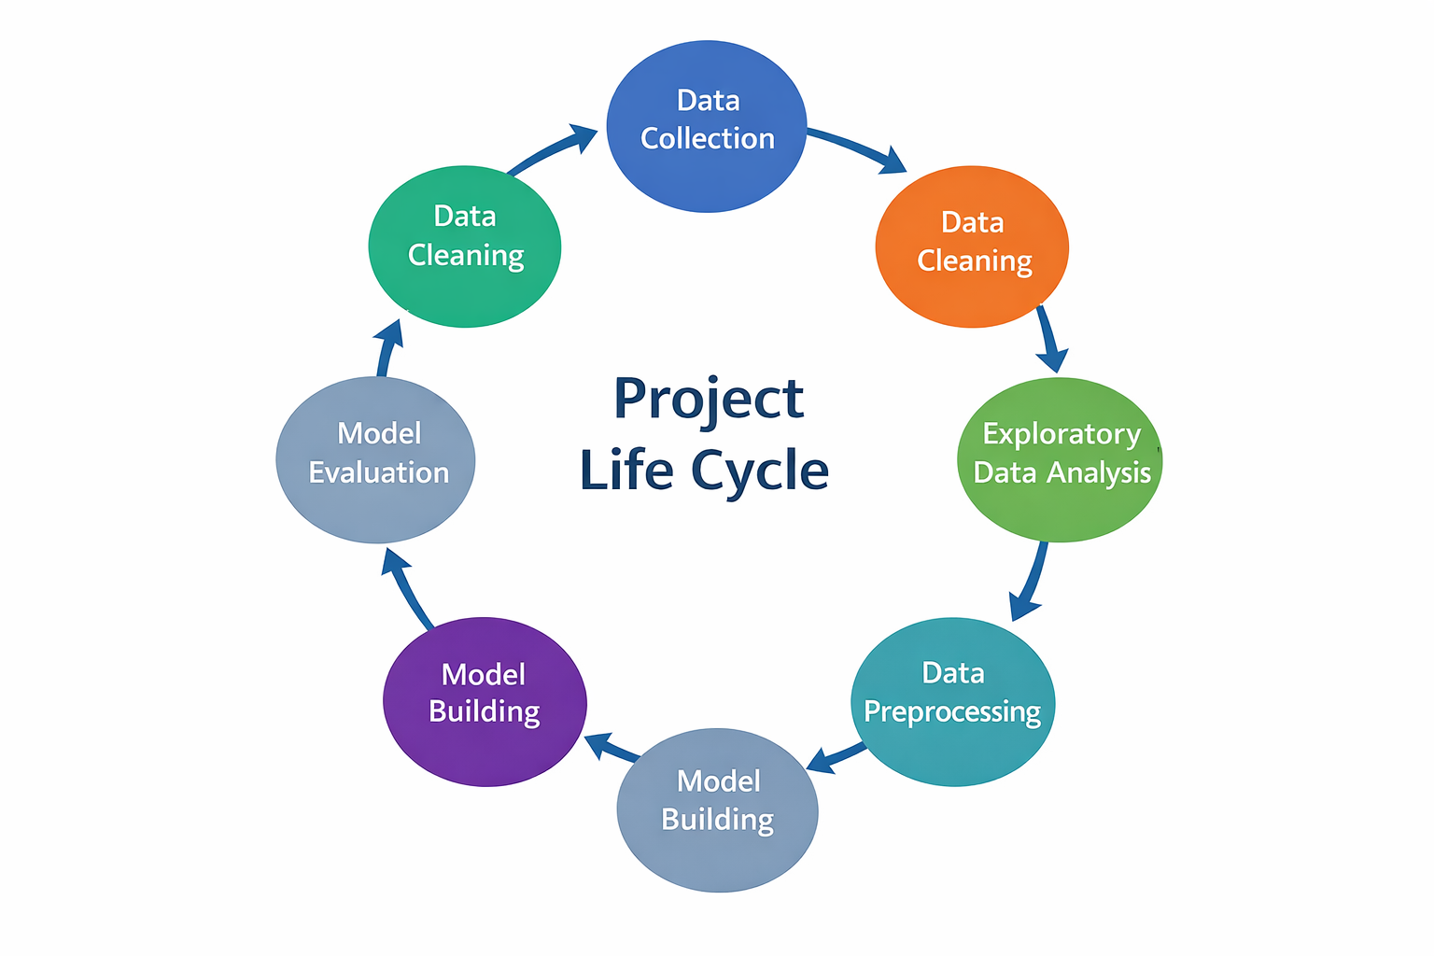
Project Life Cycle
Data Collection
Data Cleaning
Exploratory Data Analysis
Data Preprocessing
Model Building
Model Evaluation
Business Metrics & Insights

Slide 4
Data Collection
The dataset used is “Amazon Sale Report (2024)”, sourced from Kaggle (by Ilhem Djenane).
It contains real-world Amazon sales transaction data, providing detailed information on orders, products, fulfillment, shipping, and regional distribution.
Format: CSV Rows: ~128,000 Columns: 22
Key fields include Order ID, Date, Status, Category, Quantity, Amount, Fulfilment Type, Courier Status, Promotion IDs, B2B, and Region.
The dataset was collected to analyze sales performance, regional trends, and the impact of promotions and fulfillment methods on revenue.
The data is structured, reliable, and suitable for data cleaning, exploratory analysis, visualization, and predictive modeling using Python.

Slide 5
Data Cleaning
Checked Missing Values: Found ~6.8% missing, reduced to 3.7% after cleaning.
Removed Duplicates & Unwanted Columns: Dropped irrelevant fields like Order ID, SKU, B2B, etc.
Handled Missing Data: Filled missing currency with ‘INR’ and Amount with 0.0.
Categorized Columns: Identified numeric (Qty, Amount), categorical (Status, Category, etc.), and boolean (none).
Formatted Date Column: Standardized date format for consistency.
Standardized Categorical Values: Unified inconsistent entries (e.g., ‘rajsthan’ → ‘Rajasthan’).
Outlier Detection: Used boxplots to visualize and assess outliers in numeric data.

Slide 6
Exploratory Data Analysis
Exploratory Data Analysis was conducted to understand data distribution and relationships.
Univariate analysis examined sales amount and quantity distributions.
Bivariate analysis explored relationships between quantity and sales amount.
Time-based analysis examined daily, monthly, and yearly order trends. Geographic analysis assessed sales distribution across states.
These insights guided preprocessing and model selection.

Slide 7
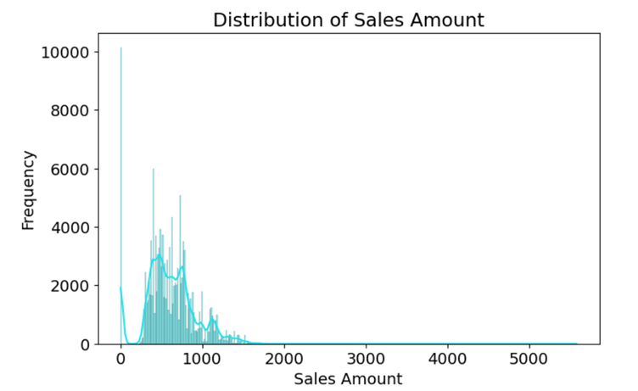
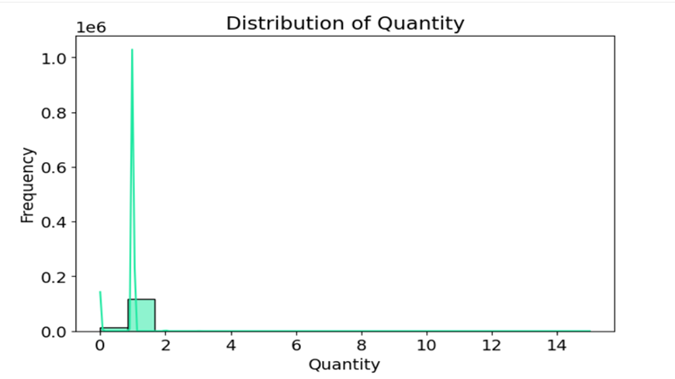
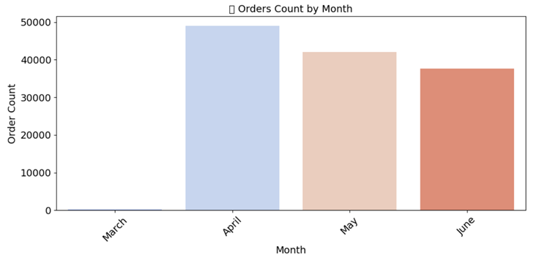
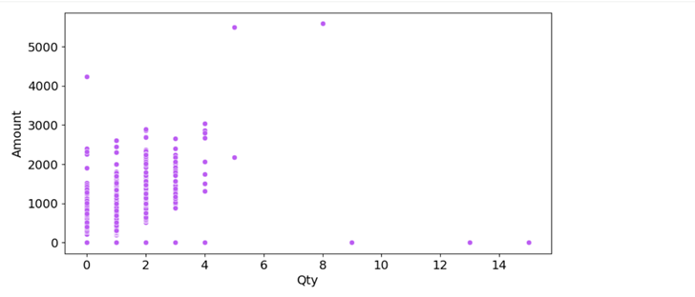
EDA: Key Visual Insights
Sales distribution is right-skewed
Most orders contain 1–2 items
Higher quantity → higher sales
Monthly trends show seasonal peaks

Slide 8
Data Preprocessing
Data Standardization & Type Conversion
Ship-State: Standardized various spellings for the same state (e.g., "Delhi", "delhi", "New Delhi" were all mapped to "Delhi").
Date: Converted the 'Date' column from an object/string to a datetime format for time-series analysis.
Feature Transformation & Scaling
Applied Label Encoding to all categorical variables.
Numerical columns were not transformed or scaled.

Slide 9
Model Building
Linear Regression (Baseline)
Model: Ordinary Least Squares (OLS) chosen for interpretability.
Initial Results: Poor performance with low R2 scores
Non-Linear Models
Strategy: Deployed to capture complex data patterns beyond linear relationships.
Algorithms Used:
Decision Tree
Random Forest
Gradient Boosting

Slide 10
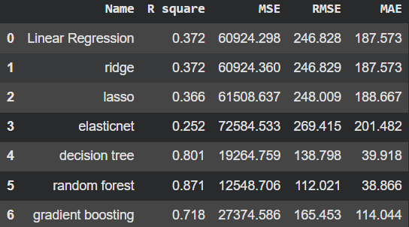
Evaluation Metrics
To assess the regression models' performance, the following statistical metrics were used for accuracy and error rates:

Slide 11
Business Metrics & Insights
Targeted Promotional Efficiency: Analysis confirms that while promotions drive sales, their effectiveness varies significantly by Region and Product Category. This indicates that inefficient campaigns should be replaced with targeted interventions on high-response segments to significantly improve ROI.
Strategic Shift: Dynamic Implementation The business should shift from static discounting to Dynamic Strategies—such as adapting to seasonality and rotating focus to "least sold" products. This approach stimulates dormant demand and maximizes revenue without relying on aggressive, marginless discounts.
Operational Optimization: Leveraging ML-driven insights for precise Demand Forecasting and Inventory Management allows the organization to optimize promotional budgets. This ensures that revenue quality is maximized while simultaneously reducing excess stock overhead.

Slide 12
Conclusion & Future Steps
Conclusion
Sales amount shows clear patterns across time, region, and order status
EDA identified skewed sales distribution and demand variations
Quantity and time features influence overall sales behavior
Regression modeling helped understand key sales drivers
Analysis supports data-driven business decision-making
Future Steps
Perform deeper category-wise and region-wise analysis
Include additional relevant features to improve model accuracy
Apply advanced model tuning for better performance
Build interactive dashboards for ongoing sales monitoring

