Slide 1
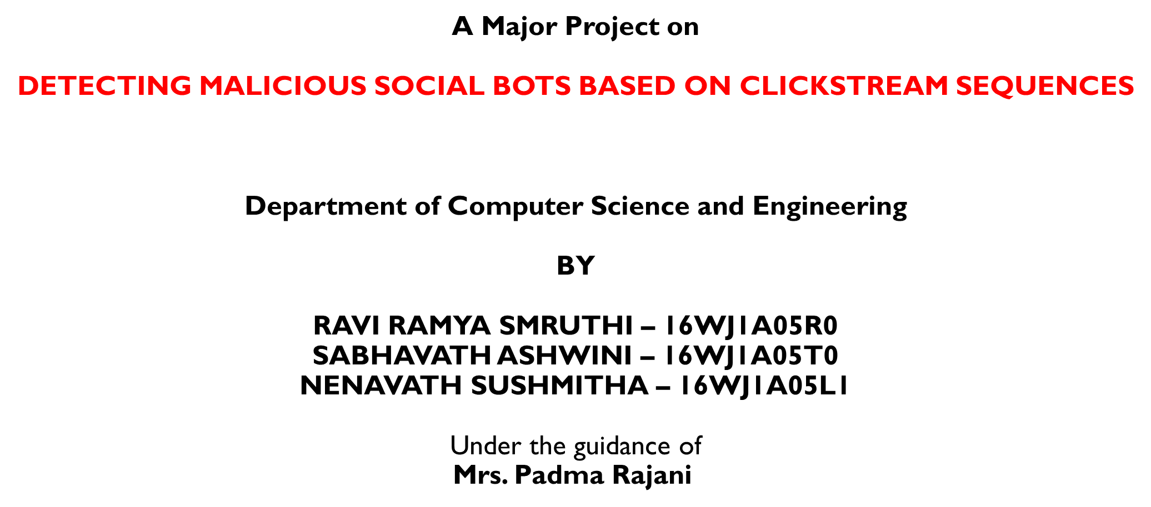


Slide 2
contents
Abstract
Literature Survey
Existing System
Proposed System
System Architecture
Modules
UML Diagrams
Screenshots
Conclusion
Future Enhancements
References

Slide 3
Abstract
Social Media and Online Social Networks are having a deep impact on our daily life
Need for a method to collect and analyze Big Data from Online Networking sites to differentiate between malicious and a normal user
Social bots understand and answer automatically without any manual work
There are Malicious Social bots which imitate the normal social bot but spread wrong or fake information
We have a method based on Feature Selection and Transition Probability that identifies the malicious bots on Social Networking Sites

Slide 4
Abstract (contd.)
Uses unsupervised learning algorithm to detect the malicious social bots better in online social networks
Based on Transition Probability, we analyze the user-behavior and recognize user Clickstreams
Not only analyze the user-behavior, but also includes the time duration of their activity

Slide 5
Literature survey
Title: Detecting Malicious Social Bots based on Clickstream Sequences
Year: 2019
Author: Peining Shi, Zhiyong Zhang, Kim-Kwang Raymond Choo
Description:
To classify a new text sentiment, we need a filter that can be used to predict the probability of a class level based on learning
Used Naïve Bayes classification method that is based on Bayes rule
For testing, we have extracted each word from the test text and matched with the dictionary words
Total political probability is found by multiplying individually matched words conditional political probability
Comparing these two probabilities we can easily predict the class level of the text.
Used 150 posts and 50 comments from political and non-political topics from the political Facebook pages. These are used for our primary training set
Shown 12 sample posts (7 political and 5 non-political). We have identified their class level based on their sentiment

Slide 6
Literature survey (contd.)
Title: Unsupervised Clickstream Clustering for User Behavior Analysis
Year: 2016
Author: Gang Wang, Xinyi Zhang, Shiliang Tang, Haitao Zheng, Ben Y. Zhao
Description:
Online services are increasingly dependent on user participation
In this paper, we build an unsupervised system to capture dominating user behaviors from clickstream data (traces of users' click events) and visualize the detected behaviors in an intuitive manner
Our system identifies "clusters" of similar users by partitioning a similarity graph (nodes are users; edges are weighted by clickstream similarity)
The partitioning process leverages iterative feature pruning to capture the natural hierarchy within user clusters and produce intuitive features for visualizing and understanding captured user behaviors
For evaluation, we present case studies on two large-scale clickstream traces (142 million events) from real social networks

Slide 7
Existing system
Existing applications make use of supervised learning algorithm, such as, Random Forest Algorithm and Naive Bayes Algorithm
Social bots are distinguished from normal users based on six features: Network, User, Making friends, Time, Content and Emotion
Supervised learning algorithms requires much time and manpower, generally not applicable for Big Data Social Networking Environment

Slide 8
Proposed system
The Proposed application uses unsupervised learning algorithm
The user-behavior is analyzed, and Clickstream Sequences are recognized in order to differentiate normal and malicious user
We aim to detect malicious social bots on social network platforms in real-time, by
proposing the transition probability features between user clickstreams
designing an algorithm for detecting malicious social bots based on clickstream sequences

Slide 9
modules
Administrator:
Can view the list of users
Can view the user’s details: username, email address, contact number etc.
Can track the user’s behavior
Can view the list of friend requests and responses
Authorizes the users
View all posts
User:
Can view their own profile details: email address, contact number, profile image etc.
Can search other users by their names
Can send friend requests and view the friend requests from other users
Can see all his friend details with their images and personal details.

Slide 10
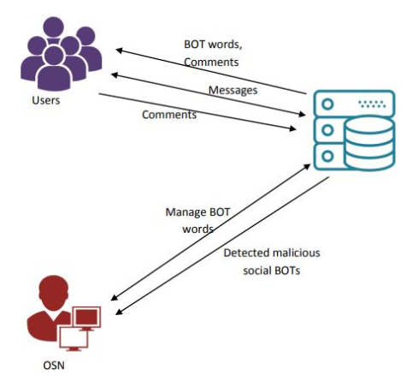
System architecture

Slide 11
UML DIAGRAMS

Slide 12
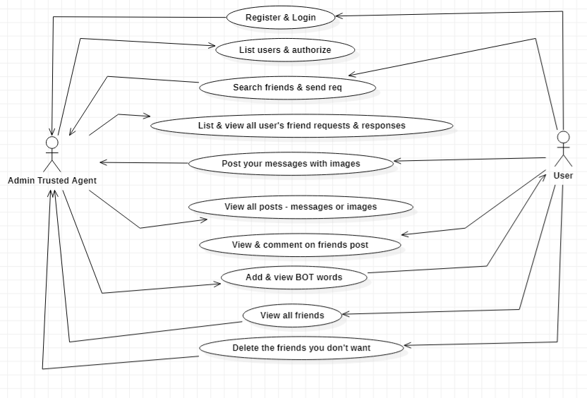
USE CASE DIAGRAM

Slide 13
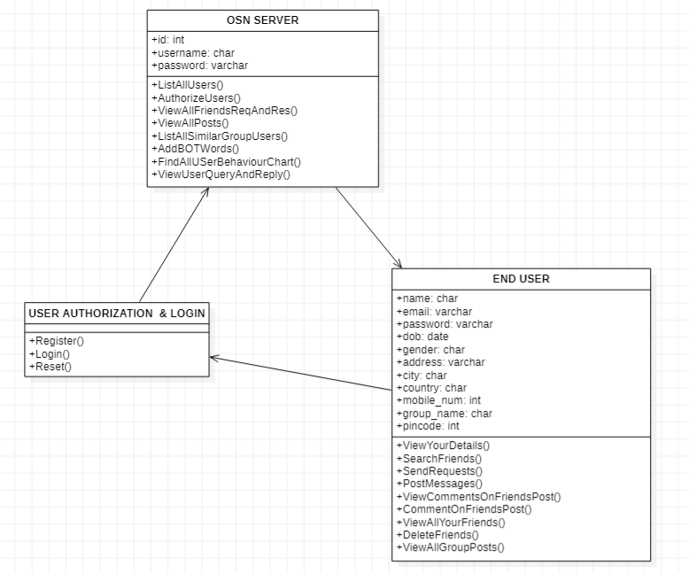
CLASS DIAGRAM

Slide 14
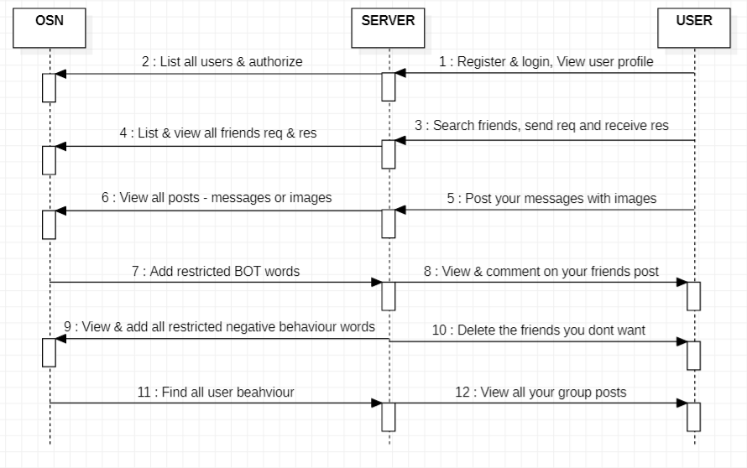
SEQUENCE DIAGRAM

Slide 15
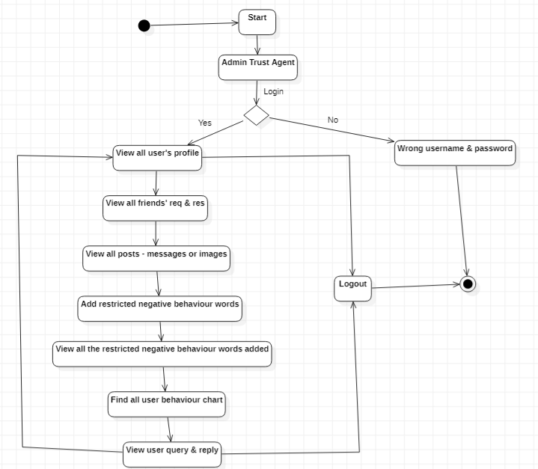
ACTIVITY DIAGRAM - ADMIN

Slide 16
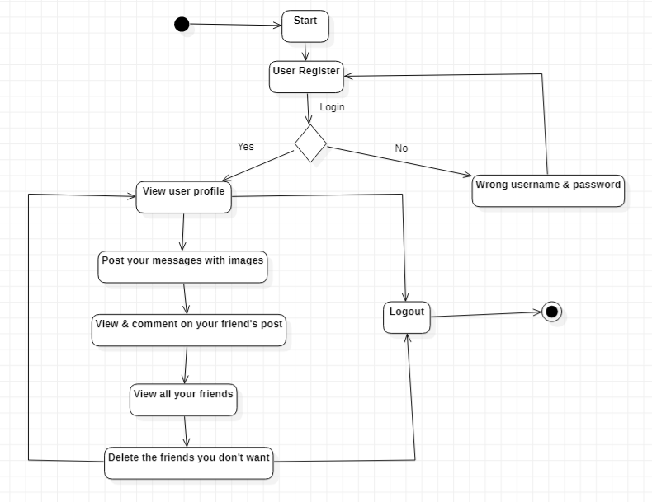
ACTIVITY DIAGRAM - USER

Slide 17
SCREENSHOTS

Slide 18
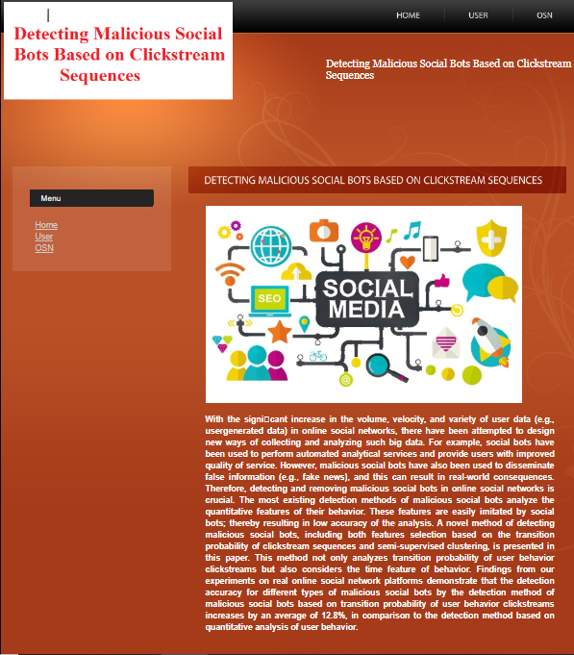
HOME PAGE

Slide 19
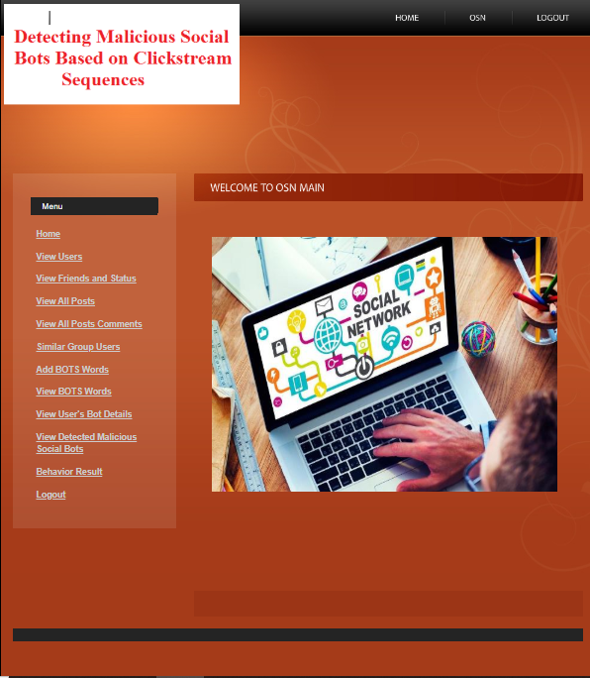
ADMIN HOME PAGE

Slide 20
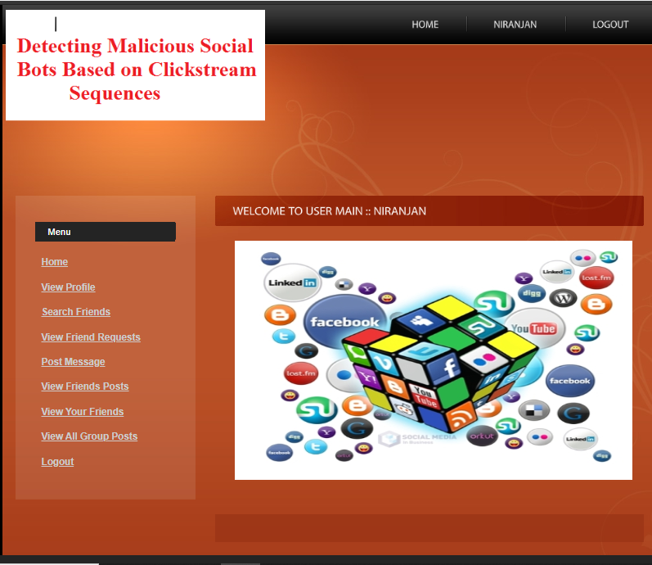
USER HOME PAGE

Slide 21
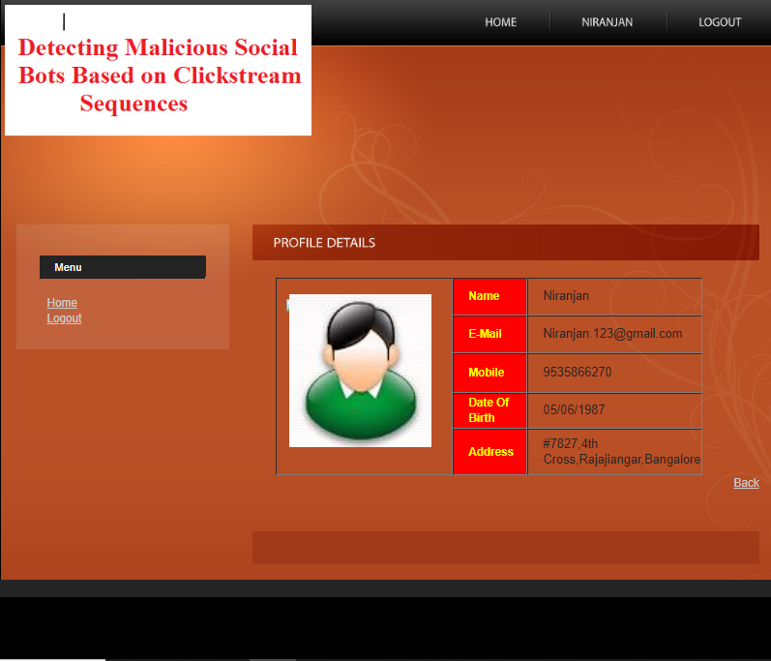
USER PROFILE

Slide 22
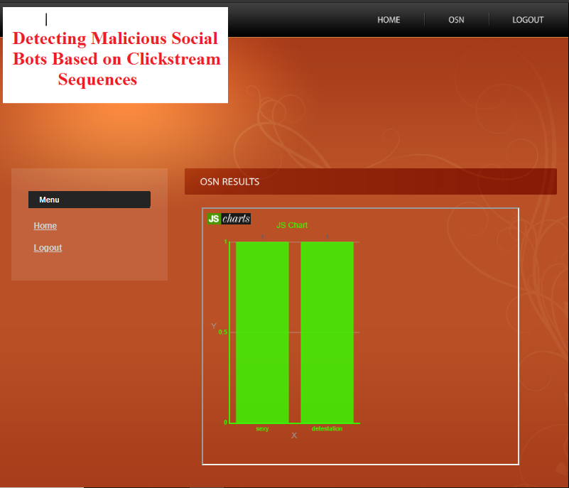
USER BEHAVIOUR CHART

Slide 23
conclusion
We proposed a novel method to accurately detect malicious social bots in online social networks.
Experiments showed that transition probability between user click streams based on the social situation analytics can be used to detect malicious social bots in online social platforms accurately.
The proposed detection approach will be extended and optimized to identify specific intentions and purposes of malicious social bots.

Slide 24
FUTURE ENHANCEMENTS
The administrator cannot delete any posts that are malicious or by the malicious user
Operate in real-time thus facilitating timely detection
Future methods should be evaluated using an extensive set of network traces originating from different types of bots
Special attention to be placed on minimizing the number of errors in identifying bot

Slide 25
REFERENCES
F. Morstatter, L. Wu, T. H. Nazer, K. M. Carley, and H. Liu, ``A new approach to bot detection: Striking the balance between precision and recall,'' in Proc. IEEE/ACM Int. Conf. Adv. Social Netw. Anal. Mining, San Francisco, CA, USA, Aug. 2016, pp. 533_540.
C. A. De Lima Salge and N. Berente, ``Is that social bot behaving unethically?' Commun. ACM, vol. 60, no. 9, pp. 29_31, Sep. 2017.
M. Sahlabadi, R. C. Muniyandi, and Z. Shukur, ``Detecting abnormal behavior in social networkWebsites by using a process mining technique,'' J. Comput. Sci., vol. 10, no. 3, pp. 393_402, 2014.
F. Brito, I. Petiz, P. Salvador, A. Nogueira, and E. Rocha, ``Detecting social-network bots based on multiscale behavioral analysis,'' in Proc. 7th Int. Conf. Emerg. Secur. Inf., Syst. Technol. (SECURWARE), Barcelona, Spain, 2013, pp. 81_85.

Slide 26
Thank you

