Slide 1
STUDENT DIGITAL PORTFOLIO
STUDENT NAME : R.Ramya
REGISTER NO AND NMID: EB5F5080A888D7B90684297C5A0599AB
DEPARTMENT : BSC COMPUTER SCIENCE
COLLEGE : JEPPIAAR COLLEGE OF ARTS AND SCIENCE .

Slide 2
PROJECT TITLE
STUDENT DIGITAL PORTFOLIO

Slide 3


AGENDA
Problem Statement
Project Overview
End Users
Tools and Technologies
Portfolio design and Layout
Features and Functionality
Results and Screenshots
Conclusion
Github Link
3/21/2024 Annual Review

Slide 4

PROBLEM STATEMENT
Traditional resumes are static and lack interactivity.
Difficult to showcase projects, skills, and achievements effectively.
Need for a digital portfolio to present personal and professional details in an engaging way.

Slide 5

PROJECT OVERVIEW
Developed a personal portfolio website using HTML, CSS, and JavaScript.
Includes About, Education, Skills, Projects, and Contact sections.
Designed to be responsive, professional, and easy to navigate.

Slide 6

WHO ARE THE END USERS?
Students – to showcase skills and academic details.
Recruiters & Employers – to view candidate profiles and projects easily.
Faculty & Mentors – for academic evaluations and project reviews.
General Audience – to know more about the student’s achievements.

Slide 7

TOOLS AND TECHNIQUES :
HTML – For webpage structure.
CSS – For styling and responsive design.
JavaScript – For smooth scrolling and interactivity.
VS Code – Development environment.
Browser (Chrome/Edge) – Testing and execution.

Slide 8
PORTFOLIO DESIGN AND LAYOUT
Header – Profile photo, name, short intro.
Navigation Bar – Smooth links to each section.
About Me – Personal and career goals.
Education Section – Academic background.
Skills Section – Technical and soft skills.
Projects Section – Sample projects with descriptions.
Contact Section – Email, phone, and social links.
8

Slide 9
FEATURES AND FUNCTIONALITY
Responsive modern design.
Smooth scroll navigation.
Organized skills & education cards.
Interactive projects showcase.
Direct email button for contact.
Professional footer with credits.

Slide 10
RESULTS AND SCREENSHOTS
3/21/2024 Annual Review
10

Slide 11
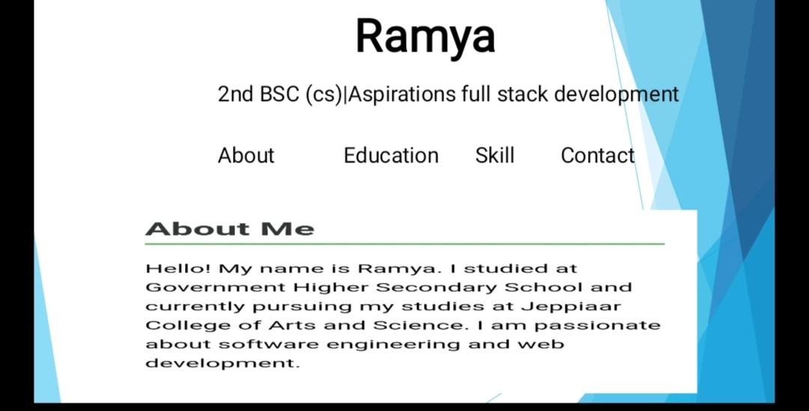
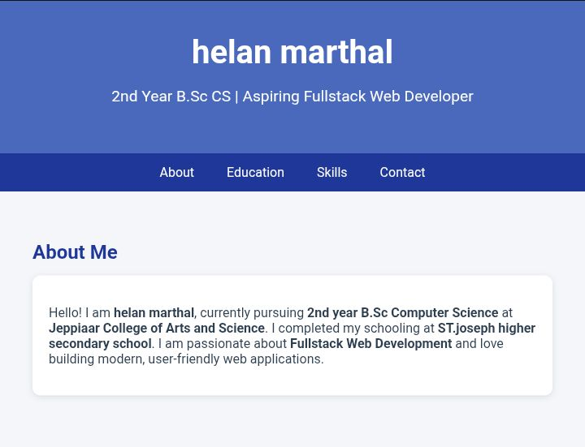
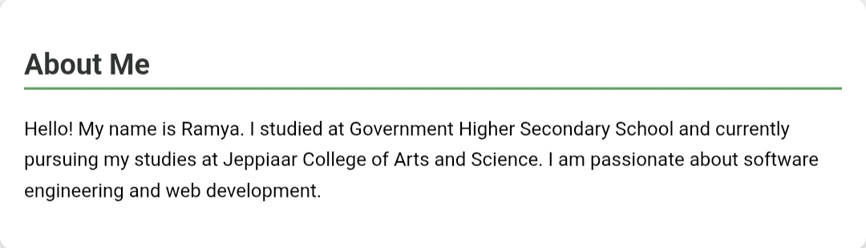

Slide 12
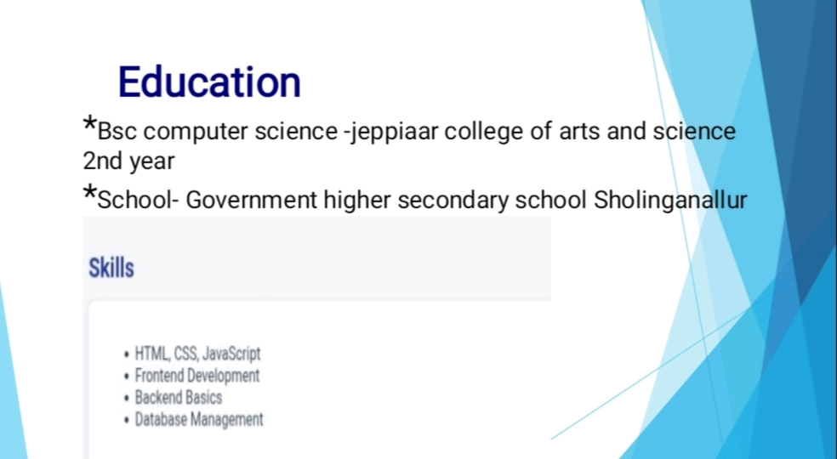
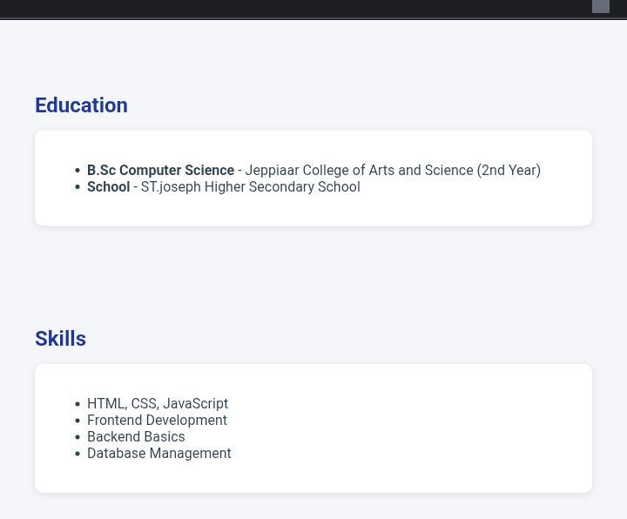

Slide 13
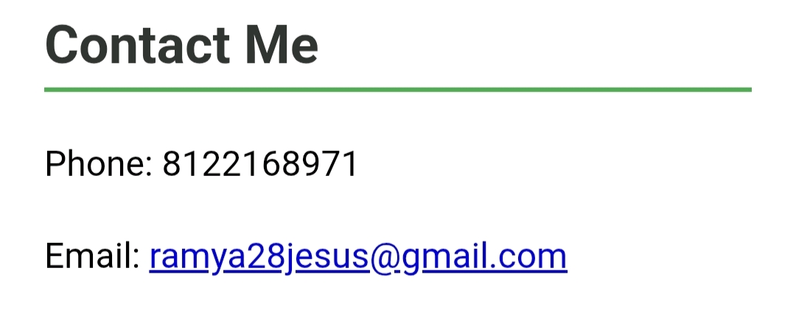
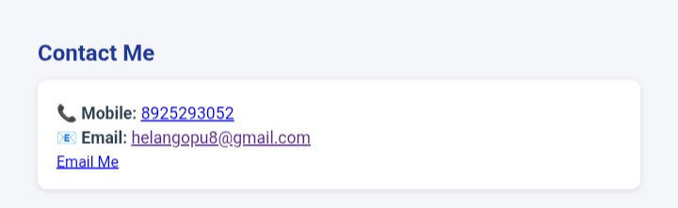

Slide 14
CONCLUSION
Successfully developed a student digital portfolio.
Learned front-end development (HTML, CSS, JavaScript).
Improved skills in design, presentation, and coding.
Portfolio acts as a digital resume for future career opportunities.
14

Slide 15
GITHUB LINK :
https://github.com/ramya28jesus

