Slide 1

IOT BASED ALERT SYSTEM ON A PROCESS STATUS
PRESENTED BY
Meena.P

Slide 2
OBJECTIVE
The objective of the project is to get status of Build of a project running remotely via Alarm and Flash Screen ,by reading Email Notifications.

Slide 3
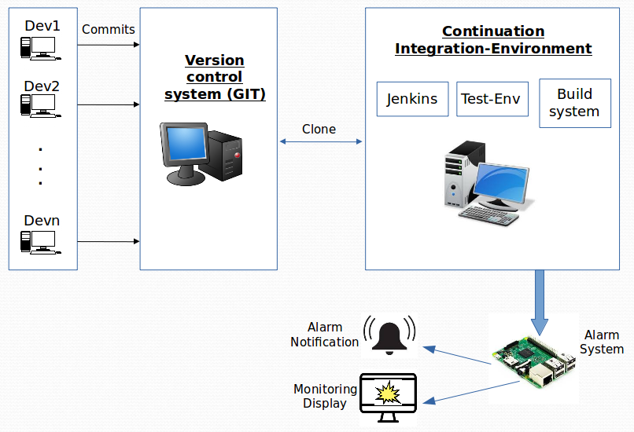
ARCHITECTURE & DESIGN DIAGRAM

Slide 4
Tools & Hardware Requirement
Jenkins
Git
Rassberrypi Board
Speakers
Monitor

Slide 5
ROLES & RESPONSIBILITIES
Followed V-gate Procces in each stage
    Analysing Requirement
    Designing
    Developing
    Execution
    Testing
Git and Jenkins Setup
Setuping the Environment for Execution of project.

Slide 6
Thank You......

