Slide 1
VotaryTech – Multimedia Image Processing using OpenCV

Slide 2
Objective
To register a person into the database by using either captured image or camera feed through devices like smart phone,camera device.

Slide 3
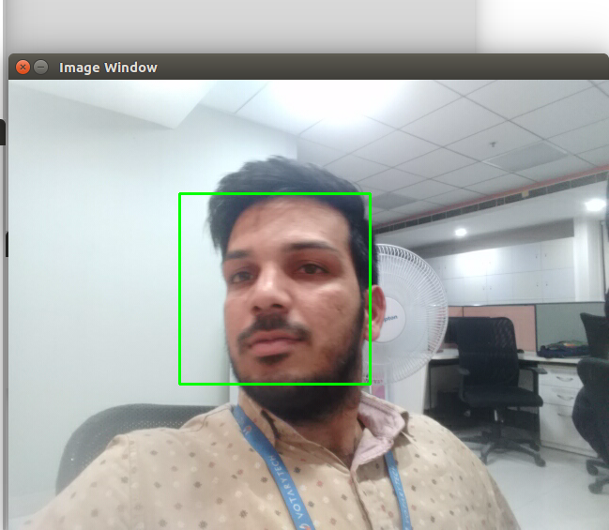
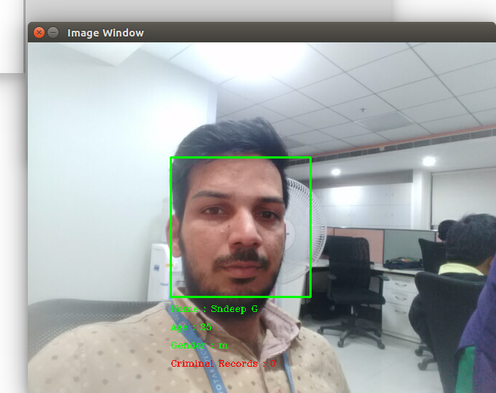
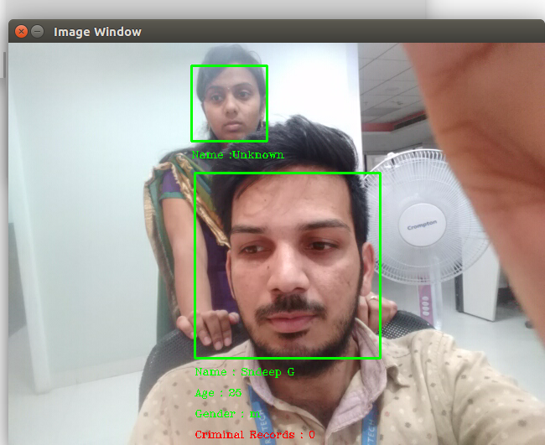
Project output
Training a Person
Detecting a Person ,Display the details
Recognising known&Unknown persons

Slide 4
Project output

Slide 5
Thank You

