Slide 1

MultiMedia ImageProcessing
Using OpenCV
Presented By
D.Ramya
Votary Softech Solution Pvt. Ltd.

Slide 2
Contents
Objective
Tools required
Architecture Diagram
Sequence Diagram
Roles and Resposibility
Contribution
Achievements

Slide 3
Objective
To develop and Integrate Image processing technology (Face detection, in this phase) to the real world applications, like capturing the subject face information metadata when, user takes the picture.

Slide 4
V-gate Process
For Architeure,Design and Implementation phase I referred Detail Design Document.
For Validate phase I referred Test Case Document.

Slide 5
Tools and Hardware Requirements
Git Repository
Raspberry Pi Board
Raspberry Pi camera
Sqlite3 database
OpenCV Library

Slide 6

Architecture Diagram
Image Acquisition
Image Processing Environment
Camera
database
OpenCV
Local browse
Input
Image
Output
Database
Display Image details

Slide 7
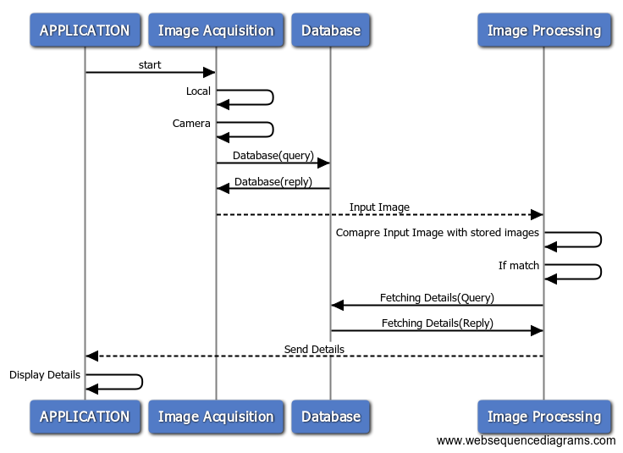
Sequence Diagram
If Image matched with any of the database images

Slide 8
Roles and Responsibilities
Setup a Git server
Setup mysql server
Installation of OpenCV library
Python application to take and process the image.
Writing Test cases
Manual testing for each test case.

Slide 9
Contribution
OpenCV library installed.
Gathered OpenCV libraries for detect and recognisation of face.
Designing GUI for user interaction.
Implemeting Application for recognising face.

Slide 10
Team Achievements
Developed GUI for user interaction.
Recognising face for trained and non trained persons.
Implemented wrapper.

Slide 11
?

Slide 12
Thank You

