Slide 1

MultiMedia ImageProcessing
Using OpenCV
Presented By
D.Ramya
Votary Softech Solution Pvt. Ltd.

Slide 2
Contents
Objective
Tools required
Architecture Diagram
Description
Roles and Resposibility

Slide 3
Objective
The main objective of this project is to identify a person by using OpenCV library.

Slide 4
V-gate Process
For Architeure,Design and Implementation phase I referred Detail Design Document.
For Validate phase I referred Test Case Document.

Slide 5
Tools and Hardware Requirements
Git Repository
Raspberry Pi Board
Raspberry Pi camera

Slide 6
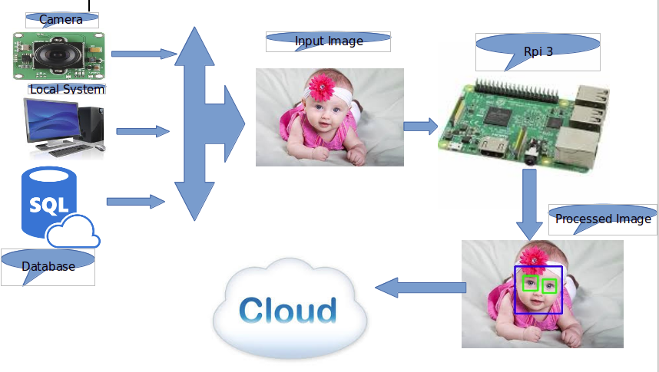
Architecture Diagram

Slide 7
Project Description
This Project contains Total 3 Modules.
Image Acquisation
Image Processing
Storage

Slide 8
Image Acquisation
Image Acquisation module has 3 API’s
Cam():It will capture image from the connected camera.
Local_browse():It will browse image from the local system .
Database():It will take image from the any database.

Slide 9
Image Processing
Image Processing module has 1 API.
face_detect(Path of image filename): It will take the input from the Image Acqusation module,detect the face,compare with the images which are in another database.
If any of the image matches with the input image it has to extract the details.

Slide 10
Storage
Extracted details from the Image Processing should be store in mysql database.

Slide 11
Roles andResponsibility
Setup of GIT server
Setup of Mysql server
Python script to Acquire, Process Image and detect the faces
Installation of OpenCV Library
Written test cases
Manual testing for each test cases

Slide 12
?

Slide 13
Thank You

