Slide 1
Final Project
House Price Prediction
Ramya A
PSG Institute of Technology and Applied Research
B.E. Computer Science and Engineering
NM id: au715521104032
Email: ramyaa060303@gmail.com
3/21/2024 Annual Review

Slide 2
PROJECT TITLE
Title : House Price Prediction
Description: Predicting House Prices Using Deep Learning involves developing a sophisticated model that accurately estimates house prices based on key features like location, age, and amenities. By leveraging advanced algorithms and data analysis techniques, this project aims to provide valuable insights for buyers, sellers, and investors in the real estate market.
3/21/2024 Annual Review

Slide 3


AGENDA
The agenda of this project is to utilize machine learning techniques to accurately predict the prices of houses based on various features such as the year of sale, age of the house, distance from the city center, number of stores in the locality, latitude, and longitude. By employing advanced algorithms and data analysis, we aim to provide valuable insights for both buyers and sellers in the real estate market.
Problem Statement
Project overview
End Users
Proposed solution
Algorithm & Deployment
Modelling
Result
3/21/2024 Annual Review

Slide 4

PROBLEM STATEMENT
In the dynamic real estate market, accurately determining the price of a house is a complex task influenced by numerous factors. Traditional methods often lack precision and may lead to undervaluation or overvaluation of properties. Moreover, with the increasing demand for data-driven decision-making, there is a growing need for predictive models that can leverage available data to provide more accurate estimations of house prices. The problem statement revolves around developing a robust deep learning model capable of predicting house prices with high accuracy based on key features.
3/21/2024 Annual Review

Slide 5

PROJECT OVERVIEW
This project focuses on building a predictive model for house prices by employing deep learning techniques. Initially, we import and preprocess the dataset containing relevant features and the corresponding prices of houses. After performing data normalization and splitting the dataset into training and testing sets, we design a neural network architecture for modeling. The model is trained on the training dataset using the Mean Squared Error (MSE) loss function and the Adam optimizer. Additionally, early stopping is implemented to prevent overfitting. Finally, the trained model is evaluated using the test dataset, and predictions are made on unseen data to assess its performance.
3/21/2024 Annual Review

Slide 6

WHO ARE THE END USERS?
The end users of this predictive model include potential homebuyers, real estate agents, property investors, and homeowners looking to sell their properties. By accurately predicting house prices, this tool can assist homebuyers in making informed decisions, help real estate agents in setting competitive prices, aid property investors in identifying lucrative investment opportunities, and empower homeowners in determining the optimal selling price for their properties.
3/21/2024 Annual Review

Slide 7

YOUR SOLUTION AND ITS VALUE PROPOSITION
The solution involves leveraging deep learning algorithms to develop a predictive model that can accurately estimate house prices based on various features. By analyzing historical data and identifying patterns, the model can provide valuable insights into the factors influencing house prices. The value proposition lies in offering stakeholders in the real estate market a reliable tool for price estimation, which can enhance decision-making processes, mitigate risks, and optimize outcomes.
3/21/2024 Annual Review

Slide 8

THE WOW IN YOUR SOLUTION
One of the notable aspects of the solution is its ability to handle a diverse range of features, including both numerical and geographical data. By incorporating features such as the distance from the city center and the number of stores in the locality, our model captures nuanced aspects that contribute to house prices. Additionally, the use of neural networks enables the model to learn complex relationships between features and prices, leading to more accurate predictions.
3/21/2024 Annual Review

Slide 9
MODELLING
The modeling phase involves designing a neural network architecture tailored to the task of house price prediction. The model comprises multiple layers, including input, hidden, and output layers, with Rectified Linear Unit (ReLU) activation functions to introduce non-linearity. The architecture is trained using the Mean Squared Error (MSE) loss function and the Adam optimizer, with early stopping implemented to prevent overfitting. Through iterative training on the dataset, the model learns to map input features to corresponding house prices.
3/21/2024 Annual Review

Slide 10
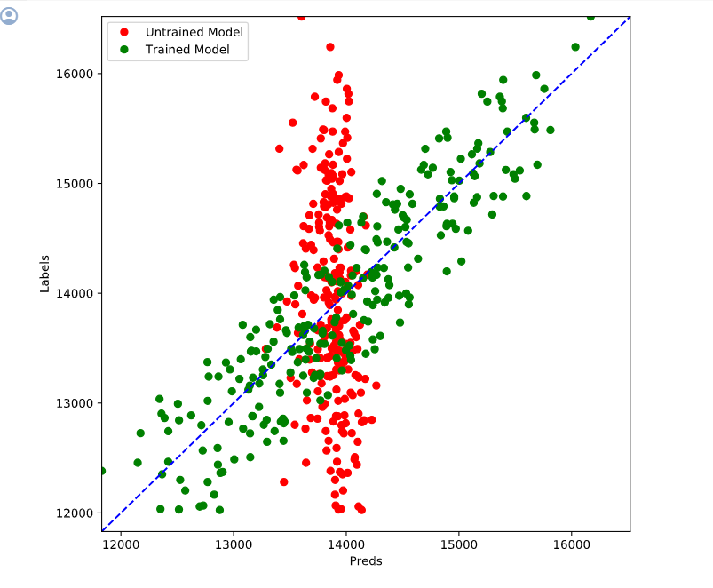
RESULTS
Demo Link
3/21/2024 Annual Review

