Slide 1
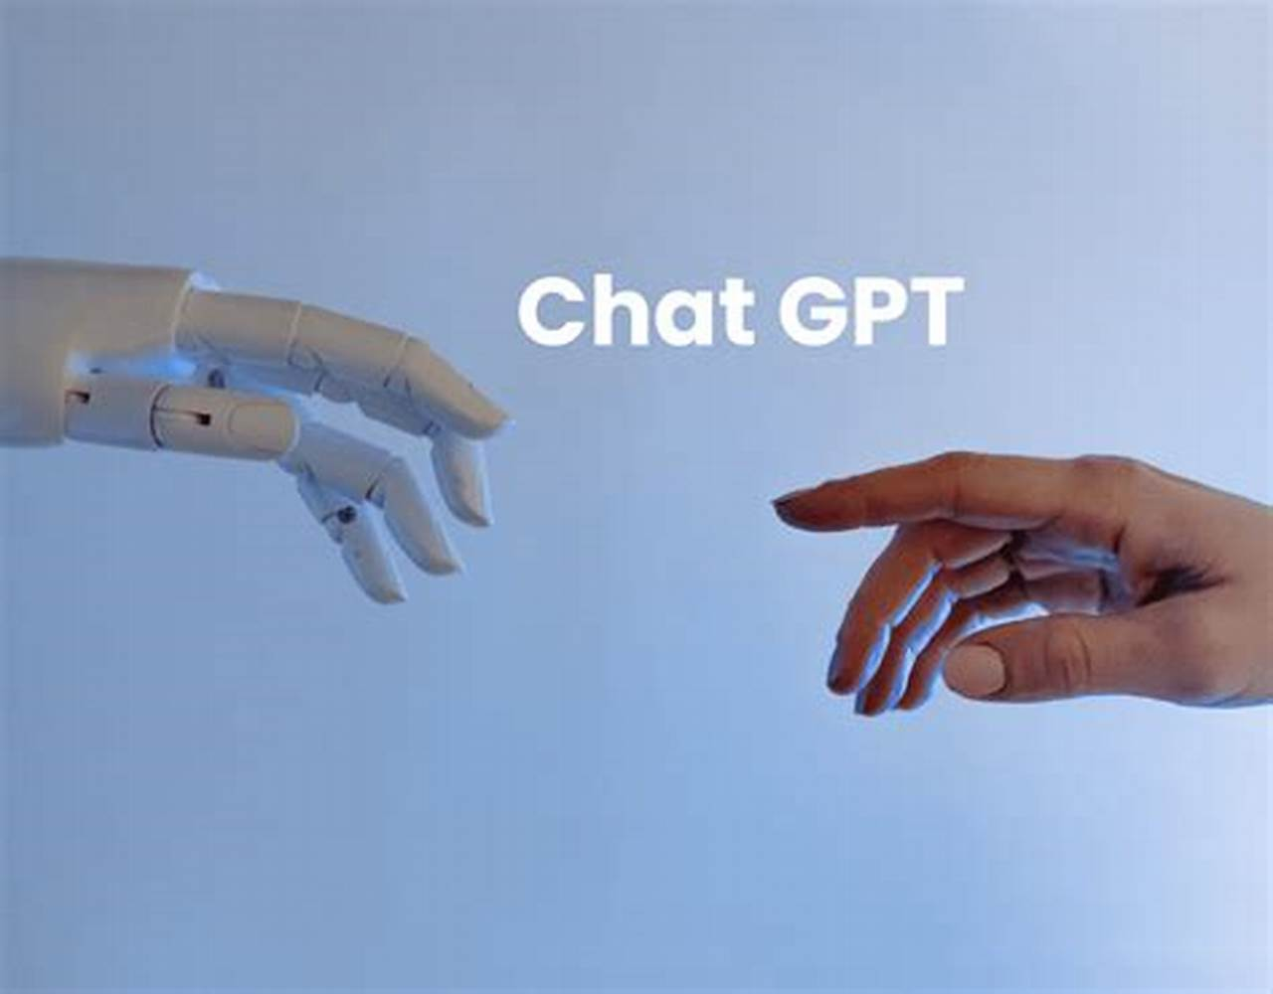


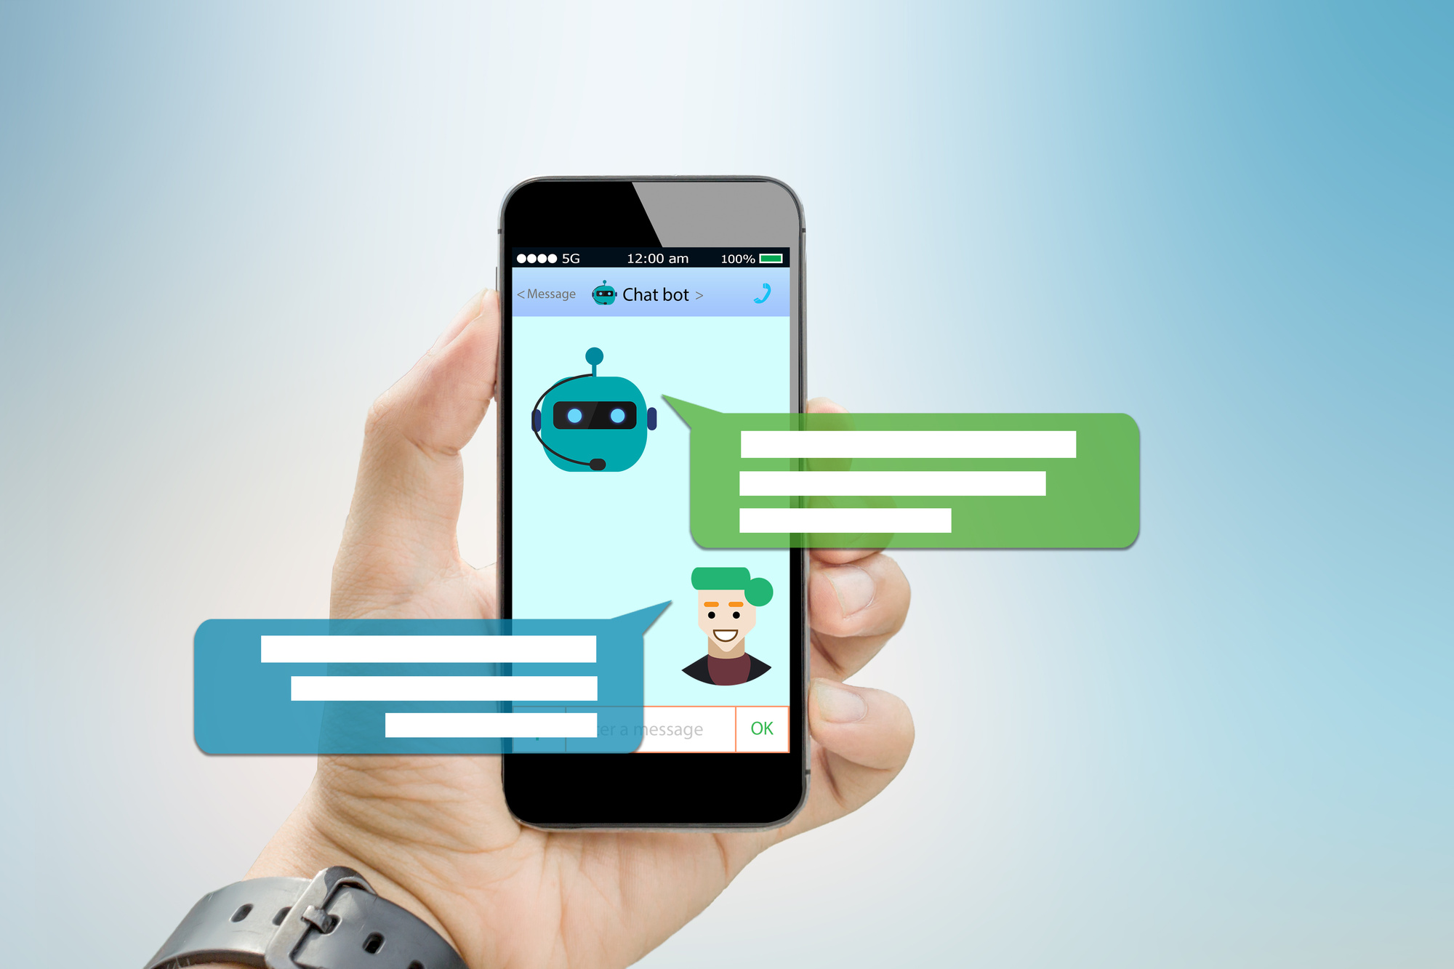
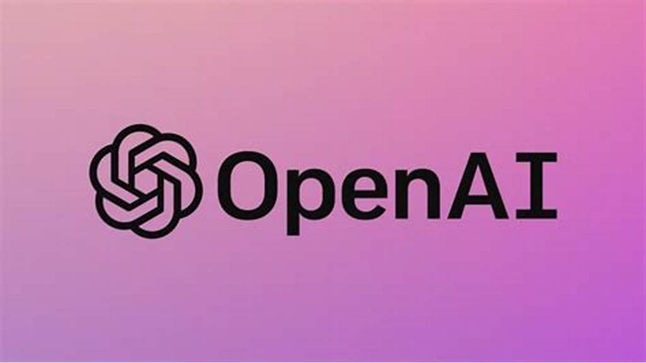

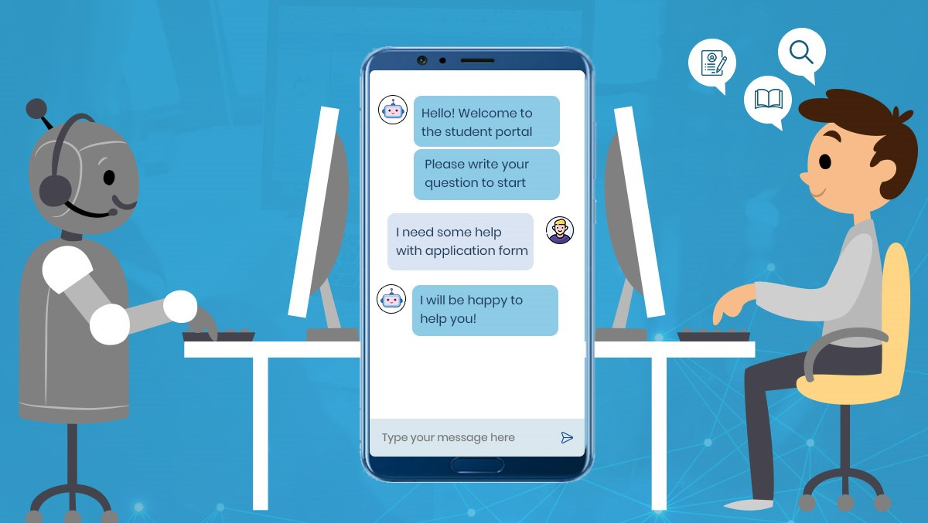
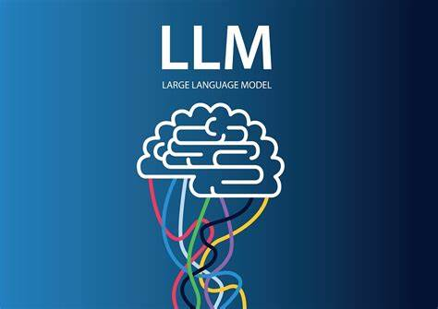
Domain Specific PDF based Chat GPT for Educational Institutions.

Slide 2
Project Introduction
This Project is a Domain Specific PDF based Chat GPT
The primary objective of this project was to create an intelligent chatbot capable of autonomously acquiring knowledge from PDF documents in diverse domains. This chatbot harnesses the power of natural language processing (LLM) techniques to offer precise and context-aware answers to user inquiries, all driven by the content extracted from the supplied PDFs.
LLMs are AI models designed to understand and generate human-like text based on the input they receive.
I have used two LLM’s for this project
Open AI
Google Palm
Business Use Case
Educational Institution (Digital library)
Business website ( FAQs)
Law Firms

Slide 3
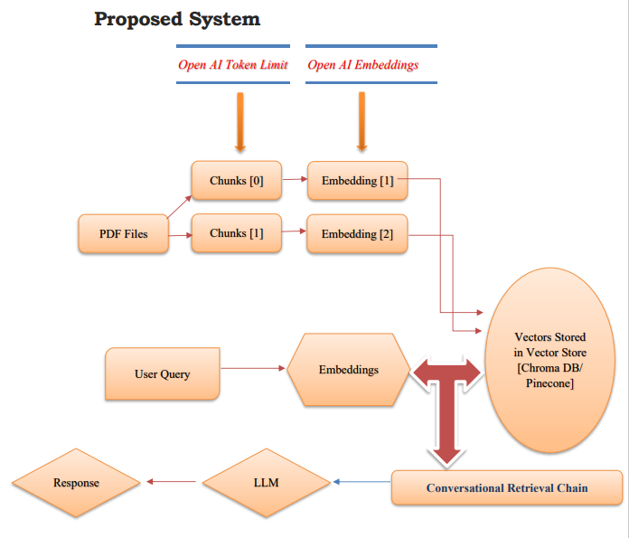

Behind ChatGPT there is a model called GPT4. GPT4 is the LLM behind chat GPT. The company who build this is OpenAI. Similar to GPT4 there are 2 other LLM’s in the market Lama by META and Palm by Google. Lama and Palm are free but Open AI charges.

Slide 4


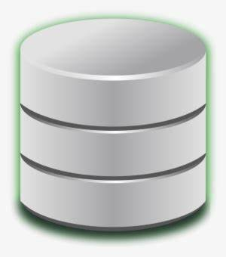
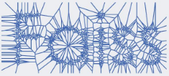
Proposed System
FAISS
(Facebook AI Similarity Search)
Vector Database
Embedding
Question of user
Answer
Prompt
RetrievalQA
LLM
Used to pull the similar looking embedding vectors and to form a prompt
LLM Google PALM

Slide 5
Data Preparation
I have collected 2 educational PDF documents covering topics
NLP
Supervised Learning.
Text extraction was performed using the PyPDF2 library, resulting in a total of 2 documents with 4400 characters from these documents.
Vectorization
The extracted text data was converted into vectorized embeddings using OpenAI's embeddings and stored in a Chroma DB vector store / Pinecone vector store.
Also for another trial extracted text data was converted into vectorized embeddings using HuggingFaceInstruct embeddings and stored in a vector store FAISS (Facebook AI Similarity Search) .

Slide 6
Output
When the user ask a question, that particular question is embedded and perform similarity search between the embedded vectors in the vector store and the embedded vectors created from user query. The Retrieval QA used in the case of Google Palm and Conversational Retrieval chain used in the case of Open AI, looks for similar vectors as mentioned above. Conversational Retrieval chain also saves/remembers the chat history and it shows the previous chats.
Remembering chat history | 🦜️🔗 Langchain
Then these similar vectors are converted into original sentence/ chunks and then we can form a prompt. These text chunks will be possible answers that we have in our pdf files. And when we give our prompt to our llm, OpenAI / GooglePalm will produce a coherent human readable answer.

Slide 7
Along with Retrieval QA, prompt template also was added which ask for the exact answer and avoid giving wrong answer.
from langchain.prompts import PromptTemplate
prompt_template = """Given the following context and a question, generate an answer based on this context only.
In the answer try to provide as much text as possible from "response" section in the source document context without making much changes.
If the answer is not found in the context, kindly state "I don't know." Don't try to make up an answer.
CONTEXT: {context}
QUESTION: {question}""“
PROMPT = PromptTemplate(
template=prompt_template, input_variables=["context", "question"]
)
chain_type_kwargs = {"prompt": PROMPT}
Using a Retriever | 🦜️🔗 Langchain

Slide 8


