Slide 1
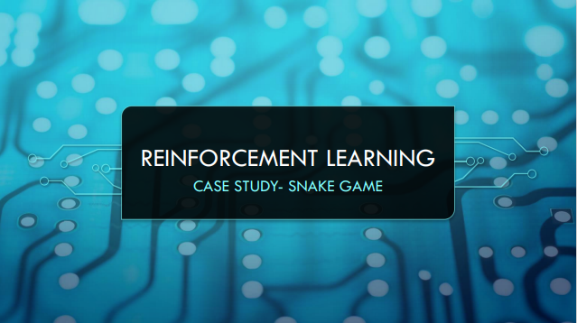

Slide 2
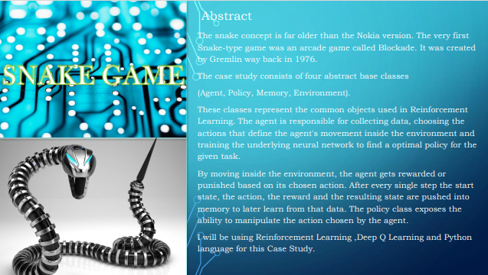

Slide 3
We have to create three Modules for this project:
The Environment (the game that we build)
The Model (Reinforcement model for move prediction)
The Agent (Intermediary between Environment and Model)
Algorithm:
We have snake and food on the board randomly placed.
Calculate the state of the snake using the 11 values and if any of the conditions is true then set that value to zero else set one.
Based on the current Head position agent will calculate the 11 state values as described above.
After getting these states, the agent would pass this to the model and get the next move to perform.
After executing the next state calculate the reward. Rewards are defined as below:
Eat food : +10
Game Over : -10
Else : 0
Update the Q value (which will be discussed later) and Train the Model.
After analyzing the algorithm now we have to build the idea to proceed with coding this algorithm.

Slide 4
The model is designed using Pytorch, but you can also use TensorFlow based on your comfort.
We are using a Dense neural network with an input layer of size 11 and one dense layer with 256 neurons and an output of 3 neurons. You can tweak these hyper parameters to get the best result.
How do the models work?
The game starts, and the Q-value is randomly initialized.
The system gets the current state s.
Based on s, it executes an action, randomly or based on its neural network. During the first phase of the training, the system often chooses random actions to maximize exploration. Later on, the system relies more and more on its neural network.

Slide 5
Actions and State Value
Actions → action determines our next move. We have 4 direction L R U AND D and if we design it like this if we go right then we might take the action left and we immediately die so this is basically a 180 degree turn so we don’t allow that so the better approach to design the action is to only use 3 different numbers and this is dependent on the current direction
[1 0 0 → Straight (if we stay in same direction that is if we go right we go right itself or if we go left we go left
0 1 0 → Right (here we do a right turn and again it depends on the current direction ..go right and do right turn again we go down next again if we do a right turn again we go left and then we go right turn again we go up.
0 0 1]→ Left
Reward
SNAKE EAT FOOD +10
GAME OVER -10
ELSE 0

Slide 6
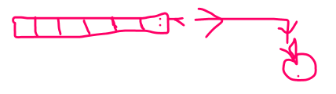
State 11 Values
Danger Straight, Danger Right, Danger Left (this depends on current location if any direction move hits the wall its danger with that direction)
Directions
Direction Left, Direction Right, Direction Up, Direction Down
Food
Food Left , Food Right, Food Up, Food Down
Current State values
[0, 0, 0
0, 1, 0, 0
0, 1, 0, 1]
[1 0 0 → Straight (if we stay in same direction that is if we go right we go right itself or if we go left we go left
0 1 0 → Right (here we do a right turn and again it depends on the current direction ..go right and do right turn again we go down next again if we do a right turn again we go left and then we go right turn again we go up.
0 0 1]→ Left

Slide 7
MODEL – PYTORCH
DEEP Q LEARNING → Q value = Quality of Action
(each action should improve the quality of the snake)
INIT Q VALUE= INIT MODEL→ (we start by initializing our Q value ..here we initialize our model with some random parameters)
Choose Action= model.predict (state)→(then we choose action by calling model.predict(state))
Model.predict(state) → (action)
PERFORM ACTION→ (and with this action we perform the next move)
MEASURE REWARD
UPDATE Q VALUE + TRAIN MODEL
Loss Function → And we use loss function to optimize or minimize so for that we use Bell man equation

Slide 8
AGENT.py
-GAME
-MODEL
-get the current state from the game.py
State = get_state(game)→ based on the game we will calculate the state
Action = get_move(state) and based on the state we calculate the new action
Model.predict() and this involves calling the model to predict
Reward, game_over,score= game.play_step (action) and then with the new action we do the next play step and we get a reward, game over state and a score
New_state= get_state(game) then with that information we calculate a new state
Remember() and then we remember all of this and we store the new state ,the old state and the game over state and the score
Model.train and then with the above information we train our model
And for model I have called the Linear Qnet( it’s a feed forward neural net with the few linear layers ) it needs to have the above information new state and old state then training the model model.predict and we get new action

Slide 9
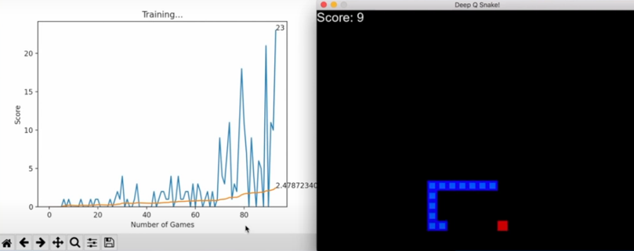
Output

Slide 10
