Slide 1
15CSE302 Database Management Systems Lecture 4 Relational Algebra B.Tech /III Year CSE/V Semester L T P C 2 0 2 3
DBMS Team
Dr G Jeyakumar
Bindu K R
Dr Priyanka Kumar
R. Manjusha
Department of CSE
Amrita School of Engineering

Slide 2
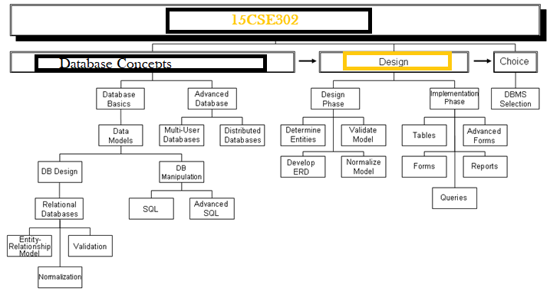
Syllabus
Dept. of CSE, Amrita School of Engineering, Coimbatore July 2020

Slide 3
Brief Recap of Previous Lecture
Structure of Relational Databases
Keys
Schema Diagrams
Dept. of CSE., Amrita School of Engineering, Coimbatore

Slide 4
Today’s Lecture
Relational Query Languages
Relational Algebra
RelaX tool
Dept of CSE,Amrita School of Engineering, Coimbatore

Slide 5
Relational Query Language
Query languages: Allow manipulation and retrieval of data from a database.
Relational model supports simple, powerful QLs:
Strong formal foundation based on logic.
Allows for much optimization.
Query Languages != programming languages!
QLs not expected to be “Turing complete”.
QLs not intended to be used for complex calculations.
QLs support easy, efficient access to large data sets.

Slide 6
Relational Query Language
A query language is a language in which a user requests information from the database.
They are on a lever higher than that of standard programming languages.
Two mathematical Query Languages form the basis for “real” languages (e.g. SQL), and for implementation:
Relational Algebra: More operational(procedural), very useful for representing execution plans.
Relational Calculus: Lets users describe what they want, rather than how to compute it. (Non-operational, declarative.)
Relational Query Language
Procedural
Relational Calculus
Non Procedural
Relational Algebra

Slide 7
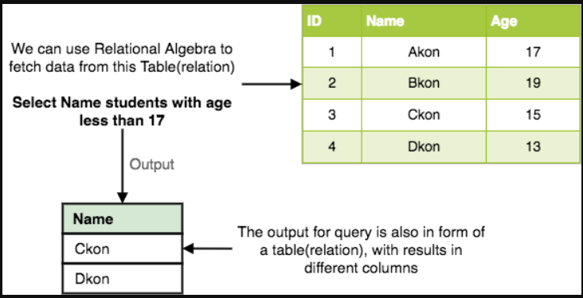
Relational Algebra
Algebra - language based on operators and a domain of values
Operators map values taken from the domain into other domain values
Hence, an expression involving operators and arguments produces a value in the domain
When the domain is a set of all relations (and the operators are as described later), we get the relational algebra
We refer to the expression as a query and the value produced as the query result
Relational algebra is a procedural query language, which takes instances of relations as input and yields instances of relations as output.
It uses operators to perform queries.

Slide 8
Relational Query Language
Two Categories
Procedural Languages non-procedural language
User instructs the system to perform the user describes the desired results
a sequence of operations on the database without giving a specific procedure
to compute desired result. for obtaining it.
* Query languages in practise use both the approaches.
Dept. of CSE., Amrita School of Engineering, Coimbatore

Slide 9
Relational Algebra
Domain: set of relations
Basic operators: select, project, union, set difference, Cartesian product
Derived operators: set intersection, division, join
Procedural: Relational expression specifies query by describing an algorithm (the sequence in which operators are applied) for determining the result of an expression

Slide 10
Relational Algebra
Optimized
Relational
algebra
expression
Relational
algebra
expression
Query
execution
plan
Executable
code
SQL
query
Code
generator
parser
Query optimizer
DBMS

Slide 11
Relational Operations
The procedural query languages provide a set of operations that can be applied one or more relations.
These operations have desired properties.
These operations can be combined in a modular way.
Common operations –
Selection
Projection,
Union,
Difference,
Intersection and
Join (natural join and Cartesian Product)

Slide 12
Relational Operations
Basic operations:
Selection ( σ ) Selects a subset of rows from relation.
Projection ( π ) Deletes unwanted columns from relation.
Cross-product ( X ) Allows us to combine two relations.
Set-difference ( - ) Tuples in relation. 1, but not in relation. 2.
Union ( ⋃ ) Tuples in relation. 1 and in relation. 2.
Additional operations:
Intersection(∩)
join(⨝)
division(÷)
Renaming ρ
Since each operation returns a relation, operations can be composed!
(Relational Algebra is “closed” – closure property (means: input and output are relations.)

Slide 13
Select Operator
Produce table containing subset of rows of argument table satisfying condition
σ_{condition} relation
Example:
Person σ_{Hobby=‘stamps’}(Person)
Person
Id | Name | Address | Hobby
1123 | John | 123 Main | stamps
1123 | John | 123 Main | coins
5556 | Mary | 7 Lake Dr | hiking
9876 | Bart | 5 Pine St | stamps
Person
Id | Name | Address | Hobby
1123 | John | 123 Main | stamps
9876 | Bart | 5 Pine St | stamps

Slide 14
Selection Condition
Operators: <, ≤, ≥, >, =, ≠
Simple selection condition:
<attribute> operator <constant>
<attribute> operator <attribute>
<condition> AND <condition>
<condition> OR <condition>
NOT <condition>

Slide 15
Selection Condition - Examples
Display all persons whose id greater than 3000 and hobby is hiking
Display all persons whose id between 3000 and 4000
Display all persons whose hobby is not hiking
Display all persons whose hobby is not hiking
Person
Id | Name | Address | Hobby
1123 | John | 123 Main | stamps
1123 | John | 123 Main | coins
5556 | Mary | 7 Lake Dr | hiking
9876 | Bart | 5 Pine St | stamps

Slide 16
Selection Condition - Examples
Display all persons whose id greater than 3000 and hobby is hiking
σ _{Id>3000 v Hobby=‘hiking’} (Person)
Display all persons whose id between 3000 and 4000
σ _{Id>3000 ʌ Id <3999} (Person)
Display all persons whose hobby is not hiking
σ _{NOT(Hobby=‘hiking’)} (Person)
Display all persons whose hobby is not hiking
σ _{Hobby!=‘hiking’} (Person)

Slide 17
Project Operator Π
Produces table containing subset of columns of argument table
Π_{attribute list}(relation)
Example:
Person Π_{Name, Hobby}(Person)
Person
Id | Name | Address | Hobby
1123 | John | 123 Main | stamps
1123 | John | 123 Main | coins
5556 | Mary | 7 Lake Dr | hiking
9876 | Bart | 5 Pine St | stamps
Person
Name | Hobby
John | stamps
John | coins
Mary | hiking
Bart | stamps

Slide 18
Project Operator Π
Example: Person Π_{Name,Address}(Person)
Person
Id | Name | Address | Hobby
1123 | John | 123 Main | stamps
1123 | John | 123 Main | coins
5556 | Mary | 7 Lake Dr | hiking
9876 | Bart | 5 Pine St | stamps
Person
Name | Address
John | 123 Main
Mary | 7 Lake Dr
Bart | 5 Pine St
Result is a table (no duplicates)

Slide 19
Project Operator Π Expression
Person
Id | Name | Address | Hobby
1123 | John | 123 Main | stamps
1123 | John | 123 Main | coins
5556 | Mary | 7 Lake Dr | hiking
9876 | Bart | 5 Pine St | stamps
Person
Id | Name
1123 | John
9876 | Bart
Result is a table (no duplicates)

Slide 20
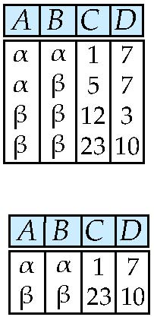
Select Operation – selection of rows (tuples)
Relation r
σ_{A=B ^ D > 5} (r)

Slide 21
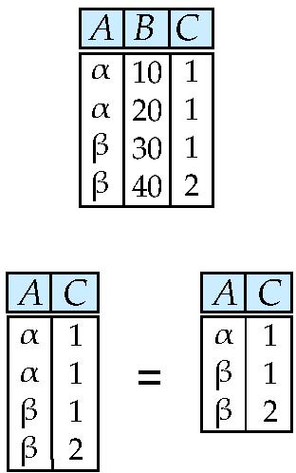
Project Operation – selection of columns (Attributes)
Relation r:
∏_{A,C} (r)

Slide 22
Set Operators
Relation is a set of tuples
Result of combining two relations with a set operator is a relation => all its elements must be tuples having same structure
Hence, scope of set operations limited to union compatible relations

Slide 23
Union Compatible Relations
Two relations are union compatible if
Both have same number of columns
Names of attributes are the same in both
Attributes with the same name in both relations have the same domain
Union compatible relations can be combined using
union
Intersection
set difference

Slide 24
Example
Tables:
Person (SSN, Name, Address, Hobby)
Professor (Id, Name, Office, Phone)
are not union compatible.

Slide 25
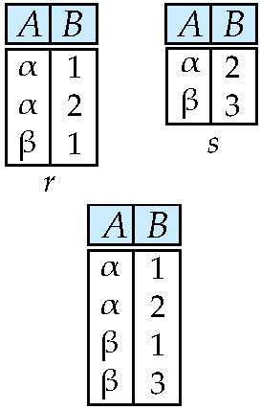
Union of two relations
Relations r, s:
r ∪ s:

Slide 26
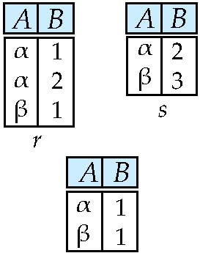
Set difference of two relations
Relations r, s:
r – s:

Slide 27
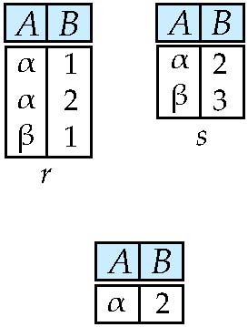
Set intersection of two relations
Relation r, s:
r ∩ s
Note: r ∩ s = r – (r – s)

Slide 28
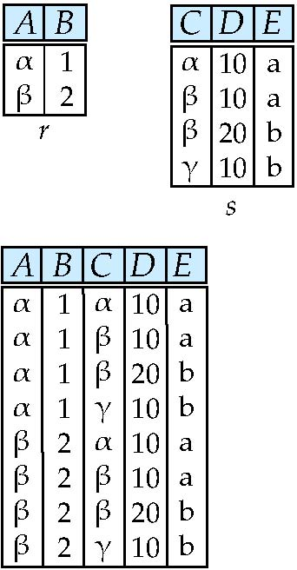
joining two relations -- Cartesian-product
Relations r, s:
r x s:

Slide 29
Cartesian-product – naming issue
B
Relations r, s:
r.B
s.B
r x s:

Slide 30
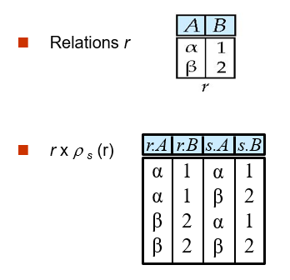
Renaming a Table
Allows us to refer to a relation, (say E) by more than one name.
ρ _{x} (E)
returns the expression E under the name X

Slide 31
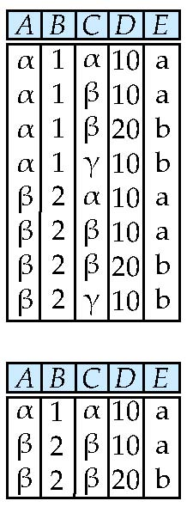
Composition of Operations
Can build expressions using multiple operations
Example: σ_{A=C} (r x s)
r x s
σ_{A=C} (r x s)

Slide 32
Joining two relations – Natural Join
Let r and s be relations on schemas R and S respectively. Then, the “natural join” of relations R and S is a relation on schema R ∪ S obtained as follows:
Consider each pair of tuples t_{r} from r and t_{s} from s.
If t_{r} and t_{s} have the same value on each of the attributes in R ∩ S, add a tuple t to the result, where
t has the same value as t_{r} on r
t has the same value as t_{s} on s

Slide 33
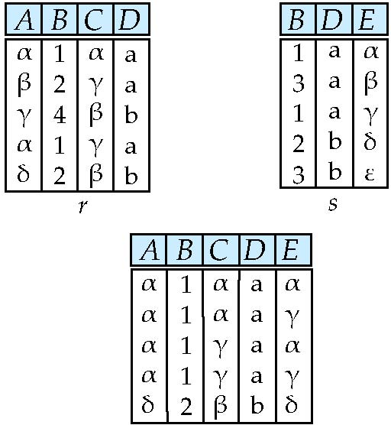
Natural Join Example
Relations r, s:
Natural Join
r s
∏ _{A, r.B, C, r.D, E} (σ _{r.B = s.B ˄ r.D = s.D} (r x s)))

Slide 34
Summary of Relational Algebra Operators
Symbol (Name) Example of Use
σ
(Selection) ^{σ} salary > = 85000 ^{(instructor)}
Return rows of the input relation that satisfy the predicate.
Π
(Projection) ^{Π} ID, salary ^{(instructor)}
Output specified attributes from all rows of the input relation. Remove duplicate tuples from the output.
x
(Cartesian Product) instructor x department
Output pairs of rows from the two input relations that have the same value on all attributes that have the same name.
∪
(Union) ^{Π} name ^{(instructor) ∪ Π} name ^{(student)}
Output the union of tuples from the two input relations.
-
(Set Difference) ^{Π} name ^{(instructor)} ^{-- Π} name ^{(student)}
Output the set difference of tuples from the two input relations.
⋈
(Natural Join) instructor ⋈ department
Output pairs of rows from the two input relations that have the same value on all attributes that have the same name.

Slide 35
Contents
Structure of Relational Databases
Keys
Schema Diagrams
Relational Query Languages
Relational Operations
Dept. of CSE., Amrita School of Engineering, Coimbatore

Slide 36
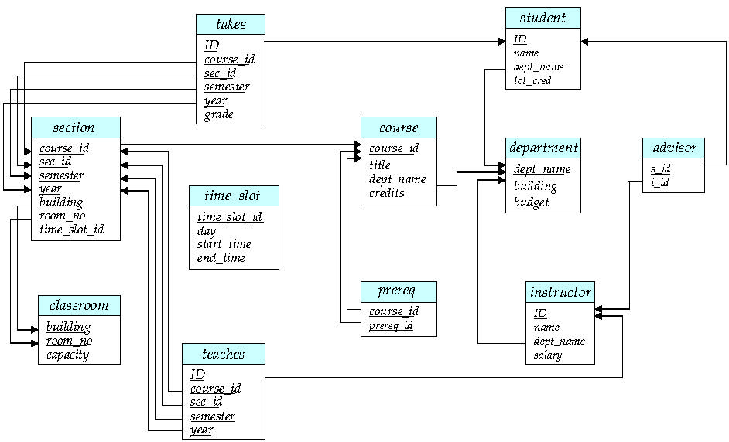
Schema Diagram
The database schema and its keys can be visualized in Schema Diagram.
Dept. of CSE., Amrita School of Engineering, Coimbatore

Slide 37
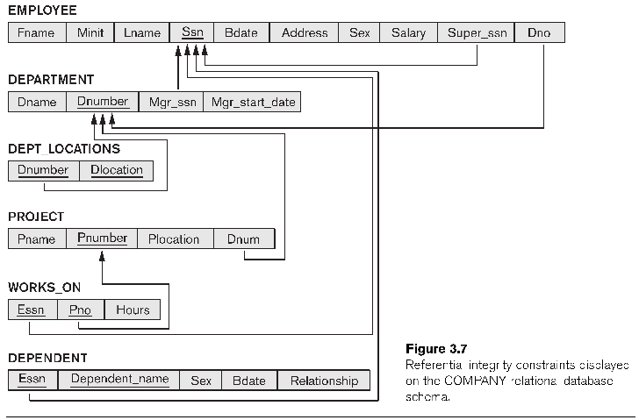
Schema Diagram
The database schema and its keys can be visualized in Schema Diagram.
Company database
Dept. of CSE., Amrita School of Engineering, Coimbatore

Slide 38
Summary
Structure of Relational Databases
Keys
Schema Diagrams
Dept. of CSE., Amrita School of Engineering, Coimbatore

Slide 39
Next Lecture
Relational Query Languages
Relational Algebra
Dept. of CSE., Amrita School of Engineering, Coimbatore

Slide 40
References
https://docs.oracle.com/en/database/oracle/oracle-database/20/newft/new-features.html
https://www.pda.org/scientific-and-regulatory-affairs/regulatory-resources/data-integrity
https://www.digipay.guru/blog/all-you-need-to-know-about-agency-banking/
https://md.ekstrandom.net/teaching/cs4332-f15.pdf
https://https://bit.ly/31eE2Ar
https://ipronline.com/oracle-the-pioneers-of-the-software-world/

Slide 41
Thank You
Happy to answer any questions ! ! !
Notes:
Not covering all.

Slide 42
Contents
Structure of Relational Databases
Keys
Schema Diagrams
Relational Query Languages
Relational Operations
Dept. of CSE., Amrita School of Engineering, Coimbatore

Slide 43
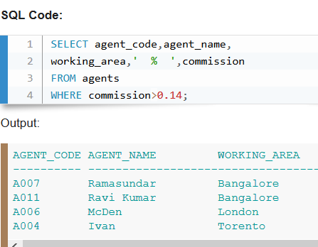
Relational Query Language
A query language is a language in which a user requests information from the database.
They are on a lever higher than that of standard programming languages.
An example
Dept. of CSE., Amrita School of Engineering, Coimbatore

Slide 44
Relational Query Language
Two Categories
Procedural Languages non-procedural language
User instructs the system to perform the user describes the desired results
a sequence of operations on the database without giving a specific procedure
to compute desired result. for obtaining it.
* Query languages in practise use both the approaches.
Relational algebra is a procedural query language, which takes instances of relations as input and yields instances of relations as output. It uses operators to perform queries.
Dept. of CSE., Amrita School of Engineering, Coimbatore

Slide 45
Structure of Relational Databases
Keys
Schema Diagrams
Dept. of CSE., Amrita School of Engineering, Coimbatore

Slide 46
Relational Operations
The procedural query languages provide a set of operations that can be applied one or more relations.
These operations have desired properties.
These operations can be combined in a modular way.
Common operations – Selection, Projection, Union, Difference, Intersection and Join (natural join and Cartesian Product)

Slide 47
Select Operation – selection of rows (tuples)
Relation r
σ_{A=B ^ D > 5} (r)

Slide 48
Project Operation – selection of columns (Attributes)
Relation r:
∏_{A,C} (r)

Slide 49
Union of two relations
Relations r, s:
r ∪ s:

Slide 50
Set difference of two relations
Relations r, s:
r – s:

Slide 51
Set intersection of two relations
Relation r, s:
r ∩ s
Note: r ∩ s = r – (r – s)

Slide 52
joining two relations -- Cartesian-product
Relations r, s:
r x s:

Slide 53
Cartesian-product – naming issue
B
Relations r, s:
r.B
s.B
r x s:

Slide 54
Renaming a Table
Allows us to refer to a relation, (say E) by more than one name.
ρ _{x} (E)
returns the expression E under the name X

Slide 55
Composition of Operations
Can build expressions using multiple operations
Example: σ_{A=C} (r x s)
r x s
σ_{A=C} (r x s)

Slide 56
Joining two relations – Natural Join
Let r and s be relations on schemas R and S respectively. Then, the “natural join” of relations R and S is a relation on schema R ∪ S obtained as follows:
Consider each pair of tuples t_{r} from r and t_{s} from s.
If t_{r} and t_{s} have the same value on each of the attributes in R ∩ S, add a tuple t to the result, where
t has the same value as t_{r} on r
t has the same value as t_{s} on s

Slide 57
Natural Join Example
Relations r, s:
Natural Join
r s
∏ _{A, r.B, C, r.D, E} (σ _{r.B = s.B ˄ r.D = s.D} (r x s)))

Slide 58
Summary of Relational Algebra Operators
Symbol (Name) Example of Use
σ
(Selection) ^{σ} salary > = 85000 ^{(instructor)}
Return rows of the input relation that satisfy the predicate.
Π
(Projection) ^{Π} ID, salary ^{(instructor)}
Output specified attributes from all rows of the input relation. Remove duplicate tuples from the output.
x
(Cartesian Product) instructor x department
Output pairs of rows from the two input relations that have the same value on all attributes that have the same name.
∪
(Union) ^{Π} name ^{(instructor) ∪ Π} name ^{(student)}
Output the union of tuples from the two input relations.
-
(Set Difference) ^{Π} name ^{(instructor)} ^{-- Π} name ^{(student)}
Output the set difference of tuples from the two input relations.
⋈
(Natural Join) instructor ⋈ department
Output pairs of rows from the two input relations that have the same value on all attributes that have the same name.

Slide 59
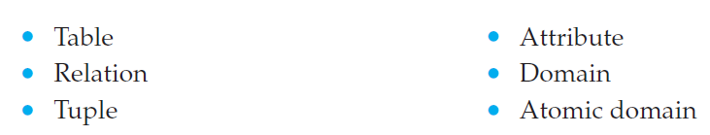
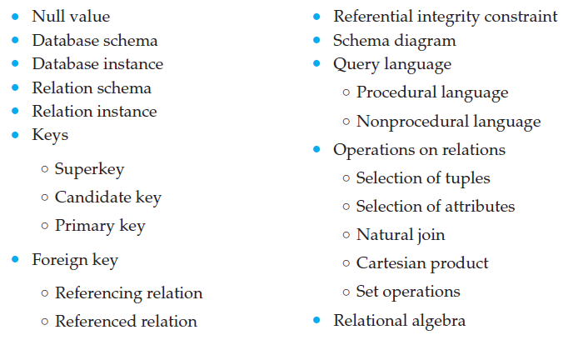
Review Terms

Slide 60
Summary
Relational Query Languages
Relational Operations

Slide 61
Next Lecture
ER Model

Slide 62
References
https://www.db-book.com/db6/index.html

Slide 63
Thankyou
Questions?

