Slide 1
15CSE302 Database Management Systems Normalization B.Tech /III Year CSE/V Semester L T P C 2 0 2 3
DBMS Team
Dr G Jeyakumar
Bindu K R
Dr Priyanka Kumar
R. Manjusha
Department of CSE
Amrita School of Engineering
Slides Courtesy : Carlos Alvarado, San Jose State University

Slide 2
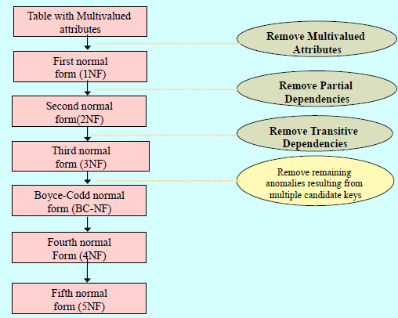

Slide 3
Functional Dependency
FDs allow us to express constraints that we can not express with super key. (α → β)
Inst_Dept(ID, Name, Salary, Dept_name, Building, Budget)
FD (dept_name → budget)
Super Key (Id, dept_name → name, salary, building, budget)
We use FDs in two ways
(1) To specify constraints on the set of legal relations.
(2) To test instances of a relation to see whether they satisfy a given set F of FDs.
if a relation schema r(R) satisfies all the FDs of a set F, then we say F holds on r(R)

Slide 4
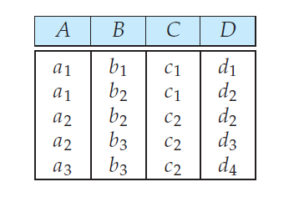
Find out the FDs
Referring the instance
A → B --- No
A→ C – Yes
A→ D – No
B→ A – No
B→ C – NO
B→ D – NO
C→ A -- No
C→ B – No
C→ D – No
D→ A No
D→ B – Yes
D→ C - No

Slide 5
Trivial FDs
FDs Satisfied by all the relations
A→ A
AB → A ( ie., for (α → β) if β is the subset of α then (α → β) is trivial)
Some relation instance may satisfy some FDs, but they may not be satisfied by the relation schema
Eg. Room_Number → Capacity
Because different building may have same room number. However the following FD would be correct
Building, Room_Number → Capacity

Slide 6
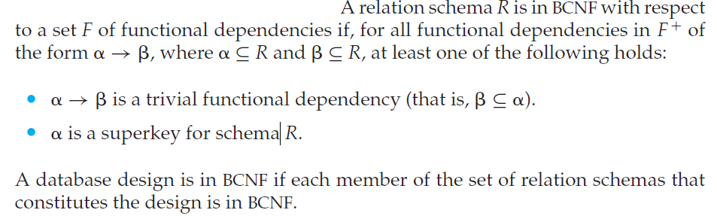
BCNF- Boyce Codd Normal Form
It eliminates all the redundancy that can be identified by the FDs.
Ex
dept_name → building, budget It is non-trivial and dept_name is not a superkey.
So inst_dept is not in BCNF.

Slide 7
BCNF
Instructor(ID, Name, DeptName, Salary)
F = {ID → Name, DeptName, Salary}
only one FD, it is non-trivial, L.H.S is the key
So, Instructor is in BCNF
Department(Dept_Name, Building, Budget)
F = {Dept_Name → Building, Budget}
only one FD, it is non-trivial, L.H.S is the key
So, Department is in BCNF

Slide 8
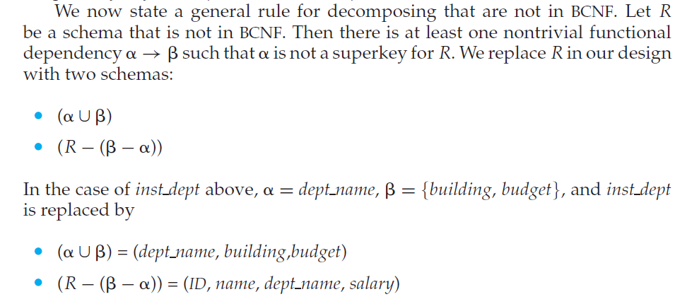

BCNF Decomposition
In this example , there are FDs where α is in both the sides.
The decomposed schemas to be tested with BCNF again.

Slide 9
BCNF – Dependency Preservation
There are several ways in which to express database consistency constraints: primary-key constraints, functional dependencies, check constraints, assertions, and triggers.
Testing these constraints, on every database update, are very costly.
Hence it is useful to design the database in a way the constraints are tested efficiently.
If the FDs are tested in a single relation it is easier.
BCNF decomposition, sometimes, prevent the efficient testing of FDs

Slide 10
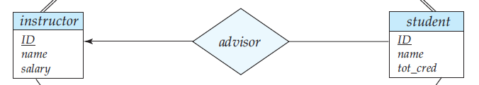
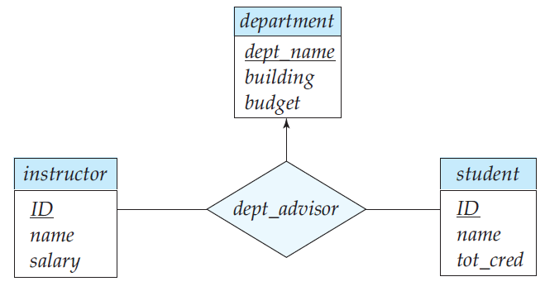
Illustration
Assume University database with following existing constraints
“A student may have only one advisor (can use the relationship set advisor with many-to-one cardinality from student to advisor)”
We make a small change
“an instructor can be associated with only a single department and a student may have more that one advisor, but at most one from a given department”
Ternary relationship.
Many-to-one from the pair (student, instructor)
The schema is dept_advisor(s_ID, i_ID, dept_name)

Slide 11
dept_advisor(s_ID, i_ID, dept_name)
Suppose, to add an additional constraint
“an instructor can act as advisor for only a single department”
The following FDs hold
fd1: i_ID → dept_name “an instructor
can act as an advisor for only one department”
fd2: s_ID, dept_name → i_ID “a student may have at most one
advisor for a given department”
By
i_ID → dept_name
Non-trivial, LHS is not key
Not in BCNF
Decomposition
(i_ID, dept_name)
(s_ID, i_ID)
Fd1 is preserved.
Fd2 is not preserved.
In BCNF….Dependency is not preserved, but it is essential.
3NF preserves the dependency.

Slide 12
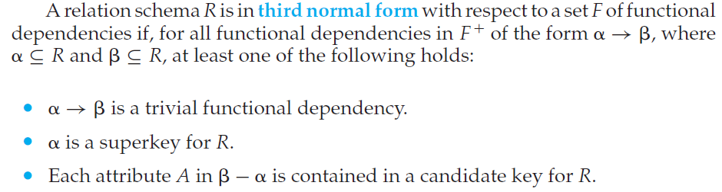
3 NF
BCNF requires that all nontrivial dependencies be of the form α → β , where α is a superkey.
Third normal form (3NF) relaxes this constraint slightly by allowing
certain nontrivial functional dependencies whose left side is not a superkey.

Slide 13
3NF
dept_advisor(s_ID, i_ID, dept_name)
Is not is BCNF, but in 3NF.
The FDs are
i_ID → dept_name
s_ID, dept_name → i_ID
dept_advisor is not in BCNF by the fd i_ID → dept_name
Rule 3 of 3NF says
In i_ID → dept_name, β = dept_name which is in the candidate_key (s_ID, dept_name). .. So, dept_advisor is in 3 NF

Slide 14
BCNF and 3 NF
Observe that any schema that satisfies BCNF also satisfies 3NF, since each of its functional dependencies would satisfy one of the first two alternatives. BCNF is therefore a more restrictive normal form than is 3NF.
Any schema that satisfies 3 NF (by the third rule), may not satisfies BCNF.

Slide 15
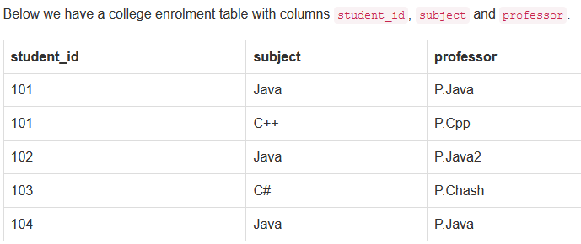
Constraints
One student can enrol for multiple subjects.
For each subject, a professor is assigned to the student.
And, there can be multiple professors teaching one subject like we have for Java.
One professor teaches only one subject, but one subject may have two different professors
FD- Professor → Subject.
Key: student_id, subject
Student_id, Subject → Professor
This table satisfies the 1st Normal form because all the values are atomic, column names are unique and all the values stored in a particular column are of same domain.
This table also satisfies the 2nd Normal Form as their is no Partial Dependency.
And, there is no Transitive Dependency, hence the table also satisfies the 3rd Normal Form.
But this table is not in Boyce-Codd Normal Form.
Decompose: Schema1(Student_id, Professor), Schema2(Professor, Subject)

Slide 16

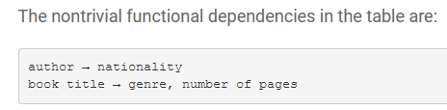


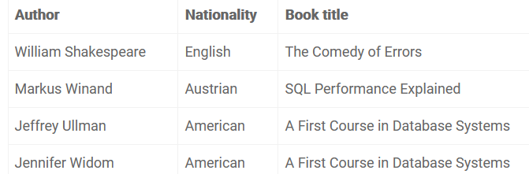

Slide 17
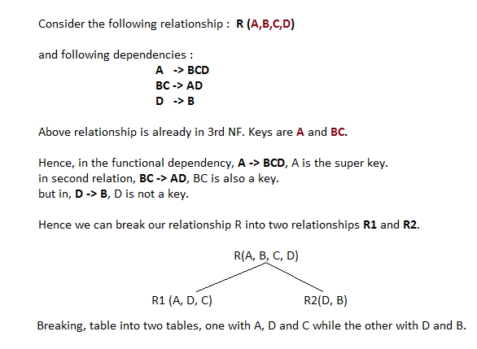
BCNF more examples

Slide 18
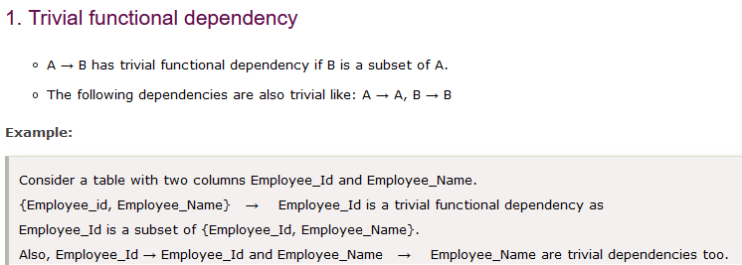
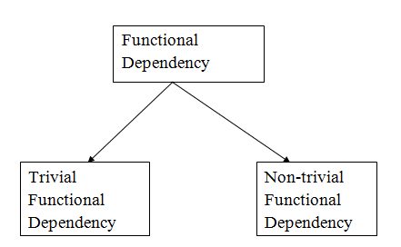
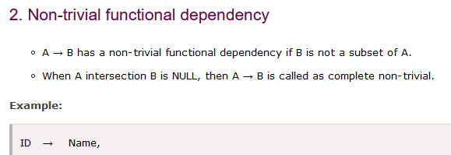

Slide 19
End of 1 NF, 2 NF, 3 NF and BCNF

