Slide 1
SIMD Control Flow
Si Li

Slide 2
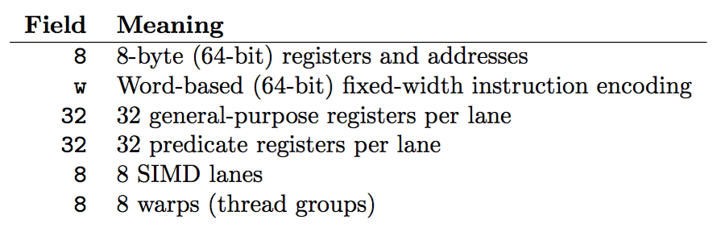
SIMD Overview

Slide 3
SIMD Overview
SIMD lane – scalar thread
Warp – a group of scalar threads that share the same instruction

Slide 4
SIMD Execution of Scalar Threads
All threads run the same kernel
Warp = Threads grouped into a SIMD instruction
Thread Warp 3
Thread Warp 8
Thread Warp
Common PC
Scalar
Scalar
Scalar
Scalar
Thread Warp 7
Thread
Thread
Thread
Thread
W
X
Y
Z
SIMD Pipeline

Slide 5
The Problem: Control flow
GPU uses SIMD pipeline to save area on control logic.
Group scalar threads into warps
Branch divergence occurs when threads inside warps branches to different execution paths.
Branch
Branch
Path A
Path A
Path B
Path B

Slide 6
Dominator
Node d dominates node n if every path from the entry node to n must go through d

Slide 7
Dominator
Node d dominates node n if every path from the entry node to n must go through d
What node dominates node 5?

Slide 8
Dominator
Node d dominates node n if every path from the entry node to n must go through d
What node dominates node 5?
Node 1 and node 2

Slide 9
Immediate Dominator
Node d immediate dominates node n if every path from the entry node to n must go through d and no other nodes dominate n between d and n
What node immediate dominates node 5?
Node 2

Slide 10
Post Dominator
Node d post dominates node n if every path from the node n to the exist node must go through d
What node dominates node 5?
Node 1 and node 2

Slide 11
Immediate Post Dominator
Node d immediate post dominates node n if every path from node n to the exist node must go through d and no other nodes post dominate n between d and n
What node immediate post dominates node 4?
Node 5

Slide 12
SPMD Execution on SIMD Hardware: The Branch Divergence Problem
A
Thread Warp
Common PC
B
Thread
1
Thread
2
Thread
3
Thread
4
C
D
F
E
G

Slide 13
Baseline: PDOM
Stack
A/1111
A
Reconv. PC
Next PC
Active Mask
-
-
E
E
1111
TOS
1111
TOS
TOS
TOS
-
-
-
-
-
G
A
E
B
E
1111
1111
1111
1111
1111
E
E
D
D
0110
TOS
E
D
0110
0110
B
B/1111
TOS
TOS
E
E
C
E
1001
1001
C
C/1001
D
D/0110
F
Thread Warp
Common PC
E
E/1111
Thread
1
Thread
2
Thread
3
Thread
4
G/1111
G
A
B
C
D
E
G
A
Time

Slide 14
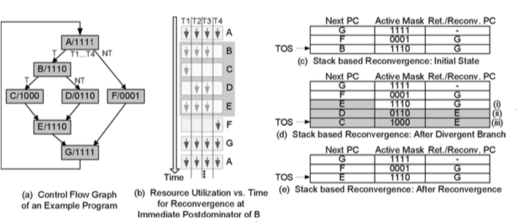
Implementation

Slide 15
Assignment 4
Implement control flow divergence/reconvergence in HARP emulator
Support SIMD control instructions
clone %lane Clone register state into %lane
jalis %link, %n, #RelDest Jump and link immediate, spawn N active lanes
jalrs %link, %n, %dest Jump and link indirect, spawn N active lanes
jmprt %addr Jump indirect, terminate execution on all but one lane
split Control flow diverge
join Control flow reconverge
Warp Control instructions
wspawn %dest, %pc, %src Create new warp
bar %id, %n

Slide 16
Stack-based reconvergence
Needed to support nested split/join operations
Split
Split
Split
Join
Join
Join
Split
Join

Slide 17
Split/Join
Split enables control flow divergence by adding entries to the stack
Split separates threads into contexts based on predicate register
Control flow divergence can then occur on the same predicate register (or another with the same values)
Triggers trap if this condition is not satisfied – will not occur in assignment 4
Join pops entries to allow execution of other threads

Slide 18
Split/Join - Behavior
If no control flow instruction in between split/join pair
One set of threads will execute the region from split to join
Next set of threads will execute the same region
Continue execution from join with both set of threads
If a control flow instruction exists in between split/join pair
One set of threads will execute a branch taken, eventually reach a join
Next set of threads execute fall through and reaches join
Continue execute threads

Slide 19
Split/Join - Mechanism
Operates on the stack
Does not affect control flow
Split pushes two entries onto the stack
1 entry for fall through – uses CURRENT_MASK, starting PC not given (uses PC after join)
1 entry for return to split – uses CURRENT_MASK & ~PRED
Resumes execution using CURRENT_MASK & PRED
Join pops top entry

Slide 20
Notes for Assignment 4
Use vectors, not maps
Make sure it builds on PACE
module load gcc – loads 4.9 by default
module available gcc – lists available gcc/g++ versions
Include a readme and a makefile
Build steps, bugs, configurations, usage, version of g++ used (if not 4.9)
Don’t modify input binary

