Slide 1

K-Means Clustering to classify tweets in Rapid Miner
Ramya HM (10388022)
KRITI DHYANI (10505719)
VISHAL MATORIA (10383366)

Slide 2
Agenda
Text Analytics-Challenges and Benefits
Extracting the value from Unstructured data
Crisp-DM Methodology
Typical Use Case
Visualising the results

Slide 3
Phases in CRISP-DM Model
Phase 1: Business Understanding
Phase 2: Data Understanding
Phase 3: Data Preparation
Phase 4: Modelling
Phase 5: Evaluation
Phase 6: Deployment

Slide 4
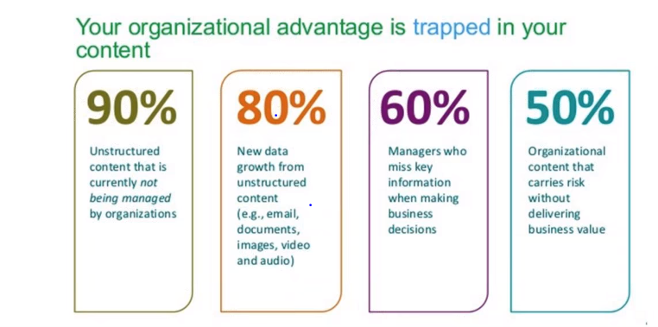
Business Understanding
Why Text Analytics is a big deal ???
Identification of Business Goal-Mining the Live Data from Twitter using a keyword

Slide 5
Data Understanding
Unstructured data (or unstructured information) is information that either does not have a pre-defined datamodel or is not organized in a pre-defined manner.Unstructured information is typically text-heavy, but may contain data such as dates, numbers, and facts as well.
Dataset Reference: https://twitter.com/
Exploring data: The dataset contains various columns named: From User, From User Id,Id,Language,Retweet Count,Source, To User,User-Id,Text
Verifying data quality: The dataset contains missing values and NULL values which are treated by data filtering in Rapid Miner
Regular expressions to eliminate url in the collected tweets

Slide 6

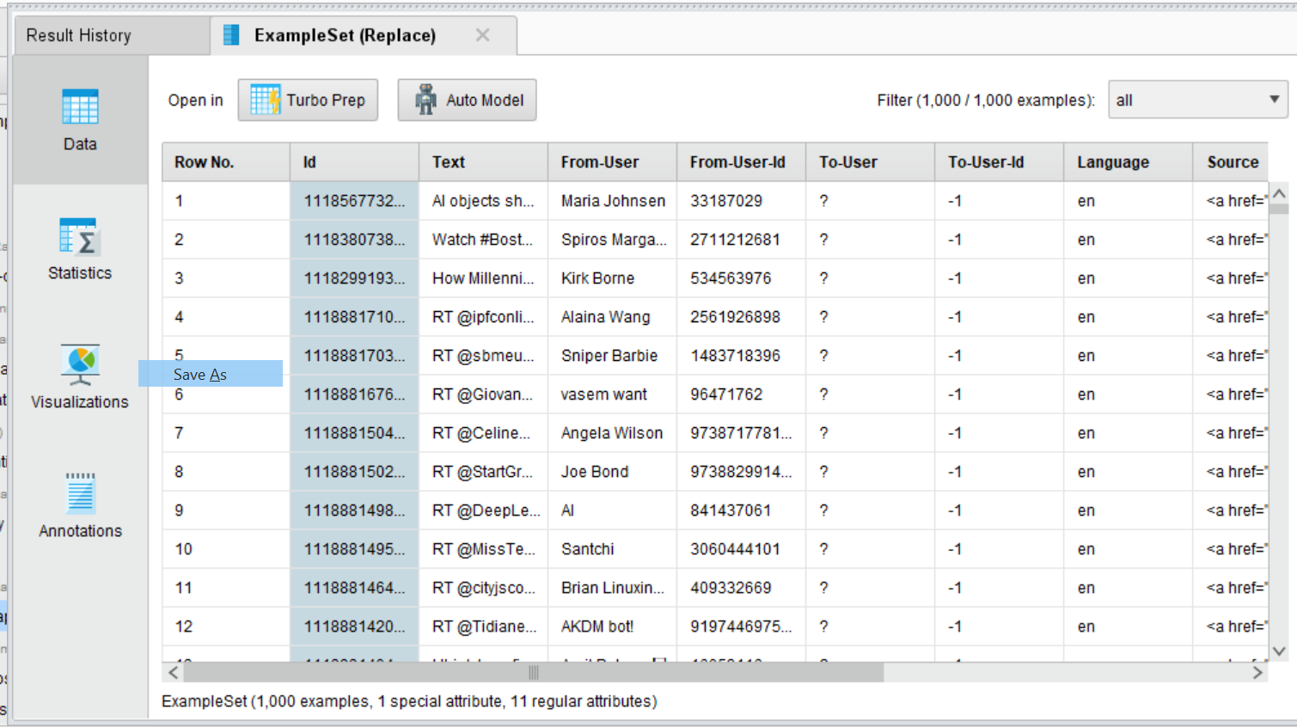



Dataset

Slide 7
Data Preparation
Data preprocessing is a data mining technique that involves transforming raw data into an understandable format. Real-world data is often incomplete, inconsistent, and/or lacking in certain behaviors or trends, and is likely to contain many errors. Data preprocessing is a proven method of resolving such issues
Data Selection: Select tweet Text in the text processing
Data Cleaning: The NULL values and missing values are eliminated through data filtering
Data Construction: Tokenize Tweets into Vector
Converts text to vector
Convert all letters to lower cases
Eliminate letters that are too short or too long
Filter out stop words
Integrating data: Only single dataset is chosen. So, merging data is not required

Slide 8
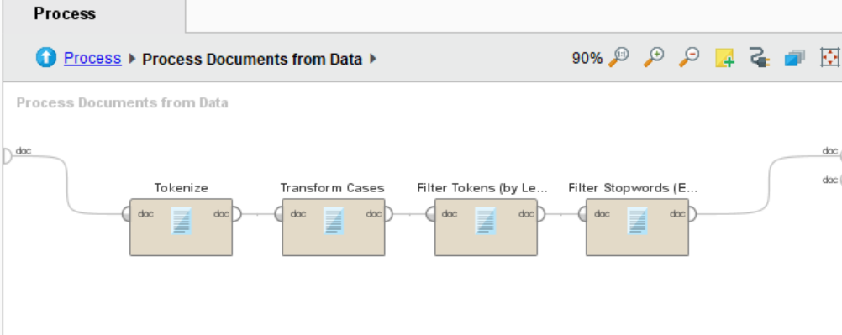
Data Preparation

Slide 9
Modelling
Selecting modelling techniques – K- Means Cl
Designing test(s)
Building model(s)
Assessing model(s)

Slide 10
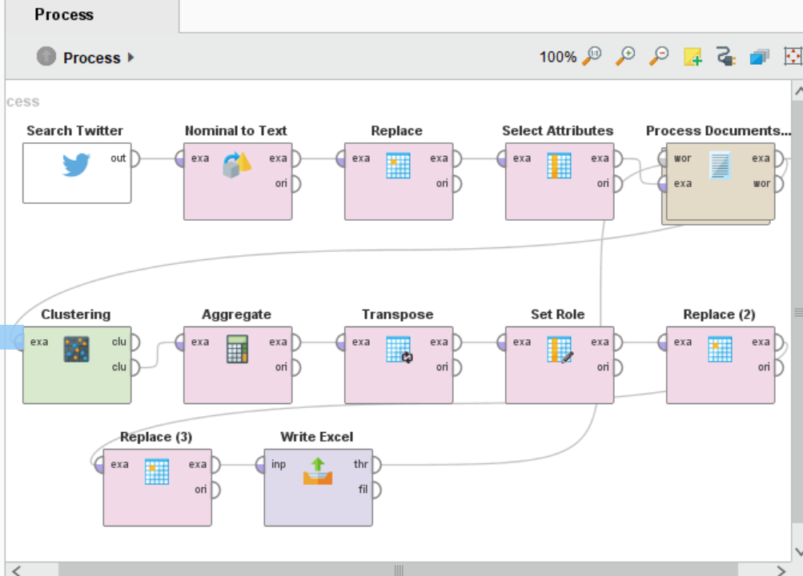

Slide 11
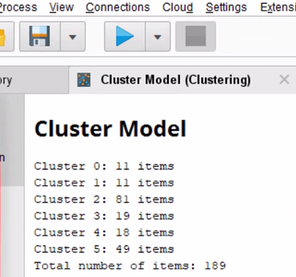
Modelling

Slide 12
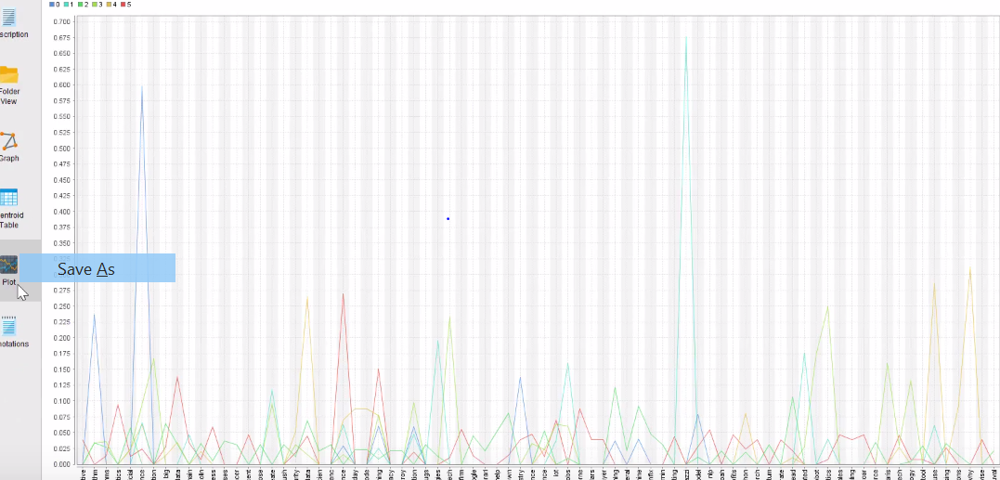
Plots using Rapid Miner
Plot shows the popular keywords in different cluster

Slide 13
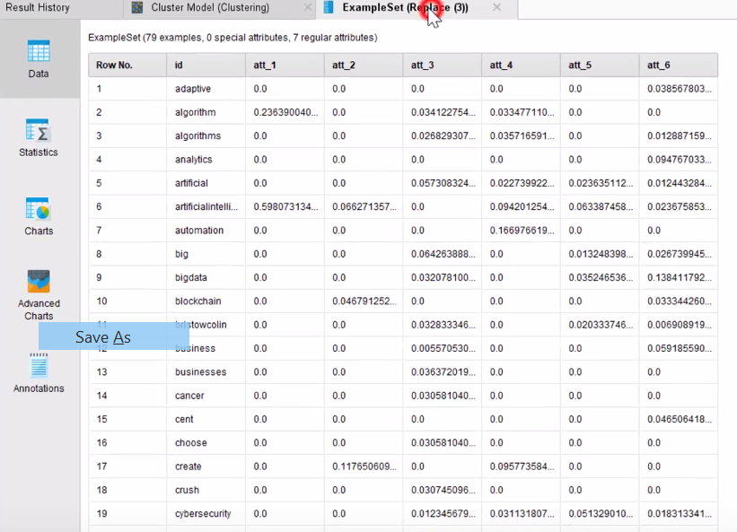
We can sort the average TF-IDF score of the words in each cluster to see what keyword are most popular in those clusters

Slide 14
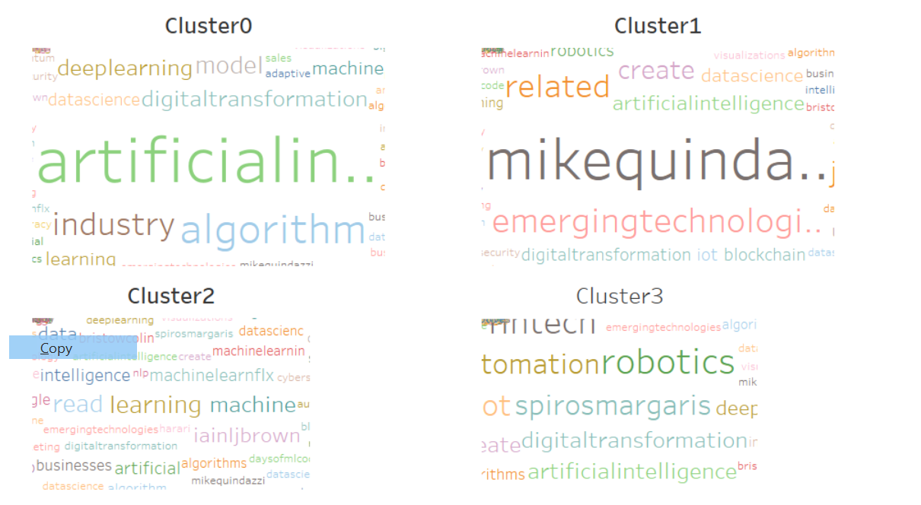
Word Cloud using Tablueu

Slide 15
Phase 5: Evaluation
Evaluating results
Reviewing the process
Determining the next steps

Slide 16
Phase 6: Deployment
Planning deployment (your methods for integrating data-mining discoveries into use)
Planning monitoring and maintenance
Reporting final results
Reviewing final results

