Slide 1
Inheritance in C++
Prabodh C P

Slide 2
Inheritance
Inheritance is a mechanism for enhancing existing, working classes.
If a new class needs to be implemented and a class representing a more general concept is already available, then the new class can inherit from the existing class.

Slide 3
Class Relationships
IS - A Relationships
  generalization-specialization Inheritance
HAS - A Relationships
  whole-part Composition aggregation

Slide 4
IS - A Relationships
IS - A generalization-specialization
Inheritance has to qualify the IS - A test
Student GraduateStudent , UndergraduateStudent
Shape Circle , Triangle , Rectangle , Sphere , Cube
Loan CarLoan , HomeImprovementLoan , MortgageLoan
Employee Faculty , Staff
Account CheckingAccount , SavingsAccount

Slide 5
HAS - A Relationships
Whole part relationship
Aggregation or Composition
Class contains an instance(object) of another class
Should not use in Inheritance
House has a kitchen
Polygon has a side
Line has a point
Employee has an address

Slide 6
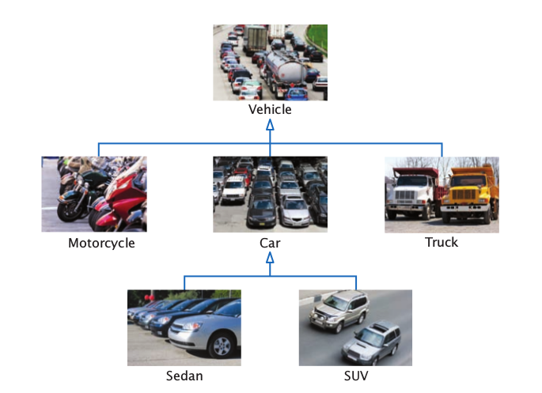
Vehicle Inheritance Heirarchy

Slide 7
TYPES
Single Inheritance
Heirarchial Inheritance
Multilevel Inheritance
Multiple Inheritance
Hybrid Inheritance

Slide 8
Single Inheritance
POLYGON
EMPLOYEE
RECTANGLE
MANAGER

Slide 9
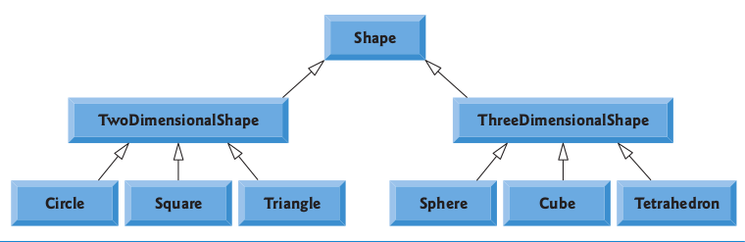
Heirachial Inheritance

Slide 10
Multilevel Inheritance
PERSON
POLYGON
EMPLOYEE
QUADILATERAL
MANAGER
SQUARE

Slide 11
Multiple Inheritance
TEACHER
STUDENT
TEACHING ASSISTANT

Slide 12
Hybrid Inheritance
PERSON
TEACHER
STUDENT
TEACHING ASSISTANT
DAY SCHOLAR

Slide 13
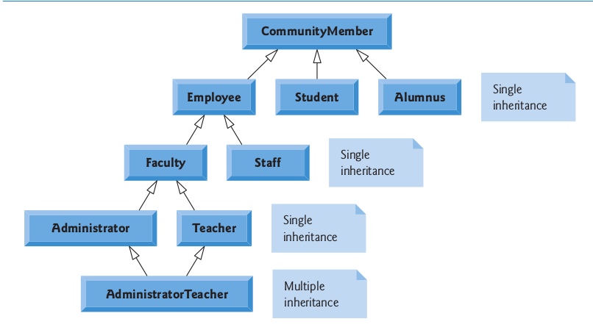
Class Heirarchy

Slide 14
Inheritance Basics
general class is called the base class.
The more specialized class that inherits from the base class is called the derived class.
//Inheritance Syntax
class derived-class-name : access base-class-name
{
// body of class
};

Slide 15
Example
class Polygon
{
};
class Triangle : public Polygon
{
};

Slide 16
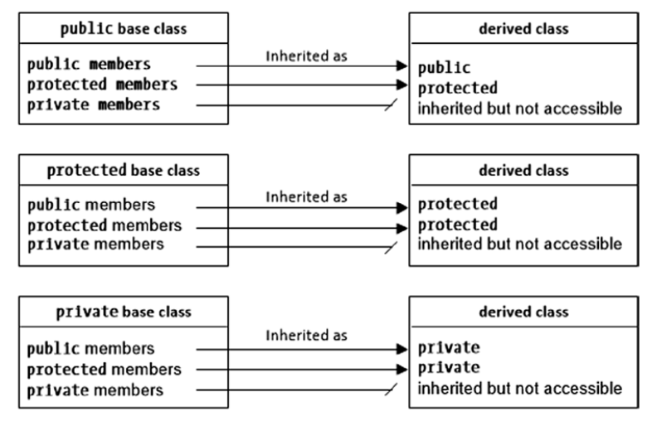
Effect of access specifier
If no base-class access specifier is present,
the access specifier is private by default

Slide 17
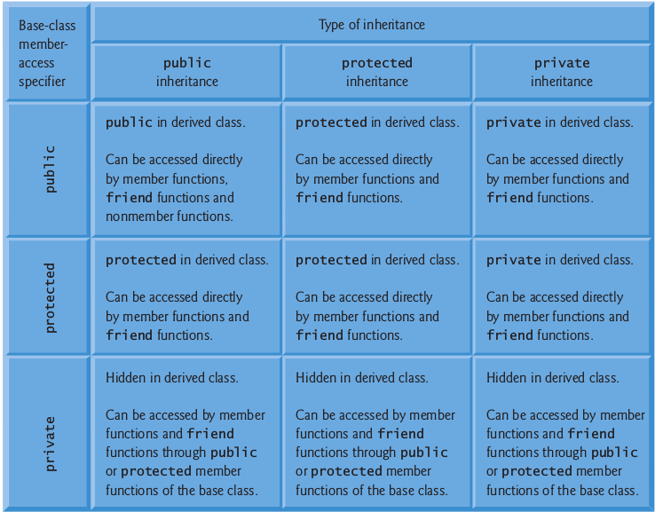
Base-class member accessibility in a derived class

