Slide 1

APSCHE - KickStack
Andhra Pradesh State Council of Higher Education
Domain: Artificial Intelligence & Machine Learning
SUMMER INTERNSHIP
Rising Waters
Machine Learning-Based Flood Prediction System
Predicting Flood Risk from Rainfall and Weather Data
Duration: 20 May 2026 – 20 July 2026
SUBMITTED BY
Kolakaluri Ramya
Artificial Intelligence and Machine Learning | APSCHE-KickStack
A Summer Internship Report — APSCHE-KickStack

Slide 2
PROJECT OVERVIEW
Introduction
Rising Waters is an advanced, data-driven machine learning system built to identify possible flood risks using rainfall and weather conditions.
It integrates historical weather data with trained ML models to assess flood risk in real time.
The system analyzes these inputs through a Flask web application to generate real-time flood risk predictions.
Purpose of this presentation: to walk through the motivation, design, development process, and outcomes of the Rising Waters internship project.
Ultimate goal: provide early flood warnings to support disaster management, evacuation planning, and resource allocation.
2 / 17

Slide 3
FOUNDATIONS
About the Project
Duration
Summer Internship, 20 May – 20 July 2026
Objective
Design and deploy a machine learning-based flood prediction engine integrated with a Flask web application.
Track
Artificial Intelligence and Machine Learning, via APSCHE-KickStack
Training Modules
Python &amp; ML fundamentals, data preprocessing, model building &amp; evaluation, Flask web development, and deployment
3 / 17

Slide 4
PROBLEM STATEMENT
Why Rising Waters?
The Challenge
The Gap
The Solution
Communities often rely on delayed or manual flood monitoring, leading to inadequate preparation and slow disaster response.
Rainfall and weather patterns vary widely from region to region, yet there is no simple tool linking this data to real-time flood risk assessment.
Rising Waters bridges historical weather data and machine learning — turning rainfall and weather readings into early, actionable flood warnings.
4 / 17

Slide 5
WHERE RISING WATERS FITS
Application Scenarios
1
2
3
Flood Risk Prediction
Disaster Management
Evacuation &amp; Resource Planning
A user enters current rainfall and weather conditions. The system predicts whether flood conditions are likely, in real time.
Authorities use early flood warnings generated by the system to coordinate disaster response and mitigate impact.
Flood risk predictions support evacuation planning and resource allocation, helping communities prepare before flooding occurs.
5 / 17

Slide 6
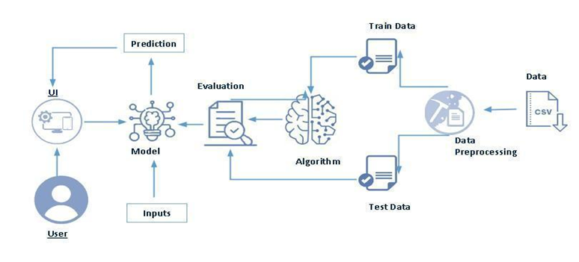
METHODOLOGY
System Architecture
Weather data flows through preprocessing and feature scaling, then splits into train/test sets. An algorithm builds the model, which is evaluated and connected to the Flask UI, where user inputs generate real-time flood risk predictions.
6 / 17

Slide 7
TECH STACK
Technologies Used
Python
Pandas
Scikit-learn
XGBoost
Core programming language
Data handling &amp; analysis
Machine learning models
Gradient boosting model
HTML
CSS
Flask
Joblib
Frontend structure
Styling &amp; layout
Web application framework
Model persistence
Core Discipline: Machine Learning
7 / 17

Slide 8
GROWTH THROUGH THE PROJECT
Skills Gained
Technical Skills
Soft Skills
Data preprocessing: handling missing values and feature scaling
Training &amp; evaluating ML algorithms (Decision Tree, Random Forest, KNN, XGBoost)
Building modular Flask backends for prediction services
Model persistence and reuse with Joblib
Designing responsive UIs with HTML, CSS &amp; JavaScript
Analytical problem-solving with real-world weather and rainfall data
Structured project planning across epics and tasks
Clear technical documentation and reporting
Presenting complex ML concepts in an accessible way
Time management under internship deadlines
8 / 17

Slide 9
HOW RISING WATERS WAS BUILT
Development Approach
1
Environment Setup — Python 3.10+, virtual environment, and core libraries configured
2
Model Selection — preprocessed the weather dataset and compared Decision Tree, Random Forest, KNN, and XGBoost
3
Backend Development — modular Flask functions for preprocessing, training, and prediction
4
Data Persistence — trained model and transformer stored using Joblib for reuse during prediction
5
Frontend Development — responsive input forms and results built with HTML, CSS &amp; JavaScript
6
Testing &amp; Deployment — validated locally via the Flask development server and browser testing
9 / 17

Slide 10
WORKING TOGETHER
Team Collaboration
Mentor Guidance
Peer Discussions
Structured Reviews
Regular check-ins with APSCHE-KickStack mentors to review progress, validate model choices, and refine the project roadmap.
Collaborated with fellow interns to troubleshoot data preprocessing issues and compare approaches to model selection.
Work was tracked and reviewed across epics, stories, and subtasks, keeping development organized and on schedule.
10 / 17

Slide 11
OBSTACLES &amp; RESOLUTIONS
Challenges Faced
Key Challenges
How They Were Overcome
Handling missing values and inconsistent scales across rainfall, temperature, humidity and other weather data
Selecting the best-performing algorithm among four candidate ML models
Balancing prediction accuracy with a simple, responsive Flask interface
Applied systematic preprocessing: cleaning, feature scaling, and data transformation
Compared models using accuracy and evaluation metrics before finalizing the best fit
Iterated on the UI design and tested repeatedly with real weather input values
11 / 17

Slide 12
MILESTONES REACHED
Key Achievements
Accomplishments | Certifications | Performance Recognition
Built and deployed a working ML-based flood prediction engine Compared four ML algorithms and selected the best-performing model Designed and developed a complete Flask web application with a responsive UI Achieved reliable, real-time flood risk predictions from live user input | APSCHE-KickStack Internship — Program Completion Certificate Python &amp; Machine Learning Fundamentals Certification Flask Web Development Certification Data Preprocessing &amp; Model Evaluation Certification | Recognized for on-time delivery of all project milestones Positive mentor feedback on model accuracy and design Project highlighted as a strong cohort submission Commended for clear documentation and presentation
12 / 17

Slide 13
REFLECTION
Overall Learning Experience
Gained hands-on experience applying machine learning algorithms to a real-world flood-prediction problem.
Learned the complete ML project lifecycle — from data preprocessing to model deployment.
Understood how to connect a trained model to an interactive Flask front end for real-time use.
Strengthened understanding of rainfall-weather relationships and flood risk patterns.
Developed confidence in independently planning, building, and testing an end-to-end AI-powered application.
13 / 17

Slide 14
WHAT'S NEXT FOR RISING WATERS
Future Scope &amp; Growth
IoT Integration
Expanded Recommendations
Connect real-time IoT sensors and live weather feeds for continuous flood monitoring instead of manual input.
Extend the model to suggest evacuation routes, resource allocation plans, and disaster response guidance.
Cloud Deployment
Accessibility
Deploy Rising Waters on cloud platforms for wider, always-on accessibility to communities and authorities.
Add multilingual and voice-based interfaces to better serve vulnerable and rural communities.
14 / 17

Slide 15
CONCLUSION
Conclusion
Rising Waters evolved from an idea into a fully functional, data-driven flood prediction system — demonstrating how machine learning can turn rainfall and weather data into early, actionable flood warnings for disaster management.
4
100%
4
ML Algorithms Compared
On-Time Delivery
Certifications Earned
15 / 17

Slide 16
ACKNOWLEDGEMENT
With Sincere Gratitude
✓
Grateful to the internship organization for providing the opportunity to work on Rising Waters and gain valuable hands-on industry experience
✓
Heartfelt thanks to my mentors and project guides for their invaluable guidance, technical insight, and encouragement throughout the project
✓
Sincere appreciation to the development team and colleagues for their collaboration, support, and valuable feedback at every stage
✓
Warm thanks to everyone who contributed, directly or indirectly, to the successful completion of this project
16 / 17

Slide 17
Thank You

