Slide 1
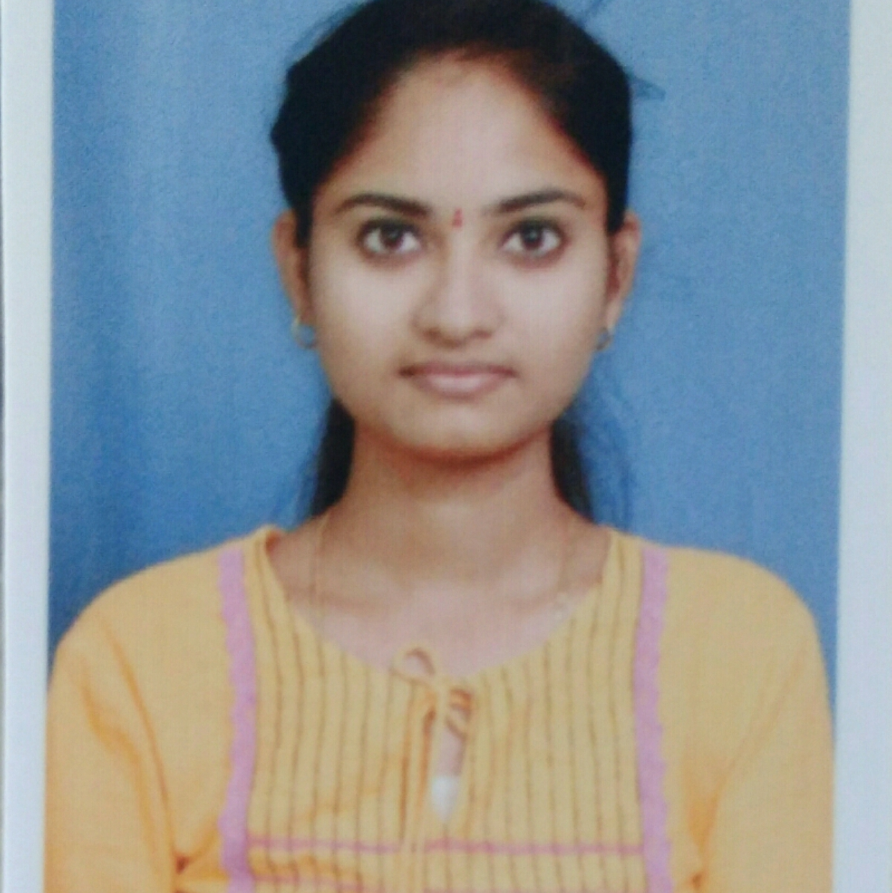


KOLLATI RAMYA
Analyst/Software Engineer
Bachelor of Technology
Electronics and Comm. : 2016 - 2020
Skills
Java | Java Basics, OOPS, Generics, Collections, Arrays, Loops, Stream API
Spring core | IOC & Dependency Injection, Autowire
Spring REST | REST controllers, Implementation of GET, POST, PUT & DELETE, Bean Validation ,Testing Services, Controller & Repository layer
Spring Data Mongo | Implement DAO layer using spring Data repositories
Spring Boot Microservices | Spring Boot Starters, annotations, Sync/Async comms, Swagger API documents
Spring Cloud | Eureka, Netflix Hystrix, Netflix Zuul & Config Server
Angular | Components, Service, Module, Routing, Forms & Validations
Database | NoSQL database Mongo DB
UI Tech | HTML & CSS ,JavaScript, ES6 & TypeScript
Tools | Git, Postman, Maven, IDE,STS
Add On skills | Communication, team player
Bangalore
ramya.kollati@capgemini.com
+91 9440290010
A4
Full Stack Developer
Hands on experience in creating microservices with Spring boot, Spring Security, Spring Cloud API Gateway, Eureka server, load balancing, resttempalte, Hystrix circuit breaker.
Proficient in creating Single page Web Application in Angular with components, Service, Module, Routing, Forms &Validations TypeScript, CSS,HTML.
Experience in creating documentation with Swagger and also Experience in configuring the actuator.
Working knowledge with Mongo Db and Mongo queries and Spring mongo data with creating Repository class and custom finder methods
Crop Deal Application
Completed end to end case study of Crop Deal Application along with Swagger , responsive UI with Angular, CSS, HTML , Bootstrap
The Technology Stacks used for the case study:
Java, Spring boot, Mongo DB, Angular ,HTML,CSS ,TypeScript , Bootstrap 5
Check out my work on GitHub & Video Profile

