Slide 1
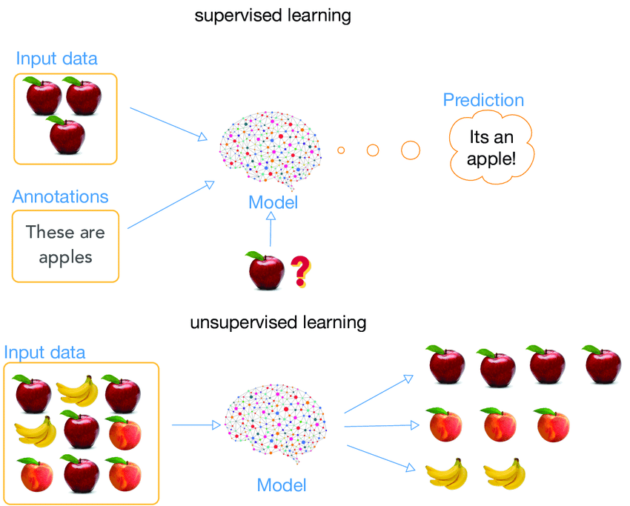
UNSUPERVISED LEARNING
Unsupervised Learning is a machine learning technique in which the users do not need to supervise the model. Instead, it allows the model to work on its own to discover patterns and information that was previously undetected. It mainly deals with the unlabelled data.

Slide 2
SUPERVISED vs UNSUPERVISED
Supervised Learning - The presence of outcome variable is available to guide the learning process.
There must be a training dataset in which the target variable is already known
Algorithms are trained against known labels
Unsupervised Learning - The target labels are not known.
We have to cluster the data to reveal meaningful partitions and hierarchy
Algorithms are trained against known labels

Slide 3
WHY UNSUPERVISED LEARNING ?
Unsupervised machine learning finds all kind of unknown patterns in data.
Unsupervised methods help you to find features which can be useful for categorization.
It is taken place in real time, so all the input data to be analyzed and labelled in the presence of learners.
It is easier to get unlabelled data from a computer than labelled data, which needs manual intervention.

Slide 4
Customer Segmentation
Document Segmentation
Image Segmentations
Anomaly Detection
Pattern Recognition.
APPLICATIONS

Slide 5
TYPES OF UNSUPERVISED LEARNING
Hierarchical Clustering
K-Means Clustering
Principal Component Analysis(PCA)
Association Rules
Singular Value Decomposition (SVD)

Slide 6
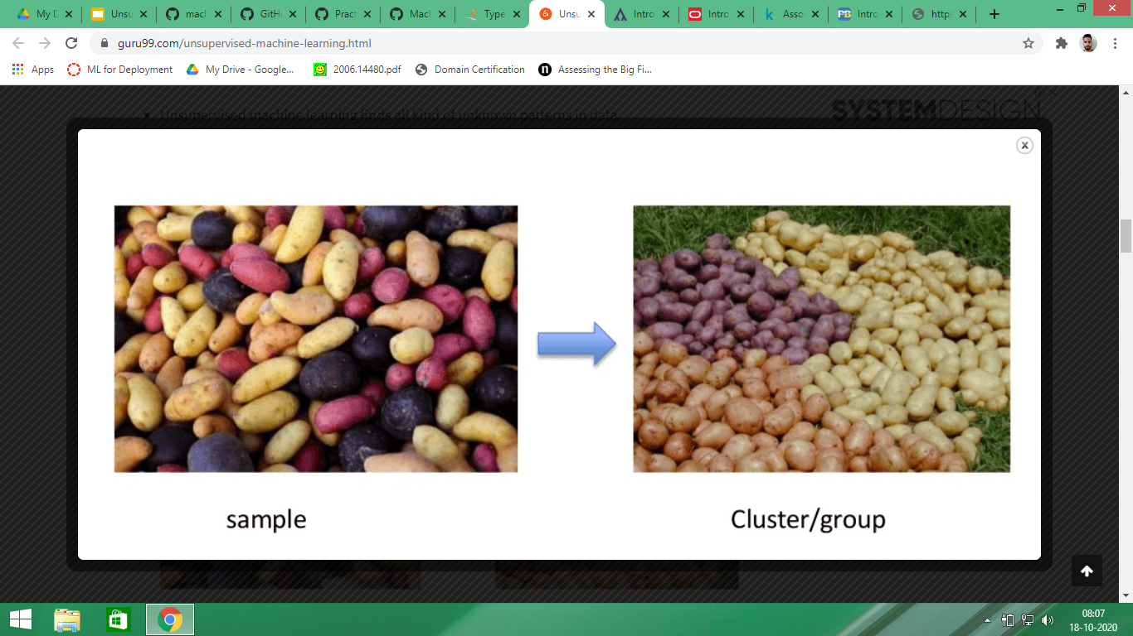
CLUSTERING
The method of identifying similar groups of data in a data set is called clustering.
It deals with finding structures in a collection of unlabelled dataset.
We look at the data and then try to club similar observations and form different groups.

Slide 7
TYPES OF CLUSTERING
Hierarchical Clustering : - It builds the hierarchy of clusters. Initially the individuals data points are assigned to their own clusters and then we group the close clusters into one clusters and keep doing it until we have one big cluster.
K-Means clustering :- In K-means clustering first we select the desired number of clusters(K) then we divide our clusters into K-groups.
Dimensionality reduction techniques (PCA) :- Sometimes our variables in dataset becomes very large and it causes problems like high training time, less accurate models and high computational complexities. We use dimensionality reduction techniques to reduce the dimensionality of the dataset by transforming large set of variables into smaller ones that still contains most of the information.

Slide 8
PROPERTIES OF CLUSTERS
All the data points in clusters should be similar to each other.
All the data points from different clusters should be as different as possible.

Slide 9
ASSOCIATION RULES
Association rules analysis is a technique to uncover how items are associated to each other
Association Rules work on the basis of if/then statements. These statements help to reveal associations between independent data in a database, relational database or other information repositories. These rules are used to identify the relationships between the objects which are usually used together.
Association rules allow us to establish association amongst data objects. It help us to discover interesting relationships between variables. For example, people who has bought bread are most likely to buy butter as well.

Slide 10
Disadvantages of Unsupervised Learning
You cannot get precise information regarding data sorting, and the output as data used in unsupervised learning is labelled and not known
Less accuracy of the results is because the input data is not known and not labelled by people in advance. This means that the machine requires to do this itself.
The user needs to spend time interpreting and label the classes which follow that classification.

